Slide 1

EEG Correlates of a Reiki Sender-Recipient Dyad: A Randomized Single-Case Pilot Study
Edward A. Fox, Ph.D., Emeritus Professor of Computer Science, fox@vt.edu
Zhuo Fu, Ph.D., Neuroscience Instructor, Virginia Tech, zhuofu@vt.edu
Chin-Hui Chen, Ph.D. student, Virginia Tech, chinhui@vt.edu
International Reiki Research Conference -- October 3-4, 2026
Outline
Three slides taken from 2025 IRRC presentation “Small-scale Research Studies at a University Reiki Club”
Practitioner eyes closed occipital alpha-power increase
Suggestive results
Suggestions for larger study as follow-up
Suggestions for related study with mice
Conclusions, Call for Collaboration
https://fox.cs.vt.edu/talks/2026/FoxIRRC20261003.pptx
https://www.edwardafox.com/reikibooks

Slide 2
Small-scale Research Studies at a University Reiki Club
Edward A. Fox, Ph.D.
Emeritus Professor of Computer Science, fox@vt.edu
International Reiki Research Conference -- October 4-5, 2025
Outline
Reiki Club
Canine Hip Dysplasia Related Pain
Tissue Cultures
Infrared Videography of Palms
Survey of Staff Recipients
EEG Recording to Assess Effects of Distant Reiki
Conclusions, Call for Collaboration
https://fox.cs.vt.edu/talks/2025/FoxIRRC20251005.pptx
https://www.edwardafox.com/reikibooks

Slide 3
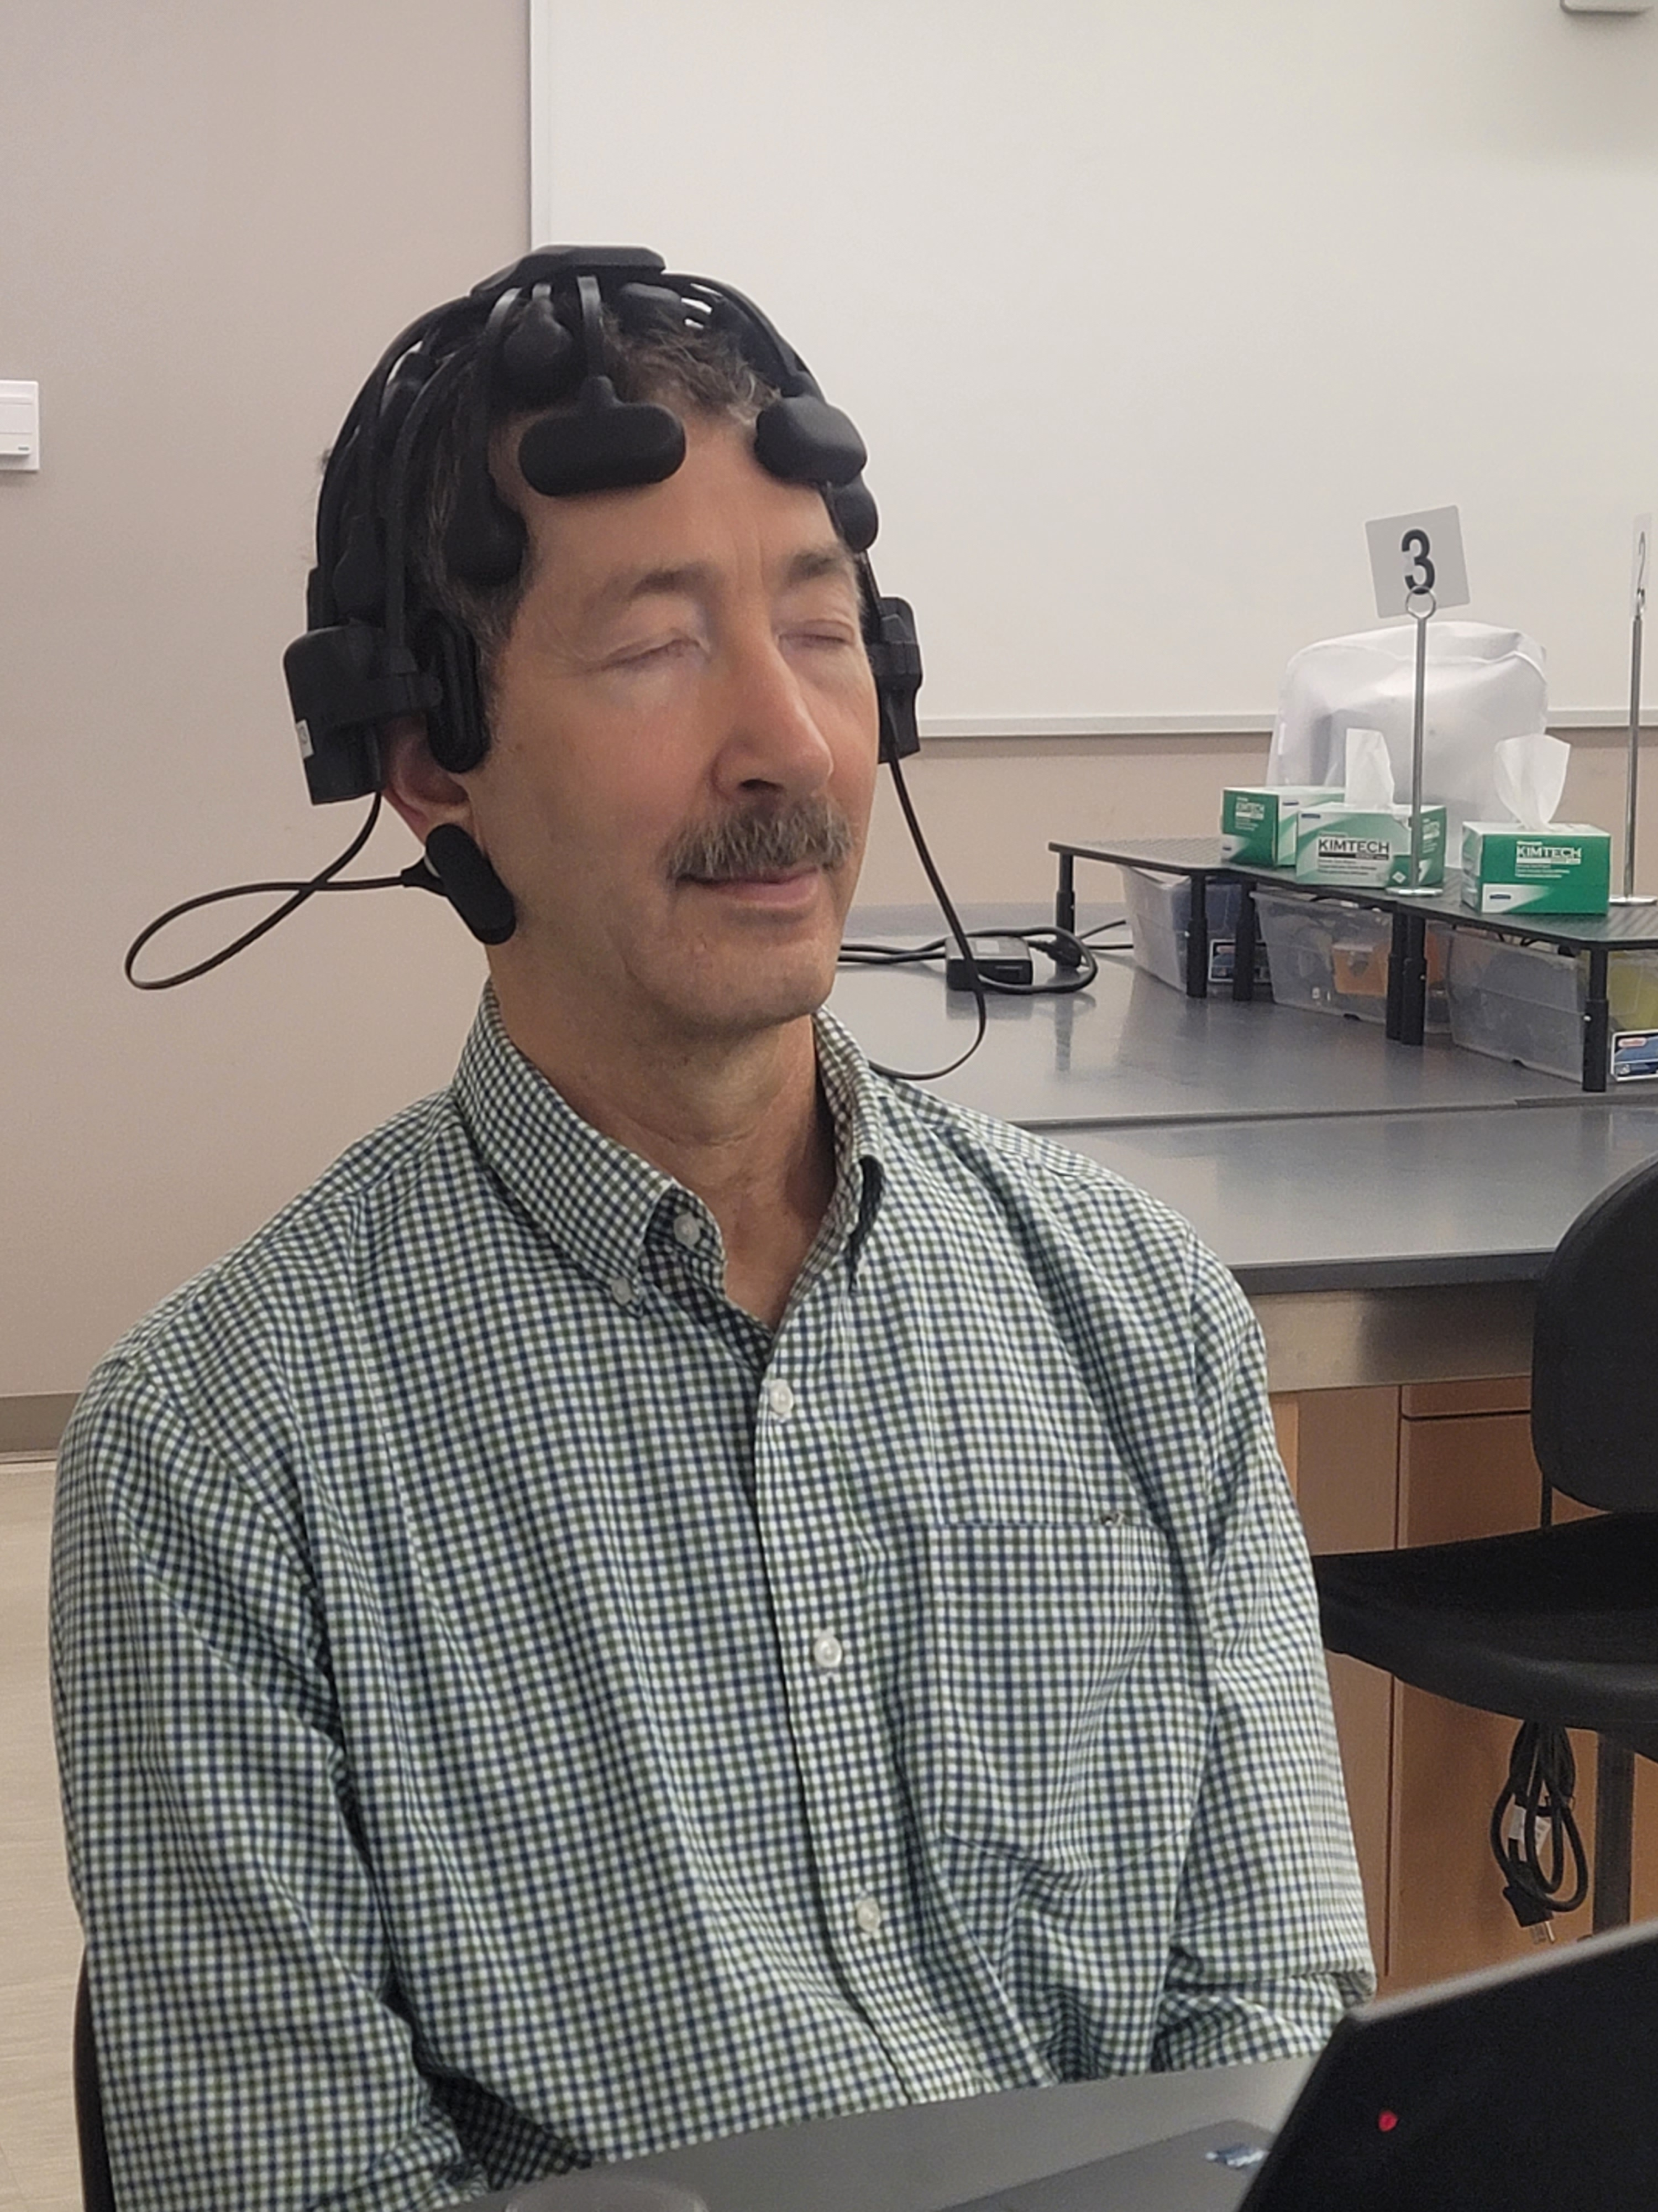
EEG Study – Reiki Practitioner
Reiki Master Teacher (author), with 8 leads monitored
CGX 20 channel wireless dry EEG headset like https://www.cgxsystems.com/quick-20m

Slide 4
EEG Study
Lab and equipment and experimental design supported by Zhuo (April) Fu, Instructor, Neuroscience. Assisted by doctoral student Chin-Hui Chen.
EEG headsets on each of Reiki practitioner “R” and collaborator “C”
Baselines: 10 min each: eyes open/closed
Math problems (stress): 10 min
Random sessions (6) with R doing: self-Reiki, distant-Reiki
C felt relaxed only during distant-Reiki

Slide 5
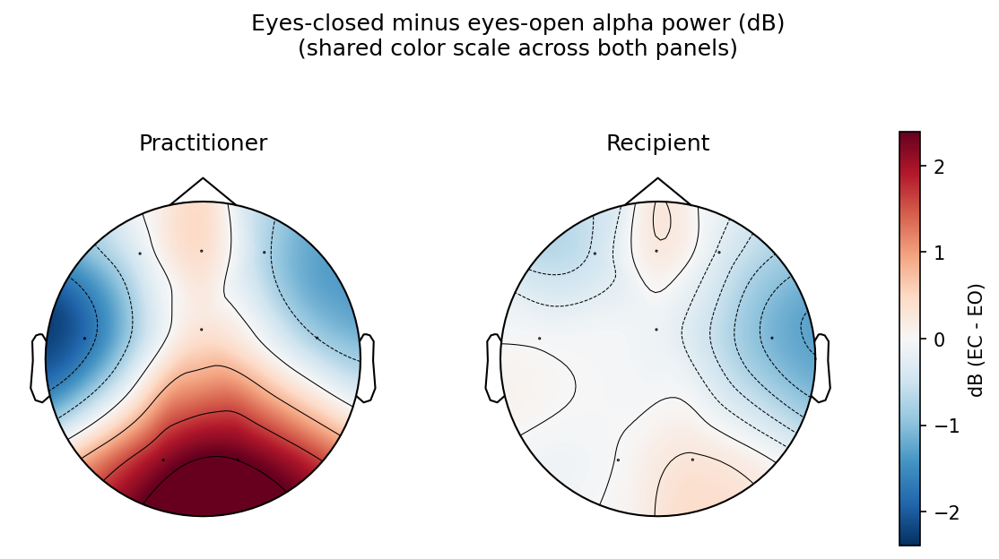
Practitioner eyes closed occipital alpha-power increase

Slide 6
Practitioner eyes closed occipital alpha-power increase (cont’d)
Practitioner’s posterior-concentrated, strongly positive (red) region at O1/O2 is visually distinct from recipient’s essentially flat, near-white topography across the scalp.
Practitioner’s alpha frequency was consistently lower than recipient’s across all 8 channels (by roughly 0.1-0.9 Hz, largest occipitally).
These practitioner observations are similar to those recorded for trained meditators.
The practitioner has not had a formal meditative practice, but was trained in Reiki in 2002 through Level 3, with further training (Holy Fire, Karuna) through ICRT.

Slide 7
Suggestive results
EEG data was analyzed by VT co-authors and by Duke collaborators; analysis aided by Anthropic’s Claude that is presented herein was confirmed by them.
There is some support for the recipient’s delta-band power at O2 being higher during receiving sessions, which suggests confirmation of a distant Reiki effect.
Tests for inter-brain connectivity were inconclusive.

Slide 8
Suggestions for larger study as follow-up
Have more practitioner-recipient dyads
Have more (and longer) sessions per dyad
Improve the recordings: 32 sensors, synchronized with shared hardware trigger
Add a non-EEG arousal measure (such as skin conductance) to determine if any alpha-power finding reflects a specific attentional or relaxation process rather than a general change in arousal

Slide 9
Suggestions for related study with mice
Above findings confirmed by Bradley Jason Kolls, M.D., Ph.D., MMCi, Neurologist; Duke Associate Professor (of Neurology & in Neurosurgery) and Andreas Seas, M.D., Ph.D., Duke Neurosurgery
They are interested in collaborating on a related study with mice.

Slide 10
Suggestions for related study with mice (cont’d)
Rodent (mice) electroencephalogram (EEG)
Reiki applied by distant and local practitioners vs. no Reiki (control)
Response to stress/injury also measured with rotarod performance
Prior work: “Optimization of a translational murine model of closed-head traumatic brain injury”, 2024, Neurological Research, https://doi.org/10.1080/01616412.2024.2302261

Slide 11
EEG Correlates of a Reiki Sender-Recipient Dyad: A Randomized Single-Case Pilot Study
Summary
Last year’s talk mentioned EEG study, prior to data analysis:
Experienced Reiki practitioner EEG observations are similar to those observed for experienced meditators.
Suggestive results were observed supporting distance Reiki.
A larger study is recommended to confirm results and to investigate distance Reiki and inter-brain connectivity.
A mouse study with EEG could investigate healing effects of Reiki on animals vs. control, with both local and distant Reiki practitioners.
Discussion, Q&A
https://fox.cs.vt.edu/talks/2026/FoxIRRC20261003.pptx
https://www.edwardafox.com/reikibooks

