Slide 1
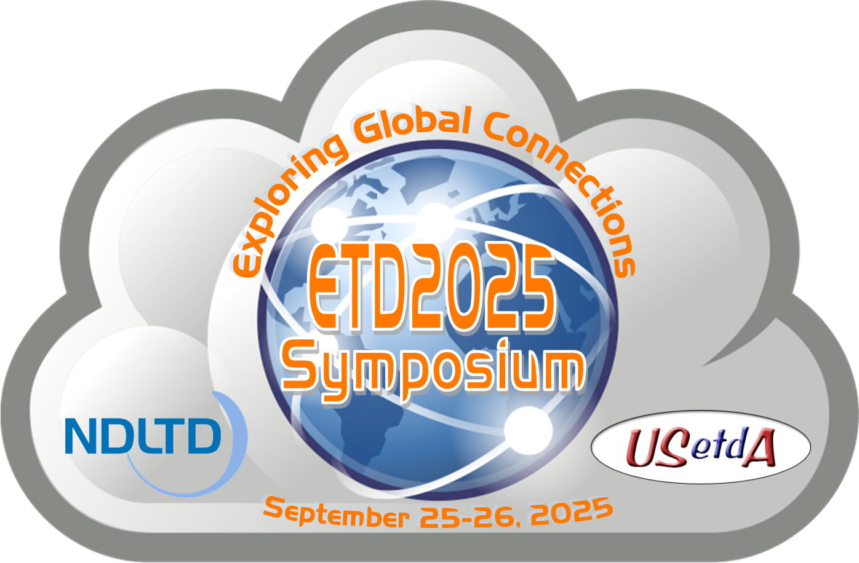
ETDs for Beginners Workshop 9/23/2026
Introduction and Brief History of the ETD Movement
Presentation at USETDA 2026, Virtual
Edward A. Fox
Emeritus Professor of Computer Science, Virginia Tech, Blacksburg, Virginia 24061, USA
Executive Director, NDLTD
With Additional Information from
Dr. Jian Wu, Associate Professor of Computer Science, Old Dominion University, Virginia, USA
http://fox.cs.vt.edu/talks/2026/20260923BeginnersIntro.pptx

Slide 2
The Networked Digital Library of Theses and Dissertations
www.NDLTD.org
Advocate:
Training Authors
Expanding Access
Preserving Knowledge
Improving Graduate Education
Enhancing Scholarly Communication
Empowering Students & Universities
Leading the Worldwide ETD (Electronic
Thesis and Dissertation) Initiative

Slide 3
Mission
The Networked Digital Library of Theses and Dissertations (NDLTD) is an international organization that, through leadership and innovation, promotes the adoption, creation, dissemination, use, and preservation of electronic theses and dissertations (ETDs).
The NDLTD encourages and supports the efforts of institutions of higher education & their communities to advance and apply electronic publishing & digital libraries (including repositories), thus enabling them
  to provide open access to scholarship
  to share knowledge more effectively, in order
  to unlock the potential benefits worldwide

Slide 4
Scenarios Supported
Universities
  Save space and costs relative to paper theses and dissertations
  Improve the visibility of their research
  Allow ETDs → launch an ETD program → enhance graduate education → require ETDs → scan old works into ETDs
  Have permanent preservation support
Graduate Students
  Save expenses related to paper copies
  Learn effective ways to communicate results using the latest electronic publishing methods and practices
  Share datasets, software, videos, and other born-digital content
  Gain greater visibility for research, receive more citations

Slide 5
Website
ndltd.org = theses.org = dissertations.org
Supports worldwide open access and member services.
Includes resources for university administrators, librarians, faculty, students, and the general public.
Topics include:
  how to find, create, and preserve ETDs;
  how to set up an ETD program;
  legal and technical questions; and
  the latest news and research in the ETD community

Slide 6
Board of Directors (BoD)
Edward A. Fox: Executive Director, Chairman of the Board, NDLTD
Current Members of BoD
  Ana Pavani: Pontificate Catholic University (Brazil)
  Austin McLean: ProQuest LLC (Treasurer)
  Dragana Stolić: University Library “Svetozar Markovic” (Serbia)
  Iryna Kuchma: Electronic Information for Libraries (Netherlands)
  Jian Wu: Old Dominion University
  Josiline Chigwada: Chinhoyi University of Technology (Zimbabwe)
  Libio Huaroto: Universidad Peruana de Ciencias Aplicadas UPC (Peru)
  Lighton Phiri: University of Zambia
  Prashant Pandey: Charles Darwin University (Australia)
  Ramesh C. Gaur: South Asian University (New Delhi)
  Roxanne Missingham: State Library of Victoria (Australia)
  Teresa M. Green: The University of Toledo
  William A. Ingram: Virginia Tech (Webmaster)

Slide 7
A Brief History of NDLTD
1987 mtg in Ann Arbor: UMI, VT, Arbortext, Softquad
1992 mtg in Washington: CNI, CGS, UMI, VT+10U’s
1993 mtg in Atlanta: Monticello Electronic Library
1994 mtg at VT: std: PDF + SGML + multimedia
1996 mtg with funding by SURA and then also by the US Dept. of Education (FIPSE)
1997 meetings in UK, Germany, ...
1998 – 1st symposium – Memphis (20)
1999 – 2nd symposium – Blacksburg (70)
2000 – 3rd symposium – St. Petersburg, FL (225)
2001 – 4th symposium – Caltech, Pasadena (200)
2002 – 5th symposium – BYU, Provo, Utah
2003 – NDLTD incorporated as int’l non-profit
Notes:
Coalition for Networked Information: CNI
CGS: Council of Graduate Schools
SURA: Southeastern Universities Research Association

Slide 8
A Brief History of NDLTD (cont.)
2003 – 6th symposium – Berlin (215 attendees)
2004 – 7th symposium – U. Kentucky, USA
2005 – 8th symposium – Sydney, Australia
2006 – 9th symposium – Quebec City, Canada
2007 – 10th symposium – Uppsala, Sweden
2008 – 11th symposium – Aberdeen, Scotland
2009 – 12th symposium – Pittsburgh, PA, USA
2010 – 13th symposium – Austin, TX, USA
2011 – 14th symposium – Cape Town, S. Africa
2012 – 15th symposium – Lima, Peru
2013 – 16th symposium – Hong Kong
2014 – 17th symposium – Leicester, England

Slide 9
A Brief History of NDLTD (cont.)
2015 – 18th symposium – New Delhi, India
2016 – 19th symposium – Lille, France
2017 – 20th symposium – Washington, D.C.
2018 – 21th symposium – Taipei, Taiwan
2019 – 22th symposium – Porto, Portugal
2020 – 23th symposium – Al Ain, UAE
2021 – 24th symposium – Abu Dhabi, UAE
2022 – 25th symposium – Novi Sad, Serbia
2023 – 26th symposium – Gandhinagar,India
2024 – 27th symposium - Livingstone, Zambia
2025 – 28th symposium – Jt. with USETDA (Virtual)

Slide 10
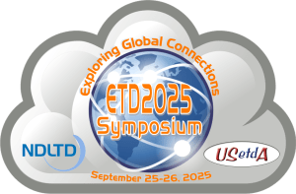
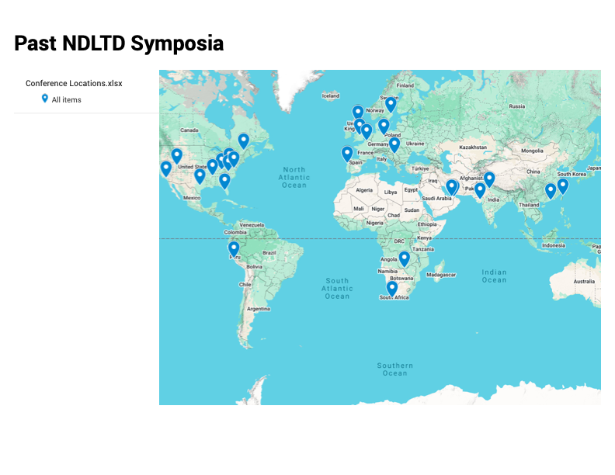
NDLTD Symposium Locations (1998 – 2025)
The USETDA and the NDLTD co-hosted
ETD 2025, the 28th international symposium on electronic theses and dissertations (ETDs) and
USETDA 2025, the 15th national US conference on ETDs
as a joint virtual event via Zoom September 25-26, 2025.

Slide 11
Selected Additional Benefits
Union Catalog and Global Search of ETD metadata collected via OAI-PMH
  See talk by Bill Ingram
  Interim service at https://oatd.org/
Journal: http://j-etd.org
Website with educational and informational content: ndltd.org
Mailing list: etd@ndltd.org
Social Media
  https://www.facebook.com/NDLTD
  https://x.com/NDLTD
  https://bsky.app/profile/ndltd.org
  https://www.linkedin.com/groups/2024919/
Awards: https://ndltd.org/ndltd-awards/
  Innovative ETD Award
  ETD Leadership Award

Slide 12

A peer-reviewed, open-access scholarly journal published by the Networked Digital Library of Theses and Dissertations (NDLTD)
j-etd = scholarworks.uaeu.ac.ae/j-etd/
Since 2021
Hosted at the Library Scholarworks Repository of the University of the United Arab Emirates
Executive Editor
  Edward A. Fox (United States)
Managing Editor
  Prashant Pandey (Australia)
Associate Editors
  Ramesh C. Gaur, India
  John Hagen, United States
  Nabi Hasan, India
  William Ingram, United States
  Daisy Selematsela, S. Africa
  Janette Wright, Australia

Slide 13
Publishing and Resources for Professionals
J-ETD is YOUR journal!
Especially since it is open-access — please search, browse, download, and read any/all of the works there.
Learn more about the Global ETD movement, and related research, development, and best practices.
Everyone involved in ETD-related activities and events is encouraged to make submissions to J-ETD, so we can publish your works and share your knowledge, that can guide others.

Slide 14
Popular J-ETD Articles
Analyzing and Navigating ETDs Using Topic Models
Restructuring and Upgradation of the DSpace-based Institutional Repository of CEPT University Library: A Case Study
Creating Web Accessibility Standards for Thesis and Dissertation Submission at Mississippi State University
Who is keeping an eye on FAIR principles?
Open Science ETDs and Institutional Repositories: Making Research Data FAIRer
Building and Using Digital Libraries for ETDs
Digital Preservation, Accessibility, and Use of Electronic Theses and Dissertations in University Libraries in Nigeria
Six Steps Toward Improving Discoverability of Ph.D. Dissertations
From Idea to Functional ETD: Experiences from the University of Novi Sad, Serbia

Slide 15
Selected Sponsors
Google
IMLS (Institute for Museum and Library Services) National Leadership Grants Program
NSF (US National Science Foundation)
OCLC
Qatar National Research Fund
SOLINET (Southeastern Library Network)
SURA (Southeastern University Regional Network)
UNESCO
U.S. Dept. of Education, FIPSE (Fund for the Improvement of Post-Secondary Education) Program
Virginia Tech: University Libraries, Computer Science

Slide 16
Selected Research Theses and Dissertations
William A. Ingram, "Goal-Conditioned Evaluation of Sustainable Development Goal Contributions in Theses and Dissertations", Virginia Tech, Computer Science, doctoral dissertation defended May 8,2026, https://hdl.handle.net/10919/143528
Satvik Chekuri. "Scholarly Information System for Long Documents and their Elements: Structured Representation and Exploration using Knowledge Graphs and LLMs", Virginia Tech, Computer Science, doctoral dissertation defended December 16, 2025, https://hdl.handle.net/10919/141065Chenyu Mao, "Enhancing Layout Understanding via Human-in-the-Loop: A User Study on PDF-to-HTML Conversion for Long Documents", Virginia Tech, Computer Science, MS thesis defense February 7, 2025, https://hdl.handle.net/10919/125076
Pradyumna Upendra Dasu, "Topic Modeling for Heterogeneous Digital Libraries: Tailored Approaches Using Large Language Models," Virginia Tech, Computer Science, MS thesis defense December 13, 2024, https://hdl.handle.net/10919/124154
Bipasha Banerjee. "Improving access to ETD elements through chapter categorization and summarization," Virginia Tech, Computer Science, doctoral dissertation defended 6/21/2024, https://hdl.handle.net/10919/120890
Aman Ahuja. "Analyzing and Navigating Electronic Theses and Dissertations", PhD defense 12 June 2023, Virginia Tech, Computer Science, with demonstration of HTML results and related user manual, http://hdl.handle.net/10919/115817, winner of 2023 Innovative ETD Award (awarded by NDLTD).
Dhanush Dinesh, "Utilizing Docker and Kafka for Highly Scalable Bulk Processing of Electronic Theses and Dissertations (ETDs)", MEng project and report defended May 9, 2023, Virginia Tech, ECE, http://hdl.handle.net/10919/115782
Javaid Akbar Manzoor, "Segmenting Electronic Theses and Dissertations By Chapters." Virginia Tech, Computer Science, MS thesis defended September 23, 2022, http://hdl.handle.net/10919/113246
Eman H. Abdelrahman, "Improving the Accessibility of Arabic Electronic Theses and Dissertations (ETDs) with Metadata and Classification." Virginia Tech, Computer Science, MS thesis defended November 29, 2021, http://hdl.handle.net/10919/107790
Sampanna Yashwant Kahu, "Figure extraction from scanned electronic theses and dissertations", final MS thesis defense 9/29/2020, Virginia Tech, Electrical and Computer Engineering, http://hdl.handle.net/10919/100113
Palakh Mignonne Jude, "Increasing Accessibility of Electronic Theses and Dissertations (ETDs) Through Chapter-level Classification", June 2020, MS thesis, Computer Science, http://hdl.handle.net/10919/99294
W. Ryan Richardson, "Using Concept Maps as a Tool for Cross-Language Relevance Determination", July 2007, PhD dissertation, http://hdl.handle.net/10919/28191
Aniket Prabhune, "XML for ETDs", Dec. 2002, MS independent study report, Virginia Tech Dept. of Computer Science Technical Report TR-02-28, http://hdl.handle.net/10919/20115
Hussein Suleman, "Open Digital Libraries", Nov. 2002, PhD dissertation, http://hdl.handle.net/10919/29712

Slide 17


Collaboration between NDLTD and USETDA
ETD 2017
  George Mason University, Washington Research Library Consortium, and USETDA
  Collaboratively run in Washington, D.C. from August 7, 2017
Last year’s virtual event – run collaboratively
Participation of NDLTD members in USETDA events

Slide 18
Collaboration between NDLTD and Internet Archive
I am pleased to announce that NDLTD is launching today its global collaboration with the Internet Archive, run by Brewster Kahle.
  https://en.wikipedia.org/wiki/Brewster_Kahle
  Home of the Wayback Machine https://web.archive.org/
  https://archive.org/
  https://en.wikipedia.org/wiki/Internet_Archive
GOAL: Have all of the theses and dissertations in the world be securely archived, and made easily accessible.
Please ask questions after Brewster Kahle’s presentation this morning about Preservation – he is THE expert!
Please meet with Brewster Kahle during this conference!

Slide 19
Questions?
Discussion?
Thank You!
fox@vt.edu
fox@ndltd.org
j-etd@ndltd.org

