Slide 1

Small-scale Research Studies at a University Reiki Club
Edward A. Fox, Ph.D.
Emeritus Professor of Computer Science, fox@vt.edu
International Reiki Research Conference -- October 4-5, 2025
Outline
Reiki Club
Canine Hip Dysplasia Related Pain
Tissue Cultures
Infrared Videography of Palms
Survey of Staff Recipients
EEG Recording to Assess Effects of Distant Reiki
Conclusions, Call for Collaboration
https://fox.cs.vt.edu/talks/2025/FoxIRRC20251005.pptx
https://www.edwardafox.com/reikibooks

Slide 2

Reiki Club at Virginia Tech
Author served as faculty advisor for Reiki Club at VT from March 2003.
  Reiki Master/Teacher in both Usui and Holy Fire approaches
  Professional member, centerforreikiresearch.com
  Professional member, ICRT (reiki.org)
Student-run club with student officers
Weekly club meetings during academic semesters
  Reiki circle, Reiki share, teaching Reiki at all levels
Open to community as well as students, staff, and faculty
Zoom option since COVID-19 in 2020
Listserv for group: 259 members
Web page (in addition to QR-related page – see above:) https://fox.cs.vt.edu/reikiclub.html
Many Reiki practitioners in Blacksburg and the region
Access to University researchers and facilities
Periodic experiments (see following slides)

Slide 3
Canine Hip Dysplasia Related Pain
Sponsor: Argyll Foundation, $8500 (for videographs, staff time)
Title: Relief for Canine Hip Dysplasia Related Pain through Reiki
PI: Dr. Marie Suthers-McCabe, Center for Animal Human Relationships (CENTAUR), Virginia-Maryland College of Veterinary Medicine
Co-PIs:
  Peter K. Shires, BVSc, MS, Diplomate ACVS; Veterinary Surgeon
  Edward A. Fox
Hypothesis: Arthritis pain associated with hip dysplasia in animals will respond favorably to Reiki.
Dog selection: 2 years, 40+ lbs., “arthritic hip”
Screening: clinical exam, blood test, X-ray
Sample: 6 each, control vs. treatment

Slide 4
Canine Hip Dysplasia Related Pain - 2
EXPERIMENT:
Force-plate lab (immediate gait measurement)
Video record of dogs walking
Treatment: 1 hour of Reiki
Repetitions: 3 times, 3-week intervals
Other observations:
  Daily record by owner
  Final examination at end of project
CONCLUSIONS: overly complicated study and analysis; insufficient funds for definitive results

Slide 5
Tissue Cultures
Collaborator: Karen Duca, Research Assistant Professor @ Virginia Bioinformatics Institute, and Adjunct Assistant Professor of Biology)
Background study: http://hdl.handle.net/10919/21933
Mouse (DBT), Hampster (BHK) cells in Petri dishes
Exposed to virus
Reiki: None, or on Day 1, or also on Days 2 and 3
Results: Virus concentration values reduced by Reiki
  3 days Reiki < 1 day Reiki < no Reiki
  Stronger effect observed with BHK cells.
Limitation: What was the effect of removing Petri dishes from the controlled environment during Reiki treatment?

Slide 6
Infrared Videography of Palms
Collaborator: Willem G. (Hardus) Odendaal, Associate Professor of Electrical and Computer Engineering
Infrared camera focused on participants’ hands (palms):
  High sensitivity, high resolution, high relative accuracy
Videos to detect any rapid rise in skin temperature
  Colors used to represent temperatures.
Participants
  18 unfamiliar with Reiki receiving treatment
  4 Reiki practitioners, practicing Reiki
    2 male, 2 female
    2 at level 2 with 2 years experience, 2 at level 3 (2, 3 years)
Scenario
  Participants refrained from eating at least 3.5 hours before.
  Participants came 30 minutes earlier to complete consent and pre-survey forms.
  Participants blindfolded during study.
  Practitioner: used Reiki to help improve health and energy flow, especially regarding hands, logging what was done during session.
  Video recording for 5-10 minutes, matched with Reiki practitioner log.
  Post-survey form

Slide 7
Infrared Videography of Palms - 2
Treatments:
  Local and distant (across room or in different room) Reiki
  Participants unaware of: if or when or how Reiki was applied
Observations/Limitations:
  Some evidence of Reiki yielding temperature changes
  Some evidence of distant Reiki yielding changes
  Confounding variables: room temperature, movement
  Varied individual baseline temperatures (e.g., cold hands due to poor circulation)
  Recordings were for very short time period; should change to at least 15-20 minutes.
  Sudden temperature spikes are difficult to explain.
  Since Reiki may “go to where the energy is needed”, only measuring hand temperature is incomplete.
  By half-way during the experiment, “the room felt charged”, so there may have been other effects at play.
  Participants varied in their sensitivity and noticing of changes.

Slide 8
Survey of Staff Recipients
Reiki at Staff Appreciation Day event; 18 participants receiving Reiki
15 questions, Likert scale (1. Not at all true, …, 5. Completely true); averages
Knowing about Reiki: 1.44 to 3.38
Feeling fine: 3.05 to 4.64
Feeling warmth (4.83), tingling (4.16)
More relaxed (4.72), energized (4.11)
Less pain (3.88), healthier (4.16)
Would like to learn about Reiki (4.38)

Slide 9
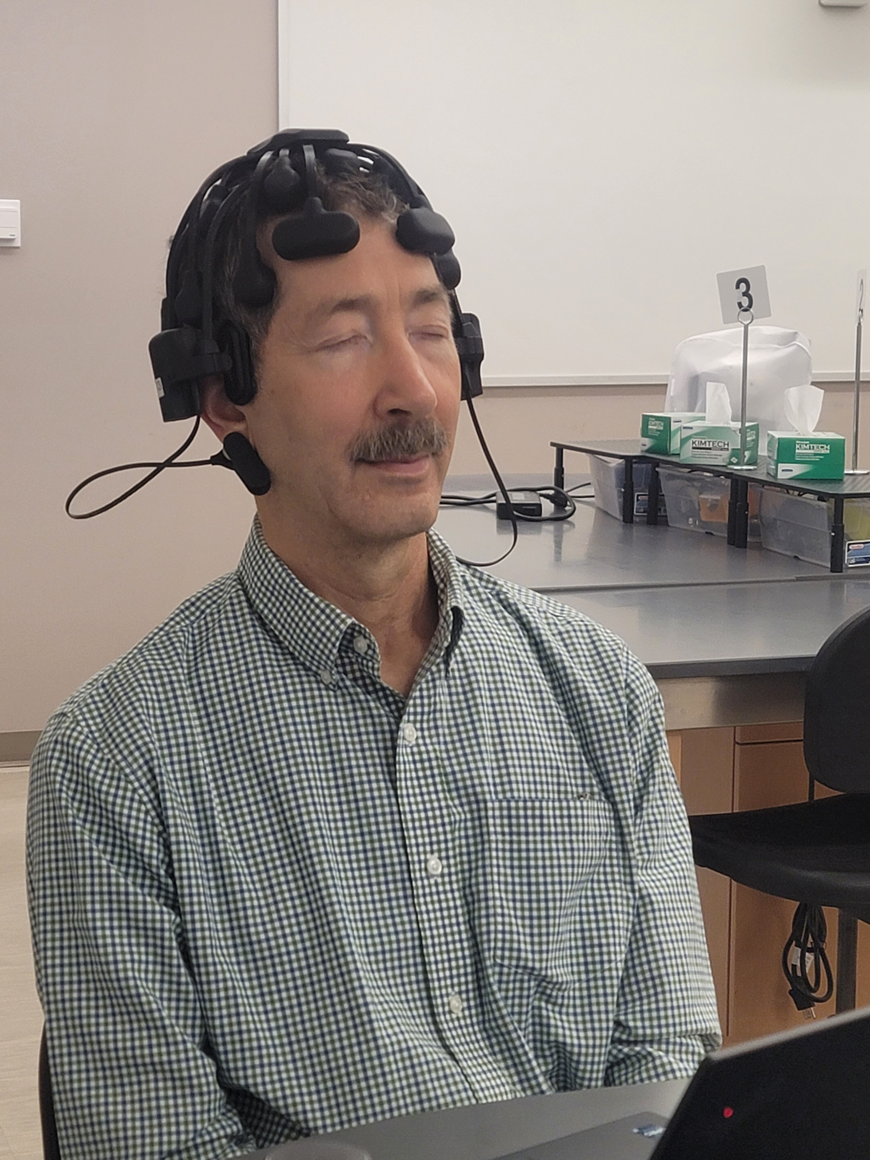
EEG Study – Reiki Practitioner
Reiki Master Teacher (author), with 8 leads monitored
CGX 20 channel wireless dry EEG headset like https://www.cgxsystems.com/quick-20m

Slide 10
EEG Study
Lab and equipment and experimental design supported by Zhuo (April) Fu, Instructor, Neuroscience. Assisted by doctoral student Chin-Hui Chen.
EEG headsets on each of Reiki practitioner “R” and collaborator “C”
Baselines: 10 min each: eyes open/closed
Math problems (stress): 10 min
Random sessions (6) with R doing: self-Reiki, distant-Reiki
C felt relaxed only during distant-Reiki

Slide 11
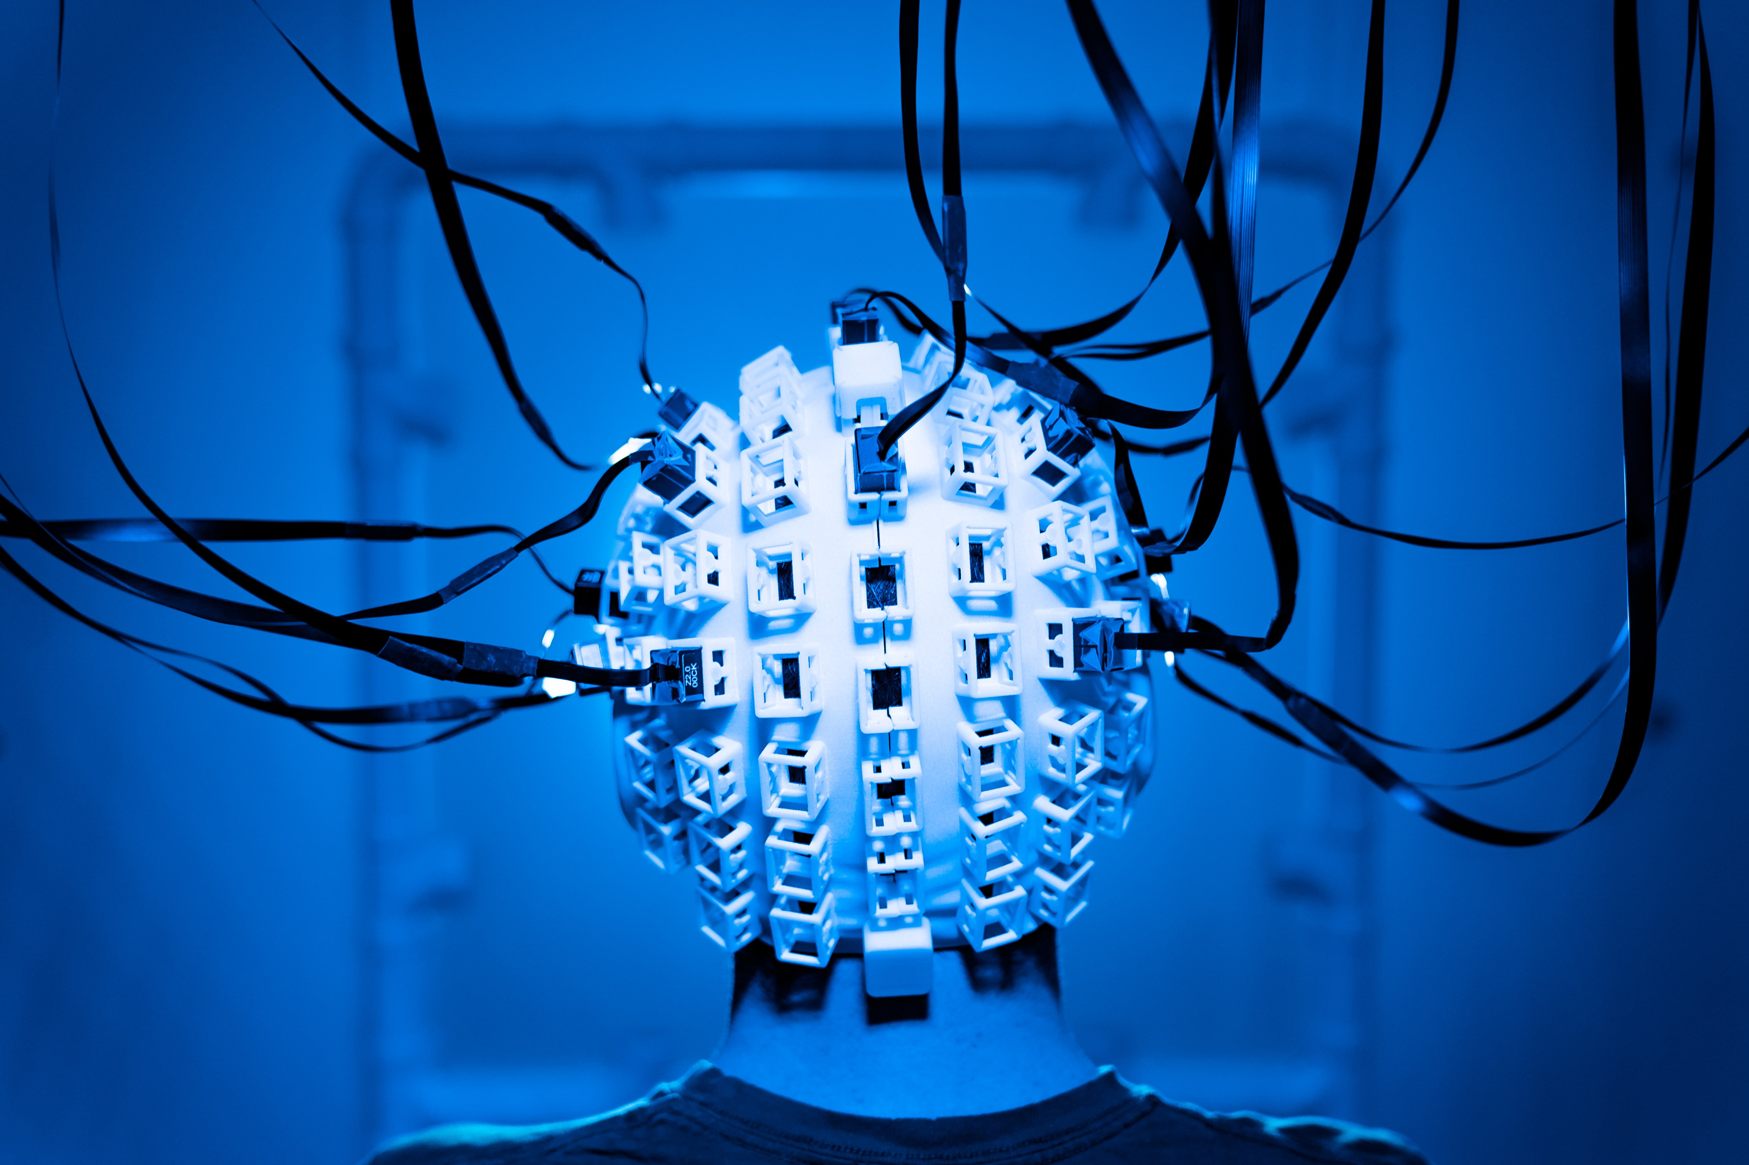
Conclusions, Collaboration
Universities can host a Reiki Club, that can advance research plus outreach.
Experiments were approved by Institutional Review Board or Animal Research Protocol Review Board.
Small pilot studies can explore ideas in Reiki research.
Collaboration is invited to:
  Extend the EEG study and data analysis
  Expand on promising pilot studies
  Help convince cutting-edge university research groups to undertake more Reiki research (e.g., with novel equipment: https://news.vt.edu/categories/impact/decoding-mental-health.html)

Slide 12
Small-scale Research Studies at a University Reiki Club
Edward A. Fox, Ph.D.
Emeritus Professor of Computer Science, fox@vt.edu
Summary
Reiki Club
Canine Hip Dysplasia Related Pain
Tissue Cultures
Infrared Videography of Palms
Survey of Staff Recipients
EEG Recording to Assess Effects of Distant Reiki
Conclusions, Call for Collaboration
Discussion, Q&A
https://fox.cs.vt.edu/talks/2025/FoxIRRC20251005.pptx
https://www.edwardafox.com/reikibooks

