Slide 1
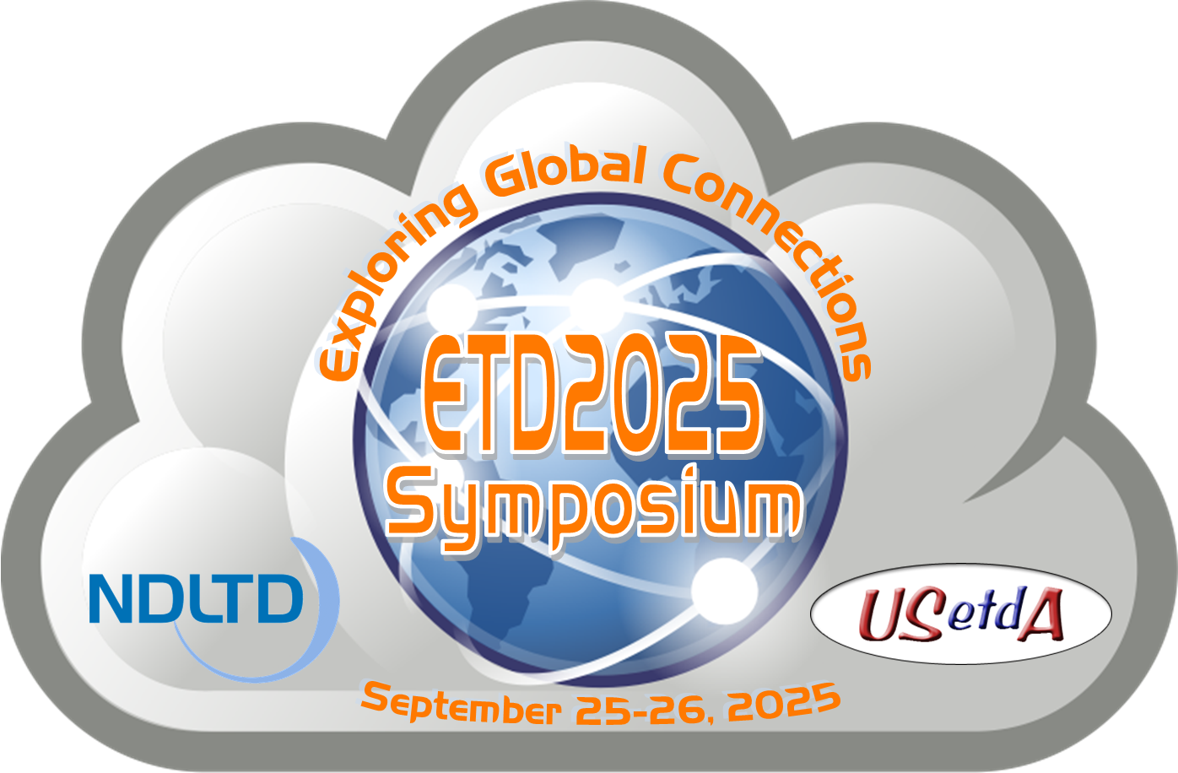
ETDs for Beginners Workshop 9/25/2025
Preservation Strategies
Presentation at ETD/USETDA 2025, Virtual
Edward A. Fox
Emeritus Professor of Computer Science, Virginia Tech, Blacksburg, Virginia 24061, USA
Executive Director, NDLTD
With Additional Information from
NDLTD Website (ndltd.org)
http://fox.cs.vt.edu/talks/2025/20250925BeginnersPreservation.pptx

Slide 2
Wikipedia Pages
https://en.wikipedia.org/wiki/Digital_preservation
https://en.wikipedia.org/wiki/British_Library_Preservation_Advisory_Centre
https://en.wikipedia.org/wiki/Digital_Preservation_Coalition (UK)
https://en.wikipedia.org/wiki/Digital_repository_audit_method_based_on_risk_assessment (DRAMBORA)
https://en.wikipedia.org/wiki/HathiTrust (US, Canada, Europe)
https://en.wikipedia.org/wiki/Information_lifecycle_management
https://en.wikipedia.org/wiki/Internet_Archive (USA)
https://en.wikipedia.org/wiki/MetaArchive_Cooperative
https://en.wikipedia.org/wiki/National_Digital_Preservation_Program (India)
https://en.wikipedia.org/wiki/Open_Content_Alliance

Slide 3
Selected Web Pages
NDLTD page on ETD Preservation: https://ndltd.org/etd-preservation/
  Since 2008, worked with MetaArchive Cooperative (see next slide)
  List of Digital Preservation Systems (DPS), e.g., DuraSpace/LYRASIS (https://lyrasis.org/), Portico (https://www.portico.org/)
Digital Preservation Coalition: https://www.dpconline.org/
OAIS: Reference Model for an Open Archival Information Systems, 2012, then ISO 14721:2025
  https://www.iso.org/standard/87471.html
  http://www.oais.info/
US Library of Congress Preservation Directorate: https://www.loc.gov/preservation/

Slide 4
MetaArchive Cooperative
Founded in 2004
Sunset March 31, 2025
Variety of data types and genres of content, including ETDs, digital newspapers, archival content (photograph collections and A/V materials), business/e-records, and datasets
Transformation/support with LOCKSS (Lots of Copies Keep Stuff Safe) program: https://www.lockss.org/, https://www.lockss.org/news/metaarchive-transformation

Slide 5
Manage ETDs https://ndltd.org/thesis-resources/manage-etds/
Guidance Documents for Lifecycle Management of ETDs
Educopia Institute: ETDplus Guidance Briefs and ETD+ Toolkit, a set of free introductory training resources on crucial data curation and digital longevity techniques: https://educopia.org/blog/two-year-imls-grant-awarded-to-study-management-of-supplemental-data-for-etds/
ETD Metadata Standard (ETD-MS)

Slide 6
Preservation Topics and Issues
Access
Authenticity
Data preservation
Emulation
Encapsulation
Fixity
Format obsolescence
Identification
Integrity
Layers of archiving
Migration
Physical media obsolescence
Preservation metadata
Refreshing
Renderability
Replication
Software preservation
Sustainability
Trusted Digital Repository (TDR)
Trustworthy Digital Objects (TDOs)

Slide 7
Possible Future Collaborations
Internet Archive
  Possible harvesting using metadata from OATD.org
OCLC: https://www.oclc.org/
  CONTENTdm: https://www.oclc.org/en/contentdm.html
  Preservation Health Check (through 2014): https://www.oclc.org/research/areas/research-collections/phc.html
Theses Canada (with Library and Archives Canada)
  https://www.canada.ca/en/library-archives/services/heritage/theses.html

Slide 8
Questions?
Discussion?
Thank You!
fox@vt.edu
fox@ndltd.org
j-etd@ndltd.org

