Slide 1

Reiki for Scalable Whole Health
Whole Health Consortium -- September 4, 2025
Tech4WholeHealth: Integrating Technology for Whole Health Solutions
Edward A. Fox, Ph.D., Emeritus Professor of Computer Science, fox@vt.edu
Research Snapshot:
Benefits: Whole Health: Physical, Mental, Emotional, Spiritual
  Practice for stress reduction and relaxation that promotes healing
Advantages
  Very easy to learn
    Beginners can start in an hour
  Enables self-treatment, as well as help to others
  Complementary to other wellness approaches
  97 NIH Reiki Clinical Trials
  https://clinicaltrials.gov/search?term=reiki
Methodology
  Zoom breakout rooms for training and feedback
  Online delivery of "universal life energy": Treatments, Training
Evaluation
  Using surveys and remote instrumentation
Populations: Public, Massage Therapists, Health-Care Practitioners, …

Slide 2
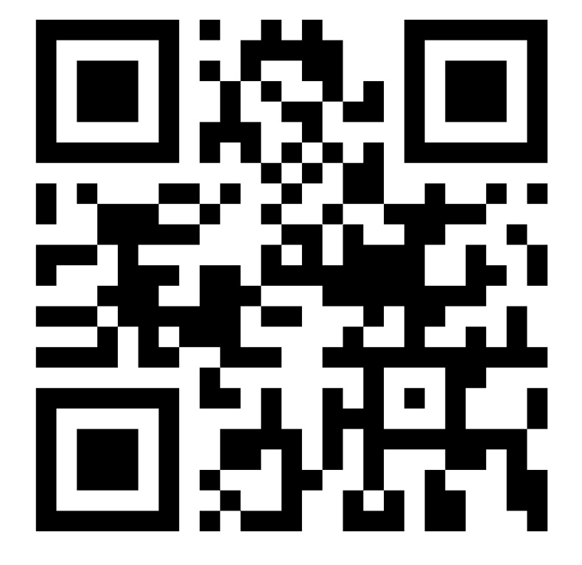
Reiki for Scalable Whole Health
Expertise and Resources:
Faculty advisor for Reiki Club at VT from March 2003
  Club meetings: Wed. 5:30-6:45pm, Johnson Student Center 102
  https://fox.cs.vt.edu/reikiclub.html
  Club experiments: EEG, infrared camera, dog gait, petri dishes
Reiki Master/Teacher in both Usui and Holy Fire approaches
Professional member, centerforreikiresearch.com
Training materials from International Center for Reiki Training (reiki.org)
Over 50 Reiki-related books at https://www.amazon.com/
Free references
  Web pages from: https://fox.cs.vt.edu/reiki.htm
  Overview book: https://www.edwardafox.com/reikibooks
Many Reiki practitioners in Blacksburg and the region

Slide 3
Reiki for Scalable Whole Health
Opportunities Sought:
Help with Studies Demonstrating Beneficial Effects
Co-Investigators
  Medical/Health-care Credentials
  Evaluators: Surveys, EEGs, fMRI, etc.
Other Collaborators, e.g., those to learn and teach “Rei-ki”
Participants/Subjects in Various Populations
  General Public
  Massage Therapists
  Nurses
  Students
  Other Health-care Practitioners
Please Contact Me!
fox@vt.edu, https://www.edwardafox.com/reikibooks
https://wholehealth.isce.vt.edu/members-directory/fox-edward-bio.html

