Slide 1
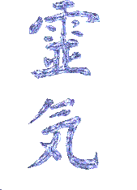
Reiki at Virginia Tech
Edward A. Fox
Former Faculty Advisor, Reiki Club (Virginia Tech)
Member, IARP (Int’l Assn. Reiki Professionals)
Professor (retired), Dept. of Computer Science, VT
http://fox.cs.vt.edu/reiki.htm fox@vt.edu
Presented 3/17/2025 & 3/18/2025
http://fox.cs.vt.edu/talks/2025/20250317ReikiHNFE2334.pptx

Slide 2
Key Concepts
Humans have an energetic anatomy and physiology that work together, and that can be modeled in various ways.
Energy transfer and interactions can be managed based on mental intention, and can operate over a distance.
Energy work can be facilitated not only by practice, but also by training, if a person is open to, and pursuant of, connection to an infinite source.

Slide 3
Outline
Background
  Fit, Terminology, History, Training
Why Reiki?
Energy, Energy Systems, Energy Medicine
Reiki Practice: Principles, Ethics, Activities
For more information: Club, References
Tong Ren Therapy
Summary

Slide 4
Fit
Reiki can be a part of an integrative health regime, covering all health dimensions.
Reiki benefits from, and facilitates, mindfulness.
Reiki helps with stress. It can address physiological, emotional, mental, and spiritual healing and development, e.g., addressing repercussions of stress.
Reiki works at a distance; one can practice while maintaining social distance.

Slide 5
Terminology
Reiki = “universal life energy” (rei + ki)
Mikao Usui = founder of Reiki (in 1922), associate / contemporary of those who founded karate and akido
RMT = Reiki “Master/Teacher”
Levels = 1, 2, 3 (at which point can teach)
Attunement = process of RMT-aided learning Reiki (tuning in, so you can “channel” energy)

Slide 6
History
August 1865: Mikao Usui born in Gifu prefecture in Japan
March 1922: Usui-sensei experienced spiritual awakening after 3rd wk fasting on Mt. Kurama, Kyoto; named healing as Usui Reiki Ryoho
March 1926: Usui-sensei passed away in Fukuyama
Chujiro Hayashi (1879-1940)
Western Reiki: Hawayo Takata (1900-1980), Phyllis Furumoto, …

Slide 7
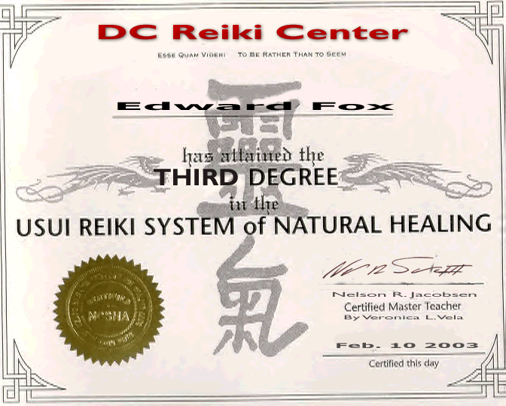

Slide 8
Experience with “Energy Work”
Acupressure since 1979 (“Touch for Health”)
Reiki: 100s of attunements, 1000s hours practice
Worked with RMTs in many countries, e.g.,
  Brazil
  China
  England
  Germany
  Greece
  India
  Italy
  Malaysia
  Russia
  USA

Slide 9
Outline
Background
  Fit, Terminology, History, Training
Why Reiki?
Energy, Energy Systems, Energy Medicine
Reiki Practice: Principles, Ethics, Activities
For more information: Club, References
Tong Ren Therapy
Summary

Slide 10
Why Reiki?
Very easy to learn; anyone can do it.
To help oneself and others (people+animals)
Promotes health/healing & development: physical/emotional/mental/spiritual
Can “power” and lead to benefits of acupuncture, hatha and kundalini yoga, homeopathy, qigong, tai chi, tong ren healing, and other types of “energy medicine”

Slide 11
What Can Reiki Do?
Sense energy “blockages”
Clear an acupoint
Clear a meridian
Clear a chakra; balance chakras
Clear the aura including its layers
Speed up healing
Help calm, relax, reduce pain
Non-invasive help to body internals
  Work on cells, organs, structures, systems

Slide 12
89 NIH Reiki Clinical Trials for
AIDS (HIV)
Anxiety
Bone Marrow Transplants
Cancer
Catheters
Cesareans
Coronary Disease
Depression
Diabetes
Distress
Elderly
Fatigue
Fibromyalgia
Gulf War Veterans
Gynecology,Cramps, Pregnancy, Birth
Heart Disease
Hemodialysis
HIV
Kidneys
Knees
Menopause
MS (Multiple Sclerosis)
Myeloma
Neuropathy
Nursing
Oncology
Osteoarthritis
Pain
Palliative Care, Hospice
Pediatric Patients
PTSD
Pulmonary Hypertension
Sexuality/Disfunction
Sleep
Stress
Surgery Fear
Tinnitus
Ventilators, Tubes
Veterans
…
https://clinicaltrials.gov/ct2/results?term=reiki&Search=Search

Slide 13
Outline
Background
  Fit, Terminology, History, Training
Why Reiki?
Energy, Energy Systems, Energy Medicine
Reiki Practice: Principles, Ethics, Activities
For more information: Club, References
Tong Ren Therapy
Summary

Slide 14
Terms related to “Energy”
Aura
Biological energy (Wilhelm Reich)
Chi, Ki, Qi (China, Japan)
EMF (electromagnetic force)
HEF (human energy field)
Huna (Hawaii)
Prana (India)
Spirit (Jesuit translation of Chinese “Qi”)
Vital force (homeopathy)

Slide 15
Measurement of “Energy”
Electrocardiogram, electroencephalogram
Magnetoencephalograph, SQUID
Galvanic skin response (acupoints)
Kirlian photography
Gaseous Discharge Visualization (GSV)
Or by skilled human practitioners:
  Reiki, Traditional Chinese Medicine (e.g., pulse check), Therapeutic Touch

Slide 16
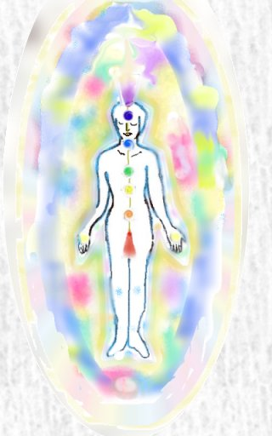
Aura,
Human energy field,
Human energy system

Slide 17
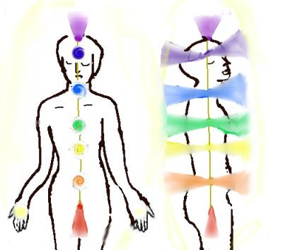

Slide 18
Glands, Chakras, Nervous System
Number, Gland | Chakra | Nervous System
7 pituitary | Crown | Brain upward
6 pineal | Brow (3rd eye) | Brain
5 (para)thyroid | Throat | Cervical plexus
4 thymus | Heart | Cardiac plexus
3 pancreas | Solar plexus | Solar plexus
2 gonads | Hara (center) | Pelvic plexus
1 adrenals | Root | Sciatic plexus

Slide 19
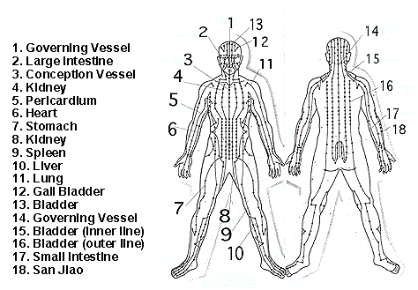
Chinese: Acupoints, Meridians

Slide 20
Outline
Background
  Fit, Terminology, History, Training
Why Reiki?
Energy, Energy Systems, Energy Medicine
Reiki Practice: Principles, Ethics, Activities
For more information: Club, References
Tong Ren Therapy
Summary

Slide 21
Usui Reiki Principles
Version a:
For today only
anger not,
worry not.
Be humble, and
With Gratitude work on yourself.
Be Compassionate.
Version b:
Just for today
do not worry,
do not anger.
Treat others with respect and forgiveness.
Work with integrity.
Be grateful.

Slide 22
Attunement
Opens Chakras:
  7 Major Chakras
  Hand (Foot) Chakras – to heal self / others
Teacher:
  radiates energy so student will “tune in”
  helps with clearing blockages to flows
  makes affirmations about student attunement
Student:
  hands in “prayer position”
  “return” when ready, drink extra water

Slide 23
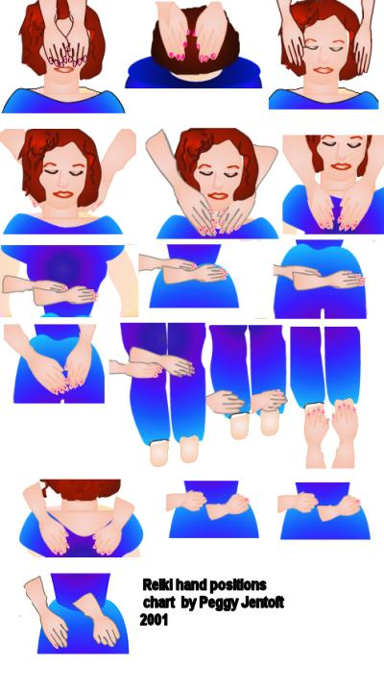

Slide 24
IARP (iarp.org) Code of Ethics
Code of Ethics for Registered Practitioners
The Registered Practitioner (RP) agrees to:
1. Abide by a vow of confidentiality. Any information that is discussed within the context of a Reiki session is confidential between the client and the Practitioner.
2. Provide a safe and comfortable area for client sessions and work to provide an empowering and supportive environment for clients.
3. Always treat clients with the utmost respect and honor.
4. Provide a brief oral or written description of what happens during a session and what to expect before a client's initial session.
5. Be respectful of all other's Reiki views and paths.

Slide 25
6. Educate clients on the value of Reiki and explain that sessions do not guarantee a cure, nor are they a substitute for qualified medical or professional care. Reiki is one part of an integrated healing or wellness program
7. Suggest a consultation or referral to qualified licensed professionals (medical doctor, licensed therapist, etc.) when appropriate.
8. Never diagnose or prescribe. Never suggest that the client change prescribed treatment or interfere with treatment of a licensed health care provider.
9. Never ask clients to disrobe (unless in the context of a licensed massage therapy session). Be sensitive to the boundary needs of individual clients. Do not touch the genital area or breasts. Practice hands off healing of these areas if treatment is needed.
10. Be actively working on your own healing so as to embody and fully express the essence of Reiki in everything that you do.

Slide 26
Gassho
Common practice in many eastern traditions, holding the hands clasped in a “prayer position” at about the level of the chest; this completes the meridians that terminate in the hands.
Called "Namaste" in the Indo-Tibetan traditions.
Formally practiced by sitting on the floor or on a chair, with the eyes closed.
Try “energy ball” before, after, and later.

Slide 27
Kenyoku-ho
Kenyoku-ho (dry bathing): to clear and strengthen the energy channels. The technique was common to many martial arts and chi kung schools such as JuJitsu, Aikido and KiKo and was added by Usui. It is likely that this technique comes from the rituals of Shinto priests. The ritual action was to cleanse the body before contacting the deity.
Those familiar with the martial arts will recognize the two parts of this technique as common techniques. The first is a down block across the midsection (this technique is used in a variety of martial arts such as Karate, Kung Fu, Aikido, etc.). This down block is followed by what is commonly called in the martial arts as a "shirk" or technique to remove an opponent’s hand from your wrist that is done by sliding the knife edge of your hand down the arm.
A. Place your right hand on the left shoulder so that the right fingertips are on the left shoulder. The hand is open, the fingers held together all point upwards. The hand (palm down) is against the body.
B. Slide the hand downward toward the right hip. Move the hand, going across the chest and ending up fingers down at the right hip. The hand (palm down) stays in light contact with the body the entire movement. (This is what is called an open handed down block in the martial arts)
C. Repeat this process starting with the left hand on the right shoulder and going down to the left hip.

Slide 28
Part Two
D. Place the right hand again on the left shoulder. Slide the right hand down the left arm (inside or outside, each will cover different meridians - see below) all the way to the fingertips. (This is what would be called a "shirk" in the martial arts, used to remove an opponent’s hand that is grabbing your arm.)
E. Repeat this with the left hand on the right arm.
F. Start with the right hand on the inside of the left elbow, and slide the hand down to the fingertips.
G. Repeat this with the left hand on the right inside of the elbow.
Note - Some masters teach the hand should slide to the inside of the arm and others teach it should slide down the outside of the arm. Different meridians are stimulated for each. The inside slide is yin and will effect the lung, heart, and kidney meridians. The outside slide is yang and will effect the triple warmer, colon and small intestine meridians.

Slide 29
Reiki Mawashi
Reiki Mawashi = Reiki Circle.
Group of Reiki practitioners in a circle.
Hands are held with your left-hand palm up and your right palm down.
Your left palm is placed against the next person's right hand that is palm down on top of it.
All members are connected in this manner making a complete circle.
The circle is part energy movement and part meditation.
The Reiki flows from the crown down the right arm to the hand and the overflow goes into the left hand of the person next to you. The energy moves into all and around the circle in this manner.
The energy can be quite intense over time.
Some traditions hold an inch to three inches between the participant's hands.
Some traditions have a master stand in the center of the circle to direct the flow.

Slide 30
Outline
Background
  Fit, Terminology, History, Training
Why Reiki?
Energy, Energy Systems, Energy Medicine
Reiki Practice: Principles, Ethics, Activities
For more information: Club, References
Tong Ren Therapy
Summary

Slide 31
VT Reiki Club
https://fox.cs.vt.edu/reikiclub.html
reiki@vt.edu
Weekly meetings when student organizations are allowed to meet
Wed 5-6:30pm, Squires 147+ Zoom: https://virginiatech.zoom.us/my/alexlilly
Open to public: Free “treatments” and “attunements”

Slide 32
Reiki References - Getting Started
Vennells, David F. Beginner’s Guide to Reiki. Barnes and Noble, New York, 1999. ISBN 0-7607-3798-3
Jewell, Penelope. Reiki: A Guide to your Practice of Reiki Energy Healing. Latham, NY: Adirondack Press, 2003, ISBN 0-9664072-0-2
Ellis, Richard. Practical Reiki: Focus Your Body’s Energy for Deep Relaxation and Inner Peace. Sterling Pub. Co., Inc., New York, 1999. ISBN 0-8069-6807-9.
Burack, Marsha. Reiki, Healing Yourself & Others: A Photo-Instructional Art Book. Reiki Healing Institute, Encinitas, CA: ISBN 1-880441-39-X,1995.
Lubeck, Walter, Frank Arjava Petter, William Lee Rand. The Spirit of Reiki. Lotus Press, Shangri-La; 2001, ISBN: 0-914955-67-5, 200. (Has lots of guidance on treating various conditions - a good manual.)

Slide 33
Reiki References - Intermediate
Honervogt, Tanmaya (Reiki Master-Teacher). The Power of Reiki: An Ancient Hands-on Healing Technique. An Owl Book, Henry Holt and Company, New York, 1998, ISBN 0-8050-5559-2
Honervogt, Tanmaya. Inner Reiki. New York: Owl Book, Henry Holt & Company, 2001. ISBN 0-8050-6690-X.
McKenzie, Eleanor. Healing Reiki. Ulysses Press; ISBN: 1569751625 (November 1998)
Muller, Brigitte and Horst H. Gunther. A Complete Book of Reiki Healing. LifeRhythm, Mendocino CA, 1995,ISBN 0-940795-16-7
Rowland, Amy Z. Traditional Reiki for Our Times: Practical Methods for Personal and Planetary Healing. Healing Arts Press, Rochester, VT, 1998. ISBN 0-89281-777-1.

Slide 34
Reiki References - More Advanced
Stein, Diane. Essential Reiki: A Complete Guide to an Ancient Healing Art. The Crossing Press, ISBN 0-89594-736-6, 1995.
Usui, Dr. Mikao and Frank Arjava Petter, Foreword by William Lee Rand. The Original Reiki Handbook of Dr. Mikao Usui. Translated by Christine M. Grimm, Lotus Press, Shangri-La, 2000, ISBN 0-914955-57-8
Kelly, Maureen J. Degrees of Reiki. Twin Lakes, WI: Lotus Press, 2002, ISBN 0-940985-56-X
Lübeck, Walter. Aura Healing Handbook. Lotus Press, Shangri-La; 1991 Germany, 2000 English, ISBN: 0-914955-61-6
Lübeck, Walter, Frank Arjava Petter. Reiki Best Practices: Wonderful Tools of Healing for The First, Second, and Third Degree of Reiki. Lotus Press, Shangri-La; 2003, ISBN: 0-914955-74-8

Slide 35
Reiki References - Historical
Frank Arjava Petter, Tadao Yamaguchi, Chujiro Hayashi. The Hayashi Reiki Manual: Traditional Japanese Healing Techniques from the Founder of the Western Reiki System. Lotus Press, Shangri-La; 2003, ISBN: 0-914955-75-6
Usui, Dr. Mikao and Frank Arjava Petter, Foreword by William Lee Rand. The Original Reiki Handbook of Dr. Mikao Usui. Translated by Christine M. Grimm, Lotus Press, Shangri-La, 2000, ISBN 0-914955-57-8
Doi, Hiroshi. Modern Reiki Method for Healing. Fraser Journal Publishing, Canada, ISBN: 0-9688100-0-4
Stein, Bronwen and Frans. The Reiki Sourcebook. Alresford, UK: O Books, 2003, ISBN 1 903 816 55 6

Slide 36
Related References - Healing
Burger, Bruce. Esoteric Anatomy: The Body as Consciousness. North Atlantic Books, 1998, ISBN 1-55643-224-0
Brennan, Barbara Ann. Hands of Light, A Guide to Healing Through the Human Energy Field. Bantam, NY, ISBN 0-553-34539-7, 1987
Brennan, Barbara Ann. Light Emerging, The Journey of Personal Healing. Bantam, NY, ISBN 0-553-35456-6, 1993
Eden, Donna with David Feinstein (foreward by Caroline Myss). Energy Medicine. Penguin/Putnam, NY, 1999, ISBN 1-58542-021-2
Gach, Michael Reed. Basic Acupressure: The Extraordinary Channels & Points. Acupressure Inst., Berkeley, 1999
Gach, Michael Reed. Intermediate & Advanced Acupressure Course Booklet. Acupressure Inst., Berkeley, 1984

Slide 37
Related References - Healing (cont.)
Gienger, Michael. Crystal Power, Crystal Healing: The Complete Handbook. Cassell & Co, London, 2002, ISBN 0-7137-2677-6
Mitchell, Emma. Energy Now: Simple ways to gain vitality, overcome tension, and achieve harmony and balance. Macmillan, Singapore, 1998, ISBN 0-02-862675-3
Angelo, Jack. Hands-On Healing: A Practical Guide to Channeling Your Healing Energies; Healing Arts Press, Rochester, VT, 1997, ISBN 0-89281-734-8
Thie, John, Keith Marks (Photographer). Touch for Health: A Practical Guide to Natural Health Using Acupressure Touch and Massage to Improve Postural Balance and Reduce Physical and Mental Pain and Tension, DeVorss & Company, Dec. 1979, ISBN: 0875161804

Slide 38
Related References - Science
Gerber, Richard. Vibrational Medicine, 3rd Edition, 2001. Bear & Company, Rochester, VT ISBN 187918158-4
Jonas, Wayne B and Crawford, Cindy C., ed. Healing, Intention, and Energy Medicine: Science, Research Methods and Clinical Implications. New York: Elsevier Science Ltd., 2003. ISBN 0443-07237 X.
Oschman, James L. (with foreward by Candace Pert). Energy Medicine: The Scientific Basis. Churchill Livingstone (an imprint of Elsevier Science Ltd), Edinburgh, 2002, ISBN 0-443-06261-7
Oschman, James L. Energy Medicine in Therapeutics and Human Performance. Butterworth Heinemann (an imprint of Elsevier Science Ltd), Philadelphia, PA, 2003, ISBN 0-7506-5400-7
Pert, Candace B. Molecules of Emotion: Why You Feel the Way You Feel. New York: Scribner, 1997. ISBN 0-684-84634-9
Benor, Daniel J.; Healing Research: Holistic Energy Medicine and Spirituality; Volume 2: Holistic Energy Medicine and the Energy Body; Helix Editions, Munich, 1992, ISBN 3-927930-22-9
Francomano, Clair A. and Wayne B. Jonas (ed. Ronald A. Chez); Proceedings: Measuring the Human Energy Field: State of the Science; The Gerontology Research Center, National Institute of Aging, National Institutes of Health, Baltimore, MD, April 17-18, 2002

Slide 39
Related References - Animals
Zidonis, Nancy A. and Amy Snow. Acu-Cat: A Guide to Feline Acupressure. Tailgrass Publishers, Denver CO, 2000, ISBN 0-9645982-5-6
Zidonis, Nancy A. and Marie K. Soderberg. Canine Acupressure: A Treatment Workbook. Equine Acupressure, Parker CO, 1995, ISBN 0-9645982-0-5

Slide 40
Reiki Web Sites
http://fox.cs.vt.edu/reiki.htm - my Reiki site
https://fox.cs.vt.edu/reikiclub.html - VT Reiki Club
http://www.iarp.org/ - International Association of Reiki Professionals
https://thereikipage.com/ - broad site, by David Herron
http://www.reiki.org - international center
http://reikirays.com – Reiki Rays, listing 33 books, and with a variety of free resources
http://ihreiki.com – International House of Reiki, with Frans Stiene
and a few from individuals:
http://reikifor.life – Reiki and Psychic Services, by Dave Lewis
http://beradiantreiki.com – Be Radiant, by Deanna Jaromay-Arriva

Slide 41
Outline
Background
  Fit, Terminology, History, Training
Why Reiki?
Energy, Energy Systems, Energy Medicine
Reiki Practice: Principles, Ethics, Activities
For more information: Club, References
Tong Ren Therapy
Summary

Slide 42
Tong Ren Therapy
Visit by Chad J. Dupuis, L.Ac.
Presentation of Feb. 3, 2006 for Reiki Club
Based on collaboration with Tom Tam
Supported by acupuncture, qi gong, martial arts theory – further improved upon by western medical understandings of anatomy and physiology, and proven by clinical practice with a broad range of conditions.

Slide 43
Chinese Medicine
Has been utilized by millions of people over thousands of years to heal disease and promote health.
A strength of the approach is in its ability to treat each person as an individual - using a variety of diagnostic factors to fine tune treatments to each person.

Slide 44
Acupuncture
Acupuncture is but one technique within Traditional Chinese Medicine (TCM).
Herbal medicine and adjunctive techniques -- such as cupping, moxibustion, and tuina -- are all important aspects of TCM.

Slide 45
Meridians and Points
Acupuncture meridians and points have been developed over many years by many masters.
Imbalances in the meridians signify underlying health problems.
Stimulation/sedation of the points, and regulation of the meridians, promote health and heal disease.

Slide 46
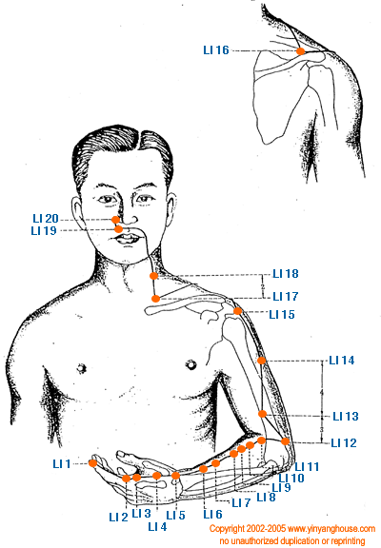
Large Intestine Meridian

Slide 47
Qi Gong
Qi – is energy, e.g., the energy of the meridians and the physical body, but it is also related to the energy of emotions and interactions.
Qi Gong techniques are drawn from the martial arts and Buddhist/Taoist meditation techniques, many of which are thousands of years old.
If we have Qi and this Qi effects the functioning of the body – then we should be able to manipulate that Qi and treat disease.

Slide 48
Western Medicine Aspects
Using the tools of Chinese Medicine and the sense of energy from Qi Gong practice, one can better utilize western medical understandings for healing.
A variety of acupuncture points have been proven to directly stimulate physiological functions of the body. Understanding this mechanism better and the result of such changes is behind Tong Ren techniques.

Slide 49
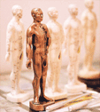
Tong Ren Techniques
The “Tong Ren” or “Bronze Man” model serves as a way to focus our intent and to stimulate the collective unconscious.
The collective unconscious allows the effect to be present within the patient (and others at the same time).
The “blockage theory” guides the focus on the areas treated.
Removal of blockages allows the body to heal.
Important blockages relate to nerves as well as muscles.

Slide 50
Blockage Theory
Cancer, as an example:
  Eastern – yin and yang are out of balance
  Western – cells have mutated for some reason
  Tong Ren – a “blockage” causes a disruption in the flow of energy and bioelectricity leading to disease.

Slide 51
Blockage Theory cont.
The existence of a “blockage” does not indicate disease per se, but a disease will not manifest without exhibiting a blockage.
Finding these blockages and devising the best mechanisms to resolve them is our goal.
The blockages can be sensed energetically, but also by palpation, and will generally illicit pressure pain.
Many blockages relate to the nervous system, including around the spine, head, and neck.
Location is easy relative to acupoints and vertebrae.

Slide 52
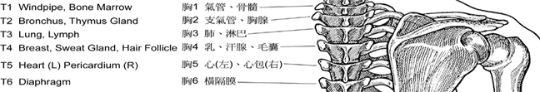
Focus Areas: the Spine
Use of the huatuo-jiaji points – the areas next to each vertebral segment.
Improve the flow of bio-electricity by reducing impediments to nerve conduction.

Slide 53
Focus Areas: Scalp
Use of acupuncture points on the scalp differs somewhat from TCM usage.
Tong Ren is used to change brain function as well as remove tumors.

Slide 54
Breast Cancer Treatment
Main Points – T4, ST 12, Ouch Point
Secondary Points – T3, GV 22, BL 9, CV 17
  T4 – Breast, Sweat Glands, Hair follicles, PC Shu
  ST 12 – Open the chest
  Ouch Point – Qi Gong to dissipate tumor
    T3 – Often added with T4 – controls lung and skin in TCM
    GV 22 – Open the unconscious, effect frontal lobe
    UB 9 – Cerebellum, movement, open Qi flow
    CV 17 – Energize the upper dantian/chest

Slide 55
More Examples
Anxiety: C2r, GB13r, SI16r – T5l, LV3, HT7, Yiming, LI 18
  C2 & GB 13 – Frontal lobe/emotions (L for ADHD), SI16/LI18/Yiming free body/mind circulation, T5l heart, HT7, Effects HT Qi, LV3 descend energy
Parkinson's: C1, SI16, TH16, Tiandong – C2, Yiming, LI4, GV19, ST36, LV3
  C1, SI16, TH16, Open sky window – brain/body, Tiandong vertebral artery, LI4/LV3 open circulation throughout body (4 gates), ST36 tonify Qi, GV19 sensory cortex

Slide 56
More Examples
MS: C2, Tiandong, SI16, TH16 – C1, Yiming, BL9, GV17, GB19, ST36
  Similar to Parkinson's & ALS, any brain problem (stroke, etc.)
Crohn’s: T1, T2, T3, T11 – T12, ST12, CV6, ST36
  T1/2/3 – Autoimmune conditions, T11/T12 open SI/LI, ST12 vagus/esophagus, CV6 tonify lower dantian, ST36 build qi

Slide 57
More Information
https://yinyanghouse.com
http://www.tongrenstation.com/
https://tongrenstation.com/tomtam/
  General Chinese Medicine Theory
  Acupuncture Meridians and Points
  Tong Ren Therapy Information
  Tong Ren Books and Supplies
  Discussion Board with Testimonials

Slide 58
Summary
Background
  Fit, Terminology, History, Training
Why Reiki?
Energy, Energy Systems, Energy Medicine
Reiki Practice: Principles, Ethics, Activities
For more information: Club, References
Tong Ren Therapy
Summary

