Slide 1
Proposing research to fill in the jigsaw puzzle of one’s long-term vision of meeting essential human needs
Funding Foundry Success Story
13 December 2024, GP 3001, Virginia Tech
Edward A. Fox, fox@vt.edu
http://fox.cs.vt.edu

Slide 2
Abstract
This talk will summarize how to obtain almost 150 research awards over 40 years, with a high percentage of success with proposals. Key is focusing on a basic human need, e.g., for information. Helpful is being open to serendipity, in its various forms, related to: leading or participating in workshops on future research directions, asking graduate students about their long-term goals, traveling extensively, teaching a capstone wherein people across campus are encouraged to ask for assistance from a team of CS seniors, and collaborating with people around the globe as well as locally in a variety of centers and institutes (e.g., CHCI, FBRI, GCC, ICTAS, Sanghani, VTCAR). Sponsors like to see a long-term vision, and persistent progress that fills in the picture, like fitting together the pieces of a large jigsaw puzzle.

Slide 3
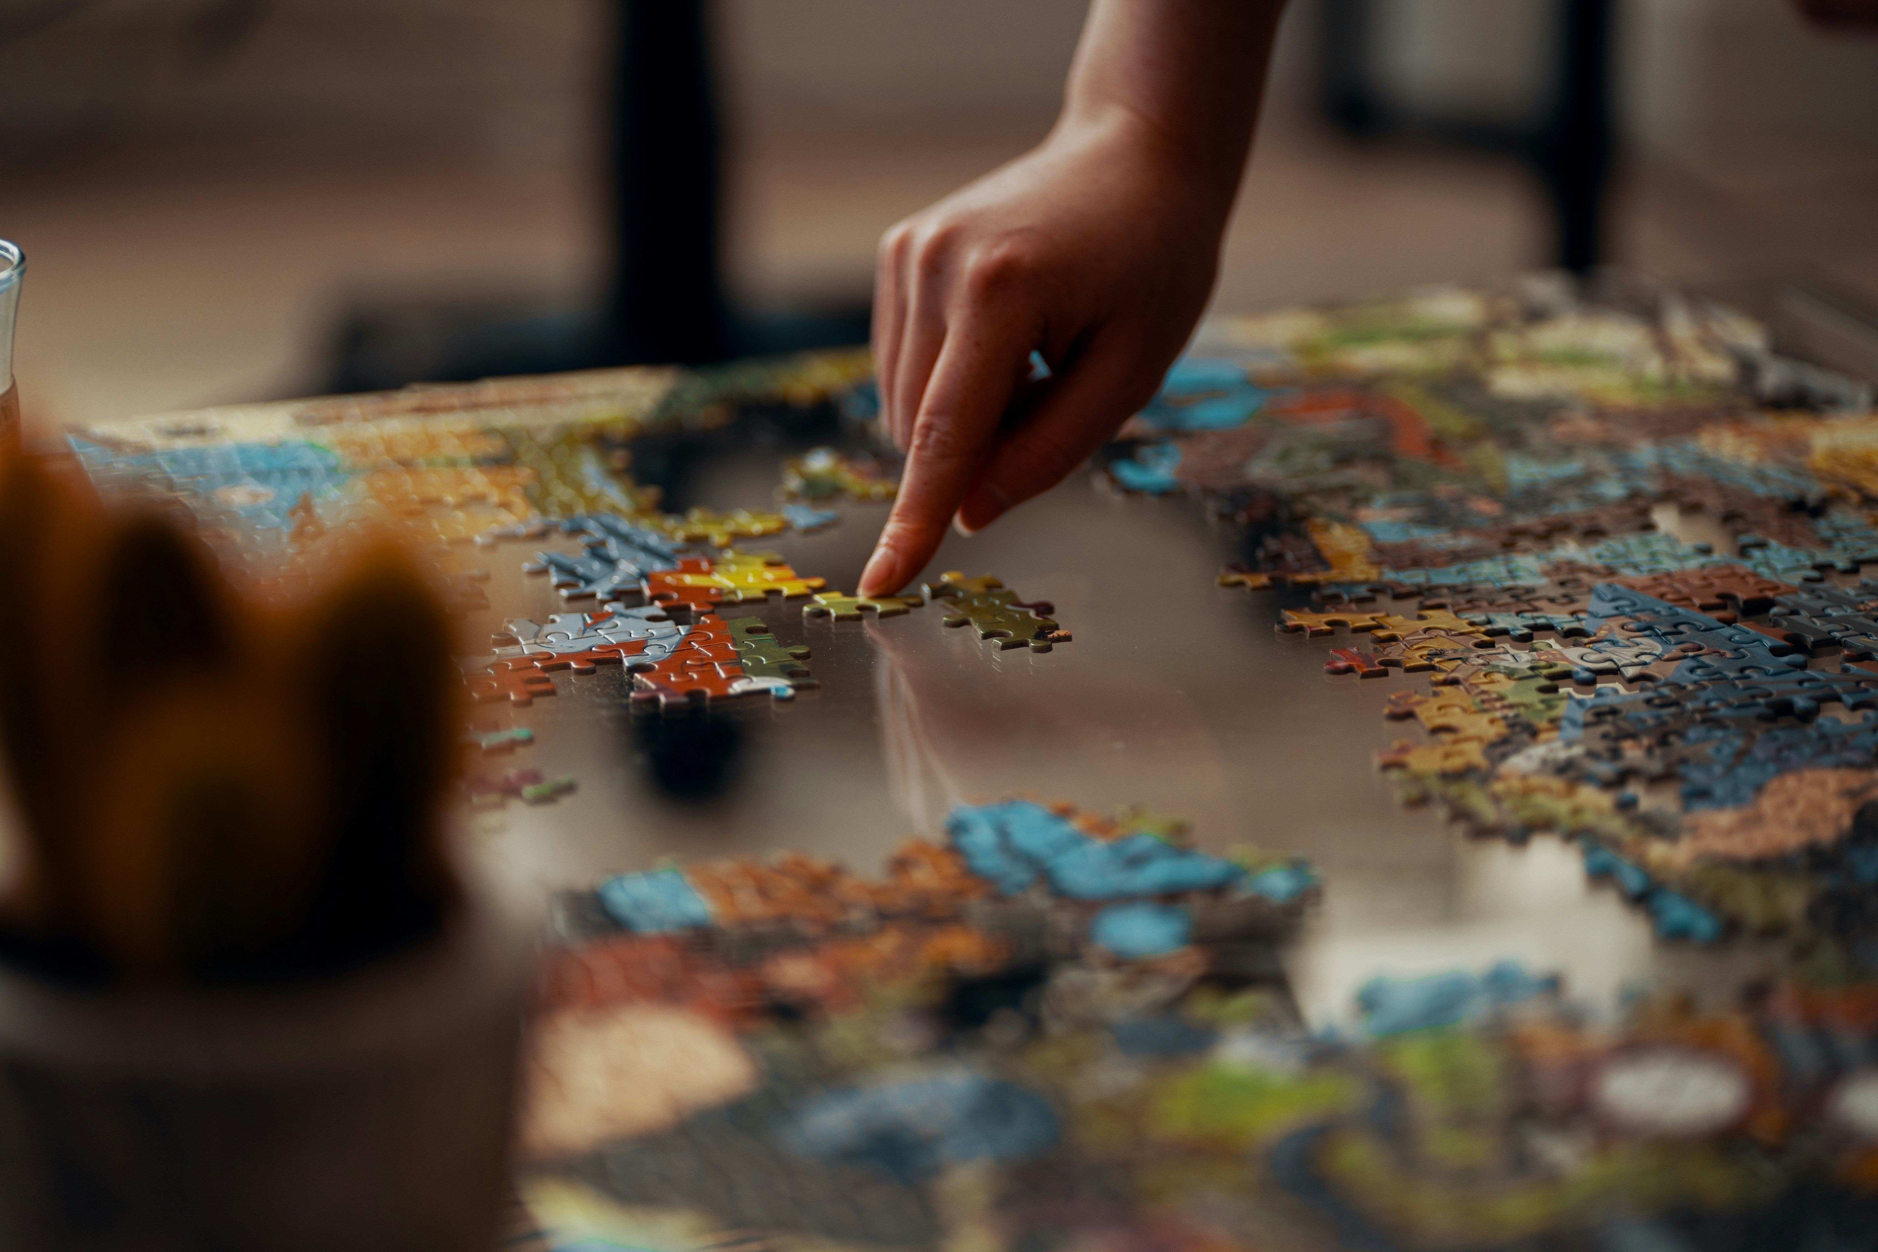
Photo by
Ross Sneddon
on Unsplash

Slide 4
Statistics on Funding
Total funding: Over $32M
Advisees: 34 PhD, 51 MS, 20 other Master’s
US Gov: DARPA/NIST, FIPSE, Idaho NL, NAL, NEH, NIA, NIJ, NLM, NSWC
Corporate: Advance Auto, AOL, AT&T, AWS, BAE, Chem Abs, e-Numerate, General Dynamics, Google, HAL, IBM, Intel, Mayfair, Microsoft, NCR, NewWave, Nimbus, OCLC, PCGI, PRC, Sun, VTX, West
Int’l/Regional: CCSR, CIT, Indo-US, Qatar, SOLINET, SURA, UNESCO, Virginia
Foundations: Argyll, Council on Library Resources, Mellon, Seale
 |  |  |  |  |  |  |  |  |  |  | TOTALS
Sponsor | PI | Sole | NSF | IMLS | NIH | US Gov | Int’l/ Regional | Corporate | Foundation | VT | 10
Count | 100 | 56 | 48 | 7 | 2 | 13 | 16 | 44 | 4 | 10 | 146

Slide 5
Funding Purposes/Uses
Collaboration across universities
Domains: archaeology, chemistry, health, law, geography, physics
Education: curricula, teaching, repositories
Equipment: workstations, clusters, HPC
Library related: accessibility, archiving, documents
Promoting electronic theses & dissertations
Seed grants with junior faculty
Student funding, class teams
Technologies: AI, CD-ROM, Digital Video, Images, Memex , NLP, VR
University activities (e.g., mentoring)
Workshops

Slide 6
Serendipity Example
Information STORAGE & Retrieval
Nimbus opened near Charlottesville
Virginia Discs 1, 2, 3
Filling? With video! -> digital video -> interactive digital video
Faster database access
Hashing
MPHF
OPMPHF

Slide 7
Essential Human Needs
Health and well-being
  Enormous body of knowledge
  Integrative, complementary approaches
  Behavior: diet, exercise, delayed gratification
Useful information
  Collecting, crawling, harvesting
  Archiving
  Preserving, transforming
  Exploration: browse, recommend, search, visualize

Slide 8
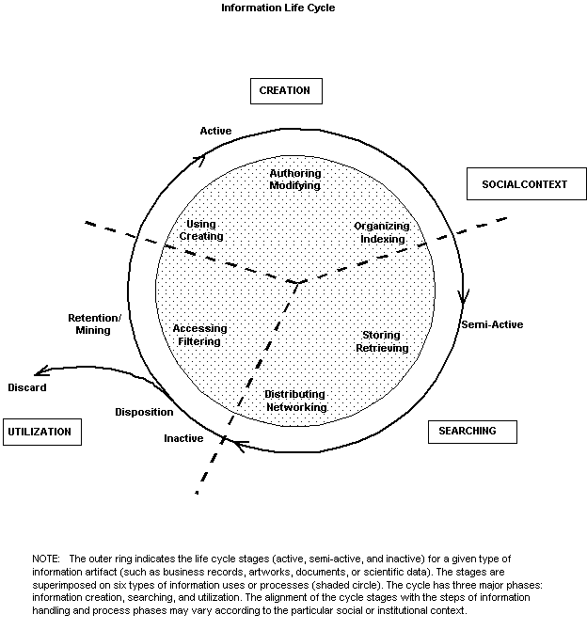
Information
Life
Cycle
Borgman et al.:
Workshop Report on
Social Aspects of
Digital Libraries:
http://www.dlib.org/dlib/january97/01clips.html
Notes:
Thanks to Christine Borgman and others at this workshop.

Slide 9
Digital Libraries --- Objectives
World Lit.: 24hr / 7day / from desktop
Integrated “super” information systems: 5S: Table of related areas and their coverage
Ubiquitous, Higher Quality, Lower Cost
Education, Knowledge Sharing, Discovery
Disintermediation -> Collaboration
Universities Reclaim Property
Interactive Courseware, Student Works
Scalable, Sustainable, Usable, Useful

Slide 10
Informal 5S & DL Definitions
DLs are complex systems that
help satisfy info needs of users (societies)
provide info services (scenarios)
organize info in usable ways (structures)
present info in usable ways (spaces)
communicate info with users (streams)

Slide 12
Handling the Explosion of Information
Conferences
Journals
Open source / open access
Technical reports
Education-related
  Courseware
  ETDs

Slide 13
NSDL (National Science Digital Library)
1991 Chicago SIGIR Workshop on Future Directions
Michael Lesk, Michael McGill
Why not have a national library to be used across the nation?
Digital Library Initiative: multiple sponsors and phases
  Google was a spin-off from the Stanford project
DELOS in Europe
Smaller efforts in Asia, Brazil, India, Russia, …

Slide 14
Another Digital Library Case Study
Domain: graduate education, research
Genre:ETDs=electronic theses & dissertations
Submission
Collection
Project:
Networked Digital
Library of Theses
& Dissertations
(NDLTD)
http://www.ndltd.org

Slide 15
VT Centers: “We Collaborate”
CHCI
FBRI
GCC
Sanghani
VTCAR
CS5604 Information Retrieval
CS4624 (Multimedia, Hypertext, and Information Access) https://hdl.handle.net/10919/18655

Slide 16
Q & A
fox@vt.edu
http://fox.cs.vt.edu
2160G Torgersen Hall

