Slide 1
Welcome
ETD 2024: 27th Int’l Symposium on ETDs
Livingstone, Zambia
Nov. 4-6, 2024
Edward A. Fox
Executive Director, Chairman of the Board
NDLTD, www.ndltd.org fox@ndltd.org http://fox.cs.vt.edu/talks/2024/
Professor, Department of Computer Science
Virginia Tech, Blacksburg, VA 24061 USA

Slide 2
Acknowledgments
Family, mentors, teachers, students, collaborators, colleagues
All those working with ETDs
NDLTD, including its Members and Volunteers: Board, Committees, and multiple special assignments
ETD 2024 Conference Team
Sponsors, Invited Speakers, Paper/Poster Presenters, Workshop Organizers, and Attendees (in-person, remote)

Slide 3
Acknowledgements (2): Mtgs
1987 mtg in Ann Arbor: UMI, VT, Arbortext, Softquad
1992 mtg in Washington: CNI, CGS, UMI, VT+10U’s
1993 mtg in Atlanta: Monticello Electronic Library
1994 mtg at VT: std: PDF + SGML + multimedia
1996 mtg with funding by SURA and then also by the US Dept. of Education (FIPSE)
1997 meetings in UK, Germany, ...
1998 – 1st symposium – Memphis (20)
1999 – 2nd symposium – Blacksburg (70)
2000 – 3rd symposium – St. Petersburg, FL (225)
2001 – 4th symposium – Caltech, Pasadena (200)
2002 – 5th symposium – BYU, Provo, Utah
2003 – NDLTD incorporated as int’l non-profit
Notes:
3
3

Slide 4
Acknowledgements (3): Mtgs
2003 – 6th symposium – Berlin (215 attendees)
2004 – 7th symposium – U. Kentucky, USA
2005 – 8th symposium – Sydney, Australia
2006 – 9th symposium – Quebec City, Canada
2007 – 10th symposium – Uppsala, Sweden
2008 – 11th symposium – Aberdeen, Scotland
2009 – 12th symposium – Pittsburgh, PA, USA
2010 – 13th symposium – Austin, TX, USA
2011 – 14th symposium – Cape Town, S. Africa
2012 – 15th symposium – Lima, Peru
2013 – 16th symposium – Hong Kong
2014 – 17th symposium – Leicester, England
Notes:
3
3

Slide 5
Acknowledgements (4): Mtgs
2015 – 18th symposium – New Delhi, India
2016 – 19th symposium – Lille, France
2017 – 20th symposium – Washington, D.C.
2018 – 21th symposium – Taipei, Taiwan
2019 – 22th symposium – Porto, Portugal
2020 – 23th symposium – Al Ain, UAE
2021 – 24th symposium – Abu Dhabi, UAE
2022 – 25th symposium – Novi Sad, Serbia
2023 – 26th symposium – Gandhinagar,India
2024 – 27th symposium – Livingstone, Zambia
2025 – 28th symposium – virtual w. USETDA
Notes:
3
3

Slide 6
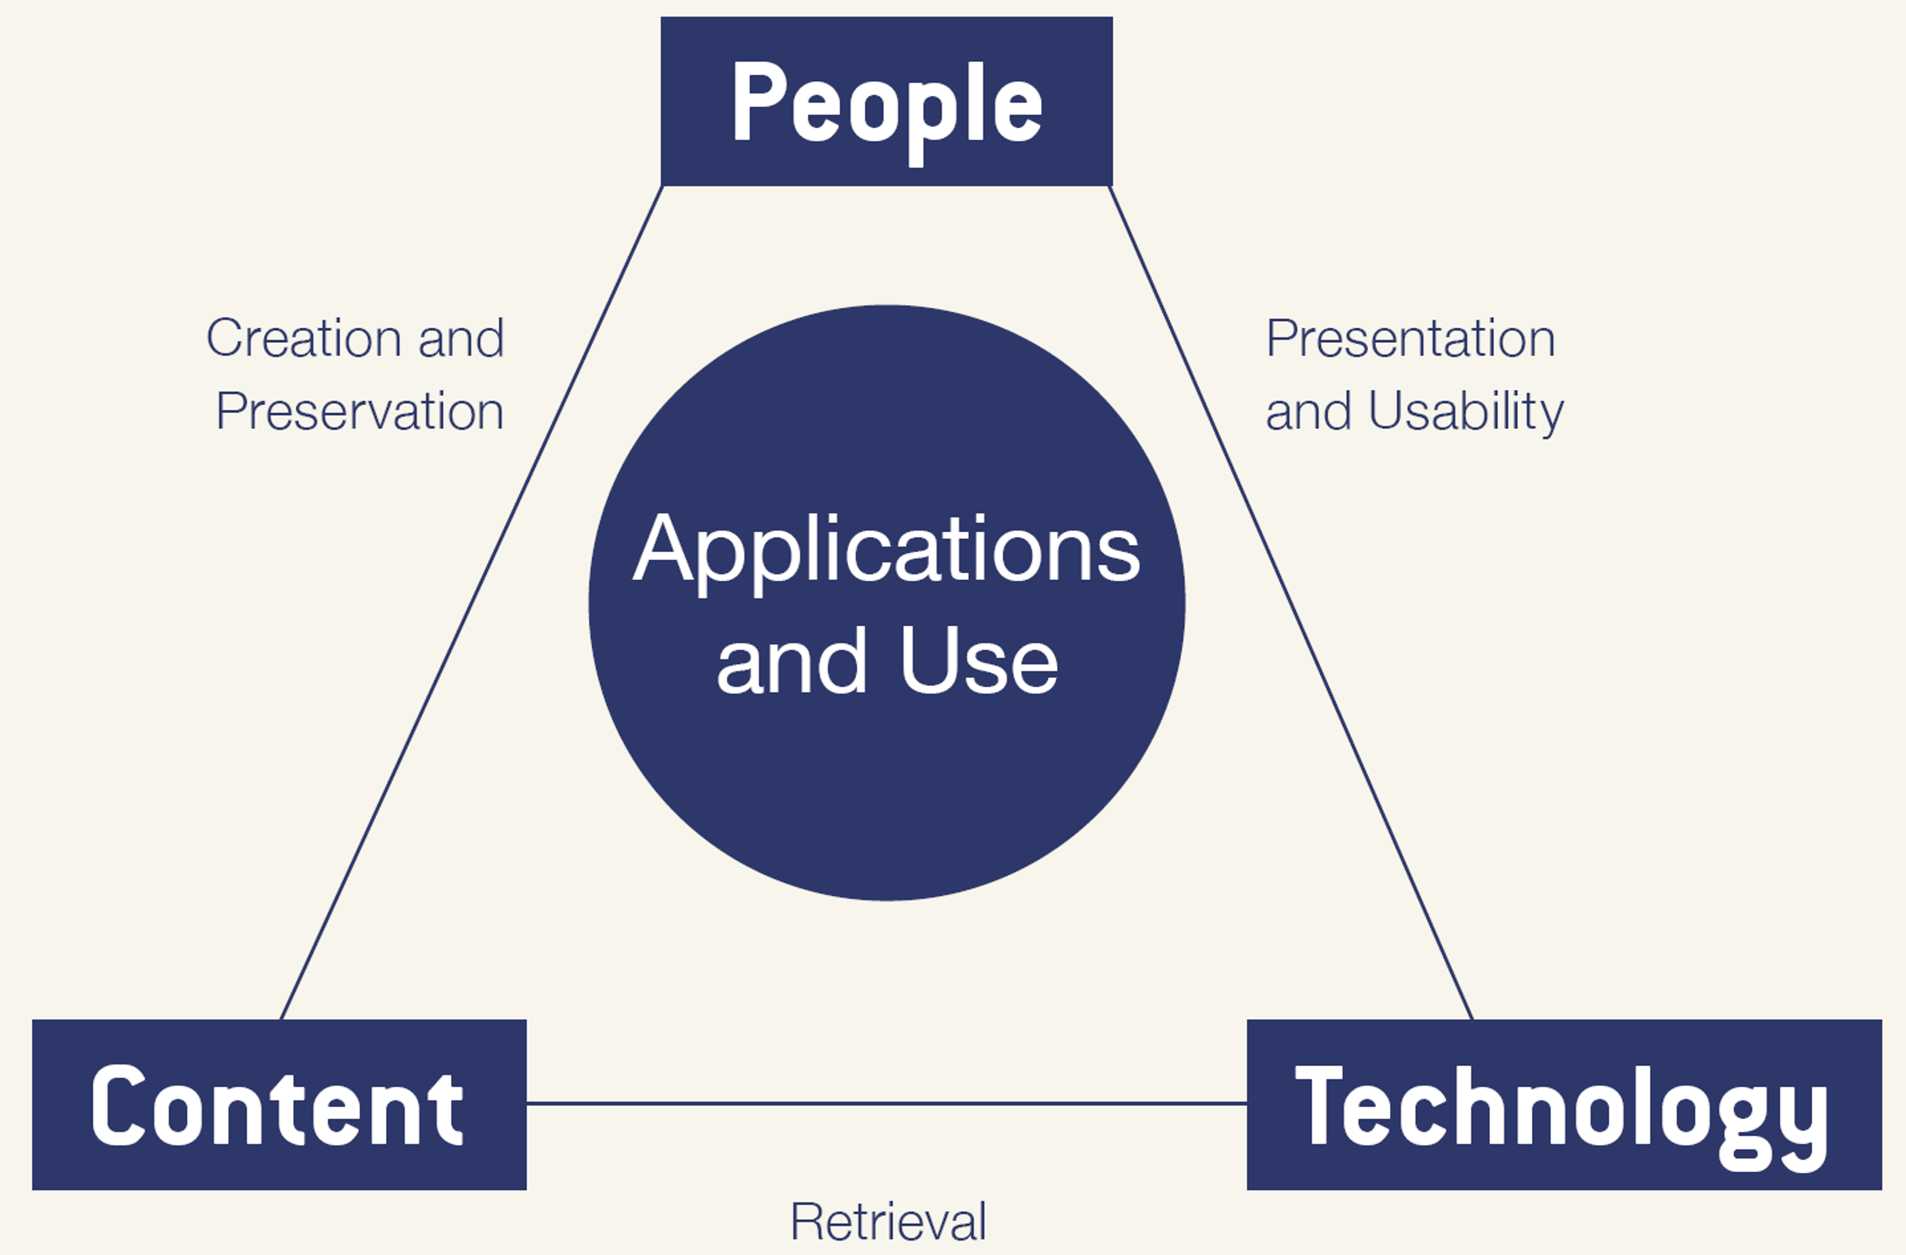
Digital
Library
Triad
15-17 June 2003 NSF-sponsored Workshop on
Post-DL Research Directions, Chatham, MA

Slide 7
PEOPLE:
How You Can Participate
Membership (individual, institution, consortium), Donations
Ambassador/mentor (local, national, global)
NDLTD Committees and special roles:
  Conference (incl. awards, webinars)
  Finance, Journal of ETDs (J-ETD.org)
  Membership: soon using MemberPress, PayPal, and Stripe
  Nominations
  Union Catalog, Global Search
  Website (news & social media), R&D

Slide 8
CONTENT

Slide 9
Technology
completeness,
Information
Life
Cycle
conformance
accuracy,
Active
accessibility, preservability
preservability,
Semi-active
authoring, modifying,
describing organizing, indexing
storing, archiving,
networking
similarity,
timeliness,
creation
distribution
utilization
seeking
pertinence,
searching,
browsing,
recommending
accessing,
filtering
significance,
relevance
accessibility,
Gonçalves et al. 2007
http://dx.doi.org/
10.1016/j.ipm.2006.11.010
Inactive
timeliness
Notes:
Information life cycle with respective dimensions of quality added for each major phrase and related activities

Slide 10
ETD-MS
ETD Metadata Standard
  XML-encoded metadata standard (content and encoding) for Electronic Theses and Dissertations (ETDs)
  In part conforming to Dublin Core (DC)
  Adds details about level, etc.
  http://www.ndltd.org/standards/metadata
With specified relationship to MARC
Aim: Rich, high quality metadata
See paper “ETD MS v2.0 …”

Slide 11
OAI - Open Archives Initiative https://www.openarchives.org/
Interoperability
Standard for transferring metadata among digital libraries
  Protocol for Metadata Harvesting (PMH)
NDLTD Union Catalog
Local site –> national/regional site –> Union Catalog –> service providers (Global ETD Search, …)

Slide 12
Applications and Use

Slide 13
The Networked Digital Library of Theses and Dissertations
www.NDLTD.org
Advocate:
Training Authors
Expanding Access
Preserving Knowledge
Improving Graduate Education
Enhancing Scholarly Communication
Empowering Students & Universities
Leading the Worldwide ETD (Electronic
Thesis and Dissertation) Initiative

Slide 14
Mission
The Networked Digital Library of Theses and Dissertations (NDLTD) is an international organization that, through leadership and innovation, promotes the adoption, creation, dissemination, use, and preservation of electronic theses and dissertations (ETDs).
The NDLTD encourages and supports the efforts of institutions of higher education & their communities
to advance and apply electronic publishing & digital libraries (including repositories), thus enabling them
to share knowledge more effectively in order
to unlock the potential benefits worldwide.

Slide 15
Selected Benefits
Global ETD Search 6.5M: http://search.ndltd.org
Journal: http://j-etd.org
Social Media
  https://www.facebook.com/NDLTD
  https://twitter.com/NDLTD
  https://www.linkedin.com/groups/2024919/
Awards: https://ndltd.org/ndltd-awards/
  Travel grants
  Innovative ETDs, Leadership

Slide 16
Spirit of NDLTD
Assuage fears->build confidence->promote sharing of graduate research
Help make a better (smaller) world
Win-win-win (everyone can benefit)
Have fun helping others
Build on standards
ETDs are preservable, popular, expressive -> “better”(w. multimedia, datasets, software, …)
Doable, feasible, learnable, affordable, sharable
Please support NDLTD!

Slide 17
ETD 2024 Symposium Theme: ETD Visibility at a Global Scale
SUB-THEMES:
Application of Large Language Models to ETDs (e.g., automatic summarisation of ETDs, bibliometric analysis)
Automatic Analysis of ETDs (e.g., topic modeling)
ETD Implementation Use Cases (e.g., infrastructure implementation)
ETD Policies and Practices (e.g., policy implementation)
ETDs and e-Infrastructures (e.g., national ETD initiatives)
ETDs and Long-term Preservation
ETDs and Open Access
ETDs and Open Science
ETDs and Persistent Identifiers
ETDs and Research Data
General Issues Related to ETDs
Global Visibility of ETDs
Graduate Education and Training
Institutional Repository Platforms
National and Global ETD Initiatives

Slide 18
Questions?
Discussion?
Recommendations?
Please also chat with Board members attending, and the conference organizers!
Thank You!
fox@ndltd.org
http://fox.cs.vt.edu

