Slide 1
Characterizing events and human behavior based on AI-aided analysis of data collected from web and social media sources For Workshop: Human-Centered AI for Research, Innovation, and Creativity: Creating Connections Across Disciplines 25 March 2022, Hybrid, Virginia Tech by Edward A. Fox¹, Steven D. Sheetz²
1. fox@vt.edu, Computer Science
2. sheetz@vt.edu, Accounting & Info Systems
Virginia Tech, Blacksburg, VA 24061 USA
http://fox.cs.vt.edu/talks/2022/20220325CHCI6panelSheetzFox.pptx

Slide 2
Some areas of collaboration: disciplines / industries
Agriculture | Entrepreneurship | Linguistics
Archaeology | Fisheries | Medicine
Archival science | Geography | Networks, WWW
Biodiversity | Gerontology | Network science
Biometrics | Health | Neuroscience
Biology | History | Publishing
Chemistry | Information science | Physics
Civil engineering | Insurance | Psychology
Education: computing, graduate | Law / legal | Sociology
Electrical engineering | Library science | Wildlife

Slide 3
Grants
Living In the KnowlEdge Society (LIKES), NSF CCF-0722259, 2007-2010
CTRnet (Crisis, Tragedy & Recovery Net), NSF IIS-0916733, 2009-2013
Social Media for Cities, Counties, and Communities, CCSR (partnership between Arlington Co., IBM Research, VT), 2010
Integrated Digital Event Archiving and Library (IDEAL): NSF IIS–1319578, 2013-6
Thanks also to: Andrea Kavanaugh, Donald Shoemaker, …

Slide 4
Selected Papers
Steven D. Sheetz, Andrea Kavanaugh, Hamida Skandrani, Edward A. Fox. Uses and Gratifications of Political Information: Student Perceptions of Information from the 2014 Tunisian Elections. In Proc. Deep Transformations and the Future of Organisations, 4th International Conference of the Interdisciplinary Laboratory of University-Business Management, University of Manouba, Tunis, Tunisia, 6-7 December 2019
Steven Sheetz, Andrea Kavanaugh, Edward Fox, Riham Hassan, Seungwon Yang, Mohamed Magdy, and Donald Shoemaker. (2019). Information Uses and Gratifications Related to Crisis: Student Perceptions since the Egyptian Uprising. Proceedings of the 16th International Conference on Information Systems for Crisis Response And Management, ISCRAM 2019, pp. 674-690. Valencia, Spain, 19-22 May 2019
Andrea Kavanaugh, Steven D. Sheetz, Hamida Skandrani, and Edward A. Fox. Media use by young Tunisians during the 2011 revolution vs 2014 elections. Information Polity 22(2-3): 137-158 (Oct. 20, 2017), DOI 10.3233/IP-170412
Andrea Kavanaugh, Steven D. Sheetz, Hamida Skandrani, John C. Tedesco, Yue Sun, and Edward A. Fox. The Use and Impact of Social Media during the 2011 Tunisian Revolution, Proc. 17th International Digital Government Research Conference (dg.o 2016), Fudan University, China, June 8-10, 2016, 20-30
Andrea L. Kavanaugh, Steven D. Sheetz, Rodrigo Sandoval-Almazan, John C. Tedesco, Edward A. Fox. Media use during conflicts: Information seeking and political efficacy during the 2012 Mexican elections. Government Information Quarterly, 33(3): 595-602, Feb. 2016, DOI: 10.1016/j.giq.2016.01.004
Andrea Kavanaugh, Steven Sheetz, John Tedesco, Sandoval-Almazan Rodrigo, and Edward Fox. Media Use during Conflicts: Gratifications & Efficacy during 2012 Mexican Elections. 15th Annual International Conference on Digital Government Research (dg.o 2014), Aguascalientes City, Mexico, June 18-21, 2014
Andrea Kavanaugh, Steven D. Sheetz, Riham Hassan, Seungwon Yang, Hicham G. Elmongui, Edward A. Fox, Mohamed Magdy, and Donald J. Shoemaker. Between a Rock and a Cell Phone: Communication and Information Technology Use during the 2011 Uprisings in Tunisia and Egypt. Int'l J. of Information Systems for Crisis Response and Management (IJISCRAM), 5(1): 1-21, January - March 2013
Seungwon Yang, Haeyong Chung, Xiao Lin, Sunshin Lee, Liangzhe Chen, Andrew Wood, Andrea L. Kavanaugh, Steven D. Sheetz, Donald J. Shoemaker, and Edward A. Fox. (2013). PhaseVis1: What, when, where, and who in visualizing the four phases of emergency management through the lens of social media. 10th International Conference on Information Systems for Crisis Response and Management, ISCRAM 2013 (pp. 912-917). KIT; Baden-Baden, Germany
Andrea L. Kavanaugh, Edward A. Fox, Steven D. Sheetz, Seungwon Yang, Lin Tzy Li, T. Whalen, Donald J. Shoemaker, Apostol Natsev, Lexing Xie. Social Media Use by Government: From the Routine to the Critical. Government Information Quarterly (GIQ) 29(4): 480-491, Oct. 2012
Andrea L. Kavanaugh, Steven D. Sheetz, Riham Hassan, Seungwon Yang, Hicham G. Elmongui, Edward A. Fox, Mohamed Magdy, and Donald Shoemaker. (2012). Between a rock and a cell phone: Communication and information technology use during the 2011 Egyptian uprising. 9th International Conference on Information Systems for Crisis Response and Management, ISCRAM 2012. Vancouver, BC, Apr. 22-25: Simon Fraser University.
Kavanaugh, A., Fox, E., Sheetz, S., Yang, S., Li, L.T., Whalen, T., Shoemaker, D., Natsev, A., Xie, L. Social Media Use by Government: From the routine to the critical. ACM 2011 Digital Government Research Conference (dg.o 2011), June 12-15, 2011 (College Park, MD), 121-130.
Andrea Kavanaugh, Seungwon Yang, Steven D. Sheetz, and Edward A. Fox. Microblogging in crisis situations: Mass protests in Iran, Tunisia, Egypt. Workshop on Transnational HCI at CHI 2011, May 7-12, Vancouver, 6 pages
Wingyan Chung, Seungwon Yang, Edward A. Fox, and Steven D. Sheetz. Integrating Computational Thinking Into Information Systems and Other Curricula. Proceedings AIS SIG-ED IAIM 2010 Conference, St. Louis, Missouri, Dec. 10-12, 8 pages
Uma Murthy, Edward Fox, Naren Ramakrishnan, Andrea Kavanaugh, Steven Sheetz, Donald Shoemaker, and Venkataraghavan Srinivasan. Building an Ontology for Crisis, Tragedy, and Recovery. NKOS Workshop, ECDL 2009, 1 Oct. 2009, Corfu, Greece
Edward A. Fox, Christopher Andrews, Weiguo Fan, Jian Jiao, Ananya Kassahun, Szu-Chia Lu, Yifei Ma, Chris North, Naren Ramakrishnan, Angela Scarpa, Bruce H. Friedman, Steven D. Sheetz, Donald Shoemaker, Venkat Srinivasan, Seungwon Yang, & Laura Boutwell, A Digital Library for Recovery, Research, and Learning from April 16, 2007 at Virginia Tech. Traumatology, 14(1): 64-84 (2008), DOI: 10.1177/1534765608315632

Slide 5
Crisis, Tragedy, and Recovery
~10 TB, ~100 tweet + ~50 webpage collections
Human tragedies that result from man-made and natural events affect humans and communities significantly.
During and after a tragic event, there are a series of needs that have to be addressed.
Compounded by communication failures and a confusing plethora of data and information

Slide 6
Categories from focus group study
Results from focus group interviews following the April 16, 2007 tragedy at Virginia Tech

Slide 7
CTR stakeholders
Notes:
Help affected communities to recover more quickly and effectively
Provide global network with relevant information and resources
Support the research community, emergency personnel, decision makers, and the public in reacting to and recovering from crises

Slide 8
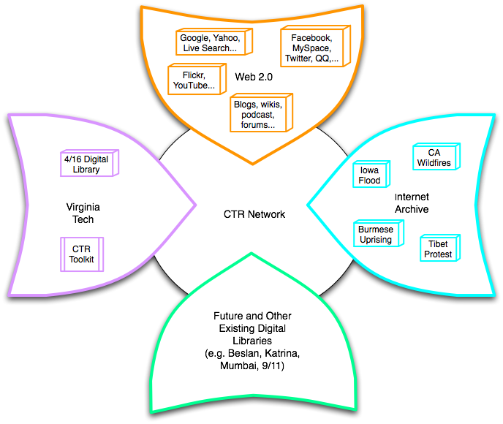
Build a networked digital library relating to CTR
Citations
Papers, …
Support information exploration
Aided by an ontology (DL Book 3 Ch. 3)
Integrate community, content, and services relating to CTR, making it accessible, and preserving it for long-term reuse
www.ctrnet.net

Slide 9
University Libraries Tweets
6+ billion tweets covering important events
Going to University Libraries by May 2022
JSON files of tweets for each event-related collection
JSON file for collection level metadata
Services to help with searching, etc.
CS4624 Twitter Archives team (Griffin Knock, Nicole Fitz, Ryan Nicholas, Matthew Gonley, and Derek Bruce); extending prior project: http://hdl.handle.net/10919/107086

Slide 10
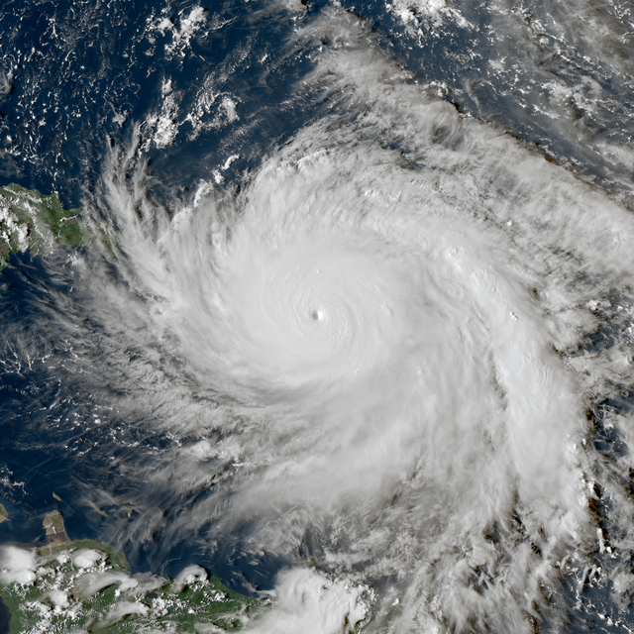
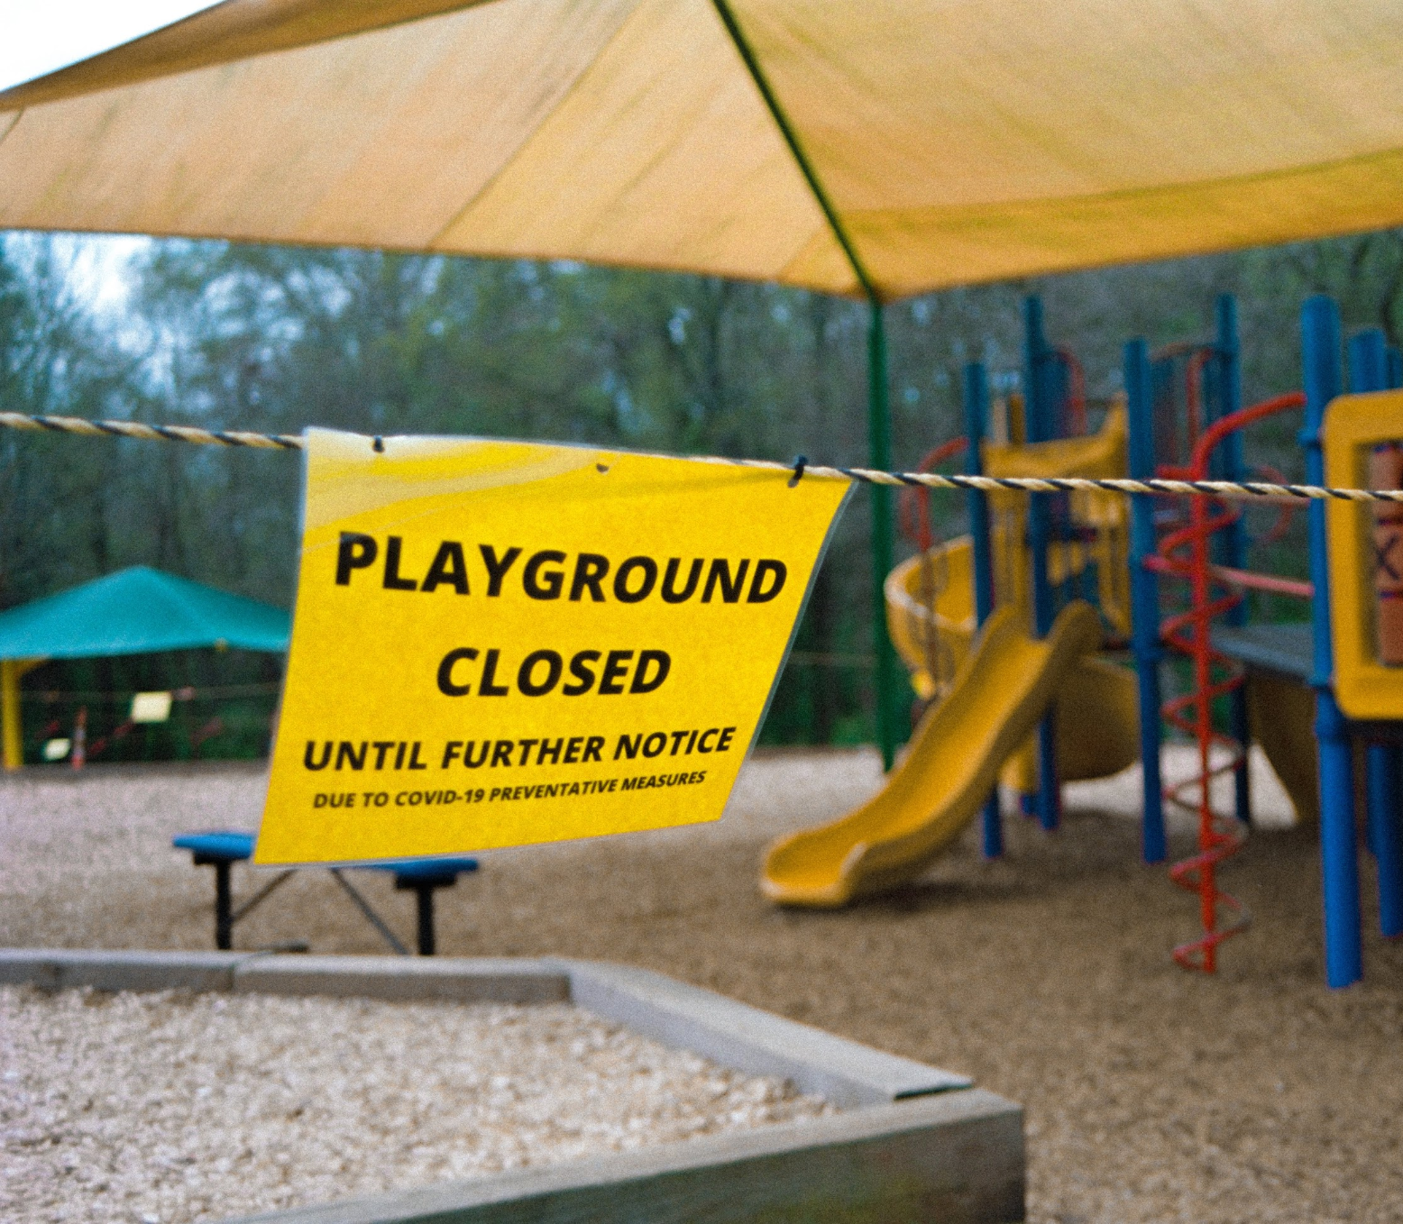
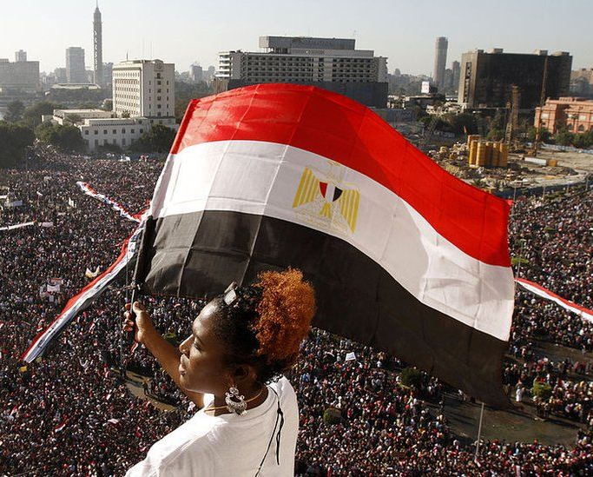
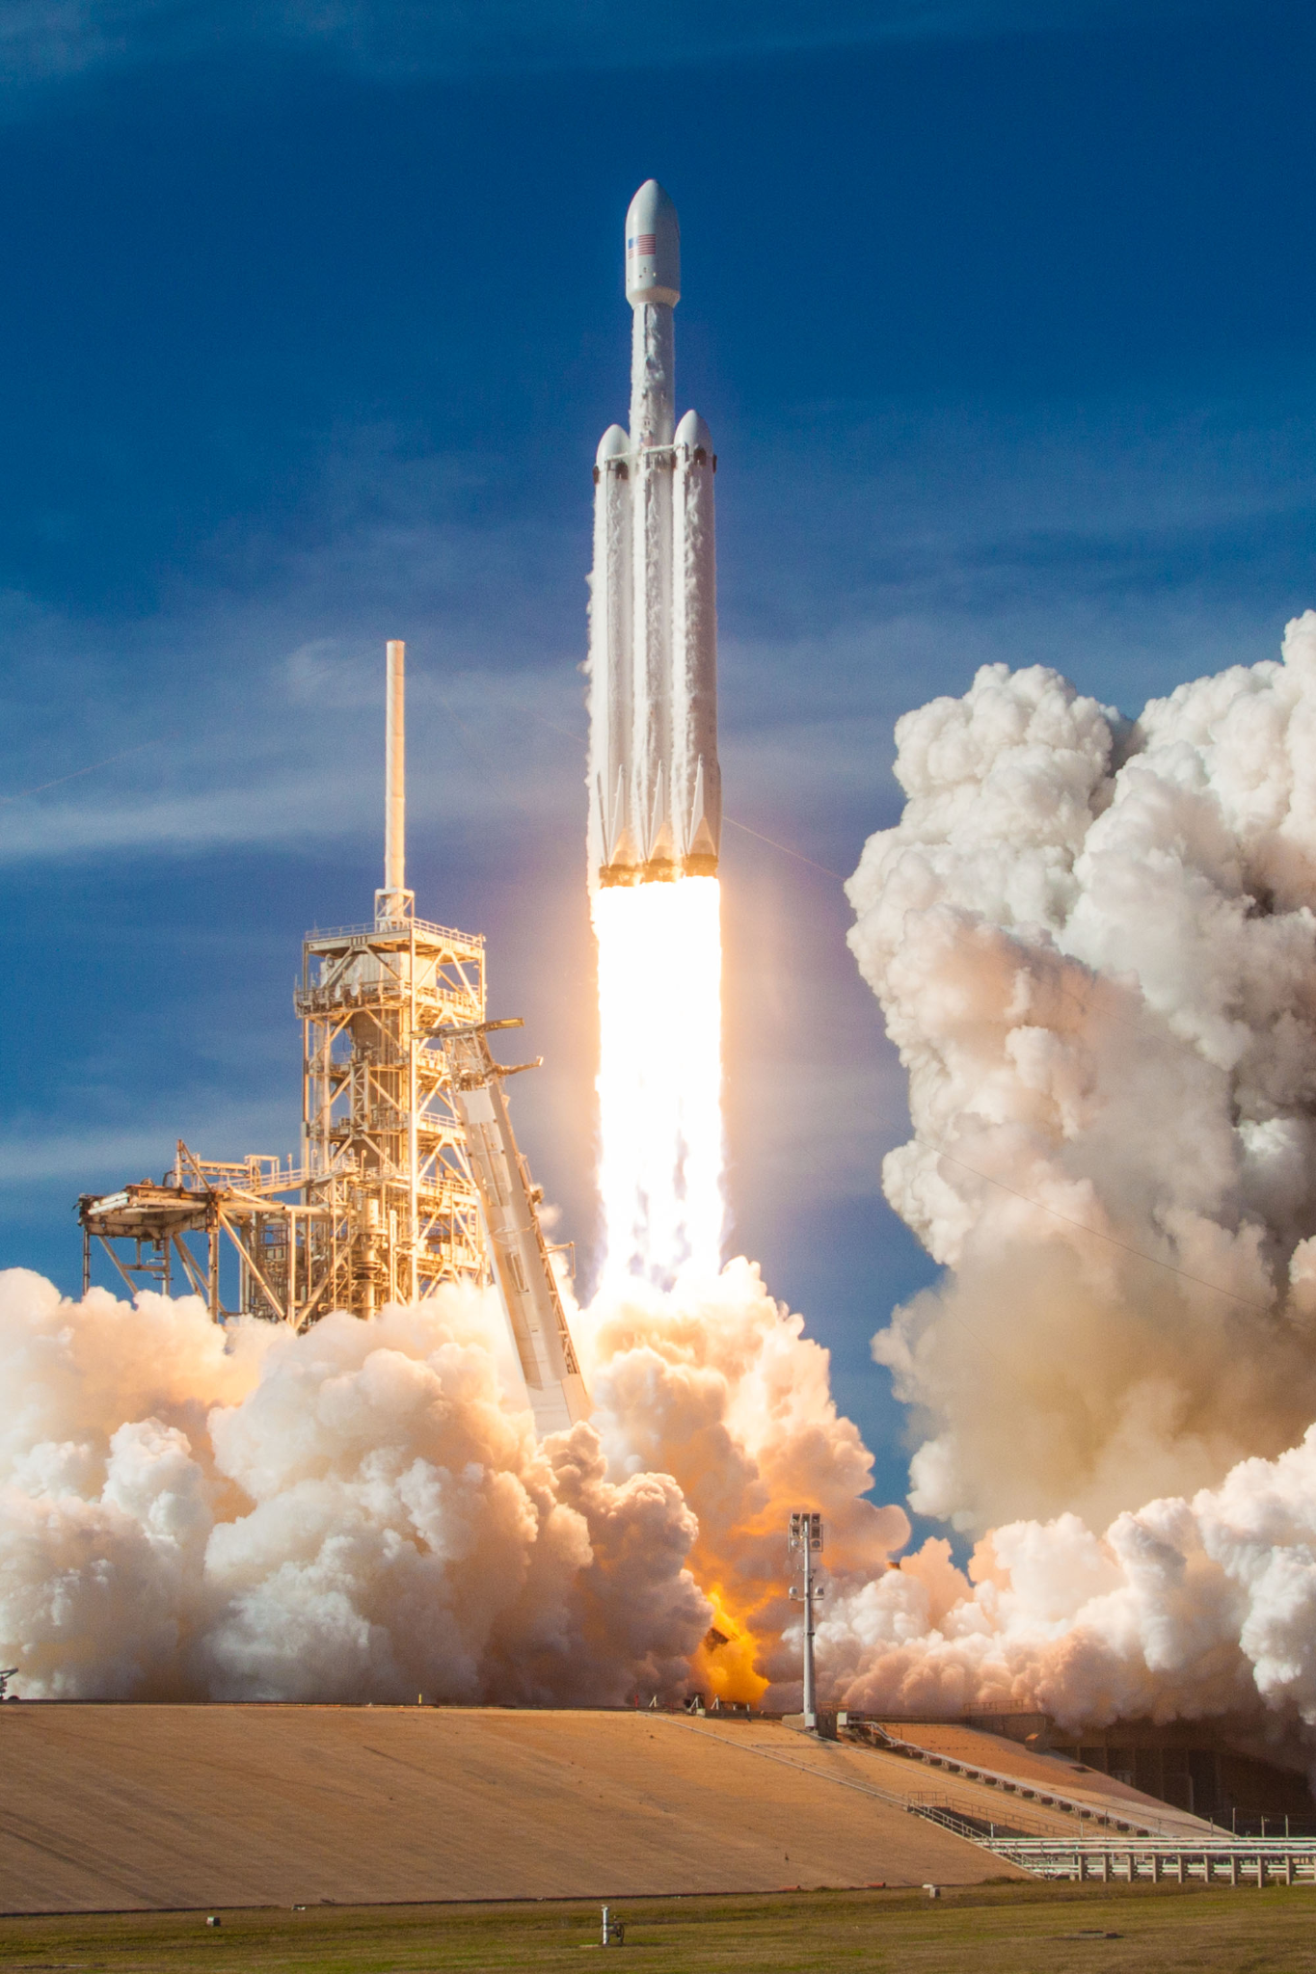
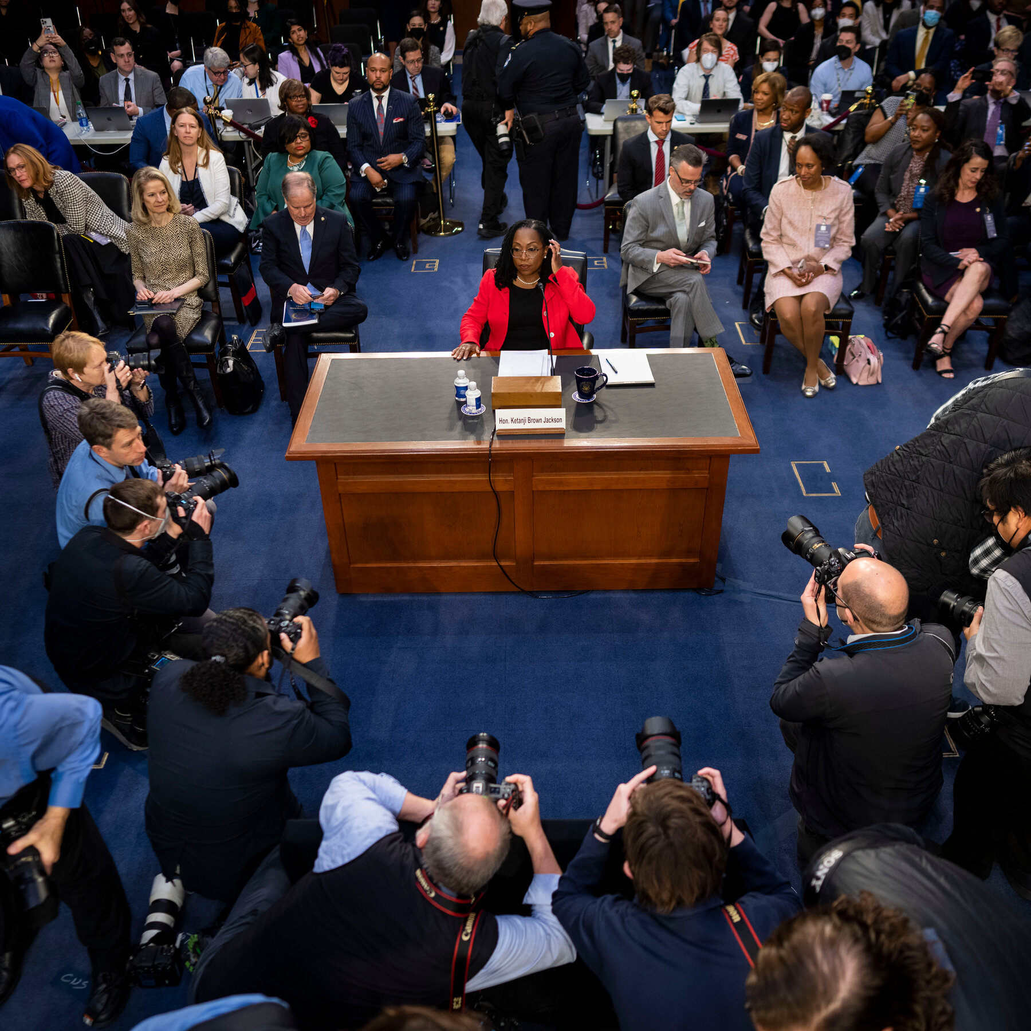
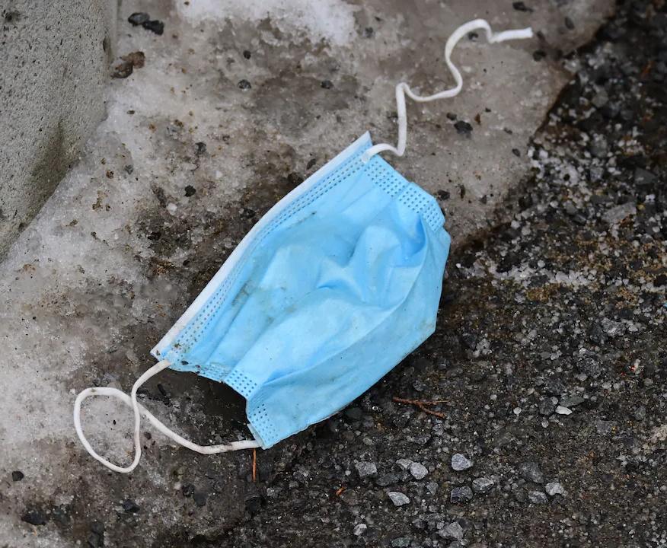
Topics Include
Natural Disasters Diseases Political Events More!

Slide 11
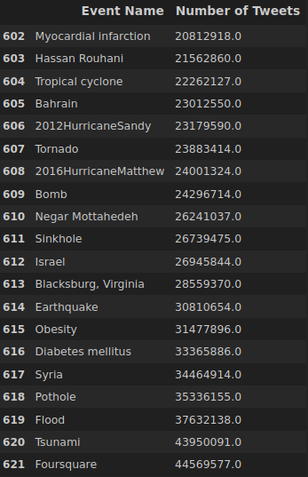
Coll#

Slide 12
Questions? Discussion?
Thank You!
fox@vt.edu, sheetz@vt.edu

