Slide 1
#ETD2021: Open Scholarship in a Post-Pandemic World
24th International Symposium on ETDs
Nov. 15-18; United Arab Emirates University, VIRTUAL
“Welcome Note and
Opening Presentation”
Edward A. Fox, Ph.D., Professor
fox@vt.edu http://fox.cs.vt.edu
Dept of Computer Science (& ECE by courtesy)
Virginia Tech, Blacksburg, VA 24061 USA
NDLTD: Exec. Director, Chairman of the Board

Slide 2
Outline
Acknowledgments
NDLTD
Opportunities
  Content, Collection
  Information Life Cycle, Quality
  Services
  Research

Slide 3
Acknowledgments
Family, mentors, teachers, colleagues, students
All those working with ETDs
NDLTD (ndltd.org=theses.org=dissertations.org) Networked Digital Library of Theses and Dissertations
Members, Board, Committees,
Working Groups, Task Forces
ETD 2021 Conference Team
Presenters, Attendees, Sponsors
UAEU team

Slide 4
Acknowledgements (2): Mtgs
1987 mtg in Ann Arbor: UMI, VT, Arbortext, Softquad
1992 mtg in Washington: CNI, CGS, UMI, VT + 10U’s
1993 mtg in Atlanta: Monticello Electronic Library
1994 mtg at VT: stds: PDF + SGML + multimedia
1996 mtg with funding by SURA and then also by the US Dept. of Education (FIPSE)
1997 meetings in UK, Germany, ...
1998 – 1st symposium – Memphis (20)
1999 – 2nd symposium – Blacksburg (70)
2000 – 3rd symposium – St. Petersburg, FL (225)
2001 – 4th symposium – Caltech, Pasadena (200)
2002 – 5th symposium – BYU, Provo, Utah
2003 – 6th symposium – Berlin (NDLTD inc. as int’l non-profit)
2004 – 7th symposium – U. Kentucky, USA
2005 – 8th symposium – Sydney, Australia
Notes:
3
3

Slide 5
Acknowledgements (3): Mtgs
2006 – 9th symposium – Quebec City, Canada
2007 – 10th symposium – Uppsala, Sweden
2008 – 11th symposium – Aberdeen, Scotland
2009 – 12th symposium – Pittsburgh, PA, USA
2010 – 13th symposium – Austin, TX, USA
2011 – 14th symposium – Cape Town, S. Africa
2012 – 15th symposium – Lima, Peru
2013 – 16th symposium – Hong Kong
2014 – 17th symposium – Leicester, England
2015 – 18th symposium – New Delhi, India
2016 – 19th symposium – Lille, France
2017 – 20th symposium – Washington, D.C.
2018 – 21st symposium – Taipei, Taiwan
2019– 22nd symposium – Porto, Portugal
2020– 23rd symposium – United Arab Emirates
Notes:
3
3

Slide 6
The Networked Digital Library of Theses and Dissertations
www.NDLTD.org
Advocate:
Training Authors
Expanding Access
Preserving Knowledge
Improving Graduate Education
Enhancing Scholarly Communication
Empowering Students & Universities
Leader of the Worldwide ETD
(Electronic Thesis and Dissertation) Initiative

Slide 7
NDLTD: www.ndltd.org
N D Ltd or Noodle TD
Vision: Every thesis and dissertation in the world is:
  Devised to take advantage of the most helpful electronic publishing methods
  Shared globally and easily found
  Supported by a suite of digital library services to aid authors, researchers, learners, universities
  Preserved and migrated permanently

Slide 8
NDLTD: Mission
The Networked Digital Library of Theses and Dissertations (NDLTD) is an international organization dedicated to promoting the adoption, creation, use, dissemination, and preservation of electronic theses and dissertations (ETDs). We support electronic publishing and open access to scholarship in order to enhance the sharing of knowledge worldwide. Our website includes resources for university administrators, librarians, faculty, students, and the general public. Topics include how to find, create, and preserve ETDs; how to set up an ETD program; legal and technical questions; and the latest news and research in the ETD community.

Slide 9
Journal: J-ETD.org, j-etd@ndltd.org
Journal of Electronic Theses and Dissertations
Open-access. Please support!
Managing Editor: Charles J. Greenberg
Executive Editor: Edward A. Fox; Associate Editors : Suzanne Lorraine (Suzie) Allard (USA), Ramesh C. Gaur (India), Charles J. Greenberg (USA), Libio Huaroto (Peru), William A. Ingram (USA), Ana Sofia de Sousa Machado Mota (Portugal), Prashant Pandey (Australia), Ana Pavani (Brazil), Joachim Schöpfel (France), Janette Wright (Australia).

Slide 10
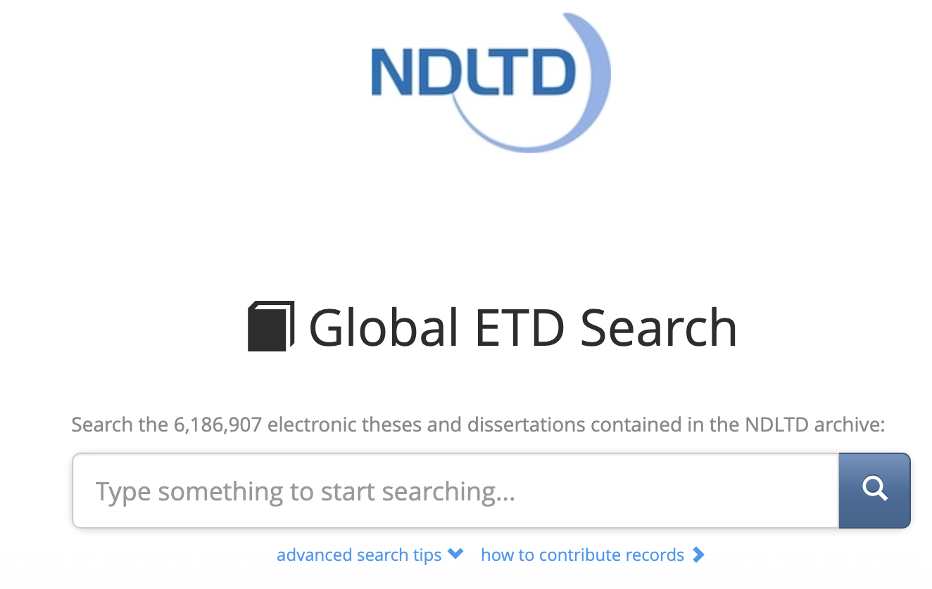
search.ndltd.org

Slide 11
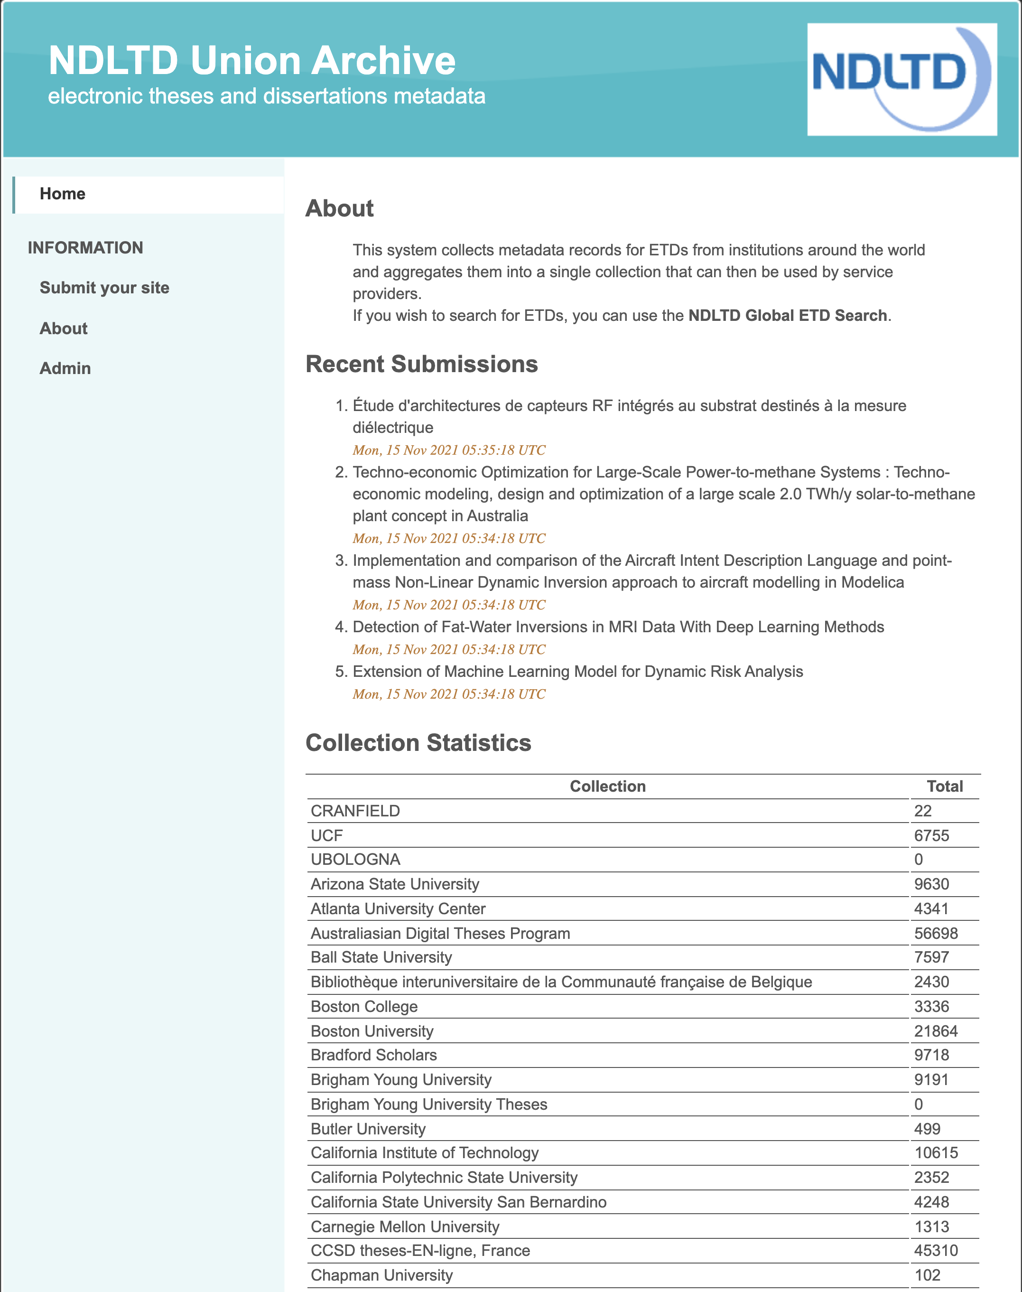
union. ndltd. org/ portal/

Slide 12
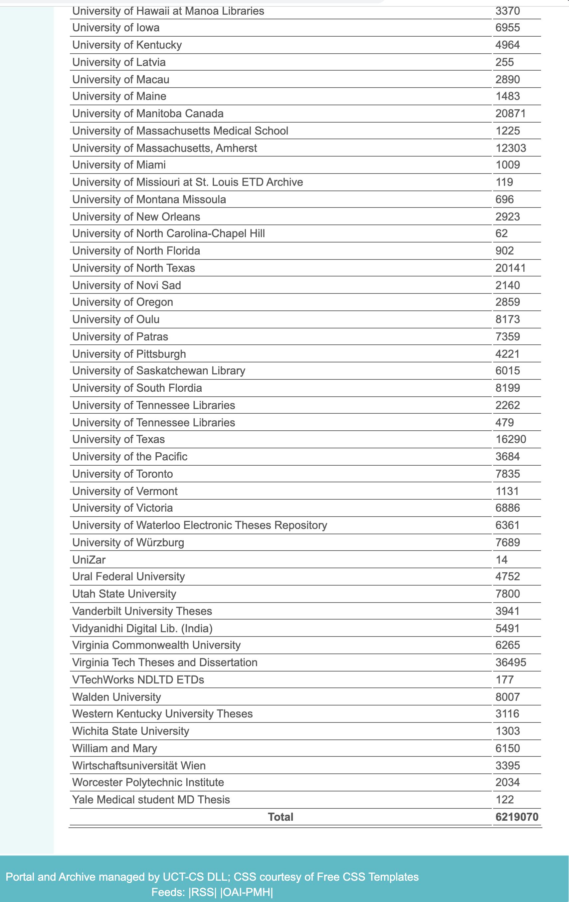
union.
ndltd.
org/
portal/

Slide 13
Spirit of NDLTD
Assuage fears -> build confidence -> promote sharing
Help make a better (smaller) world
Win-win-win (everyone can benefit)
Have fun helping others
Build on standards
ETDs are preservable, popular, expressive -> “better”
Doable, feasible, learnable, affordable, sharable
Please support NDLTD!

Slide 14
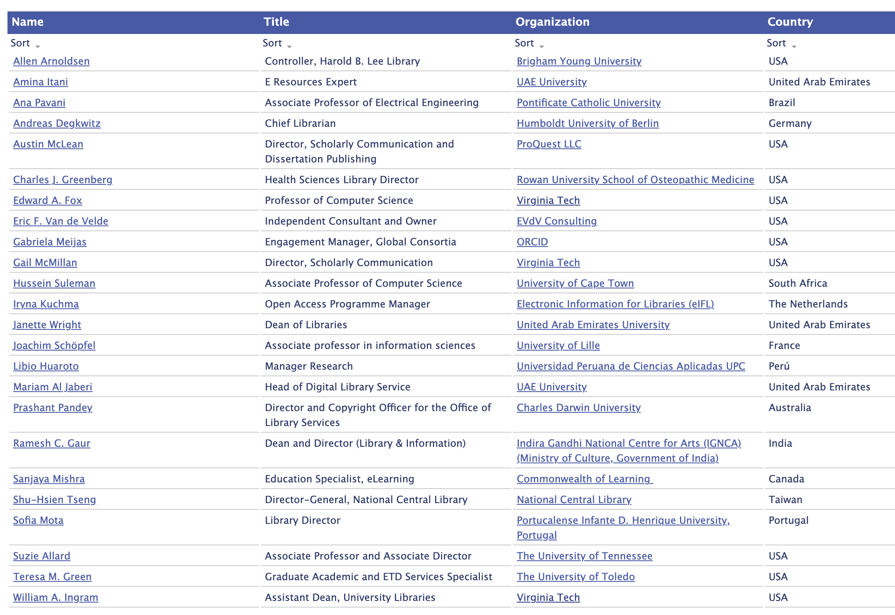
NDLTD Board of Directors

Slide 15
How You Can Participate
Be a: Member (individual, institution, consortium)
Join: NDLTD Committees, Working Groups:
  Awards (Charles Greenberg)
  Communications (Iryna Kuchma)
  Conference (Ramesh Gaur)
  Finance (Austin McLean)
  Membership (Joachim Schöpfel)
  Nominating (Janette Wright)
  Union Catalog (Ana Pavani)
Be an: Ambassador (local, national, global)
Meet people 18 November in Regional Meetings

Slide 16
Invitation: to extend your involvement in the global ETD community
You are invited to serve as an ambassador for NDLTD,
  to connect with those back home,
  sharing about ETD 2021.
This week:
  ask questions,
  share your thoughts, and
  help make both ETD2021 and the ETD movement a greater success.

Slide 17
Digital Library Content

Slide 18
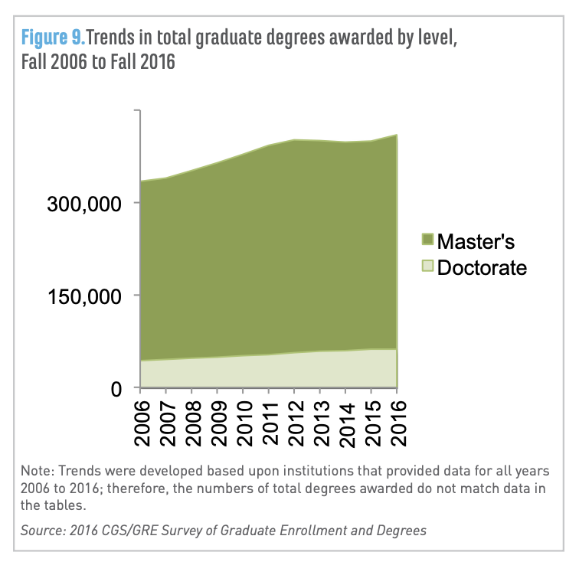
Potential Collection Size
Fall 2016 U.S. graduate schools: >1.8 million students enrolled in grad certificate, master's, or doctoral programs (https://cgsnet.org/ckfinder/userfiles/files/CGS_GED16_Report_Final.pdf)
2018 US degree holders
Master’s 21M, doctoral 4.5M (https://www.census.gov/library/stories/2019/02/number-of-people-with-masters-and-phd-degrees-double-since-2000.html )
* Guess: 65 million ETDs could exist, with growth of 1M/year, if world count is at least 3X that of US (https://ourworldindata.org/tertiary-education#share-of-the-population-with-tertiary-education )

Slide 19
OAI - Open Archives Initiative: Technical Umbrella for
Practical Interoperability…
Metadata Harvesting
Reference
Libraries
Museums
Publishers
E-Print
Archives
…that can be exploited by different communities

Slide 20
The World According to OAI
Service Providers
Discovery
Current
Awareness
Preservation
Metadata
harvesting
Data Providers

Slide 21
Information Life Cycle
Creation
Active
Authoring
Modifying
Social Context
Using
Creating
Organizing
Indexing
Retention
/ Mining
Accessing
Filtering
Storing
Retrieving
Semi-
Active
Utilization
Distributing
Networking
Inactive
Searching
Notes:
This is a simplification of the previous slide.

Slide 22
Quality and the Information Life Cycle

Slide 23
Supporting Services across the Lifecycle

Slide 24
Related Funded Grants
IMLS LG-37-19-0078-19: Opening Books and the National Corpus of Graduate Research. 2019-2022. PI: William A. Ingram Co-PIs: Edward A. Fox and Jian Wu
Indo-US S&T Forum: Open Digital Libraries and Interoperability Workshop, 2003, PI Fox; Co-chairs: Shalini Urs, Mohammad Zubair, N. Balakrishnan
NSF IIS-0086227: Open Archives: Distributed services for physicists and graduate students (OAD): 2001-2004; PD Fox; German DFG PI E. Hilf
UNESCO: International Guide for the Creation of Electronic Theses and Dissertations: 12/28/2000-3/31/2002. PD (project director) E. Fox
SOLINET (Southeastern Library Network, USA): Networked Digital Library of Theses and Dissertations: 2000. PD (project director) Fox
NSF IIS-0090153 (427963): US-Korea Joint Workshop on Digital Libraries: Removing Barriers to International Collaboration on Research and Education through Digital Libraries, 8/1/2000-9/30/2002. PD Fox, co-PIs R.L. Larsen, R. W. Moore
U.S. Dept. of Education, FIPSE Program P116B61190: Improving Graduate Education with a National Digital Library of Theses and Dissertations: 1996-99; PIs Fox, J. Eaton, G. McMillan; support by SURA, Microsoft, Adobe

Slide 25
Opening Graduate Research
IMLS; 2019-2022; PI: William Ingram
Early work: 2019-2021
  Collecting: 500K +
    English, Arabic Large universities, HBCUs, HSIs
  Analyzing: parsing references for database
  Extracting: tables, figures, definitions, references
  Scanned ETDs -> improved metadata
  Classification into ProQuest categories
  Segmenting: chapters
Goals: Pilot services + Software for universities, regions, nations

Slide 26
http://fox.cs.vt.edu/talks/2021/20211116FoxETD2021opening.pptx
Questions?
Discussion?
Recommendations?
Chat with an
NDLTD Board or Committee member!
Thank You!
fox@vt.edu
fox@ndltd.org
j-etd@ndltd.org

