Slide 1
Tutorial: Introduction to Digital Libraries
Edward A. Fox & Yinlin Chen
{fox, ylchen}@vt.edu
Virginia Tech, Blacksburg, VA 24061, USA
27 Sept. Presentation at JCDL 2021
http://fox.cs.vt.edu/talks/2021/20210927IntroTutorialSlidesJCDLpt2Chen.pptx

Slide 2
Session 2: Agenda
Building digital libraries
Cloud, Serverless Computing
NLP, Deep Learning, and Machine Learning, MLOps

Slide 3
Learning Objectives
Be able to build a digital library
Describe Cloud and Serverless technologies that extend DL capabilities
Explain different serverless architectures and how to apply them in different DL scenarios
Apply cloud services and microservices to build DL services
Describe how to handle text collections with NLP and ML operations (MLOps)

Slide 4
Session 2: Agenda
Building digital libraries
Cloud, Serverless Computing
NLP, Deep Learning, and Machine Learning, MLOps

Slide 5
5S in Serverless Digital Library
Scenarios: under the serverless architecture, a DL can continue to evolve to accomplish tasks
Spaces: under the constraints in local, cloud, or hybrid environments
Structures: managed services and microservices are organized as an organic group
Societies: services communicate with each other to perform different tasks
Streams: tasks flow through different services and each step is triggered by events

Slide 6
Session 2: Agenda
Building digital libraries
Cloud, Serverless Computing
NLP, Deep Learning, and Machine Learning, MLOps

Slide 7
Components of a Digital Library
Collection Services
Index Services
Name Service
Repository Services
User Interface
Digital Preservation Service
…
Notes:
Handle, DOI

Slide 8
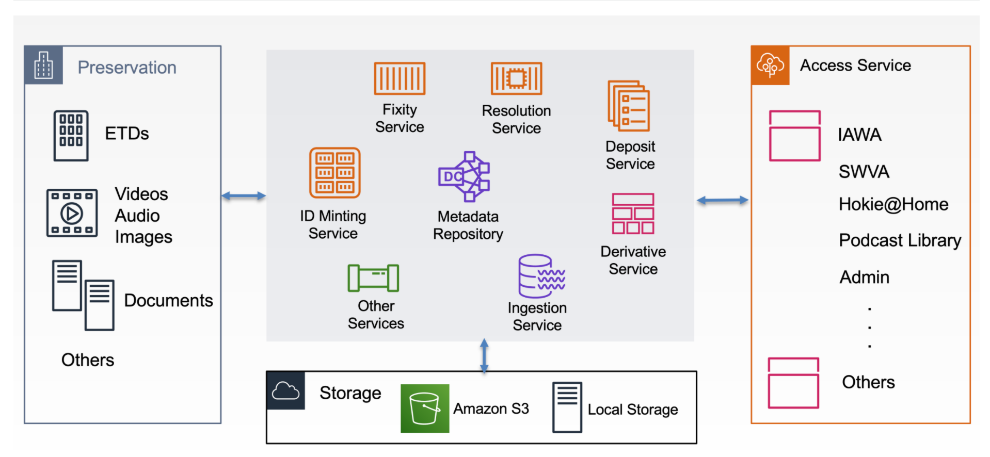
Virginia Tech Digital Libraries Platform (VTDLP)
Notes:
https://iawa.lib.vt.edu/archive/8x13502w

Slide 9
Cloud Computing
Types of cloud computing: Public vs. Private vs. Hybrid cloud
Types of cloud services: IaaS, PaaS, Serverless, and SaaS
Quick development and deployment
Automatic software updates and integration
Security, reliability, scalability, and flexibility
Efficiency and cost optimization and reduction

Slide 10
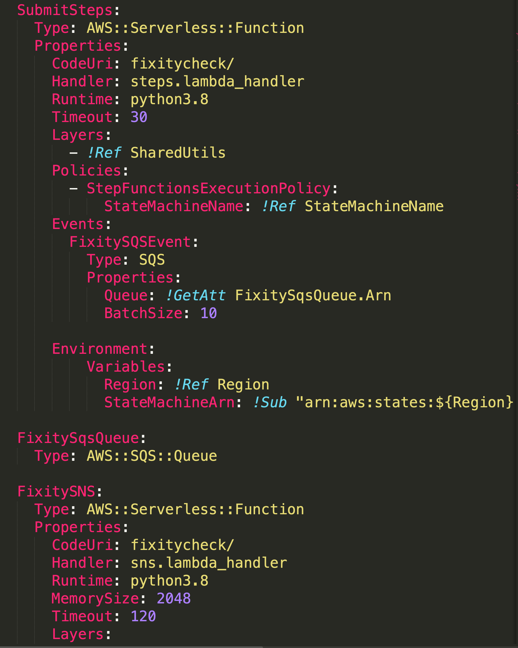
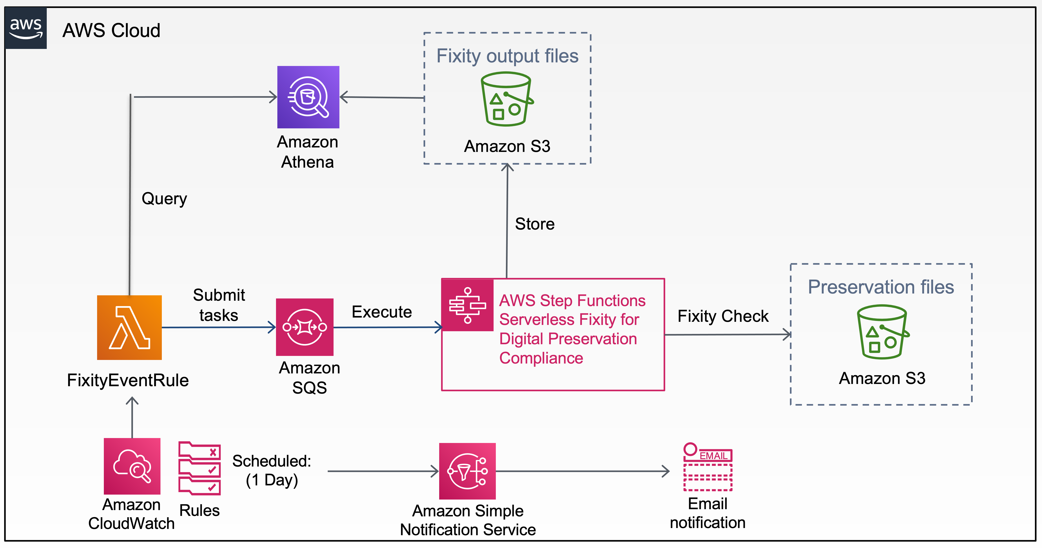
Infrastructure as Code
One click deploy
Notes:
Github - Demo

Slide 11
Monitor Metrics for Applications in Near Real-time

Slide 12
Resource Usage Optimization and Automation
Consume only the required resources for the applications
Scale up and down automatically
Service and function oriented, not server oriented
Utilize cloud services to help understand applications (CloudWatch, Auto Scaling, Trusted Advisor, etc.)
Notes:
Segment application into microservices
Pay as you go
Utilize cloud services to help you understand your application and keep evolving

Slide 13
Monolithic Architecture
Develop and deploy as a single unit
Often requires human intervention
Long-term commitment to a technology stack or even version
Hard to scale development
Difficult to scale the application
Notes:
Hard to adopt/replace a new technology

Slide 14
Serverless Computing
Focus more on developing features to achieve business goal, and less on the managing and operating underlying infrastructure
Takes advantage of Agile development practices across entire Serverless Software Development Lifecycle (S-SDLC)
Build fast and ship fast, automate deployment, and auto-scale applications
Enable reliable, resilient, and scalable Library services
Lower operational and development costs; we pay only what we use

Slide 15
Microservices
Small software piece
Messaging enabled – communicate with messages
Decentralized
Autonomously developed
Independently deployable
Can change independently of each service
Scale individually by load
Built and released with automated processes
More complex architecture

Slide 16
Microservices Architecture
Structures the software application as a suite of independently deployable services
Each service can be written in any programming language, apply any techniques, and be deployed and tested separately
Each (micro)service focuses on doing one job (task), and does that job very well
Each service can be changed and scaled independently
Notes:
Complex applications designed as a collection of services and data are fully decoupled from the application
They are independently deployable and organized around business capabilities.
Model View Controller (MVC) framework. Sidecar, Ambassador, and Adapter are some of the frameworks that support microservices architectures.

Slide 17
Monolithic Architecture
Serverless Architecture
User Interface
User Interface
API Interface
User Interface
Business Logic Layer
Microservices & Managed services
Data Access Layer
Purpose-built databases
Database
Notes:
The Right Tool for the Right Job
Micro Frontends
Everything is bundled together. If you need to update, you need to deploy the entire application
An application can become too large and complex to make frequent changes.
The maintenance involves at least three layers of hardware and software.

Slide 18
Serverless Architectures
Microservices architecture
Cloud-native architecture
Event-driven serverless architecture
Cloud-based architecture
Notes:
A serverless architecture is a way to build and run applications and services without having to manage infrastructure. Your application still runs on servers, but all the server management is done by cloud provider.

Slide 19
Serverless Design Best Practices
Design push-based, event-driven pipelines
Write single-purpose, stateless functions
Execute functions on demand and use the exact resources that are needed
Three Pillars of Observability: Logs, Metrics, & Traces
Notes:
Front end should be able to interact with services directly in order to limit the number of serverless functions.

Slide 20
A Cloud-based Serverless Microservices Application for Digital Preservation
Yinlin Chen, James Tuttle, Alex Kinnaman. "A Cloud-based Serverless Microservices Application for Digital Preservation." Digital Preservation 2020, Virtual, Nov. 9-13, 2020
Notes:
Digital preservation combines policies, strategies and actions that ensure access to digital content over time.
Digital preservation strategies and actions address content creation, integrity and maintenance.
Content integrity includes verification mechanisms, routine audits, etc.
Check fixity of content held on preservation storage systems at regular intervals
Maintain logs of fixity info and supply audit on demand
Ability to detect corrupt data
A Cloud-based serverless and microservice application
Run large amounts of fixity creation and validation asynchronously
Routine checking based on the policies we defined
The system can automatically scale up and down
Use only the resources that are required.
Without human intervention and system maintenance

Slide 21
Step Function Workflow

Slide 22
Serverless Fixity Events for Digital Preservation

Slide 23
Event-driven Serverless Architecture
Uses events to trigger and communicate between decoupled services
Three key components:
Event producer: publishes events to the routers
Event router: filters and pushes the events to consumers
Event consumer: consumes received events
Producer services and consumer services are decoupled, which allows them to be scaled, updated, and deployed independently

Slide 24
Image Processing Workflow - IIIF Image Tiling
AWS Batch
Batch Job – image set 1
Raw
images
Batch Job – image set 2
Amazon S3
AWS Lambda
Batch Job – image set 3
Amazon S3
Tiles &
Manifest
Task files
Batch Job – image set N
Yinlin Chen, Soumik Ghosh, Tingting Jiang, and James Tuttle. Scaling IIIF Image Tiling in the Cloud. Code4Lib Journal Issue 47, Feb. 2020

Slide 25
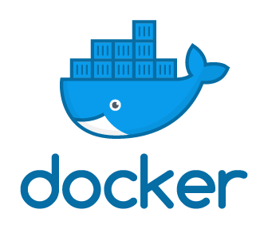
Batch Job Workflow
AWS Batch
Amazon S3
Amazon S3
IIIF
Command
Parameters
Environment variables
vCPUs
Memory
Raw
images
Tiles &
Manifest

Slide 26
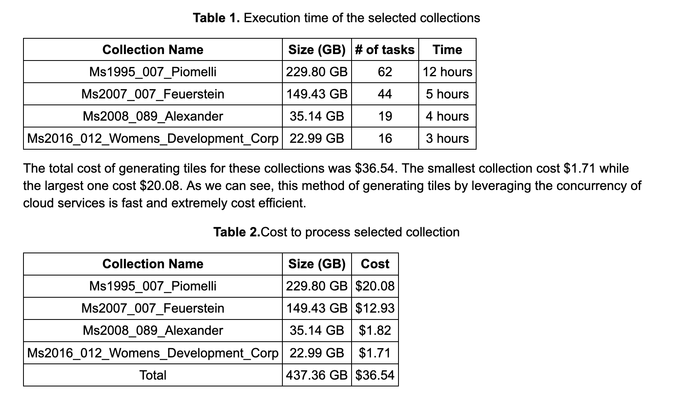
Execution Time and Cost

Slide 27
AWS Cloud
AWS Batch
Common Crawl data files
Batch Job –
Warc file 1
Batch Job –
Warc file 2
Amazon S3
Batch Job –
Warc file 3
Amazon S3
AWS Lambda
Batch Job –
Warc file 4
Result output files
Task file
Batch Job –
Warc file n
Amazon S3
Yinlin Chen. "Analyzing WARC on serverless computing." IIPC Web Archiving Conference 2021. Virtual, June 15-16, 2021
Notes:
Task files upload to a S3 bucket
S3 URL location of Common Crawl data
Trigger a Lambda function
Lambda function reads content in a task file and submits a batch job
Each batch job runs a container and processes the program workflow
Results upload to a S3 bucket

Slide 28
Manage Compute Environment Automatically

Slide 29
Cloud Native Architecture
Cloud native applications are designed to build and deploy specifically in the cloud (public, private, and hybrid)
Cloud native architecture includes DevOps, continuous integration (CI), continuous delivery (CD), microservices, and containers
Exploits the advantages of the cloud computing delivery model as much as possible
Apply twelve-factor methodology to design scalable and robust cloud native applications
Applications are stateless by nature, and communicate with each other using REST-based protocols or messaging
Notes:
Applications planning to deploy in the cloud, and microservices are a critical part.
Delivery models: Storage-as-a-Service
Database-as-a-Service
Security-as-a-Service
Communication-as-a-Service
Integration-as-a-Service
Testing-as-a-Service
Process-as-a-Service
Amazon Web Services (AWS) has its well-architected framework.
Cloud native development is essential to getting applications to market quickly; it helps people, processes, and technologies to build, deploy, and manage apps that are ready for the cloud.

Slide 30
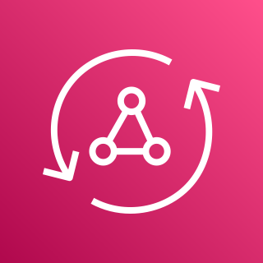
AWS Amplify
AWS Cloud
GitHub
Devs
Amazon Cognito
AWS Lambda
Users
AWS AppSync
Amazon Elasticsearch Service
React
AWS Amplify
AWS Identity and Access Management (IAM)
Amazon DynamoDB

Slide 31
Fully Automated CI/CD Pipeline

Slide 32
Cloud-based Architecture
Building and deploying modern web applications in the cloud environment
Traditional cloud-based application architecture involves load balancers, web servers, application servers, and databases
Serverless cloud-based application architecture involves web servers, databases, and other cloud-native services

Slide 33
Monitor & Logging
Log everything and monitor it at near realtime
Track resource usage
Monitor task status
Log analysis
Cost reports
And more…

Slide 34
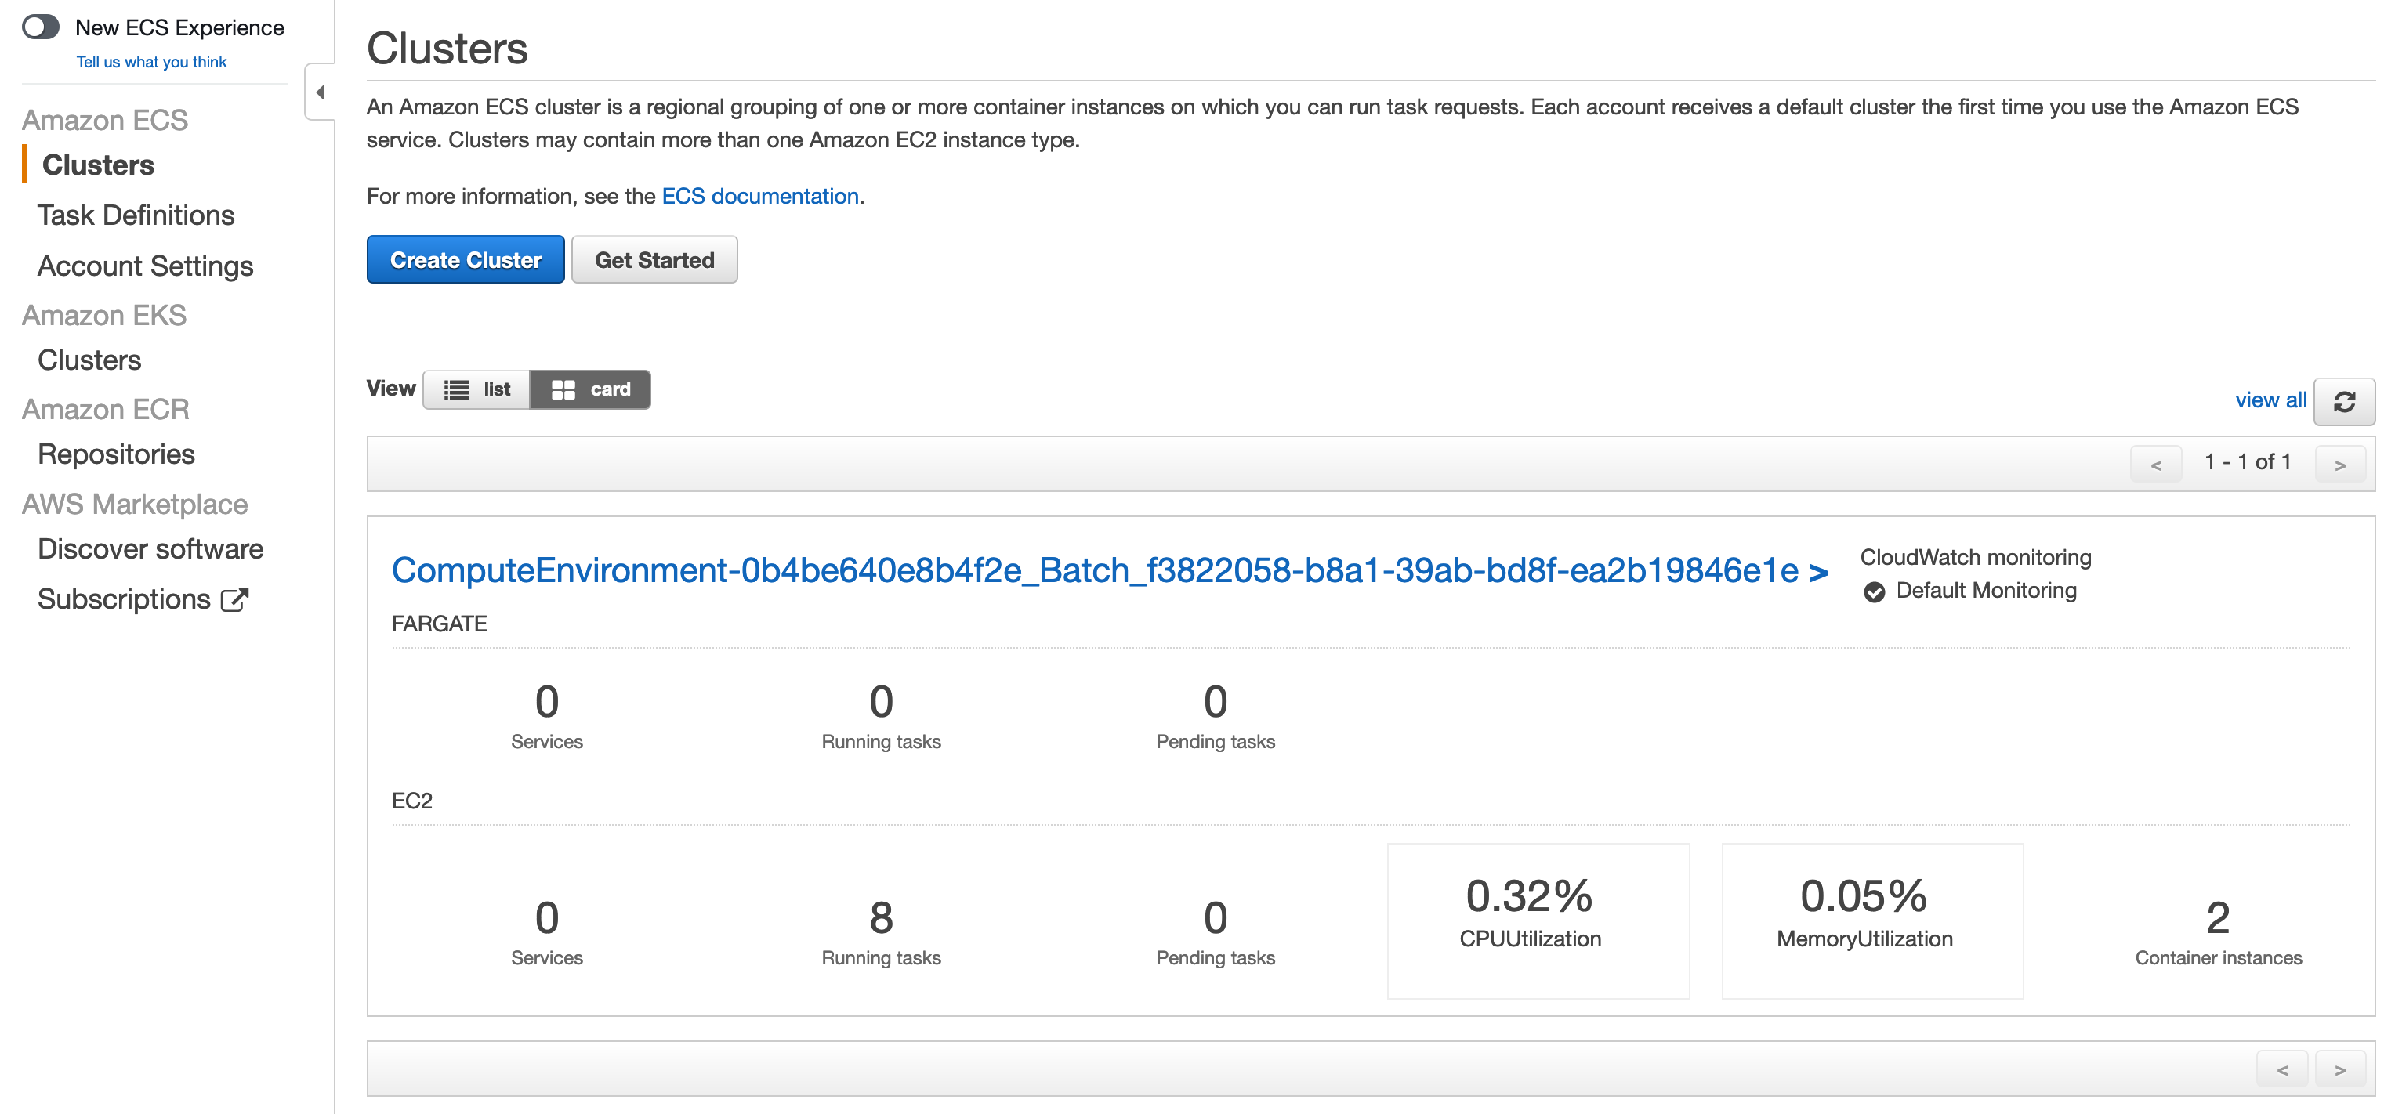
Monitor Cluster Status

Slide 35
Monitor Lambda Status

Slide 36
Monitor Batch Job Progress

Slide 37
Monitor Multiple Batch Job Process in Parallel
Notes:
Using AWS Batch.

Slide 38
Logs, Metrics, and Traces
Notes:
From multiple data source. On AWS and on-premises

Slide 39
Query Log Results

Slide 40
Demo: Name Resolution Service
ID Minting Service: Nice Opaque Identifier (NOID) minting
https://github.com/vt-digital-libraries-platform/mint
Resolution service
https://github.com/vt-digital-libraries-platform/resolution-service
Service integration
https://github.com/vt-digital-libraries-platform/DLPServices

Slide 41
Session 2: Agenda
Building digital libraries
Cloud, Serverless Computing
NLP, Deep Learning, and Machine Learning, MLOps

Slide 42
Natural Language Processing (NLP)
Natural Language Processing (NLP) is a field of artificial intelligence (AI) that enables computers to analyze and understand human language, both written and spoken
Natural languages: English, Mandarin, French, Swahili, Arabic, Nahuatl, ….
Ultimate goal: Natural human-to-computer communication

Slide 43
NLP Applications
Spell checking, keyword search
Information extraction
Classification, positive/negative sentiment of documents
Machine translation
Spoken dialog systems, chat bots
Question answering

Slide 44
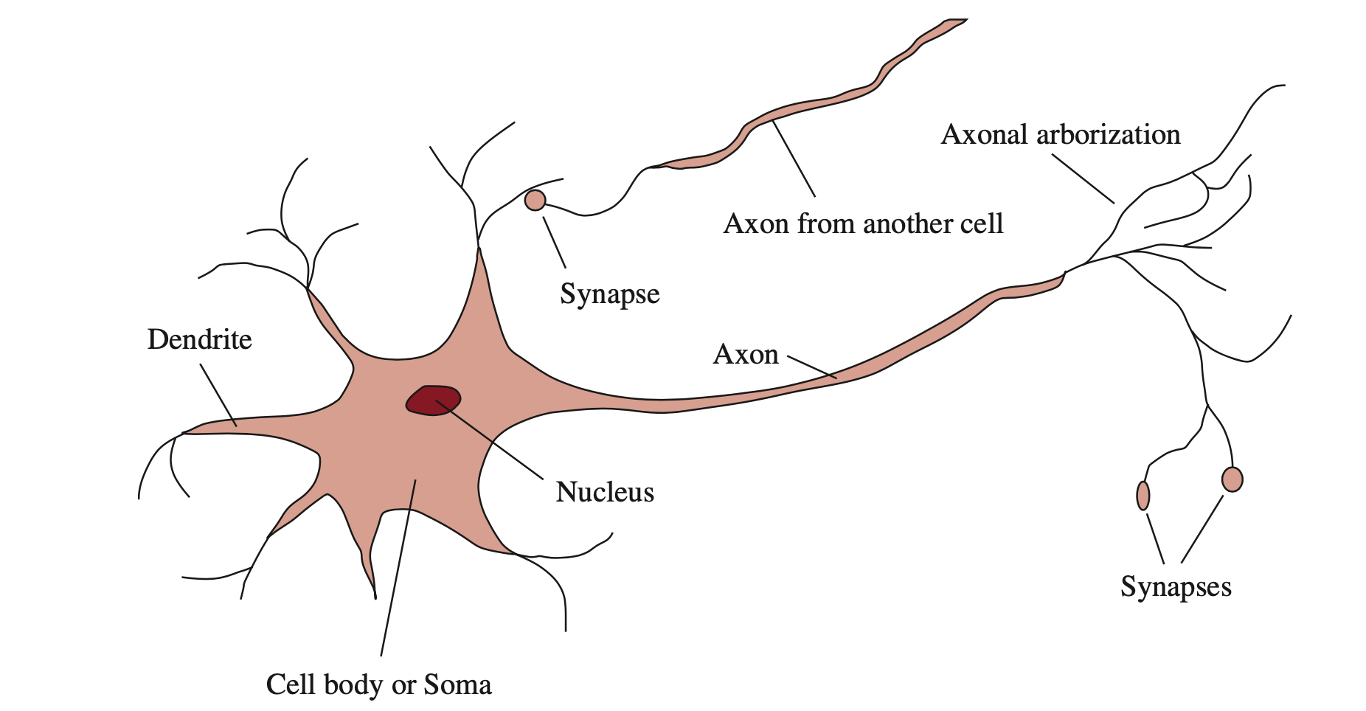
Deep Learning
Neural network: the networks trained by deep learning methods
Applications:
Visual object recognition
Machine translation
Speech recognition
Image synthesis
Reinforcement learning
Many many more
Notes:
Model networks of neurons in the brain

Slide 45
Deep Learning Network
Notes:
Modularity ---- build a complex network from simpler functional units

Slide 46
Deep Learning Advantages
Deep learning algorithms attempt to learn (multiple levels of) representation by using a hierarchy of multiple layers
Representation learning attempts to automatically learn good features or representations
Learned Features are easy to adapt, fast to learn
Deep learning provides a very flexible, universal, learnable framework for representing world, visual, and linguistic information
Both unsupervised and supervised learning methods
Notes:
Learning representations of data. Exceptionally effective at learning patterns

Slide 47
Deep Learning in NLP
Challenges in current NLP systems:
Handcrafting features is usually difficult and time-consuming
Symbolic representation (grammar rules) makes NLP system fragile
Advantages of deep learning
Distributed representation is more (computationally) efficient than one-hot vector representation
Learn from unlabeled data
Learn multiple levels of abstraction: word – phrase – sentence

Slide 48
Pre-training and Transfer Learning
Pre-trained word embeddings have been an essential component of most deep learning models
Pre-train a language model (LM) on a large general-domain corpus
Fine-tune it on the target task using novel techniques
Universal method
Works across tasks varying in document size, number, and label type
Uses single architecture and training process
Requires no custom feature engineering or pre-processing
Does not require additional in-domain documents or labels
BERT, GPT-2, and many more

Slide 49
Demo
Text classification
Question answering
Summarization
Fill Mask
Zero-shot classification
Notes:
https://github.com/yinlinchen/awesome-sagemaker/tree/master/examples

Slide 50
Machine Learning Workflow
Data gathering and pre-processing
Model implementing
Training, evaluating and tuning the model
Model deployment
Get predictions from the model
Monitor the ongoing predictions
Manage models and versions

Slide 51
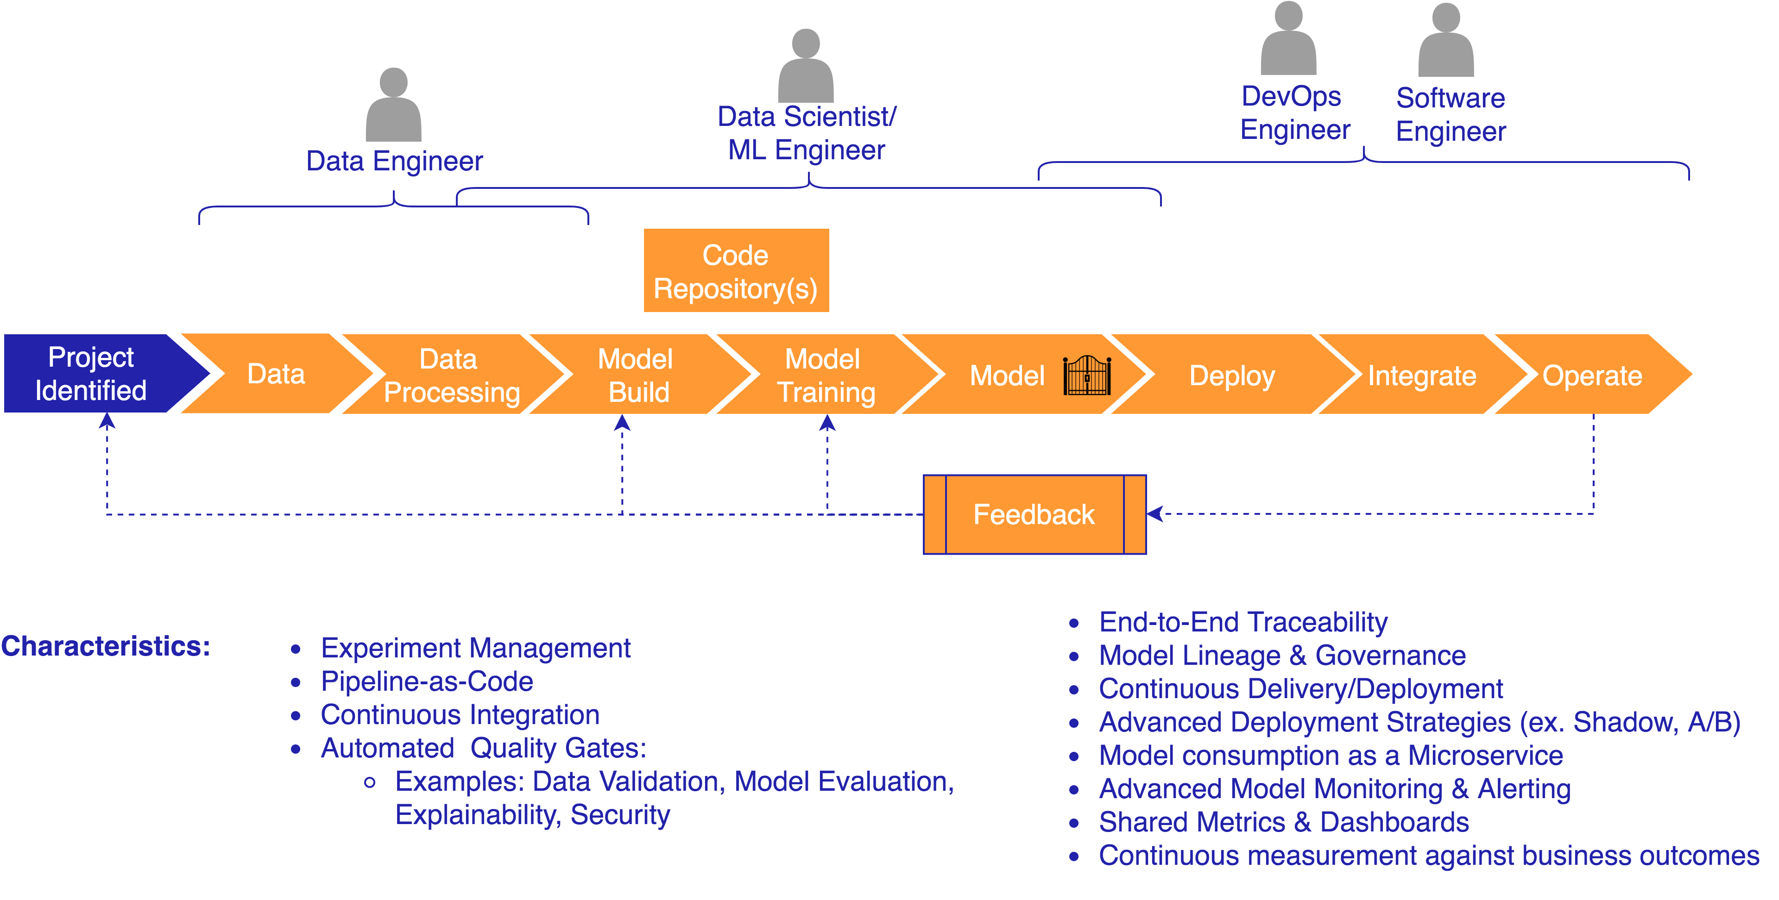
Machine Learning Operations (MLOps)
Incorporating CI/CD practices to build automated end-to-end machine learning workflow
Image source: https://github.com/aws-samples/mlops-amazon-sagemaker-devops-with-ml

Slide 52
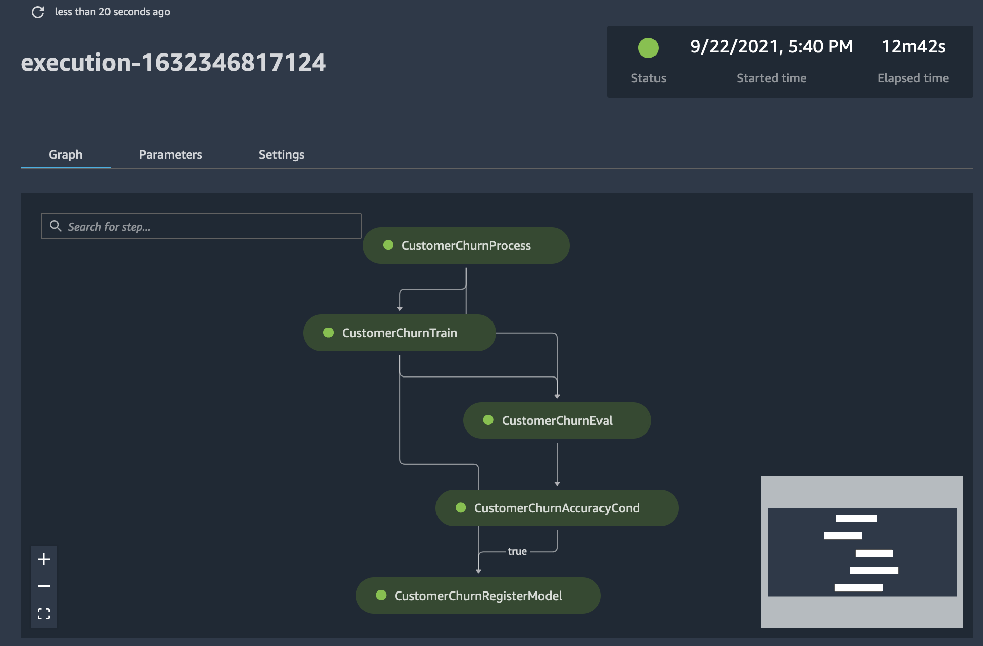
Demo: MLOPs in AWS

Slide 53
Q & A
Thank You!

