Slide 1
ISCRAM 2021
18th International Conference on Information Systems for Crisis Response and Management
Disaster Response Patterns across Different
User Groups on Twitter:
A Case Study during Hurricane Dorian
Liuqing Li
liuqing@vt.edu
Presenter
Edward A. Fox
fox@vt.edu
Department of Computer Science
Virginia Polytechnic Institute and State University
Blacksburg, VA 24061 USA
May 26, 2021

Slide 2
BACKGROUND
Disaster Response across Different Communities
News media: uniquely situated to gather & transmit information
Humanitarian organizations: provide disaster aid, ...
Individuals: rescue those affected, share experiences, ...
Social Media in Disasters
Information sharing
Different roles of users -> different behavior across disasters
Unavailable user information -> Lack of user-based research
We conduct a user-based comprehensive analysis to understand response patterns of different user groups during Hurricane Dorian.

Slide 3
RELATED WORK
User Classification
Organization-related, Democrat/Republican, …, Gender
DEMO: TwiRole for 3-way (brand, female, male) classification
User-centered Analysis
Research during disasters for many years
Specific rules to manually select a set of users
Small scale -> limited generality
We fill the gap between user classification and user-centered analysis
-> understand response patterns at scale.

Slide 4
RESEARCH QUESTIONS
1
How do tweeters and tweets demonstrate differences among user groups related to Hurricane Dorian?
2
How does the average number of tweets change each day for each group?
3
Are there any differences in certain emotions between the groups?
4
What are the favorite hashtags or words used by different types of users?
5
Regarding specific topics, is there any difference in tweet posting patterns of the two user groups?

Slide 5
METHODOLOGY
Data Flow Diagram
Cleaned Tweets
Subset of tweet collection within a time window
Sampled Users
TwiRole -> brand and individual users
Comprehensive Analysis

Slide 6
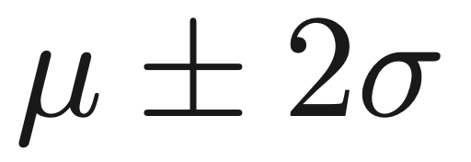
METHODOLOGY
Cleaned Tweets
Time Window:
Phase | # of Tweets
1. Raw collection | 591,094
2. Remove retweets and non-English tweets | 565,911
3. Subset within time window (08/27/2019 - 09/09/2019) | 521,886 (207,894 users)

Slide 7
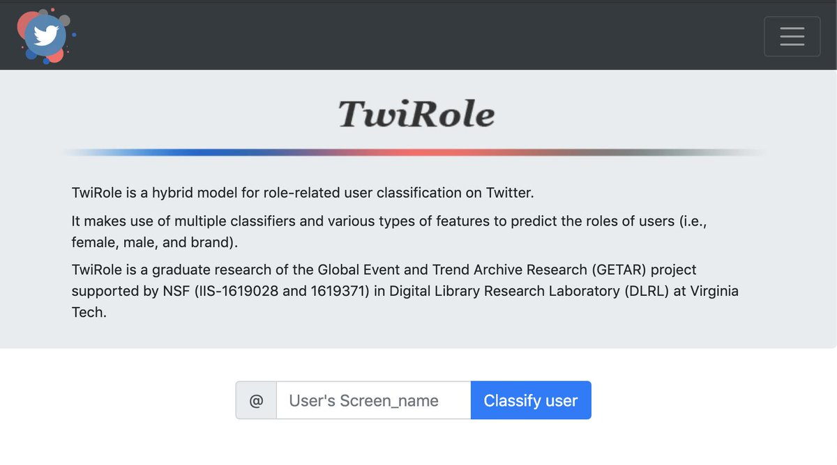
METHODOLOGY
TwiRole: Role-related User Classification
Raw Collection
56,528 users (90,000 sampled tweets)
TwiRole
48,753 users (successfully analyzed)
Within the selected time window
45,237 users (267,842 tweets)
Evaluation |  | Total | Manual Labeled |  |  | Botometer
 |  |  | Brand | Individual | Precision | Bot | Percentage
Predicted | Brand | 150 | 143 | 7 | 95.3% | 10 | 6.67%
 | Individual | 150 | 10 | 140 | 93.3% | 3 | 2.00%

Slide 8
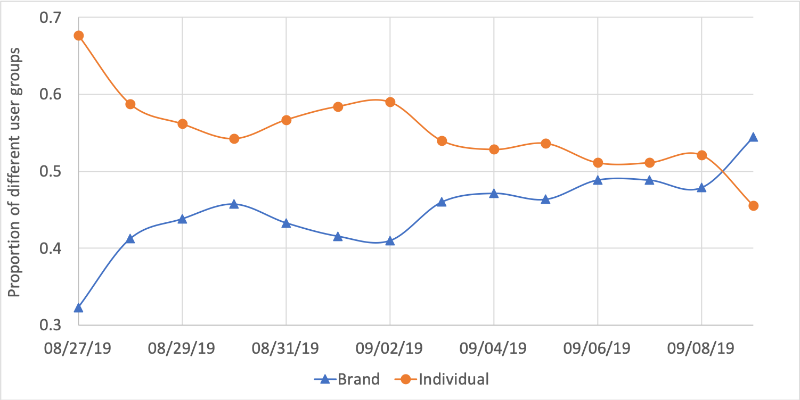
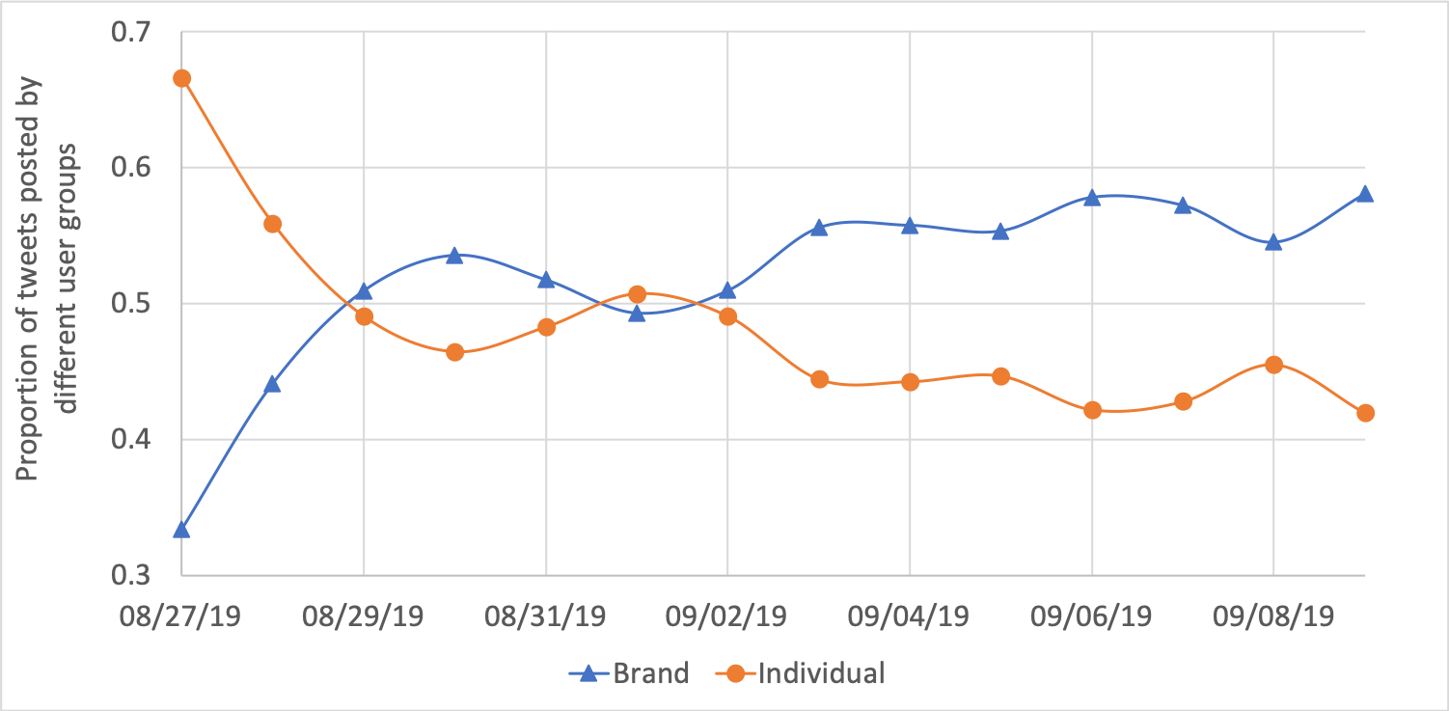
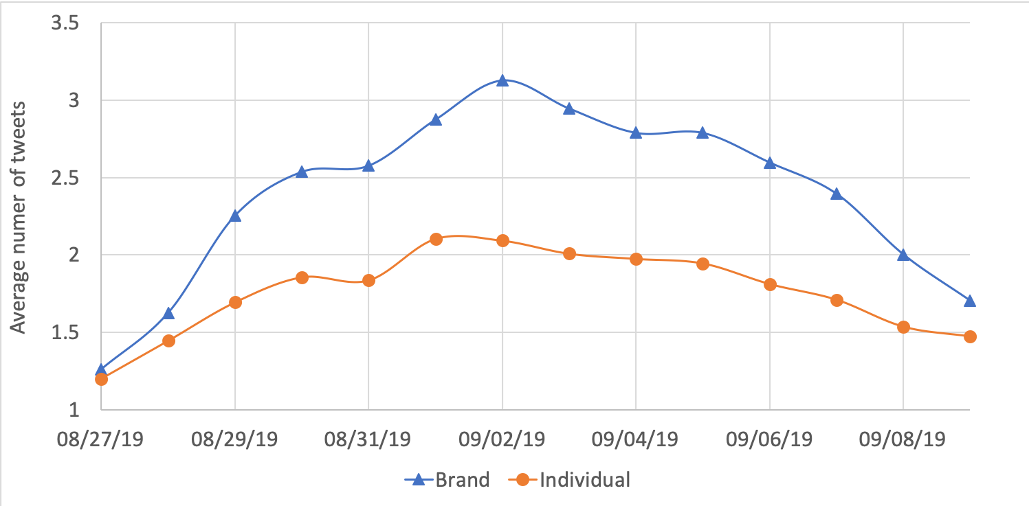
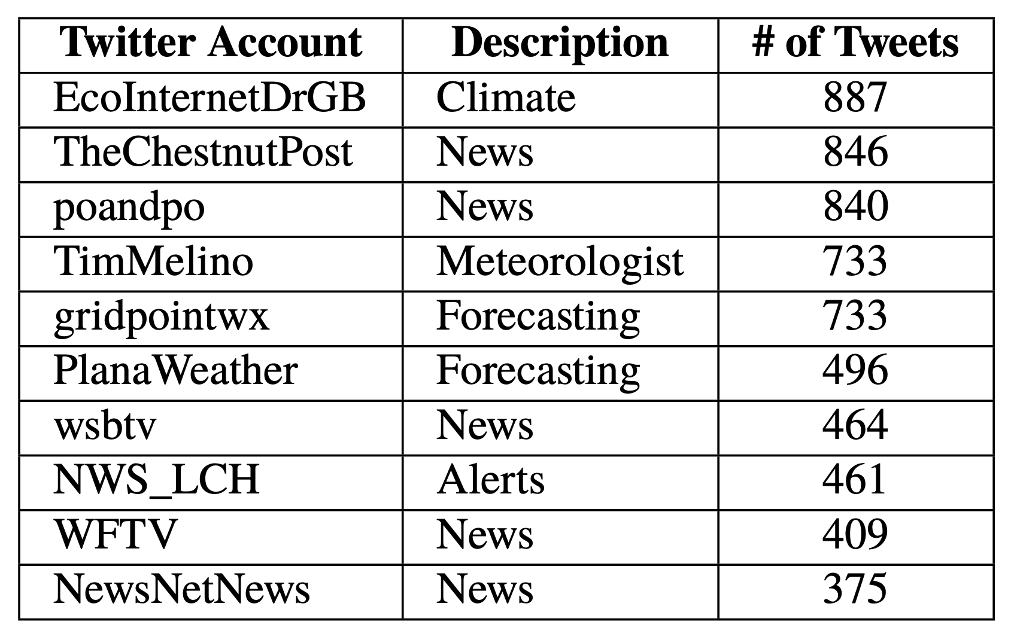
FINDINGS - BASIC ANALYSIS
Proportion of users in the two groups
Proportion of tweets posted by different user groups
Average number of tweets posted by
different user groups per day
Top 10 brand users with their descriptions
and the total number of tweets posted

Slide 9
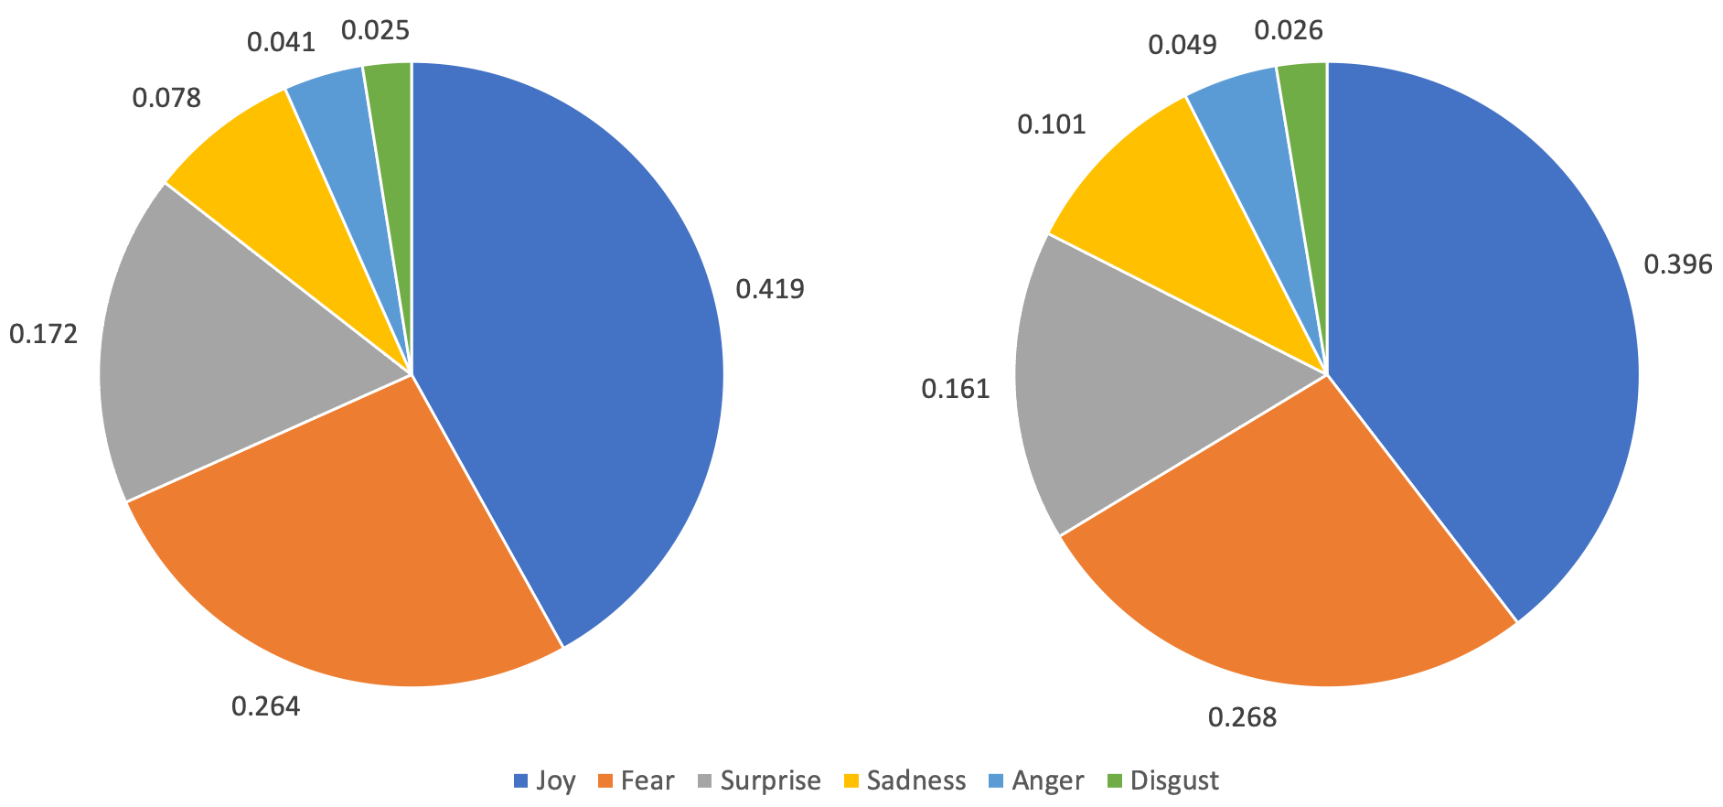
FINDINGS - EMOTION ANALYSIS
Average scores of emotions between brand users (left) and individual users (right)
Brand users posted more joy- and surprise-related tweets than individual users.
In contrast, individual users seemed sadder than brand users.

Slide 10
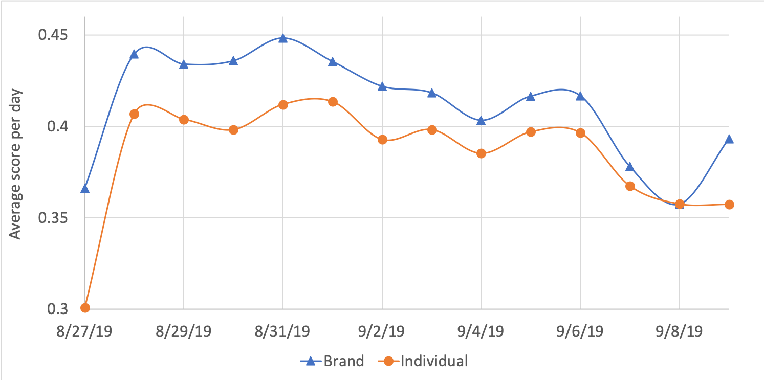
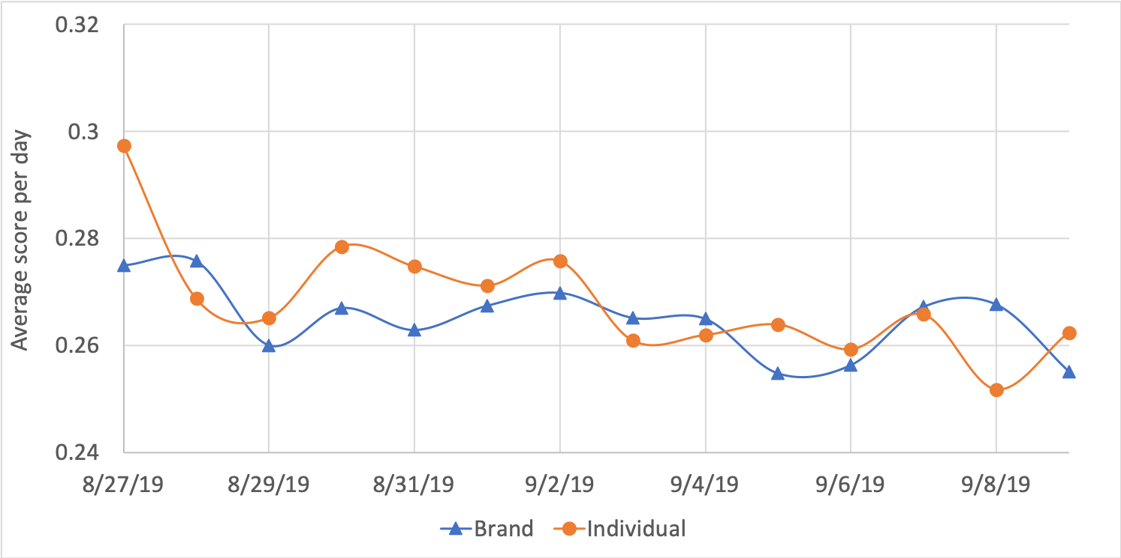
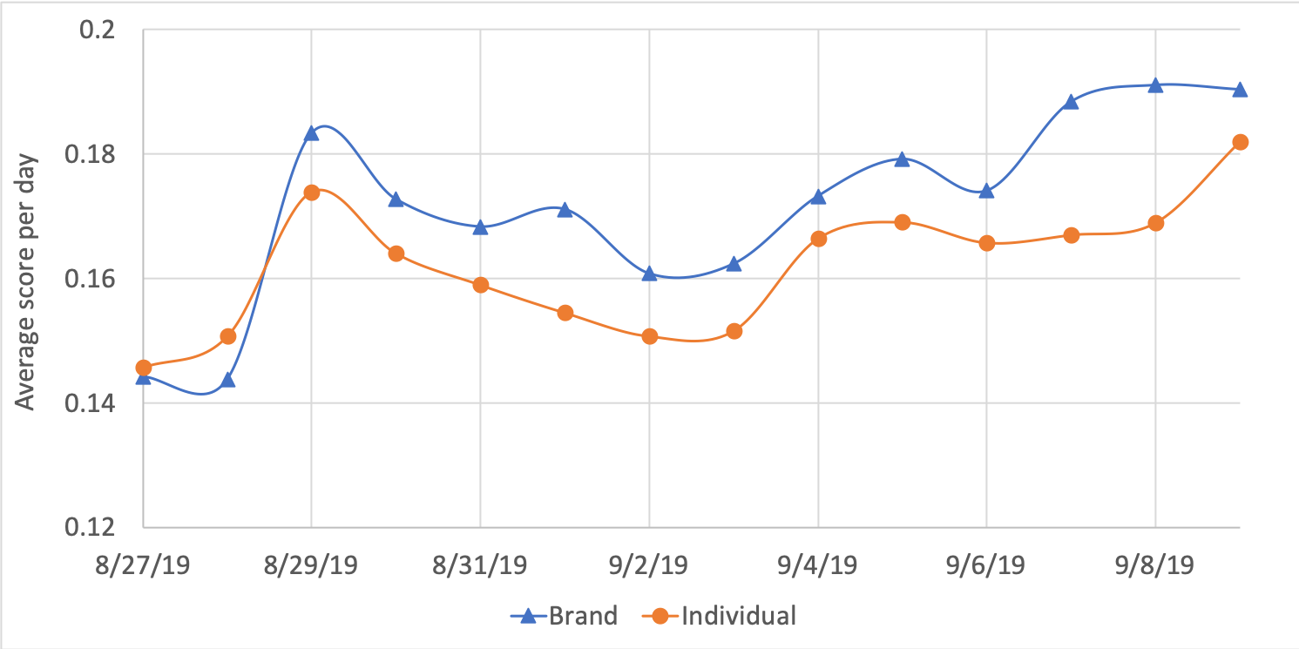
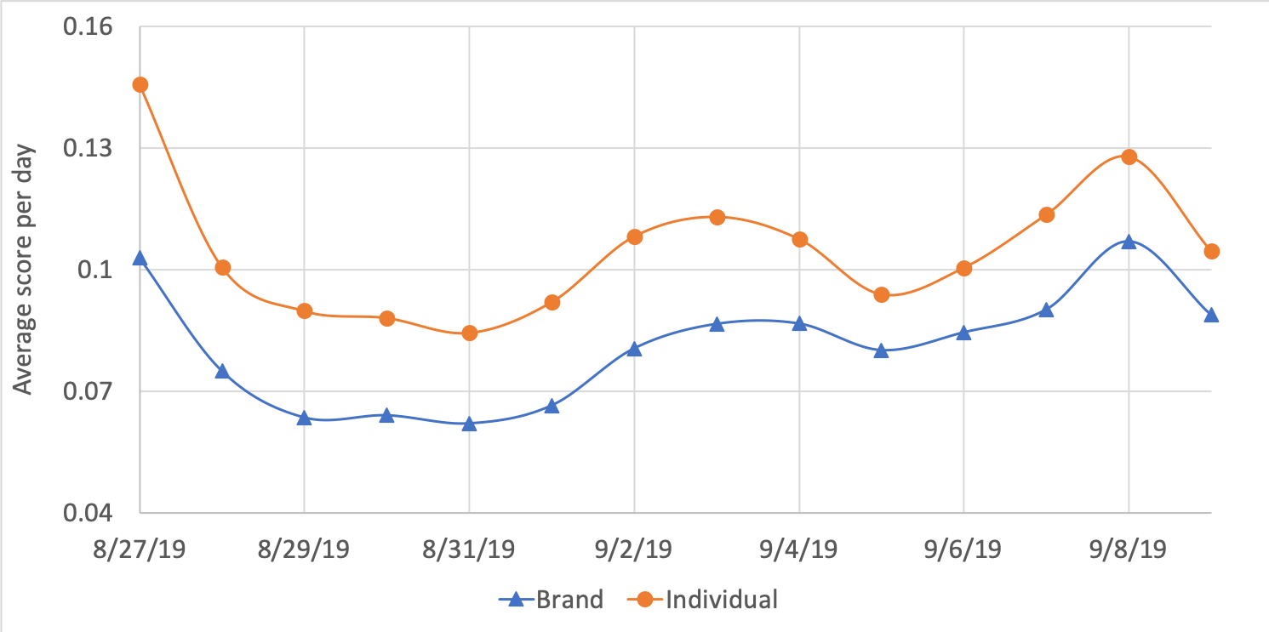
FINDINGS - EMOTION ANALYSIS
Average score of the joy emotion
Average score of the fear emotion
Average score of the surprise emotion
Average score of the sadness emotion

Slide 11
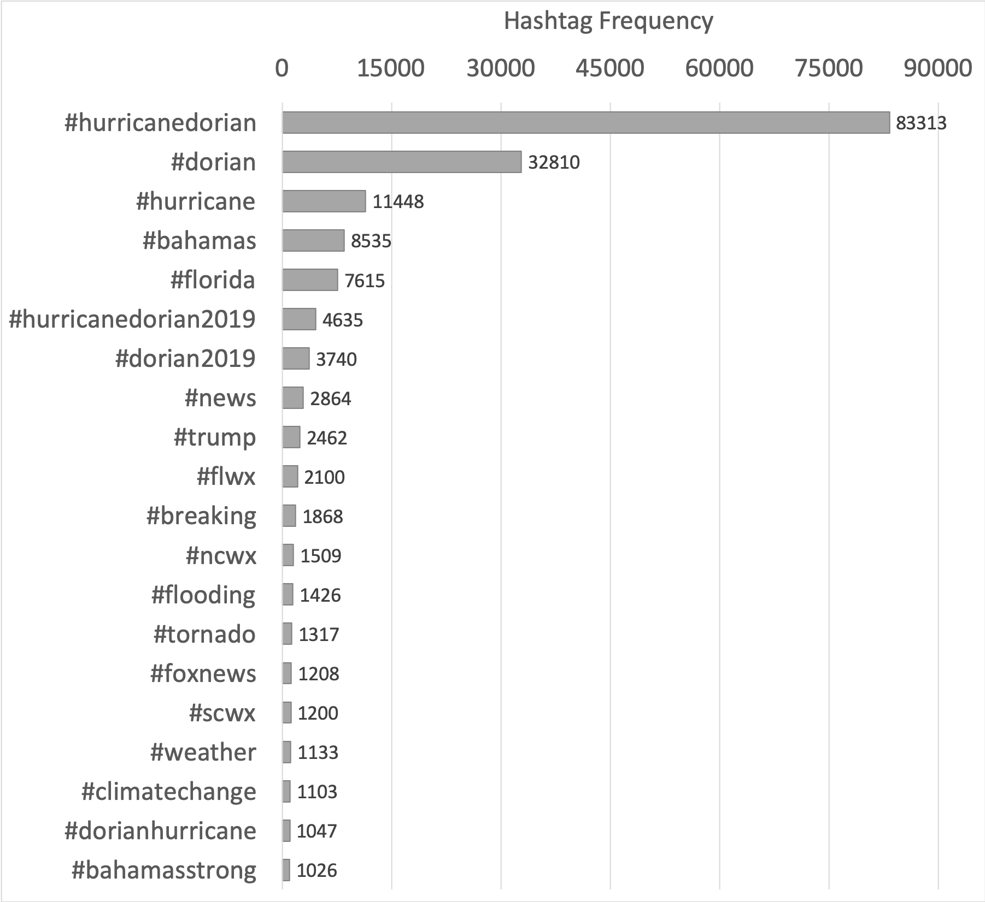
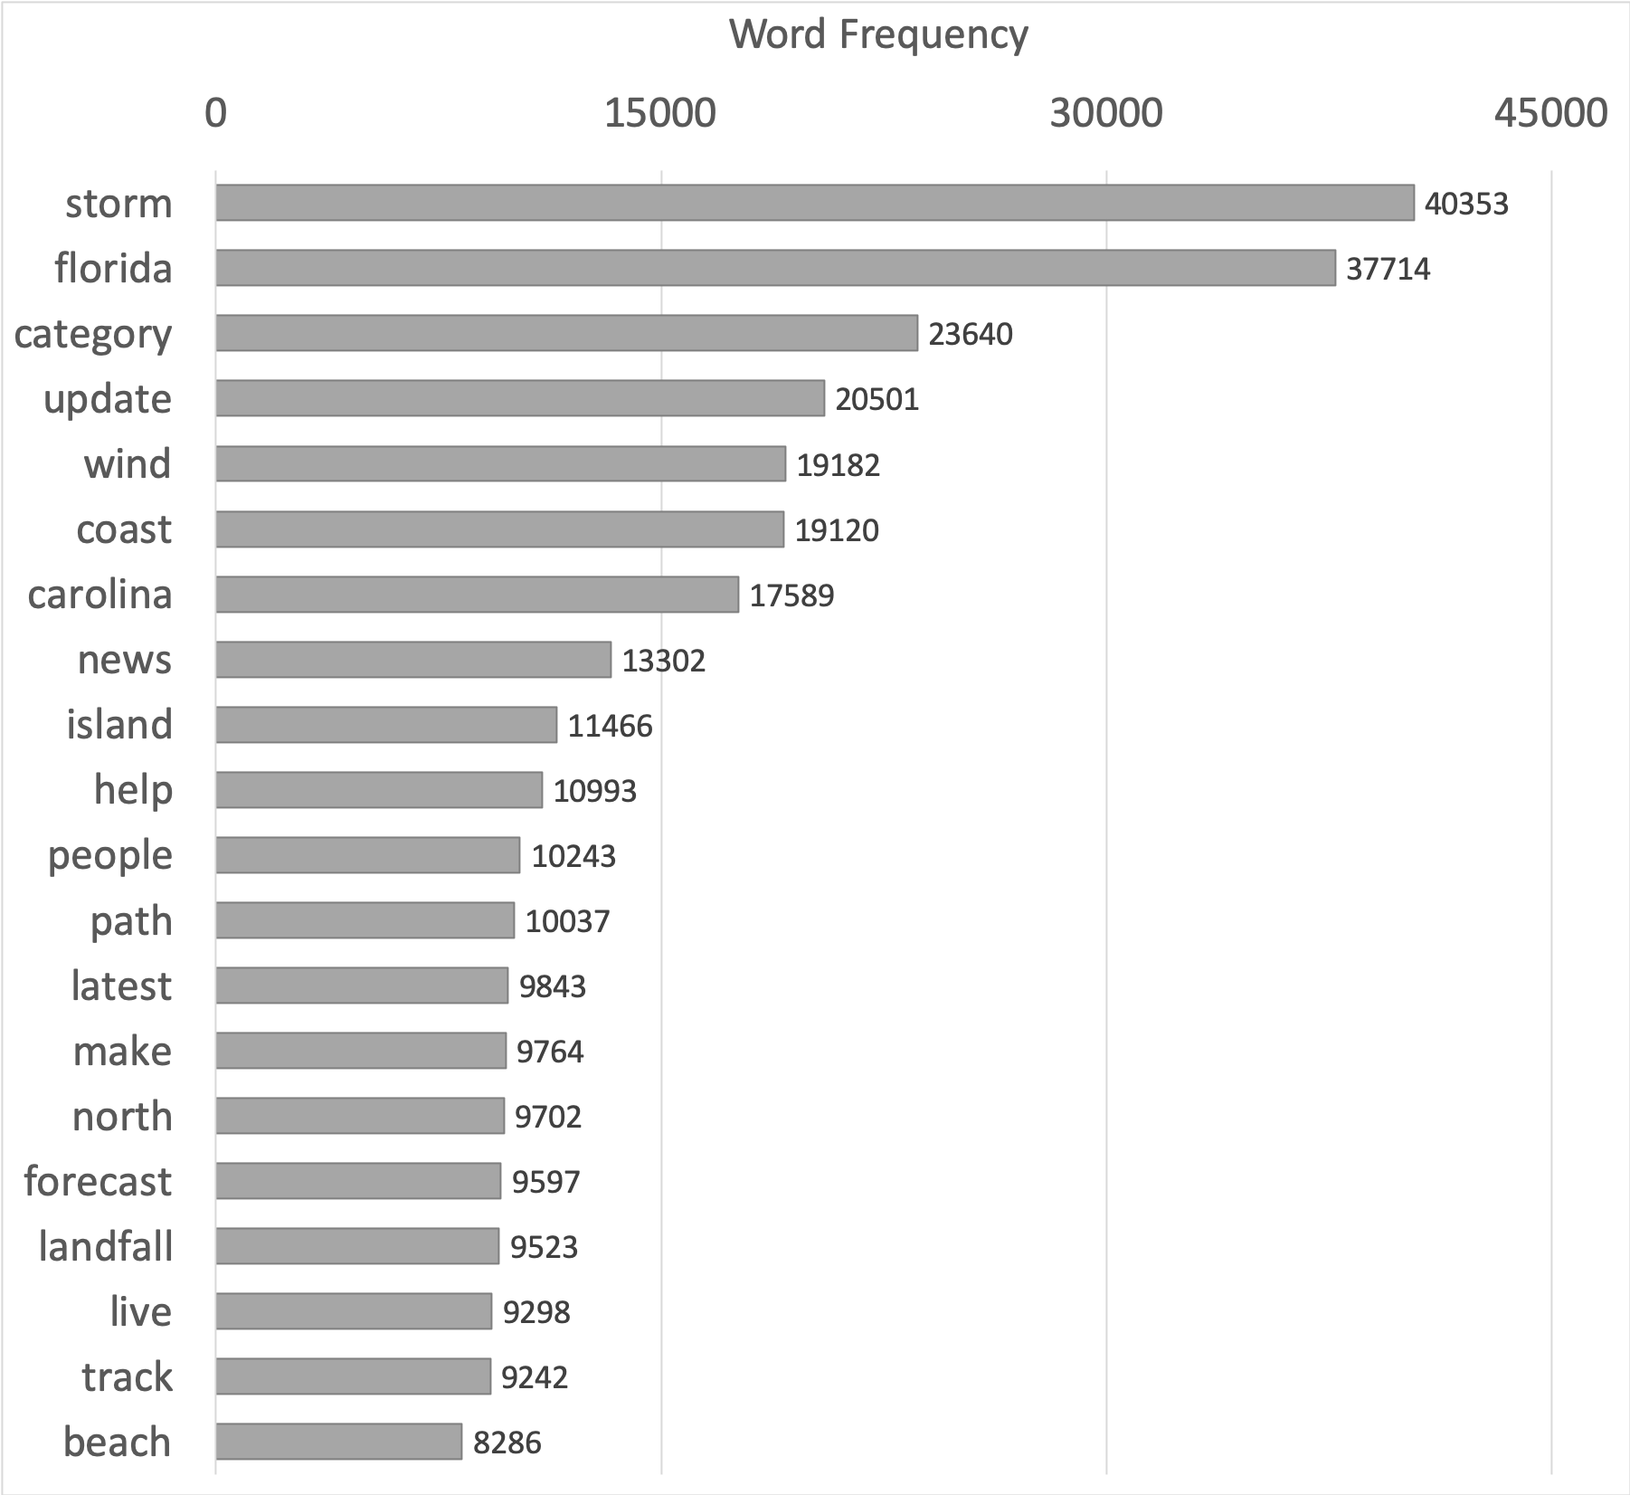
FINDINGS - TEXT ANALYSIS
Hashtags and frequencies
Words and frequencies
Top 20 hashtags (left) and words (right) posted by all users

Slide 12
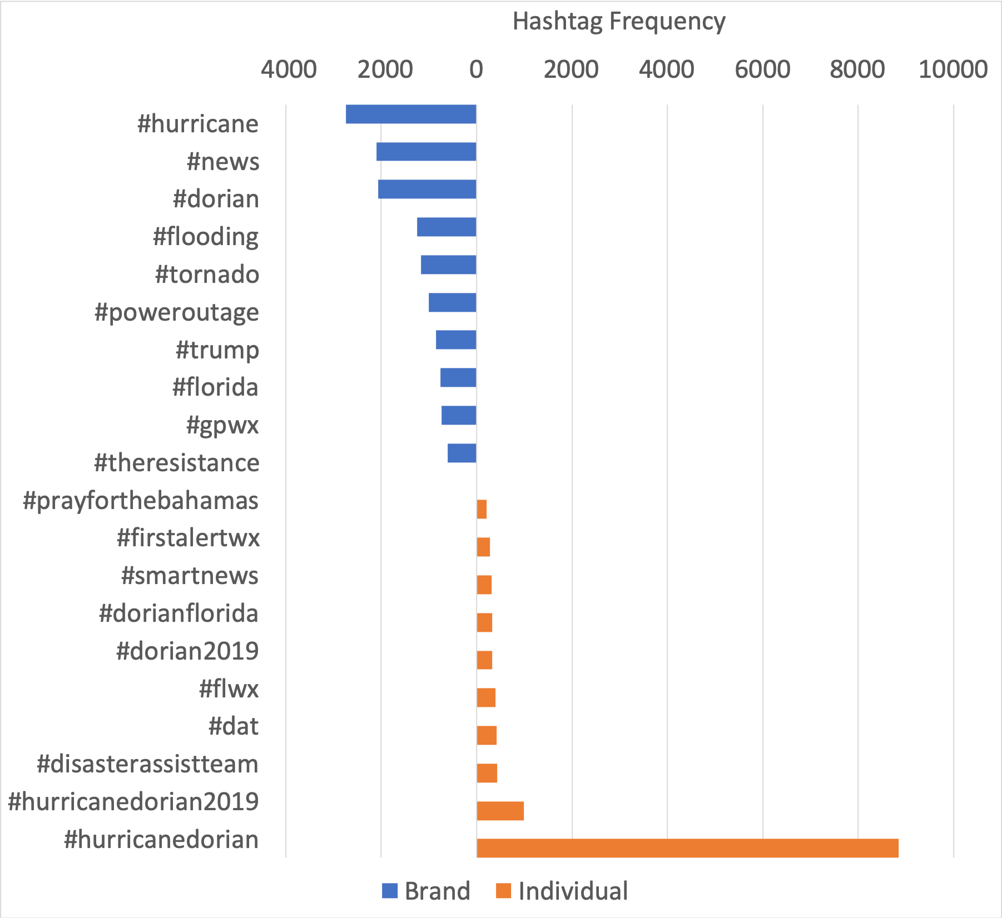
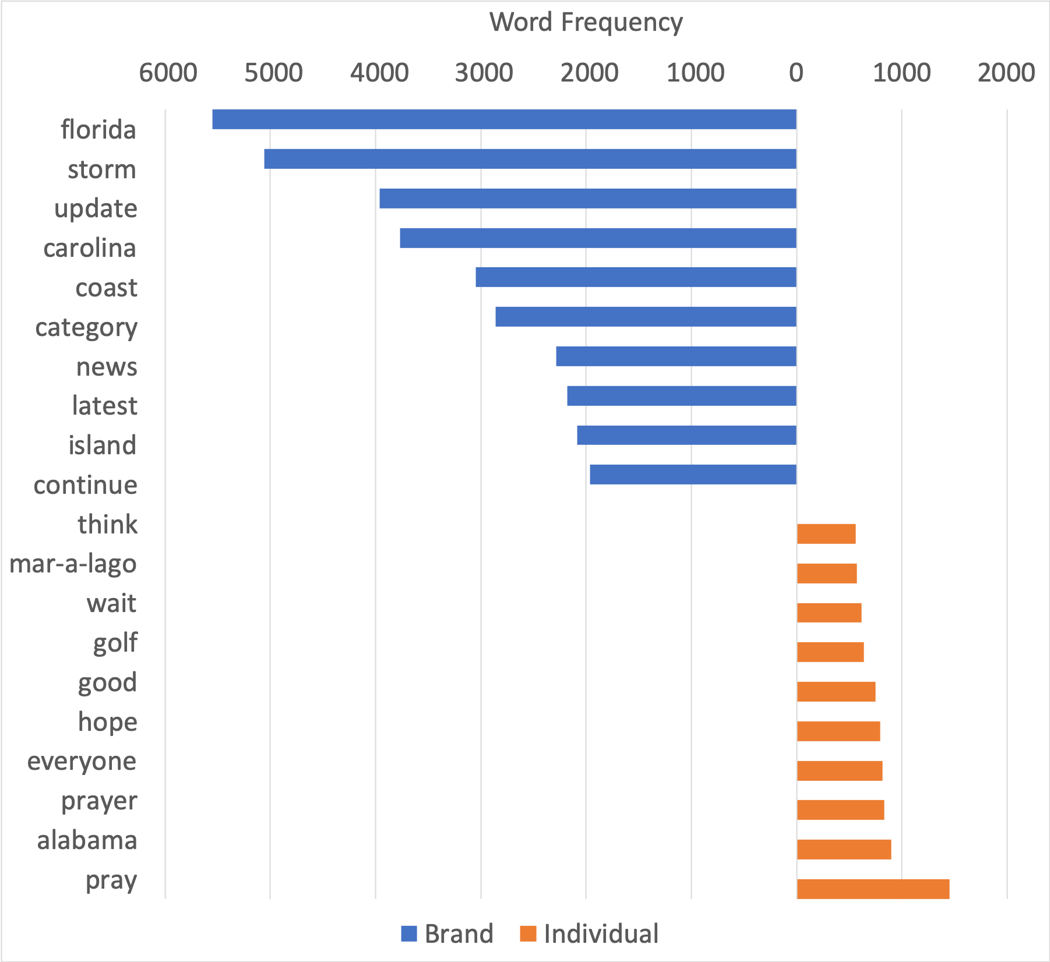
FINDINGS - TEXT ANALYSIS
Top hashtags by frequency
Top words by frequency
Top hashtags (left) and words (right) by frequency, showing |brand - individual| values

Slide 13
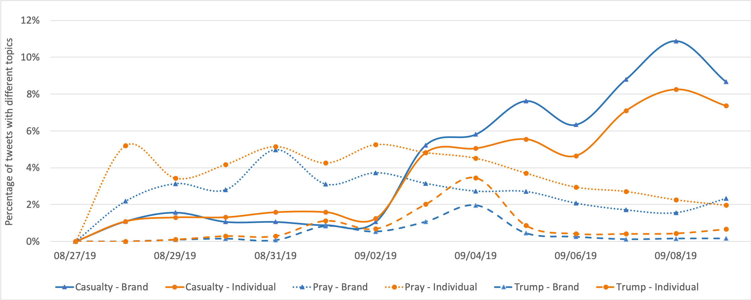
FINDINGS - TEMPORAL ANALYSIS
Topic Type | Words (lowercase)
Casualty-related | victim, dead, death, kill, die, loss, drown, missing
Prayer-related | pray, prayer, r.i.p, hope, god, wish, brace, crave, appeal
Trump-related | golf, mar-a-lago, alabama
Percentages of tweets related to the three topics posted by brand and individual users

Slide 14
CONCLUSION
A Case Study with Comprehensive Analysis
Response patterns across user groups during Hurricane Dorian
Basic analysis, emotion analysis, text analysis, and temporal analysis
Analysis Results
Brand Users | Individual Users
More and more active | Less and less active
More tweets on average | Less tweets on average
More joy- and surprise-related tweets | More sadness-related tweets
Simple hashtags | Compound hashtags
Hurricane-related words | Feeling or event-related words
Focus on casualties | Focus on topics of prayer and president

Slide 15
FUTURE WORK
More Collections
Add more hurricane-related tweet collections -> a group case study
More Information
Geo-tagged tweets -> examine spatial distribution: brand / individuals
Further Improvement
Topic modeling on emotional tweets -> understand differences regarding emotional topics (between different user groups)

Slide 16
Thank you !
Q & A
Contact Us
Liuqing Li liuqing@vt.edu https://liuqing.us/
Edward A. Fox fox@vt.edu http://fox.cs.vt.edu/
http://fox.cs.vt.edu/talks/2021/
Resources
TwiRole Code http://github.com/liuqingli/TwiRole
Hurricane Dorian https://bit.ly/3gl8QHD (Tweet ID Only)
GETAR Project http://eventsarchive.org
NSF (IIS-1619028 and 1619371)

