Slide 1
Preparing code and data
for reproducible publication:
a hands-on tutorial
JCDL 2020
August 3, 2020
William A. Ingram and Edward A. Fox
Virginia Tech
Blacksburg, VA 24061
USA
This work is licensed under a Creative Commons Attribution 4.0 International License.
Notes:
Participants should have:
A laptop or other computer.
A supported browser (not IE or Edge).
Participants should follow along with the slide deck at the bitly link.

Slide 2
Instructors
William A. (Bill) Ingram
  M.S., L.I.S. from iSchool at UIUC; Ph.D. (in progress) Computer Science at Virginia Tech
  Assistant Dean, Virginia Tech University Libraries
                Overseeing: Digital Libraries, IT Services, Digital Preservation and Imaging, Special Collections and University Archives, Policy and Governance, Finance
  ~20 years IT experience
  ~15 years in libraries, mostly in digital libraries

Slide 3
Instructors
Dr. Edward A. Fox
  Ph.D. and M.S. in Computer Science from Cornell University, and a B.S. from M.I.T.
  Fellow of both ACM and IEEE, cited for leadership in digital libraries and information retrieval
  Executive Director and Chairman of the Board of the Networked Digital Library of Theses and Dissertations
  Professor of CS at Virginia Tech
  Former Chair (now a member) of the JCDL Steering Committee as well as of the IEEE-CS Technical Committee on Digital Libraries

Slide 4
Tutorial History
A version of this tutorial was given at JCDL 2019, June 2–6, 2019, in Urbana-Champaign, Illinois, USA, by April Clyburne-Sherin and Xu Fei.
  Disclaimer: April Clyburne-Sherin and Xu Fei were employees of Code Ocean, a software service featured prominently in this tutorial.
After adapting her materials and obtaining her guidance, Ingram and Fox gave a version of this tutorial at ETD2019, November 6–8, 2019, in Porto, Portugal.
Thanks go to April Clyburne-Sherin and Xu Fei for their prior assistance.

Slide 5
Workshop POP
Purpose: To introduce skills and tools in organization, documentation, automation, containerization, and dissemination of research.
Outcome: You feel more confident applying relevant skills and tools to guide the sharing of your research code and data.
Process: You adapt & apply some skills or tools we discuss today next time your share or publish your research.
Notes:
Why are we here?
What do we hope to accomplish together?

Slide 6
Agenda
Introduction
Organization
Exercise 1: One repository
Exercise 2: Separate code & data
Documentation
Exercise 3: Document data & code
Exercise 4: Specify run environment
Exercise 5: Specify dependencies
Automation
Exercise 6: Containerization
Exercise 7: Create a master script
Exercise 8: Create relative paths
Dissemination
Exercise 9: Specify a license
Exercise 10: Share your code!
Notes:
How will we try to accomplish our Workshop POP?

Slide 7
Schedule
Beijing Time (UTC+8)
0:30-2:00 — Part 1
2:00-2:30 — Coffee/Tea Break
2:30-4:00 — Part 2
We will take a short break midway through each part, but free to take additional breaks you need.
Notes:
This is an adaptable agenda:
We will take two short breaks together, plus one long break between parts.
Participants should feel free to take breaks whenever they wish.

Slide 8
Your thoughts?
Is there a reproducibility crisis?
Notes:
With a show of hands, ask the participants whether they think there is a reproducibility crisis in their discipline:
Yes, a significant crisis.
Yes, a slight crisis.
Don’t know.
No, there is no crisis.
Source information:
1,500 scientists lift the lid on reproducibility
https://www.nature.com/news/1-500-scientists-lift-the-lid-on-reproducibility-1.19970 (2016)
“A minority of respondents reported ever having tried to publish a replication study. When work does not reproduce, researchers often assume there is a perfectly valid (and probably boring) reason. What's more, incentives to publish positive replications are low and journals can be reluctant to publish negative findings. In fact, several respondents who had published a failed replication said that editors and reviewers demanded that they play down comparisons with the original study.”
“The survey — which was e-mailed to Nature readers and advertised on affiliated websites and social-media outlets as being 'about reproducibility' — probably selected for respondents who are more receptive to and aware of concerns about reproducibility.”

Slide 9
A crisis? (Nature 2016)
Monya Baker. 2016. 1,500 scientists lift the lid on reproducibility. Nature News 533, 7604 (May 2016), 452. DOI:https://doi.org/10.1038/533452a
https://www.nature.com/news/1-500-scientists-lift-the-lid-on-reproducibility-1.19970
Notes:
Most researchers think that reproducibility is an issue in their discipline, but may disagree about the urgency.

Slide 10
An opportunity to help your future self
“It takes some effort to organize your research to be reproducible… the principal beneficiary is generally the author herself.”- Schwab & Claerbout
See: Making Scientific Contributions Reproducible
Notes:
Therefore, when thinking about adopting best practices to tackle reproducibility, adopt first those practices that will benefit yourself first - as your future self is the most frequent re-user of your research.

Slide 11
Your experience
Have you failed to reproduce an experiment?
How many participants have had difficulty reproducing someone else’s work?
How many participants have had difficulty reproducing your own work a few weeks, months, or years later?
Notes:
However, we are going to frame this question in a different way.
With a show of hands, how many participants have had difficulty reproducing someone else’s work?
And how many participants have had difficulty reproducing your own work a few weeks, months, or years later?
See survey results in
https://www.nature.com/news/1-500-scientists-lift-the-lid-on-reproducibility-1.19970 (2016)
This is how I prefer to frame issues about reproducibility.
Difficulty reproducing our own work or the work of peers is very, very common in research.
Many of the steps that a researcher can take to address irreproducibility of published research also improves the reusability of their research for themselves, labmates, and close collaborators.

Slide 12
Defining reproducibility
ACM Definitions: https://www.acm.org/publications/policies/artifact-review-badging
Repeatability: Same team; same experimental setup
Reproducibility: Different team; same experimental setup
Replicability: Different team; different experimental setup
Our definition of computational reproducibility — based Victoria Stodden et al. (2014):
The calculation of quantitative scientific results by an independent person or group using the original datasets and methods
Computational reproducibility depends on open code and data.
Notes:
Artifact Review and Badging. Retrieved August 1, 2020 from https://www.acm.org/publications/policies/artifact-review-badging
Repeatability: Same team; same experimental setup — a researcher can reliably repeat her own computation
Reproducibility: Different team; same experimental setup — an independent group can obtain the same result result by repeating the same experiment
Replicability: Different team; different experimental setup — an independent group can obtain the same result by doing a different experiment
Our definition is based on Stodden, Leisch, & Peng (2014) , which is itself based on definitions from Claerbout, Donoho, and Peng

Slide 13
Computational reproducibility
“An article about computational science in a scientific publication is not the scholarship itself, it is merely advertising of the scholarship. The actual scholarship is the complete software development environment and the complete set of instructions which generated the figure.”
Buckheit and Donoho (1995)’s distillation of Claerbout and Karrenbach (1992)
Jon F Claerbout and Martin Karrenbach. 1992. Electronic documents give reproducible research a new meaning. In SEG technical program expanded abstracts 1992. Society of Exploration Geophysicists, 601–604.
Jonathan B Buckheit and David L Donoho. 1995. Wavelab and reproducible research. In Wavelets and statistics. Springer, 55–81.
Notes:
For our purposes, computational reproducibility is the ability for a new researcher to rerun the data and code of the original research to create the same figures, tables, and values shared by the original researcher.
Almost all research relies on software and code for some aspect of its methods. Computational reproducibility relies on the sharing of that software and code in addition to a published narrative of the methods. This is why the founders of our idea of reproducibility describe a published article as just an advertising of the research. The actual research includes our research software and code.
Unavailable code and methods is a barrier to computational reproducibility. So to improve computational reproducibility, we want to know how best to share our methods and code.

Slide 14
Research data pipeline
Raw Data
Analytic Data
Computational Results
Figures & Tables
Article or Paper
Processing Code
Analytic Code
Presentation Code
Roger Peng. 2015. Report writing for data science in R. Leanpub. Retrieved from https://leanpub.com/reportwriting
Provenance tracking is important document the full chain of computational events along the research pipeline.
Notes:
Oftentimes, raw data sets are large and complex or not publicly available
Provenance tracking is important document the full chain of computational events along the research pipeline from raw data to conclusion
The Practice of Reproducible Research gives this advise on provenance tracking:
Record what software was used to process the raw data. Include the version of the software, what settings and parameters were chosen.
If databases were accessed, include the exact query used and access dates
Include all scripts for data cleaning and explain decisions about data that was decarded or missing

Slide 15
Technical barriers to computational reproducibility
“Dependency Hell”
  Frustration with software packages which have dependencies on specific versions of other software packages
Imprecise documentation
  Or none at all
Code rot
  Dependency packages no longer available
Barriers to adoption
  New technologies to learn and associated opportunity costs
Carl Boettiger. 2015. An introduction to Docker for reproducible research. SIGOPS Oper. Syst. Rev. 49, 1 (January 2015), 71–79. doi:10.1145/2723872.2723882, arXiv:1410.0846

Slide 16
Reproducibility is a spectrum
Roger D. Peng. 2011. Reproducible Research in Computational Science. Science 334, 6060 (December 2011), 1226–1227. DOI:https://doi.org/10.1126/science.1213847
See: Fig. 1. The spectrum of reproducibility
Notes:
Remember that, like reproducibility generally, computational reproducibility is a spectrum. Integrating one or two new practices into your research will make your research more reproducible - it is not all or nothing. And each of these steps will benefit yourself first!

Slide 17
Organization
Documentation
Automation
Dissemination
The Practice of Reproducible Research
Justin Kitzes, Daniel Turek, and Fatma Deniz (Eds.). 2017. The practice of reproducible research: case studies and lessons from the data-intensive sciences. Univ of California Press. Retrieved from https://www.practicereproducibleresearch.org/
“At a beginning level, the first of these practices largely involves placing files in a clear directory structure and creating metadata to describe them. The second is met by writing code, or scripts, to perform each step automatically, or where this is not possible, documenting all manual steps needed to complete a task at a level that would allow a second researcher to unambiguously repeat them. The third is met through the overall workflow design, especially a clear conceptualization of the different operations that need to occur sequentially and how they support each other. … Crucial to reproducing a study is providing sufficient details about its execution through reports, papers, lab notebooks, etc.”
Notes:
We are living in a golden age of reproducibility guidance for researchers.
Guidance on reproducible best practices is necessarily specific to discipline and research method, so it is best to look for examples of guidance specific to your discipline.
One great guidance document that is appropriate across disciplines is this free gitbook: The Practice of Reproducible Research. The strength of this book is that it includes case studies, which bridge the gap between theory and practice with real-life examples of researchers.
I have also included two more recommendations of computational reproducibility guidance in the example capsule we will be working with in a moment.
Despite the diversity of guidance, there are four facets or themes to reproducibility guidance that repeat across disciplines:
Organization
Documentation
Automation
Dissemination
But ultimately each of us needs to pick our battles and the battle I am now going to pic with you is that dependencies are bad and you probably have too many of them.

Slide 18

Questions?
Notes:
We can take a 10 minute break after questions
When we come back, we will begin our discussion of documentation

Slide 19
Agenda
Introduction
Organization
Exercise 1: One repository
Exercise 2: Separate code & data
Documentation
Exercise 3: Document data & code
Exercise 4: Specify run environment
Exercise 5: Specify dependencies
Automation
Exercise 6: Containerization
Exercise 7: Create a master script
Exercise 8: Create relative paths
Dissemination
Exercise 9: Specify a license
Exercise 10: Share your code!
Notes:
How will we try to accomplish our Workshop POP?

Slide 20
Organization
Documentation
Automation
Dissemination
We can organize for reproducibility:
Archive the exact versions of data used and include them in your repository.
Bundle dependencies and include them in your repository rather than retrieve on demand.
Link to repositories.
Notes:
Learning from Woodbridge’s finding, we can organize for reproducibility:
Archive the exact versions of data used and include them in your repository.
Bundle dependencies and include them in your repository rather than retrieve on demand.
Link to repositories rather than individual code files or data files.

Slide 21
Organization
Documentation
Automation
Dissemination
Woodbridge et al. analyzed the validity of a small sample of Jupyter notebooks associated with papers in PubMed Central.
Files, data, dependencies needed to execute analyses were often missing.
They were able to successfully execute only one of the ~25 notebooks that they tested.
Mark Woodbridge. 2017. Jupyter Notebooks and reproducible data science, https://markwoodbridge.com/2017/03/05/jupyter-reproducible-science.html.
Notes:
The first thing that Mark Woodbridge and his colleagues learned was that the files, data, and dependencies needed to execute analyses were often missing from the publication or accompanying repository.

Slide 22
Organization
Documentation
Automation
Dissemination
Exercise 1:
Create one repository that holds all related research files:
  Data
  Code
  Notebooks
  Documentation
  etc.
Notes:
So, the first way to overcome the risk of missing files, data, or dependencies that Woodbridge found is to put everything in one repository.
Therefore, exercise 2 will be to create one repository for all our research materials. We will use Code Ocean in this workshop, but you could do this locally with a file folder or using a git repository.

Slide 23
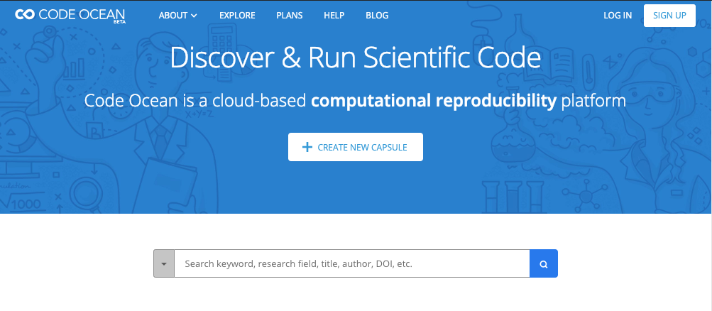
Create a Code Ocean account
https://codeocean.com/
You can delete it and opt out of any communications if you wish! For completing the exercises only. :)
You will need to verify your email address
Notes:
Everyone put your pink sticky up!
We are going to create a Code Ocean account to create a repository, called a “capsule”, on Code Ocean for all research materials.
Participants should:
Go to https://codeocean.com/
Sign up
They will need to verify their email address (sometimes they will need to resend this several times).
Participants can delete their account and opt out of any communications if you wish! There is a check box on the survey where they should select “No” to receiving news if they wish.
Code Ocean is for completing the exercises only, but the exercises can make code more reproducible no matter which platform participants which to use for themselves in the future.
Once they have successfully created an account, they should switch to a green sticky.

Slide 24
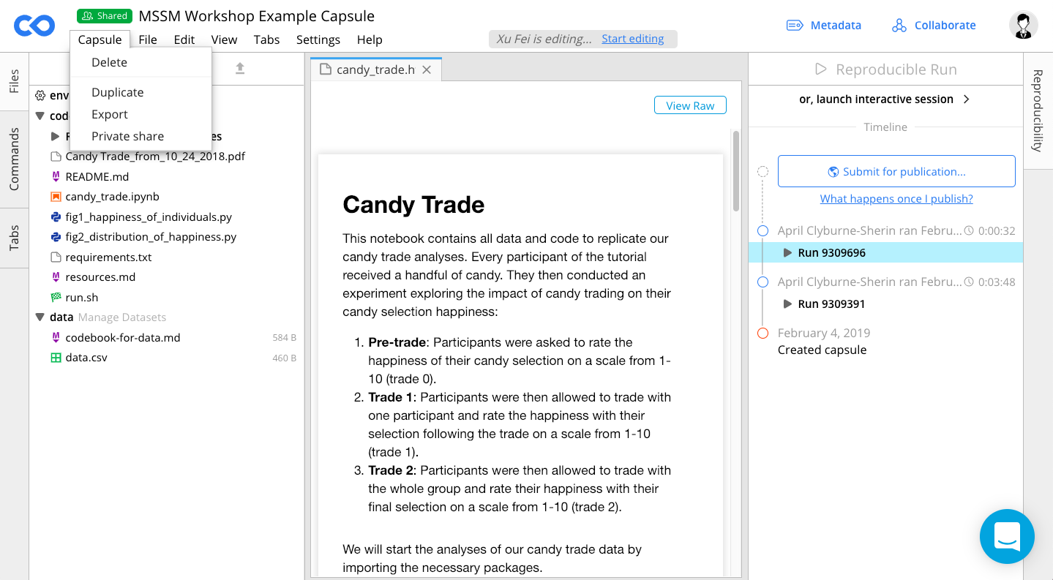
Duplicate this capsule: http://bit.ly/etd-example
Click “Capsule”
Select “Duplicate”
Notes:
Participants should
Ensure they are in “Classic” Code Ocean mode for the workshop.
Select the ellipses [...].
Click Duplicate
Duplicating this capsule creates a copy owned by you, and you know you are successful when you have a capsule named “____ Workshop (copy)”
Once they have successfully duplicated the capsule, they should switch to a green sticky.
About this capsule:
This is an example and reference capsule for the workshop.
It is a skeleton example of where are headed with our exercises.
It also includes 3 papers that can be great resources for computational reproducibility if you wish to read further.

Slide 25
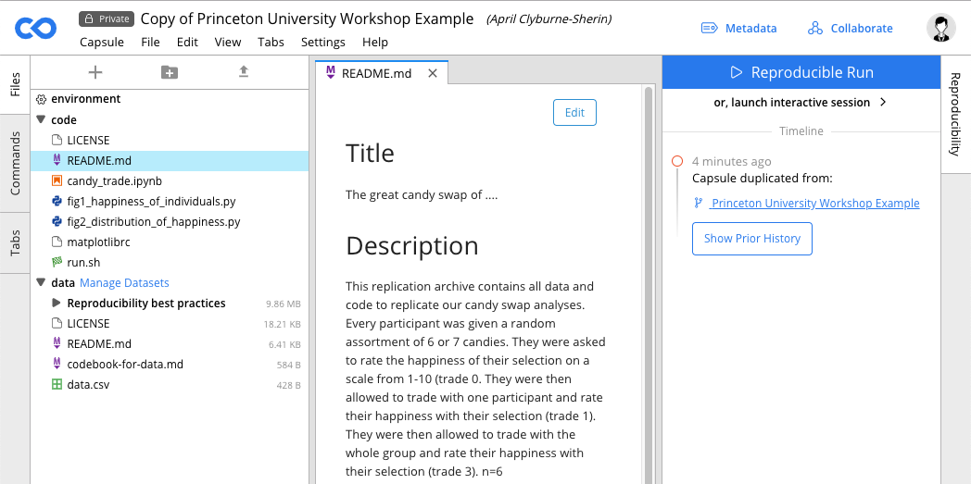
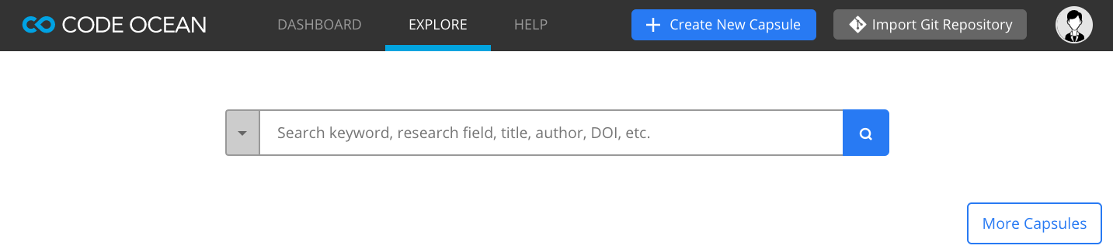
Create a new compute capsule
Pink sticky up!
https://github.com/waingram/npc-analysis
Click “Code Ocean” logo
Click “Dashboard”
Click “Import Git Repository”
Type
https://github.com/waingram/npc-analysis
Notes:
For the exercises, start a new computer capsule and import the code from my github
Alternatively, you may want to import your own project

Slide 26
Organization
Documentation
Automation
Dissemination
Organization
“Perhaps the most important step to take towards ease of reproducibility is to be organized.”
Broman, K. Initial steps toward reproducible research. http://kbroman.org/steps2rr/ (2016).

Slide 27
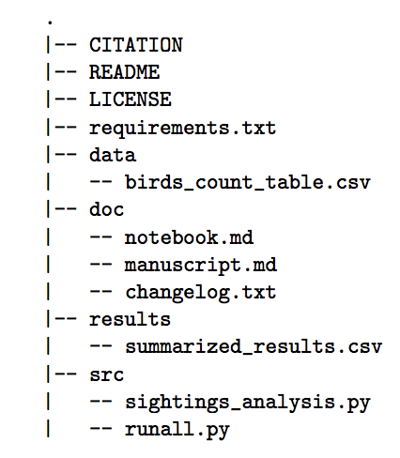
Organization
Documentation
Automation
Dissemination
Exercise 2:
Organize your research to separate code from data.
Resource on reproducible organization:
Karl Broman: http://kbroman.org/steps2rr/pages/organize.html

Slide 28
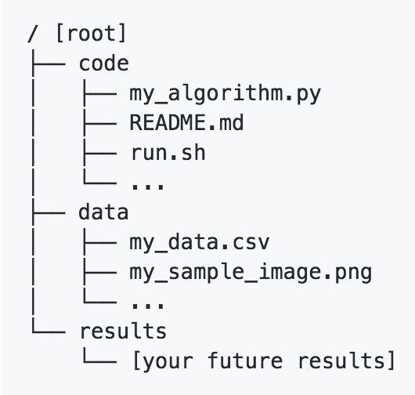

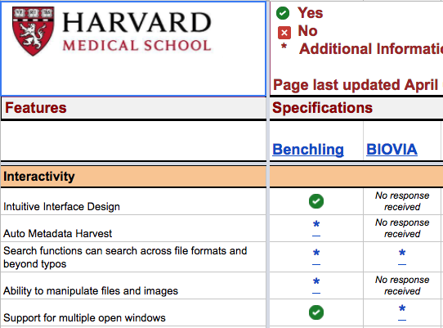



Organization
Documentation
Automation
Dissemination
Reference
Slide
Checklist
Tools
Resources
Create one repository or directory that holds all related research files.
Organize your research to separate data, code, and results.
Save results explicitly.
Identify a strategy for sensitive data.
Open Science Framework: collaborative project organization tool
GitHub: collaborative coding, and project management
eLNs: free or paid, lab organization
Code Ocean: built in best practices
Strategies for sensitive data sharing: Code Ocean Summary
Harvard eLN Features Matrix: https://docs.google.com/spreadsheets/d/1ar8fgwagOh30E31EAPL-Gorwn_g6XNf81g3VDQnQ_I8/edit?usp=sharing
Notes:
How do we organize for reproducibility?
For your reference, we have created these reference slides within the slide deck with key points, tools, and resources.
We won’t spend time on these reference slides as they are intended for your future reference, and will just go over the main points.
Reproducible organization includes:
Creating one repository for all your research materials.
Separating data and code.
And saving your results explicitly as a function of your data and code.
Free tools are available to help organize your research materials:
The OSF is a free, open source, collaboration tool.
Github provides free public repositories for collaborative coding and project management.
Electronic lab notebooks help to organize a lab, and Harvard’s Features Matrix is a great place to start comparing them.
Code Ocean structures their repository to separate data and code and save results explicitly.

Slide 29
Organization
Documentation
Automation
Dissemination
Document your data
Make a codebook or data dictionary.
  Document each element or variable
  in your dataset and data model.
Resources on making a great codebook or data dictionary:
  DataONE: https://www.dataone.org/best-practices/create-data-dictionary
  McGill Codebook Cookbook: http://www.medicine.mcgill.ca/epidemiology/joseph/pbelisle/CodebookCookbook.html
  UPenn: https://guides.library.upenn.edu/datamgmt/documentation
  Karl Broman: http://kbroman.org/dataorg/pages/dictionary.html
Example codebook:
  AJPS Replication Package: https://dataverse.harvard.edu/dataset.xhtml?persistentId=doi:10.7910/DVN/EZSJ1S
Notes:
Knuth, Donald E. 1992. “Literate Programming.” CSLI Lecture Notes, Stanford, CA: Center for the Study of Language and Information (CSLI), 1992 1.

Slide 30
Organization
Documentation
Automation
Dissemination
Create a README
Create a README.txt or README.md.
Resource on making a great README file:
  Cornell (includes a template): https://data.research.cornell.edu/content/readme
Resource on using markdown:
  GitHub: https://github.com/adam-p/markdown-here/wiki/Markdown-Cheatsheet
Notes:
Knuth, Donald E. 1992. “Literate Programming.” CSLI Lecture Notes, Stanford, CA: Center for the Study of Language and Information (CSLI), 1992 1.

Slide 31
Organization
Documentation
Automation
Dissemination
Document your code: Literate programming
Term coined by Donald Knuth in 1992
Interleave narrative text and computer code in the same document
    KnitR, RMarkdown, Sweave
    Jupyter Notebooks
Notes:
Knuth, Donald E. 1992. “Literate Programming.” CSLI Lecture Notes, Stanford, CA: Center for the Study of Language and Information (CSLI), 1992 1.

Slide 32
Organization
Documentation
Automation
Dissemination
Demo:
Consider using literate programming to document the analysis narrative with the code.
  Jupyter Notebook
  RMarkdown
Explore Jupyter notebooks in this example capsule: http://bit.ly/jcdl-example
Explore RMarkdown in this example capsule: http://bit.ly/rmarkdown-example

Slide 33
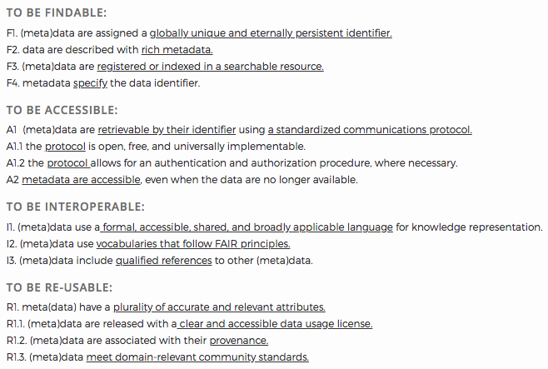
Organization
Documentation
Automation
Dissemination
Follow the FAIR Principles:
Findable
Accessible
Interoperable
Reusable
https://www.go-fair.org/fair-principles/
Notes:
https://www.go-fair.org/fair-principles/
Mark D. Wilkinson, Michel Dumontier, IJsbrand Jan Aalbersberg, Gabrielle Appleton, Myles Axton, Arie Baak, Niklas Blomberg, Jan-Willem Boiten, Luiz Bonino da Silva Santos, Philip E. Bourne, Jildau Bouwman, Anthony J. Brookes, Tim Clark, Mercè Crosas, Ingrid Dillo, Olivier Dumon, Scott Edmunds, Chris T. Evelo, Richard Finkers, Alejandra Gonzalez-Beltran, Alasdair J. G. Gray, Paul Groth, Carole Goble, Jeffrey S. Grethe, Jaap Heringa, Peter A. C. ’t Hoen, Rob Hooft, Tobias Kuhn, Ruben Kok, Joost Kok, Scott J. Lusher, Maryann E. Martone, Albert Mons, Abel L. Packer, Bengt Persson, Philippe Rocca-Serra, Marco Roos, Rene van Schaik, Susanna-Assunta Sansone, Erik Schultes, Thierry Sengstag, Ted Slater, George Strawn, Morris A. Swertz, Mark Thompson, Johan van der Lei, Erik van Mulligen, Jan Velterop, Andra Waagmeester, Peter Wittenburg, Katherine Wolstencroft, Jun Zhao, and Barend Mons. 2016. The FAIR Guiding Principles for scientific data management and stewardship. Scientific Data 3, 1 (March 2016), 160018. DOI:https://doi.org/10.1038/sdata.2016.18

Slide 34
Organization
Documentation
Automation
Dissemination
Exercise 3:
Create a README file and data dictionary.
Documenting your file overview and dependencies in your README:
AJPS Replication Package: https://dataverse.harvard.edu/dataset.xhtml?persistentId=doi:10.7910/DVN/EZSJ1S
Documenting your data in a codebook or data dictionary:
DataONE: https://www.dataone.org/best-practices/create-data-dictionary
Resource on using markdown:
GitHub: https://github.com/adam-p/markdown-here/wiki/Markdown-Cheatsheet
Pink sticky up!

Slide 35
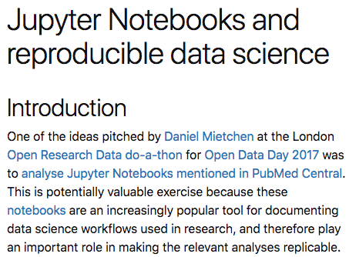
Lessons learned: testing computational reproducibility
Organization
Documentation
Automation
Dissemination
PMC “jupyter OR ipynb” -> 107 papers
“My initial thought was that analysing the validity of the notebooks would simply involve searching the text of each article for a notebook reference, then downloading and executing it … It turned out that this was hopelessly naive…”
Mark Woodbridge, Daniel Sanz, Daniel Mietchen, & Ross Mounce (2017). Jupyter Notebooks and reproducible data science, https://markwoodbridge.com/2017/03/05/jupyter-reproducible-science.html.
Notes:
We mentioned that sharing code, data, and methods is necessary for computational reproducibility.
However, sharing just the code and methods does not ensure reproducibility. This was demonstrated by an informal study by Woodbridge et al. to reproduce code from published papers in the form of Jupyter Notebooks.
They were able to successfully execute only one of the ~25 notebooks that they downloaded.
We don’t have to be naive like them - we can learn from their attempt.
If people do not know what a jupyter notebook is, you can talk about the uses of notebooks:
Documentation of analyses
A Modularized Efficient Framework for Non-Markov Time Series Estimation: https://codeocean.com/2018/01/16/a-modularized-efficient-framework-for-non-markov-time-series-estimation/code
Programming or statistical education
Fractal Generation with L-Systems:
https://codeocean.com/2017/12/08/fractal-generation-with-l-systems/code
Executable article
On Writing Reproducible and Interactive Papers: https://codeocean.com/2018/06/28/on-writing-reproducible-and-interactive-papers/code

Slide 36
Organization
Documentation
Automation
Dissemination
Specify your environment and package versions
Specify your environment and package versions.
  Example in R: use sessionInfo() to specify your environment and package versions.
  Example in Python: use pip freeze > requirements.txt
Add these to your README or create a requirements.txt file.
Example of documenting packages in your README:
  AJPS Replication Package: https://dataverse.harvard.edu/dataset.xhtml?persistentId=doi:10.7910/DVN/EZSJ1S
Example of documenting dependencies:
  Binder: http://mybinder.readthedocs.io/en/latest/using.html#preparing-a-repository-for-binder

Slide 37
Organization
Documentation
Automation
Dissemination
What Woodbridge et al. found:
There is no way for notebooks to directly express dependencies of published code.

Slide 38
Organization
Documentation
Automation
Dissemination
Dependencies in Python
###### Requirements without Version Specifiers ######`
nose
nose-cov
beautifulsoup4
###### Requirements with Version Specifiers ######`
docopt == 0.6.1 # Version Matching. Must be version 0.6.1
keyring >= 4.1.1 # Minimum version 4.1.1
coverage != 3.5 # Version Exclusion. Anything except version 3.5
Mopidy-Dirble ~= 1.1 # Compatible release. Same as >= 1.1, == 1.*
Example Requirements File — pip 9.0.1 documentation
Notes:
A standard way for managing dependencies in Python is to use the pip package-management system
Dependencies are declared in a requirements.txt file
Specific versions of packages can be declared
Problems:
Specific versions are necessary in order to recreate the computational environment of the original researchers
Optimistically declaring minimum versions only (or no version requirement at all) -- later versions might not be “backward compatible” with the packages used by the original researchers
Older versions might no longer be available -- i.e., “code rot”
Packages often have their own set of required dependencies
While it is necessary for researchers to list dependencies, it is not sufficient

Slide 39
Organization
Documentation
Automation
Dissemination
Exercise 4:
Specify the run environment for your analyses.
Example: Base Environment: Python 3.7.0
Notes:
This comes with miniconda and is called conda.

Slide 40
Organization
Documentation
Automation
Dissemination
Exercise 5:
Specify your packages and dependencies with versions.
  pip freeze > ../results/requirements.txt
Resource on documenting dependencies:
Binder: http://mybinder.readthedocs.io/en/latest/using.html#preparing-a-repository-for-binder
Example: conda installer: jupyter 1.0.0, numpy, pandas, matplotlib
Notes:
The best way to record your dependencies and their versions is to write that information down as you do your research. It is more difficult to figure out (or try to remember) what you did after your research is finished.

Slide 41
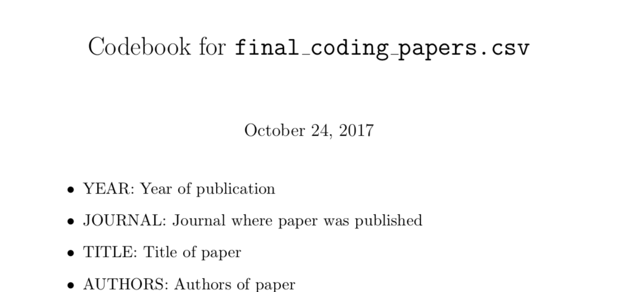

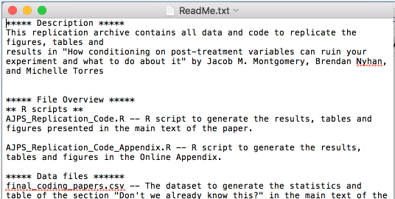

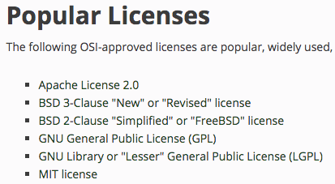
Organization
Documentation
Automation
Dissemination
Reference
Slide
Checklist
Tools
Resources
DataONE: https://www.dataone.org/best-practices/create-data-dictionary
Cornell: https://data.research.cornell.edu/content/readme
Digital Curation Center: http://www.dcc.ac.uk/resources/how-guides/license-research-data
OSI: https://opensource.org/licenses
Consider literate programming.
Document each element or variable
in your dataset with a data dictionary / codebook.
Create a README file.
Version control: git and GitHub tracks changes to documents and metadata
Literate programming: knits documentation with code (Jupyter)
Document & share metadata: Code Ocean renders documentation, notebooks, and records metadata

Slide 42
Questions?
Notes:
We can take a 10 minute break after questions
When we come back, we will begin our discussion of documentation

Slide 43

BREAK

Slide 44
Agenda
Introduction
Organization
Exercise 1: One repository
Exercise 2: Separate code & data
Documentation
Exercise 3: Document data & code
Exercise 4: Specify run environment
Exercise 5: Specify dependencies
Automation
Exercise 6: Containerization
Exercise 7: Create a master script
Exercise 8: Create relative paths
Dissemination
Exercise 9: Specify a license
Exercise 10: Share your code!
Notes:
How will we try to accomplish our Workshop POP?

Slide 45
Organization
Organization
Documentation
Documentation
Automation
Automation
Dissemination
Dissemination
What Woodbridge et al. found:
Manual manipulation or setup was needed to reproduce results, often without documentation of how the results were produced.

Slide 46
Organization
Documentation
Automation
Dissemination
DevOps
Short for Development and Systems Operation
Practice depends on scripting, rather than documenting, to set up the development environment of the original researchers
                E.g., Makefiles, bash scripts
Adds complexity
Researchers might lack the necessary technical skills
Clark, Dav et al. "BCE: Berkeley’s Common Scientific Compute Environment for Research and Education". In Proceedings of the 13th Python in Science Conference, 2014. https://research-it.berkeley.edu/publications/bce-berkeley%E2%80%99s-common-scientific-compute-environment-research-and-education

Slide 47
Organization
Documentation
Automation
Dissemination
Docker
https://docs.docker.com/
            Docker containers allow researchers to share prebuilt application runtime environments (including dependencies) from one machine to another.
            Lighter and faster than VMs, containers do not include a full operating system.
Carl Boettiger. 2015. An introduction to Docker for reproducible research. SIGOPS Oper. Syst. Rev. 49, 1 (January 2015), 71–79. DOI:https://doi.org/10.1145/2723872.2723882, https://arxiv.org/abs/1410.0846
Olivier Mesnard and Lorena A. Barba. 2020. Reproducible Workflow on a Public Cloud for Computational Fluid Dynamics. Computing in Science Engineering 22, 1 (January 2020), 102–116. DOI:https://doi.org/10.1109/MCSE.2019.2941702, http://arxiv.org/abs/1904.07981
Notes:
Docker containers ”ameliorate one of the biggest pain points for reproducible research: building the software on a different machine.” —Mesnard and Barba (2020)

Slide 48
Organization
Documentation
Automation
Dissemination
The terms:
Dockerfile: Readable instructions for how to build an image.
Image: Everything your application needs to run, all bundled together (includes Dockerfile, libraries, and code).
Layer: A Dockerfile directs Docker to build the initial image layer from a base image, and then other layers are built on top.
Container: Started and created from an image.
Registry: Images are stored and retrieved from registries.
Hale, Jeff. Learn Enough Docker to be Useful. https://towardsdatascience.com/learn-enough-docker-to-be-useful-b7ba70caeb4b

Slide 49

Organization
Documentation
Automation
Dissemination
The metaphor: PIZZA!
Dockerfile: The recipe.
Image: The recipe and the ingredients combined as an all-in-one pizza-making-kit.
Layer: The ingredients are the layers. You’ve got crust, sauce, and cheese for this pizza.
Container: Cooked pizza. Cooked by Docker (the oven).
Registry: All-in-one pizza-making-kit factories?
Hale, Jeff. Learn Enough Docker to be Useful. https://towardsdatascience.com/learn-enough-docker-to-be-useful-b7ba70caeb4b

Slide 50
Organization
Documentation
Automation
Dissemination
Containers solve:
Dependency Hell - install, error, google, install, error…
  Provides other researchers with a binary image in which all the software has already been installed, configured, and tested.
Imprecise documentation - missing installation info.
  Dockerfile provides a human readable summary of the necessary software dependencies needed to execute the code. Dependencies are automatically documented as they are installed.
Code rot - dependencies change, the code breaks
  Reduced risk with by archiving images
Boettiger, Carl. An introduction to Docker for reproducible research. 10.1145/2723872.2723882

Slide 51
Organization
Documentation
Automation
Dissemination
We can publish using containers:
Use container technology to directly express dependencies.
Configure an image for your analyses with Docker, binder, WholeTale, or Code Ocean.

Slide 52
Organization
Documentation
Automation
Dissemination
Online Container Platforms
Services include: Binder, Code Ocean, Colaboratory, Gigantum and Nextjournal
Allow researchers to run code in the cloud
Easier to use than installing Docker locally
Several journals now use Code Ocean for peer review and to promote computational reproducibility
Perkel, J. M. (2019). Make code accessible with these cloud services. Nature, 575(7781), 247. doi:10.1038/d41586-019-03366-x

Slide 53
Organization
Documentation
Automation
Dissemination
Exercise 6:
Use container technology to create an image of your complete computational environment.
  Code Ocean
  Binder
Export your capsule to see how an image and Dockerfile were created through your specifications.
Inspect the Dockerfile. Inspect the requirements.txt file.
Build a container with repo2docker using mybinder and your requirements.txt file.

Slide 54
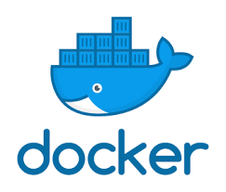
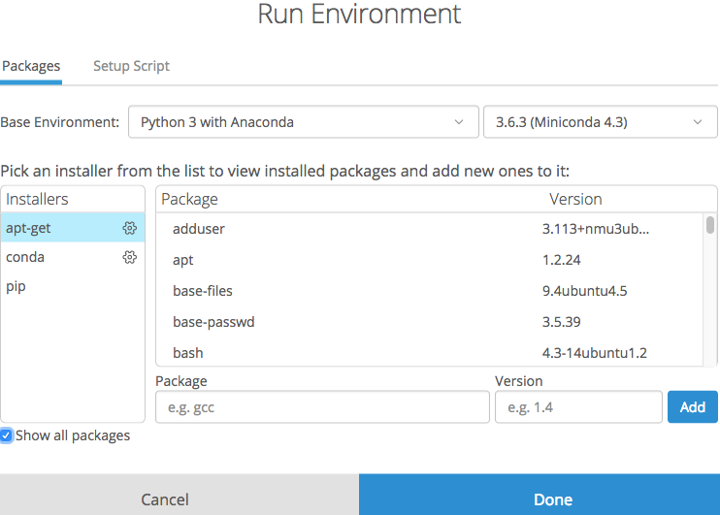
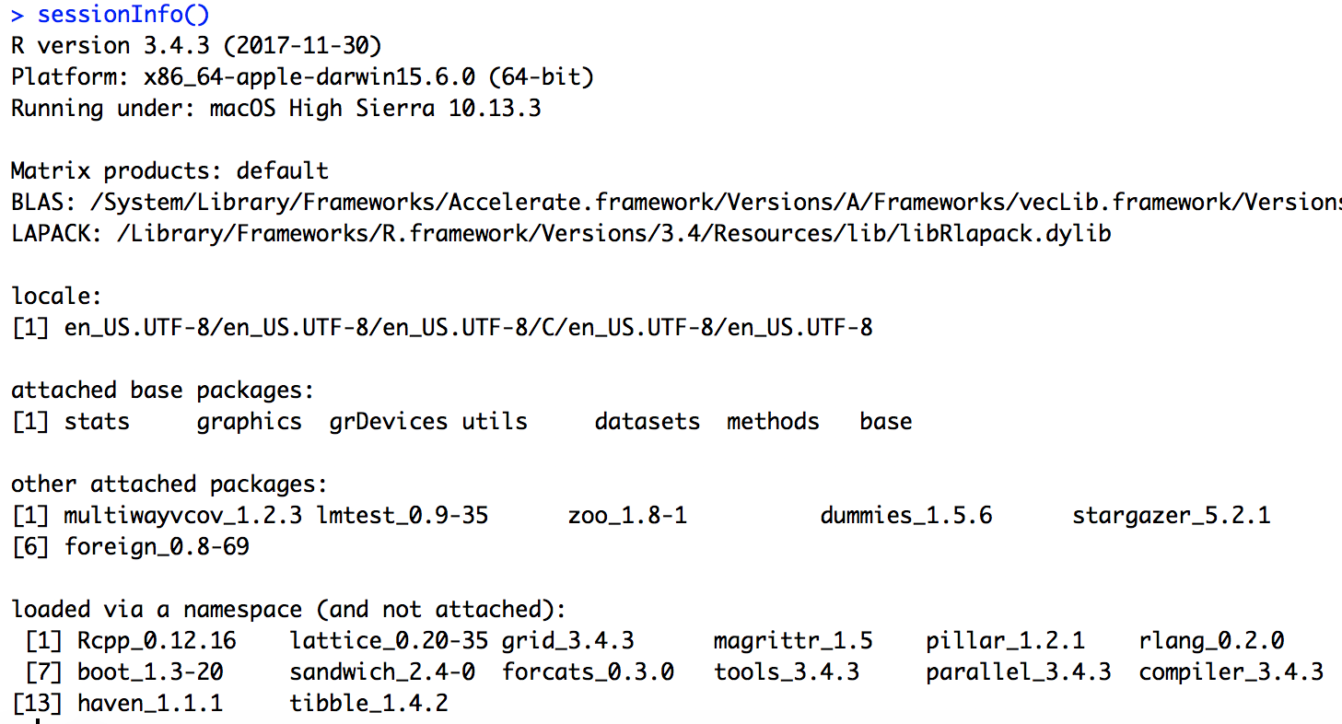


Organization
Documentation
Automation
Dissemination
Reference
Slide
Checklist
Tools
Resources
Container technology: packages data, code, metadata, & computational environment for portable analyses
Docker: container technology for devs
Code Ocean: easy configuring, preservation, & reuse of containers for researchers
Binder: configure & share containers
Documenting dependencies: http://mybinder.readthedocs.io/en/latest/using.html#preparing-a-repository-for-binder
Specifying environments: https://help.codeocean.com/getting-started/the-computational-environment/selecting-a-base-environment
Specify your computational environment and package versions.
Configure a container to make your analysis portable and reusable.

Slide 55
Questions?
Notes:
We can take a 10 minute break after questions
When we come back, we will begin our discussion of documentation

Slide 56
Agenda
Introduction
Organization
Exercise 1: One repository
Exercise 2: Separate code & data
Documentation
Exercise 3: Document data & code
Exercise 4: Specify run environment
Exercise 5: Specify dependencies
Automation
Exercise 6: Containerization
Exercise 7: Create a master script
Exercise 8: Create relative paths
Dissemination
Exercise 9: Specify a license
Exercise 10: Share your code!
Notes:
How will we try to accomplish our Workshop POP?

Slide 57
Organization
Organization
Documentation
Documentation
Automation
Automation
Dissemination
Dissemination
We can automate the execution of our analyses:
Create a master script to execute all analyses.
Reproduce results automatically as a function of the data & the code; Save results explicitly.
Use relative paths.

Slide 58
Organization
Organization
Documentation
Documentation
Automation
Automation
Dissemination
Dissemination
Exercise 6:
Create a master script to execute your code.
Explore the file "run.sh".
Use nbconvert to render your notebook.
  In your run.sh script, use nbconvert to execute your notebook into the results directory.
Case study:
https://bids.gitbooks.io/the-practice-of-reproducible-research/core-chapters/3-basic.html

Slide 59
Organization
Organization
Documentation
Documentation
Automation
Automation
Dissemination
Dissemination
Exercise 7:
Change absolute paths to relative paths.
Resource explaining paths:
Karl Broman: http://kbroman.org/steps2rr/pages/organize.html
Notes:
Show an example of changing a path:
In the python code “fig1_happiness_of_individuals”
Change “data = pd.read_csv('../data/data.csv')” to “data = pd.read_csv('C:/Users/SomeOne/Projects/data/data.csv')”

Slide 60
Code testing and continuous integration
Organization
Documentation
Automation
Dissemination
Automate code testing:
Automated testing verifies that your software is (relatively) error free.
  Most/all software has bugs
  “ubiquity of error” — Donoho, et al. (2009)
Continuous integration systems allow researchers to run code tests frequently and automatically
  Travis-CI and Jenkins are popular continuous integration systems
Notes:
David L. Donoho, Arian Maleki, Inam Ur Rahman, Morteza Shahram, and Victoria Stodden. 2009. Reproducible Research in Computational Harmonic Analysis. Computing in Science Engineering 11, 1 (January 2009), 8–18. DOI:https://doi.org/10.1109/MCSE.2009.15
“The scientific method’s central motivation is the ubiquity of error - the awareness that mistakes and self-delusion can creep in absolutely anywhere and that the scientist’s effort is primarily expended in recognizing and rooting out error.”

Slide 61
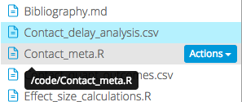
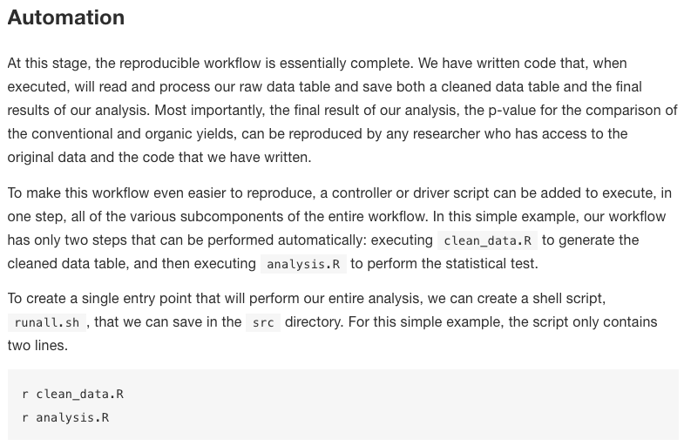
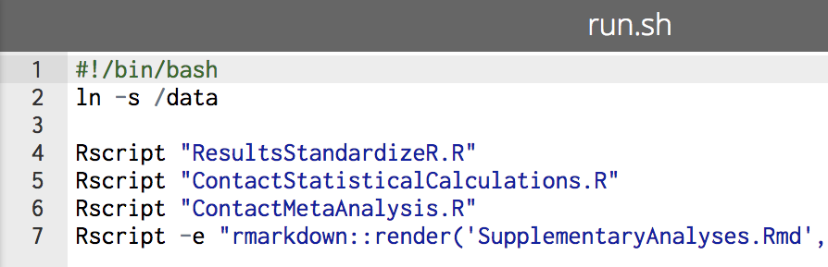
Organization
Documentation
Automation
Dissemination
Reference
Slide
Checklist
Tools
Resources
Karl Broman on paths: http://kbroman.org/steps2rr/pages/organize.html
Resource on automation using a master script: https://www.practicereproducibleresearch.org/core-chapters/3-basic.html
Use relative rather than absolute paths.
Create a master script that runs your scripts in sequence.
Docker: share automated code for devs
Code Ocean: easy configuring, preservation, & reuse of automated code
Binder: share automated code for using containers

Slide 62
Organization
Documentation
Automation
Dissemination
License your work
Add a license.txt file to your project or select one in the metadata section (CO or GitHub)
Consider Creative Commons licenses for data and text, either CC-0 or CC-BY.
For software, we recommend a permissive open source license such as the MIT, BSD, or Apache license

Slide 63
Organization
Documentation
Automation
Dissemination
Exercise 8:
Specify a license for your data and your code.
Resource on choosing a data licence:
Digital Curation Center: http://www.dcc.ac.uk/resources/how-guides/license-research-data
Resources on choosing a code licence:
Karl Broman: http://kbroman.org/steps2rr/pages/licenses.html
Open Source Initiative: https://opensource.org/licenses
Notes:
Add a licence.txt file to your project or select one in the metadata section (CO or GitHub)
Consider Creative Commons licenses for data and text, either CC-0 or CC-BY.
For software, we recommend a permissive open source license such as the MIT, BSD, or Apache license

Slide 64
Organization
Organization
Documentation
Documentation
Automation
Automation
Dissemination
Dissemination
What Woodbridge et al. found:
There is no standardized way of attaching code to published articles.
Therefore it is difficult to discover and retrieve code.

Slide 65
Organization
Documentation
Automation
Dissemination
Persistent Identifiers
Persistent identifiers increase the reproducibility of the research
DOI = Digital Object Identifier
International standard, interoperable, and widely adopted
DOI contains standard metadata about an object, including the URL to where the object can be found online
If the URL changes, the metadata can be updated so that the DOI resolves to the object’s new location
The use of DOI increases long-term citation, access, and reuse
See: https://www.doi.org/ and https://www.iso.org/standard/43506.html

Slide 66

Organization
Documentation
Automation
Dissemination
Digital Preservation
Organizational Infrastructure: policies, procedures, practices, people
Technological Infrastructure: equipment, software, hardware, secure environment
Resources Framework: ongoing and contingency funding for long-term sustainability
Technology Infrastructure
Organizational Infrastructure
Resources Framework
Digital Preservation Workshop: http://www.dpworkshop.org/
Be careful where you store your data
Use data repositories rather than lab group website or researcher’s personal website
University libraries often maintain secure digital preservation repository services and persistent identifiers for research data
Some commercial services (Code Ocean, Figshare, Zenodo, etc) also provide preservation services
Cloud storage systems (Box, Dropbox, Google Drive, etc) are not preservation repositories
Notes:
Code Ocean preserves compute capsules in the CLOCKSS Archive to ensure the long-term accessibility of code associated with research articles
Figshare uses the DuraSpace DuraCloud Vault deposit node to add content into Chronopolis
Zenodo is based on the Invenio Digital Library framework

Slide 67
Organization
Organization
Documentation
Documentation
Automation
Automation
Dissemination
Dissemination
We can embed or link code persistently:
Obtain a DOI for your repository and use this link throughout your article.
  Example: Github -> Binder/WholeTale -> Zenodo -> DOI linked in article
  Example: CodeOcean -> DOI in article
Cross link repository with published article in metadata of each.
Embed executable capsule within the article.
  Example: https://doi.org/10.1017/bpp.2018.25

Slide 68
Organization
Documentation
Automation
Dissemination
Exercise 9:
Share your code!
Check whether your container is ready to publish by hitting "Run".
Tryan interactive Jupyter or Jupyterlab session.

Slide 69
Reproducibility PI Manifesto
Organization
Documentation
Automation
Dissemination
I will teach my graduate students about reproducibility.
All our research code (and writing) is under version control.
We will always carry out verification and validation (V&V reports are posted to figshare)
For main results in a paper, we will share data, plotting script & figure under CC-BY
We will upload the preprint to arXiv at the time of submission of a paper.
We will release code at the time of submission of a paper.
We will add a "Reproducibility" declaration at the end of each paper.
I will keep an up-to-date web presence.
Lorena A. Barba. 2012. Reproducibility PI Manifesto. DOI:https://doi.org/10.6084/m9.figshare.104539.v1

Slide 70
Organization
Documentation
Automation
Dissemination
Demo:
Reproducible packages of work from the Global Event and Trend Archive Research (GETAR) project:
  TwiRole
  Event Focused Crawler
TwiRole capsule: https://codeocean.com/capsule/9584745/
Event Focused Crawler capsule: https://codeocean.com/capsule/8475497/

Slide 71

Thank you for your time :)
William A. Ingram and Edward A. Fox
Virginia Tech
Blacksburg, VA 24061
USA
{waingram, fox}@vt.edu

Slide 72
References
Artifact Review and Badging. Retrieved August 1, 2020 from https://www.acm.org/publications/policies/artifact-review-badging
Monya Baker. 2016. 1,500 scientists lift the lid on reproducibility. Nature News 533, 7604 (May 2016), 452. DOI:https://doi.org/10.1038/533452a
Lorena A. Barba. 2012. Reproducibility PI Manifesto. DOI:https://doi.org/10.6084/m9.figshare.104539.v1
Carl Boettiger. 2015. An introduction to Docker for reproducible research. SIGOPS Oper. Syst. Rev. 49, 1 (January 2015), 71–79. DOI:https://doi.org/10.1145/2723872.2723882
Karl Broman. 2016. Initial steps toward reproducible research. http://kbroman. org/steps2rr/.
Jonathan B Buckheit and David L Donoho. 1995. Wavelab and reproducible research. In Wavelets and statistics. Springer, 55–81.
Jon Claerbout. Making Scientific Contributions Reproducible. Retrieved July 29, 2020 from http://sepwww.stanford.edu/oldsep/matt/join/redoc/web/iris.html
Jon F Claerbout and Martin Karrenbach. 1992. Electronic documents give reproducible research a new meaning. In SEG technical program expanded abstracts 1992. Society of Exploration Geophysicists, 601–604.
Dav Clark, Aaron Culich, Brian Hamlin, and Ryan Lovett. 2014. BCE: Berkeley’s Common Scientific Compute Environment for Research and Education. Austin, Texas, 5–12. DOI:https://doi.org/10.25080/Majora-14bd3278-002.

Slide 73
References
David L. Donoho, Arian Maleki, Inam Ur Rahman, Morteza Shahram, and Victoria Stodden. 2009. Reproducible Research in Computational Harmonic Analysis. Computing in Science Engineering 11, 1 (January 2009), 8–18. DOI:https://doi.org/10.1109/MCSE.2009.15
Jeff Hale. 2019. Learn Enough Docker to be Useful. Medium. Retrieved July 29, 2020 from https://towardsdatascience.com/learn-enough-docker-to-be-useful-b7ba70caeb4b
Justin Kitzes, Daniel Turek, and Fatma Deniz (Eds.). 2017. The practice of reproducible research: case studies and lessons from the data-intensive sciences. Univ of California Press. Retrieved from https://www.practicereproducibleresearch.org/
Donald E Knuth. 1992. Literate programming. Number 27 in CSLI lecture notes. Center for the Study of Language and Information (1992), 349–358.
Olivier Mesnard and Lorena A. Barba. 2020. Reproducible Workflow on a Public Cloud for Computational Fluid Dynamics. Computing in Science Engineering 22, 1 (January 2020), 102–116. DOI:https://doi.org/10.1109/MCSE.2019.2941702 http://arxiv.org/abs/1904.07981
Roger Peng. 2015. Report writing for data science in R. Leanpub. Retrieved from https://leanpub.com/reportwriting
Roger D. Peng. 2011. Reproducible Research in Computational Science. Science 334, 6060 (December 2011), 1226–1227. DOI:https://doi.org/10.1126/science.1213847
Jeffrey M. Perkel. 2019. Make code accessible with these cloud services. Nature 575, 7781 (November 2019), 247–248. DOI:https://doi.org/10.1038/d41586-019-03366-x

Slide 74
References
Victoria Stodden, Friedrich Leisch, and Roger D. Peng. 2014. Implementing Reproducible Research. Chapman and Hall/CRC. DOI:https://doi.org/10.1201/9781315373461
Mark D. Wilkinson, Michel Dumontier, IJsbrand Jan Aalbersberg, Gabrielle Appleton, Myles Axton, Arie Baak, Niklas Blomberg, Jan-Willem Boiten, Luiz Bonino da Silva Santos, Philip E. Bourne, Jildau Bouwman, Anthony J. Brookes, Tim Clark, Mercè Crosas, Ingrid Dillo, Olivier Dumon, Scott Edmunds, Chris T. Evelo, Richard Finkers, Alejandra Gonzalez-Beltran, Alasdair J. G. Gray, Paul Groth, Carole Goble, Jeffrey S. Grethe, Jaap Heringa, Peter A. C. ’t Hoen, Rob Hooft, Tobias Kuhn, Ruben Kok, Joost Kok, Scott J. Lusher, Maryann E. Martone, Albert Mons, Abel L. Packer, Bengt Persson, Philippe Rocca-Serra, Marco Roos, Rene van Schaik, Susanna-Assunta Sansone, Erik Schultes, Thierry Sengstag, Ted Slater, George Strawn, Morris A. Swertz, Mark Thompson, Johan van der Lei, Erik van Mulligen, Jan Velterop, Andra Waagmeester, Peter Wittenburg, Katherine Wolstencroft, Jun Zhao, and Barend Mons. 2016. The FAIR Guiding Principles for scientific data management and stewardship. Scientific Data 3, 1 (March 2016), 160018. DOI:https://doi.org/10.1038/sdata.2016.18
Mark Woodbridge. Jupyter Notebooks and reproducible data science. Retrieved July 29, 2020 from https://markwoodbridge.com/2017/03/05/jupyter-reproducible-science.html
Digital Preservation Management Workshops and Tutorial | Digital Preservation Management. Retrieved July 29, 2020 from https://dpworkshop.org/dpm-eng

