Slide 1
ETD2020: Discovery, Data, and Dates
Nov. 16-18; United Arab Emirates University, VIRTUAL
“Building and Using Digital Libraries for ETDs”
Keynote by Edward A. Fox, Ph.D., Professor
fox@vt.edu http://fox.cs.vt.edu
Dept of Computer Science (& ECE by courtesy)
Virginia Tech, Blacksburg, VA 24061 USA
NDLTD: Exec. Director, Chairman of the Board

Slide 2
Presentation Outline
Acknowledgments
NDLTD
Big Data
Broader Perspective, OAI, 5S
Scenarios
Need-based Building

Slide 3
Acknowledgements
ETD 2020 organizers, NDLTD, and Worldwide ETD Initiative
Mentors (Licklider, Kessler, Salton); IMLS, NSF, and other sponsors
Virginia Tech, CS, Digital Library Research Laboratory (DLRL)
Students, colleagues, co-investigators (selected): Eman Abdelrahman, Monika Akbar, Hamed Alhoori, Pranav Angara, Ashish Baghudana, Bipasha Banerjee, Boots Cassel, Saurabh Chakravarty, Prashant Chandrasekar, Satvik Chekuri, Yinlin Chen, Kiran Chitturi, Alexandre Falcao, Weiguo Fan, Eric Fouh, Chris Franck, Rick Furuta, Lee Giles, Marcos André Gonçalves, Doug Gorton, Islam Harb, S.M.Shamimul Hasan, Michael Hsiao, Bill Ingram, Palakh Jude, Adheesh Juvekar, Sampanna Kahu, Tarek Kanan, Ola Karajeh, Andrea Kavanaugh, Martin Klein, Harinni Kumar, Spencer Lee, Sunshin Lee, Jonathan Leidig, Lin Tzy Li, Liuqing Li, Yi Ma, Yufeng Ma, Mohamed Magdy, Shivam Maharshi, Madhav Marathe, Gary Marchionini, Paul Mather, Maanav Mehrotra, Uma Murthy, Pranav Nakate, Michael Nelson, Sanghee Oh, Sung Hee Park, Supritha Patil, Denilson Pereira, Jeff Pomerantz, Naren Ramakrishnan, Sagnik Ray-Choudhury, Chandan Reddy, Rao Shen, Ziqian Song, Venkat Srinivasan, Hussein Suleman, Ricardo Torres, Adithya Upadhya, Saket Vishwasrao, Xinyue Wang, Barbara Wildemuth, Jian Wu, Zhiwu Xie, Seungwon Yang, Xuan Zhang, ...

Slide 4
Libraries of the Future
JCR Licklider, 1965, MIT Press
World
Nation
State
City
Community

Slide 5
Related Funded Grants
IMLS LG-37-19-0078-19: Opening Books and the National Corpus of Graduate Research. 2019-2022. PI: William A. Ingram Co-PIs: Edward A. Fox and Jian Wu
Indo-US S&T Forum: Open Digital Libraries and Interoperability Workshop, 2003, PI Fox; Co-chairs: Shalini Urs, Mohammad Zubair, N. Balakrishnan
NSF IIS-0086227: Open Archives: Distributed services for physicists and graduate students (OAD): 2001-2004; PD Fox; German DFG PI E. Hilf
UNESCO: International Guide for the Creation of Electronic Theses and Dissertations: 12/28/2000-3/31/2002. PD (project director) E. Fox
SOLINET: Networked Digital Library of Theses and Dissertations: 2000. PD (project director) Fox
NSF IIS-0090153 (427963): US-Korea Joint Workshop on Digital Libraries: Removing Barriers to International Collaboration on Research and Education through Digital Libraries, 8/1/2000-9/30/2002. PD Fox, co-PIs R.L. Larsen, R. W. Moore
U.S. Dept. of Education, FIPSE Program P116B61190: Improving Graduate Education with a National Digital Library of Theses and Dissertations: 1996-99; PIs Fox, J. Eaton, G. McMillan; support by SURA, Microsoft, Adobe

Slide 6
ETD-related VT ETDs
Sampanna Yashwant Kahu, Figure extraction from scanned electronic theses and dissertations, 2020, http://hdl.handle.net/10919/100113
Palakh Mignonne Jude, Increasing Accessibility of Electronic Theses and Dissertations (ETDs) Through Chapter-level Classification, 2020, http://hdl.handle.net/10919/99294
Sung Hee Park, Discipline-Independent Text Information Extraction from Heterogeneous Styled References Using Knowledge from the Web, 2013, http://hdl.handle.net/10919/52860
W. Ryan Richardson, Using Concept Maps as a Tool for Cross-Language Relevance Determination, 2007, http://hdl.handle.net/10919/28191
Douglas Gorton, Practical Digital Library Generation into DSpace with the 5S Framework, 2007, http://hdl.handle.net/10919/31914
Hussein Suleman, Open Digital Libraries, 2002, http://hdl.handle.net/10919/29712

Slide 7
ETD-related Class Projects
Kaushal, Kulendra Kumar; Kulkarni, Rutwik; Sumant, Aarohi; Wang, Chaoran; Yuan, Chenhan; Yuan, Liling. Collection Management of Electronic Theses and Dissertations (CME) CS5604 Fall 2019 ﻿(Virginia Tech, 2019-12-23); http://hdl.handle.net/10919/96484
Aromando, John; Banerjee, Bipasha; Ingram, William A.; Jude, Palakh; Kahu, Sampanna. Classification and extraction of information from ETD documents (Virginia Tech, 2020-01-30); http://hdl.handle.net/10919/96645
Alotaibi, Fatimah; Abdelrahman, Eman. Otrouha: Automatic Classification of Arabic ETDs (Virginia Tech, 2020-01-23); http://hdl.handle.net/10919/96571
Ma, Yufeng; Jiang, Tingting; Shrestha, Chandani. ETDseer Concept Paper (Virginia Tech, 2017-05-03); http://hdl.handle.net/10919/77868

Slide 8
NDLTD: Mission
The Networked Digital Library of Theses and Dissertations (NDLTD) is an international organization dedicated to promoting the adoption, creation, use, dissemination, and preservation of electronic theses and dissertations (ETDs). We support electronic publishing and open access to scholarship in order to enhance the sharing of knowledge worldwide. Our website includes resources for university administrators, librarians, faculty, students, and the general public. Topics include how to find, create, and preserve ETDs; how to set up an ETD program; legal and technical questions; and the latest news and research in the ETD community.

Slide 9
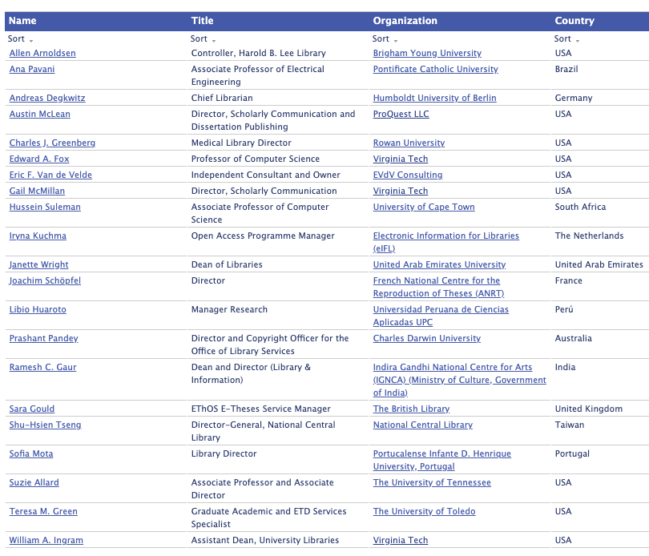
NDLTD Board of
Direc- tors

Slide 10
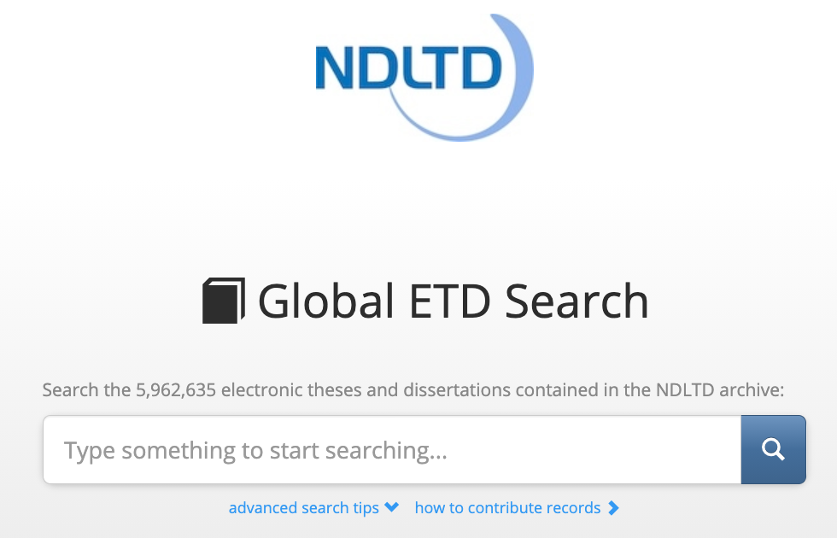
search.ndltd.org

Slide 11
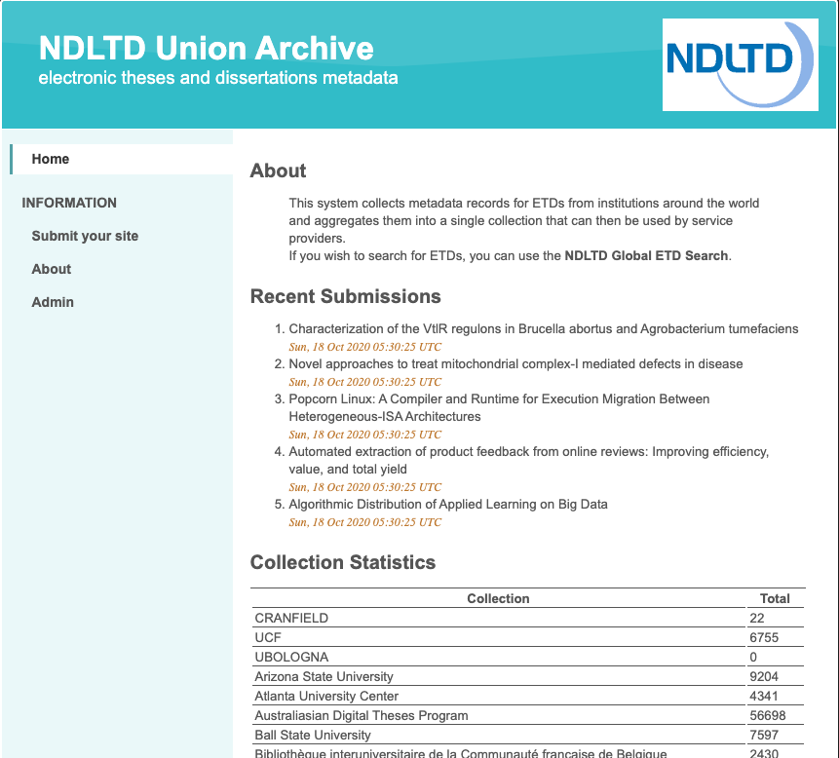
union. ndltd. org/ portal/

Slide 12
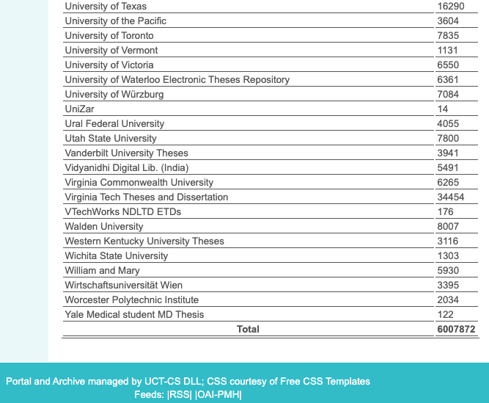
union.
ndltd.
org/
portal/

Slide 13
New Journal: J-ETD.org, j-etd@ndltd.org
Journal of Electronic Theses and Dissertations
Please complete survey! Please support!
Launch 1/1/2021: open-access
Managing Editor: Charles J. Greenberg
Executive Editor: Edward A. Fox; Associate Editors : Suzanne Lorraine (Suzie) Allard (USA), Ramesh C. Gaur (India), Charles J. Greenberg (USA), Libio Huaroto (Peru), William A. Ingram (USA), Ana Sofia de Sousa Machado Mota (Portugal), Prashant Pandey (Australia), Ana Pavani (Brazil), Joachim Schöpfel (France), and Janette Wright (UAE).

Slide 14
Big Data
Variety: content elements and types, disciplines, formats, languages, levels, styles
Velocity: peak submission times, urgent need by researchers
Volume: many millions, large files (images, videos, datasets, etc.), worldwide

Slide 15
Digital Library Content

Slide 16
Locating Digital Libraries in Computing and
Communications Technology Space
Digital Libraries technology
trajectory: intellectual
access to globally distributed information
Communications
(bandwidth, connectivity)
Computing (flops)
Digital content
Note: we should consider 4 dimensions: computing, communications,
content, and community (people)
less
more

Slide 17
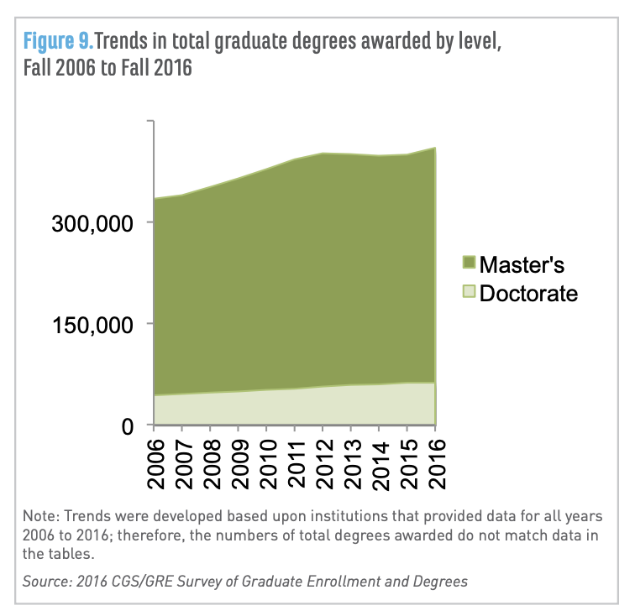
Potential Collection Size
Fall 2016 U.S. graduate schools: >1.8 million students enrolled in grad certificate, master's, or doctoral programs (https://cgsnet.org/ckfinder/userfiles/files/CGS_GED16_Report_Final.pdf)
2018 US degree holders
Master’s 21M, doctoral 4.5M (https://www.census.gov/library/stories/2019/02/number-of-people-with-masters-and-phd-degrees-double-since-2000.html )
* Guess: 60 million ETDs could exist, with growth of 1M/year, if world count is at least 3X that of US (https://ourworldindata.org/tertiary-education#share-of-the-population-with-tertiary-education )

Slide 18
Broader Perspective
Collecting Metadata (OAI/PMH)
Workshop on Social Aspects of DLs
Life Cycle of Information
Life Cycle + Quality Aspects
5S Framework
Services of a Rich DL across the Lifecycle

Slide 19
OAI - Open Archives Initiative: Technical Umbrella for
Practical Interoperability…
Metadata Harvesting
Reference
Libraries
Museums
Publishers
E-Print
Archives
…that can be exploited by different communities

Slide 20
The World According to OAI
Service Providers
Discovery
Current
Awareness
Preservation
Metadata
harvesting
Data Providers

Slide 21
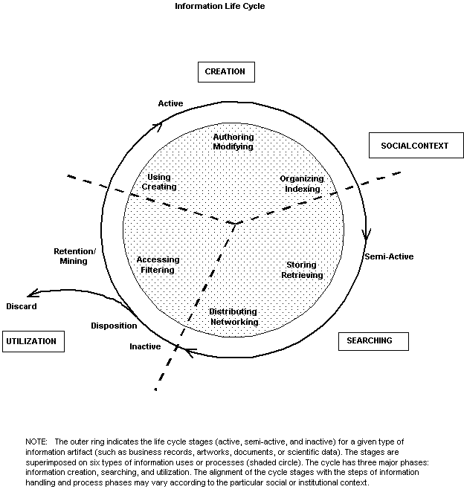
Information
Life
Cycle
Borgman et al.:
Workshop Report on
Social Aspects of
Digital Libraries:
http://www.dlib.org/dlib/january97/01clips.html
Notes:
Thanks to Christine Borgman and others at this workshop.

Slide 22
Information Life Cycle
Creation
Active
Authoring
Modifying
Social Context
Using
Creating
Organizing
Indexing
Retention
/ Mining
Accessing
Filtering
Storing
Retrieving
Semi-
Active
Utilization
Distributing
Networking
Inactive
Searching
Notes:
This is a simplification of the previous slide.

Slide 23
Quality and the Information Life Cycle

Slide 24
Quality Dimensions

Slide 25
5S Layers
Societies
Scenarios
Spaces
Structures
Streams

Slide 26
Informal 5S & DL Definitions
DLs are complex systems that
help satisfy info needs of users (societies)
provide info services (scenarios)
organize info in usable ways (structures)
present info in usable ways (spaces)
communicate info with users (streams)

Slide 27
Supporting Services across the Lifecycle

Slide 28
Scenarios of Future Use of ETD DLs
Building DLs
Open problem -> plan for research
Problem -> list of references, related ETDs
Bibliography -> clusters -> lit. review chapter
Faculty seminar based on ETDs
Final defense -> told missing cites of related ETDs
Promotion: impact of candidate’s students ETDs
Library IR assessment -> logs -> use by
  Local grad students, faculty, undergrads
  By highly-rated universities (worldwide)

Slide 29
Scenarios of Future Use: 1) Building DLs
UX: Customer discovery: subject-matter experts
UX: Validated list of:
  Jobs-to-be-done, tasks, sub-tasks, goals, sub-goals
DL software developer: knowledge graph mapping:
  Goals, sub-goals, tasks, sub-tasks
  Workflows of services: Existing, Desired
Product manager
Operations (DevOps with CI/CD)
Curators
(Doctoral work of Prashant Chandrasekar, 2021)

Slide 30
Scenarios of Future Use:
2) Open problem -> plan for research
Student volunteers to test the new DL
Goal: find problem to solve
Explains her interest and background
Receives extracts from related ETDs:
  open problems, planned future work
Selects top 5
Receives list of related ETDs, each with summary
Fetches and studies 2 ETDs from the list
Meets advisor to devise research plan

Slide 31
Need-based Building
Survey
ContentMine
Supporting Services across the Lifecycle
Classification (to aid browsing, searching)
Summarization
Opening Graduate Research

Slide 32
Survey (2017 by VT, PSU)
Sample of researchers in key areas:
  bibliometrics, computational social science,
  computer science, digital libraries, information retrieval,
  machine learning, natural language processing,
  scholarly communication, science of science,
  web search and mining, and science policy.
18 respondents expressed strong interest in:
  data (e.g., citations, figures),
  software (e.g., knowledge extraction),
  research questions (e.g., summarizing long documents)
Percentage Indicated
Percentage | Indicated:
74 | mining ETDs is valuable for their research communities
53 | highly likely to use an ETD infrastructure for their own research
68 | new collaborations would emerge as a result of this

Slide 33
ContentMine (VT visit 12 April 2017)
ContentMine.org -- Cambridge, UK
Director: Jenny Molloy: info@contentmine.org
Founder: Peter Murray-Rust (ETD 2014): peter@contentmine.org
Products and Services:
  Text & data mining tools (tables, graphs -> facts)
  Consultancy
  Industries: Chemistry, Environment, Life Science, Pharmaceutical/Clinical Trials, . . .
Processing:
  Find, download, analyse: open access works
  Convert among formats
  Extract information from graphs, tables
  Extract chemical reactions, equations.
  Create Dictionaries...and much more.

Slide 34
ETD Classification:
Algorithm Pipeline
ETDs categorized into a node of the category tree (after classification)
Category
Tree
ETD Collection
Category label for each node used as query
ETD metadata used for categorization
Categorized
ETDs
Google
Naïve Bayes Classifiers
Level-wise categorization
Top 50 webpages (for each node in the tree)
Training
Browsing
Web
Interface
Document
Sets
Training
Sets
Cleanup
(stemming,
stopword removal,
etc.)
Venkat Srinivasan: See DL Book 3 Ch. 4,
http://dx.doi.org/10.2200/S00566ED1V01Y201401ICR033

Slide 35
Summarization
To multilingual concept maps
  Dissertation of Ryan Richardson (2007) http://hdl.handle.net/10919/28191
Big Data Text Summarization
  2018 CS course for seniors, grad students
  Summarizing each chapter of each VT ETD
Doctoral research of Bipasha Banerjee (2022), including segmentation

Slide 36
ETD-related Summarization Class Projects
Liuqing Li, Jack Geissinger, William A. Ingram, Edward A. Fox. Teaching Natural Language Processing through Big Data Text Summarization with Problem-Based Learning. Data and Information Management, ISSN:2543-9251, 4(1): 18-43, March 24, 2020, open access, https://doi.org/10.2478/dim-2020-0003 (which discusses the following)
Fall 2018 CS4984/5984 (Big Data Text Summarization) projects by teams 10, 16, 17: http://hdl.handle.net/10919/86418, http://hdl.handle.net/10919/86406, http://hdl.handle.net/10919/86420

Slide 37
Opening Graduate Research
IMLS; 2019-2022; PI: William Ingram
Early work: 2019-2020
  Collecting: 30,000 -> 300K +
    English, Arabic Large universities, HBCUs, HSIs
  Analyzing: parsing references for database
  Extracting: tables, figures, definitions, references
  Scanned ETDs -> improved metadata
  Classification into ProQuest categories
  Segmenting: chapters
Goals: Pilot services + Software for universities, regions, nations

Slide 38
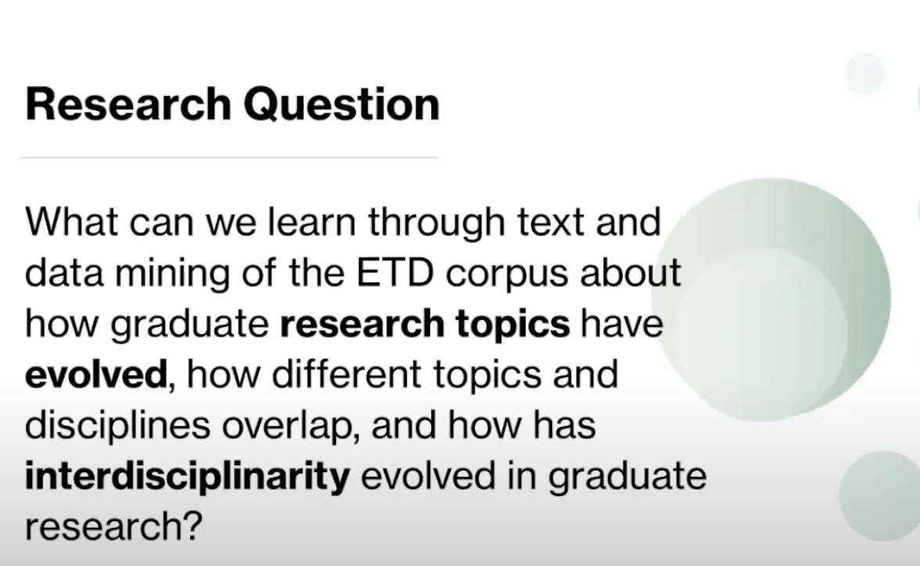
Mining ETDs for Trends in Graduate Research
YouTube from CNI (Coalition for Networked Information) Fall Meeting
https://www.youtube.com/watch?v=RvvlBhHZGLQ by William Ingram on 12 Nov. 2020

Slide 39
Summary
Acknowledgments
NDLTD
Big Data
Broader Perspective, OAI, 5S
Scenarios
Need-based Building

Slide 40
Paper Outline
Introduction
ETD Importance
History and Current Situation
  Grey Literature
  Open access, repositories, OAI
  Repositories
Personas and User Roles
  Customer discovery
Possibilities
Digital Libraries
  Services
  Advances
Future Digital Libraries

Slide 41
Questions?
Discussion?
Thank You!
fox@vt.edu
fox@ndltd.org
j-etd@ndltd.org

