Slide 1
JCDL 2020 Keynote 1
(1 August 2020, Virtual: Wuhan, PRC)
How Should One Explore the
Digital Library of the Future? by Edward A. Fox
fox@vt.edu http://fox.cs.vt.edu
Dept. of Computer Science, Virginia Tech
Blacksburg, VA 24061 USA

Slide 2
Thanks to Dean Marchionini!
Selected joint papers and projects:
E. Fox, B. Rous, and G. Marchionini. ACM's Hypertext and Hypermedia Publishing Projects. In Hypertext/ Hypermedia Handbook, ed. E. Berk and J. Devlin, McGraw-Hill, New York, 1991, 465-467
E. Fox and G. Marchionini, eds., Proceedings of the First ACM International Conference on Digital Libraries, DL'96, Bethesda, MD, March 20-23, 1996
E. Fox and G. Marchionini. Toward a Worldwide Digital Library. Guest Editors' Introduction to special section on Digital Libraries: Global Scope, Unlimited Access. CACM, 1998, 41(4): 28-32
G. Marchionini and E. Fox. Progress toward digital libraries: augmentation through integration. Guest editors' introduction to Special Issue: Progress Toward Digital Libraries, Information Processing & Management, 1999, 35(3): 219-225
E. Fox and G. Marchionini. Digital Libraries: Extending Traditional Values. Guest Editors' Introduction to special section on Digital Libraries. Commun. of the ACM, 44(5):30-32, May 2001, http://doi.acm.org/10.1145/374308.374329
NSF IIS-0910183: Collaborative Research: Curatorial Work and Learning in Virtual Environments, PI Gary Marchionini, co-PI Fox; 2009-2010

Slide 3
Short Version
Exploration is a fundamental need, and so should be well supported in future DLs:
for all Societies: Humans and/with Computers;
through diverse Scenarios, aided by Spaces and Structures, covering all types of Streams.
Theory-> Design-> Implementation-> DevOps
Integrating Sciences: computing, library, infor.; AI, Archiving, DB, HCI, HPC, Hypermedia, IR, Networking, NLP, Psychology, Sociology, . . .

Slide 4
See also: Sapiens: A Brief History of Humankind, by Yuval Noah Harari, 2015

Slide 5
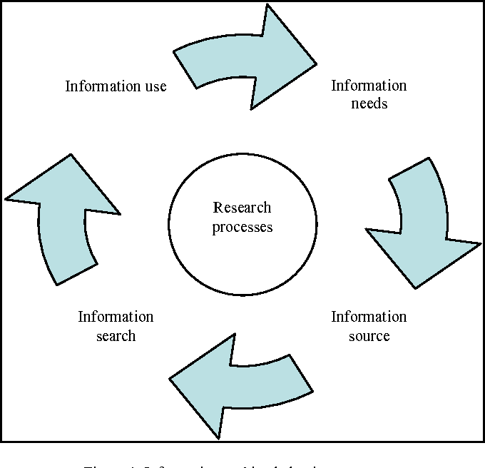
Exploration includes:
See also:
Exploratory
Search: Beyond
the Query-
Response
Paradigm, by
Ryen W. White,
Resa A. Roth,
Morgan &
Claypool, 2009
See also works on: HCIR,
Information
Seeking
Behavior, Info-
Visualization, Probing, Delving, Investigation, Discovery, Data Analysis/Science

Slide 6
Acknowledgements
Mentors (Licklider, Kessler, Salton)
Virginia Tech, CS, Digital Library Research Laboratory (DLRL)
NSF, IMLS, and many other sponsors (see http://fox.cs.vt.edu/cv.htm)
Students, colleagues, co-investigators (selected): Eman Abdelrahman, Monika Akbar, Hamed Alhoori, Pranav Angara, Ashish Baghudana, Jefferson Bailey, Bipasha Banerjee, Abigail Bartolome, Warren Bickel, Matt Bock, Boots Cassel, Prashant Chandrasekar, Saurabh Chakravarty, Prashant Chandrasekar, Raja Chava, Satvik Chekuri, Yinlin Chen, Kiran Chitturi, Lois Delcambre, Noha ElSherbiny, Alexandre Falcao, Weiguo Fan, Eric Fouh, Chris Franck, Rick Furuta, Jack Geissinger, Lee Giles, Marcos André Gonçalves, Doug Gorton, Seth Guikema, Islam Harb, S.M.Shamimul Hasan, Michael Hsiao, Bill Ingram, Palakh Jude, Adheesh Juvekar, Sampanna Kahu, Tarek Kanan, Ola Karajeh, Andrea Kavanaugh, Farnaz Khaghani, Martin Klein, Nadia Kozievitch, Abhinav Kumar, Harinni Kumar, Spencer Lee, Sunshin Lee, Jonathan Leidig, Lin Tzy Li, Liuqing Li, Yi Ma, Yufeng Ma, Mohamed Magdy, Shivam Maharshi, Ashish Malpani, Madhav Marathe, Gary Marchionini, Paul Mather, Maanav Mehrotra, Pamela Murray-Tuite, Uma Murthy, Pranav Nakate, Michael Nelson, Sanghee Oh, Sung Hee Park, Supritha Patil, Denilson Pereira, Jeff Pomerantz, Naren Ramakrishnan, Pranavi Rambhakta, Sagnik Ray-Choudhury, Chandan Reddy, Rao Shen, Cliff Shaffer, Steve Sheetz, Don Shoemaker, Ziqian Song, Venkat Srinivasan, Hussein Suleman, Amirsina Torfi, Ricardo Torres, Adithya Upadhya, Saket Vishwasrao, Xinyue Wang, Kris Wernstedt, Barbara Wildemuth, Jian Wu, Zhiwu Xie, Seungwon Yang, Xiaoyan Yu, Xuan Zhang, ...

Slide 7
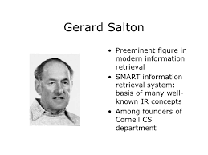
Vector space model
TF*IDF weighting

Slide 8
Outline
JCR Licklider
Libraries of the Future
5S
Building Digital Libraries
Exploring (incl. from JCDL 2006)
Future

Slide 9
For: ARPA’s Information Processing Techniques Office

Slide 10
JCR Licklider
Grandfather of Internet
Director, Project MAC: CTSS, Multics, AI Lab
M. M. Waldrop’s 2001 biography “The Dream Machine: J.C.R. Licklider and the Revolution That Made Computing Personal”:
  “He is almost alone in his conviction that computers can become not just superfast calculating machines, but joyful machines: tools that will serve as a new media of expression, inspirations to creativity, and gateways to a vast world of online information.”

Slide 11
Outline
JCR Licklider
Libraries of the Future
5S
Building Digital Libraries
Exploring (incl. from JCDL 2006)
Future

Slide 12
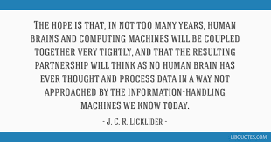

Slide 13
Overview
As JCR Licklider forecast in 1965 in his “Libraries of the Future” (report for CLR)
Highly effective human-computer symbiosis in procognitive systems that mediate online interactions with knowledge
Knowledge: acquisition, organization, use
Analysis: files, documents, texts, words
Marry information retrieval, question-answering, NLP
Adaptive self-organization, associative chaining
Leverage: set theory, spaces, functions, relations, predicate calculus, higher-order knowledge representations

Slide 14
Closing Challenge
(4) A sympathetic, cooperative, verbal, community is a fundamental essential for the development of a sophisticated verbal mechanism. To develop complex language behavior . . .
(5) no one seems likely to design or invent a formal system capable of automating sophisticated language behavior. The best approach … to call for a formal base plus an overlay of experience gained in interaction with the cooperative verbal community.

Slide 15
Outline
JCR Licklider
Libraries of the Future
5S
Building Digital Libraries
Exploring (incl. from JCDL 2006)
Future

Slide 16
5S Motivation
DLs are not benefiting from formal theories as have other CS fields: DB, IR, PL, etc.
DL construction: difficult, ad-hoc, lacking support for tailoring/customization
Conceptual modeling, requirements analysis, and methodological approaches are rarely supported in DL development.
See my 9/2004 invited talk in Beijing “Digital Libraries for Education: Foundations to Case Studies” http://fox.cs.vt.edu/talks/2004/200409BeijingDL.ppt

Slide 17
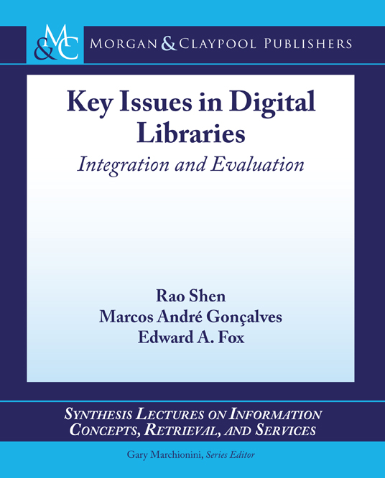
Ch. 2: Exploration;
App. D2 pp. 91-100

Slide 19
Definition: Digital Libraries are complex systems that
help satisfy info needs of users (societies)
provide info services (scenarios)
organize info in usable ways (structures)
present info in usable ways (spaces)
communicate info with users (streams)

Slide 20
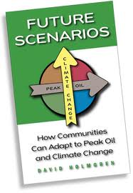
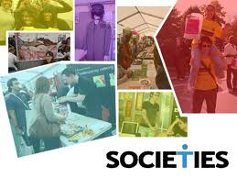

Slide 21
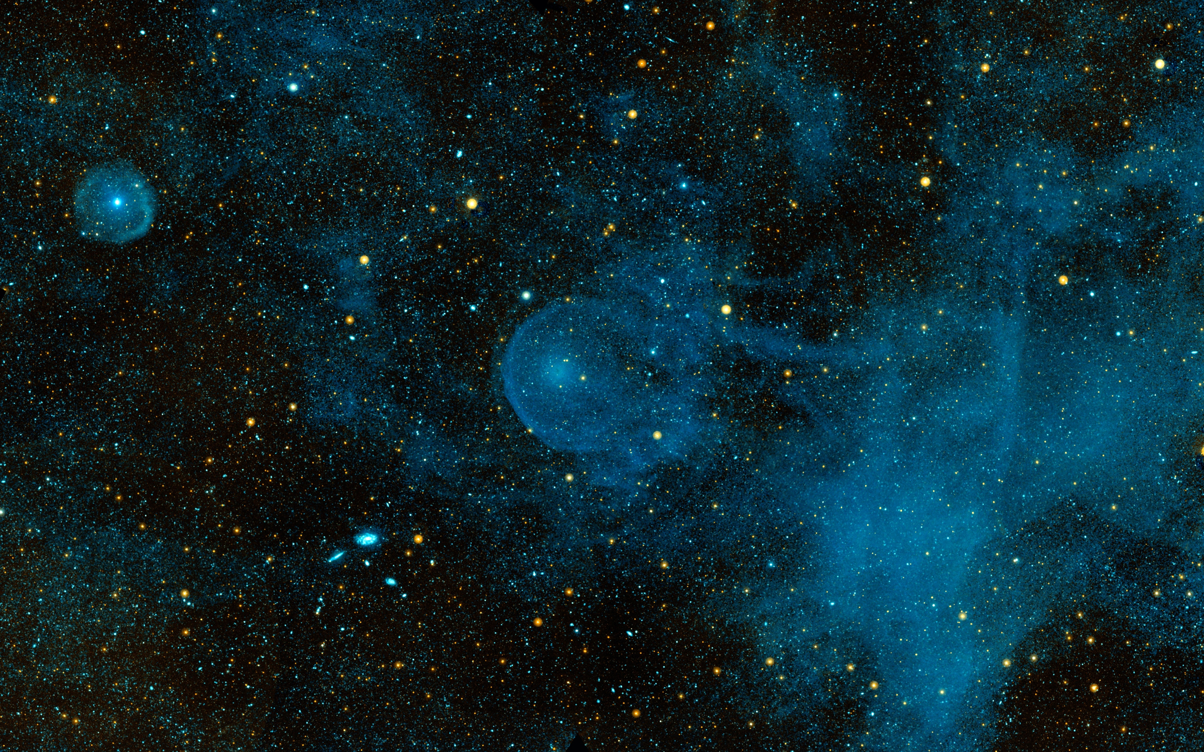

Slide 22
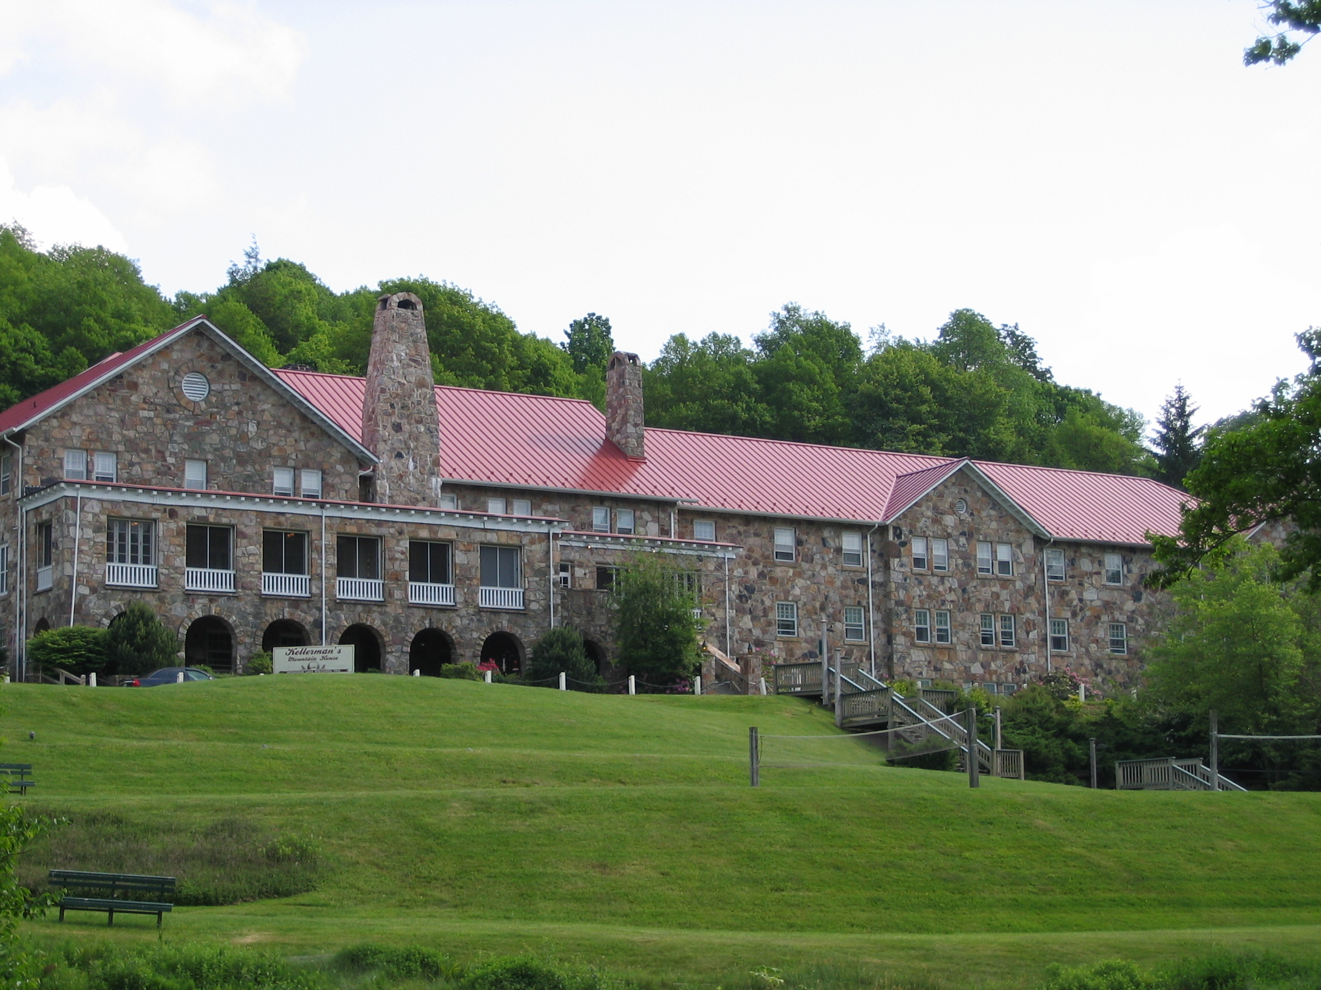

Slide 23
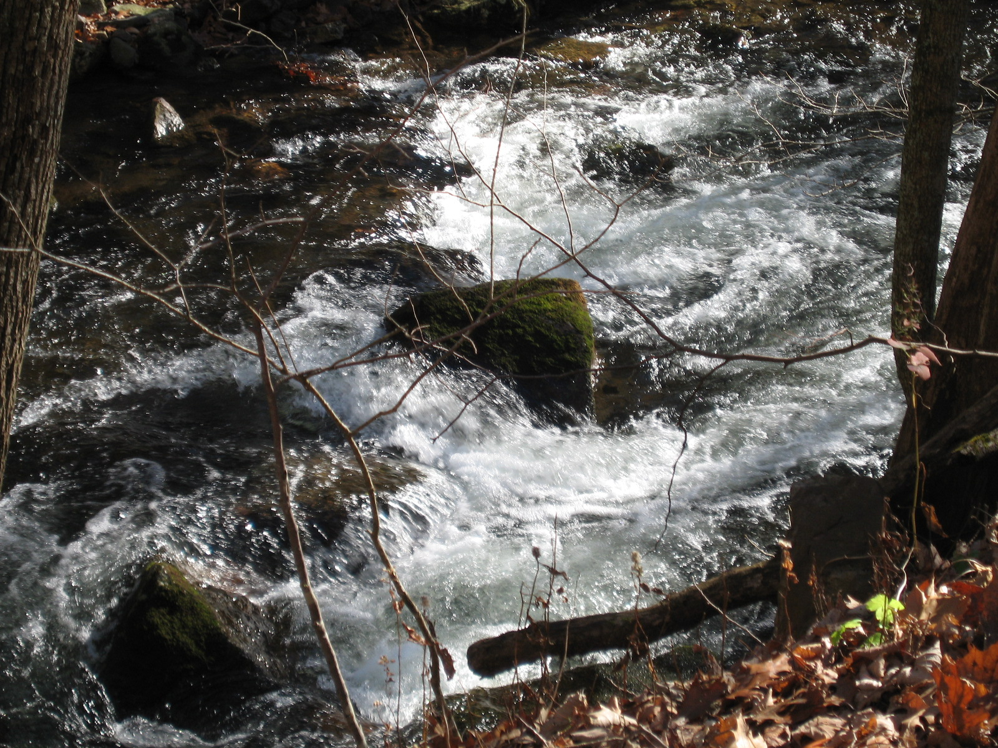

Slide 24
5S Model: Definitions
5S | Definition
Streams | Sequences of elements of an arbitrary type
Structures | Labeled directed graphs
Spatial | Sets and operations on those sets
Scenarios | Sequences of events that modify states of a computation in order to accomplish some functional requirement.
Societies | Sets of communities and relationships among them

Slide 25
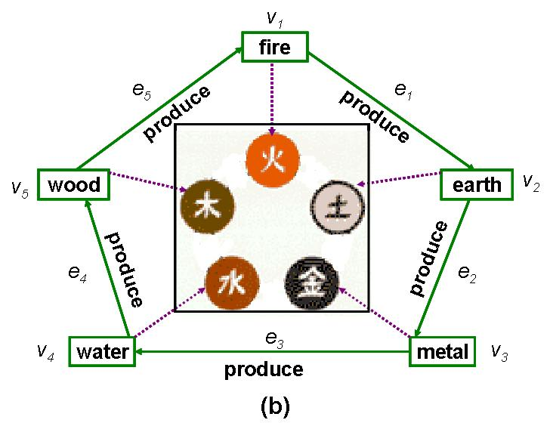
Five Elements Theory from Chinese Philosophy

Slide 26
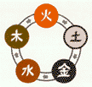
5S for DLs
Compare:
5 elements
Ss | Examples | Objectives
Streams | Text; video; audio; image | Describes properties of the DL content such as encoding and language for textual material or particular forms of multimedia data
Structures | Collection; catalog; hypertext; document; metadata | Specifies organizational aspects of the DL content
Spaces | Measure; measurable, topological, vector, probabilistic | Defines logical and presentational views of several DL components
Scenarios | Searching, browsing, recommending | Details the behavior of DL services
Societies | Service managers, learners, teachers, etc. | Defines managers, responsible for running DL services; actors, that use those services; and relationships among them
Notes:
Do not read
Pick example: structure, scenario

Slide 28
Overview of 5S and DL formal definitions and compositions

Slide 30
Semantic relationships among DL concepts: Partial concept map

Slide 32
Outline
JCR Licklider
Libraries of the Future
5S
Building Digital Libraries
Exploring (incl. from JCDL 2006)
Future

Slide 33
DL Services/Activities Taxonomy
Infrastructure Services
Information Satisfaction
Services
Repository-Building
Add
Value
Creational
Preservational
Acquiring
Cataloging
Crawling (focused)
Describing
Digitizing
Federating
Harvesting
Purchasing
Submitting
Conserving
Converting
Copying/Replicating
Emulating
Renewing
Translating (format)
Annotating
Classifying
Clustering
Evaluating
Extracting
Indexing
Measuring
Publicizing
Rating
Reviewing (peer)
Surveying
Translating (language)
Browsing
Collaborating
Customizing
Filtering
Providing access
Recommending
Requesting
Searching
Visualizing

Slide 34
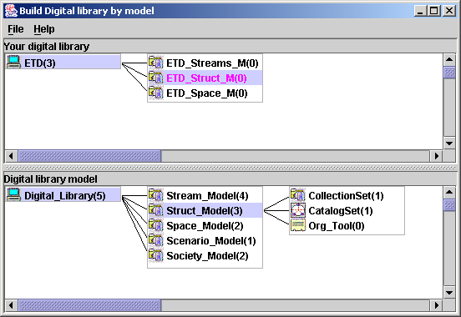
5SGraph: No Code DL
Workspace
(instance model)
Structured
toolbox
(metamodel)
See https://www.gartner.com/en/documents/3956079/magic-quadrant-for-enterprise-low-code-application-platf from August 2019: "By 2024, low-code application development will be responsible for more than 65% of application development activity."

Slide 35
5S-based Architecture for
DL Modeling and Generation
5S
Meta
Model
DL
Designer
5SGraph
DL
Expert
Practitioner
5SL
DL
Models
Teacher
component
pool
Researcher
ODLSearch,
ODLBrowse,
ODLRate,
ODLReview,
…….
Tailored
DL Services
5SLGen
Notes:
The process of building a DL:
The role of the DL expert is to design a metamodel for DLs which will be used for modeling the DL. We already have defined the 5S metamodel for DLs. The DL expert may either create a new metamodel, use the 5S metamodel or extend the 5S metamodel for digital libraries.
The 5SGraph modeling tool processes the metamodel, allowing the DL designer to visualize the components of the metamodel. The DL designer must be aware of the functional requirements . The designer uses those visualized graphical components of the metamodel to put together the final model of his own digital library. The DL requirements acquired with 5SGraph are captured with user-level 5SL models.
The 5SL DL models are input to the 5SLGen DL generator, along with a pool of reusable DL components (a component implements a specific service such as search, browse, rate, etc.,) to generate classes for the 5SFramework. The 5SFramework is a reusable design, expressed as a set of classes, that implements the modeled DL and supports reuse at a larger granularity than classes. This transformation from 5SL models to object-oriented classes involves scenario analysis, scenario-synthesis, component pool utilization and mapping of 5SL modeling elements to programming language concepts.
The DL designer completes the modeling and generation process by modifying the generated 5SFramework classes and coupling them with the user-interface provided by the web developer.

Slide 36
NSDL Information Architecture by the Technical Infrastructure Workgroup
Portals &
Clients
Portals &
Clients
User Interfaces
Portals &
Clients
NSDL
Services
NSDL
Services
Other NSDL
Services
NSDL
Collections
Core
NSDL
“Bus”
NSDL
Collections
NSDL
Collections
Usage Enhancement
Collection
Building
Core Services:
information retrieval
CI Services
browsing
CI Services
authentication
referenced
items &
collections
Core Services:
metadata gathering
CI Services
personalization
referenced
items &
collections
Special
Databases
Core Collection-
Building Services
protocols
CI Services
discussion
Core Collection-
Building Services
harvesting
CI Services
annotation

Slide 37
Digital library architecture for local
and interoperable CITIDEL services

Slide 38
Outline
JCR Licklider
Libraries of the Future
5S
Building Digital Libraries
Exploring (incl. from JCDL 2006)
Future

Slide 39
Information
Life
Cycle
Adapted
from:
Social
aspects of
digital libraries,
UCLA 1996,
eds. Christine L.
Borgman et al., https://
works.bepress.com/borgman/183/
Exploring

Slide 40
Exploring Digital Libraries: Integrating Browsing, Searching, and Visualization
JCDL 2006, Chapel Hill, NC, June 12, 2006
Rao Shen, Naga Srinivas Vemuri, Weiguo Fan,
Ricardo da S. Torres, and Edward A. Fox
DOI 10.1145/1141753.1141755
http://fox.cs.vt.edu/talks/2006/20060612JCDL06exploring.ppt

Slide 41
Introduction
What’s exploring?
  searching, browsing, investigating, studying, or analyzing
  for purposes of discovery,
  pursuing truth or facts about something
Notes:
Reflecting upon the current state and different types of exploring services for DLs has led us to the following research questions:
Though many research projects have developed different interaction strategies allowing smooth transition between browsing and searching, to the best of our knowledge, none of them generalize these two predominant exploring services in DLs.

Slide 42
Introduction (Cont.)
Are browsing and searching duals or can they be converted to each other when certain conditions are met?
Can we generalize these DL exploring services within a formal DL framework?
Can the formal generalization guide development of exploring services for domain focused DLs?
Notes:
To answer these question, we again turn to 5S.

Slide 43
Related Work on Integrating Services in DLs
integrating searching and
browsing with other services
integrating searching
and browsing
includes
clustering and visualization
has examples
Stepping Stones
& Pathways
CitiViz
RB++
Grouper
Cat-a-Cone
Kartoo
Flamenco
found in
EtanaViz
WebBook
Hieraxes
…
systems
in 1980s
systems
in 1990s
systems
in 2000s
has an example
has an example
has an example
I³R
RABBIT
PESTO
DataWeb
MIX
BBQ
ScentTrails
SenseMaker
CODER
MARIAN
ODL
Notes:
CODER: A Retrieval and Hypertext System using SGML and a Lexicon
A Testbed for Artificial Intelligence Methods in Information Retrieval
Working Toward a Comprehensive Testbed for AI in IR
Proposed and supervised development of the COmposite Document Expert/extended/effective Retrieval System, 1985-92, which was used as a testbed for the study of artificial intelligence concepts in the field of information retrieval, and applied to electronic mail digests, navy messages, and literature (and thesaurus data) on cardiology.
Expert-Based Retrieval
A Knowledge-Based System for Composite Document Analysis and Retrieval
Marian: Proposed and supervised development since 1991 of the MARIAN system, an alternative to searching on the VTLS system for library catalog data. The campus production service version of this runs on a collection of PC and NeXTstep machines in the Computing Center and is designed to support scores of simultaneous users. It builds upon data and code from the CED lexicon and CODER (both developed here in the 1980s). With support from NLM, and new support from NSF, it is being revamped in Java to become a key part of our research on digital libraries. URL: http://www.dlib.vt.edu/products/marian.html
MARIAN is an indexing, search, and retrieval system optimized for digital libraries
ODL: Open Digital Libraries (ODLs) are systems built as networks of extended Open Archives.
===========================================
The RB++ categorizes the collection offline and uses a uniform category structure to present overviews of the collection and the retrieval results. It provides visualized category overviews of an information space and allows dynamic filtering and exploration of the result set by tightly coupling the browsing and searching functions.
Cat-a-Cone used ConeTree to display the category labels of the documents retrieved, while the retrieved documents are organized as pages in a WebBook.
Hieraxes, in combination with a grid display, offer a simple approach to searching result sets by using categorical and hierarchical axes. Users can see an overview by color-coded dots or bar charts arranged in a grid and organized by familiar labeled categories. They can probe further by zooming in on desired categories or switching to another hierarchical variable.
Grouper was a dynamic clustering interface to web search results. It introduced the Suffix Tree Clustering (STC) algorithm.
Kartoo is a web interface organizing search results retrieved from relevant web search engines by topics, that displays them on a 2-dimensional map. Theoretically, Kartoo provides a node-link graph.
Flamenco: investigating how to build an intuitive interface for exploration and discovery within information collections using Hierarchical Faceted Categories (HFC)

Slide 44
Exploring Services Formalization
Within the 5S Framework
Generalize DL exploring services such as browsing, searching, clustering, and visualization.
Prove theorems and lemmas based on the generalization
  searching browsing

Slide 45
Exploring Services Formalization (Cont.)
Exploration Space (Espa) is a Space
Espa=(Q, Contents, OP_Set)
  Q is a set of conceptual representations for user information needs
  Contents: associated with collection C
  OP_Set is a set of operations on Q and
  Contents
    {OP_{viz}, OP_{clu}, OP_{s}, OP_{b}} OP_Set

Slide 46
Exploring Services Formalization (Cont.)
Sample OP_Set: {OP_{viz} , OP_{clu}, OP_{s}, OP_{b}}
  OP_{viz}: maps a set of digital objects to a visual mark
  OP_{clu}: gets similarity of a pair of subsets of collection and their associated contents
  OP_{s}: associates a query with a digital object and its contents
  OP_{b}: associates a traverse link with contents of the target node (i.e., follows a hypertext link)
Notes:
Do not read, explain, not the letter

Slide 47
Exploring Services Formalization (Cont.)
An Exploring Service (Eser) is a set of scenarios over an exploration space (Espa).
Eser=(sc₁, sc₂, …, sc_{i}, …, sc_{n}),
where sc_{i} is a sequence of events
  each event is associated with one or more of the operations in Espa

Slide 48
Exploring Services Formalization (Cont.)
State Diagram
OP_Set
Searching: Op_{s}
Browsing: Op_{b}
Clustering: Op_{clu}
Visualization: Op_{viz}
…
…
e_{i}
…

Slide 49
Theorems & Lemmas related to Operations
Theorems and Lemmas | Searching Op_{s} | Browsing Op_{b} | Clustering Op_{clu} | Visualization Op_{viz}
Theorem 1 | √
Theorem 2 |  | √
Theorem 3 (Op_{s} followed by Op_{clu} ) | √ |  | √
Theorem 4 (Op_{s} followed by Op_{viz}) | √ |  |  | √
Lemma 1 | √ | √
Lemma 2 | √ | √
Lemma 3 (Op_{b} followed by Op_{s}) | √ | √
Lemma 4 (Op_{s} followed by Op_{b}) | √ | √ | √

Slide 50
Theorem 1: Searching service
State Diagram
OP_Set
…
Searching: Op_{s}
e_{i}
query_{i}
searching results for query_{i}
…

Slide 51
Theorem 2: Browsing service
State Diagram
OP_Set
…
Browsing: Op_{b}
e_{i}
Contents of the target node
…

Slide 52
Theorem 3: Post retrieval clustering service
State Diagram
OP_Set
1
searching results for query_{i}
…
Searching: Op_{s}
Clustering: Op_{clu}
2
3
e_{i}
query_{i}
clusters of searching results
…

Slide 53
Lemma 2: Searching Browsing
Q_{search}
results
Л
query₀
query₁
query_{i} = OP_{s}⁻¹ (results)
π_{i} = OP_{b}⁻¹ (results)
…
…
π_{i}
query_{i}
query_{i}
query_{i} = π_{i}
…
…

Slide 54
Lemma 3: switch from browsing to searching; special case: query refinement/expansion
Л
Contents_{postBrowse}
browsing results
associated with
navigation path
π_{i}
Q_{postBrowse}
query₀
query₁
1
2
…
…
4
π _{i}
3
query_{i}
query_{i}
5
…
…
query_{i+1}

Slide 55
Lemma 4: switch from searching to browsing
State Diagram
OP_Set
2
searching results for query
1
Searching: Op_{s}
Clustering: Op_{clu}
…
3
4
v₁
v₂
…
v_{i}
…
Contents of cluster₁
Contents of cluster₂
…
Contents of cluster_{i}
…
e_{i}
query_{i}
π₀
v₀
π₂
5
…
π_{i}

Slide 56
Theorem 4: Post retrieval visualization service
State Diagram
OP_Set
1
searching results for query_{i}
…
Searching: Op_{s}
Visualization: Op_{viz}
2
e_{i}
query_{i}
3
…
Visual marks in a
spatial substrate

Slide 57
Theory-based approach to describing DL Exploring Services
— guides us to design and implement exploring services for ETANA-DL
Multi-dimensional browsing
Searching and browsing integration
Visualization
Usability evaluation

Slide 58
Exploring Service in ETANA-DL
—Multi-dimensional Browsing
browsing service searching service
navigation path query

Slide 59
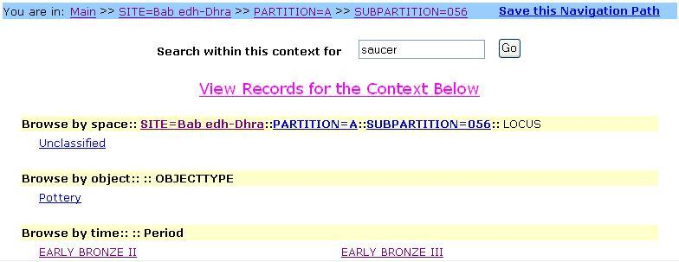
ETANA-DL:
Multi-dimensional browsing interface

Slide 60
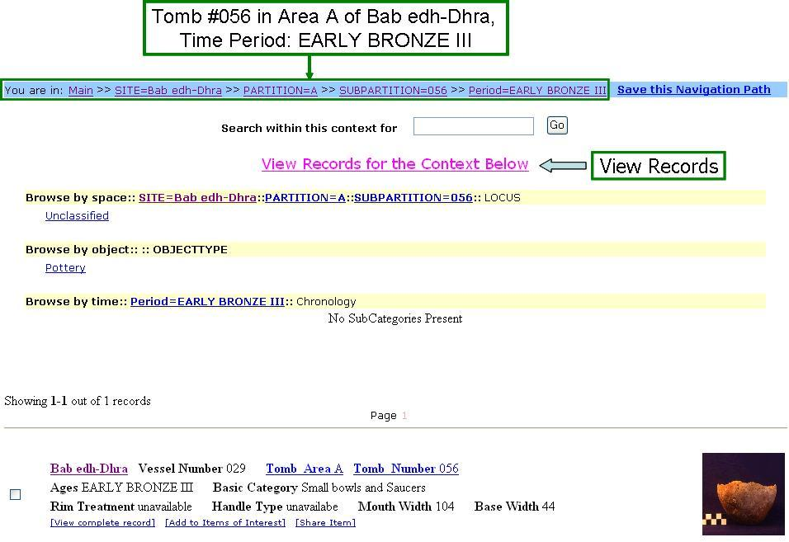
Save current navigation path for later use & view records

Slide 61
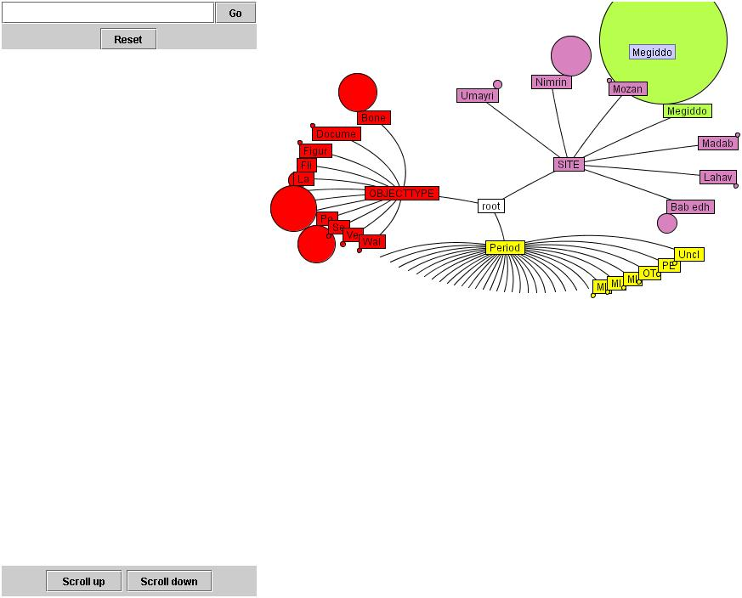
EtanaViz: Searching, Browsing, Clustering, Visualization

Slide 62
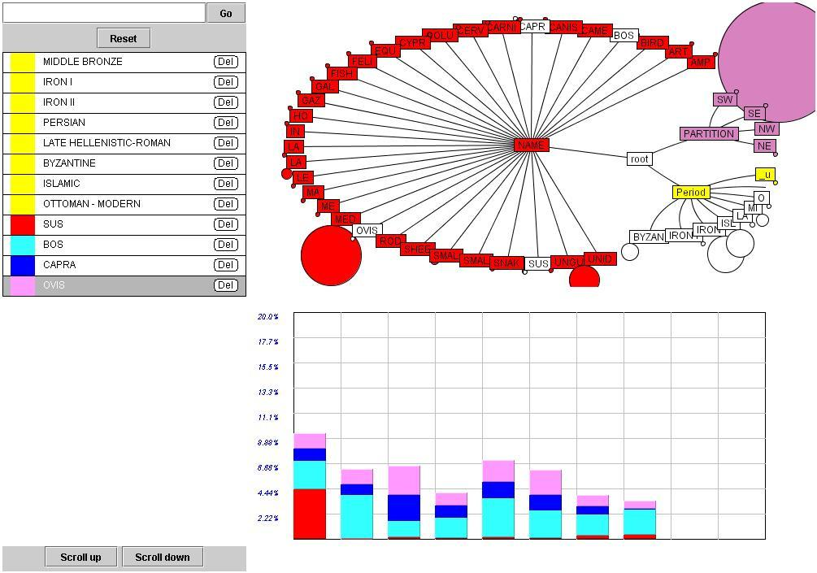
Query: “SITE=Nimrin&OBJECTTYPE=Bone”
Percentages of animal bones:
SUS, BOS, CAPRA, OVIS
Cultural phases (time periods): Middle Bronze, Iron I, . . .

Slide 63
Evaluation of ETANA-DL services (N=28, Scale 0-5)
Browse | Search | EtanaViz | Save navigation path (SNP) | Search within browsing context (SWBC)
4.0 | 4.0 | 4.0 | 4.5 | 4.5

Slide 64
Conclusions
Approach DL exploring services based on a DL theory.
Develop theorems indicating browsing and searching can be converted and switched to each other under certain conditions.
Provide a systematic and functional method to design and implement DL exploring services in an integrated archaeological DL, ETANA-DL, which was used as a case study.
Made contributions to aid both users and developers of DLs.

Slide 65
Outline
JCR Licklider
Libraries of the Future
5S
Building Digital Libraries
Exploring (incl. from JCDL 2006)
Future

Slide 66
Future (at JCDL 2020)
Discuss and learn together.
Plan for future collaborations.
Tutorial 3: Introduction to DLs
Tutorial 2: Preparing Code and Data for Computational Reproducibility
Workshop 6: Web Archiving and DLs

Slide 67
Future
Protocols / connect systems / services, e.g.,
  OAI-PMH: https://www.openarchives.org/pmh/ Protocol for Metadata Harvesting,V.2.0 (2002)
  Jun Wang, "VIDI: A Lightweight Protocol Between Visualization Systems and Digital Libraries", May 2002, MS thesis, http://hdl.handle.net/10919/33845
  Memento Protocol, RFC 7089, 2013,Time-based Access to Remote States, https://tools.ietf.org/html/rfc7089
x

Slide 68
Future: Prashant Chandrasekar’s Architecture of DL for SME Exploration
CS1 - Information System
Digital Library of SME System Req. Descriptions
UXR
CS2 - Information System
SME
Conduct
UX Research
CS1 - Information System
Service x
Service y
Service z
Capture User
Requirements
Results
Catalog of system req. descriptions
Case UX ARTIFACTS
Query
Case1
Case2
Case3
. . .
-- ----- ---- ---- -
---- --- ----- ----
--- --- --- ------- -
. . .
PRODUCE
GRAPH INTERFACE
UXR
Developer
WORKFLOW MANAGER
ARTIFACT MANAGER
Analyst
SERVICES REGISTRY

Slide 69
Future
Facilitate curiosity and wonder
Aid learning, discovery, and leveraging
Promote truth and understanding
Enable collaboration in the small and large
Support specialization and synthesis
Meet short and long term goals, with history
Tailor to groups, personalize to individuals
Cover the full information life cycle

Slide 70
Summary
JCR Licklider
Libraries of the Future
5S
Building Digital Libraries
Exploring (incl. from JCDL 2006)
Future

Slide 71
Questions?
Discussion?
Thank You!
fox@vt.edu

