Slide 1

Computer Science Colloquium
Old Dominion University, Norfolk, VA
18 January 2019
Integrating Research and Education Regarding
Global Event and Trend Archiving by Edward A. Fox
fox@vt.edu http://fox.cs.vt.edu
Dept. of Computer Science, www.cs.vt.edu

Slide 2
Acknowledgements
Mentors (MIT: Licklider, Kessler; Cornell: Salton)
Virginia Tech, CS (ECE), Digital Library Research Laboratory (DLRL)
NSF and many other sponsors; VT Centers: CHCI, DAC, GCC, VTCAR
Students, colleagues, co-investigators (selected):
Ghaleb Abdulla, Monika Akbar, Hamed Alhoori, Aman Ahuja, Pranav Angara, Ashish Baghudana, Jefferson Bailey, Abigail Bartolome, Warren Bickel, Matthew Bock, Boots Cassel, Saurabh Chakrvarty, Prashant Chandrasekar, Yinlin Chen, Kiran Chitturi, Lois Delcambre, Noha ElSherbiny, Mary English, Alexandre Falcao, Weiguo Fan, Eric Fouh, Chris Franck, Rick Furuta, Andrej Galad, Ayush Ganotra, Lee Giles, Marcos André Gonçalves, Doug Gorton, Richard Gruss, Islam Harb, S.M. Shamimul Hasan, Bill Ingram, Tarek Kanan, Andrea Kavanaugh, Nadia Kozievitch, Abhinav Kumar, Spencer Lee, Sunshin Lee, Jonathan Leidig, Lin Tzy Li, Liuqing Li, Wei Lu, Yi Ma, Yufeng Ma, Mohamed Magdy, Madhav Marathe, Uma Murthy, Pranav Nakate, Sanghee Oh, Sung Hee Park, Denilson Pereira, Jeffrey Pomerantz, Sagnik Ray Choudhury, Naren Ramakrishnan, Chandan Reddy, Rao Shen, Clifford Shaffer, Steve Sheetz, Don Shoemaker, Ziqian Song, Venkat Srinivasan, Amirsina Torfi, Ricardo Torres, Xinyue Wang, Barbara Wildemuth, Zhiwu Xie, Seungwon Yang, Xiaoyan Yu, Xuan Zhang, ...

Slide 3
Selected Funded Grants
IMLS RE-70-18-0005-18: Continuing Education to Advance Web Archiving, Zhiwu Xie, Fox; GWU, LANL, IA, ODU, U. Waterloo
NSF CMMI-1638207: Coordinated, Behaviorally-Aware Recovery for Transportation and Power Disruptions (CBAR-tpd), Clemson: Pamela Murray-Tuite; VT: Fox, Kris Wernstedt; U. Mich: Seth Guikema
NSF IIS-1619028: Global Event and Trend Archive Research (GETAR), VT: Fox, Chandan Reddy, Andrea L. Kavanaugh, Donald J. Shoemaker; Internet Archive: Jefferson Bailey
NSF IIS-1319578: Integrated Digital Event Archive and Library (IDEAL), VT: Fox, Andrea L. Kavanaugh, Steve Sheetz, Donald J. Shoemaker; Internet Archive: Jefferson Bailey

Slide 4
Theses and Dissertations
IN-PROCESS (Selected):
Prashant Chadrasekar, Bill Ingram, Liquing Li, Ziqian Song
COMPLETED:
Abigail Bartolome, "Describing Trail Cultures through Studying Trail Stakeholders and Analyzing their Tweets", June 2018, MS thesis, Computer Science, http://hdl.handle.net/10919/84528
Matthew Bock, "A Framework for Hadoop Based Digital Libraries of Tweets", May 2017, MS thesis, Computer Science, http://hdl.handle.net/10919/78351
Saurabh Chakravarty, "A Large Collection Learning Optimizer Framework", June 2017, MS thesis, Computer Science, http://hdl.handle.net/10919/78302
Sunshin Lee, "Geo-Locating Tweets with Latent Location Information", Ph.D. dissertation, defended December 2016, published 2017-02-13 in VTechWorks: http://hdl.handle.net/10919/75022
Andrej Galad, "ArchiveSpark - MS Independent Study Final Submission", December 2016, MS independent study report, Virginia Tech Dept. of Computer Science, DLRL Technical Report, http://hdl.handle.net/10919/77457
Mohamed Magdy Gharib Farag, "Intelligent Event Focused Crawling", Ph.D. dissertation, 23 September 2016, http://hdl.handle.net/10919/73035
Tarek Ghaze Kanan, "Arabic News Text Classification and Summarization: A Case of the Electronic Library Institute SeerQ (ELISQ)", June 2015, Ph.D. dissertation, published 2015-07-21 in VTechWorks: http://hdl.handle.net/10919/74272

Slide 5
VTechWorks Class Collections
CS4984 Computational Linguistics (2014) and CS4984/5984 Big Data Text Summarization (2018) (21)
CS4624 Multimedia/Hypertext/Information Access (recent years, since early 1990s) (130)
CS5604 Information Retrieval (recent years, since 1983) (35)
CS6604 Digital Libraries (recent years, since 1990s) (12)

Slide 6
Integrating
Research & Education
  Funded Projects & Student Research
  Classes, MS Projects, Theses, Dissertations
Digital Libraries & Archives
  Collecting
  Services
  Adding Value, Preserving, Internet Archive
Events & Trends
  Simple Events, Complex Events
  End of Millennium through Present

Slide 7
Design of
INFORMATION
Access
Extraction
Representation
Retrieval
Systems
Technology
Theory
Viz
Digital Libraries
Archives
Multimedia
Hypermedia
Text
WWW
Hypertext
Images
Search Engine
Crawling
Webpages
Links
Videos
Machine Learning
Mining
Analytics
Deep Learning
Relational
NLP
AI
Statistics
Database
Tables
Data
Knowledge

Slide 8
Information Life Cycle
Creation
Active
Authoring
Modifying
Social Context
Using
Creating
Organizing
Indexing
Retention
/ Mining
Accessing
Filtering
Storing
Retrieving
Semi-
Active
Utilization
Distributing
Networking
Inactive
Searching
Notes:
This is a simplification of the previous slide.

Slide 9
Digital Libraries and Archives

Slide 10
Informal 5S & DL Definitions
DLs are complex systems that
help satisfy info needs of users (societies)
provide info services (scenarios)
organize info in usable ways (structures)
present info in usable ways (spaces)
communicate info with users (streams)

Slide 11
Informal 5S & DL Definitions
DLs are complex systems that
help satisfy info needs of users (societies)
provide info services (scenarios)
organize info in usable ways (structures)
present info in usable ways (spaces)
communicate info with users (streams)

Slide 12


Slide 13


Slide 14
ETANA-DL Architecture
DigBase and DigKit
Lahav
D
A
T
A
B
A
S
E
W
R
A
P
P
E
R
S
Search
U
S
E
R
I
N
T
E
R
F
A
C
E
Browse
Nimrin
Recommend
Umayri
ETANA-DL
UNION
CATALOG
Note
Hisban
Personalize
Megiddo
Review
Jalul
Visualizations
Archaeology
Specific
…
New Sites

Slide 15

Integrated Digital Event Archive and Library (IDEAL) stakeholders
Notes:
Help affected communities to recover more quickly and effectively
Provide global network with relevant information and resources
Support the research community, emergency personnel, decision makers, and the public in reacting to and recovering from crises

Slide 16
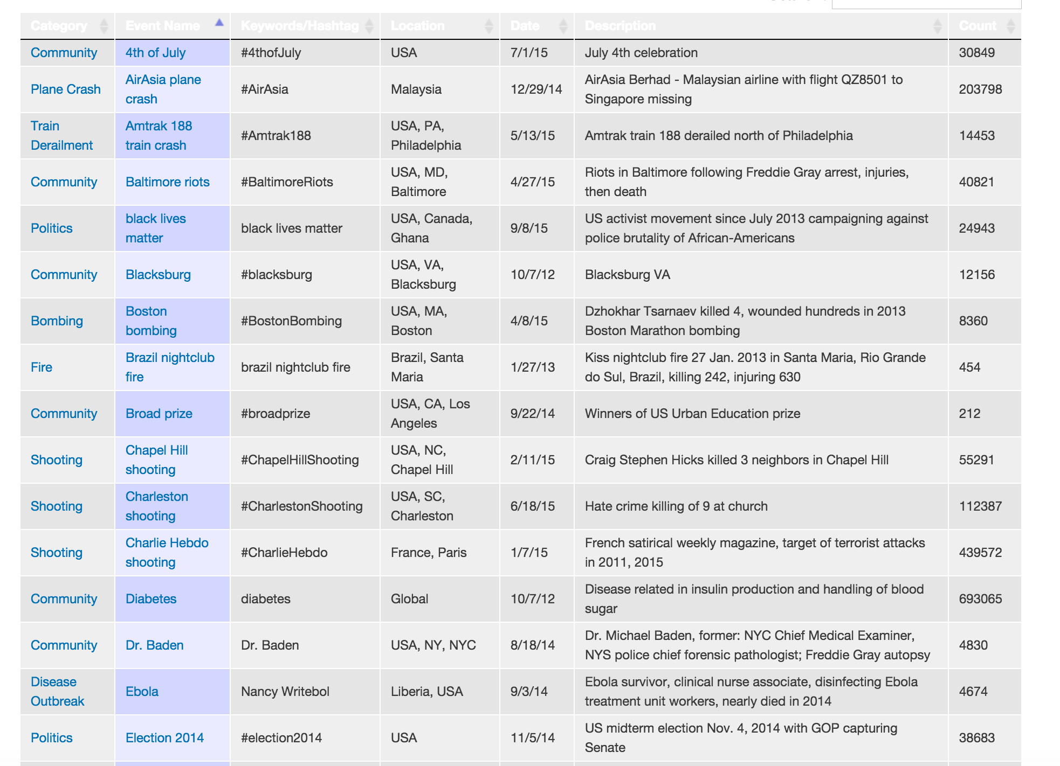
Integrated Digital Event Archiving and Library (IDEAL)
Over 11 terabytes of webpages and about 1 billion tweets
natural disasters (earthquakes, storms, floods)
man-made disasters (protests, terrorism, conflicts)
Community events
Notes:
Two different courses, where the challenge was decomposed differently:
For the undergraduate: same analysis, but everybody working with different event type & text collections.
For the graduates: worked together to aid access to a massive collection (83 million tweets plus associated metadata), but everybody performed a different element of the construction.
So, on to the courses themselves. For each, I’ll go over
Design:
the driving question, 2) how each was structured,
Evaluation
in terms of the quality of the artifacts produced
In terms of student reactions

Slide 17
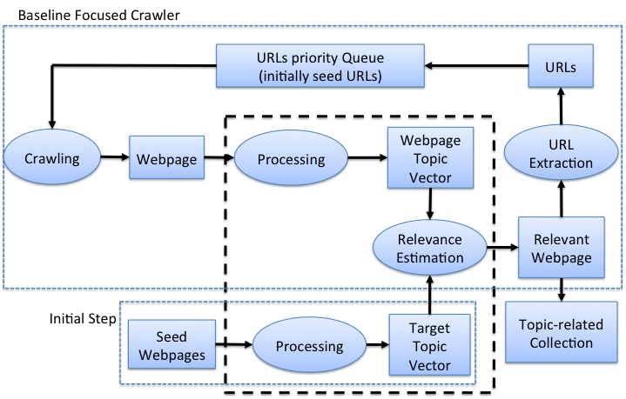
Baseline Focused Crawler
Focus of research

Slide 18

Event Focused Crawler
Focus of research

Slide 19
Event Modeling and Representation
We define an event as
  something (e.g., a disaster),
  which happened in a certain place, and
  at a certain time.
Event E is a tuple <T, L, D>.
T = topic of event, L = location, D = date
i.e.: what, where, and when.

Slide 20
PAKDD 2019 (Ahuja et al.)
A Probabilistic Spatio-Temporal Model for Event Detection
Tweets from June to December 2016: 715K sample
Washington Post for all of 2016: 148,769 news articles
STED: Spatio-Temporal Event Detection
Generative model for collection with E events
When: temporal mean and variance for an event
Where: one or more (R) regions, each with geographical center and corresponding covariance
What: set of (K) topics describing event
Better than: LDA, GeoFolk, BGM, and STED-T (tweets only)

Slide 21
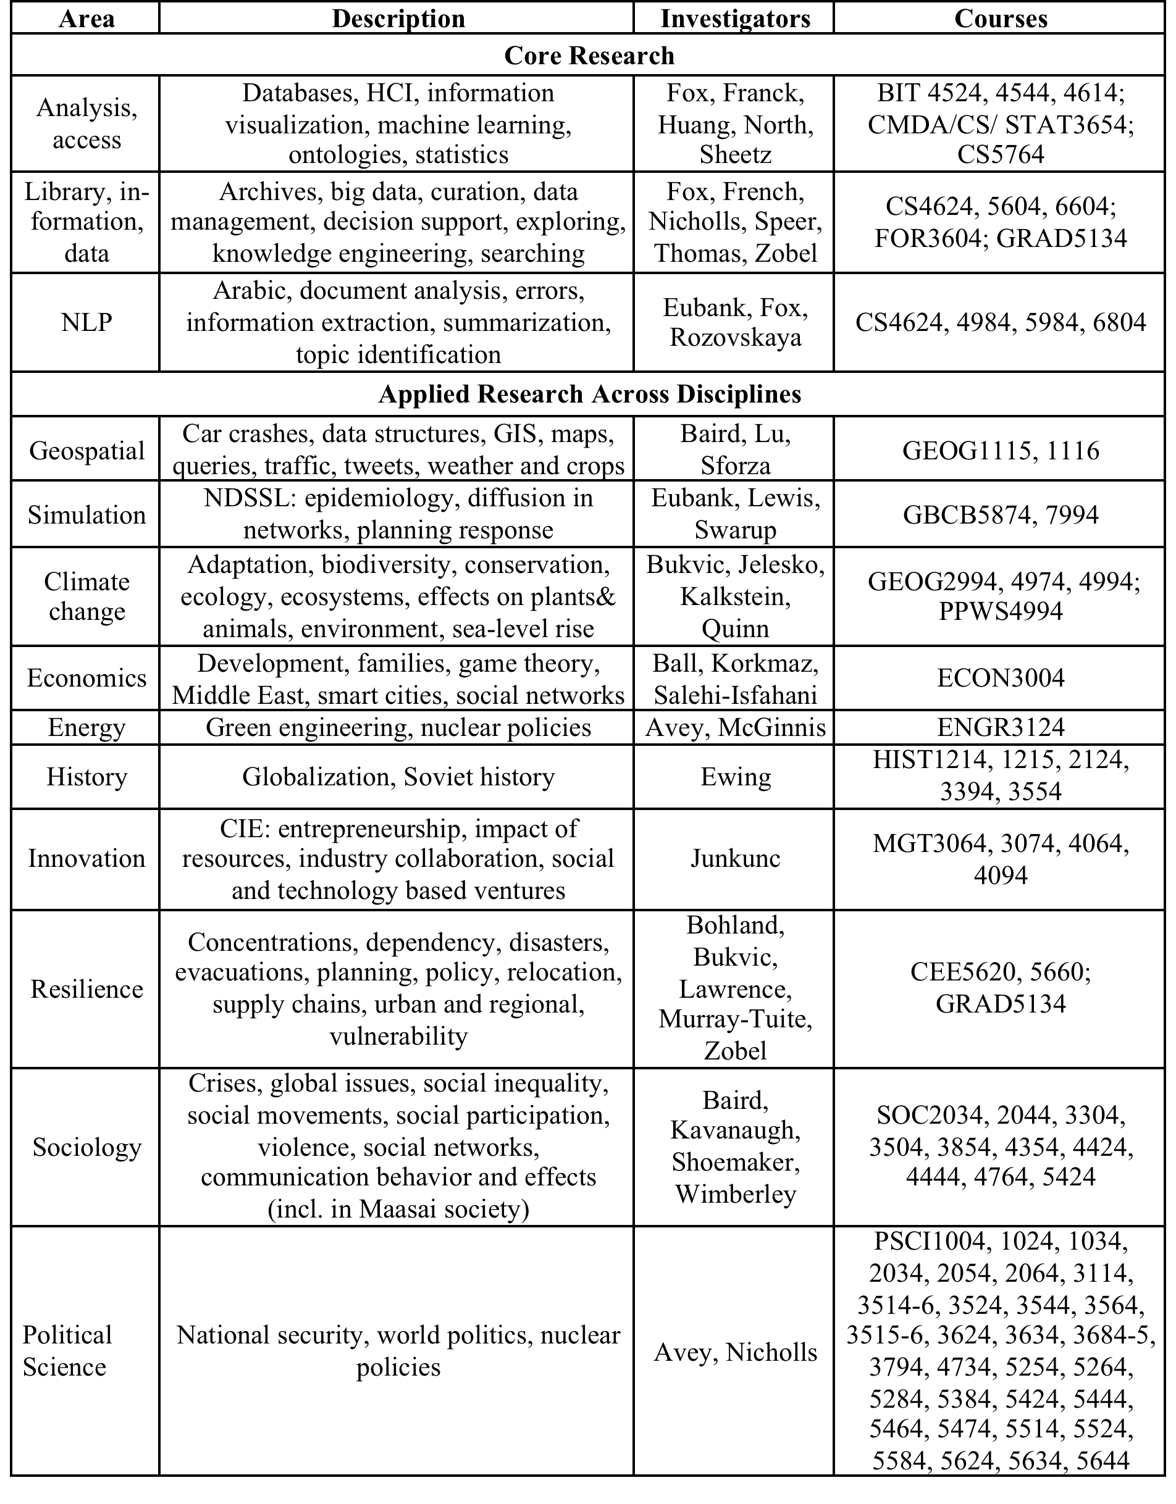
GETAR:
Areas,
Investigators,
Courses

Slide 22
GETAR Architecture
Global Event and Trend Archive Research

Slide 23
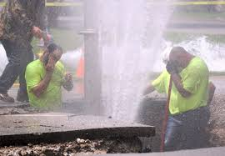
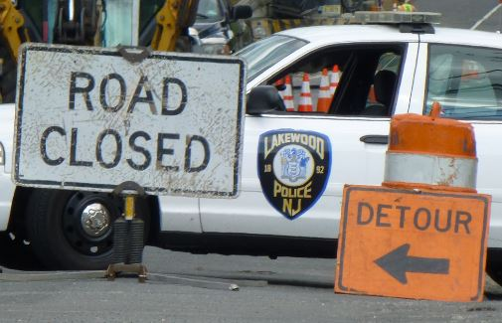
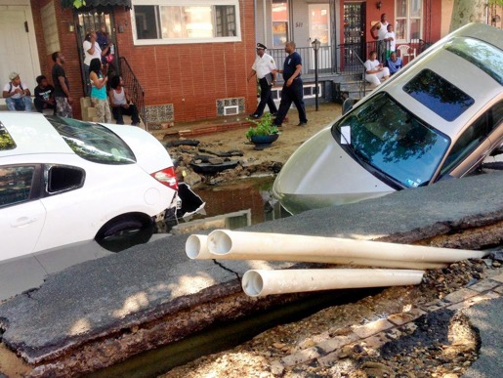
Tweets: Who is involved in a WMB ?
Fix water pipe
  Water utility
  city/town utility
Traffic
  Police
Affected
  Citizen
Others …
Lakewood, NJ, June. 2014
West Philadelphia, PA, June. 2015
Notes:
Click “NewYork” in user_city_s
See organization: FDNY, MTA (Metropolitan Transportation Authority), NYU
Person name: De Blasio
Hashtags, Mentions

Slide 24
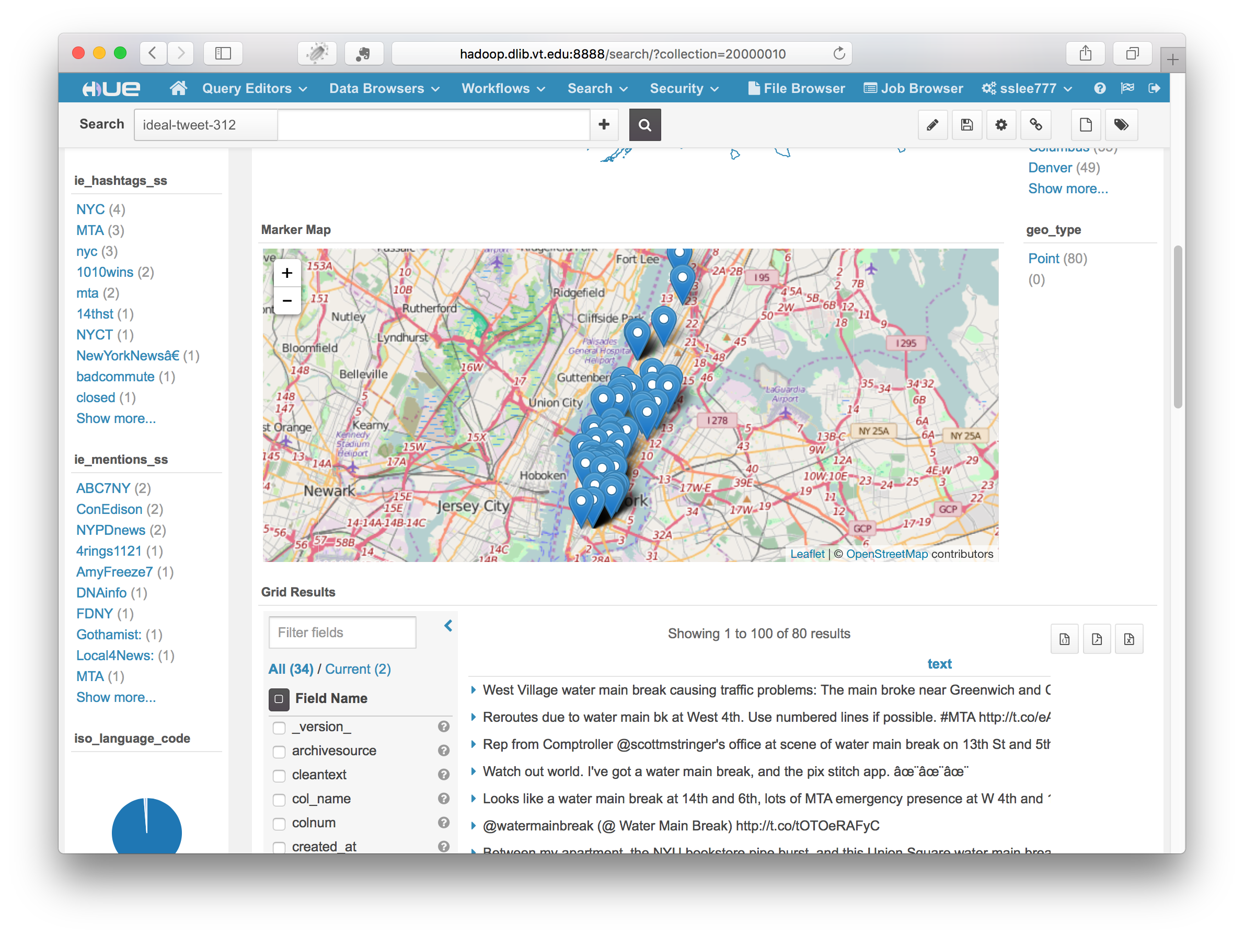

Slide 25
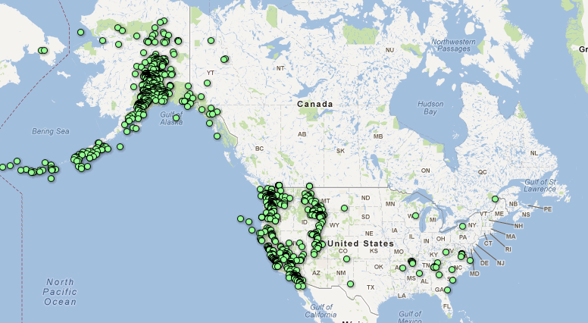
What Causes Water Main Breaks? Earthquakes (USGS)
Mar. 1 – Apr. 5, 2012
Notes:
Search earthquake
Histogram: March 2014, May 2015 => not Winter
Location Name: Fullerton, CA; La Habra, CA; Brea CA

Slide 26
Features, combinations of them
Percentages of tweets that have particular features
Up to 91.1%
LIWs may help to geo-locate tweets
Percentages of tweets with features or union of features

Slide 27
State Level Distribution
Pothole dataset
  (a) Geo-coordinates: 18K
  (b) Geonames (SNER): 30K
  (c) Geonames (SNER)
  + LIWs (Hashtags): 45K
National trends
State level distributions of unambiguously geo-coded tweets with
(a) geo-coordinates, (b) geoname (SNER), and (c) geoname (SNER) and hashtags in pothole collection

Slide 28
MAP OF (THRU) HIKING TRAILS
AT: Appalachian Trail CDT: Continental Divide Trail PCT: Pacific Crest Trail

Slide 29
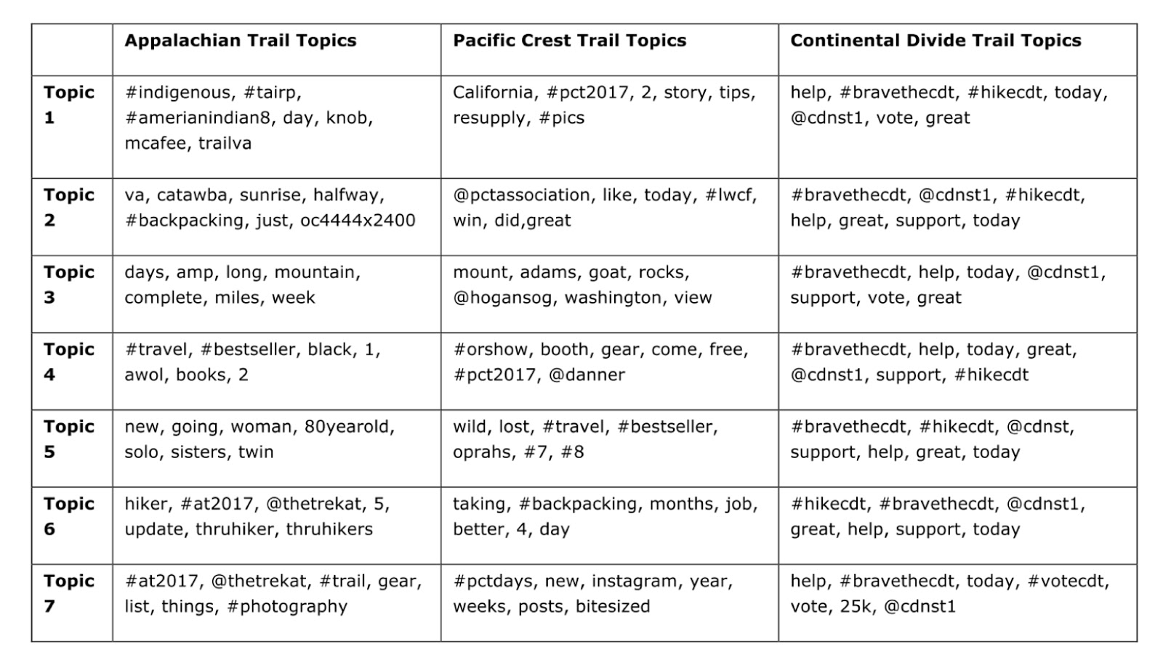
Trail Study
“Each one is different; each has a soul”- Triple Crown veteran, Karen Berger, on which trail is her favorite.
Trail Cultures:
Avid Hiking
Conservation practices
What can we learn about these cultures? What can we learn about their language?
Surprising Trail Countercultures:
Nude Hiking
Actively denying conservation practices
Why do these hikers behave in this way? What are their motivations? Who is attracted to these countercultures and can they be infiltrated?
From January-May, topic analysis reflected Appalachian Trail valued experiences, while Pacific Crest Trail focused more on the logistics of planning a hike. Are these part of hiking culture? Was this influenced by geographical (and schedule) differences?

Slide 30
Appalachian Trail Topics
Visualization from rawgraphs.io
Notes:
Reverence to the mountain… the scenery

Slide 31
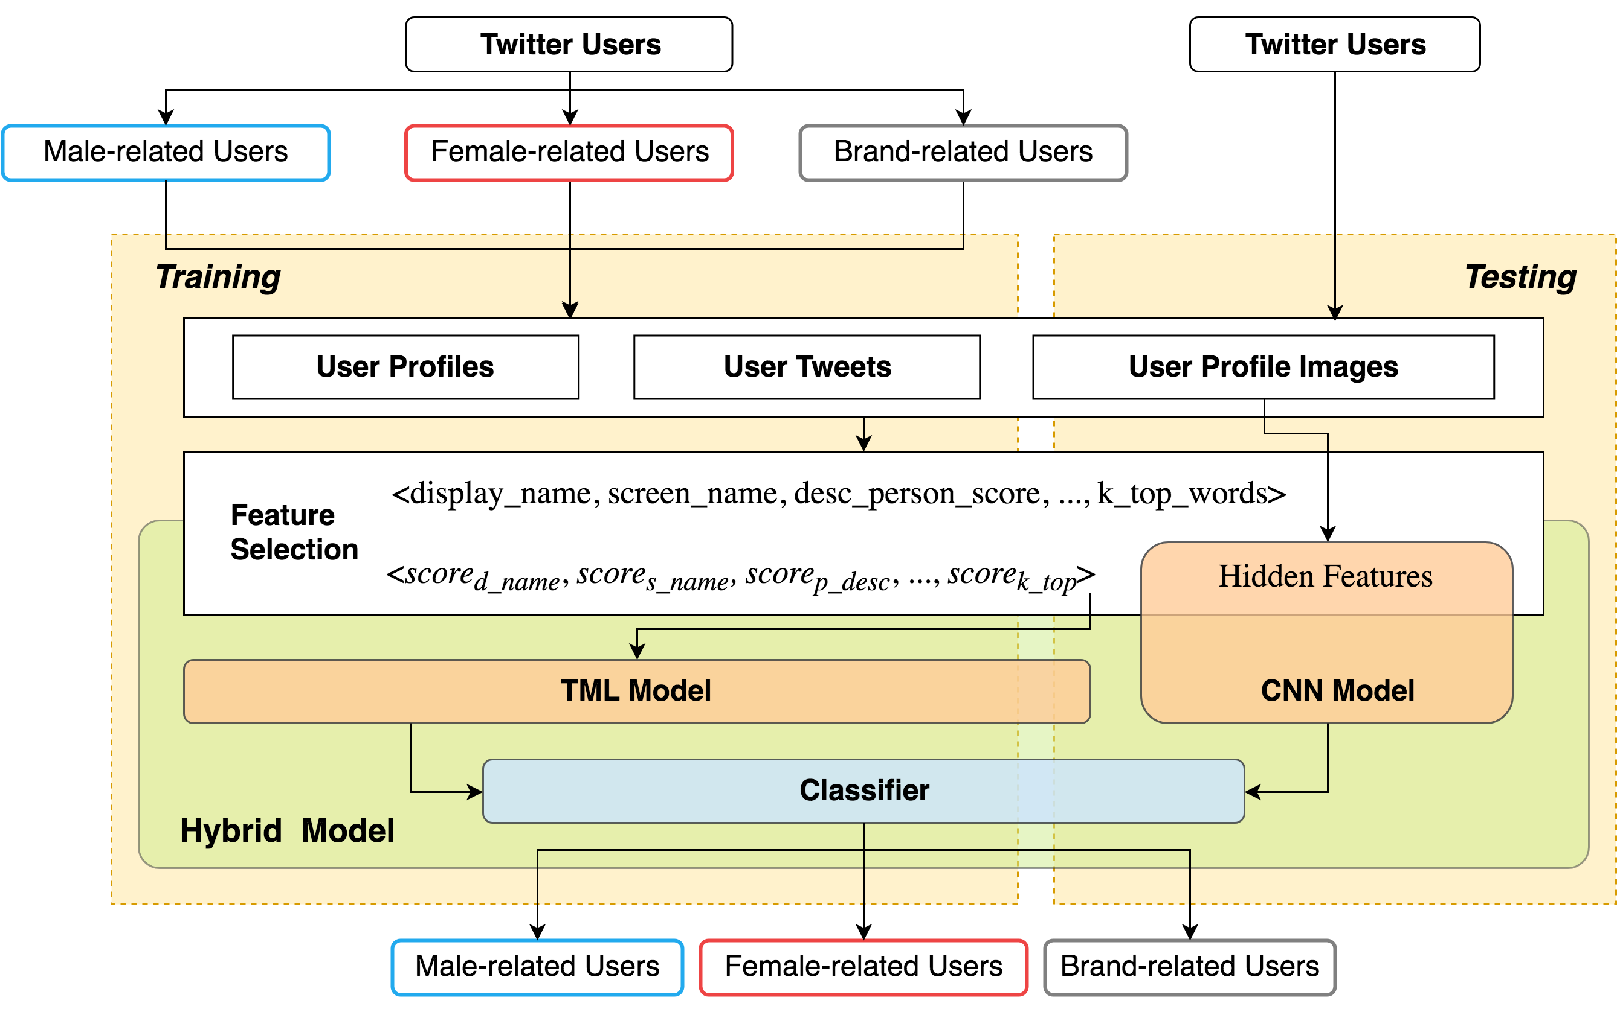
A Hybrid Model for
Role-related User Classification on Twitter

Slide 32
Data Flow

Slide 33
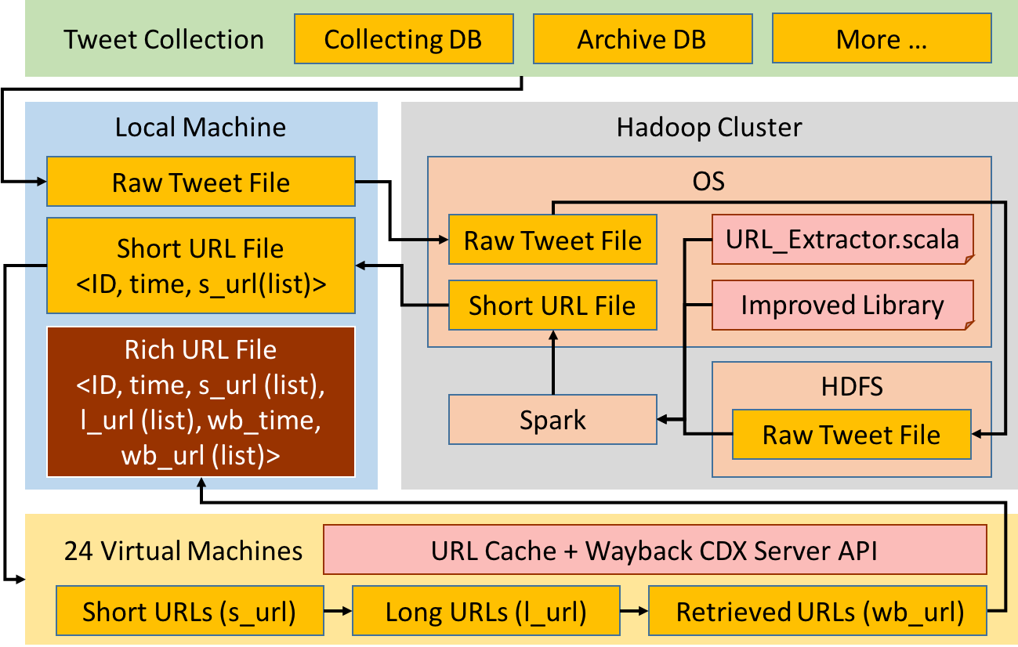
Historical Tweet URL Analysis

Slide 34
Archiving and Analyzing using Bigdata Hadoop cluster

Slide 35
DL Curriculum Framework
EDUCATION / LEARNING / TEACHING

Slide 36
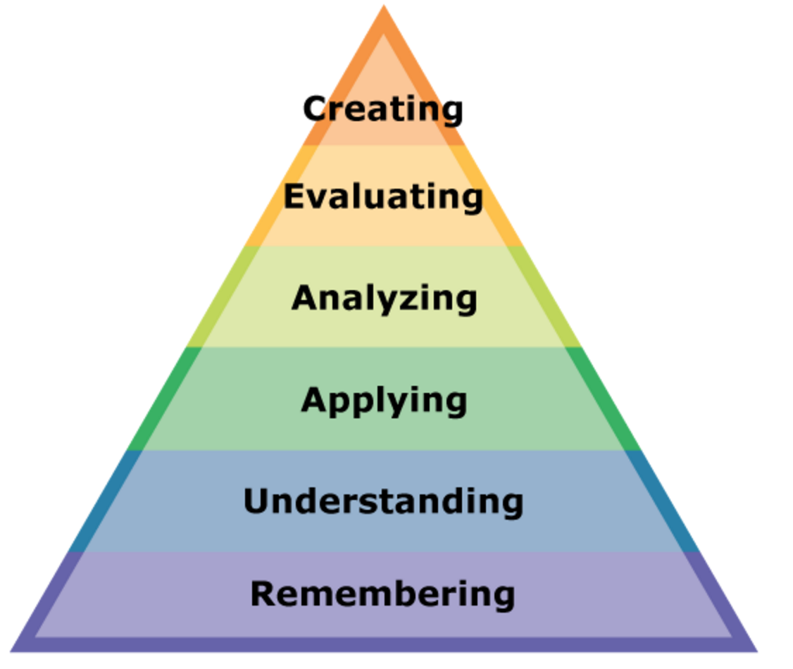
Problem-Based Learning (PBL)
Theory
John Dewey: “experiential learning” (1910s)
Lev Vygotsky: “zone of proximal development” (1930s)
Benjamin Bloom: “active learning” (1950s)
  Listening != learning
  Students in lectures are twice as likely to leave engineering, 3 times as likely to drop out
Bloom’s Taxonomy (New Version)
Notes:
PBL is a form of Active learning, one attempt to get away from lecture.
They cite literature which indicates that to learn, students must do more than just listen: They must read, write, discuss, or be engaged in solving problems.
In a 2012 report titled "Engage to Excel,"[27] the United States President's Council of Advisors on Science and Technology (PCAST) described how improved teaching methods, including engaging students in active learning, will increase student retention and improve performance in STEM courses. One study described in the report found that students in traditional lecture courses were twice as likely to leave engineering and three times as likely to drop out of college entirely compared with students taught using active learning techniques. In another cited study, students in a physics class that used active learning methods learned twice as much as those taught in a traditional class, as measured by test results.
INTRINSIC MOTIVATION

Slide 37
Problem-Based Learning (PBL)
A single question drives and organizes the learning activities.
Learning is done “Just-In-Time.”
Emphasis is placed on the process rather than the product.
The task of the instructor is to provide a relevant and authentic question and serve as a facilitator.
Notes:
How it actually works. The course has no lectures. Class time is used for group collaboration.

Slide 38
CS 5604: Information Retrieval
Introductory graduate level course
Driving Question: “How can we best build a state-of-the-art IR system in support of a large digital library project?”
7 teams, all performing different tasks along a processing pipeline
Notes:
Things were generally less concretely defined.

Slide 39
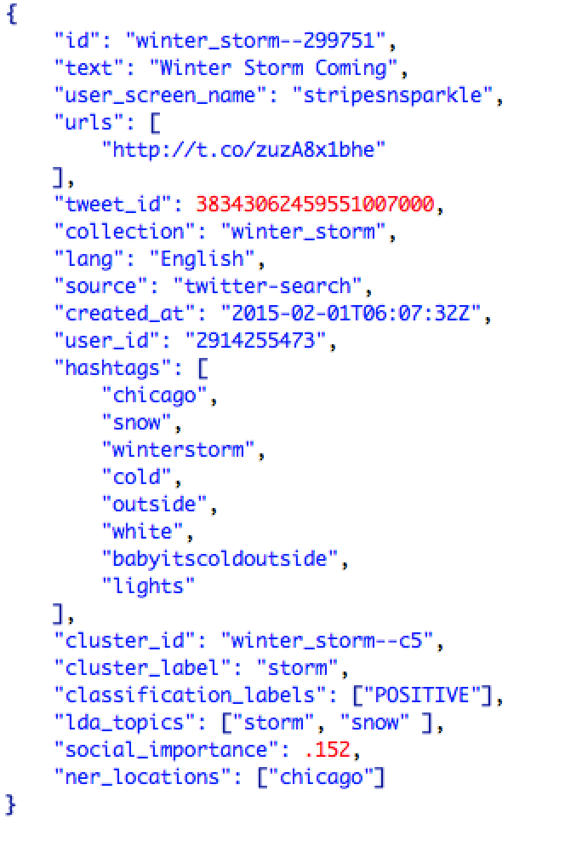
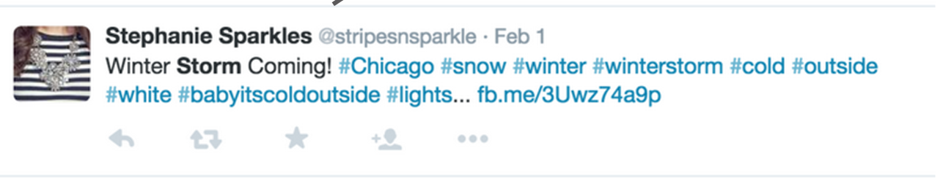
CS 5604: Information Retrieval
Course Structure: The Goal
Notes:
So from this distance, it looks like a fairly simple problem: take a document like this one (and 83 million others) and turn it into a representation like this. Then figure out the best way to customize Solr that it weighs our analysis fields in such a way that optimizes retrieval in term of precision and recall. Easy.

Slide 40
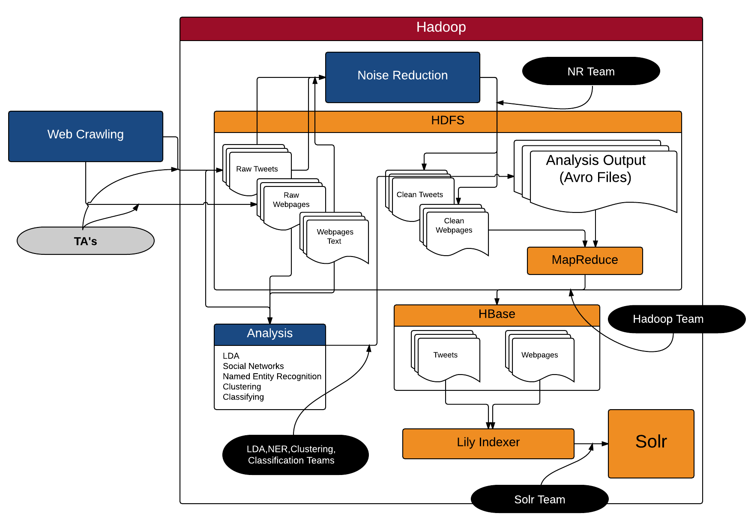
CS5604: Course Structure:
The Architecture
Notes:
The course structure emerged from the architecture.
It took extensive collaboration to arrive at this architecture. This was the first 3 weeks. Once we designed an architecture, we could divide up responsibilities.
Hadoop is a framework for storing and working on lots of data. It’s flagship components are the HDFS (dist file system) and MapReduce (programming model for working on those files and consolidating the results)
Anything in orange is a component of Hadoop.
(lower left). Another decision that took a long time to work out: what is the output of each analysis? Keyed on doc id, but then what? Vector of terms? Weights?

Slide 41
CS 5604: Information Retrieval
Concepts
Indexing: inverted, in-memory, distributed, dynamic
Vector Space Model: doc representation, TF-IDF, length normalization
Result evaluation: precision, recall, F-Score
Probabilistic Language Modeling
Text classification and clustering
Social Network Analysis
Latent Semantic Analysis
Technologies
Hadoop: HDFS, MapReduce, HBase, AVRO
Apache Mahout, Weka
Solr, Velocity, Carrot²
Notes:
Students ENCOUNTER concepts, and those concepts are reinforced through IMMERSION in technologies.

Slide 42
CS 5604: Information Retrieval
Student Response
20 question poll, rate 1-5 on “Rate how well this approach helped you to…”
Question | Score
Think independently | 4.4
Consider alternative solutions to problems | 4.3
Identify gaps in your knowledge | 4.3
100% said they would recommend this approach for future classes.

Slide 43
CS 4984: Computational Linguistics
Undergraduate capstone course
Driving Question: “What is the best summary that can be automatically generated for your type of event?”
7 teams, all performing the same analysis on different collections of text
Notes:
synthesizes and integrates skills and knowledge acquired throughout the CS undergraduate curriculum

Slide 44
Category | Collection | Event Year(s) | Location | # of Webpages
Disease | Ebola | 2014 | World | 15,000
Earthquake | Virginia earthquake | 2011 | Virginia, USA | 8,765
Fire | Brazil club fire | 2013 | Brazil | 690,281
Flood | Pakistan flood | 2011 | Pakistan | 20,416
Hurricane | Hurricane Sandy | 2012 | East Coast, USA | 75,929
Shooting | Tucson shooting | 2011 | Tucson AZ, USA | 37,829
Community | Blacksburg events | 2011-2012 | Blacksburg VA, USA | 16,024

Slide 45
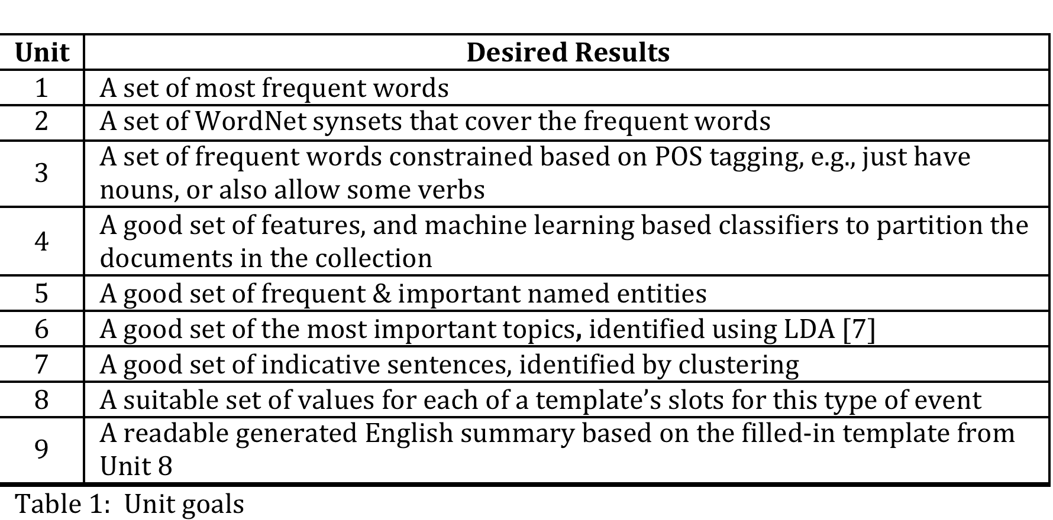
CS 4984: Computational Linguistics
Course Structure: Scaffolding
Notes:
Increasing levels of NLP sophistication. NLTK.
Frequency distributions over single words, then phrases (n grams).
Synonymy and antonymy. WordNet from Princeton. Words and their hierachical relationships. 117 000 synsets linked to other synsets by means of a small number of conceptual relations. Hyponym (more specific), hypernym (more abstract)
POS: step along the way to parsing—word category disambiguation
TF-IDF classification: way to drop documents that made it into the collection mistakenly
NER. Location, Person, Organization, Money, Percent, Date, Time. Using tools available or rolling our own. Very realistic situation. MOST USEFUL
LDA. Model of document production. Each document is generated by probabilistically selecting words from selected topics.
LDA finds this topic mixture. Backward reasoning from posterior distribution to prior distribution.
Clustering on sentences, again, using the TF-IDF as the feature vectors. The hope is that you’ll have k clusters. In our example, we were hoping for clusters around case reports, treatments, and international action, but in reality that didn’t happen.
Template filling. Start with a paragraph and fill in the blanks from your collection
Generative grammar, be more adaptive to the content of your collections.
Be selective-----
Scaffolding: new concepts inserted into existing knowledge. These provide scaffolding
Each of these units is a solution to the problem.
As you get to successive units, the solution gets better and they build on each other.

Slide 46
CS 4984: Computational Linguistics
Concepts
Linguistics concepts: morphology, semantics, inflection, meronymy, hypernymy
Tokenization, stemming, lemmatization
Word sense disambiguation
Part of Speech tagging, deep parsing
Named Entity Recognition, Topic Allocation
Information extraction
Natural language generation
Machine learning: clustering, classification
Technologies
Python, Natural Language Tool Kit (NLTK)
Natural Language Processing tools: Stanford NER, OpenNLP
Hadoop Streaming
HDFS
Notes:
Students ENCOUNTER concepts, and those concepts are reinforced through IMMERSION in technologies.

Slide 47
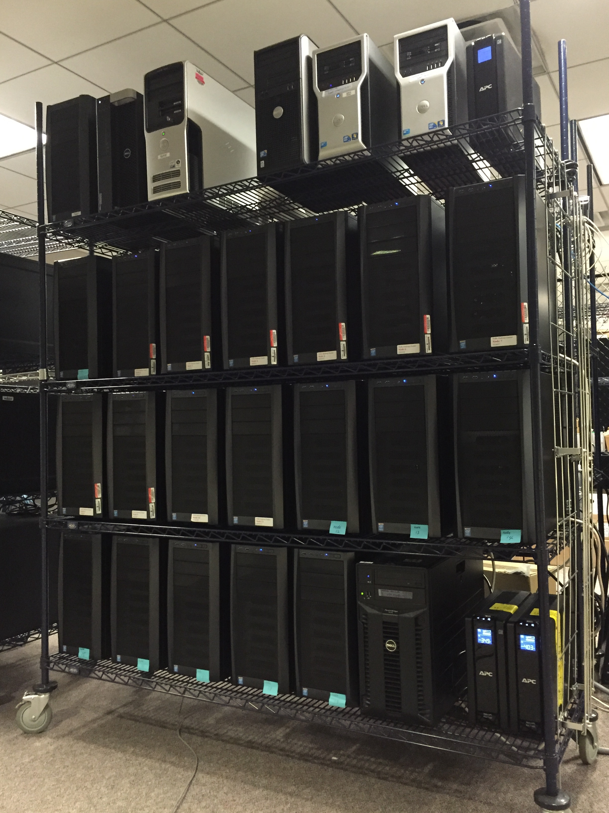
Archiving and Analyzing using
Bigdata Hadoop cluster
Using Desktop PCs
  # of Nodes: 20 + 1 (Solr)
  CPU: Intel i5 Haswell Quad core 3.3Ghz * 20, + Xeon 8C
  RAM: 704 GB (20 * 32 + 64)
  HDD: 149 TB (20 * 7 + 9)
  Backup: 32TB, 8.3TB NAS
Servers
  Tweet collecting
  Web crawling
  Geocoding
  Search (Solr)

Slide 48
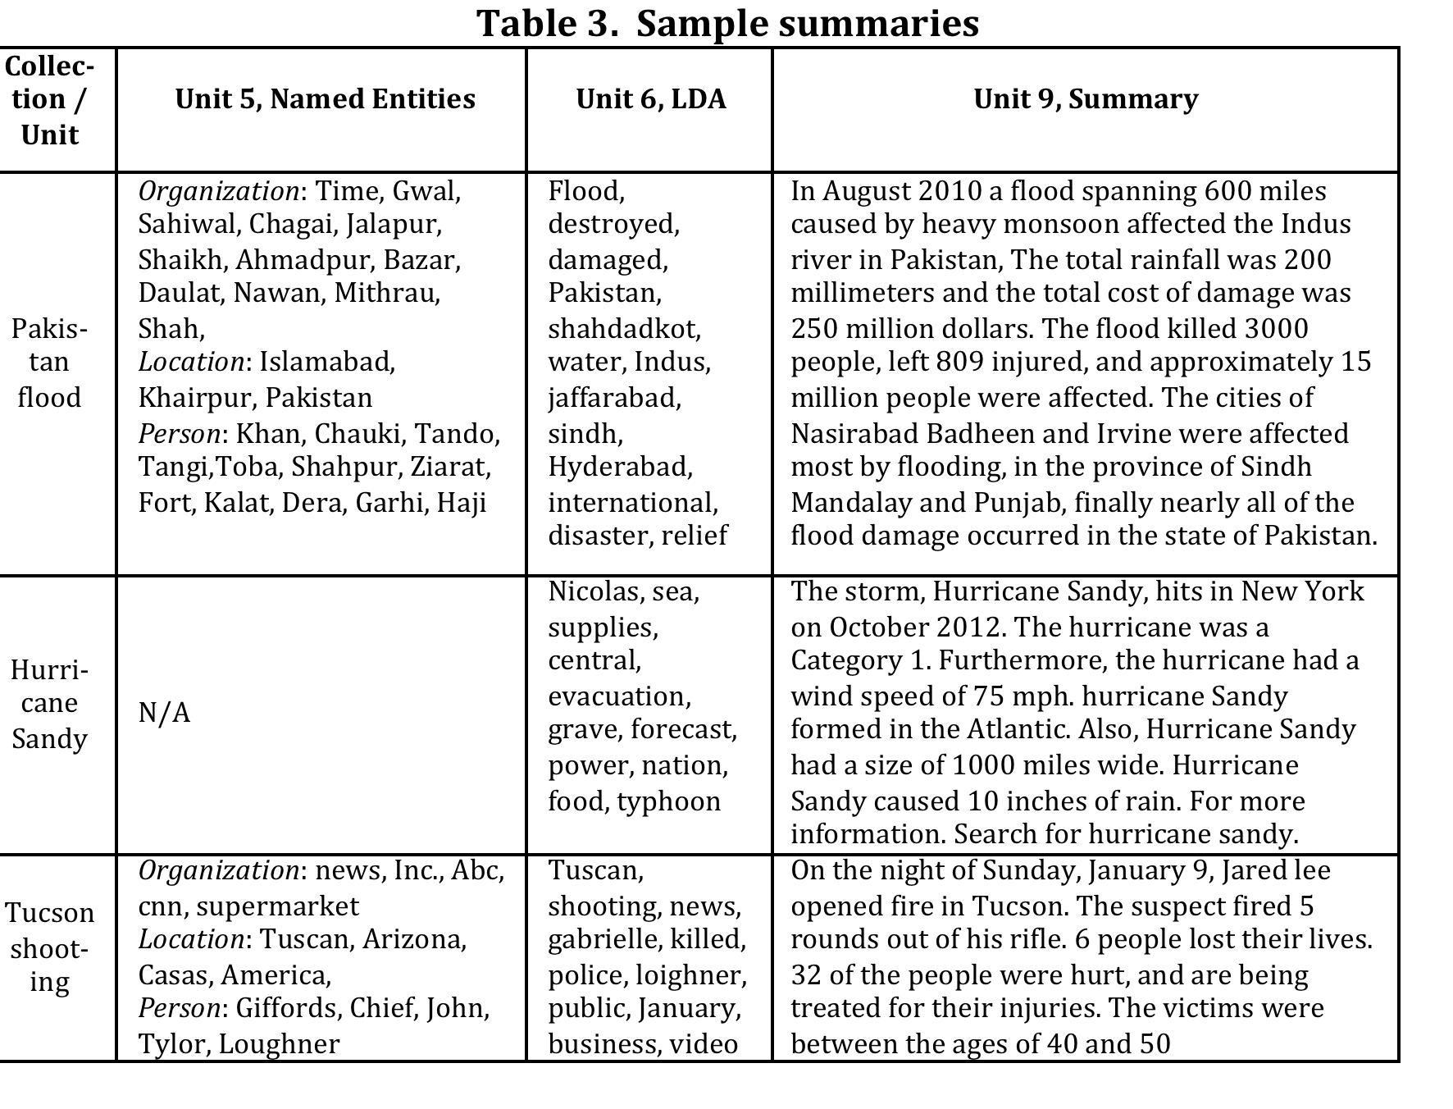
CS 4984: Computational Linguistics

Slide 49
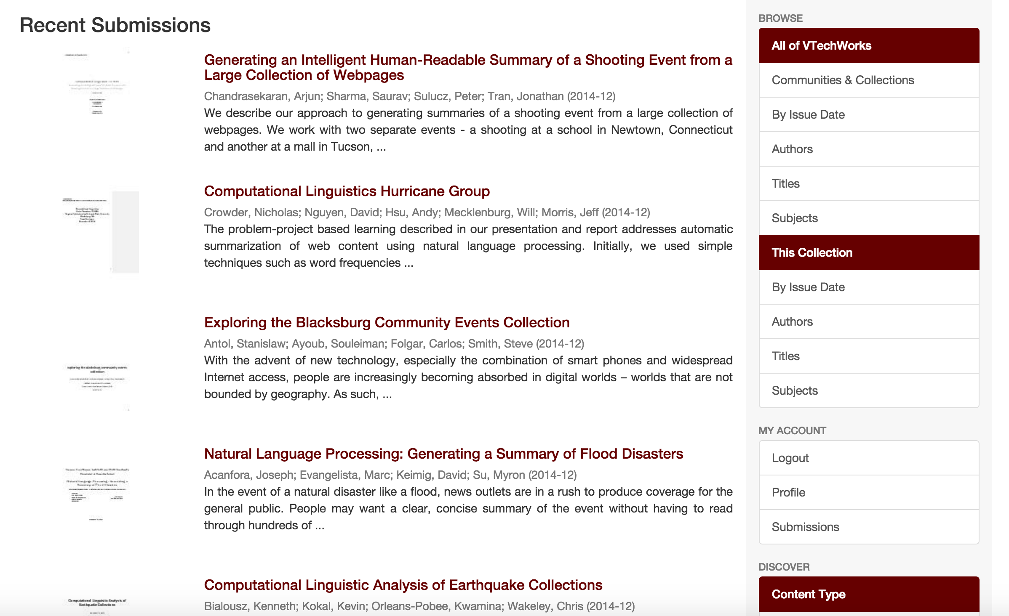
CS 4984: Computational Linguistics
VTechWorks (http://www.vtechworks.lib.vt.edu)
Notes:
Keeping with the spirit that these learning experiences should be as real as possible, students summarized their work in final reports that were submitted to VTechWorks, a digital library of faculty and student research maintained by University Libraries. So, theoretically, in future semesters, students can begin where previous students left off.

Slide 50
CS 4984: Computational Linguistics
Evaluation: Student Feedback
Question | %agree
I have a deeper understanding of the subject matter | 75
My interest in the subject matter was stimulated by this course | 88
Overall, the instructor's teaching was effective | 88
“The instructor stimulated and encouraged independent thinking and questioning. This inspired us to research and come up with our own techniques to solve problems.”
“I loved the free reign that we got to attack the problem on our own and read on our own. I think this is the best way to learn. A+”
Notes:
There’s probably a iconoclasm among these types of students that causes them to value their independence.

Slide 51
CS4984/5984 (Fall 2018)
Big Data Text Summarization
Develop the best software and processing methods to construct high quality English language summaries of the important information for a large collection.
  Summarize a webpage collections about a particular event, topic, or trend - related to GETAR.
  Summarize (using deep learning) each chapter of a thesis or dissertation (ETD).
For webpage collections, use one of the following approaches :
  In sequence, build summaries using 10 (progressively more complex) methods, which allow learning of key concepts of computational linguistics / NLP.
  Focus on deep learning abstractive summarization.

Slide 52
CS4984/5984 (Fall 2018)
Big Data Text Summarization
A set of most frequent important words
A set of WordNet synsets that cover the words
A set of words constrained by POS, e.g., nouns and/or verbs
A set of words/word stems that are discriminating features (that also are helpful in a classifier for the relevant webpages)
A set of frequent & important named entities
A set of important topics, e.g., identified using LDA
An extractive summary, as a set of important sentences, e.g., identified by clustering
A set of values for each slot matching collection semantics
A readable summary explaining the slots & values
A readable abstractive summary, e.g., from deep learning

Slide 53
BDTS Gold Standard Summaries
Tips for Writing Summaries
Select and include what is most informative and interesting.
Generalize to include key concepts, as well as supporting specifics.
Extract and include interesting specifics, like names, locations, dates, dollar values, numbers or percentages. Estimates or rounded values are fine.
Organize the summary before finalizing, using a hierarchical outline.
Make sure there is a coherent logical flow throughout.
Use the same tense throughout, typically either present or past tense.
Use the same person throughout, typically third person.
Don't plagiarize; use your own words, or have a quote with attribution.
Look at online resources on writing a good summary

Slide 54
BDTS Collections
# in team | Collection Name | # of records
5 | Hurricane Harvey | 12789
4 | Hurricane Matthew | 12004
5 | Attack Westminster | 12063
4 | Earthquake NewZealand | 11856
5 | Shooting Douglas | 10108
5 | NeverAgain | 12355
5 | NoDAPL | 12323
5 | Hurricane Irma | 153054
0 | Shooting Santa Fe | 13892
4 | Hurricane Florence | 11375
5 | Facebook Breach | 10829
5 | Shooting Maryland | 12373
4,5,6 | VT ETDs | 30K

Slide 55
Questions? Comments?
Problem-Based Learning !!
Collaboration?
Feel free to contact: fox@vt.edu
Homepage: http://fox.cs.vt.edu
See slides from http://fox.cs.vt.edu/talks/2019

