Slide 1
ETD 2018 (NCL, Taiwan – 26 September 2018) Tips for maximizing your ETD program Edward A. Fox Exec. Director, Chairman of Board, NDLTD
fox@vt.edu http://fox.cs.vt.edu
Dept. of Computer Science, Virginia Tech
Blacksburg, VA 24061 USA

Slide 2
Acknowledgments
Family, mentors, teachers, students
All those working with ETDs
NDLTD, Members, Board, Committees, Working Groups
ETD 2018 Conference Team
Presenters, Attendees, Sponsors
National Central Library
Library Association of the Republic of China (LAC)
Interlibrary Cooperation Association (ILCA)

Slide 3
Outline
Motivation
Planning, Training, Managing
Digital Artifacts, Special Content
NDLTD Website
ETDs Lifecycle Management Info. (ETDplus)
Summary

Slide 4
Stakeholder Motivations
For Students:
Gain knowledge and skills for the Knowledge Society
Richer communication (digital information, multimedia, …)
For Universities:
Easy way to enter the digital library field and benefit thereby (“no brainer” entrée into institutional repositories)
For the World:
Global digital library – large, useful, many services
General:
Save time and money
Increased visibility for all associated with research results

Slide 5
Students and the Info. Life Cycle
Learning
Respect for Teachers, Researchers
Discovery
Excitement
Documentation and reporting
Expression
Dissemination
Fame and Fortune
Community involvement
Service
Community leadership
Compassion, Cooperation
Notes:
3
3

Slide 6
Guiding Students
Assuage fears and concerns
Time and effort
Ignorance regarding publishers, university presses
Luddite faculty views of scholarly communication
Show immediate and long term benefits
Motivate to be more expressive
Guide to help ensure easy long-term preservation
Notes:
4
4
4
3
2

Slide 7
Library Goals
Improve library services
Better turn-around time
Always available
Reduce work
catalog from e-text
eliminate handling: mailing to commercial contractor, bindery prep, check-out, check-in, reshelving, etc.
Save space
Help students become digital scholars
Notes:
ETDs give libraries an avenue to demonstrate Information Age goals

Slide 8
Global Interest
National projects can preserve antiquities and heritage: cultural, historical, linguistic, scholarly
Knowledge and information are essential to economic and technological growth, education
DL - a domain for international collaboration
wherein all can contribute and benefit
which leverages investment in networking
which provides useful content on Internet & WWW
which will tie nations and peoples together more strongly and through deeper understanding
Notes:
3
3

Slide 9
Outline
Motivation
Planning, Training, Managing
Digital Artifacts, Special Content
NDLTD Website
ETDs Lifecycle Management Info. (ETDplus)
Summary

Slide 10
Planning, Training, Managing
Units: Graduate School/Registrar, IT, Library, Research Division
Stakeholders: students, faculty, administrators, trainers
Planning Team
Training Program
Operations and Refinement Team

Slide 11
Background Across the Team
Computer Literacy/Fluency -> Computational Thinking
Electronic Publishing
Scholarly Communication
Open Access
Institutional Repositories, OAI
Intellectual Property Rights, Legal Counsel
Preservation

Slide 12
Partnering
NDLTD
Regional (e.g., Australia, New Zealand)
National Library (e.g., NCL)
State (e.g., California, Ohio, Texas)
Consortia, Nearby Universities
Commercial Organizations
Training, Services, Software, Preservation, . . .

Slide 13
Outline
Motivation
Planning, Training, Managing
Digital Artifacts, Special Content
NDLTD Website
ETDs Lifecycle Management Info. (ETDplus)
Summary

Slide 14
Digital Artifacts
Research Data (e.g., datasets)
Software (e.g., toolkits, packages, libraries)
Jupyter Notebooks (or equivalent)
Separate or coupled, ETD as layered onion
To repository: Cloud (e.g., GitHub), Sponsor, Discipline, Publisher, . . .

Slide 15
Special Content
Confidential Data (medical, social science, …)
Hypermedia Webs
Interactive Systems
Performances
Simulations
(Social) Networks
Visualizations

Slide 16
Outline
Motivation
Planning, Training, Managing
Digital Artifacts, Special Content
NDLTD Website
ETDs Lifecycle Management Info. (ETDplus)
Summary

Slide 17
NDLTD Website (demo)
Board, Committees, Events, Documents
Sharing Metadata, Union Catalog
Global Search
Training and Managing Resources
IMLS Support
Educopia Coordination
http://www.ndltd.org/resources/manage-etds
ETD_Lifecycle_Workshop_Slides_Example.pptx

Slide 18
Outline
Motivation
Planning, Training, Managing
Digital Artifacts, Special Content
NDLTD Website
ETDs Lifecycle Management Info. (ETDplus)
Summary

Slide 19
Guidance Documents for Lifecycle Management of ETDs
188pp; Roadmap; Defining: ETDs & Lifecycle Management
1 Implementing Programs: Roles, Responsibilities
2 Access Levels and Embargoes
3 Copyright and Fair Use
4 Metrics, Demonstrations of Value
5 Curatorial Decisions, Practices: Complex Objects, Migration
6 Metadata: Capture, Best Practices, Quality
7 Planning and Cost Estimates, Case Studies
8 Options: Repository Systems, Management, Services

Slide 20
ETDplus
Format: Summary, Why, How, Tools, Resources, Activities; preservation, curation, research data, complex objects
Copyright (12pp): public domain, fair use, creative commons, patent
Data organization (8pp): data dictionary, spreadsheet structure
File formats (8pp): media, conversion, packaging
Metadata (8pp): properties in Windows
Storage (12pp): backup, security, preservation
Version control (8pp): manual; Git, Subversion

Slide 21
ETD Lifecycle Workshop
Manual (10pp): for Instructor
Tools Manual (28pp): Virus Checking, Format Recognition, Simple Submission, Event Recording, Reference Link Archiving
Syllabus Ex. (2pp): Mod. 1,2 Description / Outcomes
Agenda Example (1p.): 1 day schedule
Module Handout Examples: 1 (interactive overview), 2 (guidance docs), 3 (tools)
Presurvey (2pp)
Postsurvey (2pp)

Slide 22
Summary
Motivation
Planning, Training, Managing
Digital Artifacts, Special Content
NDLTD Website
ETDs Lifecycle Management Info. (ETDplus)

Slide 23
Questions? Discussion? Recommendations? Chat with an NDLTD Board or Committee member!
Thank You!
fox@vt.edu http://fox.cs.vt.edu

Slide 24
Extra Slides (for demo)

Slide 25
http://union.ndltd.org/portal/

Slide 26
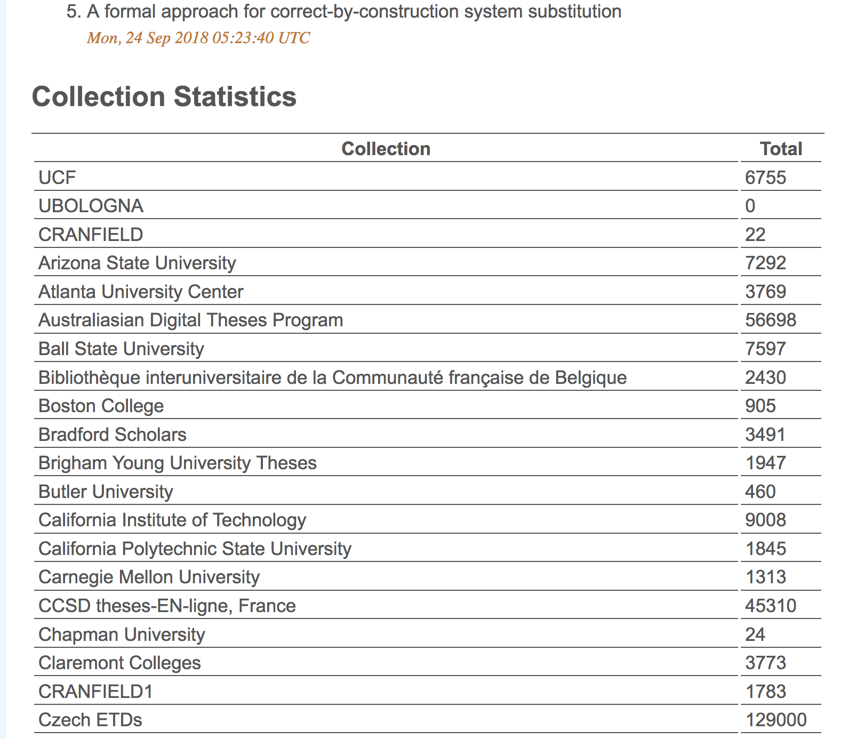

Slide 27
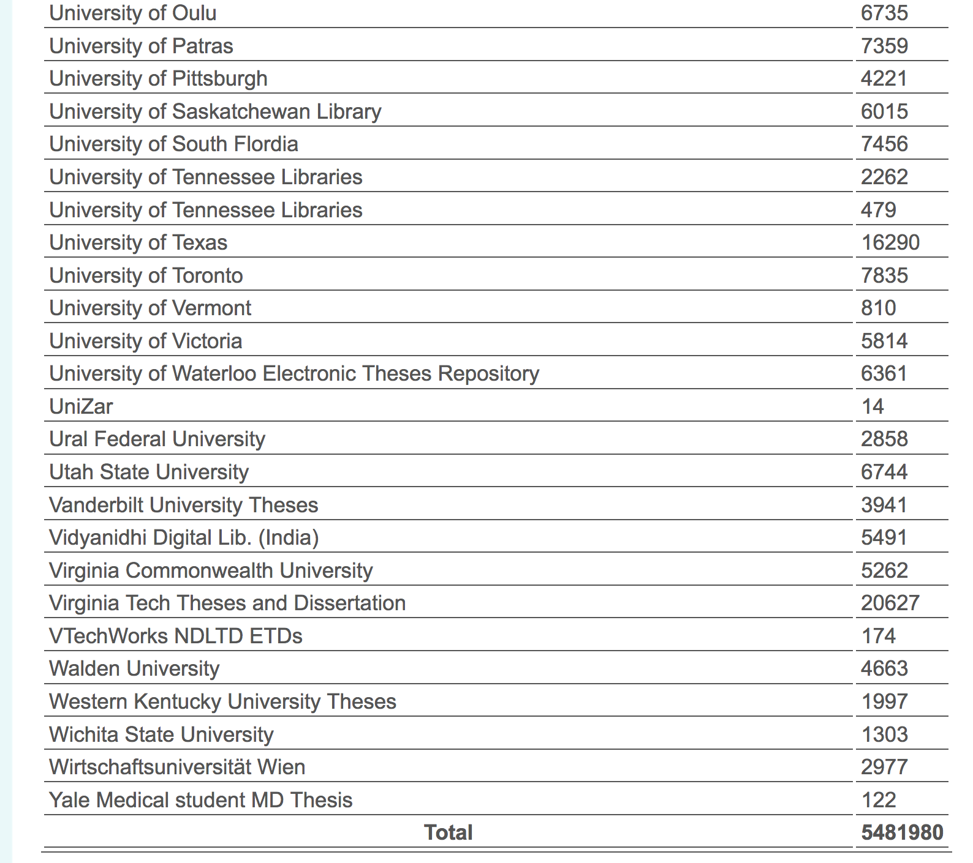

Slide 30
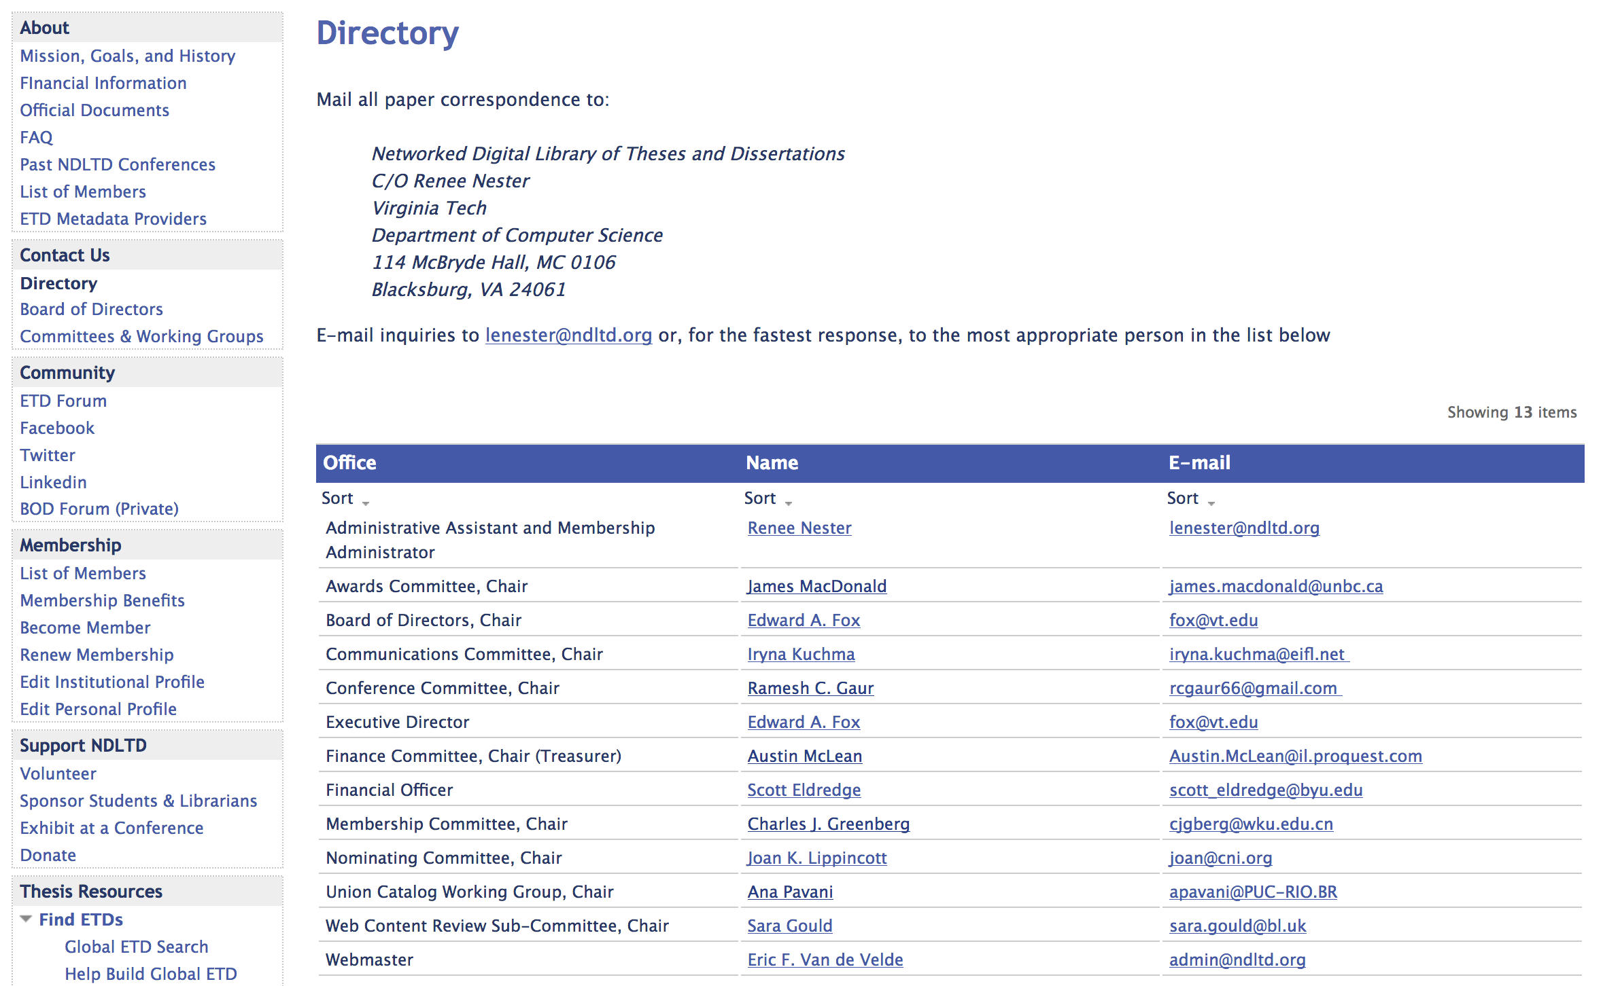

Slide 32
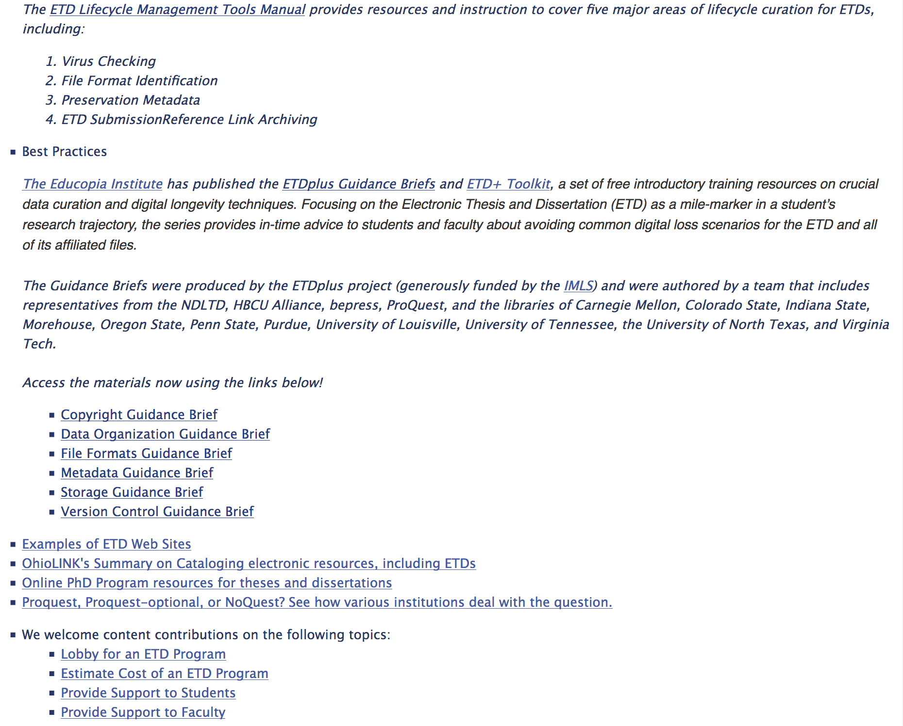

Slide 33
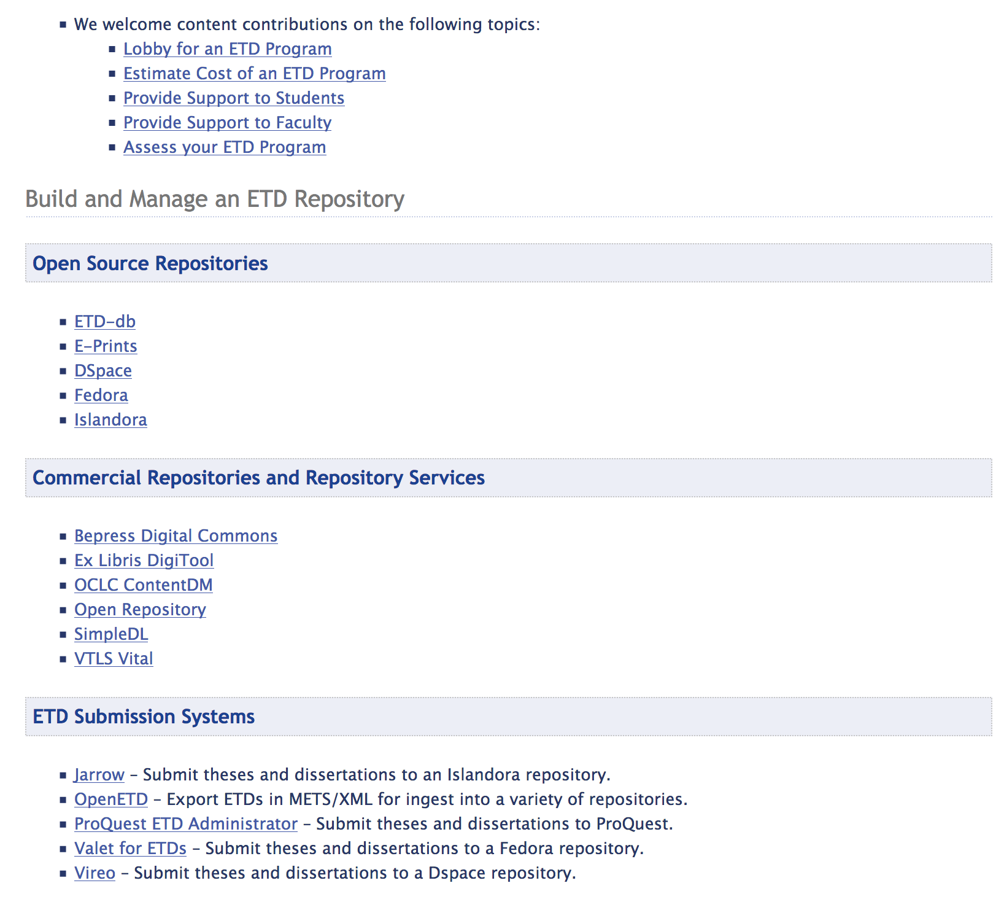

Slide 35
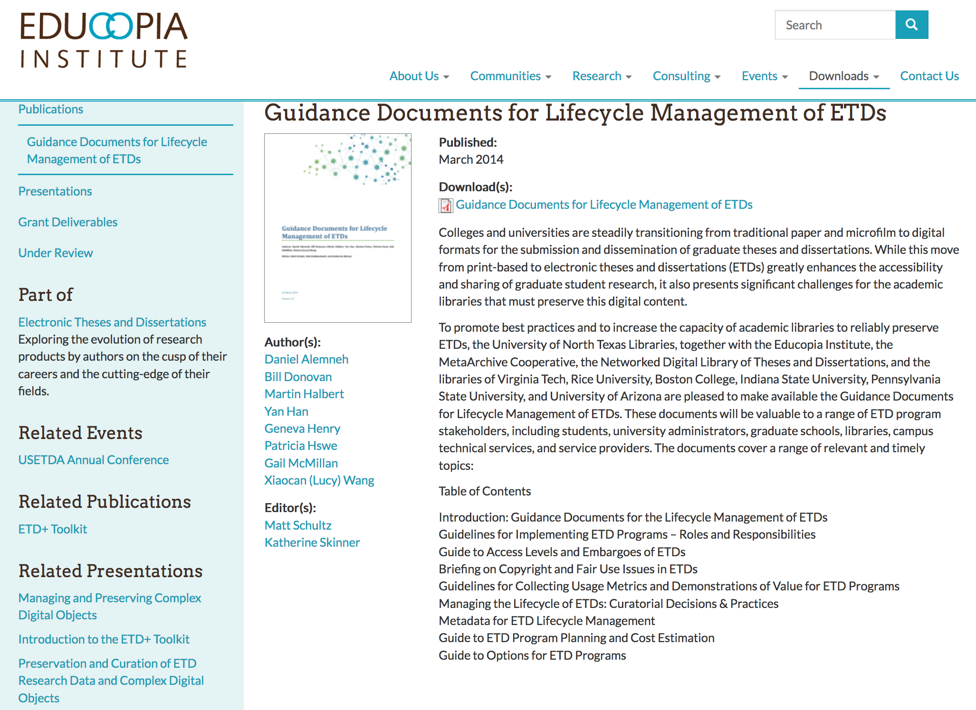

Slide 36
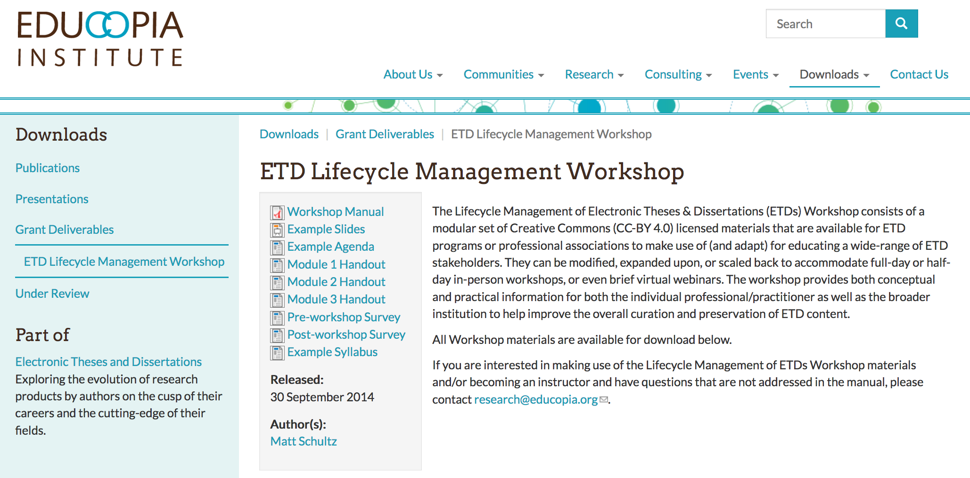

Slide 37
