Slide 1
ETD 2018 Keynote
(NCL, Taiwan – 26 September 2018)
“Applications for Big Data Analysis for the
Worldwide Collection of ETDs” by Edward A. Fox
fox@vt.edu http://fox.cs.vt.edu
Dept. of Computer Science, Virginia Tech
Blacksburg, VA 24061 USA
Exec. Director, Chairman of Board, NDLTD

Slide 2
Outline
Introduction
Big Data
Broader Perspective
Analysis

Slide 3
Introduction
Acknowledgments, Libraries of the Future
Related Grants, Library Infrastructure
Big Data
  Aspects
  Content as well as Computing, Networking
  Rich ETDs
  Many types of content

Slide 4
Acknowledgements
ETD 2018 organizers, NDLTD, and Worldwide ETD Initiative
Mentors (Licklider, Kessler, Salton)
Virginia Tech, CS, Digital Library Research Laboratory (DLRL)
IMLS, NSF and other sponsors
Students, colleagues, co-investigators (selected):
Ghaleb Abdulla, Monika Akbar, Hamed Alhoori, Pranav Angara, Abigail Bartolome, Warren Bickel, Boots Cassel, Saurabh Chakrvarty, Prashant Chandrasekar, Yinlin Chen, Kiran Chitturi, Lois Delcambre, Noha ElSherbiny, Alexandre Falcao, Weiguo Fan, Eric Fouh, Chris Franck, Rick Furuta, Ayush Ganotra, Lee Giles, Marcos André Gonçalves, Doug Gorton, Islam Harb, S.M. Shamimul Hasan, Bill Ingram, Tarek Kanan, Andrea Kavanaugh, Nadia Kozievitch, Abhinav Kumar, Spencer Lee, Sunshin Lee, Jonathan Leidig, Lin Tzy Li, Liuqing Li, Yi Ma, Yufeng Ma, Mohamed Magdy, Madhav Marathe, Uma Murthy, Sanghee Oh, Pranav Nakate, Sung Hee Park, Denilson Pereira, Jeffrey Pomerantz, Sagnik Ray Choudhury, Naren Ramakrishnan, Chandan Reddy, Rao Shen, Clifford Shaffer, Steve Sheetz, Don Shoemaker, Ziqian Song, Venkat Srinivasan, Amirsina Torfi, Ricardo Torres, Xinyue Wang, Barbara Wildemuth, Zhiwu Xie, Seungwon Yang, Xiaoyan Yu, Xuan Zhang, ...

Slide 5
VT Dissertations
Yinlin Chen, "A High-quality Digital Library Supporting Computing Education: The Ensemble Approach", http://hdl.handle.net/10919/78750
Sung Hee Park, "Discipline-Independent Text Information Extraction from Heterogeneous Styled References Using Knowledge from the Web", 2013, http://hdl.handle.net/10919/52860
W. Ryan Richardson, "Using Concept Maps as a Tool for Cross-Language Relevance Determination", 2007, http://hdl.handle.net/10919/28191
Xuan Zhang, “Product Defect Discovery and Summarization from Online User Reviews”, 2018

Slide 6
Libraries of the Future
JCR Licklider, 1965, MIT Press
World
Nation
State
City
Community

Slide 7
Related Current Funded Grants
IMLS LG: Developing Library Cyberinfrastructure Strategy for Big Data Sharing and Reuse; Zhiwu Xie, Tyler Walters, E. Fox, Pablo Tarazaga; + U. N. Texas
IMLS RE: Continuing Education to Advance Web Archiving, Zhiwu Xie, Edward A. Fox; GWU, LANL, IA, ODU, U. Waterloo
NSF CRISP : Coordinated, Behaviorally-Aware Recovery for Transportation and Power Disruptions (CBAR-tpd), Clemson: Pamela Murray-Tuite; VT: Edward Fox, Kris Wernstedt; U. Mich: Seth Guikema
NSF IIS: Global Event and Trend Archive Research (GETAR), VT: Fox, Chandan Reddy, Andrea L. Kavanaugh, Donald J. Shoemaker; Internet Archive: Jefferson Bailey

Slide 8
IMLS: Developing Library Cyberinfrastructure
Strategy for Big Data Sharing and Reuse
3 patterns for Library Big Data Services

Slide 9
Outline
Introduction
Big Data
Broader Perspective
Analysis

Slide 10
Big Data
Variety: content elements and types, disciplines, formats, languages, levels, styles
Velocity: peak submission times, urgent need by researchers
Volume: many millions, large files (images, videos, datasets, etc.), worldwide

Slide 11
Locating Digital Libraries in Computing and
Communications Technology Space
Digital Libraries technology
trajectory: intellectual
access to globally distributed information
Communications
(bandwidth, connectivity)
Computing (flops)
Digital content
Note: we should consider 4 dimensions: computing, communications,
content, and community (people)
less
more

Slide 12
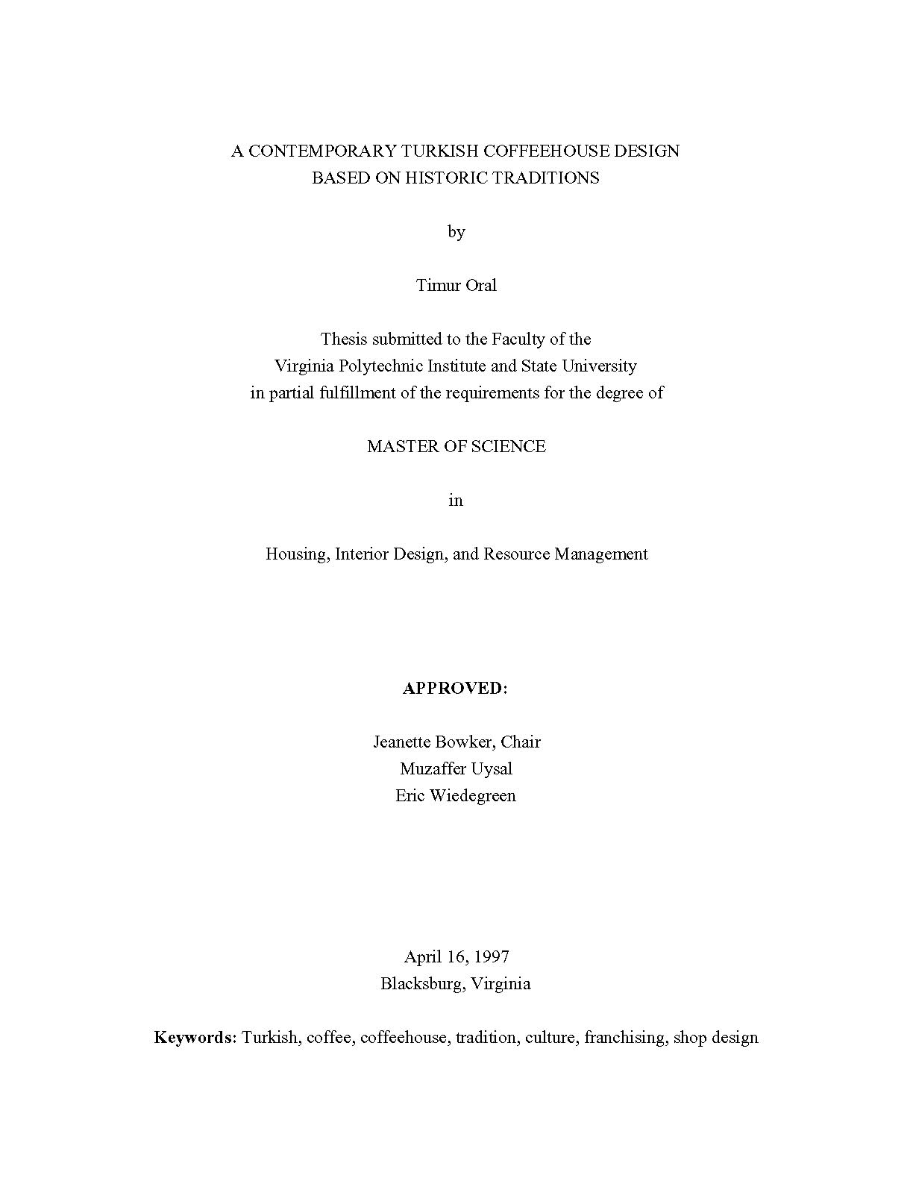

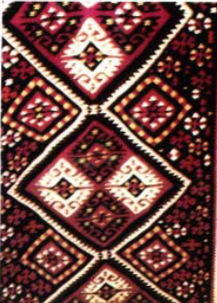
http://scholar.lib.vt.edu/theses/available/etd-2227102539751141/
Notes:
http://scholar.lib.vt.edu/theses/available/etd-2227102539751141/
What is an ETD? What it can look like:
It can have the appearance of a paper document.
It can contain a video clip.
It can contain sound.
It can contain thumbnail pages and links to aid navigation.
It can have a unique layout.
It can have photomicrographs.
It can contain a simulation.
The library resources used in an ETD initiative can include

Slide 14
Outline
Introduction
Big Data
Broader Perspective
Analysis

Slide 15
Broader Perspective
Workshop on Social Aspects of DLs
Life Cycle of Information
Life Cycle + Quality Aspects
5S Framework
Scenarios / Services of a Rich DL across the Lifecycle
Collecting Metadata (OAI/PMH)
Collection Quality

Slide 16
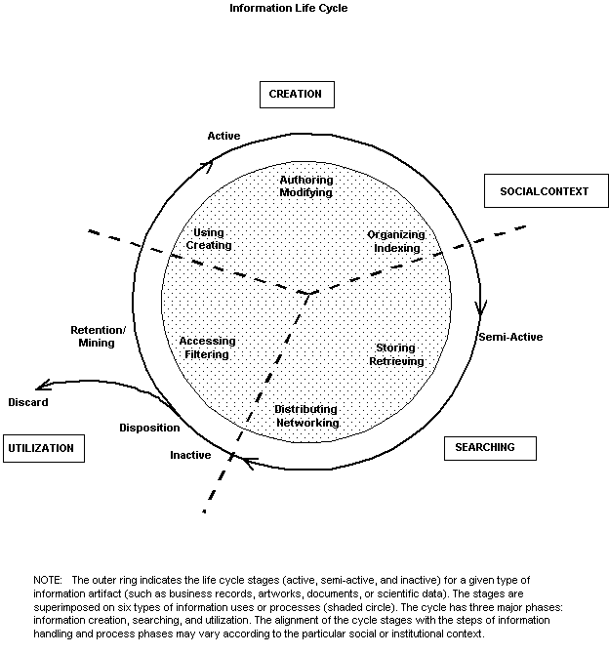
Information
Life
Cycle
Borgman et al.:
Workshop Report on
Social Aspects of
Digital Libraries:
http://www.dlib.org/dlib/january97/01clips.html
Notes:
Thanks to Christine Borgman and others at this workshop.

Slide 17
Information Life Cycle
Creation
Active
Authoring
Modifying
Social Context
Using
Creating
Organizing
Indexing
Retention
/ Mining
Accessing
Filtering
Storing
Retrieving
Semi-
Active
Utilization
Distributing
Networking
Inactive
Searching
Notes:
This is a simplification of the previous slide.

Slide 18
Quality and the Information Life Cycle

Slide 19
5S Layers
Societies
Scenarios
Spaces
Structures
Streams

Slide 20
Informal 5S & DL Definitions
DLs are complex systems that
help satisfy info needs of users (societies)
provide info services (scenarios)
organize info in usable ways (structures)
present info in usable ways (spaces)
communicate info with users (streams)

Slide 22
OAI - Open Archives Initiative: Technical Umbrella for
Practical Interoperability…
Metadata Harvesting
Reference
Libraries
Museums
Publishers
E-Print
Archives
…that can be exploited by different communities

Slide 23
The World According to OAI
Service Providers
Discovery
Current
Awareness
Preservation
Metadata
harvesting
Data Providers

Slide 24
Quality Dimensions

Slide 25
Outline
Introduction
Big Data
Broader Perspective
Analysis

Slide 26
Analysis
Survey
ContentMine
Supporting Services across the Lifecycle
Classification (to aid browsing, searching)
Summarization
Opening Graduate Research

Slide 27
Survey
Sample of researchers in key areas:
  bibliometrics, computational social science,
  computer science, digital libraries, information retrieval,
  machine learning, natural language processing,
  scholarly communication, science of science,
  web search and mining, and science policy.
18 respondents expressed strong interest in:
  data (e.g., citations, figures),
  software (e.g., knowledge extraction),
  research questions (e.g., summarizing long documents)
Percentage | Indicated:
74 | mining ETDs is valuable for their research communities
53 | highly likely to use an ETD infrastructure for their own research
68 | new collaborations would emerge as a result of this

Slide 28
ContentMine
ContentMine.org <info@contentmine.org>
Cesar Gomez <cesar@contentmine.org>
Peter Murray-Rust pm286@cam.ac.uk
Projects include:
Find, download, analyse: open access works
Convert among formats
Extract information from graphs, tables
Extract chemical reactions, equations.
Create Dictionaries...and much more.

Slide 29
Supporting Services across the Lifecycle

Slide 30
ETD Classification:
Algorithm Pipeline
ETDs categorized into a node of the category tree (after classification)
Category
Tree
ETD Collection
Category label for each node used as query
ETD metadata used for categorization
Categorized
ETDs
Google
Naïve Bayes Classifiers
Level-wise categorization
Top 50 webpages (for each node in the tree)
Training
Browsing
Web
Interface
Document
Sets
Training
Sets
Cleanup
(stemming,
stopword removal,
etc.)
Venkat Srinivasan: See DL Book 3 Ch. 4

Slide 31
Summarization
To multilingual concept maps
  Dissertation of Ryan Richardson
Big Data Text Summarization
  Current CS course for seniors, grad students
  Summarizing each chapter of each VT ETD
Related Deep Learning Work
  Recent dissertation of Xuan Zhang

Slide 32
Baseline 1: Textsum
An attention-based sequence-to-sequence model (Bahdanau et al., 2014).
  Implemented based on the Textsum Project (a site-package of TensorFlow)
Bahdanau Attention Model for Machine Translation

Slide 33
Baseline 2: Pointer-Generator Networks
Pointer-Generator Networks (See et al., 2017), state-of-the-art model for SDS task
Pointer-Generator Text Summarization Model with “Pointer” and “Coverage” Mechanisms

Slide 34
Proposed: RNN-CNN Encoder + RNN Attention Decoder

Slide 35
Opening Graduate Research
Pilot project
  Collecting: Initially > 30,000
  Segmenting: chapters
  Extracting: tables, figures, equations, references
  Analyzing: parsing references to database form
  Providing expanded access
  Sharing datasets
Software for universities, regions/nations
  For local versions of above

Slide 36
Summary
Introduction
Big Data
Broader Perspective
Analysis

Slide 37
Questions?
Discussion?
Thank You!
fox@vt.edu

