Slide 1
Architecting A Cloud-native Data Analysis Application for ETDs
Yinlin Chen & Edward A. Fox
{ylchen, fox}@vt.edu
Virginia Tech, Blacksburg, VA 24061, USA
26 Sept. Presentation at ETD 2018, Taiwan

Slide 2
Agenda
Introduction
Monolithic vs. Cloud-native applications
Cloud-native approach
Data analytics architecture
Future work

Slide 3
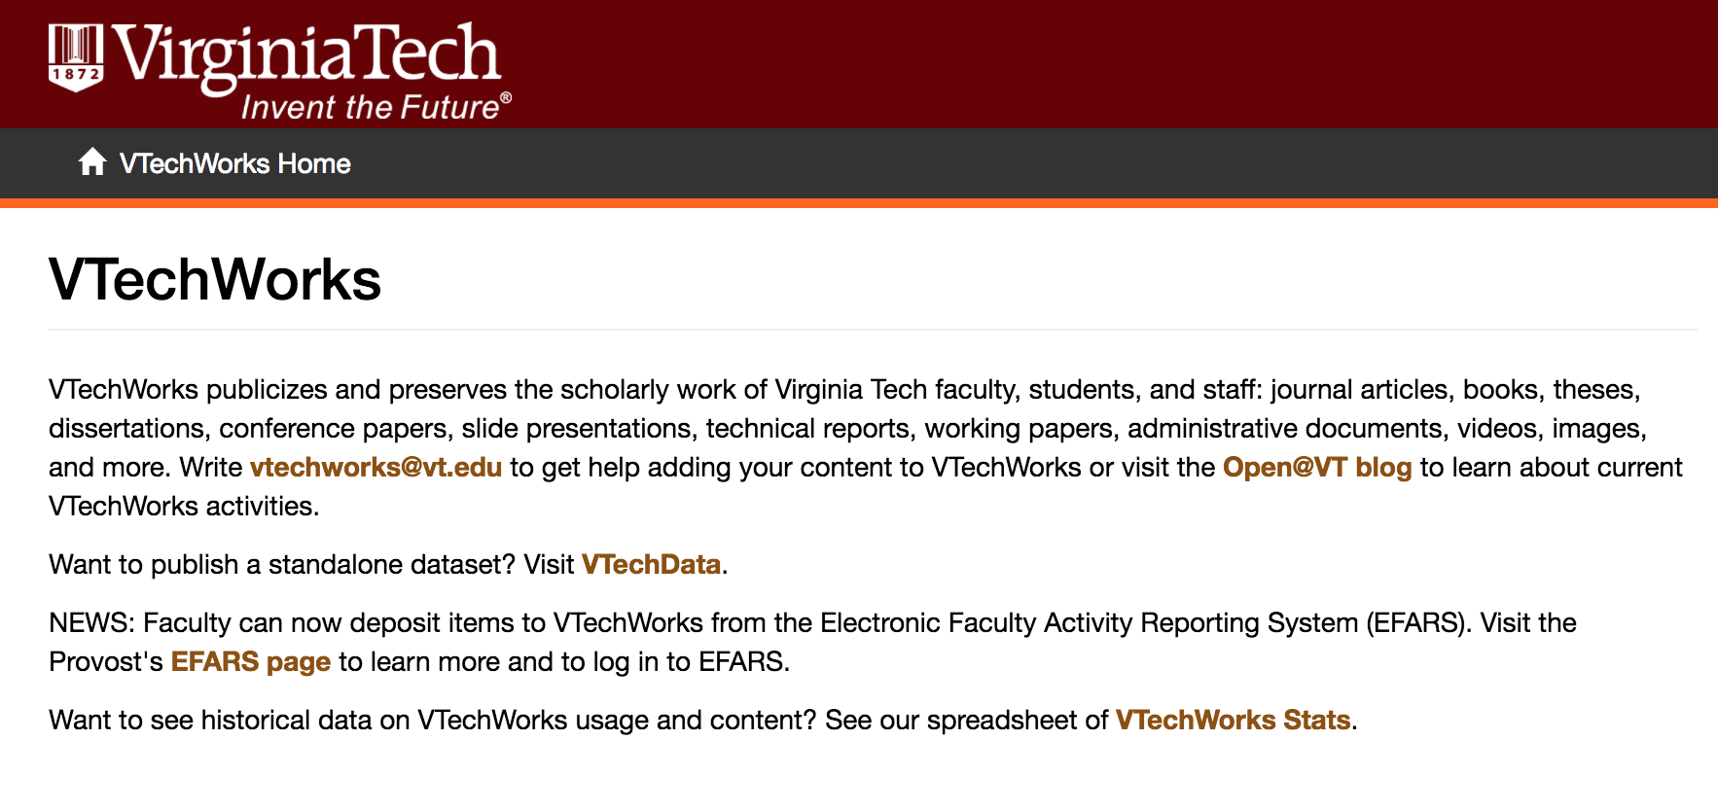
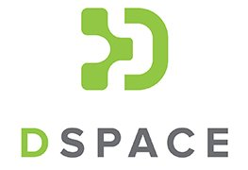
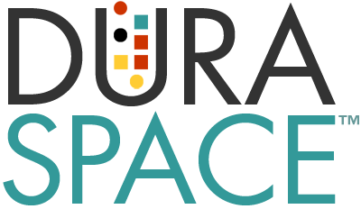
VTechWorks
Research Documents
60,000+ scholarly works
Inc. 30,000+ ETDs
Using DSpace
Open digital repository
Open source project
Monolithic architecture

Slide 4
Problems
Need for advanced analytics functionalities
Customizable
Visualization
Usable and flexible user interface (UI)
Extending existing codebase is a difficult task.
Customization that meets community needs is rare.
Version update will lose or break customized functionalities.
Notes:
We have faced problems with updates also re Drupal and its plugins.

Slide 5
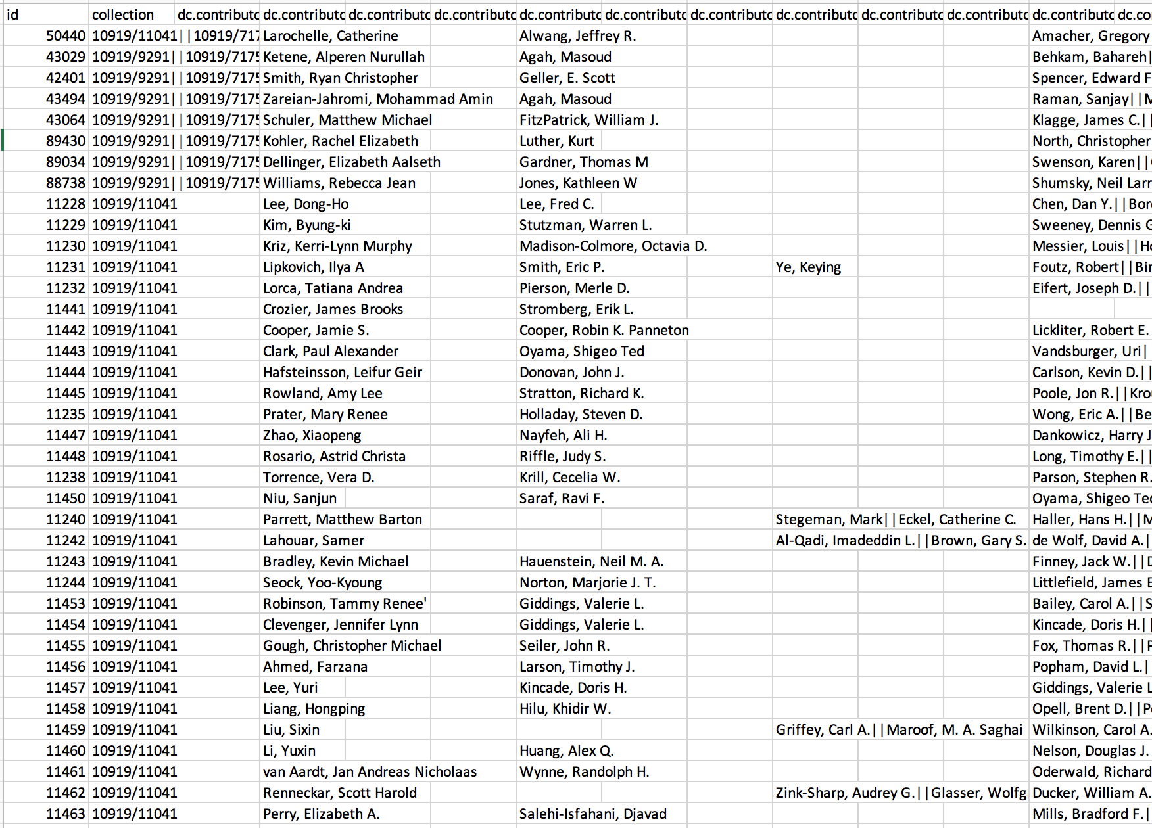
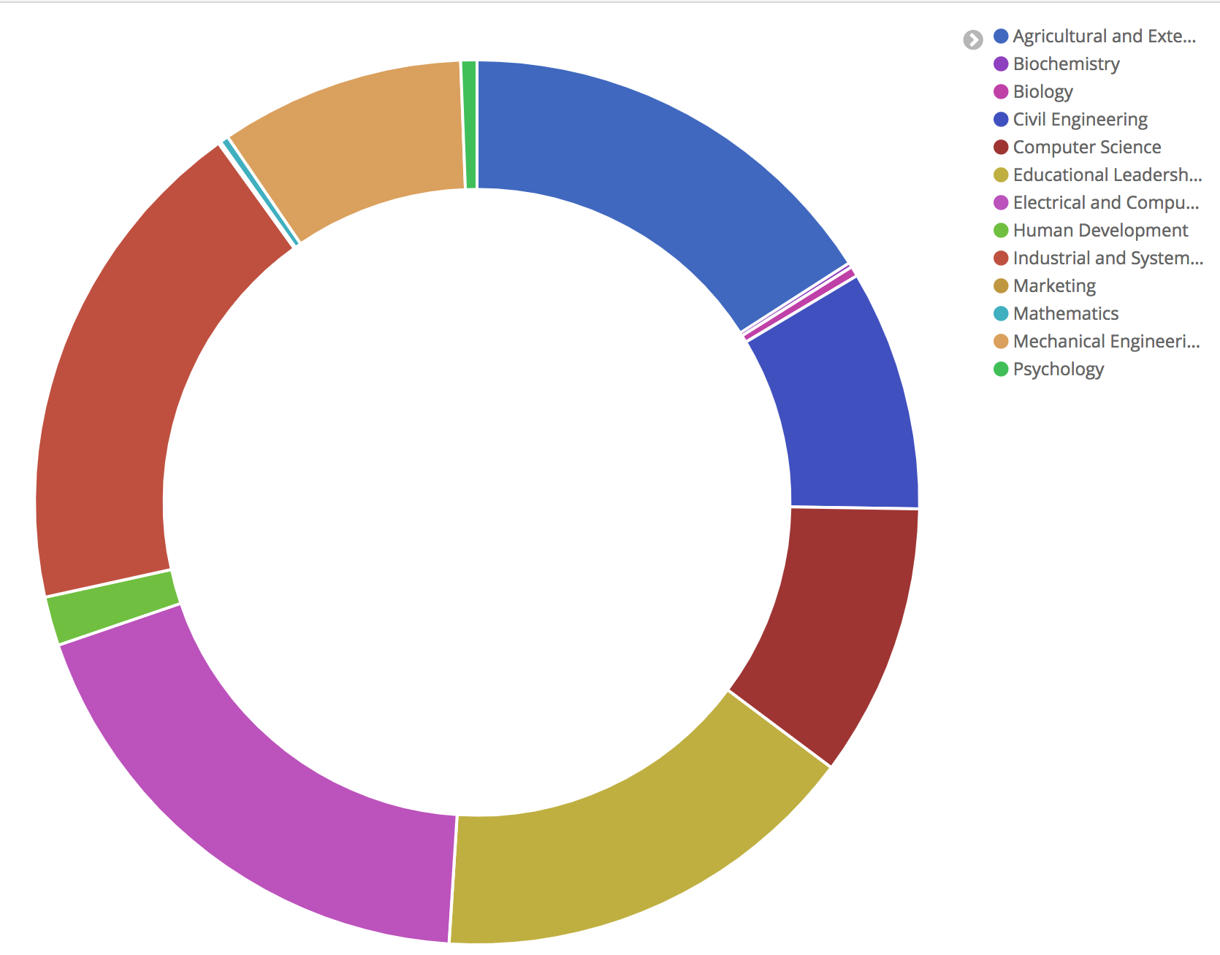
From Research Dataset to Visualization
Categorized by Department

Slide 6
From Log Data to Visualization
Notes:
Anything being logged during 12 hour period on 1/20/2018
Kibana support the Auto function

Slide 7
Agenda
Introduction
Monolithic vs. Cloud-native applications
Cloud-native approach
Data analytics architecture
Future work

Slide 8
Monolithic Architecture
Develop and deploy as a single unit
Often requires human intervention
Long-term commitment to a technology stack or even version
Hard to scale development
Difficult to scale the application
Notes:
Hard to adopt/replace a new technology

Slide 9
Why Towards Cloud Native
Limited resources:
Developers, DevOps, Infrastructure, Time
Reduce need to build everything from scratch
Use services that can help deliver the project
Facilitate the development process
Provide better services: fault-tolerant, auto-scale, update/rollback without downtime, etc.
Optimize resource utilization
Notes:
Use some technique provided by the cloud, not build everything by ourselves. Security, backup, scaling
Cloud ecosystem.
Service is hosted in the cloud, integrated in the cloud.

Slide 10
Resource Usage Optimization and Automation
Consume only the required resources for the applications
Scale up and down automatically
Service and function oriented, not server oriented
Utilize cloud services to help understand applications (CloudWatch, Auto Scaling, Trusted Advisor, etc.)
Notes:
Segment application into microservices
Pay as you go
Utilize cloud services to help you understand your application and keep evolving

Slide 11
Agenda
Introduction
Monolithic vs. Cloud-native applications
Cloud-native approach
Data analytics architecture
Future work

Slide 12
What is Cloud Native?
It is not just putting applications in the cloud.
It is about building applications in the cloud that utilize the advantages provided by the cloud
AS MUCH AS POSSIBLE.

Slide 13
Cloud Native
Cloud Native Computing Foundation (CNCF)
An open source software foundation dedicated to making cloud native computing universal and sustainable
Microservices oriented
Containerized
Dynamically orchestrated

Slide 14
Microservices oriented
Notes:
Microservices oriented. Applications are segmented into microservices. This significantly increases the overall agility and maintainability of applications.

Slide 15
Microservice
Small software piece
Messaging enabled – communicate with messages
Decentralized
Autonomously developed
Independently deployable
Can change independently of each service
Scale individually by load
Built and released with automated processes
More complex architecture

Slide 16
Serverless
Does not mean “There are no servers at all”.
Does mean “Use fully managed services”.
Focus on application development,
not server maintenance
Notes:
Besides microservice, we want to be serverless (i.e., we don’t have to manage a machine or its OS or base software).
Based on our settings, it then dynamically manages the allocation of machine resources.
Not only reduces our work on maintenance, but also helps reduce human errors
Problems like server down or auto-restart, do not require user intervention

Slide 17
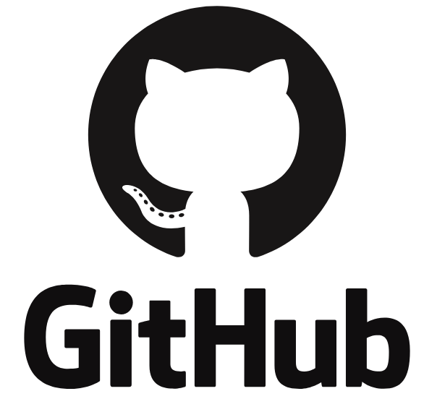
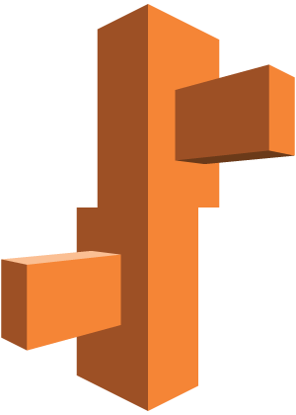
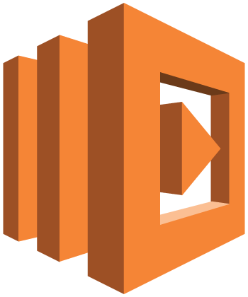
Parallel Development and Deployment
Configure
Stacks
Application
AWS Elastic Beanstalk
AWS
Lambda
Application
Amazon API Gateway
Notes:
Restful API endpoints
Serverless APIs

Slide 18
Containerized
Notes:
Containerized. Each part (applications, processes, etc) is packaged in its own container. This facilitates reproducibility, transparency, and resource isolation.
Build docker image

Slide 19
Containerization
BaaS (Backend as a Service), CaaS (Container as a Service), and FaaS (Function as a Service)
Best practice is each service in its own isolated environment, e.g., Docker container.
But a container can run multiple services, or an entire application.
Everything at Google runs in a container
4 Billion containers per week in 2018

Slide 20
Dynamically orchestrated

Slide 21
Orchestration
Infrastructure as Code
Automatic deployment and operation
Optimize resource utilization dynamically
Notes:
Dynamically orchestrated. Containers are actively scheduled and managed to optimize resource utilization, according to machine readable definition files.
Automatically deploy and destroy the containers. Consume only the resources needed.

Slide 22
Data Analytics Pipeline
Collect
Store
Process
Analyze &
Visualize
Notes:
ETD metadata and log data goes through this pipeline.
Librarians can focus on last part: analyze and visualize

Slide 23
Design Pattern and Best Practice
The Twelve-Factor App (http://12factor.net)
Codebase | Dependencies | Config
Backing services | Build, release, run | Processes
Port binding | Concurrency | Disposability
Dev/prod parity | Logs | Admin processes
Notes:
Orange font: Applied to the design of the application
Black: Didn’t apply or relevant to the design of the application. E.g. Lambda is built with massive concurrency and scale and is designed to execute as stateless processes as always. We don’t need to make extra effort to apply “Processes” and “Concurrency” principle that already come in nature.

Slide 24
Design Strategies
Microservices
Containers
Orchestration
Serverless (managed service)
Scalability
Automation
Optimization (resource usage, cost, etc.)

Slide 25
Agenda
Introduction
Monolithic vs. Cloud-native applications
Cloud-native approach
Data analytics architecture
Future work

Slide 26
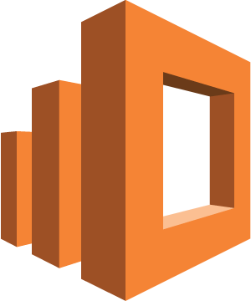
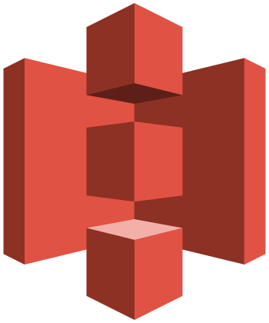
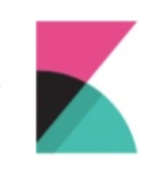
Application Architecture Overview
Amazon
ElasticSearch
S3 Bucket
Files upload
VTechWorks Repository
with ETD Data & Logs
Amazon S3
AWS
Lambda
Kibana
S3 Bucket
Amazon DynamoDB
Notes:
Batch upload – ETD metadata & Server logs

Slide 27
AWS Services
AWS S3: Object storage in the cloud
AWS Lambda: Serverless compute platform for stateless code execution in response to events
Amazon Dynamodb: Fully managed NoSQL database service
Amazon ElasticSearch: Search engine based on Lucene
Kibana: An open source data visualization plugin for ElasticSearch

Slide 28
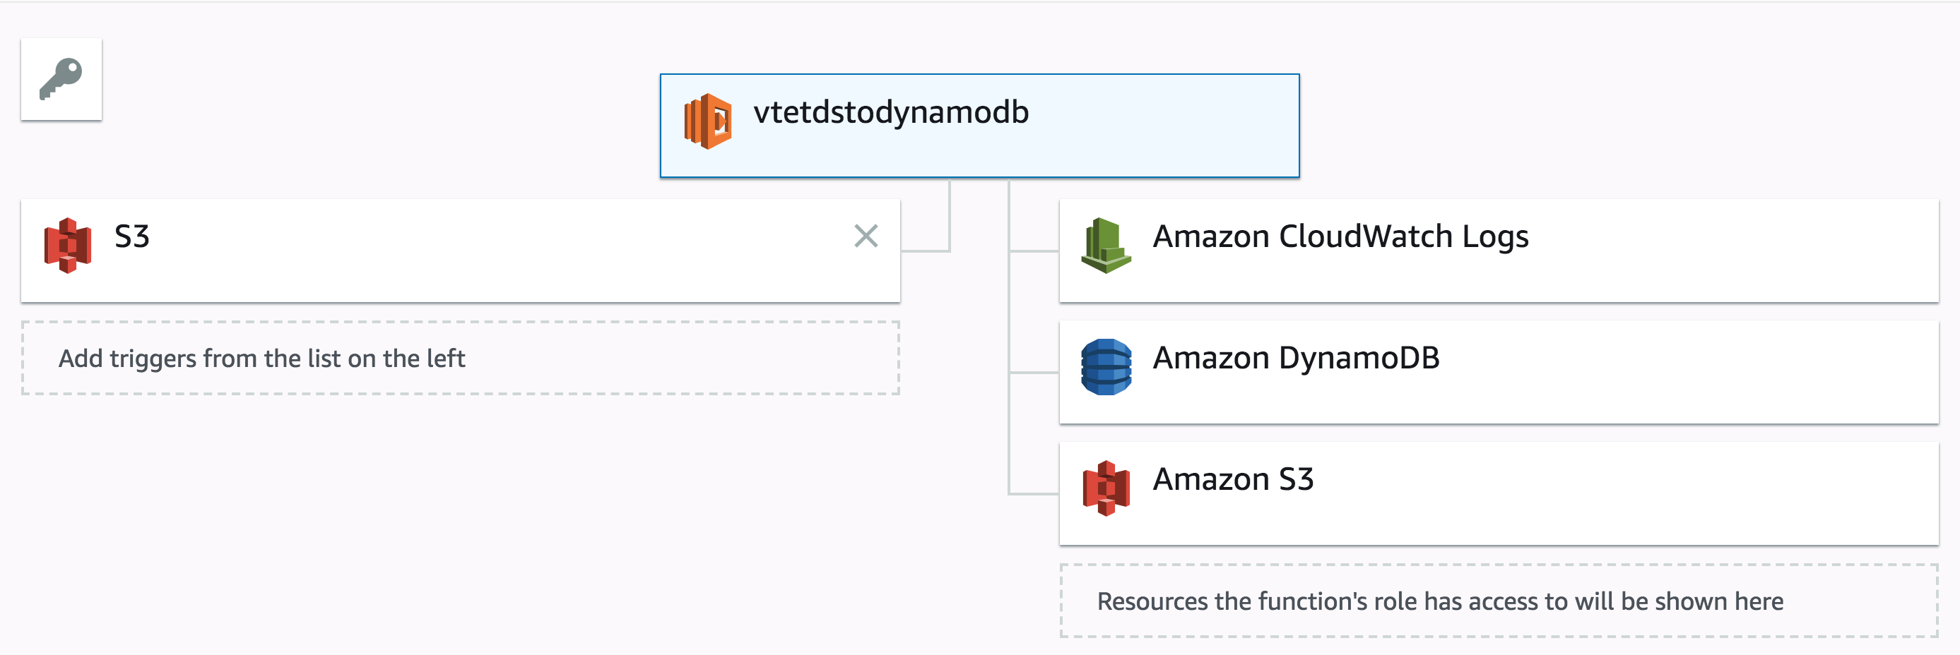
Microservice – Using AWS Lambda
Notes:
Dr. Chen wrote these two. First moves our data to the DB. Second moves data to ElasticSearch. They use Lambda to apply these functions.

Slide 29
Metadata Transformation Using AWS Lambda

Slide 30
Log Data Transformation Using AWS Lambda
"2018-01-30T08:13:13.200Z","192.168.2.6","prod_log: 202.248.84.158 vtechworks.lib.vt.edu [30/Jan/2018:03:13:15 -0500] GET /bitstream/handle/10919/33268/WGraf_Thesis_2005.pdf?sequence=1 HTTP/1.1 Mozilla/5.0 (Windows NT 6.3; WOW64; Trident/7.0; rv:11.0) like Gecko"

Slide 31
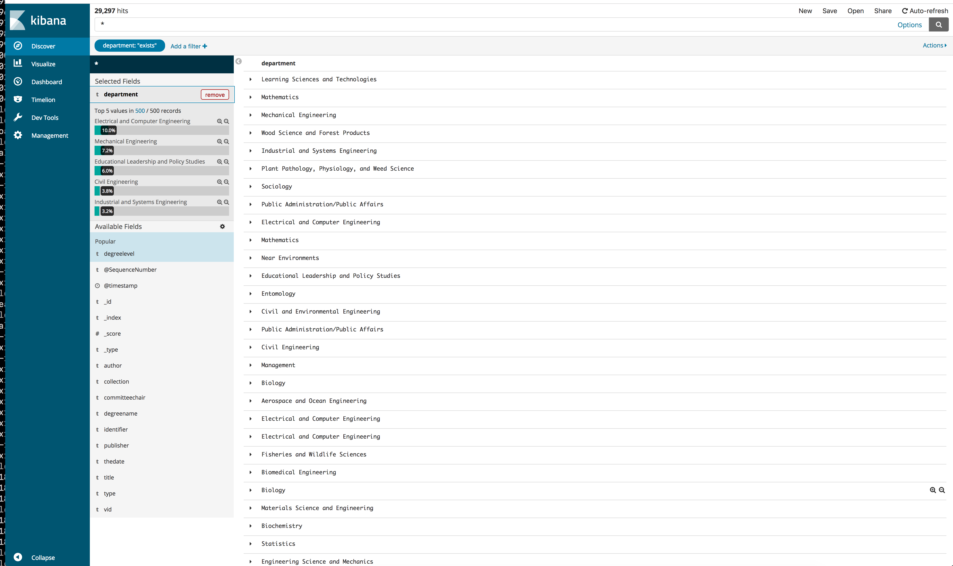
Visualization – Kibana

Slide 32
Results
Facilitate application development
Parallel development and deployment
Switch services or techniques more flexibly
Decouple the data analytics pipeline
More complex architecture and testing setup
More things to learn in order to select right tools
Delegate maintenance tasks to cloud providers

Slide 33
Agenda
Introduction
Monolithic vs. Cloud-native applications
Cloud-native approach
Data analytics architecture
Future work

Slide 34
Data analytics pipeline in AWS
Collect
Store
Process & Analyze
Visualize
Real-time
Amazon Kinesis Firehose
Data Import
Amazon Import/Export Snowball
Message Queuing
Amazon SQS
Web/app Servers
Amazon EC2
Object Store
Amazon S3
Amazon Glacier
Real-time
Amazon Kinesis Streams
RDBMS
Amazon RDS
NoSQL
DynamoDB
Search
Amazon CloudSearch
IoT
Amazon IoT
Hadoop Ecosystem
Amazon EMR
Real-time
AWS Lambda
Amazon Kinesis Analytics
Data Warehousing
Amazon Redshift
Machine Learning
Amazon Machine Learning
Elastic Search Analytics
Amazon ElasticSearch
Process & Move Data
AWS Data Pipeline
Business Intelligence & Data Visualization
Amazon QuickSight
Elastic Search Analytics
Amazon ElasticSearch
Blue: current
Green: alternate
Black: other possible

Slide 35
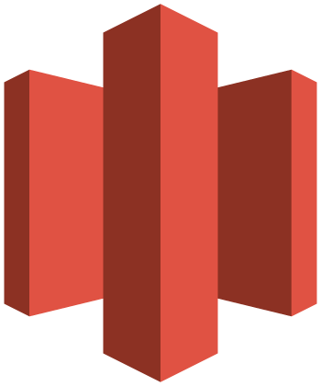
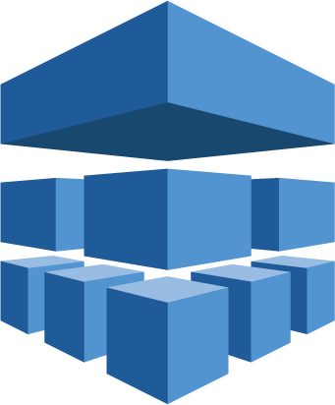
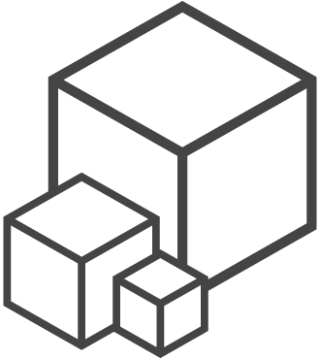
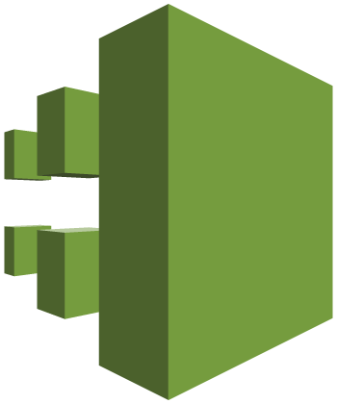
Cloud Native Data Analysis Platform in AWS
IAM
AWS Organizations
AWS
Lambda
Amazon DynamoDB
Amazon
ElasticSearch
Security & Identity
Compute & Database
Amazon S3
Amazon Glacier
Kibana
*Amazon Athena
*Amazon Machine Learning
AWS CLI
Storage
Analytics
AWS CloudFormation
AWS CloudTrail
AWS Trusted Advisor
Amazon CloudWatch
AWS Config
Management
Notes:
* Future work: green caption
Amazon Athena: Query S3 data
Amazon Machine Learning: Build ML models

Slide 36
Other Cloud Platforms
Amazon Web Services (AWS) - done
Google Cloud Platform (GCP) – easily done
Microsoft Azure, etc. – also possible
AWS | GCP | Azure
Elastic Compute Cloud | Compute Engine | Virtual Machines
Elastic Beanstalk | Google App Engine | Cloud Services
EC2 Container Service Kubernetes (EKS) | Kubernetes Engine | Container Service (AKS)
Lambda | Cloud Functions | Functions
Simple Storage Services | Cloud Storage | Storage
Virtual Private Cloud | Virtual Private Cloud | Virtual Network
Notes:
Chose the right tool

Slide 37
Q & A
Supported by
Virginia Tech Libraries and
AWS Cloud Credits for Research program
Thank You!
https://github.com/yinlinchen/ETD18

