Slide 1
Galileo Seminar
12 September 2018, Virginia Tech
“Information Research” by Edward A. Fox
fox@vt.edu http://fox.cs.vt.edu
Dept. of Computer Science, www.cs.vt.edu

Slide 2
Acknowledgements
Mentors (MIT: Licklider, Kessler; Cornell: Salton)
Virginia Tech, CS (ECE), Digital Library Research Laboratory (DLRL)
NSF and many other sponsors
Students, colleagues, co-investigators (selected):
Ghaleb Abdulla, Monika Akbar, Hamed Alhoori, Pranav Angara, Abigail Bartolome, Warren Bickel, Boots Cassel, Saurabh Chakrvarty, Prashant Chandrasekar, Yinlin Chen, Kiran Chitturi, Lois Delcambre, Noha ElSherbiny, Alexandre Falcao, Weiguo Fan, Eric Fouh, Chris Franck, Rick Furuta, Ayush Ganotra, Lee Giles, Marcos André Gonçalves, Doug Gorton, Islam Harb, S.M. Shamimul Hasan, Bill Ingram, Tarek Kanan, Andrea Kavanaugh, Nadia Kozievitch, Abhinav Kumar, Spencer Lee, Sunshin Lee, Jonathan Leidig, Lin Tzy Li, Liuqing Li, Yi Ma, Yufeng Ma, Mohamed Magdy, Madhav Marathe, Uma Murthy, Pranav Nakate, Sung Hee Park, Denilson Pereira, Sagnik Ray Choudhury, Naren Ramakrishnan, Chandan Reddy, Rao Shen, Clifford Shaffer, Steve Sheetz, Don Shoemaker, Ziqian Song, Venkat Srinivasan, Amirsina Torfi, Ricardo Torres, Xinyue Wang, Zhiwu Xie, Xiaoyan Yu, Xuan Zhang, ...
DL Curriculum: Sanghee Oh, Jeffrey Pomerantz, Barbara Wildemuth, Seungwon Yang

Slide 3
Where Can You Fit in CS?
CS Looking Outward:
CS – Looking Inside:
Interaction: Games, Graphics, HCI, VR/AR
Programming: Algorithms, Languages, Problem Solving, Workflows
Simulation: Agents, Modeling: Epidemiology
KID: Knowledge, Information, Data: AI, Machine Learning
HPC <-> PC <-> GPU
Networking
Programming
  Algorithms,
  Languages,
  Problem Solving
  Workflows
Systems
Theory

Slide 4
Current Funded Grants
IMLS LG: Developing Library Cyberinfrastructure Strategy for Big Data Sharing and Reuse; Zhiwu Xie, Tyler Walters, Edward Fox, Pablo Tarazaga; with University of North Texas
IMLS RE: Continuing Education to Advance Web Archiving, Zhiwu Xie, Edward A. Fox; GWU, LANL, IA, ODU, U. Waterloo
Mayfair Group: Deposition Summarization; Naren Ramakrishnan and Edward Fox
NIH: The Social Interactome of Recovery: Social Media as Therapy Development; Warren K. Bickel (VTCRI), Fox …
NSF CRISP : Coordinated, Behaviorally-Aware Recovery for Transportation and Power Disruptions (CBAR-tpd), Clemson: Pamela Murray-Tuite; VT: Edward Fox, Kris Wernstedt; U. Mich: Seth Guikema
NSF IIS: Global Event and Trend Archive Research (GETAR), VT: Fox, Chandan Reddy, Andrea L. Kavanaugh, Donald J. Shoemaker; Internet Archive: Jefferson Bailey

Slide 5
Design of
INFORMATION
Access
Extraction
Representation
Retrieval
Systems
Technology
Theory
Viz
Libraries
Archives
Multimedia
Hypermedia
Text
WWW
Hypertext
Images
Search Engine
Crawling
Webpage
Links
Videos
Machine Learning
Mining
Analytics
Deep Learning
Relational
NLP
AI
Statistics
Database
Tables
Data
Knowledge

Slide 6
Information Life Cycle
Creation
Active
Authoring
Modifying
Social Context
Using
Creating
Organizing
Indexing
Retention
/ Mining
Accessing
Filtering
Storing
Retrieving
Semi-
Active
Utilization
Distributing
Networking
Inactive
Searching
Notes:
This is a simplification of the previous slide.

Slide 8
Informal 5S & DL Definitions
DLs are complex systems that
help satisfy info needs of users (societies)
provide info services (scenarios)
organize info in usable ways (structures)
present info in usable ways (spaces)
communicate info with users (streams)

Slide 9


Slide 10
DL Curriculum Framework
Introduction

Slide 11
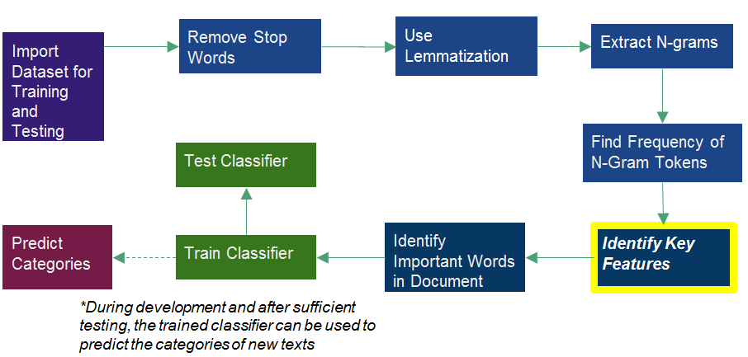
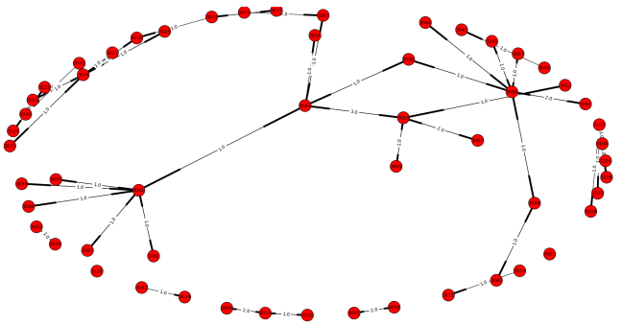
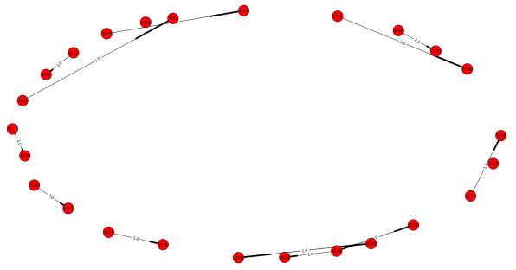
Communication Analysis in the Social Interactome
Text Classification
Abigail Bartolome, Advised by Dr. Edward A Fox
NIH Grant: 1R01DA039456-01
The Social Interactome of Recovery: Social Media as Therapy Development
Acknowledgements to Dr. Chris Franck, Prashant Chandrasekar, Lexie Mellis
Virginia Tech CS 4994, April 2016
Multinomial, naïve-Bayes classification considers the count for each feature name in making classifications
Training the classifier: built a corpus of 150 documents– 75 of which were sentences that were clearly indicative of belonging to a success story and 75 of which were sentences that were not indicative of a success story
Acknowledgements to Victoria Worrall for her efforts on this classifier last semester
Network Structures
Lattice Network | Small-world Network
128 participants | 128 participants
22 users in the most connected component | 4 users in the most connected component
Queried the Friendica database to see who the participants wrote text to and who the participants received text from
Generated graph of the private messaging communication in the lattice social network
Samples of Story Classification
Lattice Network with Administrator Removed
Small-Network with Administrator Removed
"Since being in recovery I have not been around any drugs or alcohol but if I had to, such as a wedding or something I wouldn't have a problem saying that I don't drink or I'm in recovery." => success
'Drove very drunk.' => not_success

Slide 12
ETANA-DL Architecture
DigBase and DigKit
Lahav
D
A
T
A
B
A
S
E
W
R
A
P
P
E
R
S
Search
U
S
E
R
I
N
T
E
R
F
A
C
E
Browse
Nimrin
Recommend
Umayri
ETANA-DL
UNION
CATALOG
Note
Hisban
Personalize
Megiddo
Review
Jalul
Visualizations
Archaeology
Specific
…
New Sites

Slide 13
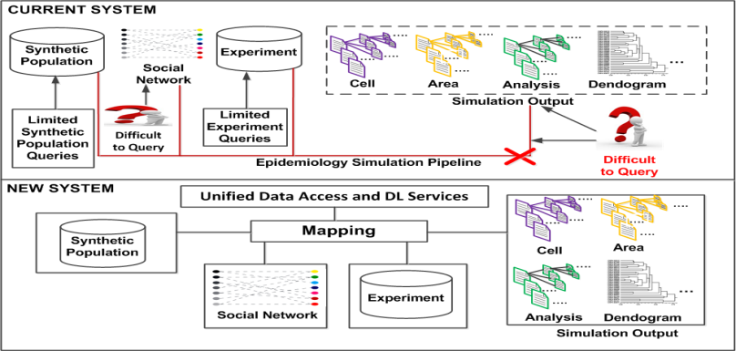



Data Mapping Framework in a Digital Library with Computational Epidemiology Datasets
S.M.Shamimul Hasan, Sandeep Gupta, Edward A. Fox, Keith Bisset, Madhav Marathe ⁻⁻⁻ Virginia Tech (CS, BI)

Slide 14
IMLS: Developing Library Cyberinfrastructure
Strategy for Big Data Sharing and Reuse
3 patterns for Library Big Data Services

Slide 15
Archiving and Analyzing using Bigdata Hadoop cluster

Slide 16

Integrated Digital Event Archive and Library (IDEAL) stakeholders
Notes:
Help affected communities to recover more quickly and effectively
Provide global network with relevant information and resources
Support the research community, emergency personnel, decision makers, and the public in reacting to and recovering from crises

Slide 17
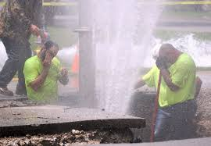
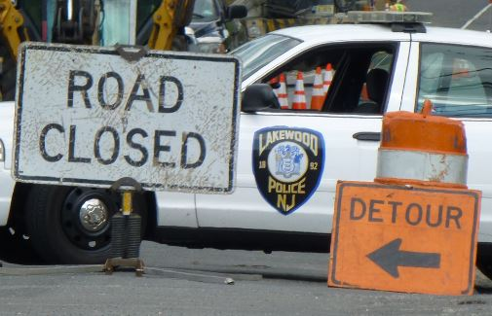
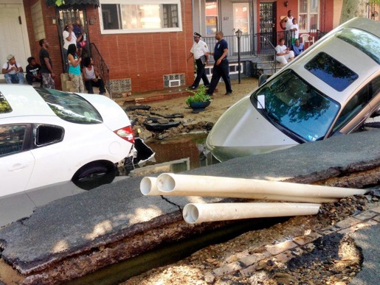
Who is involved in a WMB ?
Fix water pipe
  Water utility
  city/town utility
Traffic
  Police
Affected
  Citizen
Others …
Lakewood, NJ, June. 2014
West Philadelphia, PA, June. 2015
Notes:
Click “NewYork” in user_city_s
See organization: FDNY, MTA (Metropolitan Transportation Authority), NYU
Person name: De Blasio
Hashtags, Mentions

Slide 18
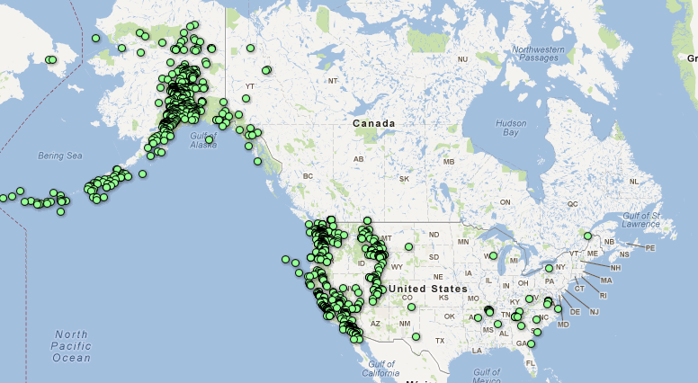
What Causes Water Main Breaks? Earthquakes (USGS)
Mar. 1 – Apr. 5, 2012
Notes:
Search earthquake
Histogram: March 2014, May 2015 => not Winter
Location Name: Fullerton, CA; La Habra, CA; Brea CA

Slide 19
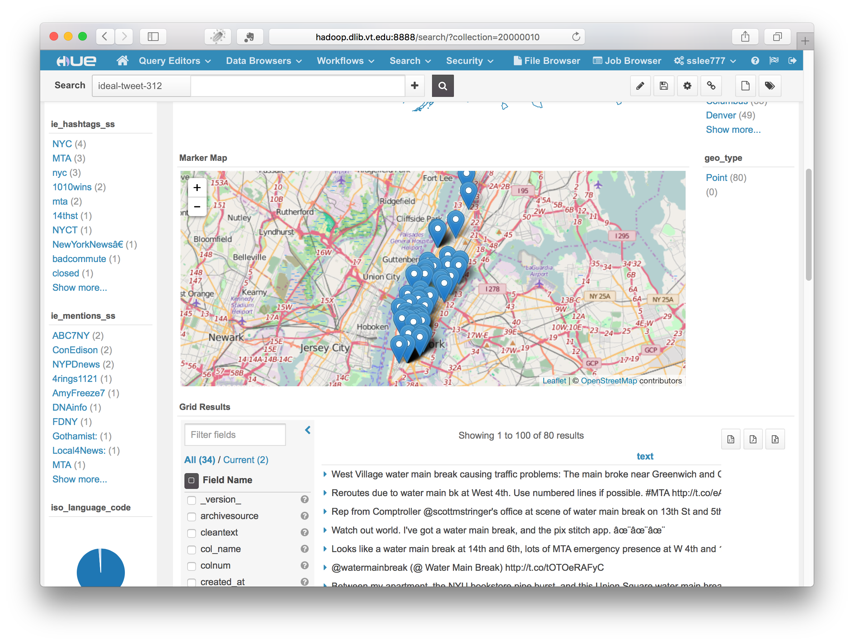

Slide 20
GETAR Architecture
Global Event and Trend Archive Research

Slide 21
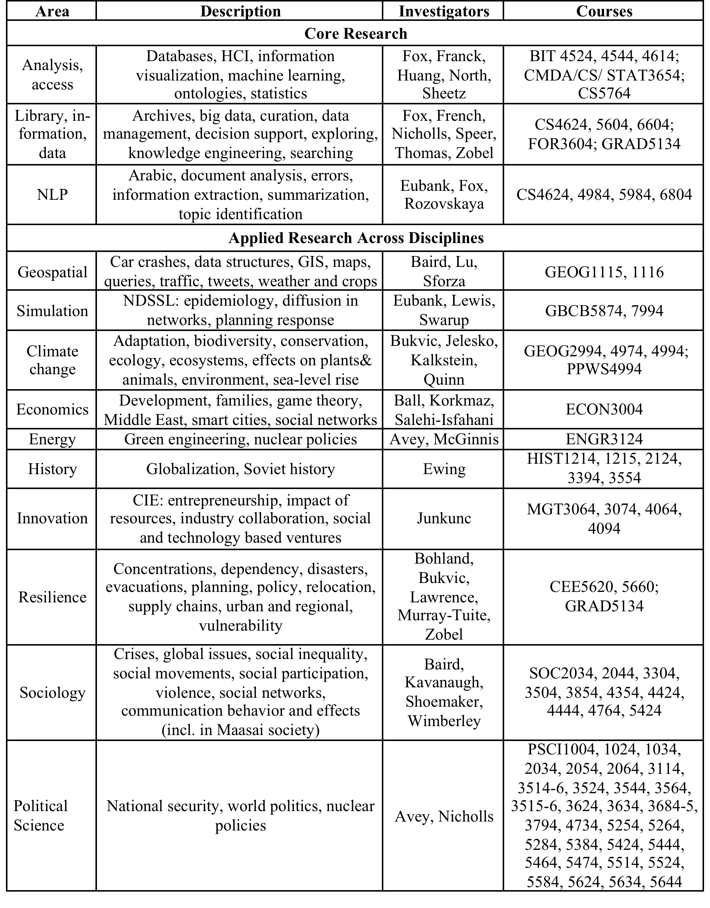
GETAR:
Areas,
Investigators,
Courses

Slide 22
Questions?
At least learn: Computational Thinking
Volunteers and students from high school to Ph.D.
http://fox.cs.vt.edu
Feel free to contact: fox@vt.edu

