Slide 1
Closing Session ETD 2017: 20th Int’l Symposium of the NDLTD Washington, D.C., USA; August 7-9, 2017 Edward A. Fox Executive Director, Chairman of the Board NDLTD, www.ndltd.org fox@vt.edu http://fox.cs.vt.edu/talks/2017 Professor, Department of Computer Science Virginia Tech, Blacksburg, VA 24061 USA

Slide 2
Thanks for ETD 2017!
Organizers, Presenters, Attendees – 122:
Country | Count | Country | Count
Bangladesh | 1 | Brazil | 1
Canada | 3 | Great Britain | 2
Hong Kong | 3 | India | 15
Sri Lanka | 1 | Peru | 1
Taiwan | 4 | USA | 91

Slide 3
NDLTD Mission
Post-secondary
education
Scholarly
communication
ETD initiative
Library,
information &
computing sciences

Slide 4
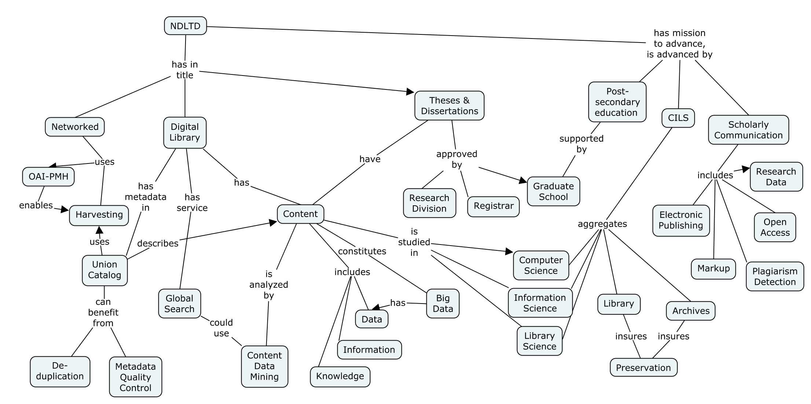

Slide 5
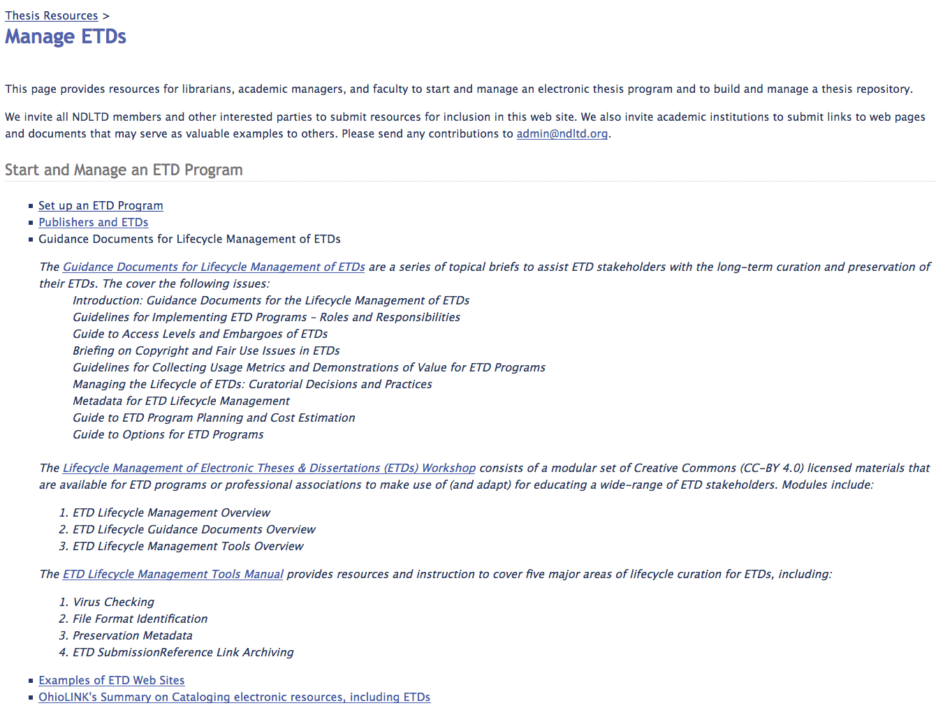

Slide 6
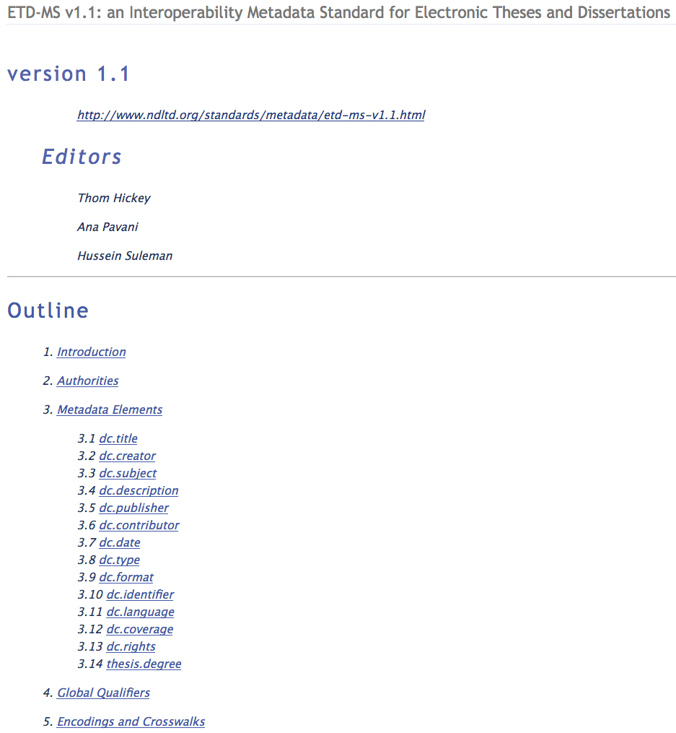

Slide 7
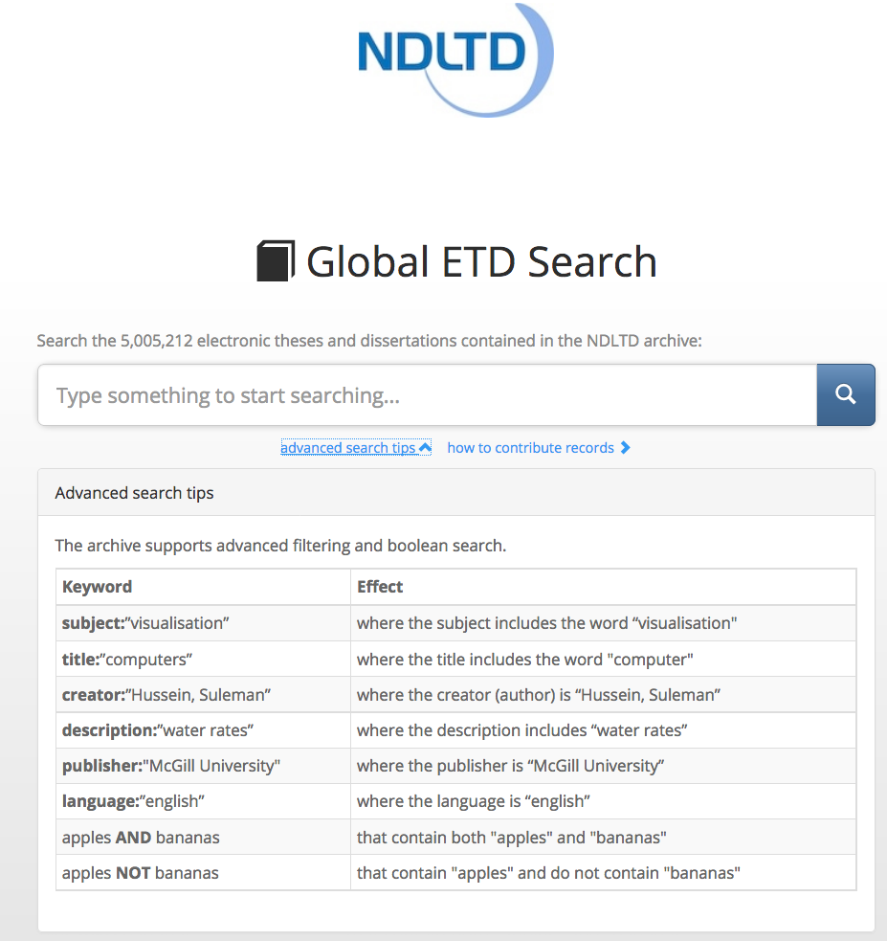

Slide 8
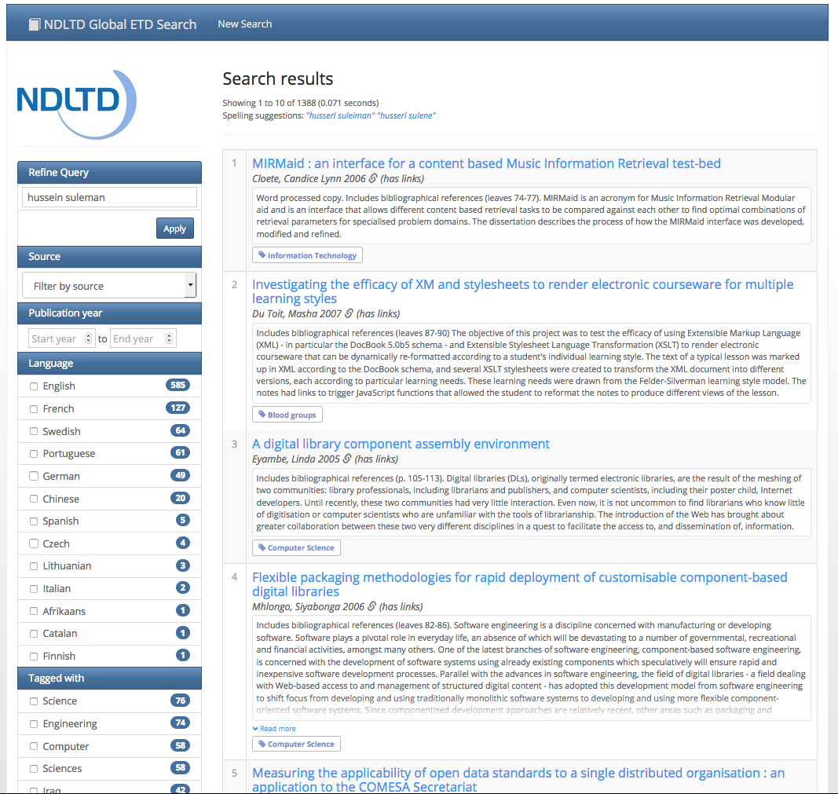

Slide 9
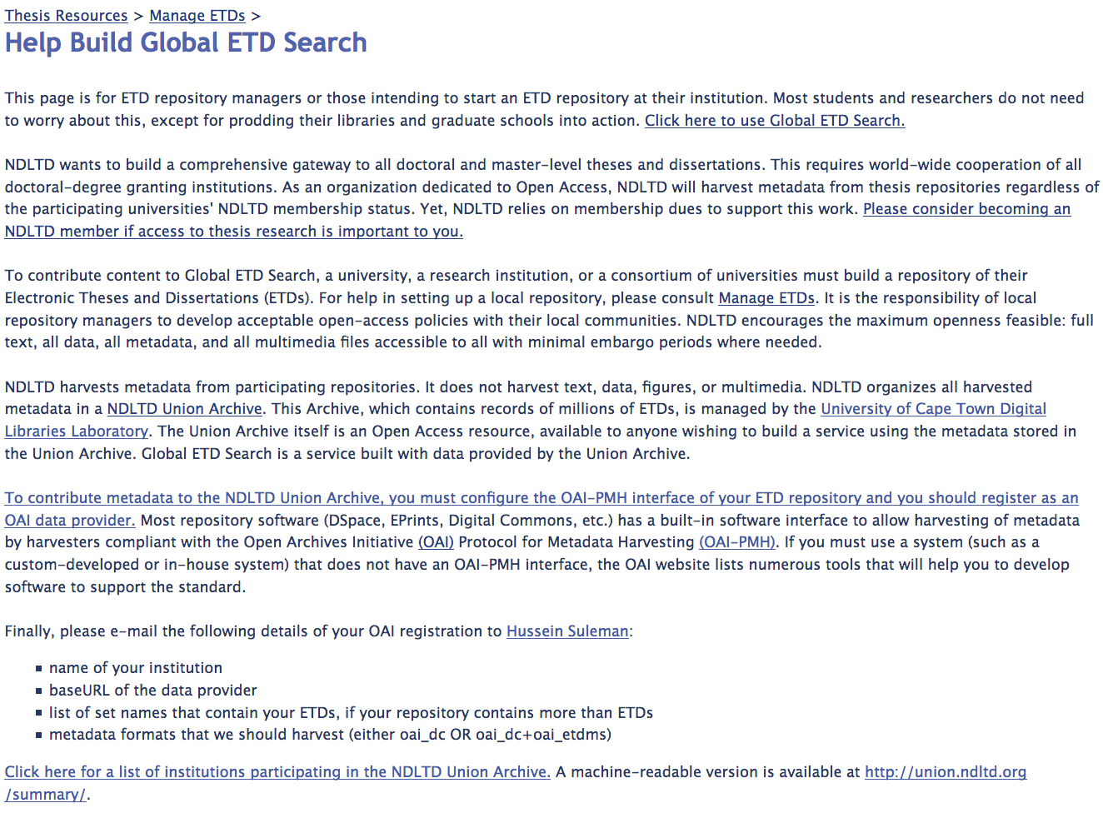

Slide 10
20th Anniversary NDLTD Links
News entry: http://www.ndltd.org/events/news/20yearsofetdsandndltdbriefly
20th anniversary short document:
https://drive.google.com/open?id=0B6G_HvAHMBqFUGIzZVZFVzI0b3c

Slide 11
Other NDLTD Links
ndltd.org
http://search.ndltd.org/
http://union.ndltd.org/portal/
http://www.ndltd.org/resources/manage-etds/help-build-global-etd-search
http://www.ndltd.org/about/membership
http://www.ndltd.org/membership-benefits/become-a-member
Listserv: etd@ndltd.org

Slide 12
Next Year (Coming up)
USA:
USETDA 2018 - Denver
Global:
ETD 2018 - Taiwan

Slide 13
Questions? Discussion? Recommendations?
Thank You!
fox@vt.edu fox@ndltd.org http://fox.cs.vt.edu http://ndltd.org

