Slide 1
Scenarios for Advanced Services in an ETD Digital Library ETD 2017: 20th Int’l Symposium of the NDLTD Washington, D.C., USA August 7-9, 2017 Yufeng Ma, Tingting Jiang, Chandani Shrestha, Edward A. Fox Virginia Tech, Blacksburg, VA 24061 USA Jian Wu, C. Lee Giles Pennsylvania State University, University Park, PA 16802 USA http://fox.cs.vt.edu/talks/2017/20170807ETD2017etdseer.pptx (, pdf)

Slide 2
Acknowledgments
NSF through grant IIS-1423337
IMLS through grant LG-71-16-0037-16
Virginia Tech
Penn State
NDLTD

Slide 3
Outline
Introduction
Advanced Scenarios
Table Overview
8 Scenarios
Key Approaches
Building upon Existing Technologies
Structured Data Extraction
Text Generation
Network Visualization
Conclusion
References

Slide 4
Introduction
Vast community of ETD authors
Even large community who could benefit from ETDs: students, faculty, researchers, scholars, authors, organizations, . . .
5 million works in NDLTD Union Catalog
NDLTD Global Search: faceted search/browse using metadata
Google Scholar: articles, author profiles, citation data, recommendations based on My Citations, alerts, metrics
CiteSeerX: documents (summary, citations, active bibliography, co-citation, clustered docs, version history), authors, citation data, tables
Need for methods and systems for book-size objects

Slide 5
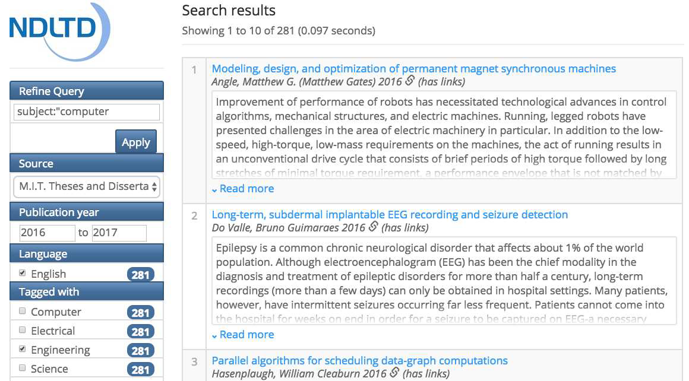
NDLTD Global Search example

Slide 6
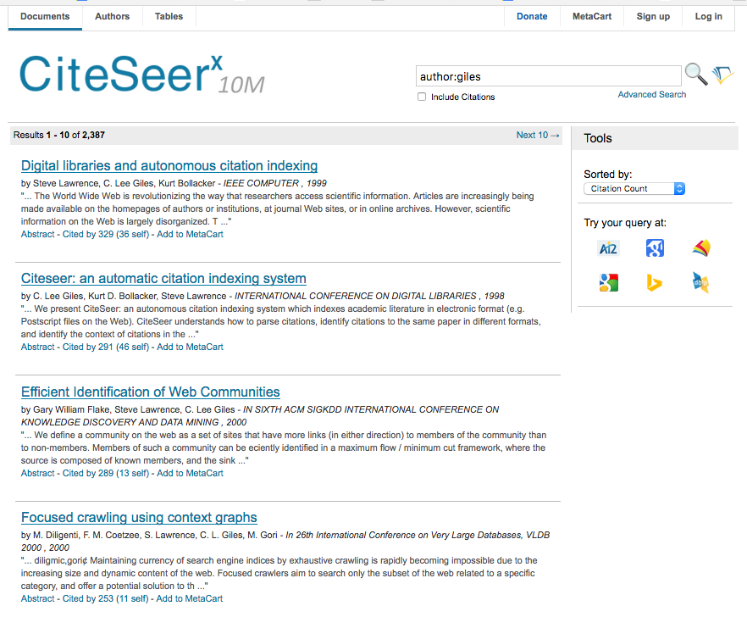
CiteSeerX example

Slide 7
Advanced Scenarios Utilizing ETDs
Stakeholders | Requirements | Expected Outputs
Cross Cutting | Faceted Browsing | Categorized exploration of ETDs
 | Filtered Searching | Metadata-based discovery of ETDs
 | Summarization | Synthesis of search results
 | Visualization | Linking of related content
Student Researcher | Aspect-specific access | Specific ETDs, e.g., within a date range or with an advisor name
 | Match research question interests | Desired ETDs with quality scores Research questions/hypotheses highlighted
 | Reference extraction | Related ETDs/books/articles/papers Tabular/Canonical representations Downloadable package of related work Lists of journals and conferences
 | ETD analysis, Generation of study aids | ETD content summarizations Figures, tables, and equations Key sections and list of related problems Visualizations (social/bibliometric networks) Timeline overview of evolutionary work
 | Linking of problems With methods | Different methods for a problem A site with detailed resources An award winning paper (outline/draft)
Faculty Researcher | Research problem exploration aid | Synthesis of related ETDs Proposed approached and solutions Future works summarization
Graduate Instructor | Advanced topics, Lecture preparation | Slides cover research question/problems Synthesis of provided potential solutions
 | Graduate course syllabus formulation | Draft with a hierarchical topical outline Link to each topical entry with a reading list
Conference Organizer | TPC member identification (ID) | List of advisor research faculty names Ranking tables of advisors
 | Potential participants ID | Subgraph of the ETD-derived citation graph CSV file of author names, contact info
Journal Editor | Peer-reviewer ID | Research interest-based reviewer list
 | Content originality check | Previous publications of the authors Estimated percentage of new content/work

Slide 8
Scenario 1: Identify a reading list
NS = new graduate student: vague interests, unclear research questions
NS searches and finds ETDs of interest
ETDseer produces
table (works, quality measures)
clusters (each a group of related research questions)
NS selects some, then receives:
Reading list: relevant references (in canonical form)
Supplement: figures, tables, equations
Optional: social/bibliographic networks

Slide 9
Scenario 2: Collect approaches to a research problem
SR = student researcher
SR identifies challenging research problem
SR finds: 3 different approaches, but lacks details, comparisons
ETDseer: extends the analysis; for each approach produces:
Summarization table
List of ETDs related
List of Source code sites
List of Datasets: including training and testing data
Values useful for comparison (e.g., time period, # publications)

Slide 10
Scenario 3: Create award-winning paper template
SR = student researcher
Almost completed ETD
SR wants to win best paper award at prestigious conference
ETDseer does deep analysis of prior award winning papers (& ETDs)
ETDseer produces a skeleton for the desired paper, from SR’s ETD
Detailed outline
List of tables, List of figures
Equations
References

Slide 11
Scenario 4: Identify collaborators
FR = faculty researcher
FR describes a research problem requiring collaboration
ETDseer produces a summary along with:
List of ETDs selected (related to research problem)
List of documents in their related work sections
List of approaches/solutions in the middle of those ETDs
List of open problems in ETD conclusion or future work sections
FR gives feedback: preferences, priorities
ETDseer produces summary, with shortlist of potential collaborators
Contact info, Brief bio-sketches, Notes (complementing FR’s background)

Slide 12
Scenario 5: ETD quality evaluation
UA: university administrator
UA seeks assessment of the quality of a locally submitted ETD
ETDseer produces a report from that ETD:
Counts of elements (references, equations, figures, tables)
Histogram of citations to key prior works of the author
Degree of match between the research problem and the proposed method
Summary of experimental results

Slide 13
Scenario 6: Prepare course syllabus and lecture slides
GI: graduate instructor, teaching a new advanced course
GI prepares course related materials on a specific research topic
ETDseer responds with a list of related ETDs
ETDseer constructs a draft course syllabus:
Using clustering, topic analysis, summarization
Includes hierarchical topical outline + summaries for each entry
Includes reading list = ETDs + open source pubs cited in ETDs
GI describes a specific problem for course focus
ETDseer produces list of related ETDs, categorized according to:
Problem statements, Research questions, Solutions provided
Finally, ETDseer produces slides, lecture notes with:
Examples, Illustrations, Summary tables

Slide 14
Scenario 7: Organize a conference
CO: conference organizer
CO prepares a list of topics from the conference announcement
ETDseer produces a candidate list of potential members of technical PC
Identifies related ETDs, Extracts advisors of authors of those ETDs
Extracts authors of highly cited ETDs (at least 5 years old)
Ranks on h-index, citation counts, ETD weight in research group
CO prepares a list of keywords related to the conference theme
ETDseer produces a list of potential conference authors, attendees
Identifies related ETDs, Builds citation graph, Extracts authors

Slide 15
Scenario 8: Manage a journal
JE: journal editor, seeking reviewers for a paper submission
JE constructs a query using keywords from the submission
ETDseer produces a list of researchers with related interests
It considers their ETDs + their recent publications
ETDseer produces a report to aid JE in checking the submission:
At least 30% original content relative to author’s prior works
Originality relative to works of the identified related researchers
Acceptability according to cloud plagiarism detection service

Slide 16
Advanced Scenarios Utilizing ETDs - top
Stakeholders | Requirements | Expected Outputs
Cross Cutting | Faceted Browsing | Categorized exploration of ETDs
 | Filtered Searching | Metadata-based discovery of ETDs
 | Summarization | Synthesis of search results
 | Visualization | Linking of related content
Student Researcher | Aspect-specific access | Specific ETDs, e.g., within a date range or with an advisor name
 | Match research question interests | Desired ETDs with quality scores Research questions/hypotheses highlighted
 | Reference extraction | Related ETDs/books/articles/papers Tabular/Canonical representations Downloadable package of related work Lists of journals and conferences
 | ETD analysis, Generation of study aids | ETD content summarizations Figures, tables, and equations Key sections and list of related problems Visualizations (social/bibliometric networks) Timeline overview of evolutionary work
 | Linking of problems With methods | Different methods for a problem A site with detailed resources An award winning paper (outline/draft)

Slide 17
Advanced Scenarios Utilizing ETDs - bottom
Stakeholders | Requirements | Expected Outputs
Faculty Researcher | Research problem exploration aid | Synthesis of related ETDs Proposed approached and solutions Future works summarization
Graduate Instructor | Advanced topics, Lecture preparation | Slides cover research question/problems Synthesis of provided potential solutions
 | Graduate course syllabus formulation | Draft with a hierarchical topical outline Link to each topical entry with a reading list
Conference Organizer | TPC member identification (ID) | List of advisor research faculty names Ranking tables of advisors
 | Potential participants ID | Subgraph of the ETD-derived citation graph CSV file of author names, contact info
Journal Editor | Peer-reviewer ID | Research interest-based reviewer list
 | Content originality check | Previous publications of the authors Estimated percentage of new content/work

Slide 18
Key Approaches: Building Upon Existing Technologies
NDLTD has relevant metadata
Pilot studies at VT have leveraged that to harvest thousands of PDFs
CiteSeerX, part of SeerSuite, has demonstrated key services
Mostly for CS or Chemistry-related works, with tables, figures
Using knowledge bases, heuristics, regular expressions, classifiers
Challenges beyond CiteSeerX methods:
All disciplines, all styles, all writing formats
Extracting passages and hard-to-specify text blocks: hypotheses
Need for robust, extensible methods

Slide 19
Key Approaches: Structured Data Extraction
Above-mentioned challenges suggest using deep (machine) learning
Locating, analyzing, and representing references
End of work, end of chapter, end of page
Thousands of styles + variations + author improvisation
Ambiguities: authors, venues, missing information
Document segmentation
Book-like structure vs. collection of published papers
Inconsistencies: front-matter vs. body, idiosyncratic taxonomies
Tables and figures: domain-specific conventions, author ingenuity

Slide 20
Key Approaches: Text Generation
Leveraging segmentation for the following:
Passage retrieval leveraging discourse and semantic analysis
Sub-languages: different jargon; by (sub)discipline, multi-discipline
Salient keywords: overall, per segment/unit
Extracting multiple topics
Over: group of ETDs, one ETD, one or multiple chapters or sections
LDA, Word2vec (for sub-language), encoder-decoder, attention, …

Slide 21
Key Approaches: Network Visualization
ETD-ETD, ETD-Paper, Paper-Paper, Author-Document, Author-Author
Attributes: Citation counts, Paper quality, Author publication count
Relationships: Student-Advisor, Co-advised, Author-of, Cites, Co-cited
Extended relationships: Co-authors, Panelists, Related research
Force-directed graph visualization
Path-based queries of networked information

Slide 22
Conclusion
Now have basic services using metadata
Need methods that can leverage full-text
Scenarios for each of diverse set of stakeholders
Leverage NDLTD, CiteSeerX, Deep learning
Broad program of research needed, leading first to useful prototypes
Broad impact on research, education, scholarly activities

Slide 23
References - 1
Blei, David M, Andrew Y Ng, and Michael I Jordan. 2003. "Latent dirichlet allocation."
Caragea, Cornelia, Jian Wu, Alina Maria Ciobanu, Kyle Williams, Juan Pablo Fernández Ramírez, Hung-Hsuan Chen, Zhaohui Wu, C Lee Giles. 2014. "CiteSeerX: A Scholarly Big Dataset."
Choudhury, Sagnik Ray, Prasenjit Mitra, Andi Kirk, Silvia Szep, Donald Pellegrino, Sue Jones, and C Lee Giles. 2013. "Figure metadata extraction from digital documents."
Choudhury, Sagnik Ray, Shuting Wang, and C Lee Giles. 2016a. "Curve separation for line graphs in scholarly documents."
Choudhury, Sagnik Ray, Shuting Wang, and C Lee Giles. 2016b. "Scalable algorithms for scholarly figure mining and semantics."
Fruchterman, Thomas MJ, and Edward M Reingold. 1991. "Graph drawing by force‐directed placement."
Giles, C Lee. 2006. "The future of Citeseer: CiteseerX."
Giles, C Lee, Kurt D Bollacker, and Steve Lawrence. 1998. "CiteSeer: An automatic citation indexing system."
Goodfellow, Ian, Yoshua Bengio, and Aaron Courville. 2016. Deep learning.
He, Kaiming, Georgia Gkioxari, Piotr Dollár, and Ross Girshick. 2017. "Mask r-cnn."
Li, Huajing, Isaac G Councill, Levent Bolelli, Ding Zhou, Yang Song, Wang-Chien Lee, Anand Sivasubramaniam, and C Lee Giles. 2006. "CiteSeerX: a scalable autonomous scientific digital library."
Liu, Xiaoyong, and W Bruce Croft. 2002. "Passage retrieval based on language models."
Liu, Ying, Kun Bai, Prasenjit Mitra, and C Lee Giles. 2007. "TableSeer: automatic table metadata extraction and searching in digital libraries."

Slide 24
References - 2
Mikolov, Tomas, Ilya Sutskever, Kai Chen, Greg S Corrado, and Jeff Dean. 2013. "Distributed representations of words and phrases and their compositionality."
Olah, Chris, and Shan Carter. 2016. "Attention and augmented recurrent neural networks."
Ororbia II, Alexander G, Jian Wu, Madian Khabsa, Kyle Williams, and Clyde Lee Giles. 2015. "Big scholarly data in CiteSeerX: Information extraction from the web."
Pennington, Jeffrey, Richard Socher, and Christopher D Manning. 2014. "Glove: Global vectors for word representation."
Ray Choudhury, Sagnik, and Clyde Lee Giles. 2015. "An architecture for information extraction from figures in digital libraries."
Ray Choudhury, Sagnik, Prasenjit Mitra, and Clyde Lee Giles. 2015. "Automatic extraction of figures from scholarly documents."
Salton, Gerard, James Allan, and Chris Buckley. 1993. "Approaches to passage retrieval in full text information systems."
Srinivasan, Venkat, Mohamed Magdy, and Edward A Fox. 2011. "Enhanced browsing system for Electronic Theses and Dissertations."
Sutskever, Ilya, Oriol Vinyals, and Quoc V Le. 2014. "Sequence to sequence learning with neural networks."
Teregowda, Pradeep B, Bhuvan Urgaonkar, and C Lee Giles. 2010. "CiteSeerx: A Cloud Perspective."
Wade, Courtney, and James Allan. 2005. Passage retrieval and evaluation.
Williams, Kyle, Jian Wu, Sagnik Ray Choudhury, Madian Khabsa, and C Lee Giles. 2014. "Scholarly big data information extraction and integration in the CiteseerX digital library."

Slide 25
Questions? Discussion? Recommendations?
Thank You!
fox@vt.edu http://fox.cs.vt.edu

