Slide 1
ETD Metadata / Union Catalog / IR Consortium Networks
ETD 2017: 20th Int’l Symposium of the NDLTD
Washington, D.C., USA; August 7-9, 2017
ETDs for Rookies
Edward A. Fox
Executive Director, Chairman of the Board
NDLTD, www.ndltd.org fox@vt.edu http://fox.cs.vt.edu/talks/2017
Professor, Department of Computer Science
Virginia Tech, Blacksburg, VA 24061 USA

Slide 2
Outline
NDLTD: services, local work, connecting
Digital Libraries: overview
Metadata, OAI-PMH
Background for Future Work
Summary

Slide 3
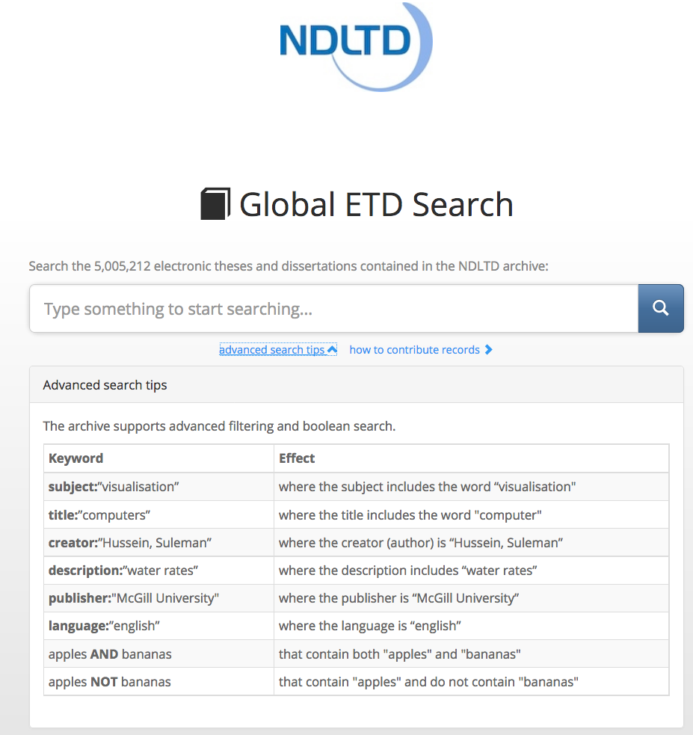

Slide 4
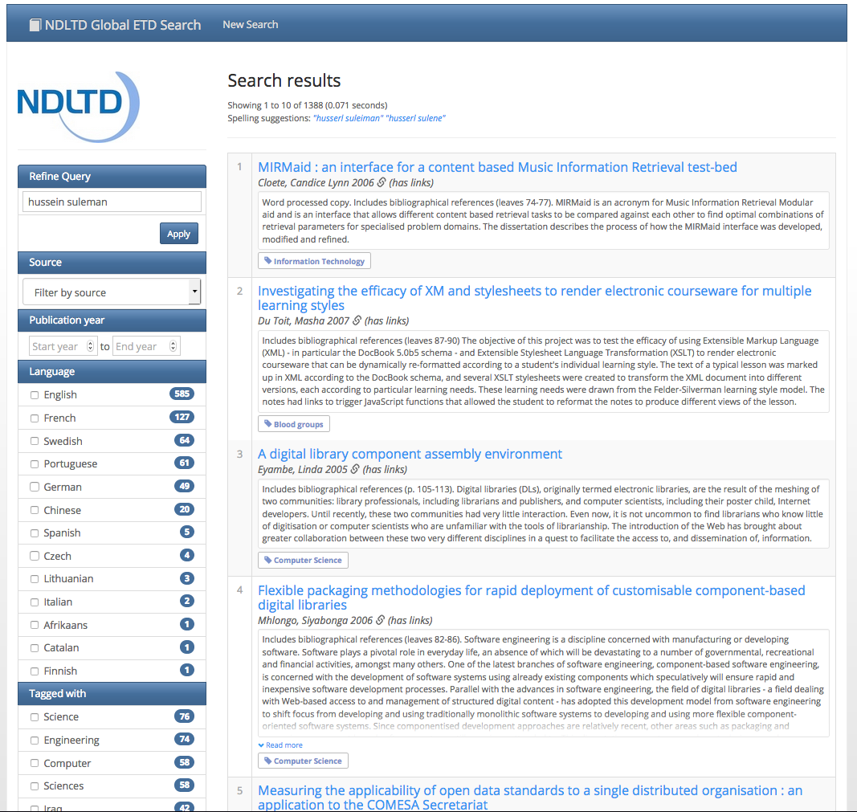

Slide 5
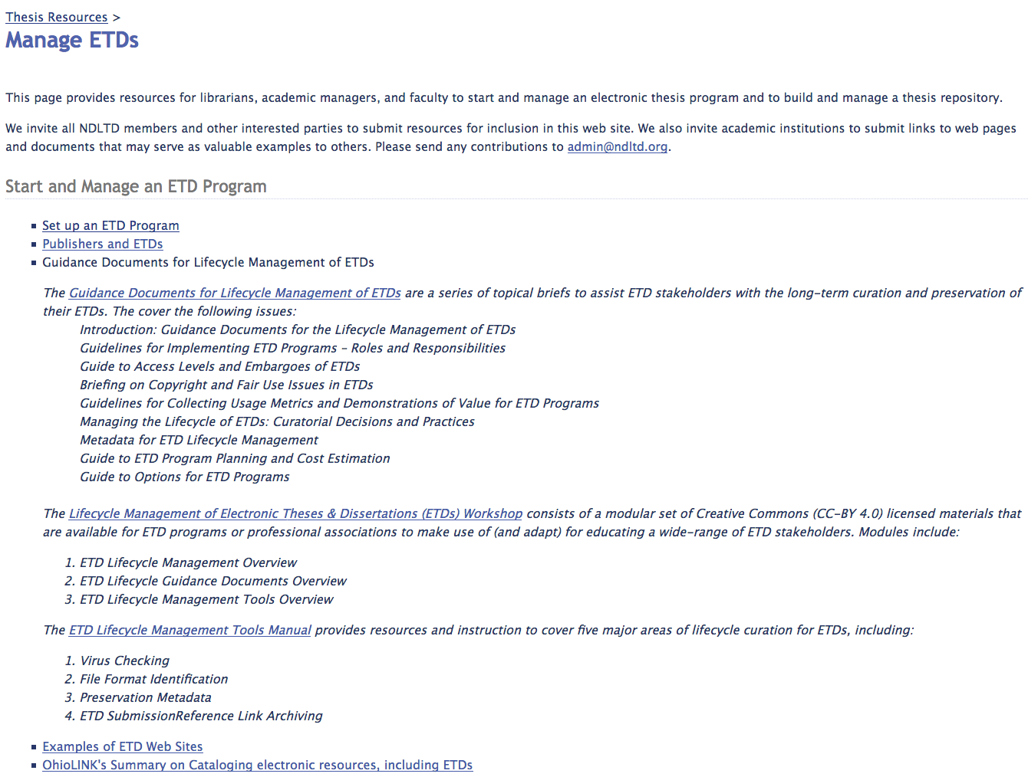

Slide 6
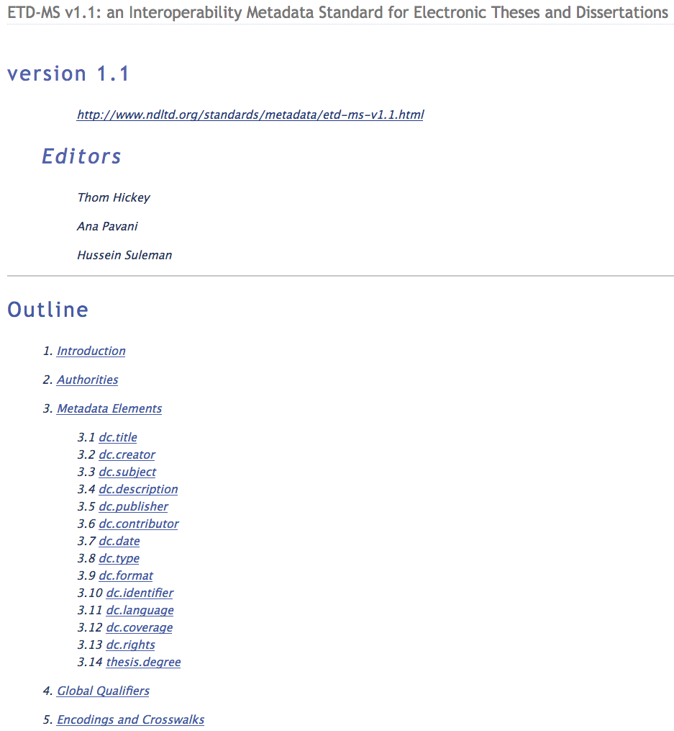

Slide 7
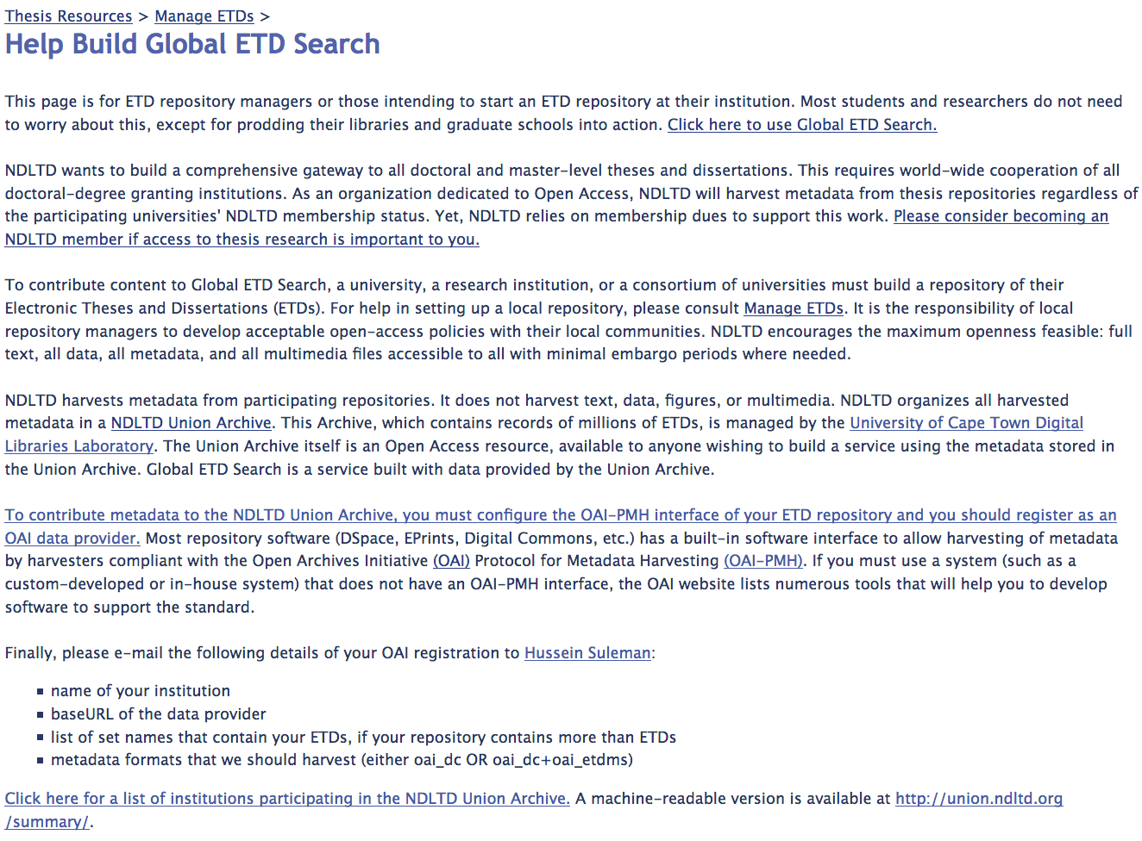

Slide 8
Modern Dissemination Methods
Social media
WWW (and Web 2.0, 3.0)
Digital libraries
  Global tailored access, including through partners
  Global access through search engines
  -> Discovery, downloading, citing, re-usable science
What aids discovery?
  Title, abstract, categories
  Figures (image search if separate)
  Commenting, rating, tagging, recommending
Notes:
3
3

Slide 9
Informal 5S & DL Definitions
DLs are complex systems that
help satisfy info needs of users (societies)
provide info services (scenarios)
organize info in usable ways (structures)
present info in usable ways (spaces)
communicate info with users (streams)

Slide 10
DLs Support Many User Roles
Roles
Digital
Library
Students
Advisors
User
Readers
Teachers
Learners
Researchers
Librarians

Slide 11
Why of Global Interest?
National projects can preserve antiquities and heritage: cultural, historical, linguistic, scholarly
Knowledge and information are essential to economic and technological growth, education
DL - a domain for international collaboration
  wherein all can contribute and benefit
  which leverages investment in networking
  which provides useful content on Internet & WWW
  which will tie nations and peoples together more strongly and through deeper understanding
Notes:
3
3

Slide 14
Information Life Cycle (adapted)
Creation
Active
Authoring
Modifying
Classifying
Tagging
Recommending
Indexing
Using
Social Context
Citing
Retention
/ Mining
Downloading
Storing
Retrieving
Discovering
Semi-
Active
Utilization
Filtering
Distributing
Networking
Inactive
Searching
Borgman et al. 1996
http://is.gseis.ucla.edu/research/dig_libraries/

Slide 15
Students and the Info. Life Cycle
Learning
  Respect for Teachers, Researchers
Discovery
  Excitement
Documentation and reporting
  Expression
Dissemination
  Fame and Fortune
Community involvement
  Service
Community leadership
  Compassion, Cooperation
Notes:
3
3

Slide 16
Institutional Repositories
“Institutional repositories are digital collections that capture and preserve the intellectual output of a single university or a multiple institution community of colleges and universities.”
Crow, R. “Institutional repository checklist and resource guide”, SPARC, Washington, D.C., USA
www.sparc.arl.org/resource/sparc-institutional-repository-checklist-resource-guide

Slide 17
For More Information (Examples)
Magazine: www.dlib.org
  Books: MIT Press: Arms (1999), Bishop (2003), Borgman (2003, 2010), Licklider (1965)
  Morgan Kaufmann: Witten... (several), Lesk (2nd edition)
  M&C: https://sites.google.com/a/morganclaypool.com/dlibrary/ (4 books: foundations, key aspects, tech., appl.)
Conferences
  ICADL: http://www.icadl2017.org/
  JCDL: http://www.jcdl.org
  TPDL: http://www.tpdl2016.org/
Associations
  ASIS&T DL SIG: http://www.asis.org/SIG/dl.html
  IEEE TCDL: http://www.ieee-tcdl.org
NSF: http://www.dlib.org/dlib/july98/07griffin.html
Labs: Cape Town: http://www.cs.uct.ac.za/research/dll, VT: http://www.dlib.vt.edu, TAMU: http://www.csdl.tamu.edu/

Slide 18
Metadata Objects (MDOs)
MARC
Dublin Core -> ETD-MS
RDF
OAI (Open Archives Initiative): ORE, Protocol for Metadata Harvesting (PMH)
Crosswalks, mappings
Ontologies, Classification systems

Slide 19
Complex to Simple
(see DL Book 3 Ch. 1)
+
thesis
MARC ($50)
Dublin Core (DC)

Slide 20
OAI - Open Archives Initiative
Advocacy for interoperability, from 1999
Standard for transferring metadata among digital libraries
  Protocol for Metadata Harvesting (PMH)
    Simplicity
    Generality
    Extensibility
Support for PMH => Open Archive (OA)

Slide 21
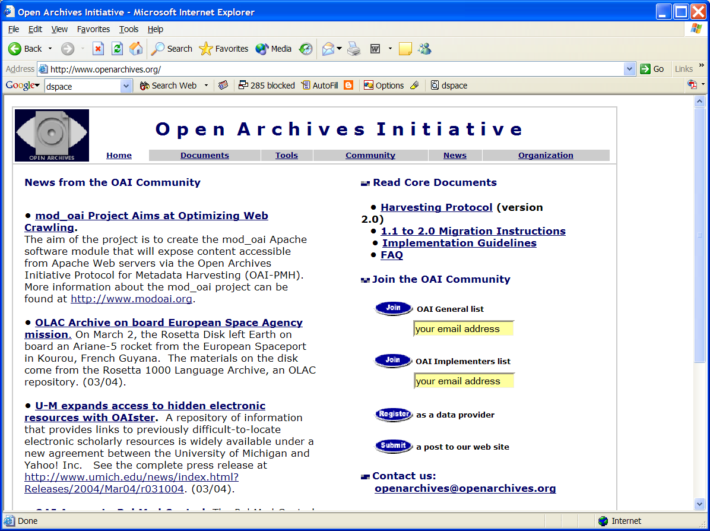

Slide 22
OAI = Technical Umbrella for
Practical Interoperability…
Metadata Harvesting
Reference
Libraries
Museums
Publishers
E-Print
Archives
…that can be exploited by different communities

Slide 23
The World According to OAI
Service Providers
Discovery
Current
Awareness
Preservation
Metadata
harvesting
Data Providers

Slide 24
OAI – Repository Perspective
Required: Protocol
Set Structure
URI Scheme
MDO
MDO
MDO
MDO
Required: DC
MDO
MDO
MDO
MDO
DO
DO
DO
DO

Slide 25
OAI – Black Box Perspective
OA 7
OA 4
OA 2
OA 3
OA 1
OA 6
OA 5

Slide 26
Early Union catalog: OCLC
OCLC ran OAI data provider on TDs.
Was getting data from WorldCat (so, from many sites!).
Need DC and either ETD-MS or MARC.
Has a set for ETDs.
Now part of larger Union Catalog run at University of Cape Town (Hussein Suleman)

Slide 27
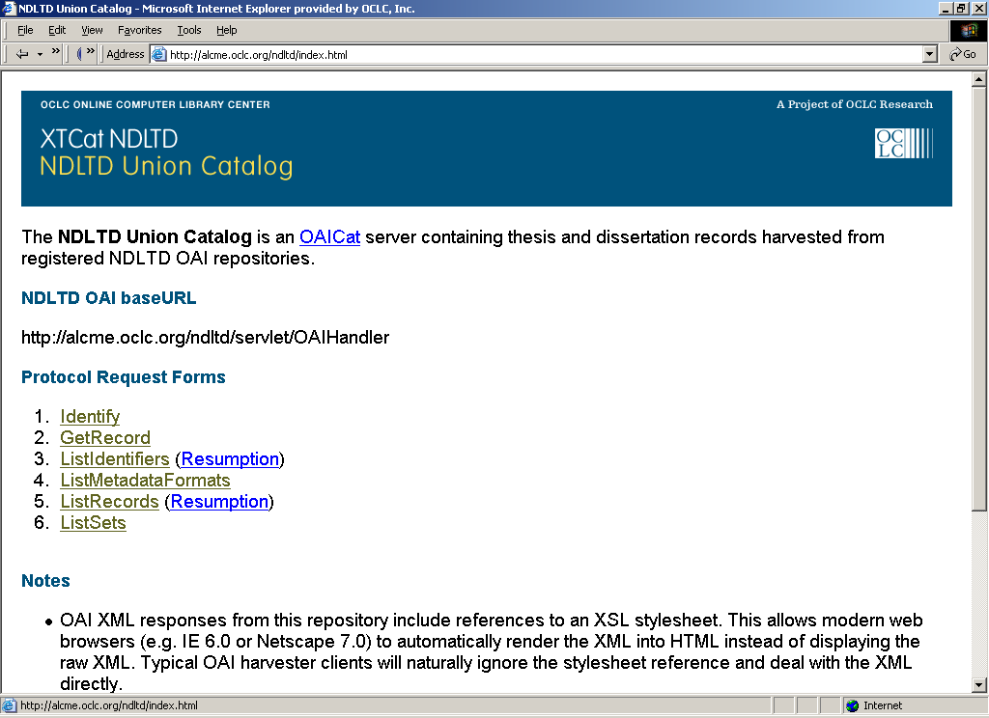

Slide 28
Metadata Specifications and Metadata Format: Completeness
OCLC NDLTD Union catalog

Slide 29
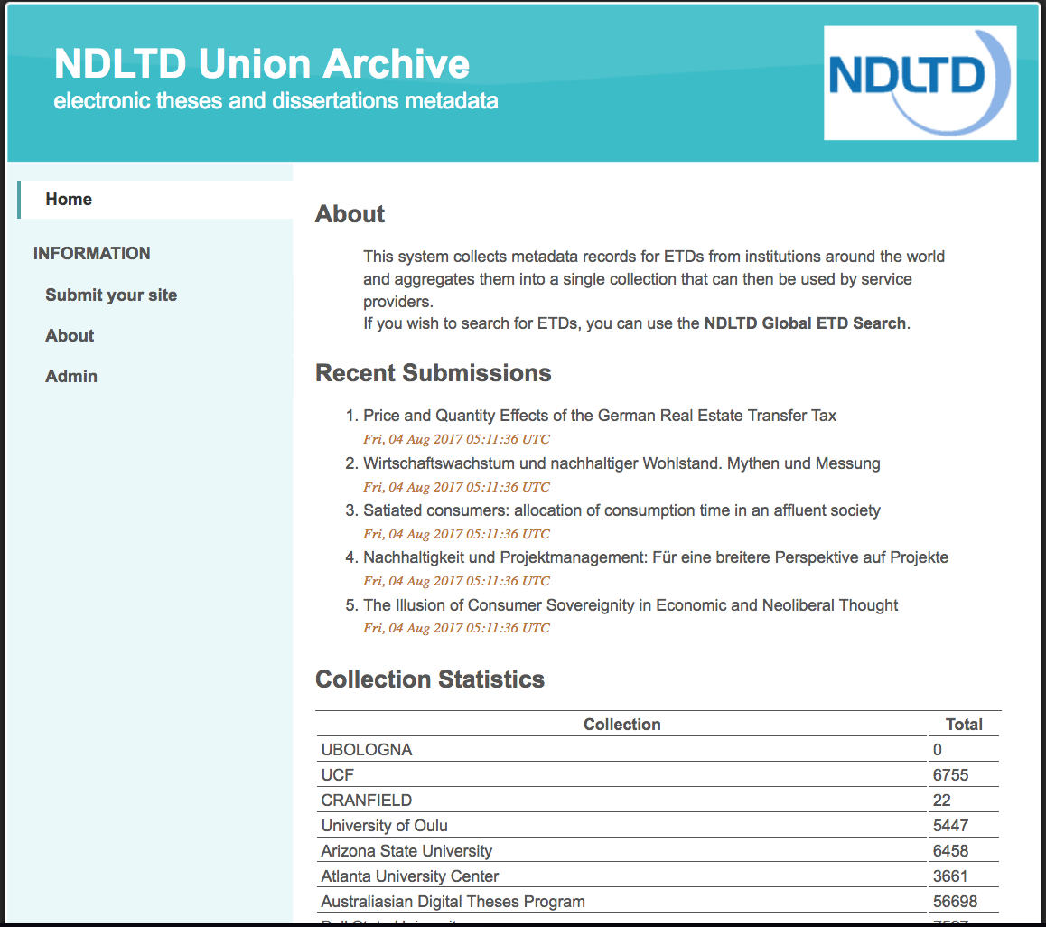

Slide 30
Background for Future Work
Electronic Publishing
Computer Literacy/Fluency -> Computational Thinking
Scholarly Communication
Open Access
Institutional Repositories
Open Archives Initiative (OAI)

Slide 31
Summary
NDLTD: services, local work, connecting
Digital Libraries: overview
Metadata, OAI-PMH
Background for Future Work
Summary

Slide 32
Questions?
Discussion?
Recommendations?
Thank You!
fox@vt.edu
http://fox.cs.vt.edu

