Slide 1
GETAR Overview
Edward A. Fox, Sunshin Lee, Mohamad Farag, Andrea Kavanaugh, Donald Shoemaker, Jefferson Bailey (IA), Steve Sheetz, Liuqing Li, Islam Harb, Seungwon Yang (LSU), . . .
Presentation for Discovery Analytics Center, Virginia Tech
2 February 2017
http://fox.cs.vt.edu/talks/2017/20170202GETAR-DAC.pptx

Slide 2
Part 1
Extracts from the GETAR proposal (NSF IIS-1619028 and 1619371)
Virginia Tech and Internet Archive, 2016 – 2020
Global Event and Trend Archive Research

Slide 3
Problems / Questions
How can K-12 students, the general public, and interdisciplinary teams study and research the important global events and trends that relate to worldwide grand challenges?
How can information systems support those needs in an integrated fashion, empowering users through interaction with content across the broad information life cycle?
How can the growing collections of Internet archives be integrated with both the constantly changing current version of the WWW and stream-oriented communications like tweets?
How can those involved in planning, policy making, innovation, economics, engineering, and the social sciences engage in focused as well as longitudinal studies (from the End of Millennium to the present: 1997-2020), in an interdisciplinary context, through those systems and collections?

Slide 4
Goals
To aid interdisciplinary research and education, regarding important global events and trends, which can benefit from DL access to Internet content, starting in 1997, up through 2020.
To develop next generation interactive and integrated information systems, connecting DLs and archives, connecting sources and documents, and connecting webpages and tweets (and other user submitted content).
To advance the state-of-the-art in DL and NLP with regard to handling archives, analyzing documents, adding value to metadata and collections, and expanding the scope of interaction across the information life cycle.

Slide 5
Objectives - 1
To develop methods, deploy them at the Internet Archive (IA), and
  get high quality collections from IA’s archives (of WARC files),
  aiming to find all relevant webpages
  (including forms like Usenet posts that have similar functionality to tweets)
  for important events we identify over the period 1997-2000.
To devise interactive techniques resulting in rich models for events and trends,
  that will lead to enhanced focused crawling, accurate classifiers, and
  helpful information visualization.
To devise interface development methods for DLs, that lead to
  generic solutions where possible, but also facilitate tailoring interfaces
  to the needs of particular disciplines.
To aid stakeholders, through interactive interfaces, to engage in
  development and curation of collections of tweets and webpages
  about events and/or trends, with high quality, that will support the
  needs in their discipline, as well as assist in interdisciplinary research studies.

Slide 6
Objectives - 2
To aid stakeholders, through interactive interfaces (with NLP), to deal with errors, spam,
  variations in doc. length / structure / focus, multiple languages /sublanguages, and their
  varying needs for analyzing and representing/describing/summarizing interesting content.
To aid stakeholders, through interactive interfaces, to analyze, visualize, and access
  those collections (with maps, timelines, social networks, and faceted browse, search, and
  exploration of content), in ways appropriate for their needs and disciplines, and to
  integrate the interaction with the collection development and curation activities.
To integrate DL and archive methods so collections can both be preserved
  for the long term, and easily accessed through highly interactive interfaces.
To aid stakeholders to advance research and education concerning important global events
  and trends, including climate change, development, disasters, energy, globalization,
  innovation, policies, resilience, social movements, and violence.

Slide 10
Category | Collection | Event Year(s) | Location | # of Webpages
Disease | Ebola | 2014 | World | 15,000
Earthquake | Virginia earthquake | 2011 | Virginia, USA | 8,765
Fire | Brazil club fire | 2013 | Brazil | 690,281
Flood | Pakistan flood | 2011 | Pakistan | 20,416
Hurricane | Hurricane Sandy | 2012 | East Coast, USA | 75,929
Shooting | Tucson shooting | 2011 | Tucson AZ, USA | 37,829
Community | Blacksburg events | 2011-2012 | Blacksburg VA, USA | 16,024

Slide 13
Users | Prototype 1 | Prototype 2 | Prototype 3
General Public | Solr/Blacklight with enhanced metadata from info. extraction | Add: PhaseVis [86], Xpantrac [84, 85], … | Add from new research versions in years 1, 2
Librarian, IA, K-12 | Heritrix + front ends (advanced, easy) | Add: Focused Crawler [30, 66] | Add: Richer event, trend models
Research Collaborators | As above + Programmatic Adds | Add: As above + Spreadsheet [92] | Tailored to discipline
 |  |  | Improved programmatic

Slide 17
Part 2
Slides from Dr. Sunshin Lee
IDEAL: NSF IIS-1319578 – 2013-2017
Integrated Digital Event and Archive Library

Slide 18
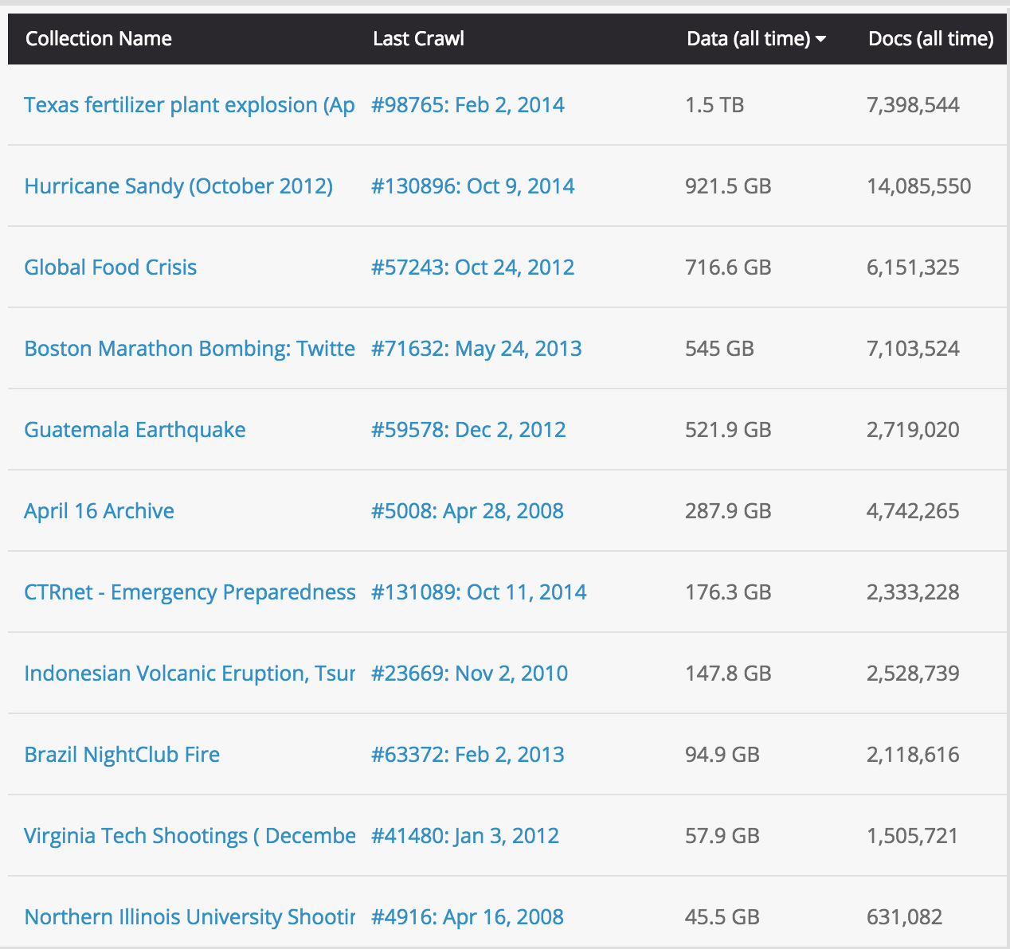
Collecting Webpages
Started 2007
Used Internet Archive (IA)
  66 collections
  ~11TB
Shooting, earthquake, bombing, hurricane

Slide 19
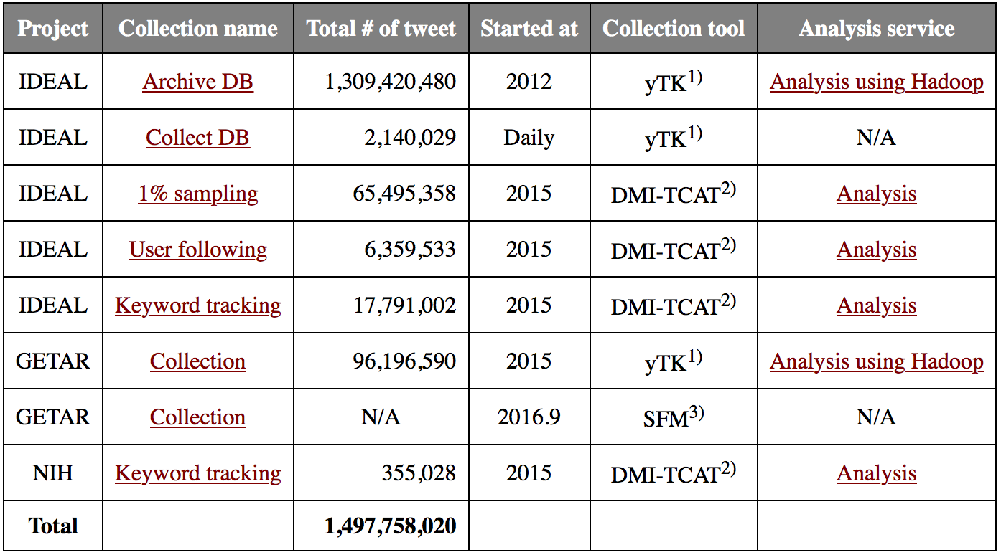
Collecting tweets
Collections for 3 projects
  Over 1,300 collections and 1.5 billion tweets

Slide 20
Collection Example: GETAR Prototype
Research key global challenges, e.g., climate change (as well as opportunities), innovation, and resilience
Collection
  Started 10/8/2015
  315 collections
  96,196,612 tweets (as of 2/1/2017)
  Including global warming,
    Internet of things,
    population,
    and the environment

Slide 21
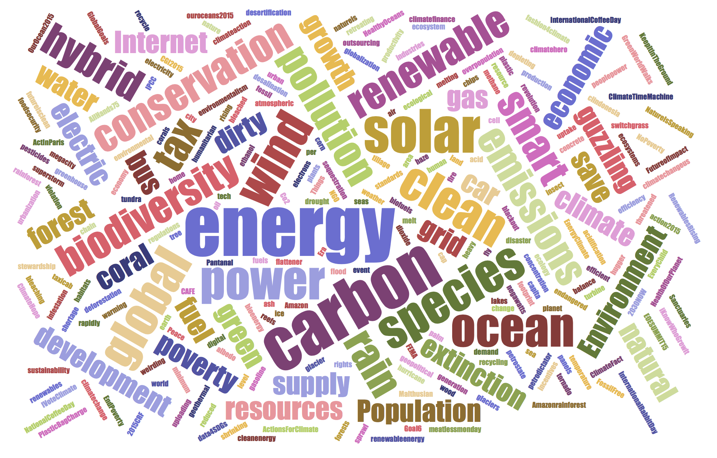
Collection Example: GETAR Prototype

Slide 22
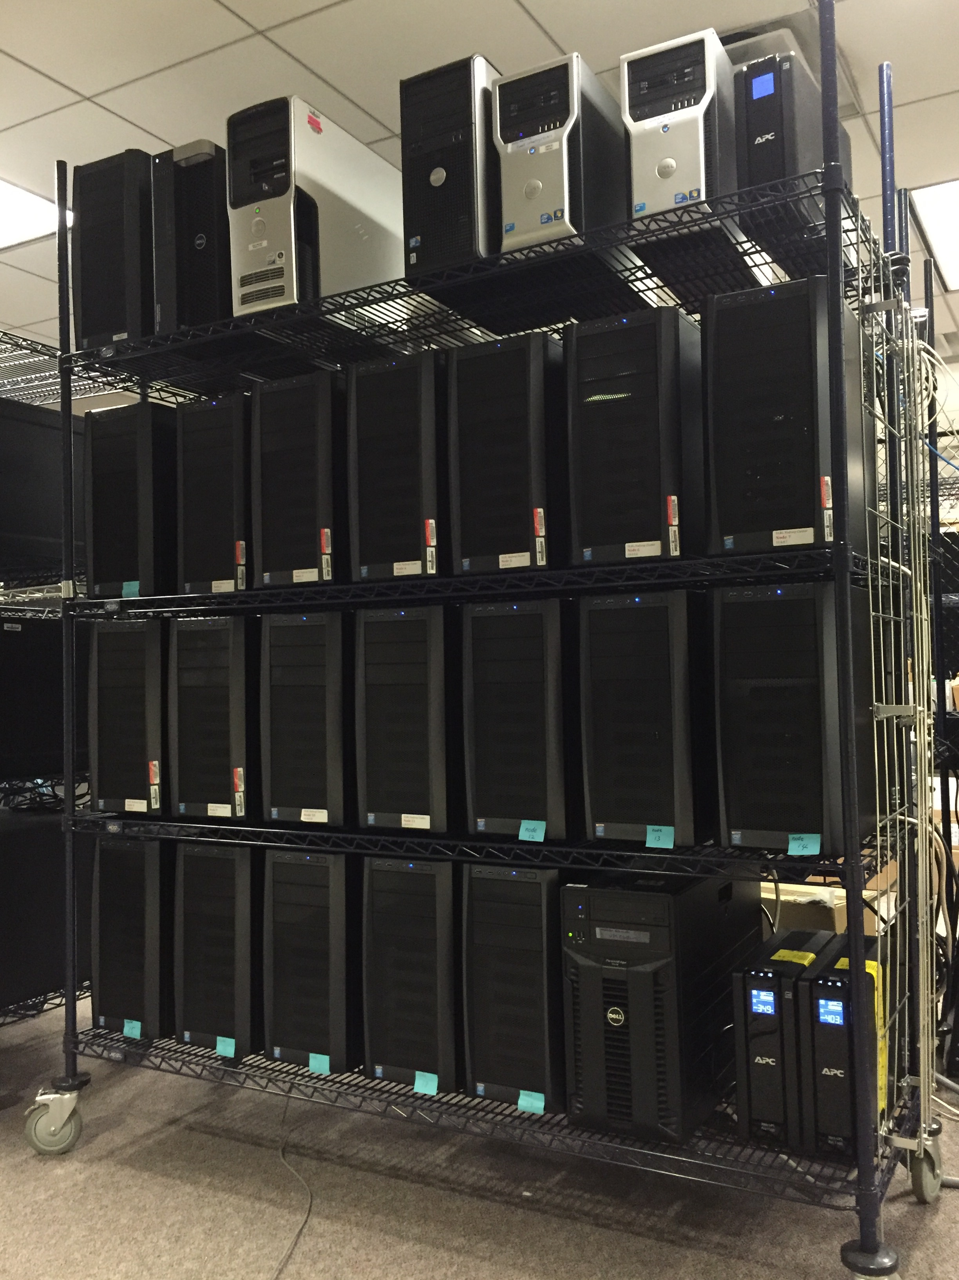
Archiving and Analyzing using
Bigdata Hadoop cluster
Using Desktop PCs
  # of Nodes: 20
  CPU: Intel i5 Haswell Quad core 3.3Ghz
  RAM: 640 GB (20 * 32GB RAM)
  HDD: 140 TB (20 * 7TB HDD)
  Backup: 32TB, 8.3TB NAS
Servers
  Tweet collecting
  Web crawling
  Geocoding
  Search (Solr) * 2

Slide 23
IDEAL System Architecture
* IDEAL project: Integrated Digital Event Archiving and Library
* Highlighted (as grey) are related to this research

Slide 24
External Tools
Spark and Mahout:
  Classification, clustering
  Topic analysis (LDA), Frequent Pattern Mining
Solr/Lucene and Blacklight: Search/(Faceted) Browse
Natural Language Processing and Named Entity Recognition
  NLTK (Python)
  SNER (Stanford NER)
Notes:
Hadoop Streaming
: The utility allows you to create and run Map/Reduce jobs with any executable or script as the mapper and/or the reducer

Slide 25
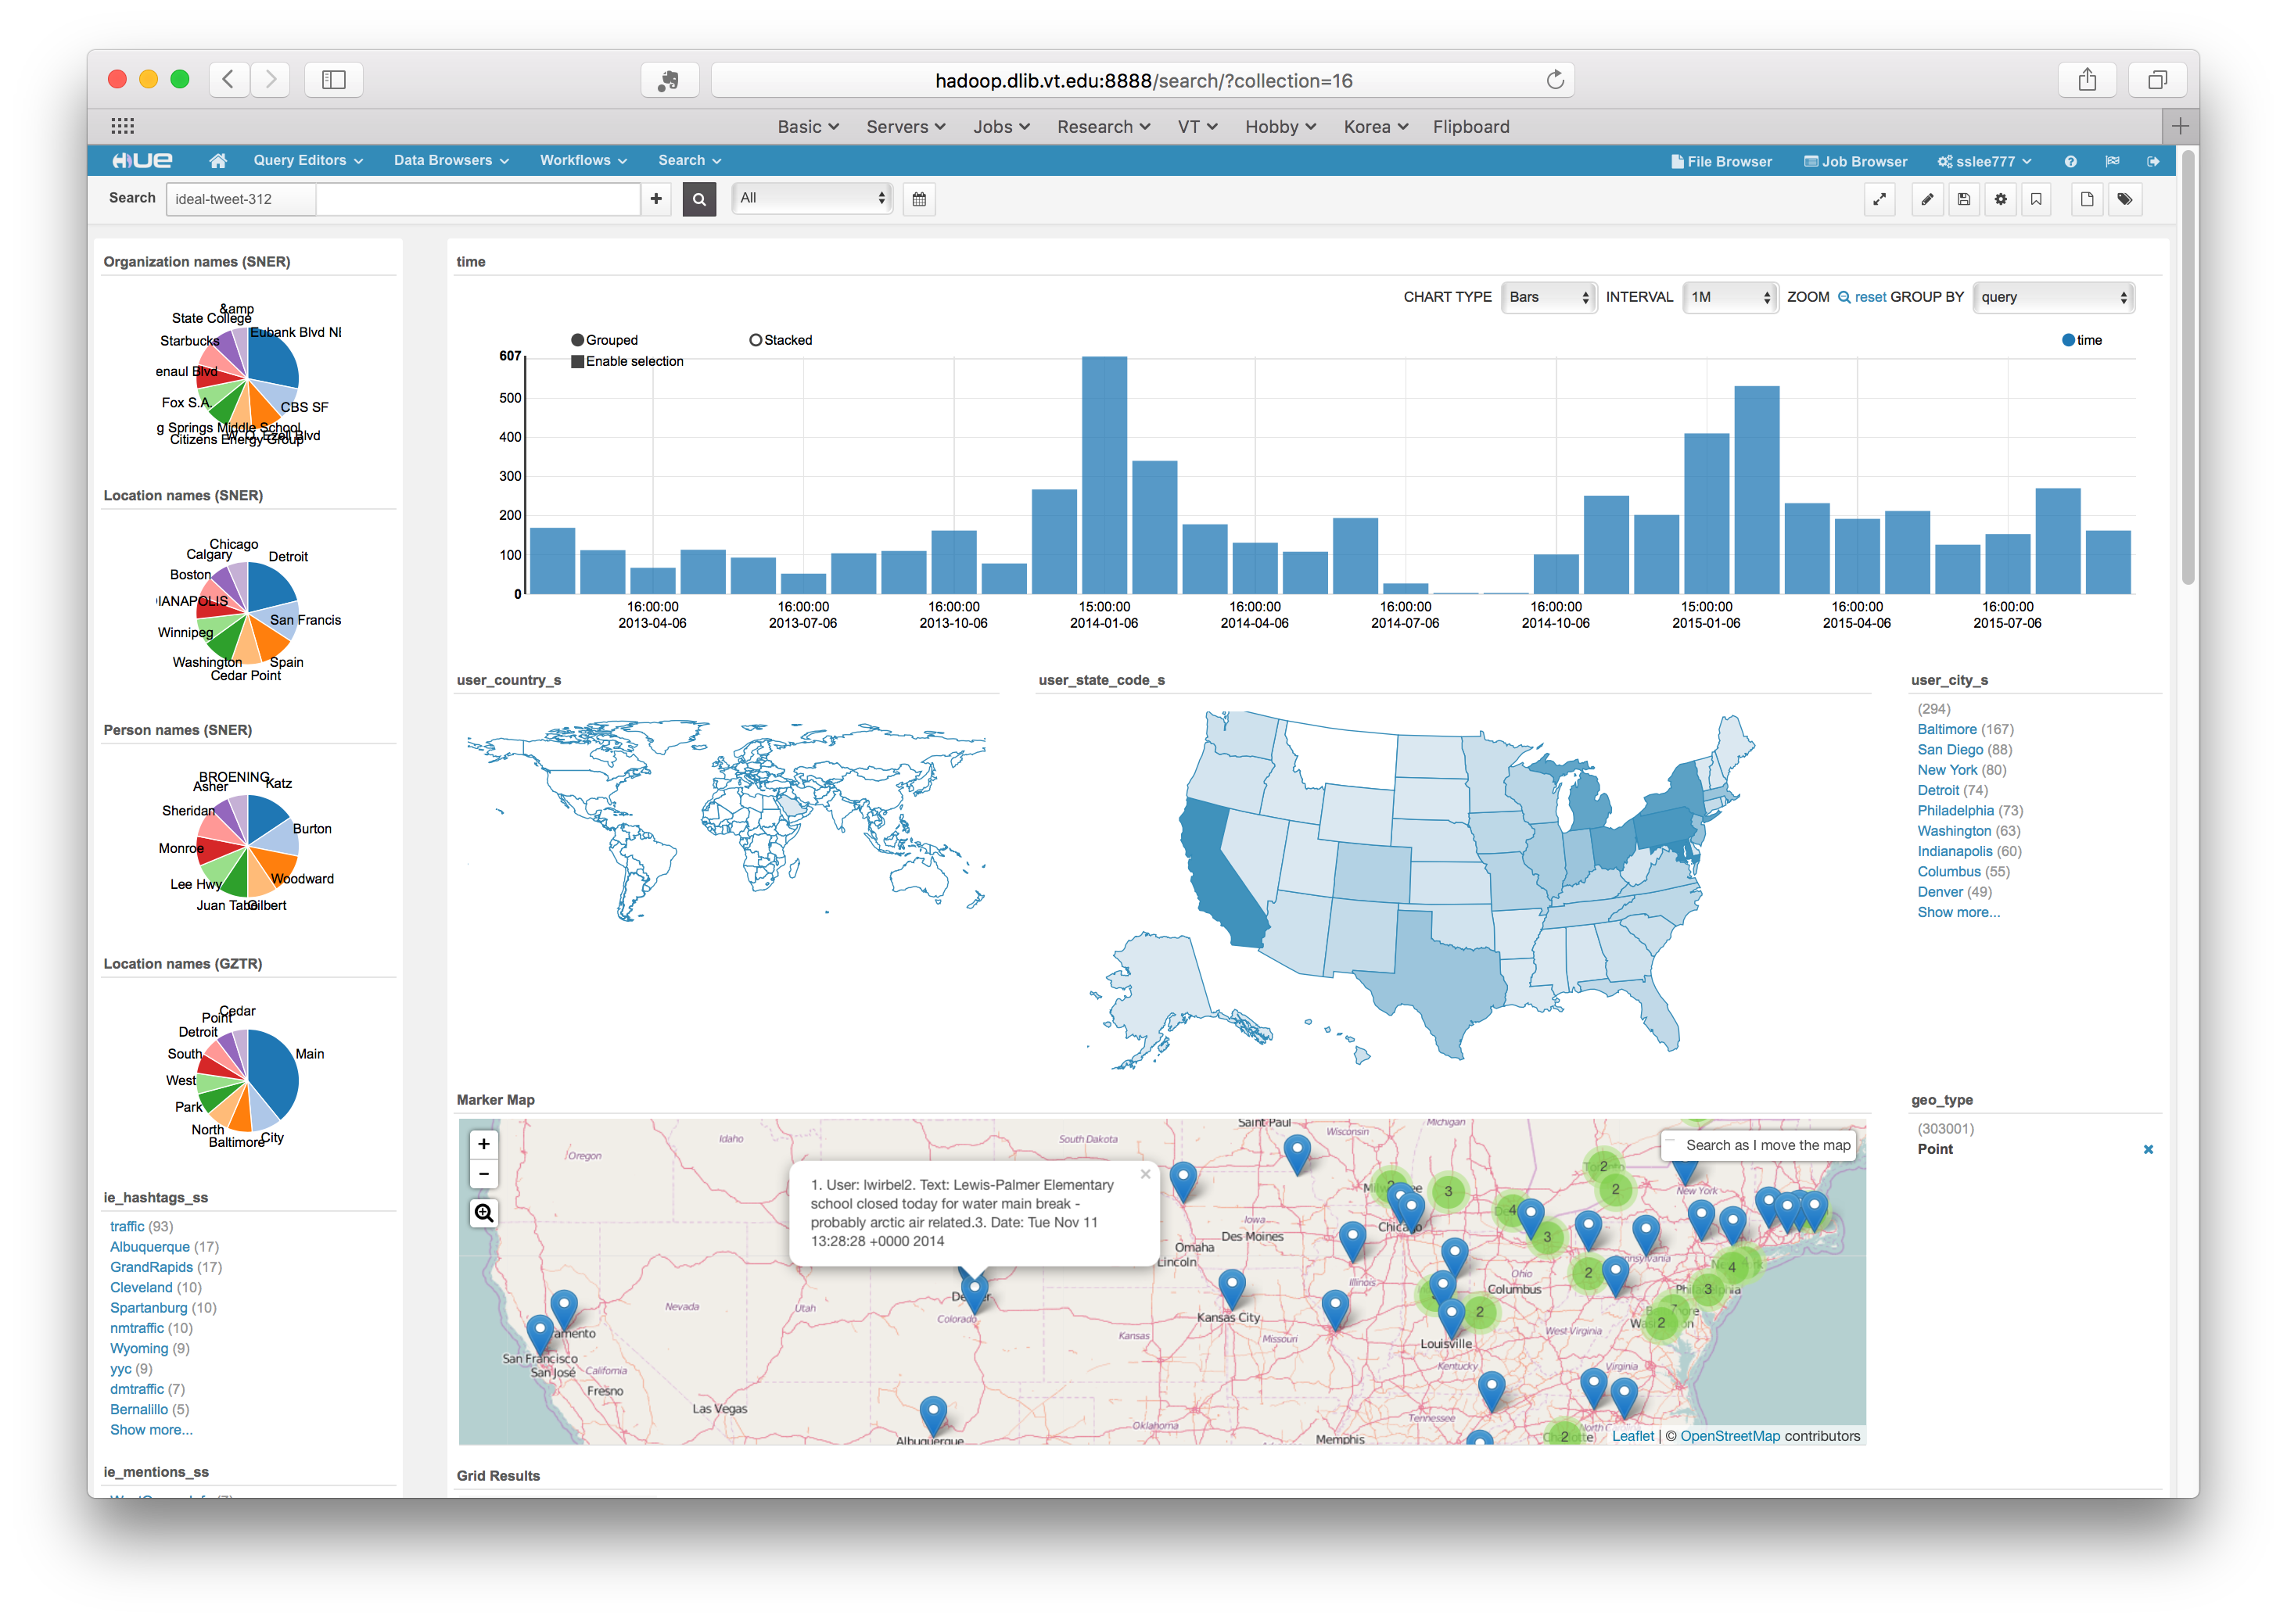
Analysis and
Visuali- zation
Example
Water Main Break collection

Slide 26
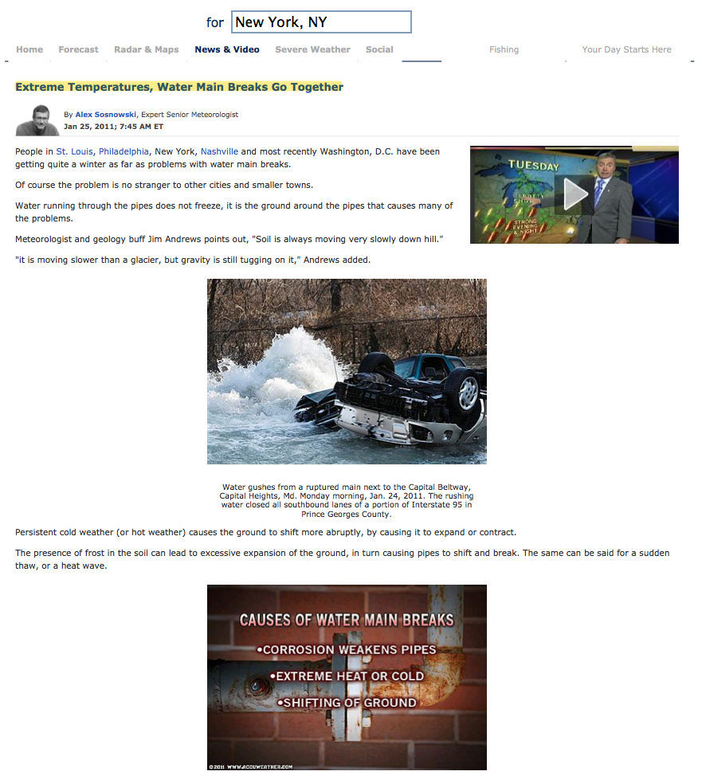
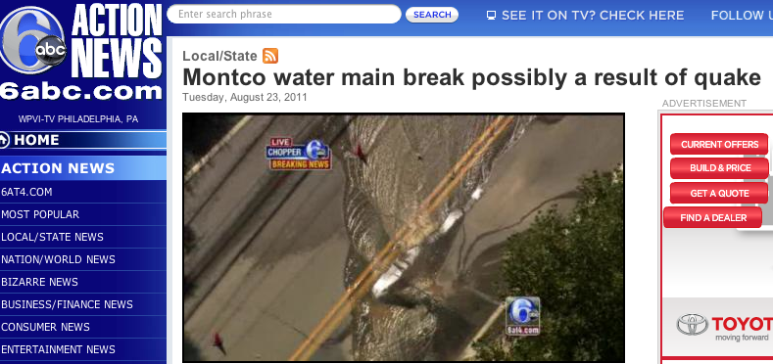
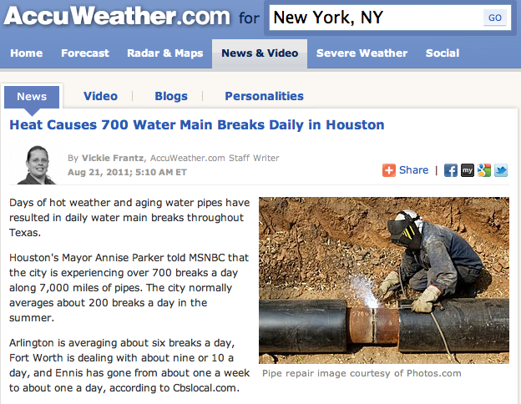
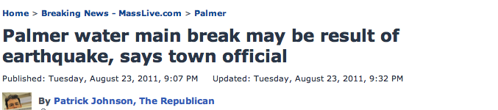
What causes Water Main Breaks?
AccuWeather.com
MassLive.com
Notes:
Many people think that there is a correlation between earthquake or severe weather and water main break.
We can easily find many example.
For example, Expert Senior Meteorologist said “Extreme Temperature, Water Main Breaks Go Together”.
Vickie Frantz, Accuweather.com Staff writer, also said “Heat causes 700 water main breaks daily in Houston”
Two news channels reporter mentioned about the correlation between earthquake and water main break. “Montco water main…”, “Palmer water…”
Alex, Meteorologist defines causes of water main breaks like this. 1. 2. 3
Let’s try to find some evidences or correlation in tweet data

Slide 27
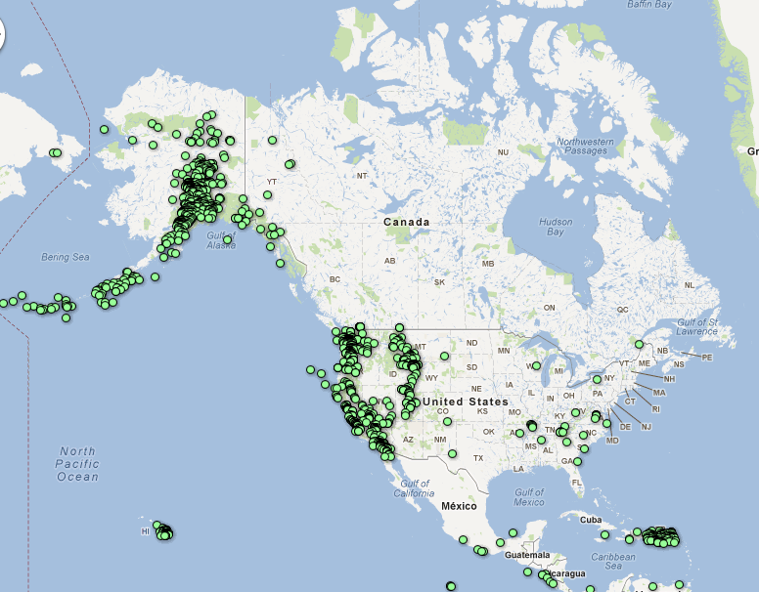
What causes Water Main Break?
=> Earthquakes (USGS)
Mar. 1 – Apr. 5, 2012
Notes:
Search earthquake
Histogram: March 2014, May 2015 => not Winter
Location Name: Fullerton, CA; La Habra, CA; Brea CA

Slide 28
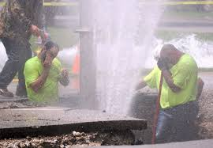
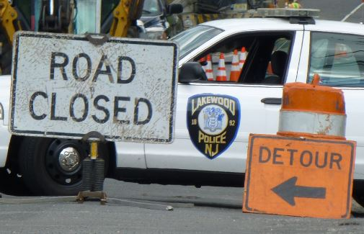
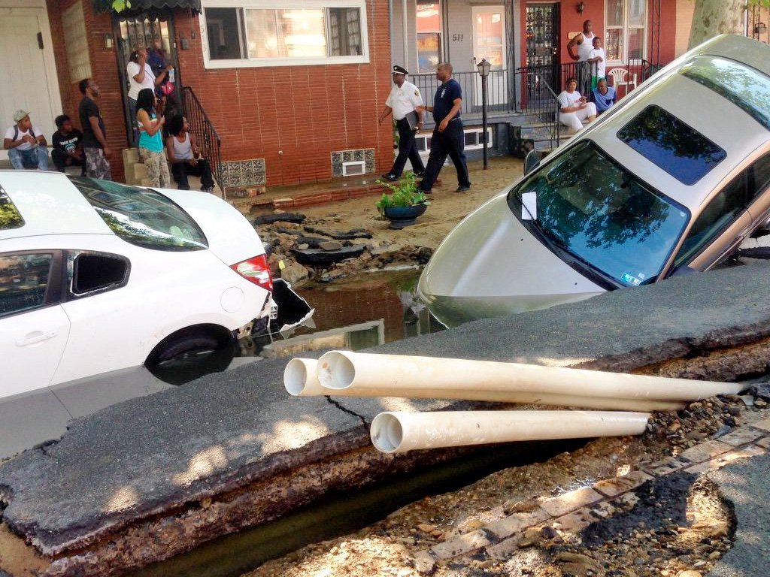
Who is involved in a WMB ?
Fix water pipe
  Water utility
  City/town utility
Traffic
  Police
Affected
  Citizen
Who else ?
Lakewood, NJ, June. 2014
West Philadelphia, PA, June. 2015
Notes:
Click “NewYork” in user_city_s
See organization: FDNY, MTA (Metropolitan Transportation Authority), NYU
Person name: De Blasio
Hashtags, Mentions

Slide 29
Datasets for Geo-location Research
5 types of road side small disasters
  Includes specific location info.
  3 small and 2 large collections
  Collected 2/1/2013 to 6/30/2014
    17 months, start and end days varying
Size | Dataset | Number of tweets
 | Total | 6,039,888
Mid-size | Water main break | 155,657
 | Sinkhole | 231,579
 | Pothole | 324,849
Big-size | Car crash | 2,510,317
 | Car accident | 2,817,486

Slide 30
States and population
Tweets with geo-coordinates
Number of tweets by state
  Ordered by Population 2013: all states
  More population, more tweets
Too many outliers, not good for national trends
    MI, MA, MD on pothole dataset (grey)
https://en.wikipedia.org/wiki/List_of_U.S._states_and_territories_by_population

Slide 31
Features, combinations of features
Figure 11. Percentages of tweets that have particular features
Up to 91.1%
LIWs may help to geo-locate tweets
Figure 12. Percentages of tweets with features or union of features

Slide 32
Comparison of Exp. 2.1-2.4 Results
Geo-locatable
Unambiguous
at country level
Unambiguous
at state level

Slide 33
State Level Distribution
Pothole dataset
  (a) Geo-coordinates: 18K
  (b) Geonames (SNER): 30K
  (c) Geonames (SNER)
  + LIWs (Hashtags): 45K
National trends
Figure 20. State level distributions of unambiguously geo-coded tweets with
(a) geo-coordinates, (b) geoname (SNER), and (c) geoname (SNER) and hashtags in pothole collection

Slide 34
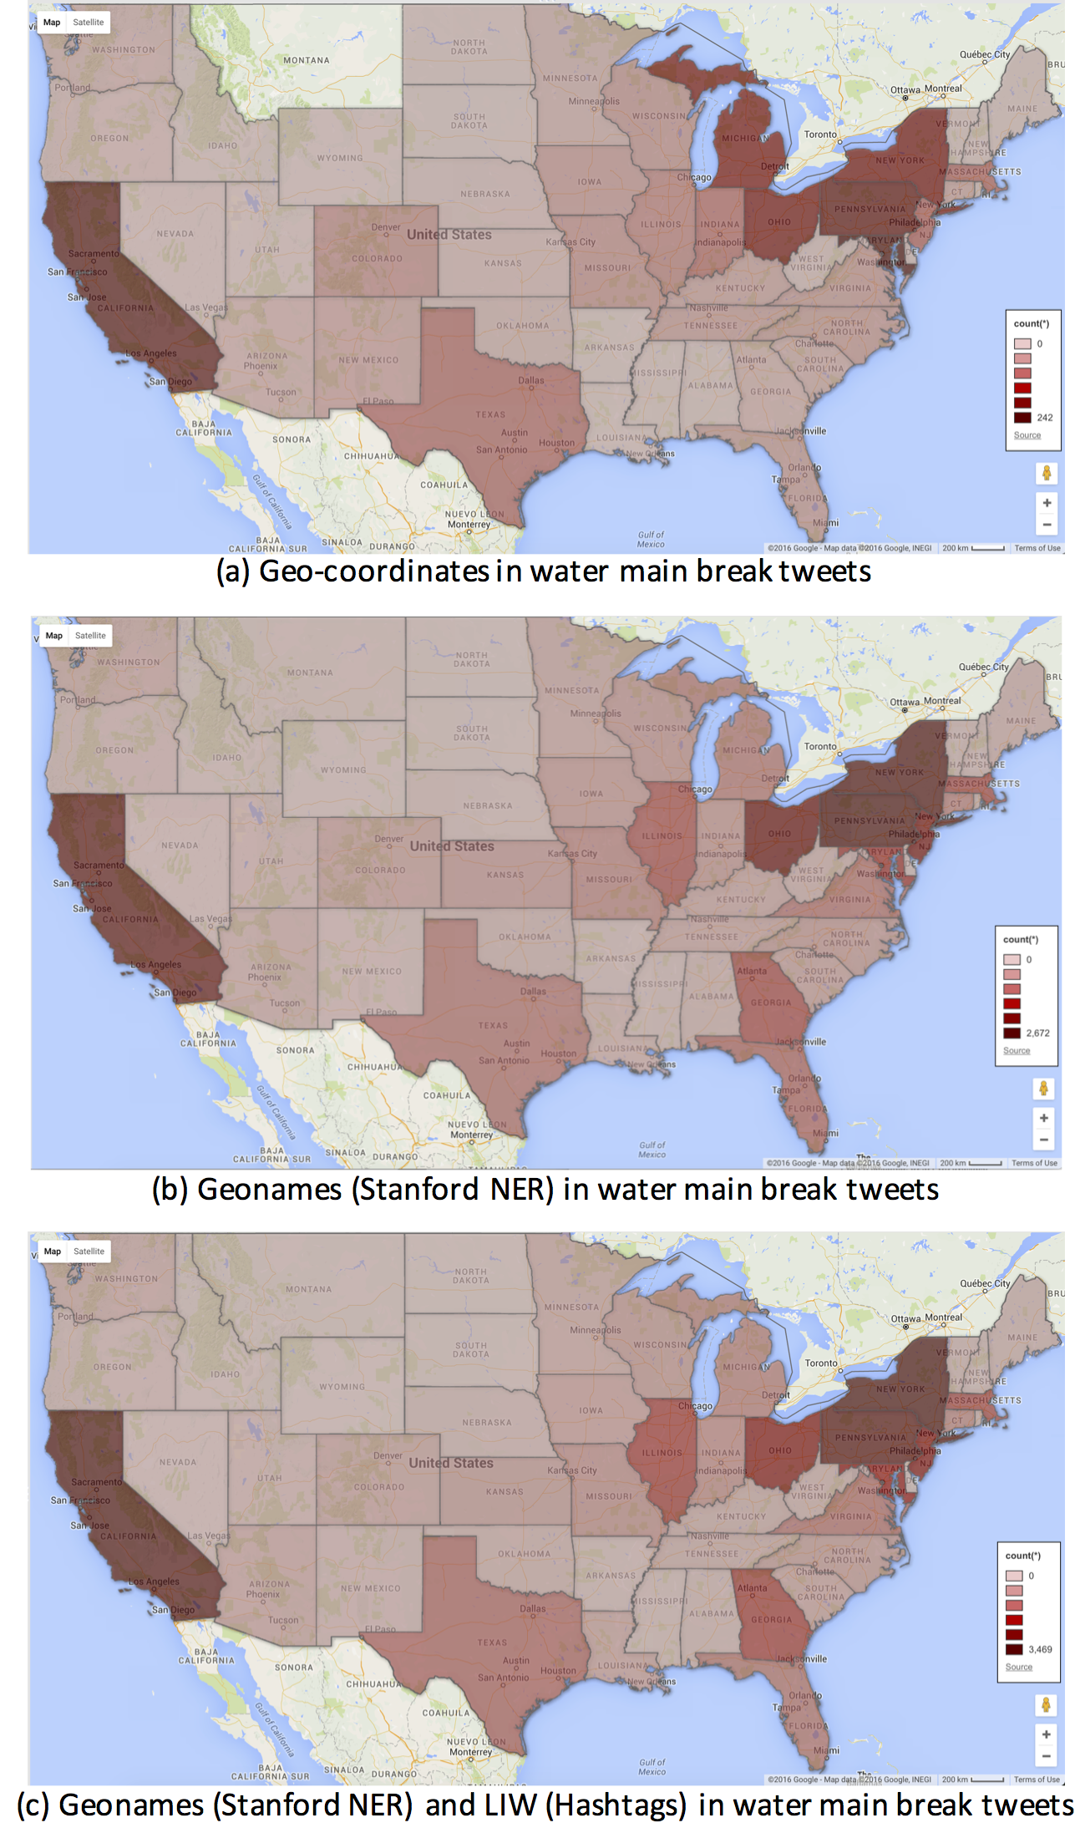
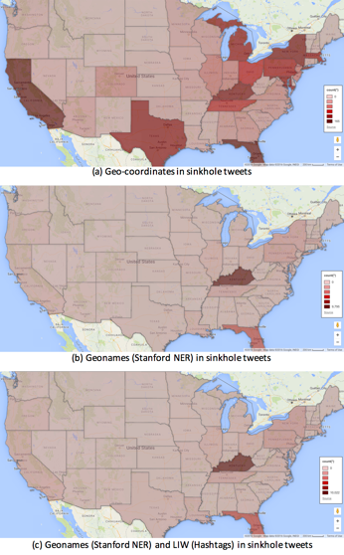
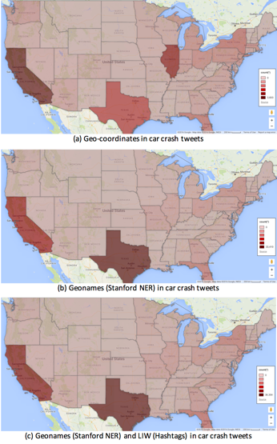
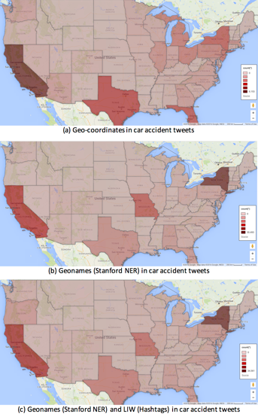
State Level Distribution

Slide 35
Part 3
Slides from Dr. Mohamed Magdy Farag
IDEAL: NSF IIS-1319578 – 2013-2017
Integrated Digital Event and Archive Library

Slide 36
Archive-It Collection Quality

Slide 37
Representative Event Types
Event Types | Examples
Shooting | Oregon, California, Orlando
Earthquake | Ecuador, Japan
Flood | Texas Floods
Fire | California wild fire
Bombing | Boston bombing
Plane Crash | Egyptair, germanwings
Building Collapse | East Harlem
Protests/Riots | Egyptian revolution
Political Issue/Conflict | Brexit, Turkey coup, Greece Bailout referendum
Hurricane | Joaquin, Sandy, Katrina
Terror Attack | Paris, Brussels, Nice
Train Derailment | Amtrak188
Scandal | Panama Papers, Sepp Blatter
Community | Lovewins

Slide 38
Data Flow

Slide 39
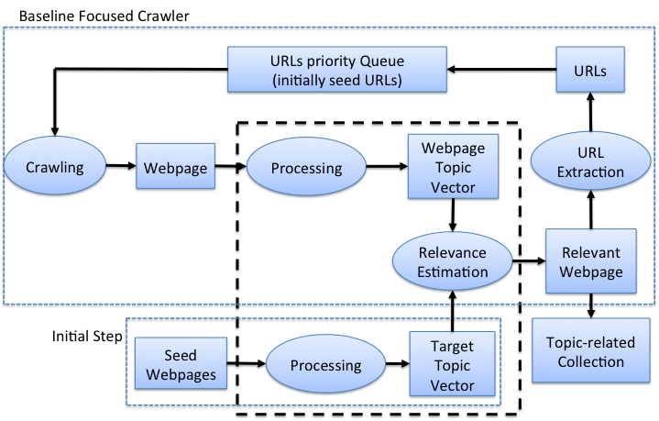
Baseline Focused Crawler
Focus of research

Slide 40

Event Focused Crawler
Focus of research

Slide 41
Event Modeling and Representation
We define an event as
  something (e.g., a disaster),
  which happened in a certain place, and
  at a certain time.
Event E is a tuple <T, L, D>.
T = topic of event, L = location, D = date
i.e.: what, where, and when.

Slide 42
Building Event Model

Slide 43
California Shooting Model
Topic | shoot | 0.93
 | san | 0.513
 | bernardino | 0.465
 | said | 0.357
 | wa | 0.323
 | 2015 | 0.321
 | peopl | 0.31
 | california | 0.305
 | polic | 0.258
 | suspect | 0.177
Location | San Bernardino | 1
 | California | 0.51
 | Calif. | 0.44
Date | 2015-12-02

Slide 44
Datasets
Event | Type | Location | Date | # of Seed URLs | # of desired webpages
California Shooting | Shooting | San Bernardino, California, USA | 12/2/2015 | 4,161 | 50,000
Brussels Attack | Terrorist Attack | Brussels, Belgium | 3/22/2016 | 4,691 | 50,000
Oregon Shooting | Shooting | Roseburg, Oregon, USA | 10/1/2015 | 22,354 | 100,000
Egyptair Plane Crash | Plane Crash | Mediterranean Sea, Alexandria, Egypt | 5/19/2016 | 1,211 | 10,000
Panama Papers Leak | Document Leak | Panama | 4/3/2016 | 18,260 | 100,000
Orlando Shooting | Shooting | Orlando, Florida, USA | 6/12/2016 | 1,988 | 50,000
Paris Attack | Terrorist Attack | Paris, France | 11/13/2015 | 88,835 | 500,000
Ecuador Earthquake | Earthquake | Ecuador | 4/16/2016 | 11,348 | 100,000

Slide 45
Large Scale: California Shooting

Slide 46
Large Scale: Brussels Attack

Slide 47
Large Scale: Egyptair Plane Crash

Slide 48
Planned Activities – Welcoming Involvement
Collaboration with Internet Archive to aid research community
Aid some 30 local stakeholders
Variety of interfaces across information life cycle
Collect, Add Value, Archive, Analyze, Search/Browse, Visualize
Displays outside 2030 Torgersen Hall (DLRL)
Many volunteers: CS4624, CS5604, CS6604, Theses, Independent Studies, and others at all levels

Slide 49
Summary
GETAR proposal
IDEAL results – Sunshin Lee
IDEAL results – Mohamed Farag
Welcoming collaboration

