Slide 1
Big Data Science Workshop
12 January 2017, Virginia Tech
Digital Libraries and Big Data
Edward A. Fox (fox@vt.edu), Prashant Chandrasekar, Islam Harb, Liuqing Li, Sunshin Lee
Dept. of Computer Science, www.cs.vt.edu http://fox.cs.vt.edu/talks/2017/20170112BigDataWkshpFoxEtAl.pptx

Slide 2
Acknowledgments: Grants
NSF CMMI-1638207 CRISP: Coordinated, Behaviorally-Aware Recovery for Transportation and Power Disruptions (CBAR-tpd), PI Pamela Murray-Tuite, Co-PIs Edward Fox, Kris Wernstedt; U. Mich. Ann Arbor, PI Seth Guikema
NSF IIS-1619028: Global Event and Trend Archive Research (GETAR), PI Fox, Co-PIs Andrea L. Kavanaugh, Chandan Reddy, Donald J. Shoemaker; and Internet Archive, PI Jefferson Bailey.
IMLS LG-71-16-0037-16: Developing Library Cyberinfrastructure Strategy for Big Data Sharing and Reuse; Zhiwu Xie (PI), Tyler Walters, Edward Fox (20%), Pablo Tarazaga; with eval. from University of North Texas
University of North Texas (NSF flow through): CREST Partnership Supplement: Building Capacity in Information Management through a Partnership with Virginia Tech …, PI Fox
VT ARC. VT-Rnet: A 10-Gbps Research Network for Virginia Tech. In-kind support to connect the Digital Library Research Laboratory Hadoop Cluster to VT's 10 gbps network
NIH Grant 1R01DA039456-01: The Social Interactome of Recovery: Social Media as Therapy Development; PI Warren K. Bickel (VTCRI), Fox as co-PI
NSF IIS - 1319578: Integrated Digital Event Archiving and Library (IDEAL); PI Fox, with co-PIs Donald Shoemaker, Andrea Kavanaugh, Steven Sheetz, and Kristine Hanna (Internet Archive)
Special thanks for: XCaliber Award 2016 "for extraordinary contributions to
technology-enriched learning activities" for project "Enhanced problem-based
learning connecting big data research with classes", with students:
Mohamed Farag, Richard Gruss, Tarek Kanan, Sunshin Lee, Xuan Zhang

Slide 3
Locating Digital Libraries in Computing and
Communications Technology Space
Digital Libraries technology
trajectory: intellectual
access to globally distributed information
Communications
(bandwidth, connectivity)
Computing (flops)
Digital content
Note: we should consider 4 dimensions: computing, communications, content, and community (people). From S. Griffin
less
more

Slide 4
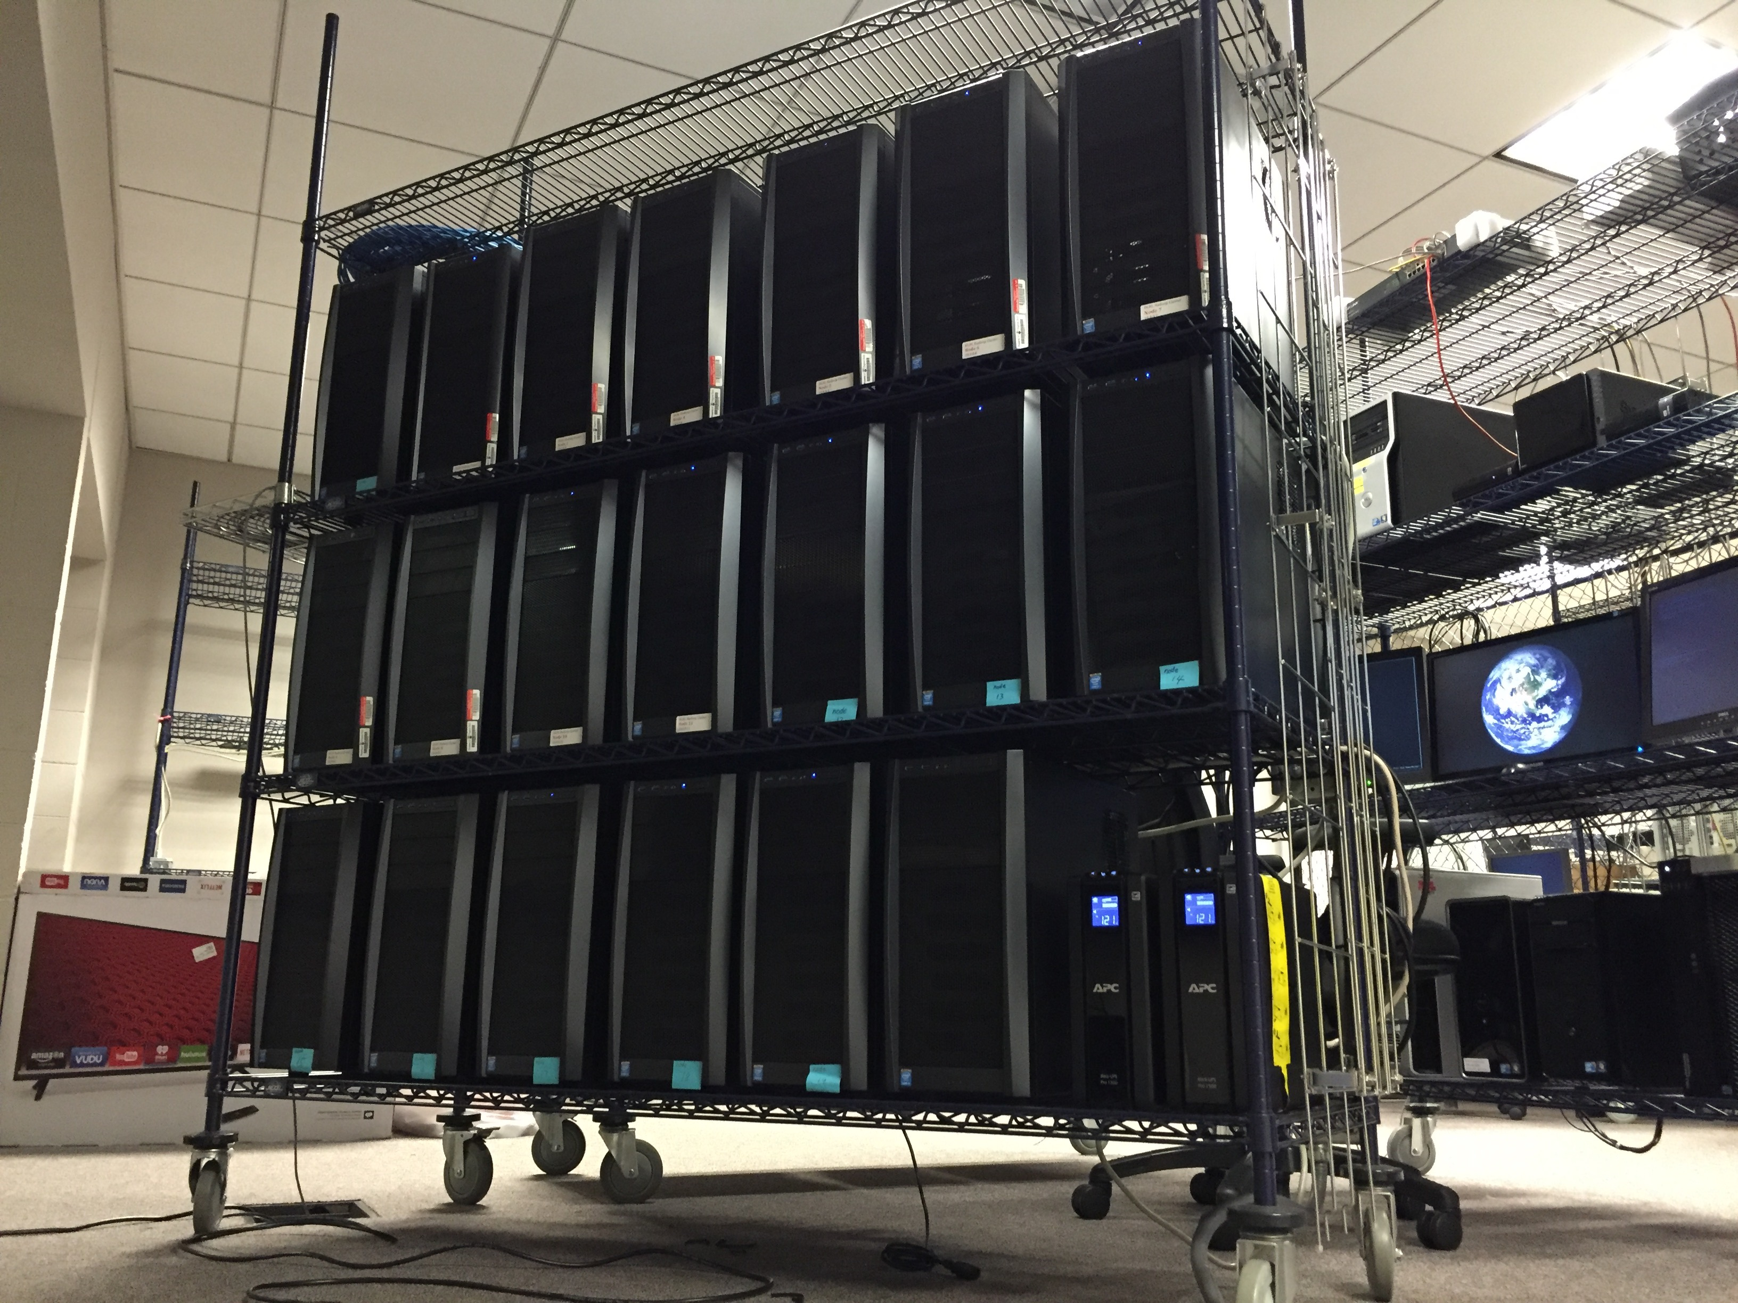
DLRL Hadoop Cluster
(Cloudera)
RAM:
2 of 128G
2 of 64G
20 of 32G
Cores: 108
TB: 160 + backup

Slide 5
5S-based DL Services Taxonomy

Slide 6
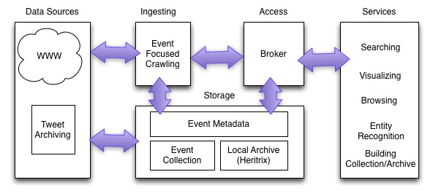
IDEAL (Integrated Digital Event Archiving and Library)
Notes:
Motivation
Problem definition

Slide 7
IDEAL Data Architecture
Highlighted (as grey) are related to Sunshin Lee’s research on tweet geo-coding.

Slide 8
Sunshin Lee’s Data Flow

Slide 9
GETAR Architecture - 1

Slide 10
GETAR Architecture - 2

Slide 11
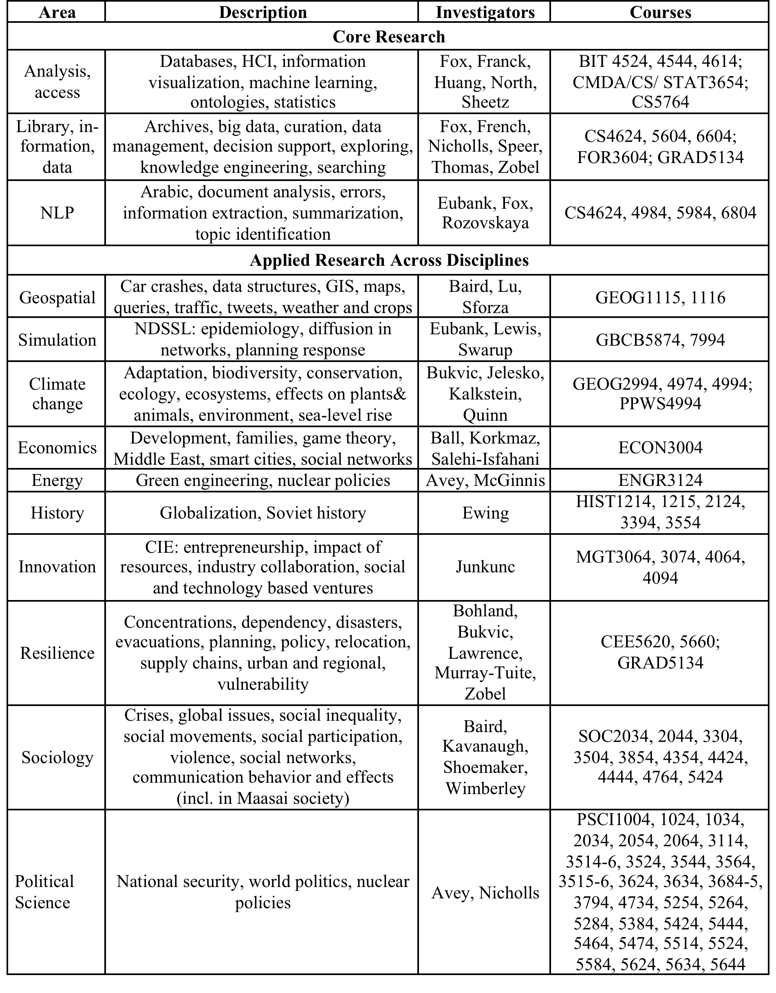
GETAR:
Areas,
Investigators,
Courses

Slide 12
CRISP, CREST
CRISP
  Multi-Agent Modeling
  Social Media and WWW: Information Extraction and Data Mining
  Coordinated, Behaviorally-Aware Recovery
    Transportation and/or Power Disruptions
  Simulation and Prediction
CREST
  Semantic Web (Ontology + RDF + SPARQL)
  Data Integration (Autonomous Distributed Heterogeneous Data Sources)
  Education Domain (Student Success in Academia wrt Institutional Programs/Activities/Initiatives)

Slide 13
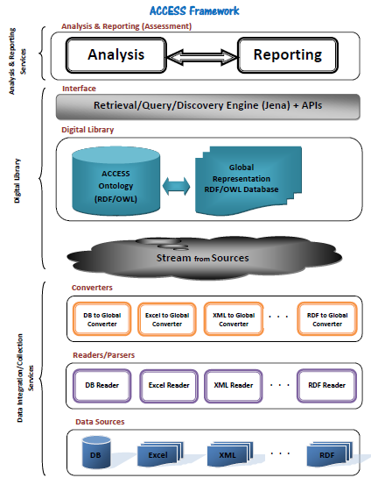
CREST

Slide 14
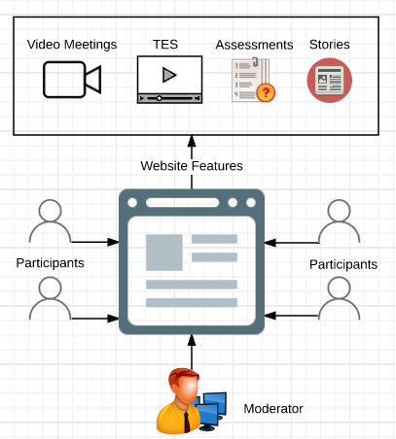
Social Interactome Experiment
2 networks: small-world, lattice
128 per network, 6 buddies/person
16 (12 constrained + 4 open) weeks
Educational (TES, stories) resources, Video meetings, Assessments
Moderator to stimulate engagement, deal with problems

Slide 15
S.I. Assessment Data Collected
Big Five Inventory
  44 items => 5 dimensions of personality
  Personality facets within the 5 dimensions
Social Connectedness Scale (w. buddies)
Addiction Severity Index
  Assess stability based on drug/alcohol use, status (family/social, psychiatric, medical legal), …
Recovery Capital Scale
  Internal/external assets to initiate and sustain recovery
Relapse Data

Slide 16
S.I. Analysis: Data Flow

Slide 17
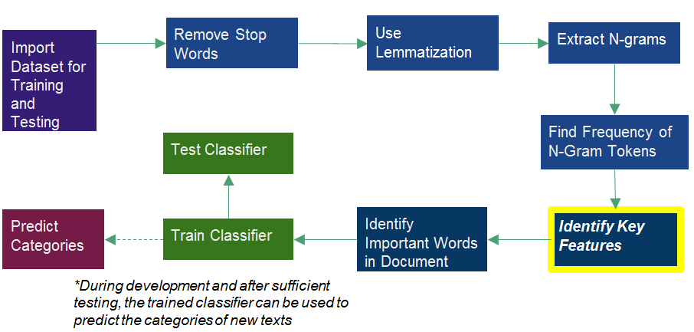
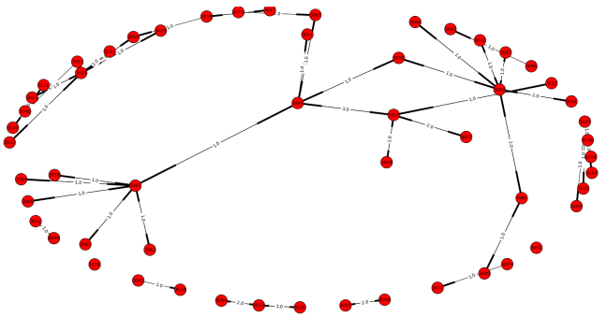
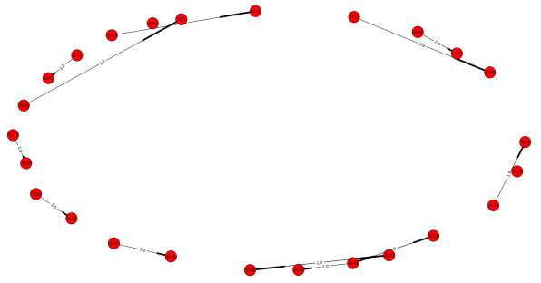
Communication Analysis in the Social Interactome
Text Classification
Abigail Bartolome, Advised by Dr. Edward A Fox
NIH Grant: 1R01DA039456-01
The Social Interactome of Recovery: Social Media as Therapy Development
Acknowledgements to Dr. Chris Franck, Prashant Chandrasekar, Lexie Mellis
Virginia Tech CS 4994, April 2016
Multinomial, naïve-Bayes classification considers the count for each feature name in making classifications
Training the classifier: built a corpus of 150 documents– 75 of which were sentences that were clearly indicative of belonging to a success story and 75 of which were sentences that were not indicative of a success story
Acknowledgements to Victoria Worrall for her efforts on this classifier last semester
Network Structures
Lattice Network | Small-world Network
128 participants | 128 participants
22 users in the most connected component | 4 users in the most connected component
Queried the Friendica database to see who the participants wrote text to and who the participants received text from
Generated graph of the private messaging communication in the lattice social network
Samples of Story Classification
Lattice Network with Administrator Removed
Small-Network with Administrator Removed
"Since being in recovery I have not been around any drugs or alcohol but if I had to, such as a wedding or something I wouldn't have a problem saying that I don't drink or I'm in recovery." => success
'Drove very drunk.' => not_success

Slide 18
Summary & Conclusions
Big data is a characteristic of many digital library projects:
  Diverse range of types and instances of services
  Support for tailored needs of diverse user communities
  Connection with linked open data, Semantic Web
  Ex.:
  Tweet & webpage collection, analysis, value-add, search, visualization
  University education data integration and assessment
  Disaster management with events => modeling, simulation, prediction
  Clinical trials data collection, analysis – for social / behavioral sciences
This can be nicely integrated with
  Courses
  Team/student projects and research
Invitation: Contact fox@vt.edu for team project this semester (CS4624: Multimedia, Hypertexts, and Information Access)

