Slide 1
ENGR 1014: Engineering Research Seminar
2 September 2016, Virginia Tech
“Information Research” by Edward A. Fox
fox@vt.edu http://fox.cs.vt.edu
Dept. of Computer Science, www.cs.vt.edu

Slide 2
Acknowledgements
Mentors (Licklider, Kessler, Salton)
Virginia Tech, CS, Digital Library Research Laboratory (DLRL)
NSF and other sponsors
Students, colleagues, co-investigators (selected):
Monika Akbar, Hamed Alhoori, Pranav Angara, Warren Bickel, Boots Cassel, Prashant Chandrasekar, Yinlin Chen, Kiran Chitturi, Lois Delcambre, Noha ElSherbiny, Alexandre Falcao, Eric Fouh, Chris Franck, Rick Furuta, Lee Giles, Marcos André Gonçalves, Doug Gorton, Islam Harb, Tarek Kanan, Andrea Kavanaugh, Nadia Kozievitch, Spencer Lee, Sunshin Lee, Jonathan Leidig, Lin Tzy Li, Yi Ma, Mohamed Magdy, Uma Murthy, Pranav Nakate, Sung Hee Park, Sagnik Ray Choudhury, Rao Shen, Clifford Shaffer, Steve Sheetz, Don Shoemaker, Venkat Srinivasan, Ricardo Torres, Zhiwu Xie, Xiaoyan Yu, Xuan Zhang, ...
DL Curriculum: Sanghee Oh, Jeffrey Pomerantz, Barbara Wildemuth, Seungwon Yang

Slide 3
Locating Digital Libraries in Computing and
Communications Technology Space
Digital Libraries technology
trajectory: intellectual
access to globally distributed information
Communications
(bandwidth, connectivity)
Computing (flops)
Digital content
Note: we should consider 4 dimensions: computing, communications,
content, and community (people)
less
more

Slide 4

Asynchronous, Digital Library Mediated Scholarly Communication
Different time and/or place

Slide 5
Digital Libraries
Shorten the Chain from
Author
Editor
Reviewer
Publisher
A&I
Consolidator
Library
Reader

Slide 6
DLs Shorten the Chain to
Roles
Digital
Library
Author
Teacher
User
Reader
Editor
Learner
Reviewer
Librarian

Slide 7
Information Life Cycle
Creation
Active
Authoring
Modifying
Social Context
Using
Creating
Organizing
Indexing
Retention
/ Mining
Accessing
Filtering
Storing
Retrieving
Semi-
Active
Utilization
Distributing
Networking
Inactive
Searching
Notes:
This is a simplification of the previous slide.

Slide 8
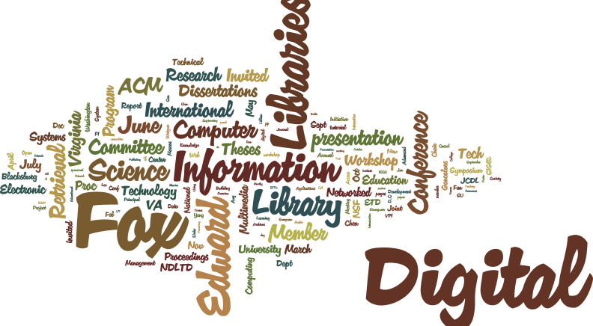
Wordle from Fox CV

Slide 9
Design of
INFORMATION
Access
Extraction
Representation
Retrieval
Systems
Technology
Theory
Viz
Libraries
Archives
Multimedia
Hypermedia
Text
WWW
Hypertext
Images
Search Engine
Crawling
Webpage
Links
Videos
Mining
Analytics
Machine Learning
Relational
Statistics
NLP
Database
Tables
AI
Data
Knowledge

Slide 10
DL Curriculum Framework
Introduction

Slide 11


Slide 12
Informal 5S & DL Definitions
DLs are complex systems that
help satisfy info needs of users (societies)
provide info services (scenarios)
organize info in usable ways (structures)
present info in usable ways (spaces)
communicate info with users (streams)

Slide 13
5Ss
Ss | Examples | Objectives
Streams | Text; video; audio; image | Describes properties of the DL content such as encoding and language for textual material or particular forms of multimedia data (see DL Book 4 Ch. 1)
Structures | Collection; catalog; hypertext; document; metadata | Specifies organizational aspects of the DL content; supports annotations including with subdocuments (see DL Book 3 Ch. 2)
Spaces | Measure; measurable, topological, vector, probabilistic | Defines logical and presentational views of several DL components
Scenarios | Searching, browsing, recommending | Details the behavior of DL services
Societies | Service managers, learners, teachers, etc. | Defines managers, responsible for running DL services; actors, that use those services; and relationships among them

Slide 15
ETANA-DL Architecture
DigBase and DigKit
Lahav
D
A
T
A
B
A
S
E
W
R
A
P
P
E
R
S
Search
U
S
E
R
I
N
T
E
R
F
A
C
E
Browse
Nimrin
Recommend
Umayri
ETANA-DL
UNION
CATALOG
Note
Hisban
Personalize
Megiddo
Review
Jalul
Visualizations
Archaeology
Specific
…
New Sites

Slide 16
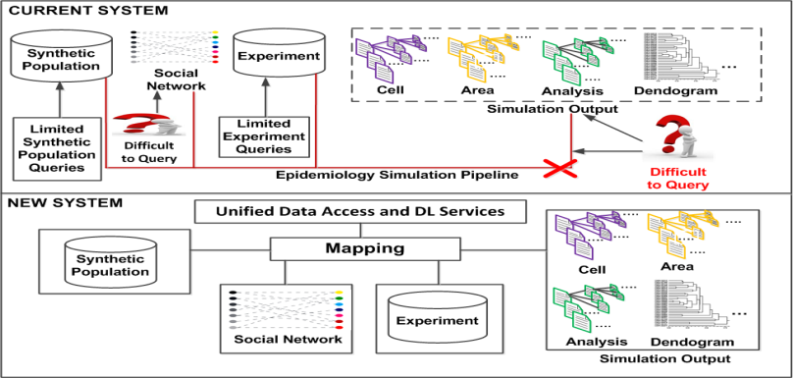



Data Mapping Framework in a Digital Library with Computational Epidemiology Datasets
S.M.Shamimul Hasan, Sandeep Gupta, Edward A. Fox, Keith Bisset, Madhav Marathe ⁻⁻⁻ Virginia Tech (CS, BI)

Slide 17
ETD Classification:
Algorithm Pipeline
ETDs categorized into a node of the category tree (after classification)
Category
Tree
ETD Collection
Category label for each node used as query
ETD metadata used for categorization
Categorized
ETDs
Google
Naïve Bayes Classifiers
Level-wise categorization
Top 50 webpages (for each node in the tree)
Training
Browsing
Web
Interface
Document
Sets
Training
Sets
Cleanup
(stemming,
stopword removal,
etc.)
Venkat Srinivasan

Slide 18
Funded Grants
NSF CRISP : Coordinated, Behaviorally-Aware Recovery for Transportation and Power Disruptions (CBAR-tpd), PI Pamela Murray-Tuite, Co-PIs Edward Fox, Kris Wernstedt; U. Mich. Ann Arbor, PI Seth Guikema
NSF IIS: Global Event and Trend Archive Research (GETAR), PI Fox, Co-PIs Alla Rozovskaya, Andrea L. Kavanaugh, Donald J. Shoemaker; Internet Archive, PI Jefferson Bailey.
IMLS LG: Developing Library Cyberinfrastructure Strategy for Big Data Sharing and Reuse; Zhiwu Xie (PI), Tyler Walters, Edward Fox (20%), Pablo Tarazaga; with eval. from University of North Texas
NSF CREST: Building Capacity in Information Management through a Partnership with Virginia Tech's Digital Library Technology Center, PI Fox (with main grant to UTEP)
VT ARC. VT-Rnet: A 10-Gbps Research Network for Virginia Tech. In-kind support to connect the Digital Library Research Laboratory Hadoop Cluster to VT's 10 gigabits per second network
NEH EH: Veterans in Society Summer Institute for College Teachers, PI James M. Dubinsky, co-PI Bruce E. Pencek, Investigator Fox
NIH: The Social Interactome of Recovery: Social Media as Therapy Development; PI Warren K. Bickel (VTCRI), Fox as co-PI
NSF IIS: Integrated Digital Event Archiving and Library (IDEAL); PI Fox, with co-PIs Donald Shoemaker, Andrea Kavanaugh, Steven Sheetz, and Kristine Hanna (Internet Archive)

Slide 19
IMLS: Developing Library Cyberinfrastructure
Strategy for Big Data Sharing and Reuse
3 patterns for Library Big Data Services

Slide 20
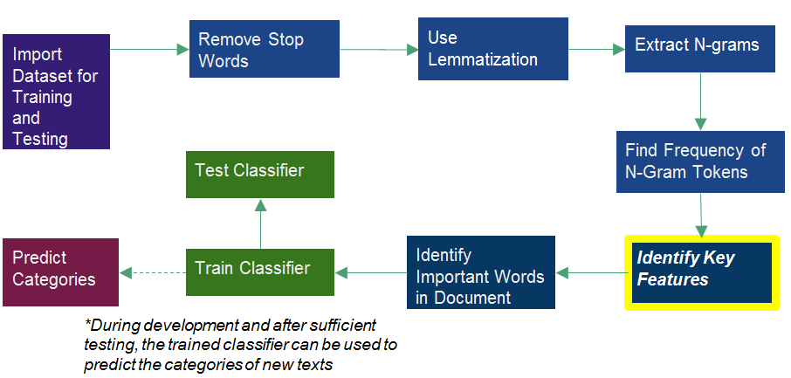
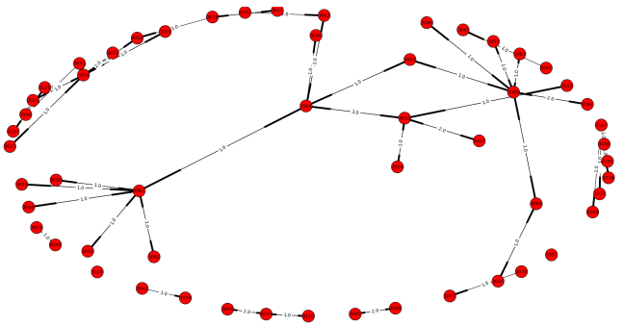
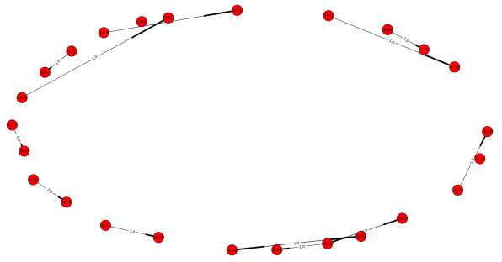
Communication Analysis in the Social Interactome
Text Classification
Abigail Bartolome, Advised by Dr. Edward A Fox
NIH Grant: 1R01DA039456-01
The Social Interactome of Recovery: Social Media as Therapy Development
Acknowledgements to Dr. Chris Franck, Prashant Chandrasekar, Lexie Mellis
Virginia Tech CS 4994, April 2016
Multinomial, naïve-Bayes classification considers the count for each feature name in making classifications
Training the classifier: built a corpus of 150 documents– 75 of which were sentences that were clearly indicative of belonging to a success story and 75 of which were sentences that were not indicative of a success story
Acknowledgements to Victoria Worrall for her efforts on this classifier last semester
Network Structures
Lattice Network | Small-world Network
128 participants | 128 participants
22 users in the most connected component | 4 users in the most connected component
Queried the Friendica database to see who the participants wrote text to and who the participants received text from
Generated graph of the private messaging communication in the lattice social network
Samples of Story Classification
Lattice Network with Administrator Removed
Small-Network with Administrator Removed
"Since being in recovery I have not been around any drugs or alcohol but if I had to, such as a wedding or something I wouldn't have a problem saying that I don't drink or I'm in recovery." => success
'Drove very drunk.' => not_success

Slide 21

IDEAL stakeholders
Notes:
Help affected communities to recover more quickly and effectively
Provide global network with relevant information and resources
Support the research community, emergency personnel, decision makers, and the public in reacting to and recovering from crises

Slide 22
Archiving and Analyzing using Bigdata Hadoop cluster

Slide 23
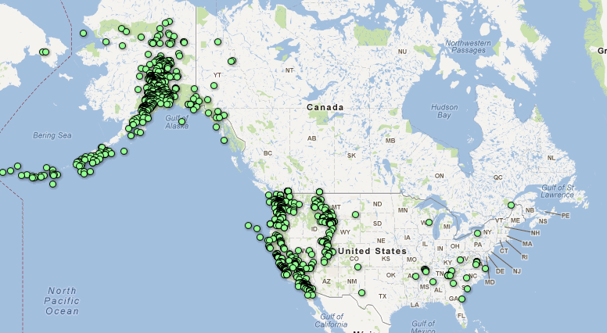
What Causes Water Main Breaks? Earthquakes (USGS)
Mar. 1 – Apr. 5, 2012
Notes:
Search earthquake
Histogram: March 2014, May 2015 => not Winter
Location Name: Fullerton, CA; La Habra, CA; Brea CA

Slide 24
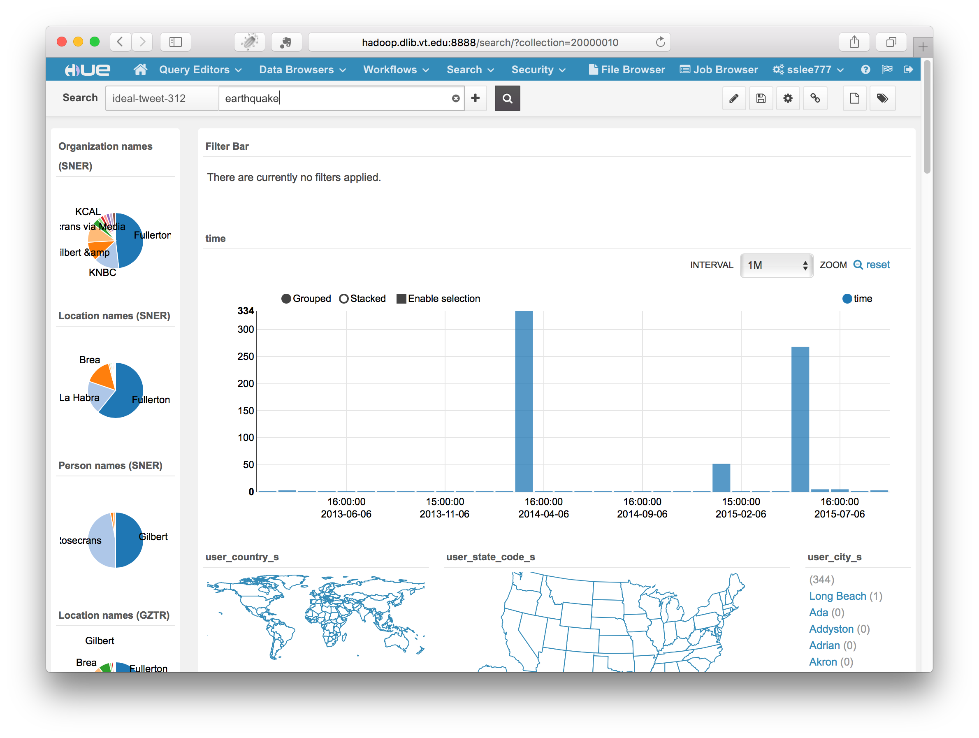

Slide 25
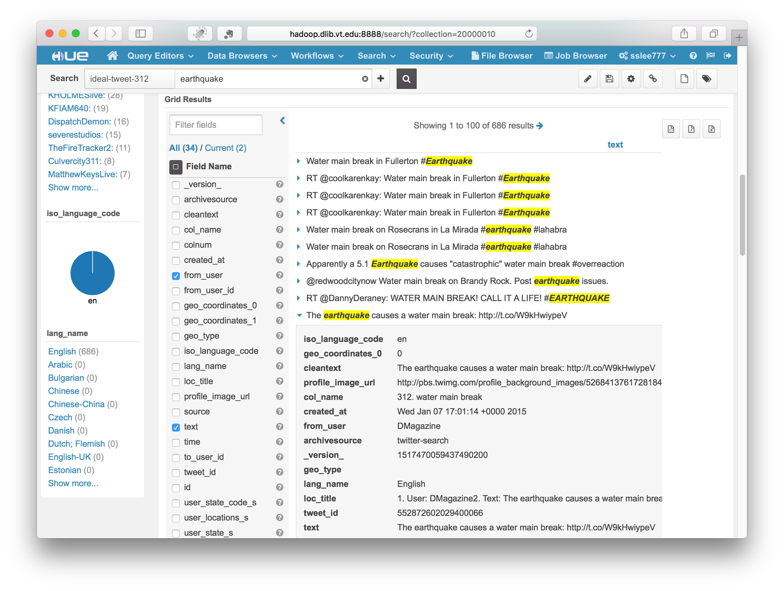

Slide 26
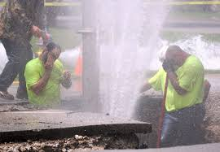
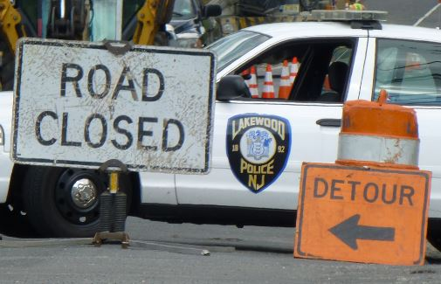
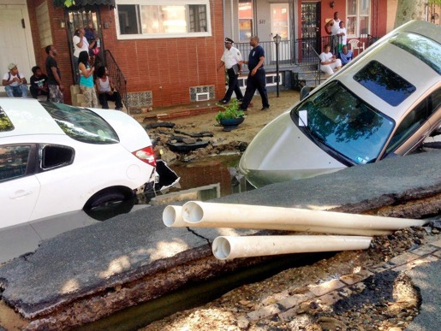
Who is involved in a WMB ?
Fix water pipe
  Water utility
  city/town utility
Traffic
  Police
Affected
  Citizen
Others …
Lakewood, NJ, June. 2014
West Philadelphia, PA, June. 2015
Notes:
Click “NewYork” in user_city_s
See organization: FDNY, MTA (Metropolitan Transportation Authority), NYU
Person name: De Blasio
Hashtags, Mentions

Slide 27
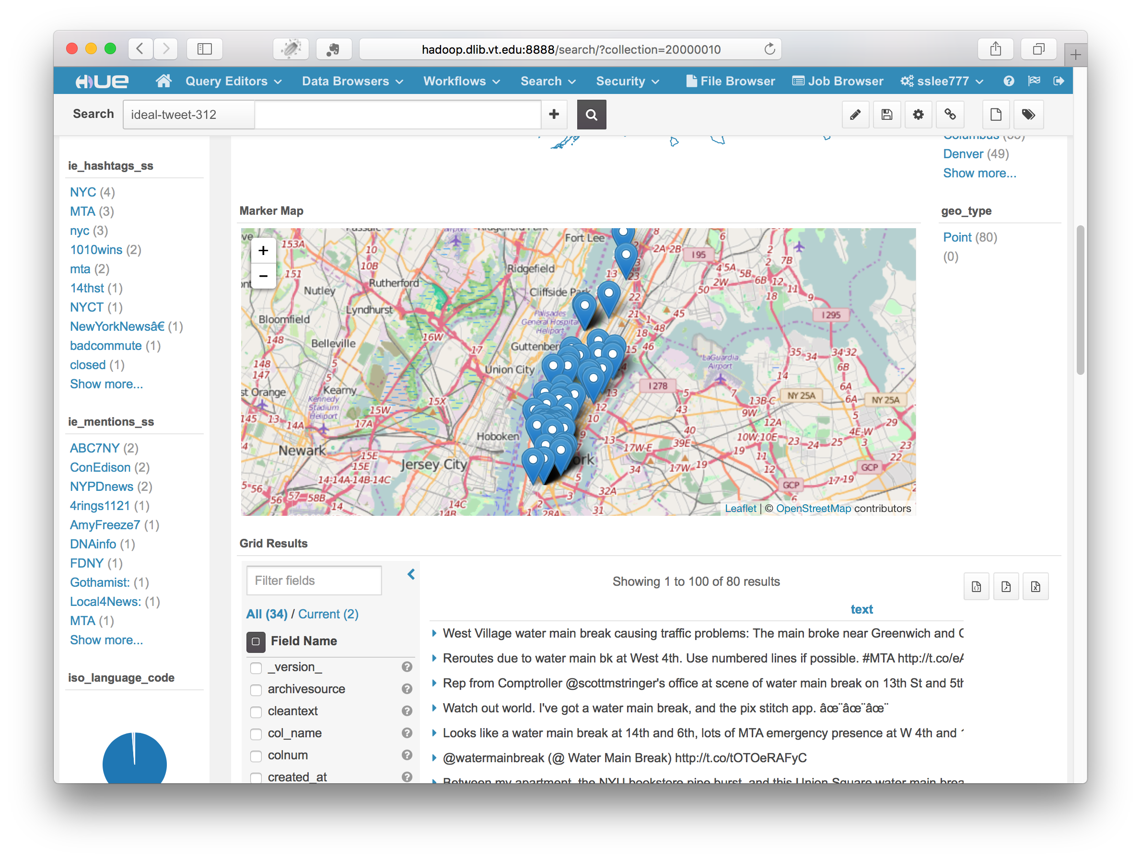

Slide 28
GETAR Architecture - 1

Slide 29
GETAR Architecture - 2

Slide 30
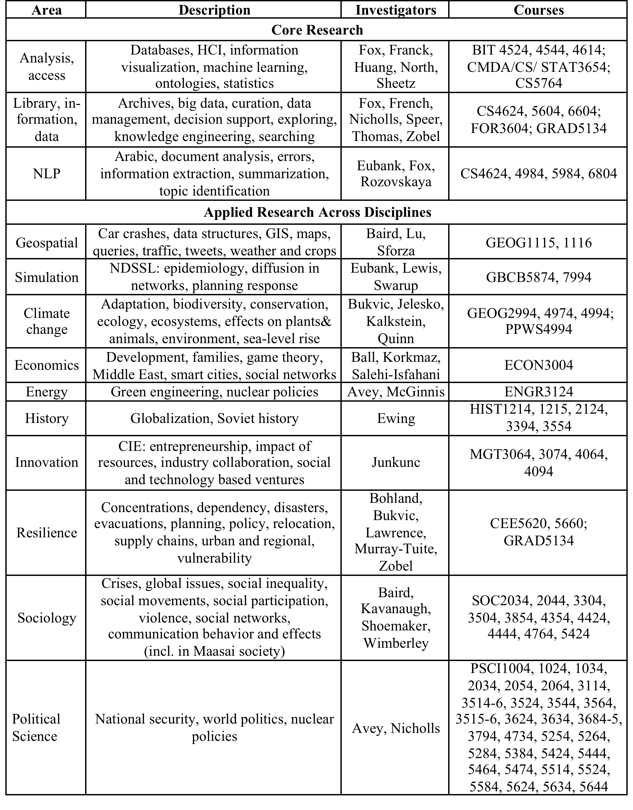
GETAR:
Areas,
Investigators,
Courses

Slide 31
Where Can You Fit in CS?
CS Looking Outward:
CS – Looking Inside:
Interaction: Games, Graphics, HCI, VR/AR
Programming: Algorithms, Languages, Problem Solving, Workflows
Simulation: Agents, Modeling: Epidemiology
KID: Knowledge, Information, Data: AI, Machine Learning
HPC <-> PC <-> GPU
Networking
Programming
  Algorithms,
  Languages,
  Problem Solving
  Workflows
Systems
Theory

