Slide 1
GFURR seminar
Can Collecting, Archiving, Analyzing, and Accessing Webpages and Tweets Enhance Resilience Research and Education?
Edward A. Fox, Andrea Kavanaugh,
Donald Shoemaker, Steven Sheetz, Mohamed Magdy and Sunshin Lee
IDEAL project, DLRL, CS, Virginia Tech
Feb. 11, 2016
Acknowledgments:
CS@VT, CHCI, CCSR #448371-19912 and NSF grants IIS-1319578, IIS-0916733, IIS-0736055, DUE-1141209
Notes:
DLRL; digital library research lab

Slide 2
Topics
CCSR project with Arlington and IBM
IDEAL: project, example collections
Big data collection, processing, tools
Case study, demo: water main breaks
Discussion: connecting IDEAL & GFURR

Slide 3


Center for Community Security & Resilience (CCSR)
Social Media for
Cities, Counties and Communities
2010-2011
with Arlington County, VA
Funded by CCSR #448371-19912

Slide 4
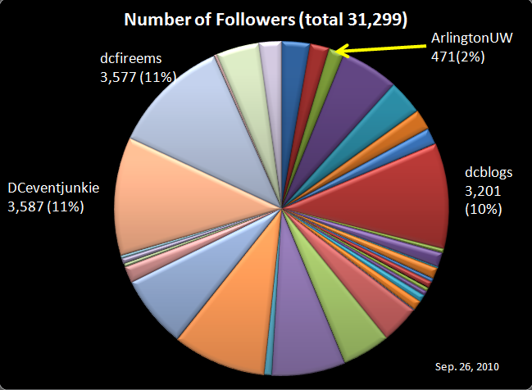
Number of Followers for 34 Civic Orgs.
Unique Followers: 22,325
Crisis, Tragedy, and Recovery Network

Slide 5
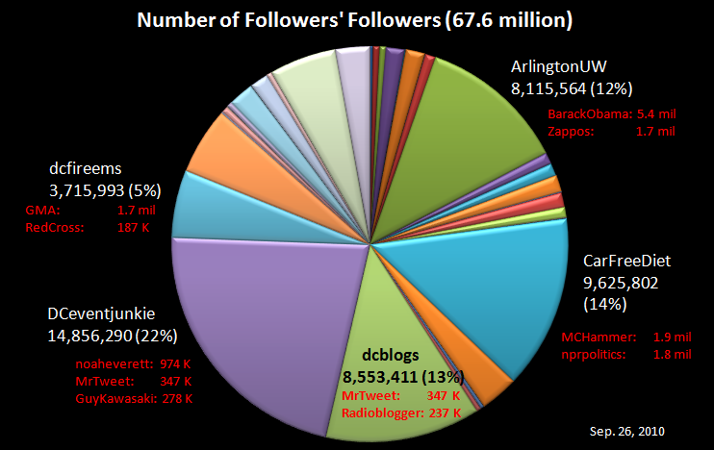
Orgs Followers’ Followers Count
Crisis, Tragedy, and Recovery Network
Notes:
zappos: shoes, clothing company
BarackObama: president of the US
GuyKawasaki: alltop.com, former chief evangelist of Apple
MrTweet: service that connects people with the same interests
Noaheverett: founder of twitpic
Nprpolitics: Political news
MCHammer: musician
RedCross:
GMA: ABC's Good Morning America
Radioblogger:

Slide 6
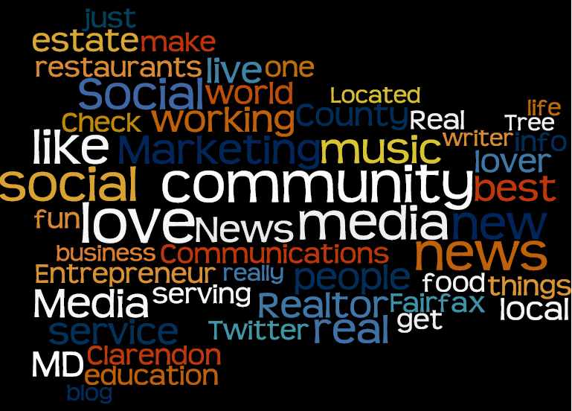
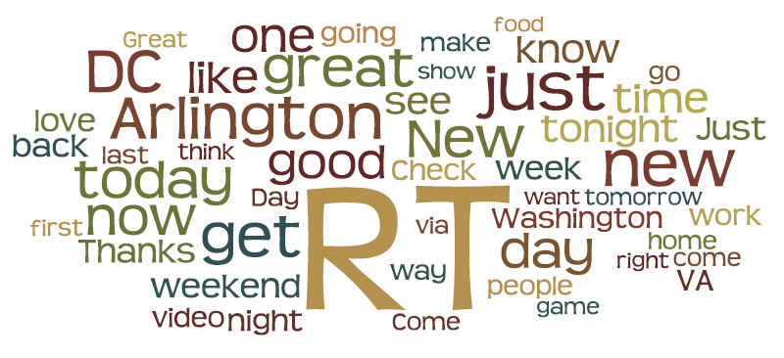
ArlingtonUW (ArlingtonUnwired.com)
Org bio: Active. Mobile. Community. Your source for everything Arlington
Followers’ bio
Followers’ recent 20 tweets
Arlington Tweet Analysis

Slide 7
Facebook Analysis
Posts by Arlington County
  112 posts over August and September 2010
  824 responses to those posts
Posts highly consistent with Social Media Policy
Evaluated county posts to identify the topics being communicated
Identified the number and overall nature (positive or negative) of responses for each post
Arlington Facebook Analysis

Slide 8
Facebook Analysis Topic Frequency
Arlington Facebook Analysis

Slide 9
Facebook Analysis Responses
824 Responses
18% of the 4500 fans on Facebook
  Responded in last 2 months (assuming 1 post per person)
Mostly Positive Responses
  Many “LIKES” (button on Facebook)
Top 21 (19%) posts received 50% of responses
Arlington Facebook Analysis

Slide 10
Facebook Analysis Top 21 Post Responses by Topic
Arlington Facebook Analysis

Slide 11
Facebook Analysis Overall Response to Post
Arlington Facebook Analysis

Slide 12
Tag Clouds for Arlington County
Produced from 1,800 YouTube Videos
Search for videos containing the phrase “Arlington County”
  Search performed using a Perl Script
  Generated from all videos that met these criteria
2 Types of Tag Clouds Generated:
  1) Using video titles
  2) Using video tags (presented in next slide)
What can we learn from these representations of social media use?
  Size of words represents the frequency with which each term
  appeared in the search
  Provides some indication of the importance of certain civic issues to
  members of the community
Arlington YouTube Tag Analysis

Slide 13
Prior History, Studies, Connections
Prior grants related to:
  4/16 archiving
  Collection and infrastructure for events related to crises, tragedies, and community recovery
Ontologies, emergency management, civil unrest
Education connections
  Problem/project based learning (PBL)
  Computational linguistics (NLP): CS4984
  Information retrieval (search engines): CS5604

Slide 14
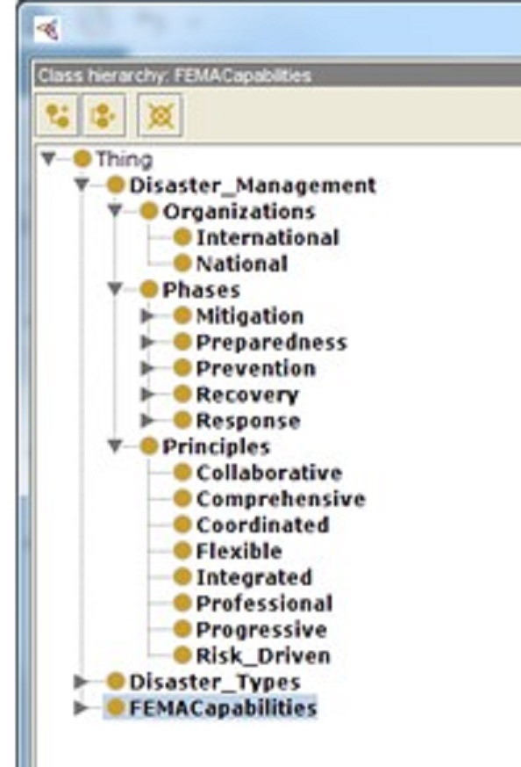

Slide 15
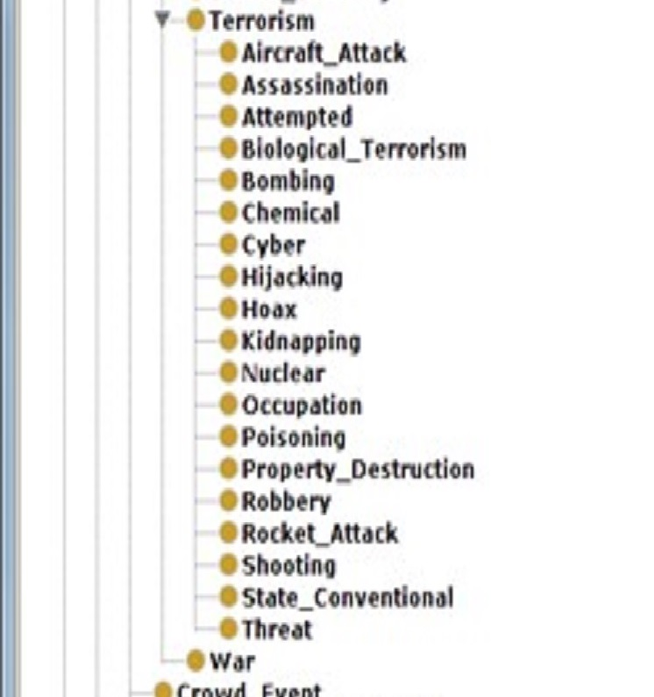

Slide 16
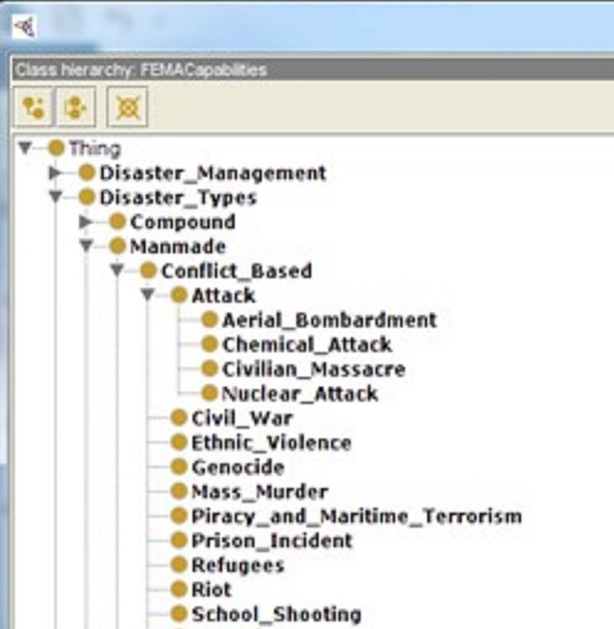

Slide 17
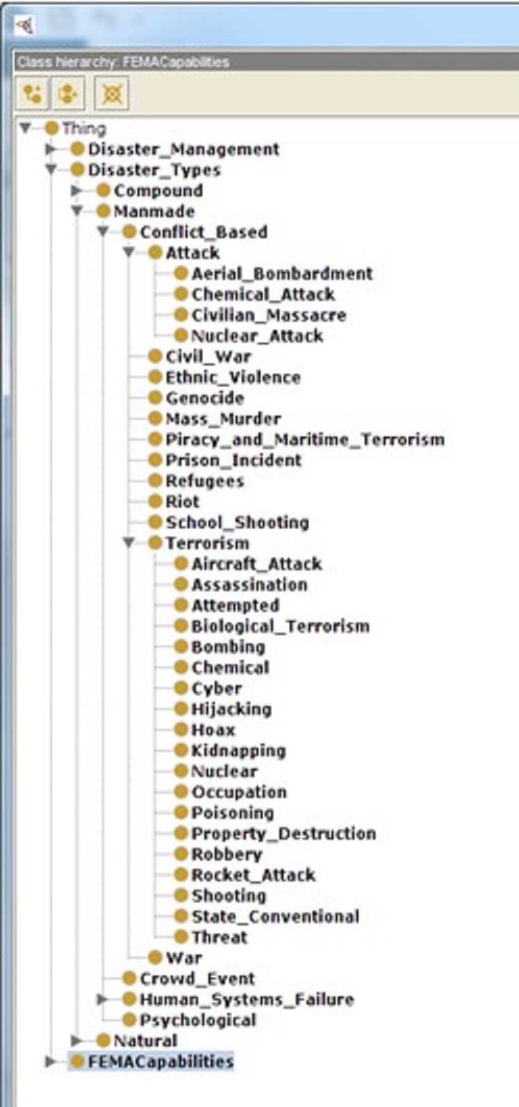

Slide 18
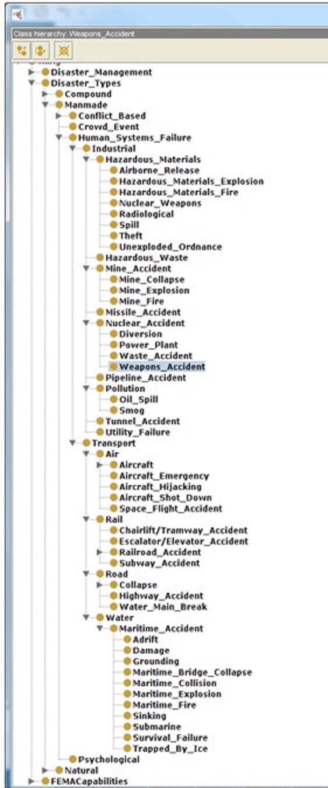

Slide 19
Integrated Digital Events Archiving and Library (IDEAL) Project
Collections
  66 webpage collections hosted by the Internet Archive through Archive-It, curated by Virginia Tech (11TB in size)
  1.1 billion tweets (across about 1000 collections): many related to important local, national, and global events /concerns
Services
  Collecting, archiving, analyzing, searching, browsing, and visualizing -- utilizing our Hadoop cluster to aid researchers and other interested parties.
http://eventsarchive.org, http://hadoop.dlib.vt.edu

Slide 20
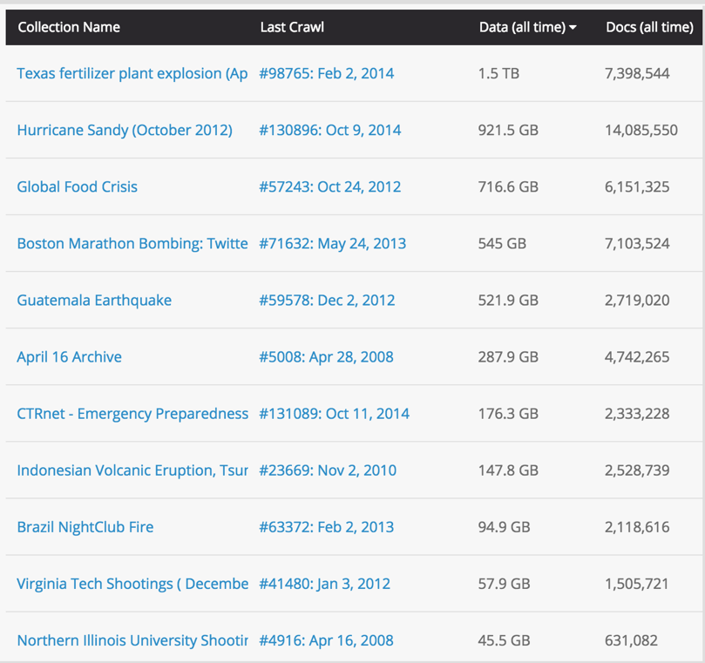
Collecting Webpages
Started 2007
Used Internet Archive (IA)
  66 collections
  11TB
Shootings, earthquakes, bombings, hurricanes, …

Slide 21
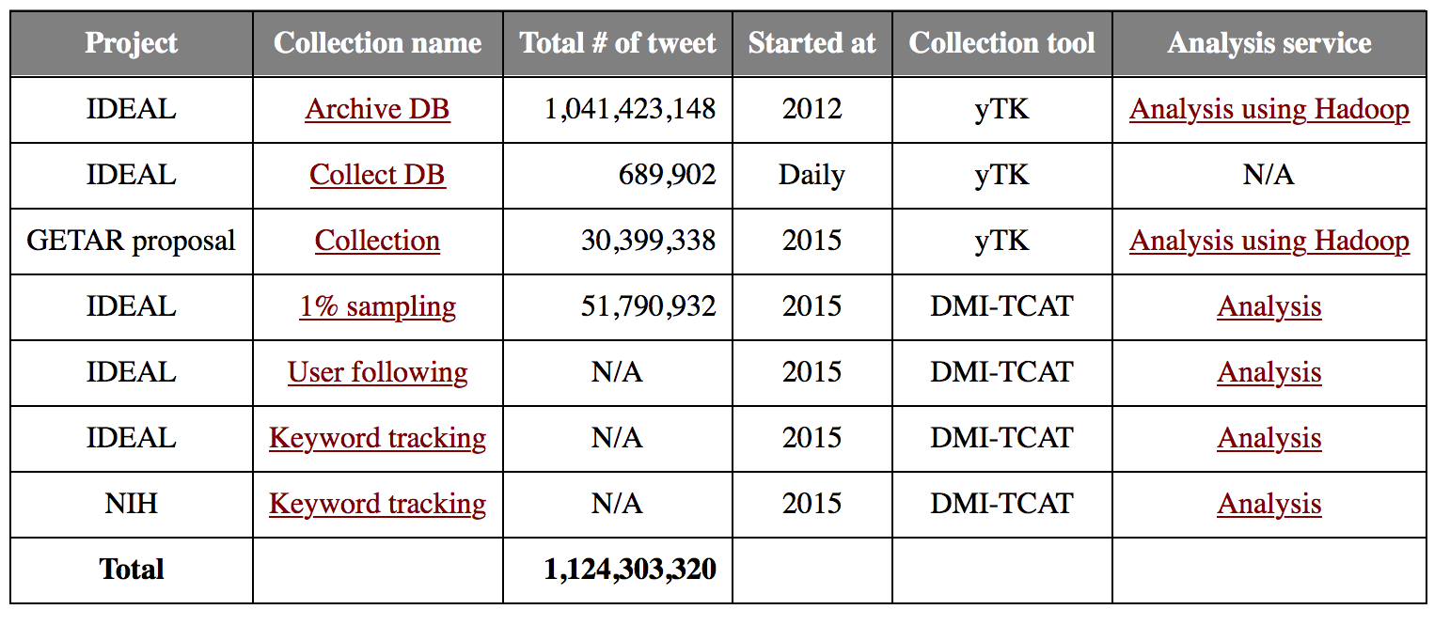
Collecting tweets
Collections for multiple projects
  Tweets from YourTwapperKeeper, DMI-TCAT

Slide 22
Collection Example 1:
School Shooting
Collection
  Over 1 million tweets concerning school shootings
  A map of worldwide school shootings and a timeline of international school shootings
Users
  First responders
  Urban and emergency planners
  Treatment and counseling therapists
  Social science researchers studying tragic events and their aftermaths (including personal and community resilience and recovery)

Slide 23
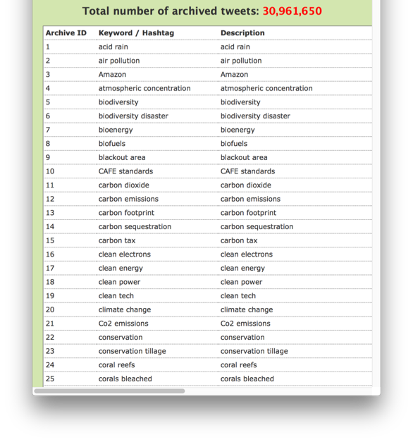
Collection Example 2:
GETAR project
Global Event and Trend Archive Research
  Tackle key global challenges, e.g., climate change (as well as opportunities), innovation and resilience
Collection
  Started 10/8/2015
  306 collections
  30,961,650 tweets (as of 2/10/2016)
  Including global warming,
  Internet of things, population,
  and environment

Slide 24
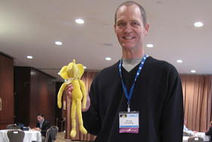
What is Big Data and Hadoop
Definition
  Big data
    a collection of data sets so large and complex that it becomes difficult to process using on-hand database management tools or traditional data processing applications.¹⁾
  Apache Hadoop
    a framework for distributed processing of large data sets across clusters of computers using simple programming models.²⁾
1) Big data definition: wikipedia.org
2) Hadoop definition: hadoop.apache.org
Notes:
Doug Cutting created open-source Hadoop Framework.
BigData
Hadoop
So, Apache Hadoop is one of the best solution for BigData
Let’s look at main two components in Hadoop

Slide 25

Hadoop solutions
Hadoop
  Cloudera Academic Partnership, software
  MapReduce (YARN: MapReduce V2)
    a programming model for processing large data sets with a parallel, distributed algorithm on a cluster
  HDFS
    a distributed, scalable, reliable, and portable file-system written in Java for the Hadoop framework
Notes:
Main Two Component
MapReduce
HDFS
But this Hadoop is inspired by Google’s papers

Slide 26
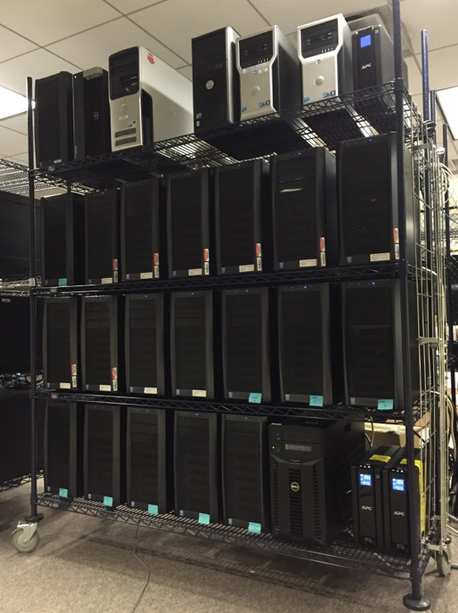
Archiving and Analyzing using Bigdata Hadoop cluster
Hadoop (using Desktop PC)
  # of Nodes: 20
  CPU: Intel i5 Haswell Quad core 3.3Ghz
  RAM: 640 GB (20 * 32GB RAM)
  HDD: 60 TB (20 * 3TB HDD)
  Backup: 12TB, 8.3TB NAS
Servers
  Tweet collecting
  Web crawling
  Geocoding
  Search (Solr)

Slide 27
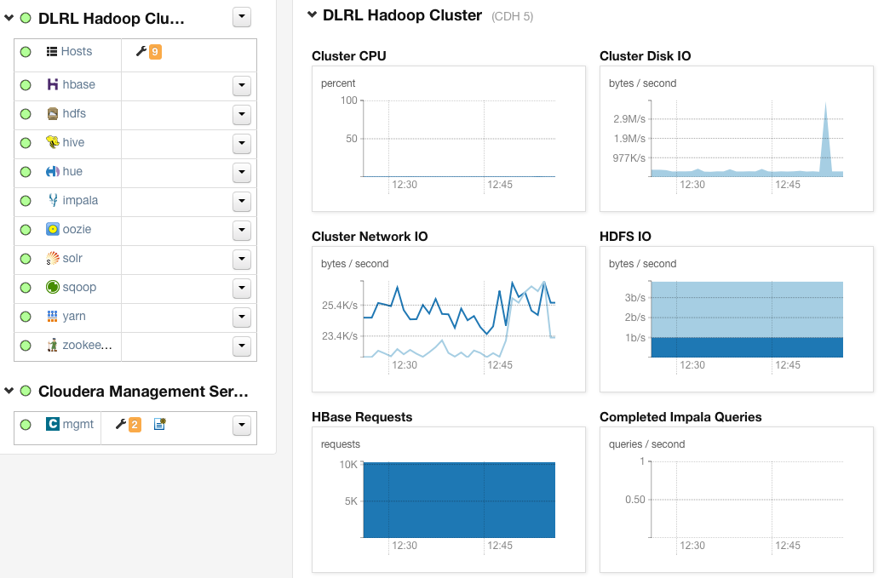
DLRL cluster - Services

Slide 28
Archiving and Analyzing using Bigdata Hadoop cluster

Slide 29
Tools for research
Spark or Mahout for machine learning:
  Classification, clustering
  Topic analysis (LDA), Frequent Patterns Mining
Solr/Lucene: Search/(Faceted) Browse
Natural Language Processing and Named Entity Recognition: NLTK (Python), SNER
Information visualization (social networks)
Connections with GIS, other data/info systems
Notes:
Hadoop Streaming
: The utility allows you to create and run Map/Reduce jobs with any executable or script as the mapper and/or the reducer

Slide 30
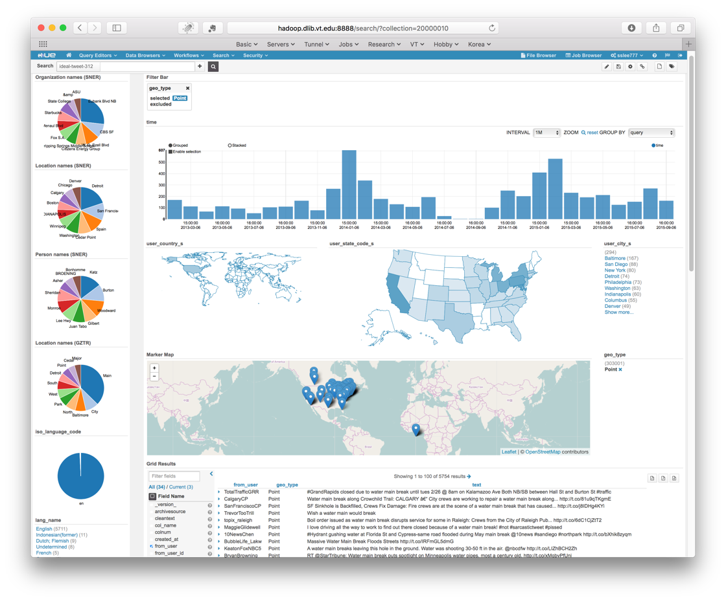
Demo: Analyze a tweet collection for water main breaks (WMBs)
Notes:
When WMB happened more? Winter

Slide 31
Processing (also for CS5604)

Slide 32
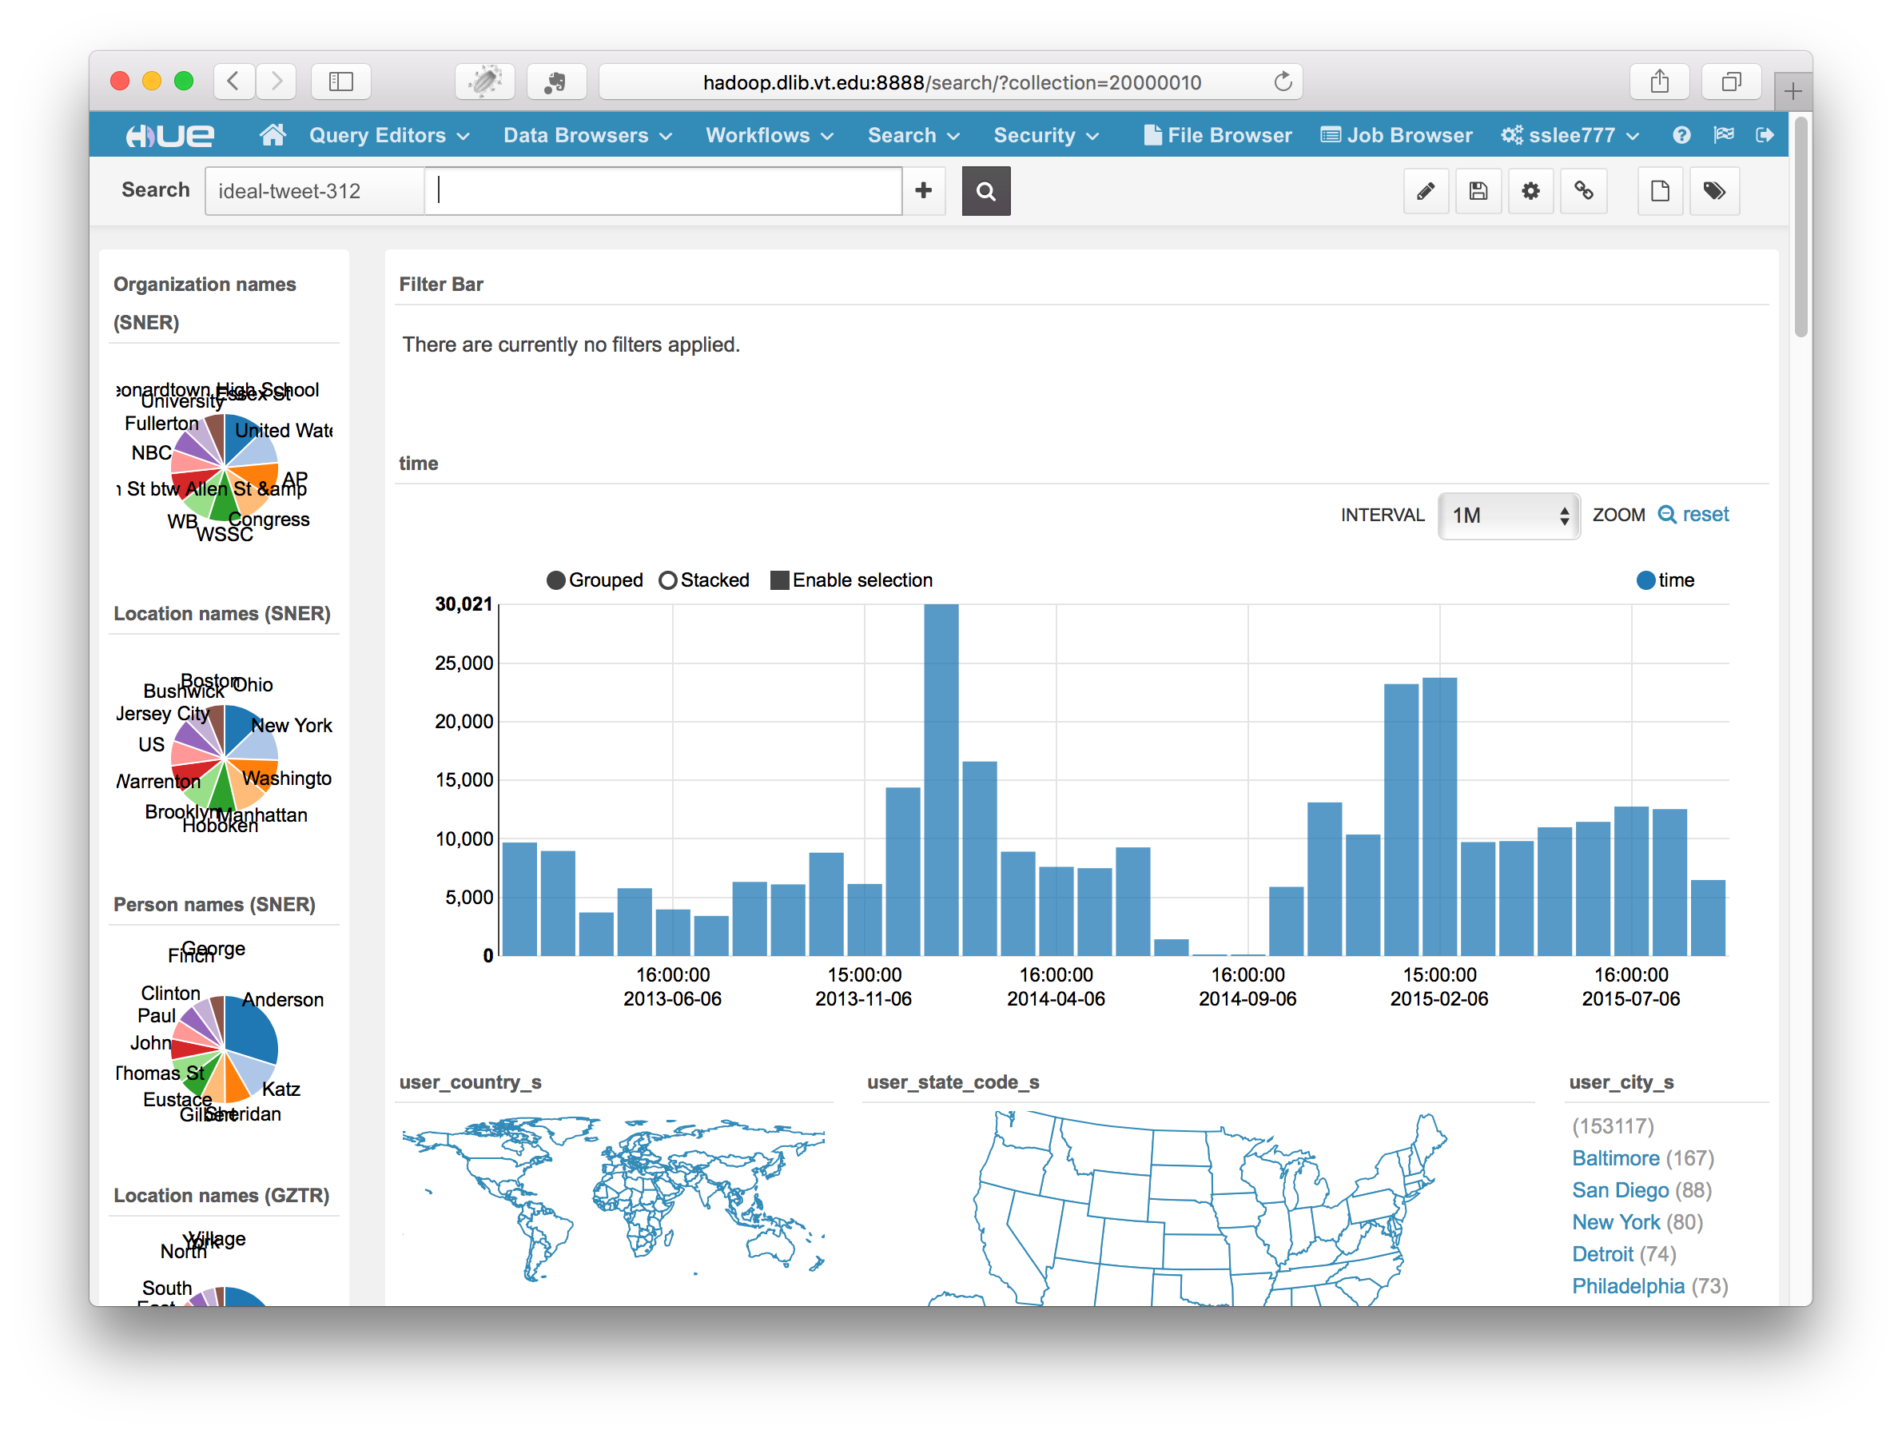

Slide 33
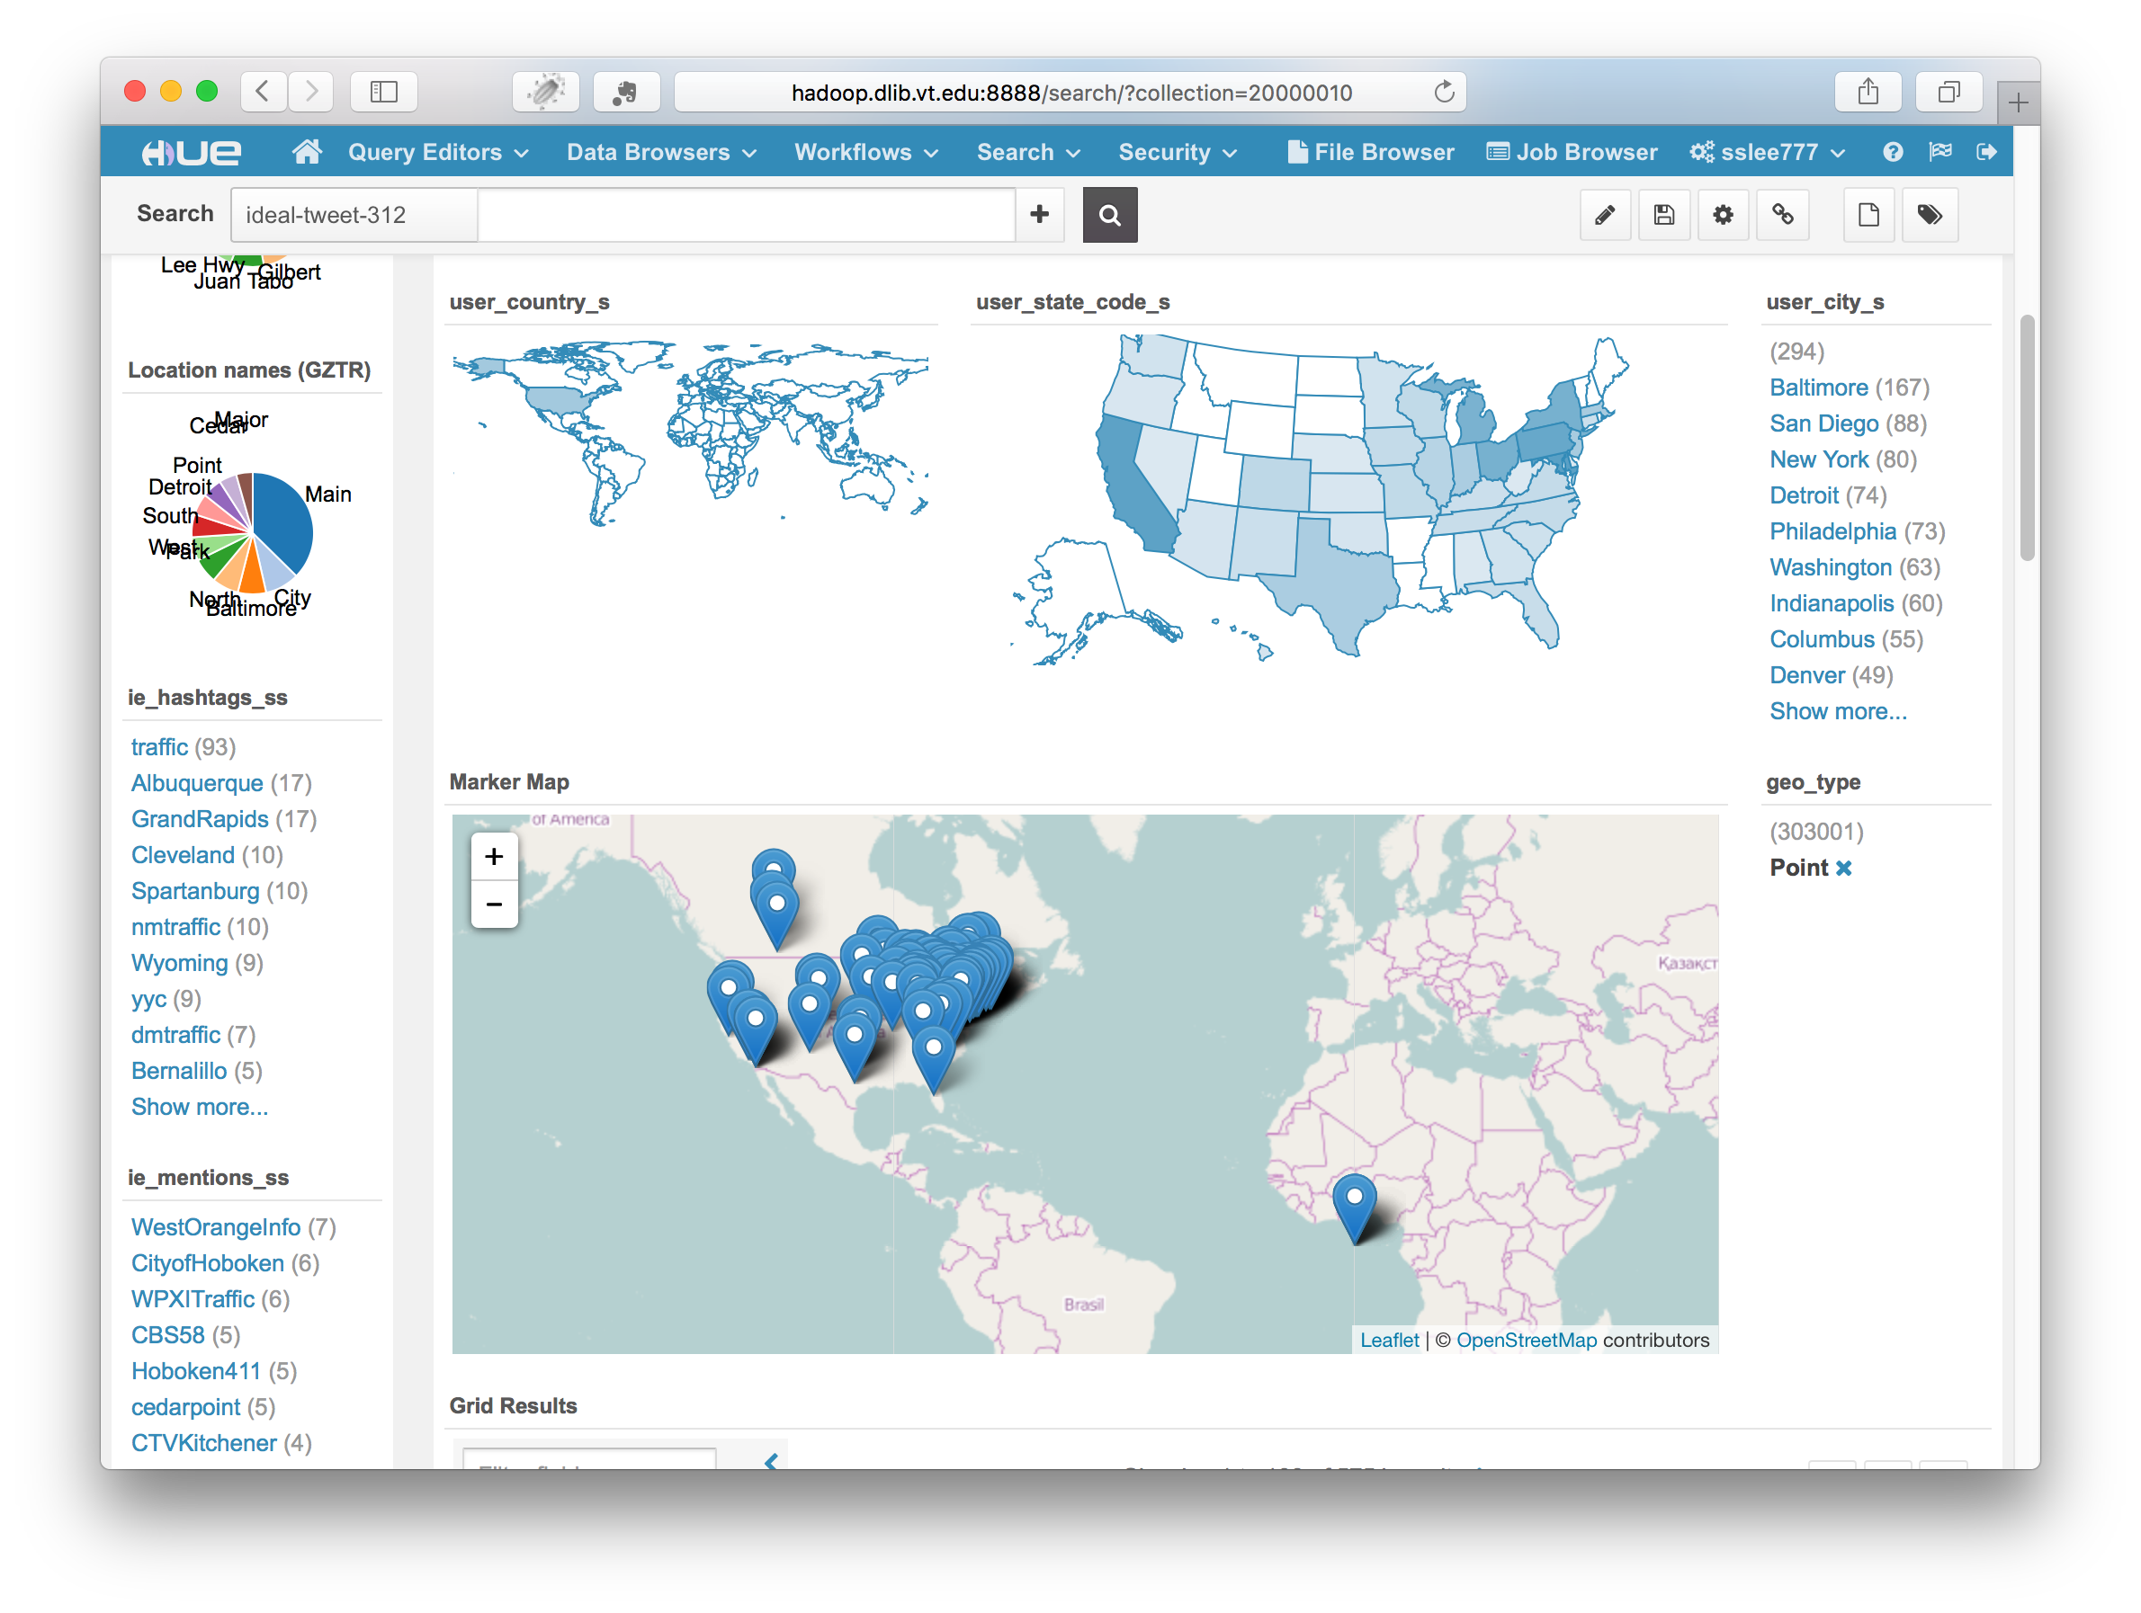

Slide 34
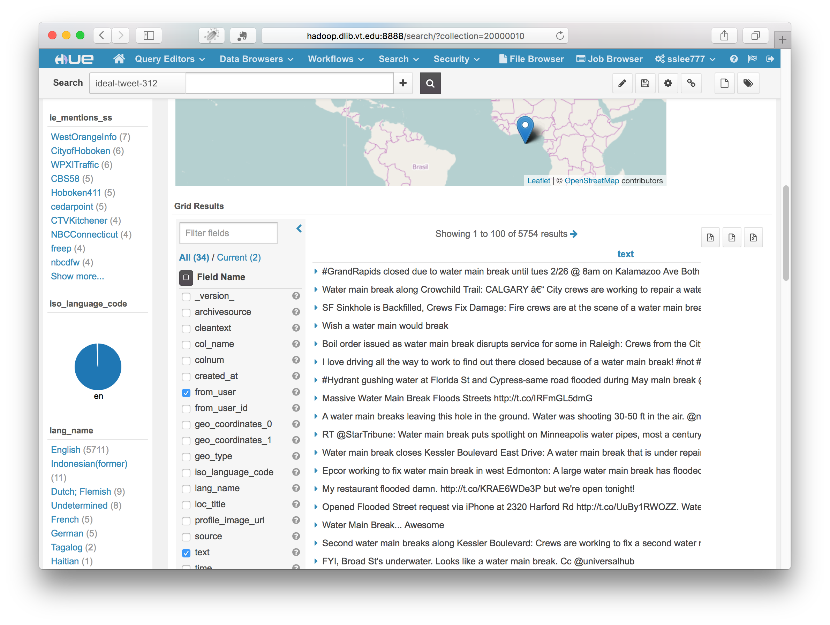

Slide 35
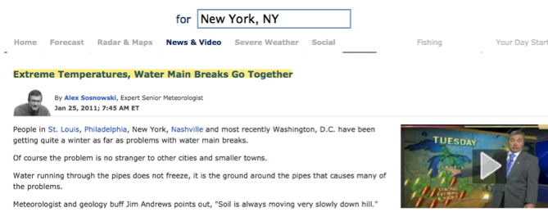
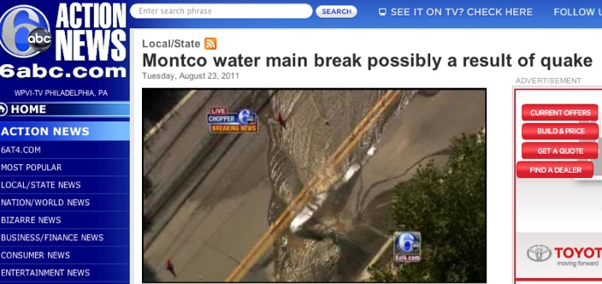
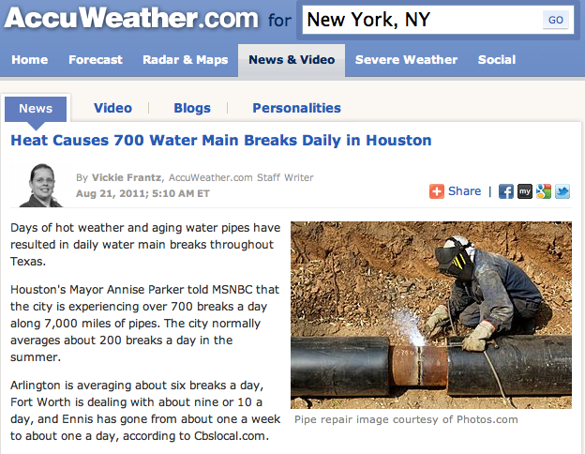
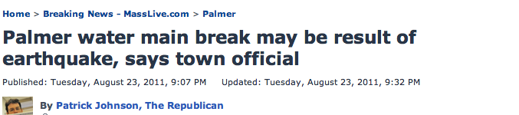
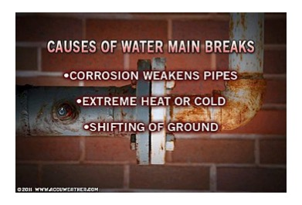
What Causes Water Main Breaks?
AccuWeather.com
MassLive.com
Notes:
Many people think that there is a correlation between earthquake or severe weather and water main break.
We can easily find many example.
For example, Expert Senior Meteorologist said “Extreme Temperature, Water Main Breaks Go Together”.
Vickie Frantz, Accuweather.com Staff writer, also said “Heat causes 700 water main breaks daily in Houston”
Two news channels reporter mentioned about the correlation between earthquake and water main break. “Montco water main…”, “Palmer water…”
Alex, Meteorologist defines causes of water main breaks like this. 1. 2. 3
Let’s try to find some evidences or correlation in tweet data

Slide 36


Slide 37
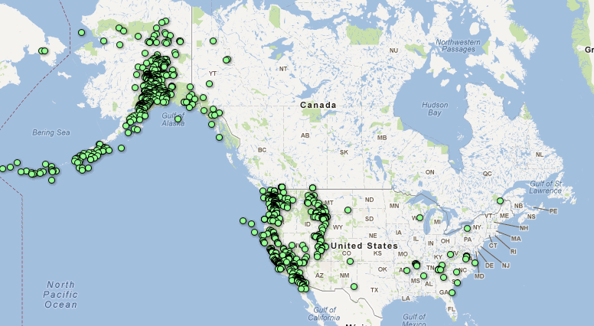
What Causes Water Main Breaks? Earthquakes (USGS)
Mar. 1 – Apr. 5, 2012
Notes:
Search earthquake
Histogram: March 2014, May 2015 => not Winter
Location Name: Fullerton, CA; La Habra, CA; Brea CA

Slide 38
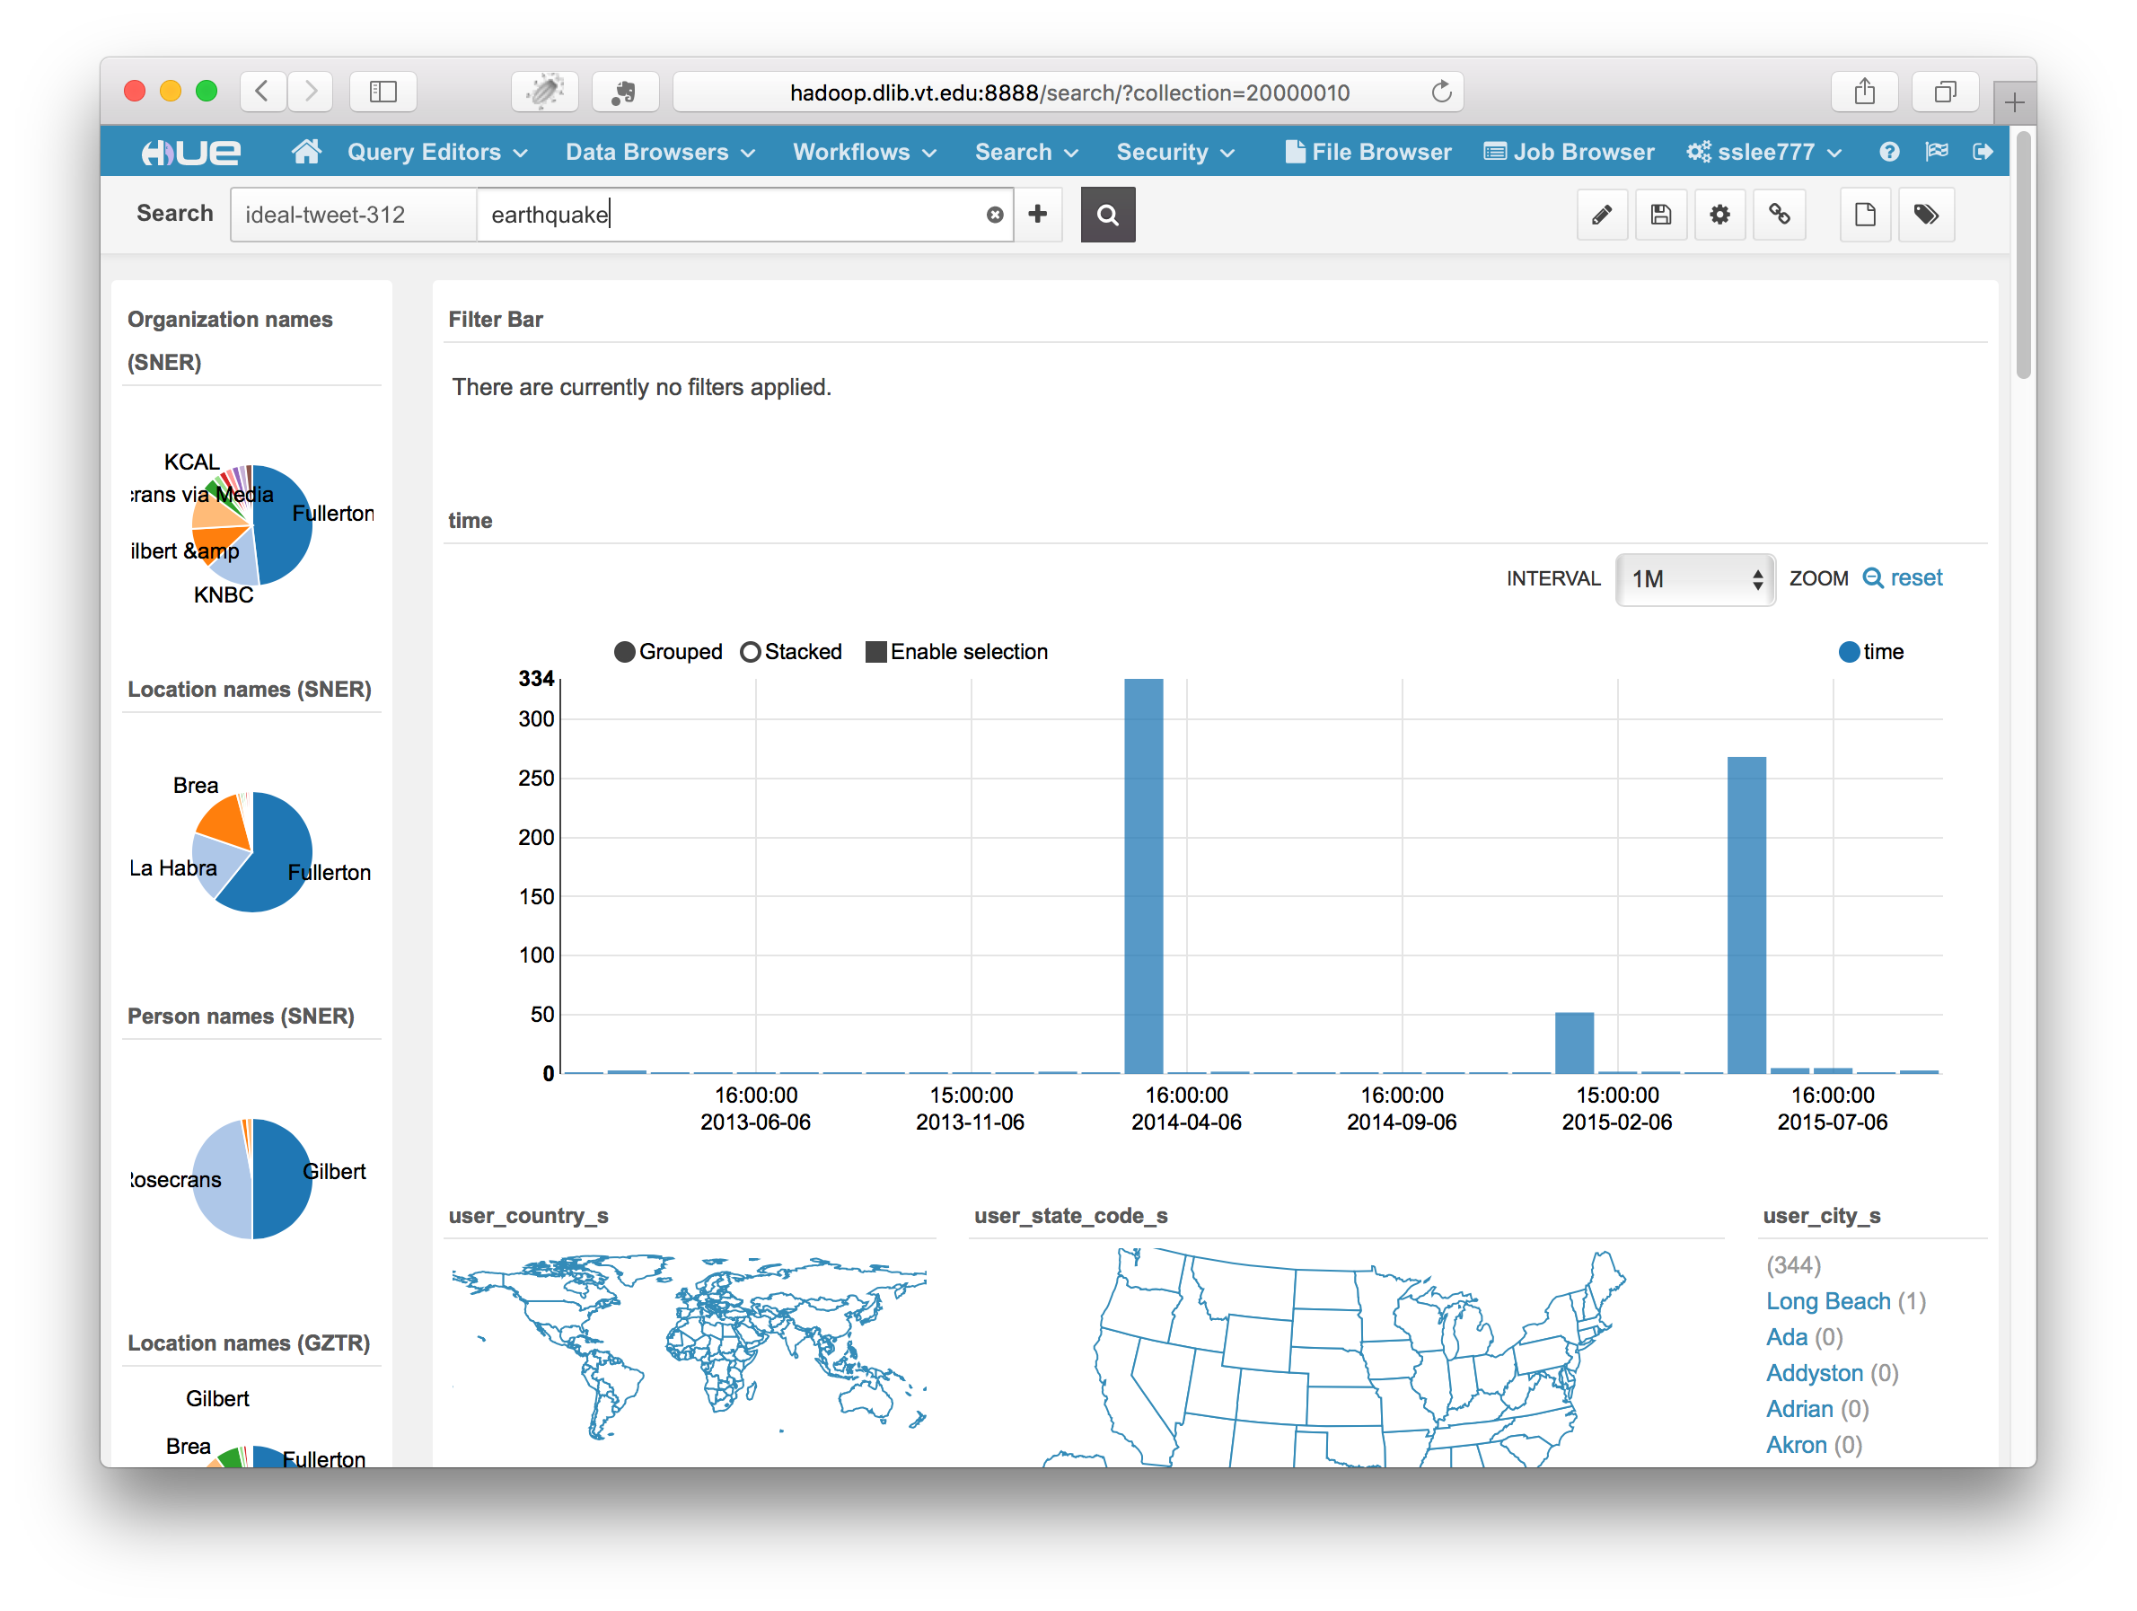

Slide 39
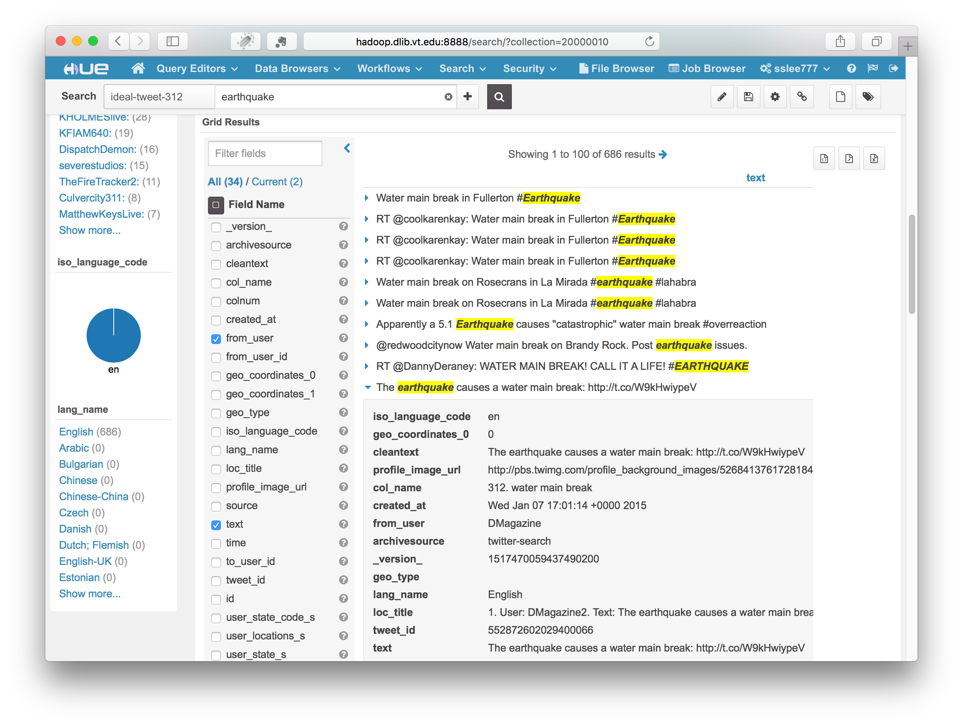

Slide 40
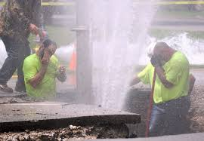
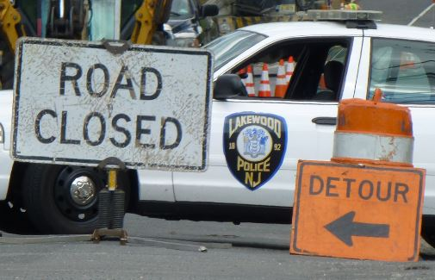
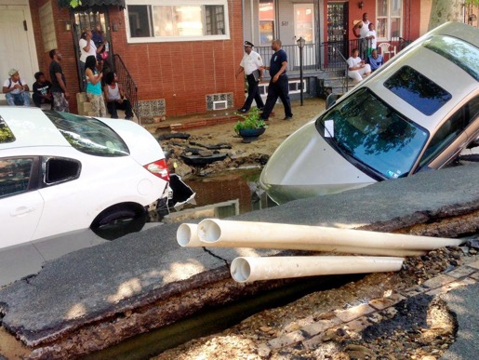
Who is involved in a WMB ?
Fix water pipe
  Water utility
  city/town utility
Traffic
  Police
Affected
  Citizen
Others …
Lakewood, NJ, June. 2014
West Philadelphia, PA, June. 2015
Notes:
Click “NewYork” in user_city_s
See organization: FDNY, MTA (Metropolitan Transportation Authority), NYU
Person name: De Blasio
Hashtags, Mentions

Slide 41
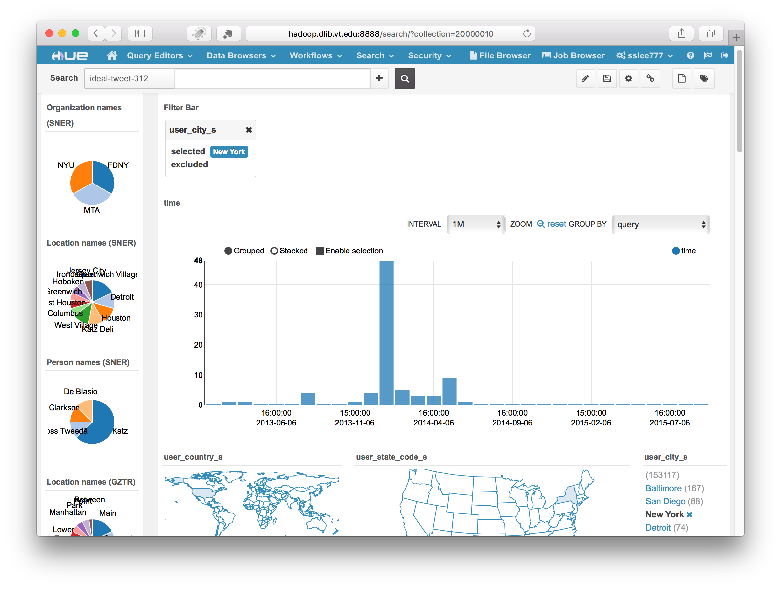

Slide 42
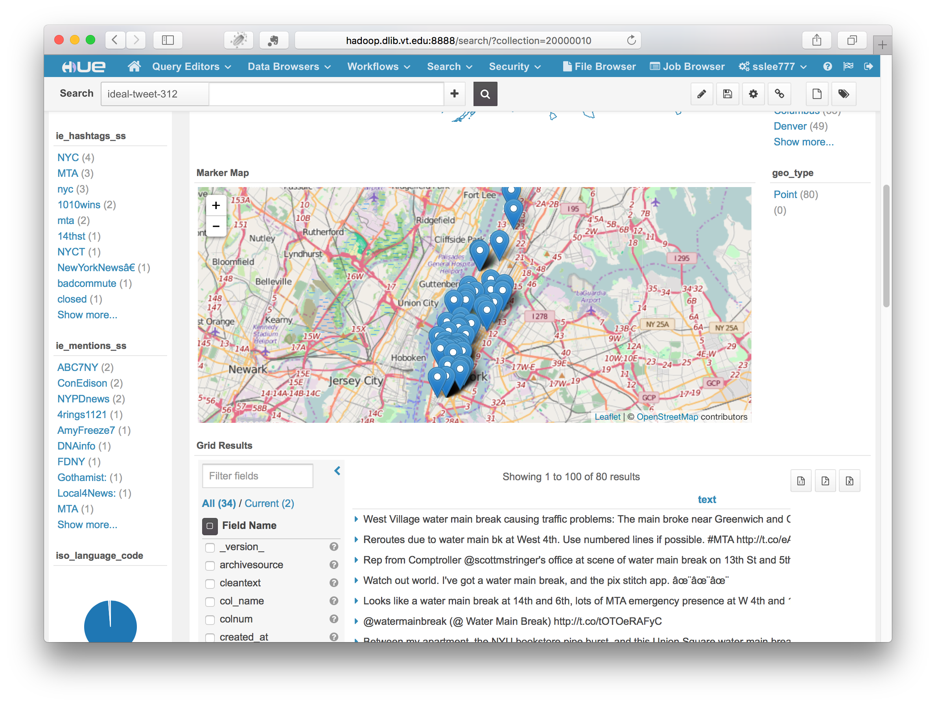

Slide 43
Discussion
Questions?
How can IDEAL help GFURR?
How can GFURR help IDEAL?
Collaborations, proposals, partners, …
(Possible supplement related to smart and connected communities)

