Slide 1
Teaching Big Data Through Problem-Based Learning
Courses in Computational Linguistics and Information Retrieval
Richard Gruss, Business Information Technology, Virginia Tech
Tarek Kanan
Software Engineering Department
Al Zaytonah University of Jordan
Xuan Zhang, Mohamed Farag, Edward A. Fox,
Computer Science, Virginia Tech
Mary C. English, The Center for Advancing Teaching and Learning
Through Research, Northeastern University
Notes:
This is about two innovative courses offered at Virginia Tech last year, an undergraduate course in the fall and a graduate course in the spring. They both used a pedagogical technique that, while not new, is rarely offered at this level. No lectures, no problem sets, no specific programming assignments. Students are set to work at the beginning of the term on a relevant problem, and they do what they need to, in groups, to solve it.
In addition to being an implementation of a different and uniquely effective style in this context, these courses train students in a skill set that in currently in hot demand: Big Data.

Slide 2
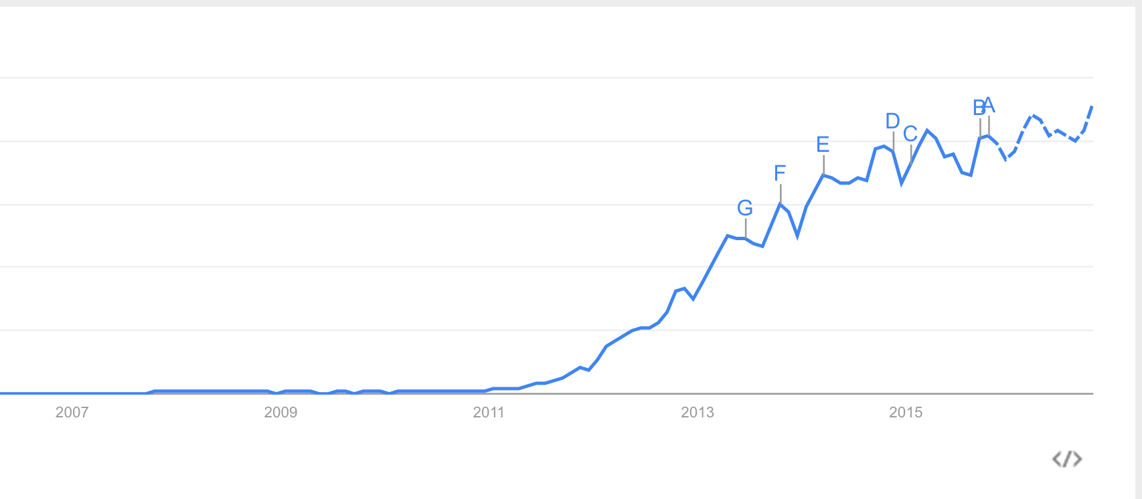
Big Data
Gartner: "Big data is high volume, high velocity, and/or high variety information assets that require new forms of processing to enable enhanced decision making, insight discovery and process optimization."
IBM: 2.5 quintillion bytes of data every day, 90% of it created in the past two years.
Merrill Lynch and Gartner: 85% of data is unstructured.
Notes:
Big Data is a buzz term, but it’s a reality, and it’s the hottest skill set when it comes to graduate employability. Major software companies invested $15 billion in firms specializing in big data analysis.
You can see from the Google trends chart that it was searched for 1 to 1, about as often as average, up to 2011. Now it’s over a hundred. Gartner has centered their definition on the these V’s. Variety—it’s coming from apps, social media sites, online searches, transactional data. Text heavy (unstructured) fields include medicine, law, finance.
This is a new skill set branching off the traditional ones. There’s a land rush as departments lay claim to producing data scientists. Which brings me to introductions….

Slide 3
Who we are
Richard Gruss,
PhD student, Business Information Technology,
Pamplin College of Business, Virginia Tech
Ed Fox,
Professor, Computer Science
College of Engineering, Virginia Tech
Tarek Kanan, Xuan Zhang, Mohamed Farag
PhD Students of Dr. Fox
Mary English
PhD in Educational Psychology
Associate Director, Center for Advancing Teaching & Learning through Research, Northeastern University (formerly Virginia Tech)
Notes:
Wehave an unusual cast of characters here…
Mary worked with faculty members across the university to implement PBL.
These two courses were the result of Dr. Fox working with Dr. English.
Throughout the presentation I want to address the question of why this approach is better? Traditional methods stress concepts and theory. By getting immersed in practice, students see how the theory has solved problems, and hopefully identify new problems that haven’t had solutions yet.

Slide 4
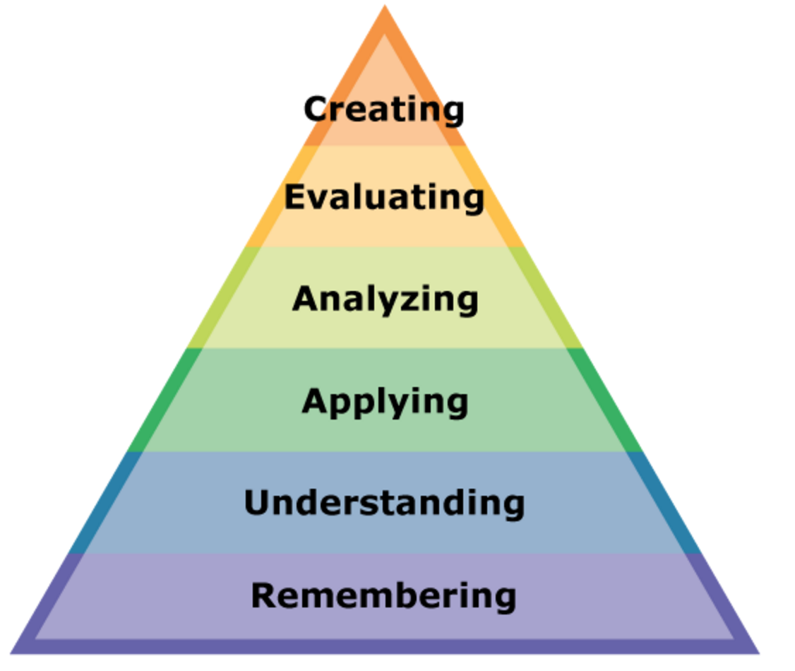
Problem-Based Learning (PBL)
Theory
John Dewey: “experiential learning” (1910s)
Lev Vygotsky: “zone of proximal development” (1930s)
Benjamin Bloom: “active learning” (1950s)
Listening != learning
Students in lectures are twice as likely to leave engineering, 3 times as likely to drop out
Bloom’s Taxonomy (New Version)
Notes:
PBL is a form of Active learning, one attempt to get away from lecture.
They cite literature which indicates that to learn, students must do more than just listen: They must read, write, discuss, or be engaged in solving problems.
In a 2012 report titled "Engage to Excel,"[27] the United States President's Council of Advisors on Science and Technology (PCAST) described how improved teaching methods, including engaging students in active learning, will increase student retention and improve performance in STEM courses. One study described in the report found that students in traditional lecture courses were twice as likely to leave engineering and three times as likely to drop out of college entirely compared with students taught using active learning techniques. In another cited study, students in a physics class that used active learning methods learned twice as much as those taught in a traditional class, as measured by test results.
INTRINSIC MOTIVATION

Slide 5
Problem-Based Learning (PBL)
A single question drives and organizes the learning activities.
Learning is done “Just-In-Time.”
Emphasis is placed on the process rather than the product.
The task of the instructor is to provide a relevant and authentic question and serve as a facilitator.
Notes:
How it actually works. The course has no lectures. Class time is used for group collaboration.

Slide 6
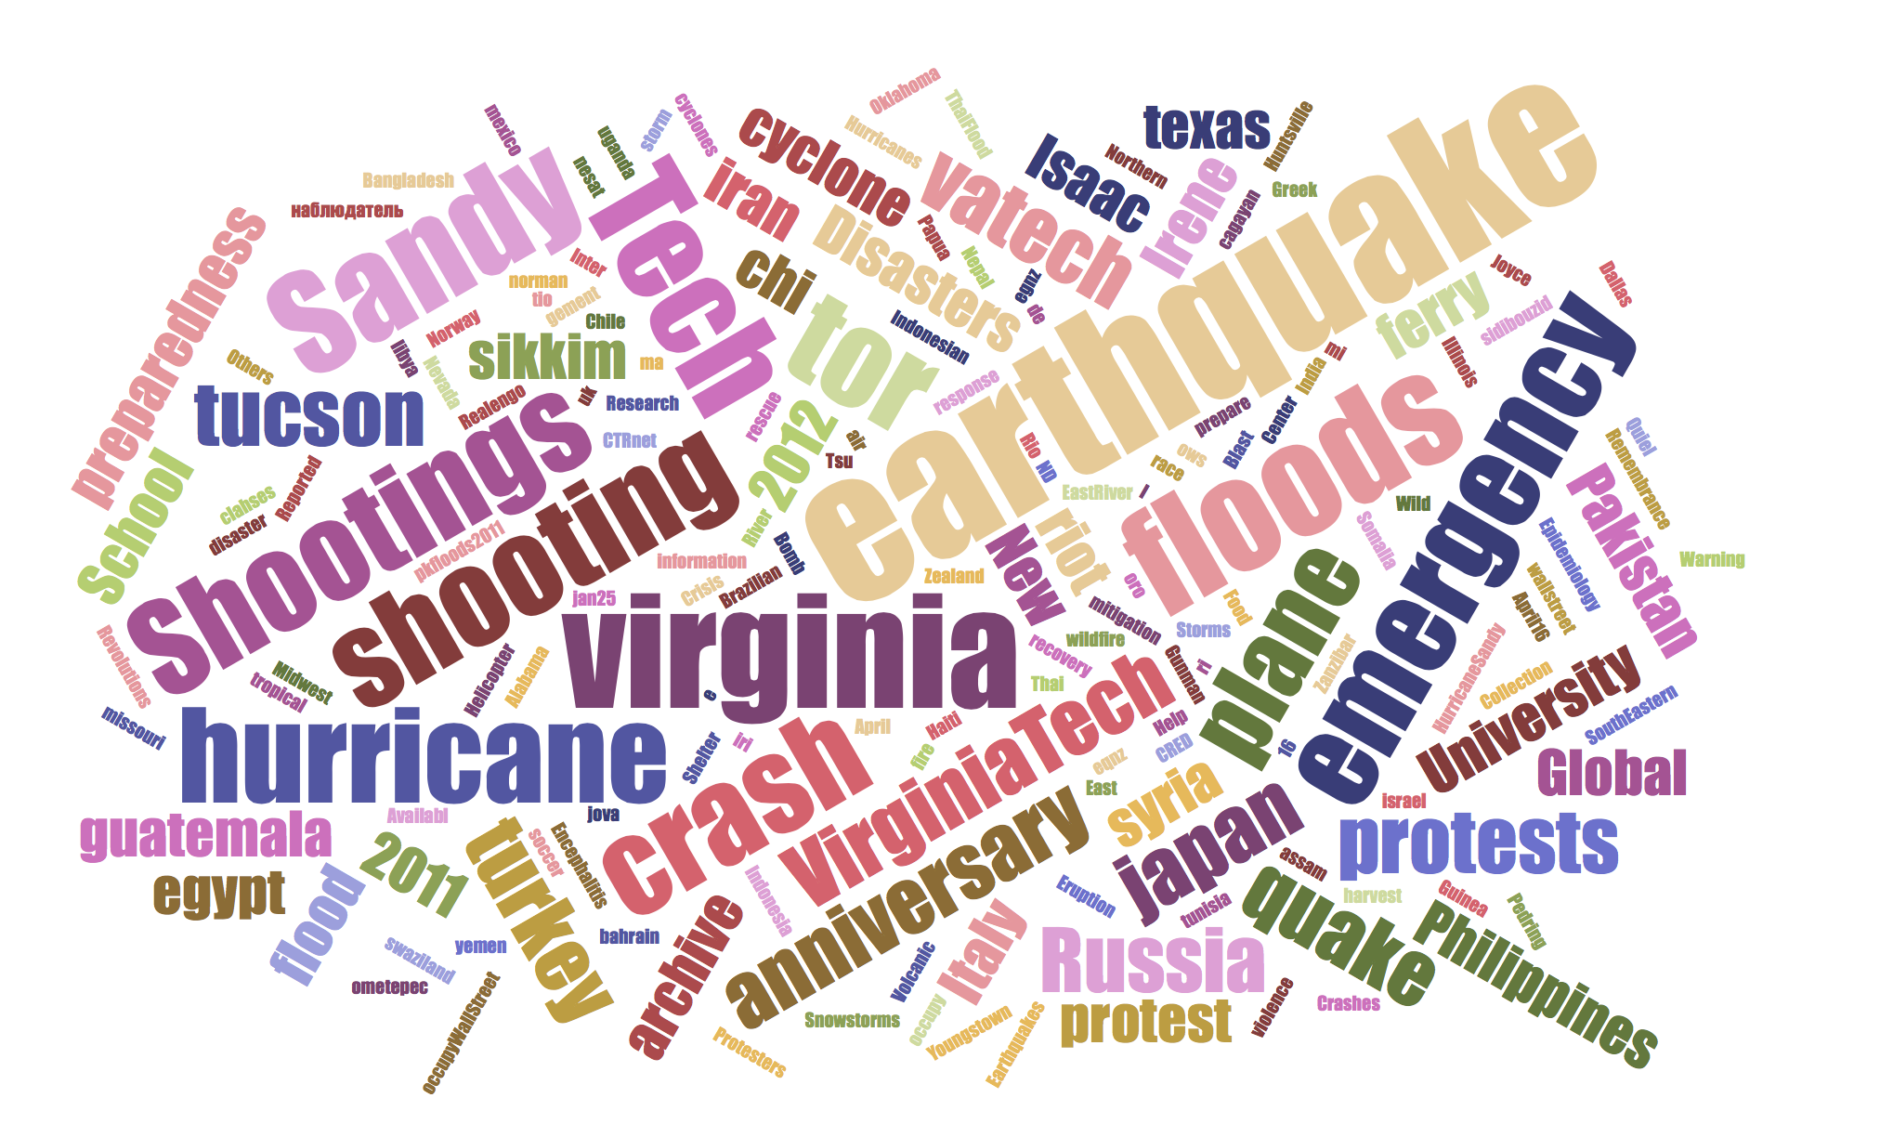
Integrated Digital Event Archiving and Library (IDEAL)
www.eventsarchive.org
Notes:
To give relevance and context to the problems, the courses were designed to meaningfully contribute to the IDEAL project.
The DL deals with events that have a long-term human impact. The project gathers, analyzes, and summarizes documents from the Web and Twitter concerning events such as shootings, natural disasters, and political uprisings. It provides tools for searching, browsing, analyzing, and reporting. So far, the growing library consists of approximately 1 billion tweets and 11TB of webpages, and is managed on a 20-node Hadoop cluster.
Each course will deal with a question that relates to a challenge in developing and using this collection.

Slide 7
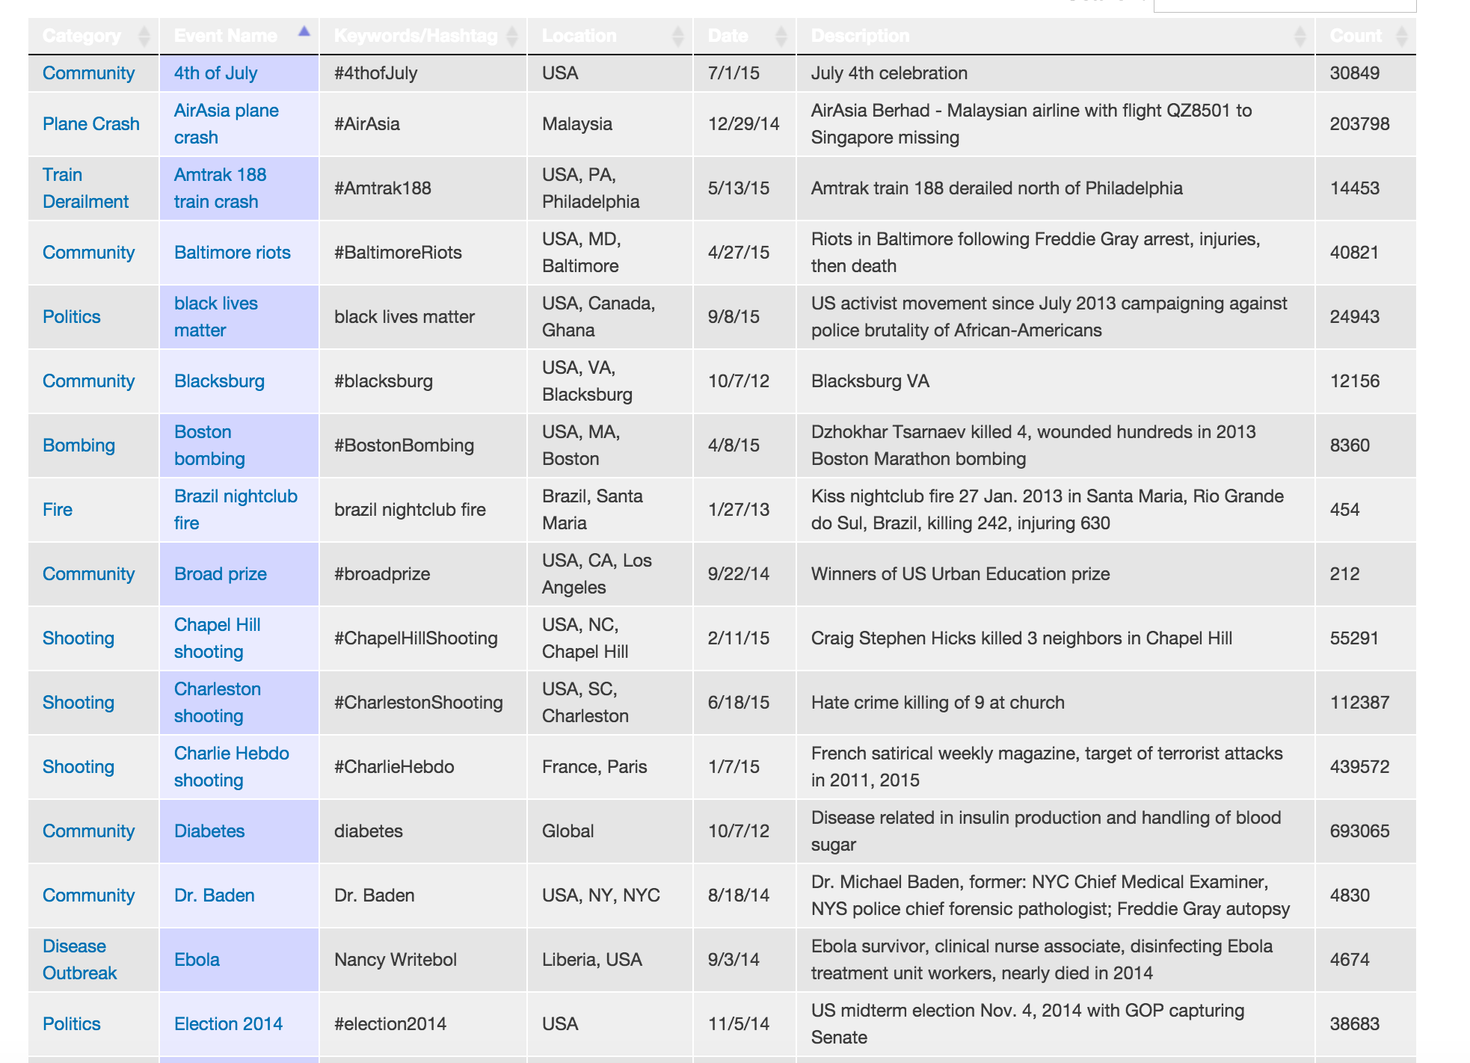
Integrated Digital Event Archiving and Library (IDEAL)
Over 11 terabytes of webpages and about 1 billion tweets
natural disasters (earthquakes, storms, floods)
man-made disasters (protests, terrorism, conflicts)
Community events
Notes:
Two different courses, where the challenge was decomposed differently:
For the undergraduate: same analysis, but everybody working with different event type & text collections.
For the graduates: worked together to aid access to a massive collection (83 million tweets plus associated metadata), but everybody performed a different element of the construction.
So, on to the courses themselves. For each, I’ll go over
Design:
the driving question, 2) how each was structured,
Evaluation
in terms of the quality of the artifacts produced
In terms of student reactions

Slide 8
Two courses: -Computational Linguistics (senior undergraduate) -Information Retrieval (intro graduate)
Driving question
Course Structure
Concepts and Technologies
Evaluation:
Technology artifacts
Student feedback
Notes:
For each course, I’ll give the following.

Slide 9
CS 4984: Computational Linguistics
Undergraduate capstone course
Driving Question: “What is the best summary that can be automatically generated for your type of event?”
7 teams, all performing the same analysis on different collections of text
Notes:
synthesizes and integrates skills and knowledge acquired throughout the CS undergraduate curriculum

Slide 10
CS 4984: Computational Linguistics
Course Structure: Scaffolding
Notes:
Increasing levels of NLP sophistication. NLTK.
Frequency distributions over single words, then phrases (n grams).
Synonymy and antonymy. WordNet from Princeton. Words and their hierachical relationships. 117 000 synsets linked to other synsets by means of a small number of conceptual relations. Hyponym (more specific), hypernym (more abstract)
POS: step along the way to parsing—word category disambiguation
TF-IDF classification: way to drop documents that made it into the collection mistakenly
NER. Location, Person, Organization, Money, Percent, Date, Time. Using tools available or rolling our own. Very realistic situation. MOST USEFUL
LDA. Model of document production. Each document is generated by probabilistically selecting words from selected topics.
LDA finds this topic mixture. Backward reasoning from posterior distribution to prior distribution.
Clustering on sentences, again, using the TF-IDF as the feature vectors. The hope is that you’ll have k clusters. In our example, we were hoping for clusters around case reports, treatments, and international action, but in reality that didn’t happen.
Template filling. Start with a paragraph and fill in the blanks from your collection
Generative grammar, be more adaptive to the content of your collections.
Be selective-----
Scaffolding: new concepts inserted into existing knowledge. These provide scaffolding
Each of these units is a solution to the problem.
As you get to successive units, the solution gets better and they build on each other.

Slide 11
CS 4984: Computational Linguistics
Concepts
Linguistics concepts: morphology, semantics, inflection, meronymy, hypernymy
Tokenization, stemming, lemmatization
Word sense disambiguation
Part of Speech tagging, deep parsing
Named Entity Recognition, Topic Allocation
Information extraction
Natural language generation
Machine learning: clustering, classification
Technologies
Python, Natural Language Tool Kit (NLTK)
Natural Language Processing tools: Stanford NER, OpenNLP
Hadoop Streaming
HDFS
Notes:
Students ENCOUNTER concepts, and those concepts are reinforced through IMMERSION in technologies.

Slide 12
CS 4984: Computational Linguistics
Evaluation: Technology Artifacts

Slide 13
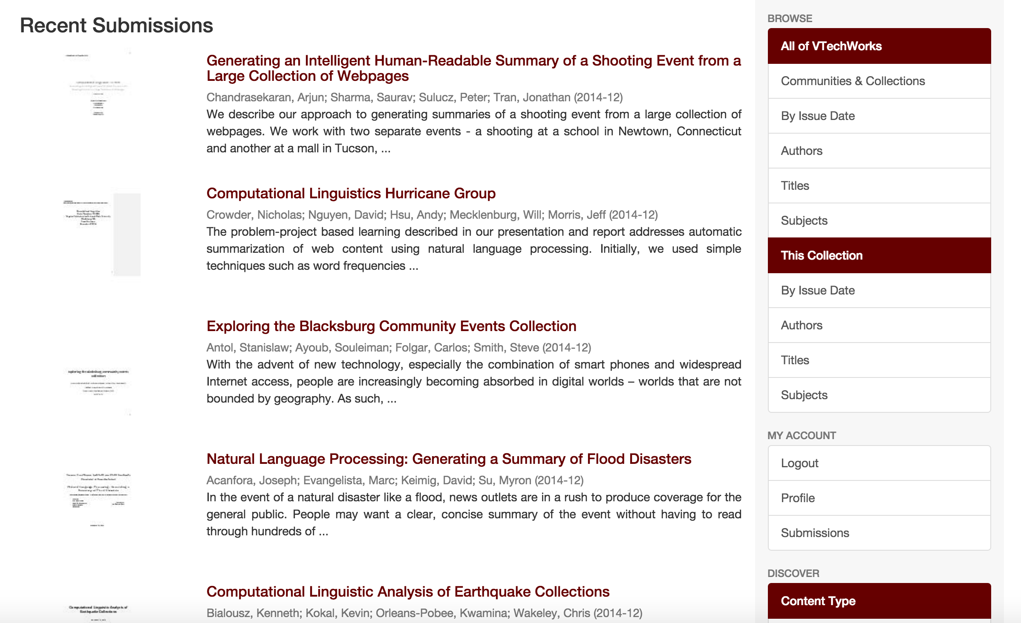
CS 4984: Computational Linguistics
VTechWorks (http://www.vtechworks.lib.vt.edu)
Notes:
Keeping with the spirit that these learning experiences should be as real as possible, students summarized their work in final reports that were submitted to VTechWorks, a digital library of faculty and student research maintained by University Libraries. So, theoretically, in future semesters, students can begin where previous students left off.

Slide 14
CS 4984: Computational Linguistics
Evaluation: Student Feedback
Question | %agree
I have a deeper understanding of the subject matter | 75
My interest in the subject matter was stimulated by this course | 88
Overall, the instructor's teaching was effective | 88
“The instructor stimulated and encouraged independent thinking and questioning. This inspired us to research and come up with our own techniques to solve problems.”
“I loved the free reign that we got to attack the problem on our own and read on our own. I think this is the best way to learn. A+”
Notes:
There’s probably a iconoclasm among these types of students that causes them to value their independence.

Slide 15
CS 5604: Information Retrieval
Introductory graduate level course
Driving Question: “How can we best build a state-of-the-art IR system in support of a large digital library project?”
7 teams, all performing different tasks along a processing pipeline
Notes:
Things were generally less concretely defined.

Slide 16
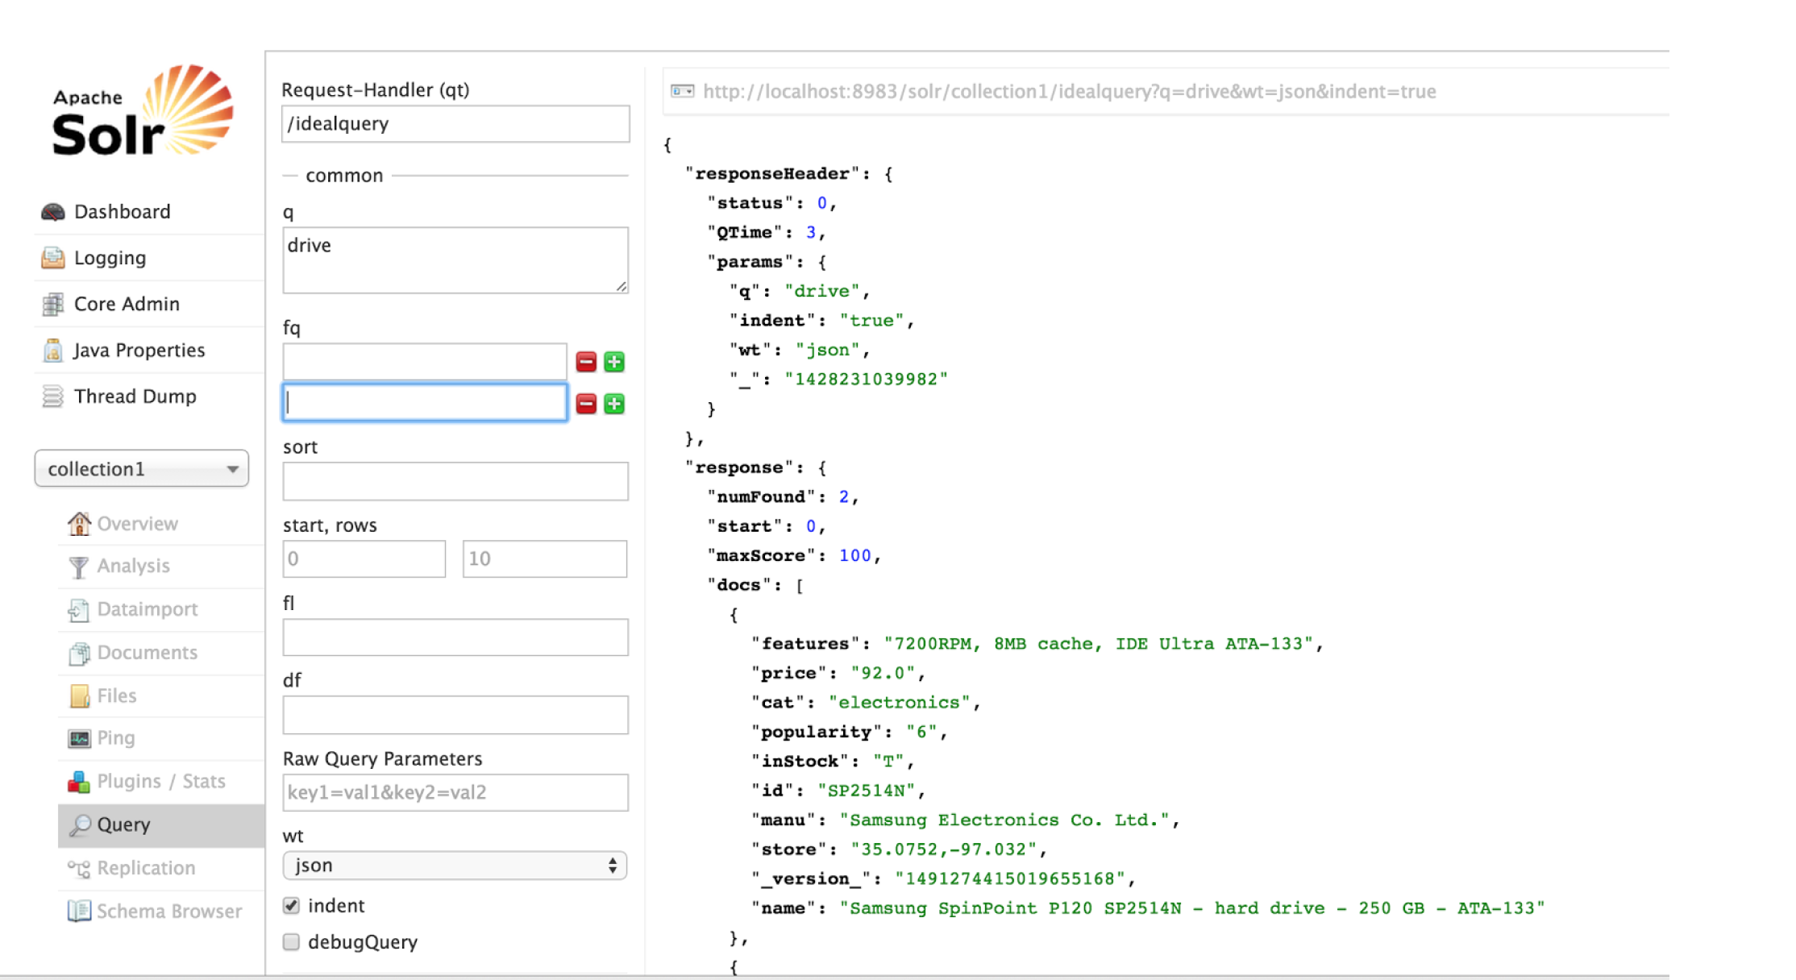
CS 5604: Information Retrieval
Course Structure: The Goal
Notes:
Beginning with a Solr instance—a web-based document indexing and retrieval system. It has the basics. We need to extend it so that it works with the amount of data (85 million tweets) and provides a way to incorporate some sophisticated analysis of the documents.

Slide 17
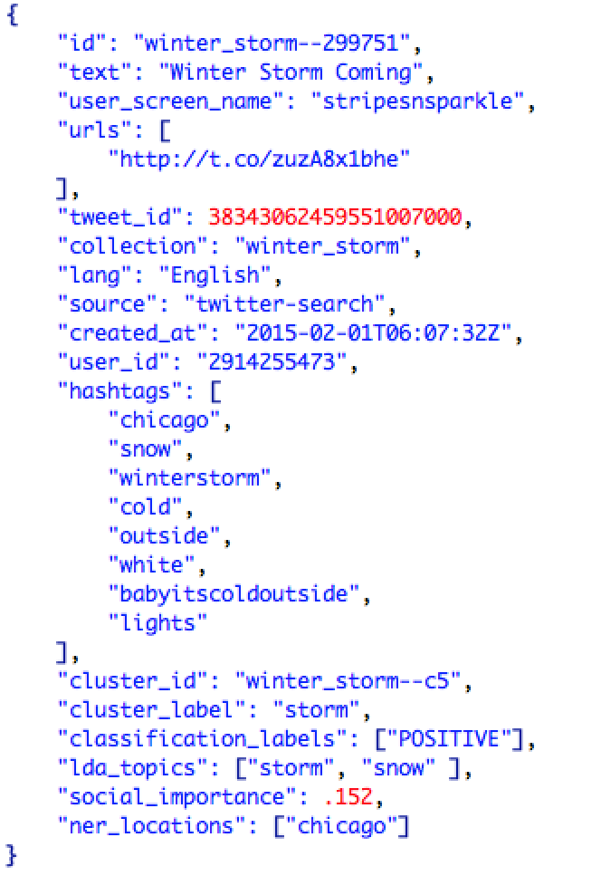
CS 5604: Information Retrieval
Course Structure: The Goal
Notes:
So from this distance, it looks like a fairly simple problem: take a document like this one (and 83 million others) and turn it into a representation like this. Then figure out the best way to customize Solr that it weighs our analysis fields in such a way that optimizes retrieval in term of precision and recall. Easy.

Slide 18
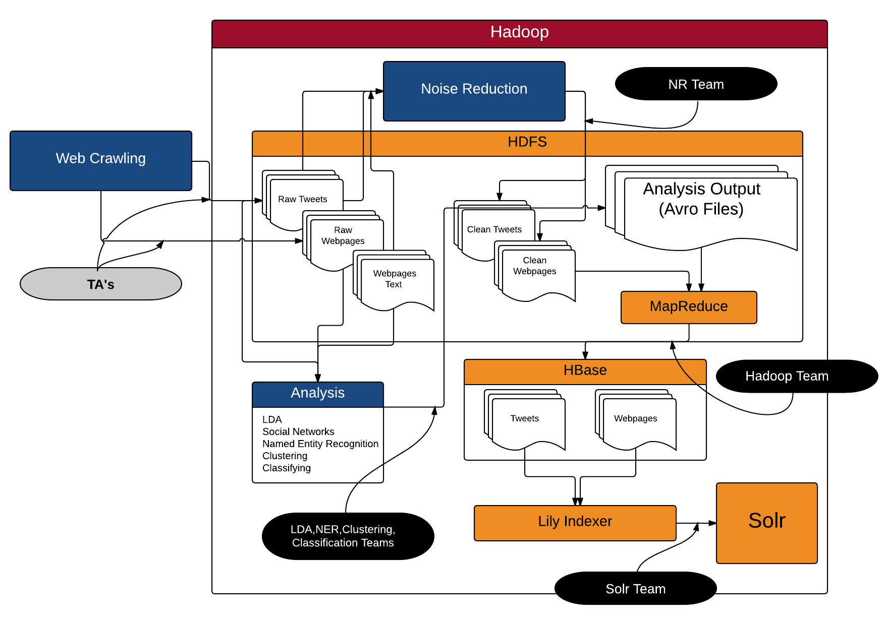
CS 5604
Course Structure The Architecture
Notes:
The course structure emerged from the architecture.
It took extensive collaboration to arrive at this architecture. This was the first 3 weeks. Once we designed an architecture, we could divide up responsibilities.
Hadoop is a framework for storing and working on lots of data. It’s flagship components are the HDFS (dist file system) and MapReduce (programming model for working on those files and consolidating the results)
Anything in orange is a component of Hadoop.
(lower left). Another decision that took a long time to work out: what is the output of each analysis? Keyed on doc id, but then what? Vector of terms? Weights?

Slide 19
CS 5604: Information Retrieval
Concepts
Indexing: inverted, in-memory, distributed, dynamic
Vector Space Model: doc representation, TF-IDF, length normalization
Result evaluation: precision, recall, F-Score
Probabilistic Language Modeling
Text classification and clustering
Social Network Analysis
Latent Semantic Analysis
Technologies
Hadoop: HDFS, MapReduce, HBase, AVRO
Apache Mahout, Weka
Solr, Velocity, Carrot²
Notes:
Students ENCOUNTER concepts, and those concepts are reinforced through IMMERSION in technologies.

Slide 20
CS 5604: Information Retrieval
Evaluation: Technology Artifacts
Performance of Information Retrieval System
Query | Time (sec) | Number of Results | Precision
election | .053 | 637,498 | .998
revolution | .045 | 13,048 | .95
uprising | .043 | 1769 | .85
storm | .043 | 429,329 | .85
ebola | .045 | 306,827 | 1.0
disease | .042 | 6802 | .993
shooting | .043 | 5366 | .744
Notes:
Students ENCOUNTER concepts, and those concepts are reinforced through IMMERSION in technologies.

Slide 21
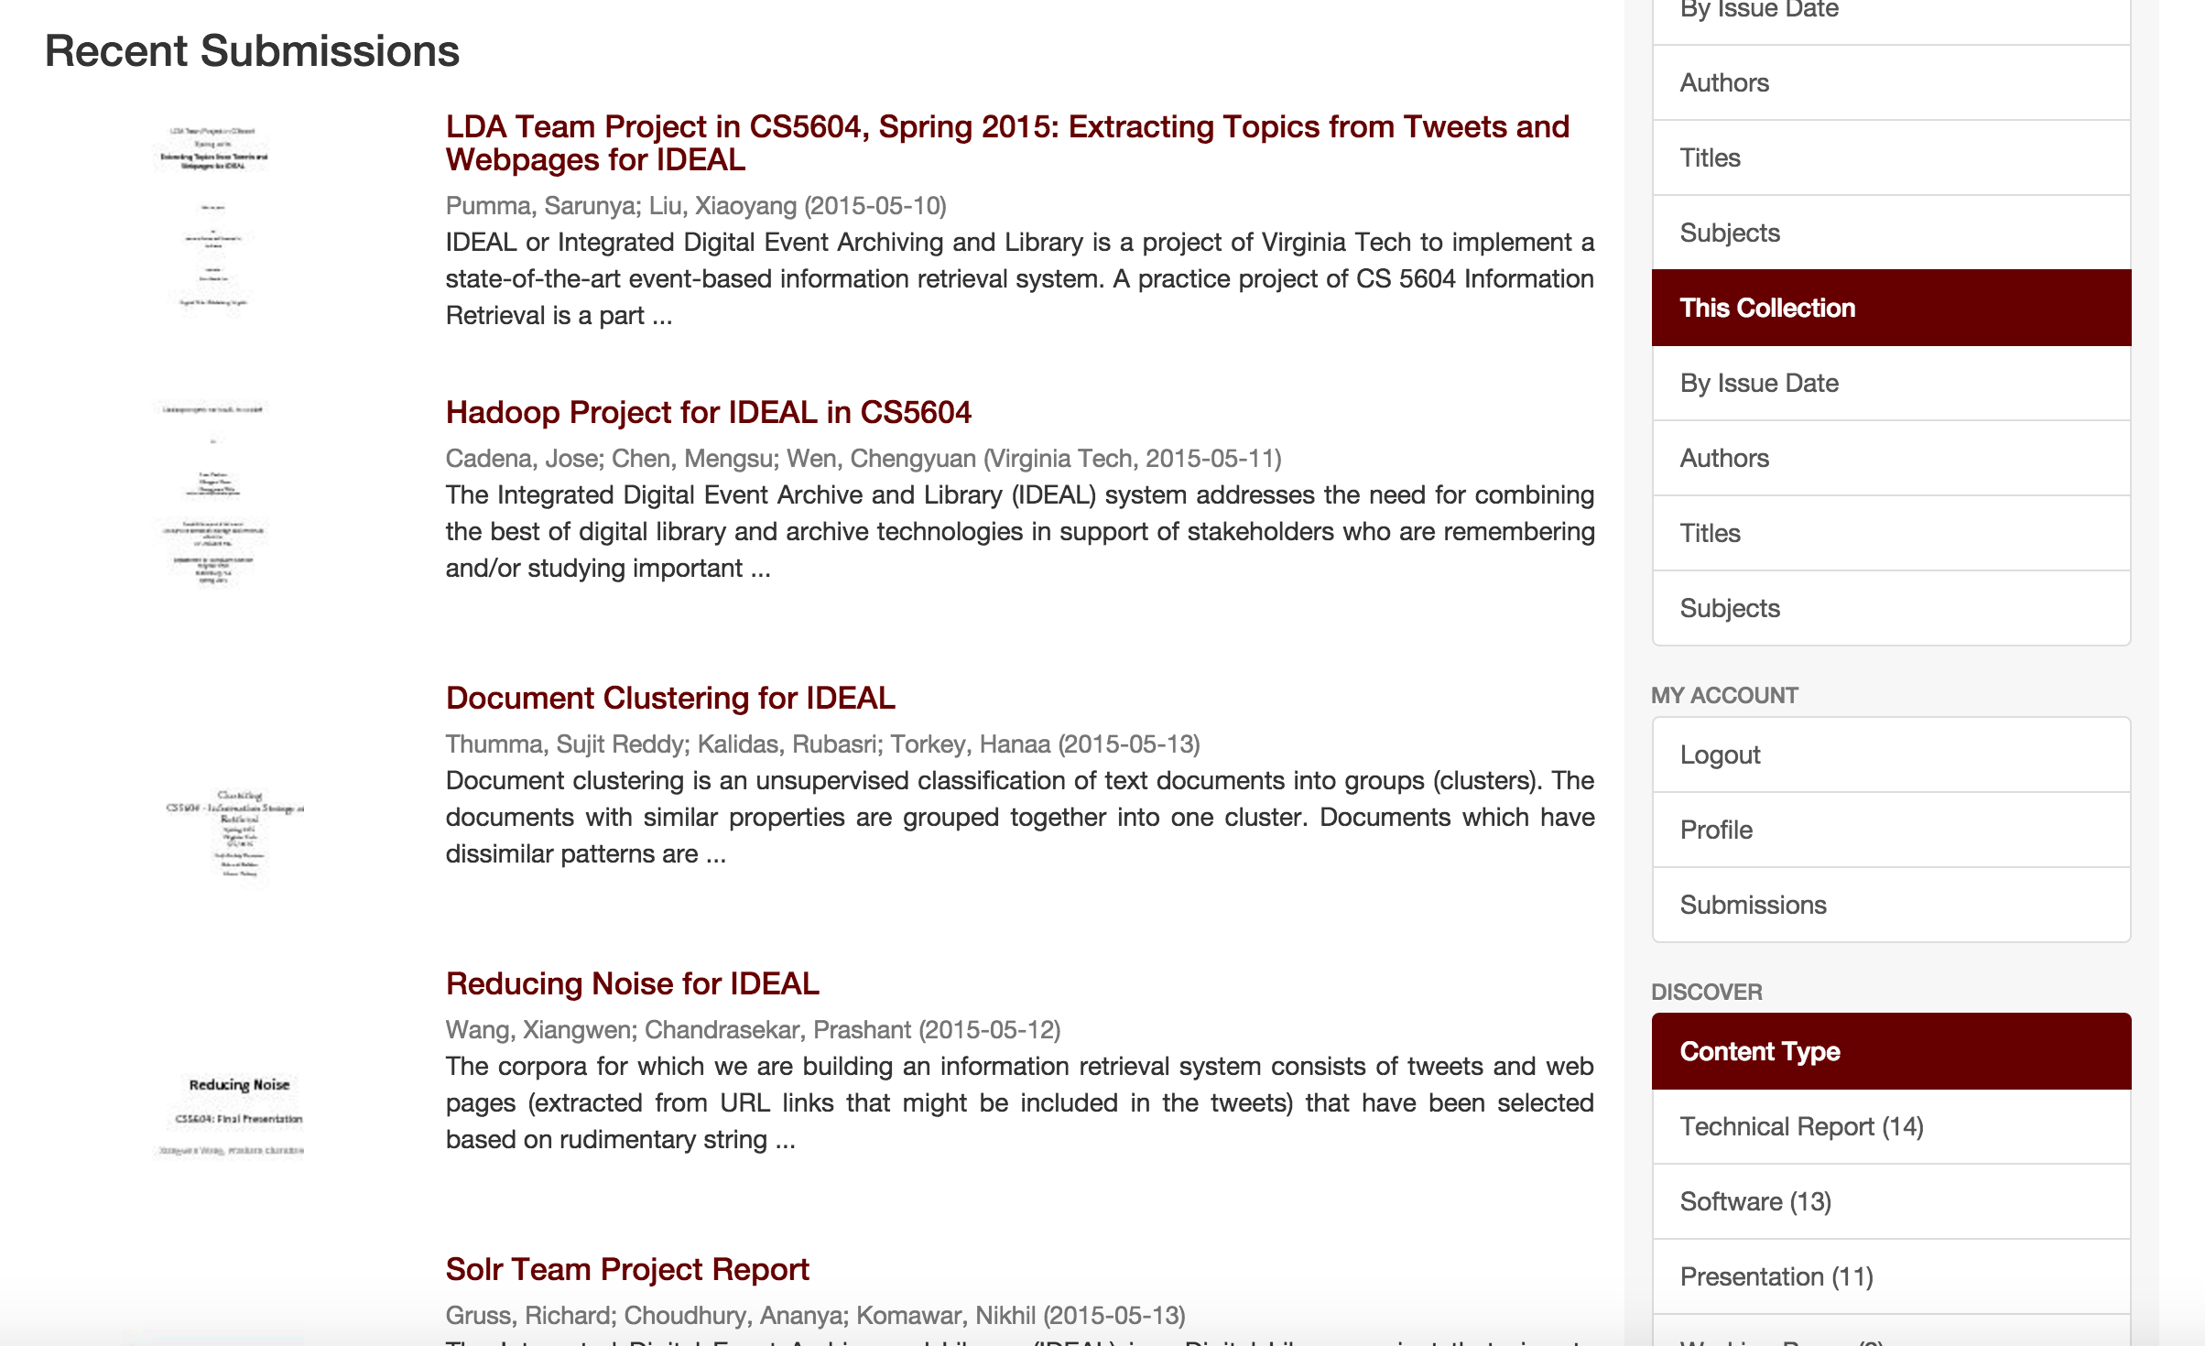
CS 5604: Information Retrieval
VTechWorks (http://www.vtechworks.lib.vt.edu)

Slide 22
CS 5604: Information Retrieval
Student Response
20 question poll, rate 1-5 on “Rate how well this approach helped you to…”
Question | Score
Think independently | 4.4
Consider alternative solutions to problems | 4.3
Identify gaps in your knowledge | 4.3
100% said they would recommend this approach for future classes.

Slide 23
Acknowledgements
US National Science Foundation, DUE-1141209
US National Science Foundation, IIS-1319578
Notes:
Personal note: It was my experience in these classes that solidified my decision to return to school and study text analytics, something I had been considering for a while. A formal introduction to these topics wouldn’t have motivated much interest in where the research is right now. In doing these tasks, we came again and again upon problems we thought were well understood and solved, and it turned out it wasn’t. I’ll never forget bumping up against the end: we finally were able to parse sentences into tree structures, and we were like, what now? How do we get meaning from the tree? We were pointed to speech act theory and told good luck.
Also—there were two graduating seniors who were offered jobs on the basis of their familiarity with these technologies. Very different objectives, both met by these courses.

Slide 24
Supplementary Materials
Notes:
Personal note: It was my experience in these classes that solidified my decision to return to school and study text analytics, something I had been considering for a while. A formal introduction to these topics wouldn’t have motivated much interest in where the research is right now. In doing these tasks, we came again and again upon problems we thought were well understood and solved, and it turned out it wasn’t. I’ll never forget bumping up against the end: we finally were able to parse sentences into tree structures, and we were like, what now? How do we get meaning from the tree? We were pointed to speech act theory and told good luck.
Also—there were two graduating seniors who were offered jobs on the basis of their familiarity with these technologies. Very different objectives, both met by these courses.

Slide 25
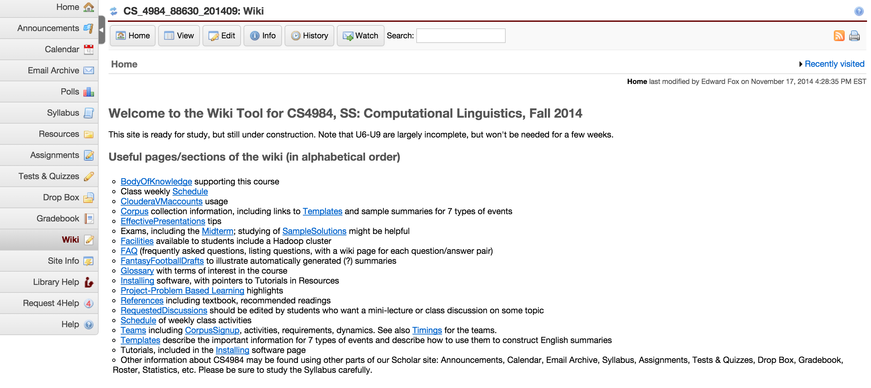
CS 4984: Computational Linguistics
Scholar Site
Notes:
The management of the course is a challenge. One of the Tas confided to me that this course was by far his most work-intensive teaching assignment.
Several different teams doing different kinds of analysis on different texts, emphasizing different techniques—lots of moving parts.
Supported by a voluminous web site on our Course Management System, Scholar.
Body of Knowledge: 12-part, 13,000 word summary of everything you need to know.

Slide 26
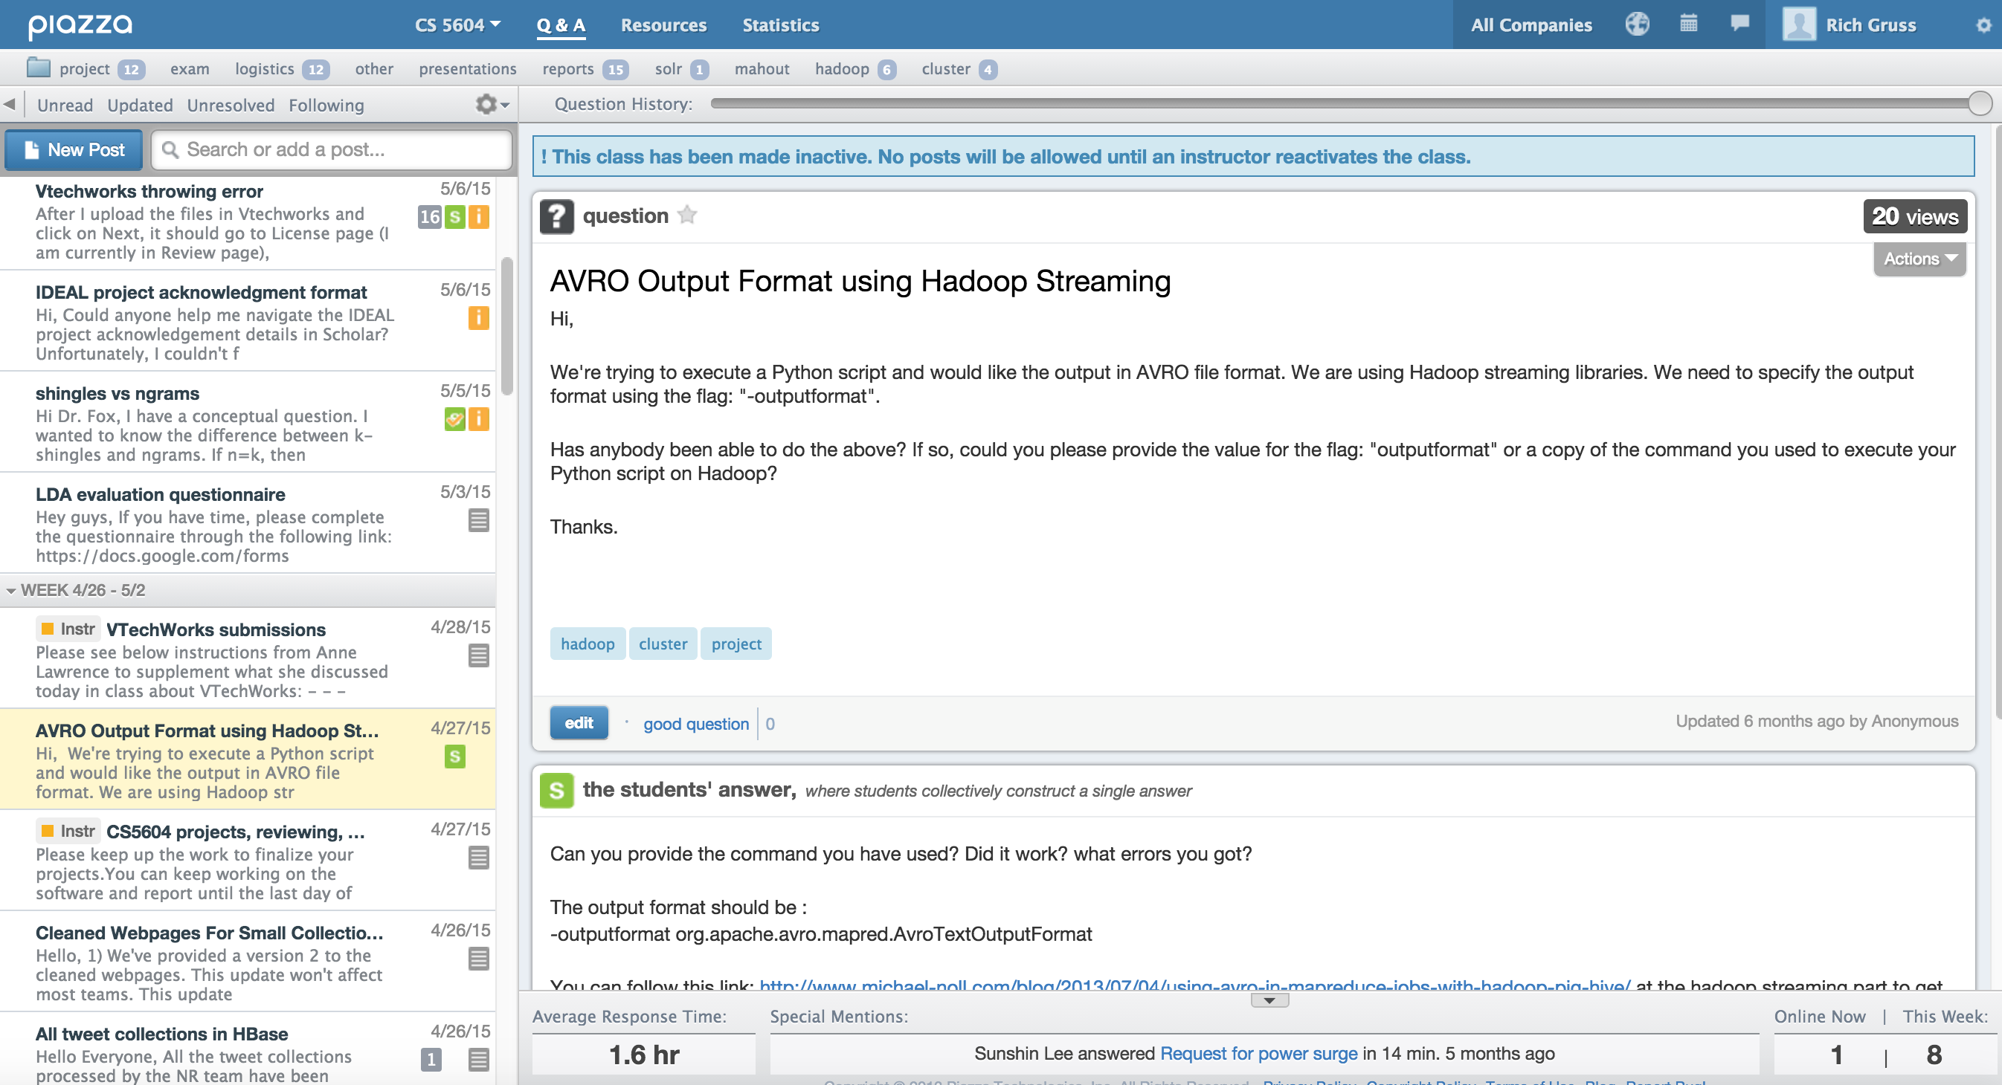
CS 4984: Computational Linguistics
Piazza Site
Notes:
Scholar has limited QA forum functionality, so we also used Piazza. Anybody could post a question or an answer, vote on answers. It even kept track of how long it took to get a response.

Slide 27
CS 4984: Computational Linguistics
Sample Results
{'date': '2014-12-06', 'source': '10567-4', 'cases': '810', 'location': 'Sierra Leone', 'deaths': '348'}
{'date': '2014-12-05', 'source': '10567-8', 'cases': '127', 'location': 'West Africa', 'deaths': 0}
{'date': '2003-12-02', 'source': '10516-4', 'cases': '784', 'location': 'Sierra Leone', 'deaths': 0}
{'date': '2014-12-08', 'source': '10474-7', 'cases': '53', 'location': 'Liberia', 'deaths': 0}
{'date': '2014-12-05', 'source': '10567-8', 'cases': '127', 'location': 'Guinea', 'deaths': 0}
{'date': '2014-08-02', 'source': '10643-16', 'cases': 0, 'location': 'Guinea', 'deaths': '1400'}
{'date': '2014-08-02', 'source': '10643-16', 'cases': 0, 'location': 'Liberia', 'deaths': '1400'}
{'date': '2003-12-02', 'source': '10954-1', 'cases': '293', 'location': 'Sierra Leone', 'deaths': 0}
Notes:
Final summary: dates from NER, numbers from unix regular expressions, locations from NER, cases and deaths from regex—human learned grammar.
Conflict resolution? Hueristic: lowest per location per date?

Slide 28
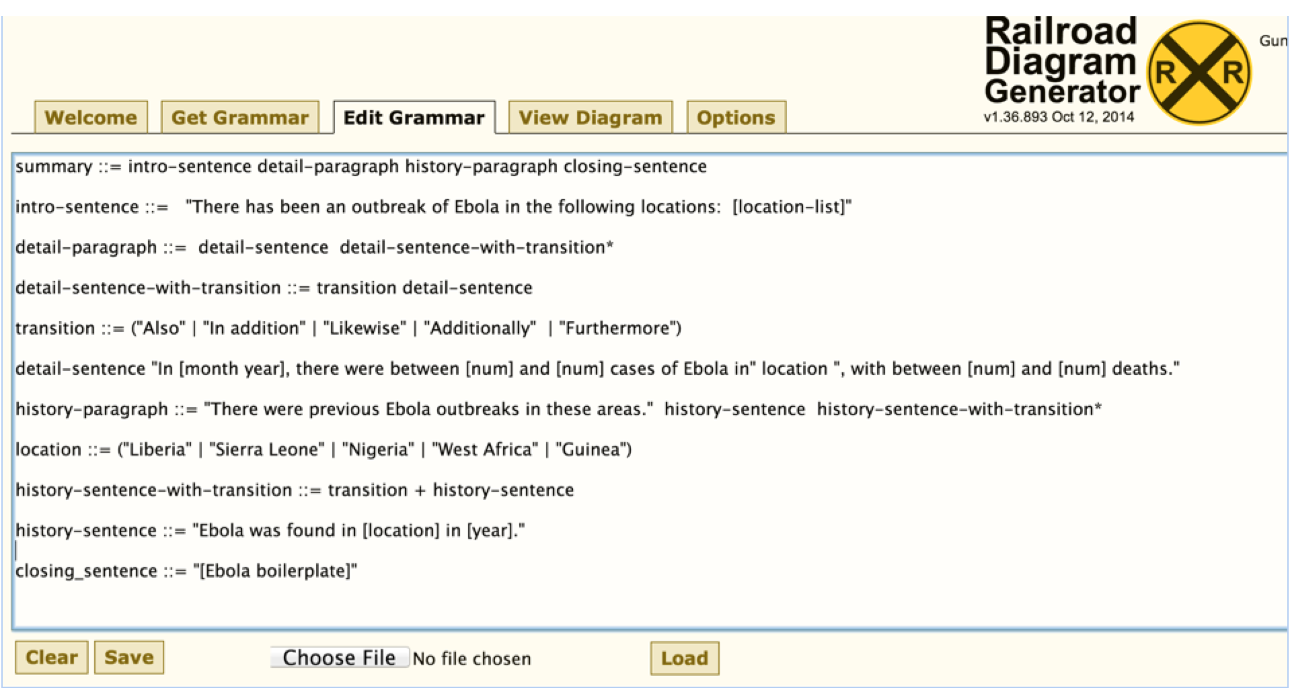
CS 4984: Computational Linguistics
Sample Results
Notes:
Recursive descent grammar for generating summary about Ebola.

Slide 29
CS 4984: Computational Linguistics
Sample Results
There has been an outbreak of Ebola reported in the following locations: Liberia, West Africa, Nigeria, Guinea, and Sierra Leone.
In January 2014, there were between 425 and 3052 cases of Ebola in Liberia, with between 2296 and 2917 deaths. Additionally, In January 2014, there were between 425 and 4500 cases of Ebola in West Africa, with between 2296 and 2917 deaths. Also, In January 2014, there were between 425 and 3000 cases of Ebola in Nigeria, with between 2296 and 2917 deaths. Furthermore, In January 2014, there were between 425 and 3052 cases of Ebola in Guinea, with between 2296 and 2917 deaths. In addition, In January 2014, there were between 425 and 3052 cases of Ebola in Sierra Leone, with between 2296 and 2917 deaths.
There were previous Ebola outbreaks in these areas. Ebola was found in 1989 in Liberia. As well, Ebola was found in 1989 in West Africa. Likewise, Ebola was found in 1989 in Nigeria. Additionally, Ebola was found in 1989 in Guinea. Also, Ebola was found in 1989 in Sierra Leone.
Notes:
Final summary: dates from NER, numbers from unix regular expressions, locations from NER, cases and deaths from regex—human learned grammar.
Conflict resolution? Hueristic: lowest per location per date?

Slide 30
CS 5604: Information Retrieval
Team Responsibilities

Slide 31
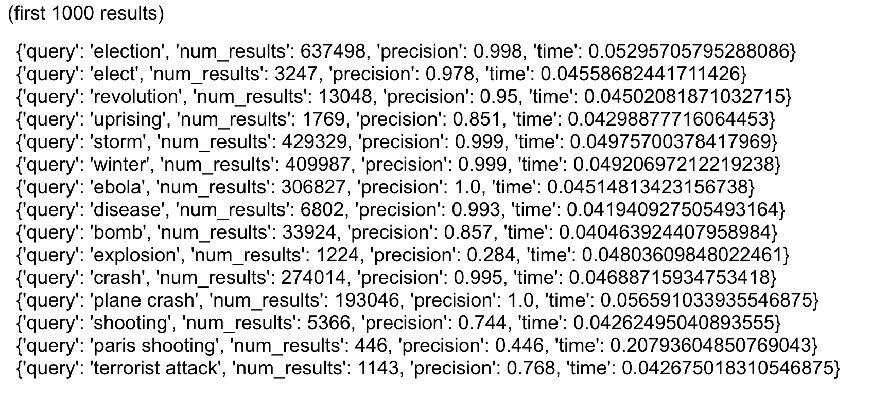
CS 5604: Information Retrieval
Search Performance (first 1000 results)
Notes:
Use this as backup

Slide 32
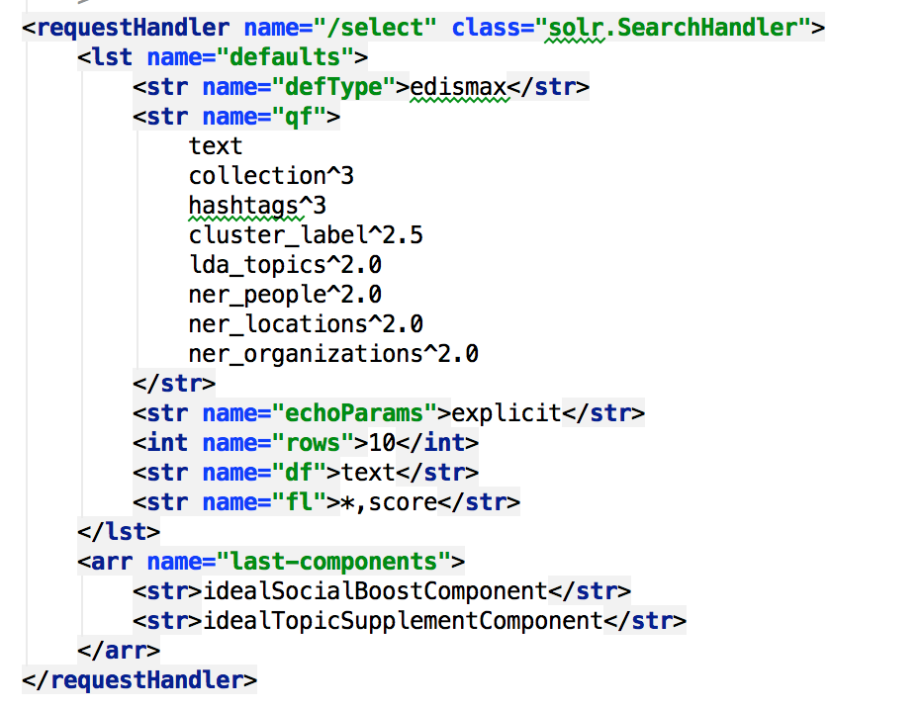
CS 5604: Information Retrieval
Custom Solr Search
Field weights
Custom result list processing

