Slide 1
Video Message: Welcome ETD 2015: 18th Int’l Symposium on ETDs New Delhi, India Edward A. Fox Executive Director, Chairman of the Board NDLTD, www.ndltd.org fox@vt.edu http://fox.cs.vt.edu/talks/2015 Professor, Department of Computer Science Virginia Tech, Blacksburg, VA 24061 USA

Slide 2
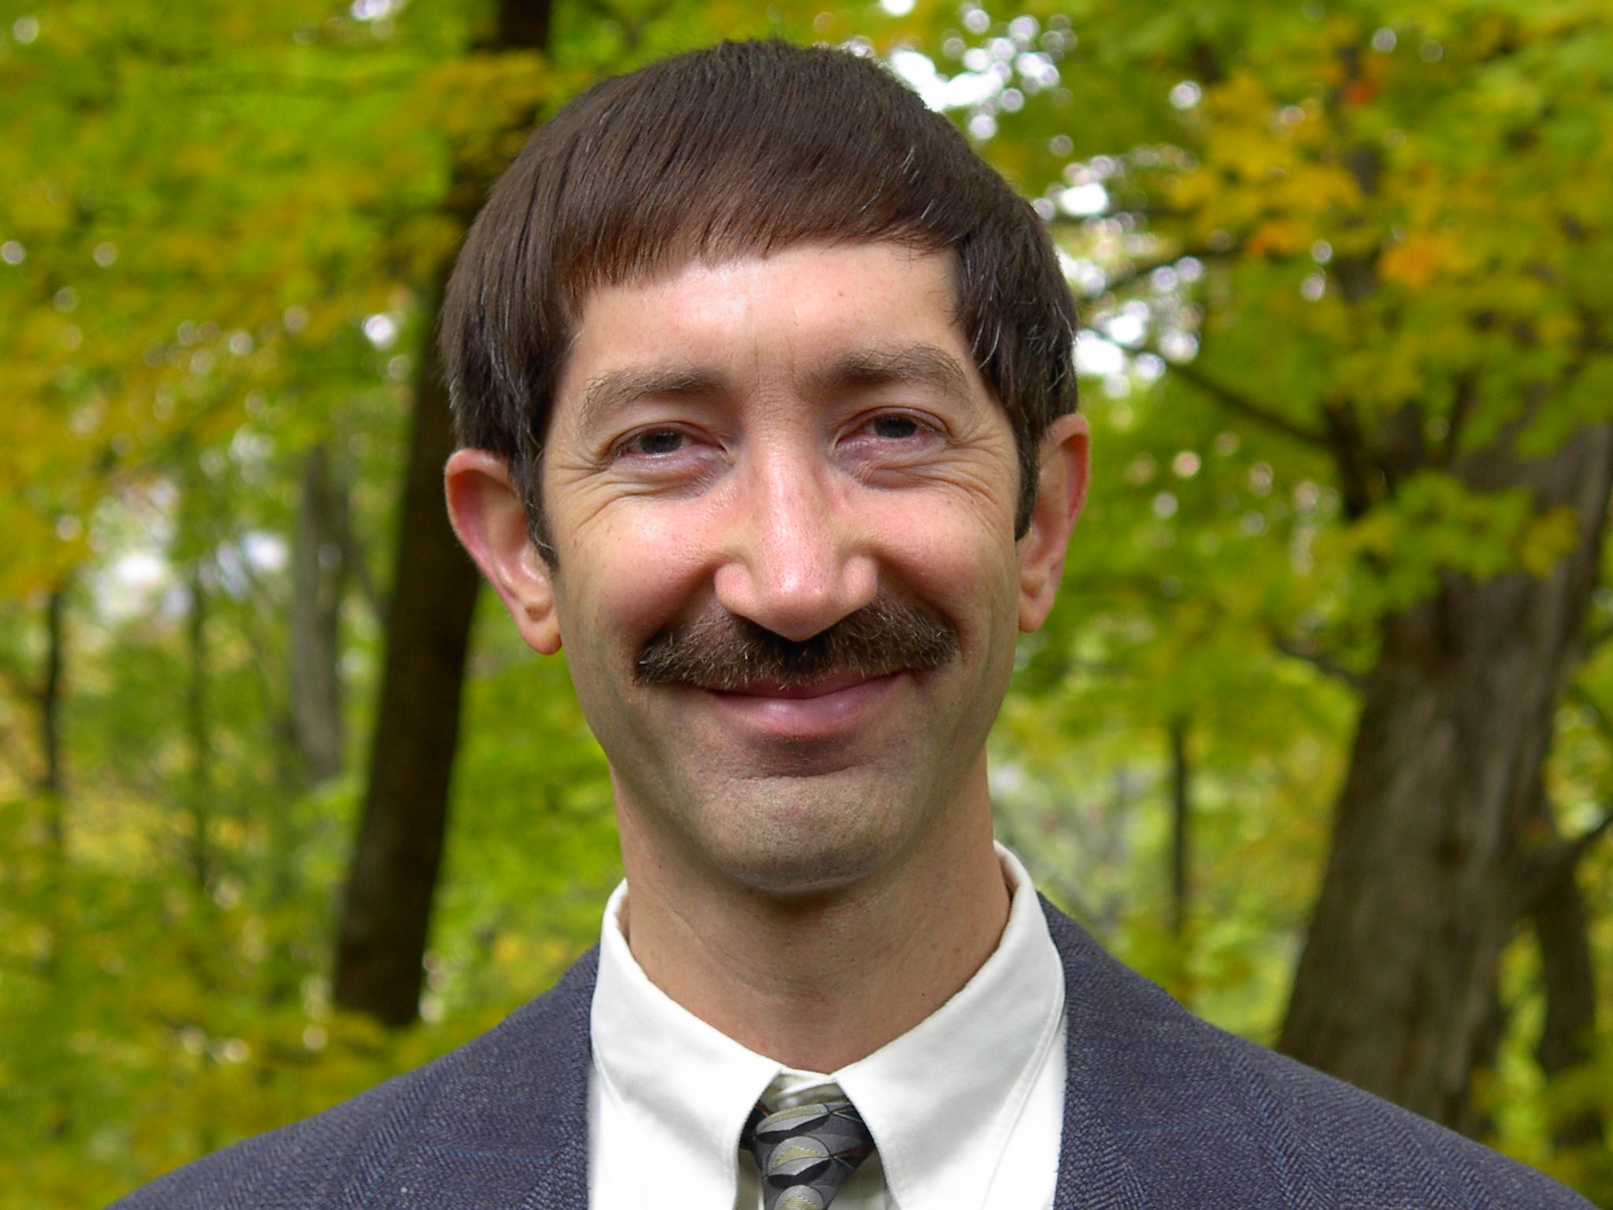

Slide 3
Outline
Acknowledgments
Digital Library Triad, Information Life Cycle
Perspective on People and Technology
Standards: ETD-ms
Technology: OAI
NDLTD
Mission, Goals
Progress/Plans, Participating
Spirit

Slide 4
Acknowledgments
Family, mentors, teachers, students
All those working with ETDs
NDLTD, including its Members, Board, Committees, and Working Groups
ETD 2015 Conference Team
Sponsors, Presenters, Attendees
Special thanks to Dr. Ramesh C. Gaur

Slide 5
Digital
Library
Triad

Slide 6
completeness,
Information
Life
Cycle
conformance
accuracy,
Active
accessibility, preservability
preservability,
Semi-active
authoring, modifying,
describing organizing, indexing
storing, archiving,
networking
similarity,
timeliness,
creation
distribution
utilization
seeking
pertinence,
searching,
browsing,
recommending
accessing,
filtering
significance,
relevance
accessibility,
Gonçalves et al. 2007
http://dx.doi.org/
10.1016/j.ipm.2006.11.010
Inactive
timeliness
Notes:
Information life cycle with respective dimensions of quality added for each major phrase and related activities

Slide 7
ETD-MS
ETD Metadata Standard
XML-encoded metadata standard (content and encoding) for Electronic Theses and Dissertations (ETDs)
In part conforming to Dublin Core (DC)
Adds details about level, etc.
http://www.ndltd.org/standards/metadata
With specified relationship to MARC
Aim: Richer, higher quality metadata

Slide 8
OAI - Open Archives Initiative https://www.openarchives.org/
Interoperability
Standard for transferring metadata among digital libraries
Protocol for Metadata Harvesting (PMH)
NDLTD Union Catalog
Local site –> national/regional site –> Union Catalog –> service providers (Global ETD Search, …)

Slide 9
The Networked Digital Library of Theses and Dissertations
www.NDLTD.org
Advocate:
Training Authors
Expanding Access
Preserving Knowledge
Improving Graduate Education
Enhancing Scholarly Communication
Empowering Students & Universities
Leader of the Worldwide ETD
(Electronic Thesis and Dissertation) Initiative

Slide 10
Mission
The Networked Digital Library of Theses and Dissertations (NDLTD) is an international organization that, through leadership and innovation, promotes the adoption, creation, dissemination, use, and preservation of electronic theses and dissertations (ETDs).
The NDLTD encourages and supports the efforts of institutions of higher education & their communities
to advance and apply electronic publishing & digital libraries (including repositories), thus enabling them
to share knowledge more effectively in order
to unlock the potential benefits worldwide.

Slide 11
Goals (1)
To be the leading international institution for promotion of ETDs worldwide.
To expand Open Access to ETDs.
To provide and encourage use of innovative services, resources, standards, and technology for the development of ETD programs.
To sponsor and co-sponsor ETD-related events regionally and globally.

Slide 12
Goals (2): Through those activities
Institutions of higher learning will develop their own ETD programs by adopting the submission, collection, and archiving of electronic theses and dissertations, to their own and to international digital libraries & repositories.
Institutions of higher education and their communities will become aware of the benefits of ETDs, including:

Slide 13
Goals (3): benefits:
facilitation of the writing process for students
increased speed and effectiveness of sharing / distribution of research methods and results
through advances in electronic publishing and archiving, leading to
improved graduate education and scholarship
and
reduced costs of ETD printing, processing, dissemination, storage, and preservation.

Slide 14
Special Goals for India
Contribute to NDLTD Union Catalog
http://union.ndltd.org/portal/ shows few from India
http://www.ndltd.org/resources/manage-etds/help-build-global-etd-search explains how to contribute
Advance librarianship, and open access to research and data, through ETDs
Lead in spreading NDLTD ideas, methods, and accomplishments throughout Asia

Slide 15
Exciting Progress and Plans
2015 Launching Collaborations
ORCID
INETDIN (Int’l Network for ETDs in Nursing)
EBSCO
Social Media
http://www.facebook.com/NDLTD
https://twitter.com/NDLTD
https://www.linkedin.com/grp/home?gid=2024919
Innovations in the Awards program
Global ETD Search: http://search.ndltd.org

Slide 16
How You Can Participate
Primarily, a volunteer organization
Local and regional “grass roots” activities
NDLTD Committees, Working Groups – join:
Awards, Communications,
Conference, Membership,
Union Catalog, Web Content

Slide 17
Spirit of NDLTD
Assuage fears -> build confidence -> promote sharing
Help make a better (smaller) world
Win-win-win (everyone can benefit)
Have fun helping others
Build on standards
ETDs are preservable, popular, expressive -> “better”
Doable, feasible, learnable, affordable, sharable
Please join/support NDLTD!

