Slide 1
Problem Based Learning To Build And Search Tweet And Web Archives
Richard Gruss
Edward A. Fox
Digital Library Research Laboratory
Dept. of Computer Science
Virginia Tech
Blacksburg, VA, USA
21 May 2015 for Qatar National Library

Slide 2
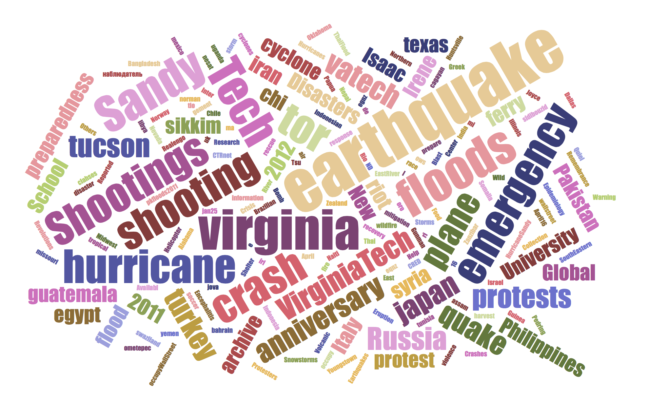
Integrated Digital Event Archiving and Library (IDEAL)
www.eventsarchive.org
https://archive-it.org/explore?q=virginia+tech&show=Collections

Slide 3
IDEAL provided data for 2 courses:
Over 11 terabytes of webpages and about 1 billion tweets
Natural disasters (e.g., earthquakes, storms, floods)
Man-made disasters (e.g., protests, terrorism, conflicts)
Community / government events

Slide 4
Problem-Based Learning (PBL)
A single question drives and organizes the learning activities.
Learning is done “Just-In-Time.”
Emphasis is placed on the process rather than the product.
The task of the instructor is to provide a relevant and authentic question and serve as a facilitator.

Slide 5
CS 4984: Computational Linguistics, Fall 2014
Undergraduate capstone course
Driving Question: “What is the best summary that can be automatically generated for your type of event?”
7 teams, all performing the same analysis on different collections of text
Institutional Repository entries from the teams: http://vtechworks.lib.vt.edu/handle/10919/50956

Slide 6
CS 4984: Computational Linguistics
Text Collections

Slide 7
CS 4984: Computational Linguistics
Unit Objectives

Slide 8
CS 4984: Computational Linguistics
Sample Results

Slide 9
CS 5604: Information Retrieval
Introductory graduate level course
Driving Question: “How can we best build a state-of-the-art IR system in support of a large digital library project?”
8 teams, all performing different tasks along a processing pipeline
Institutional Repository entries from the teams: http://vtechworks.lib.vt.edu/handle/10919/19081

Slide 10
CS 5604: Information Retrieval

Slide 11
CS 5604: Information Retrieval
Team Responsibilities

Slide 12
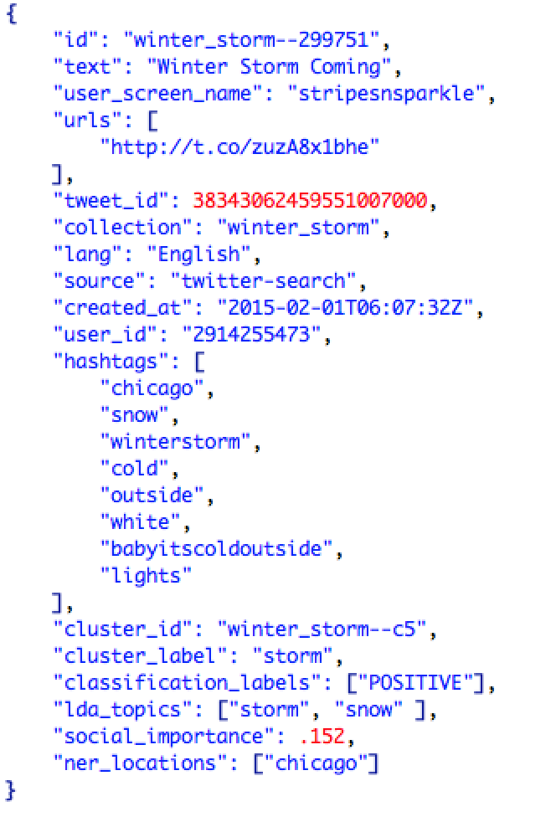
CS 5604: Information Retrieval
Indexing/analyzing Tweets into Solr

Slide 13
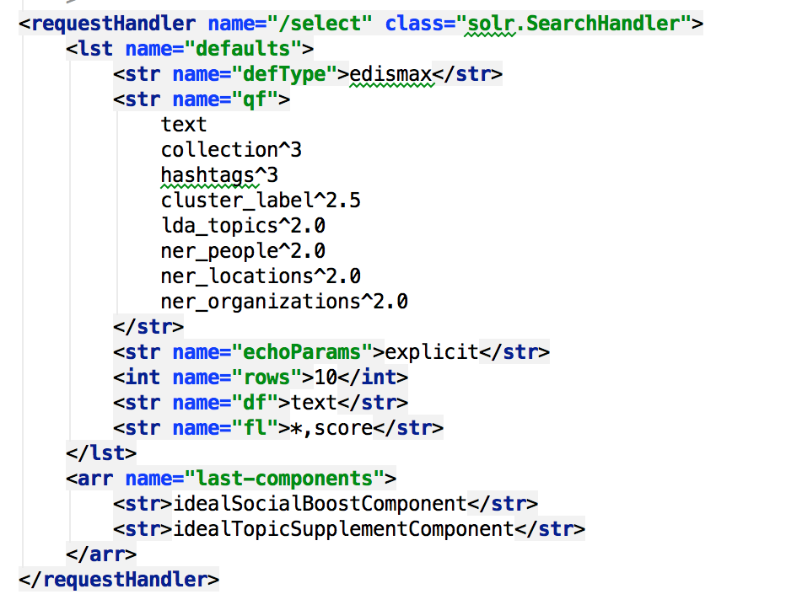
CS 5604: Information Retrieval
Custom Solr Search
Field weights
Custom result list processing

Slide 14
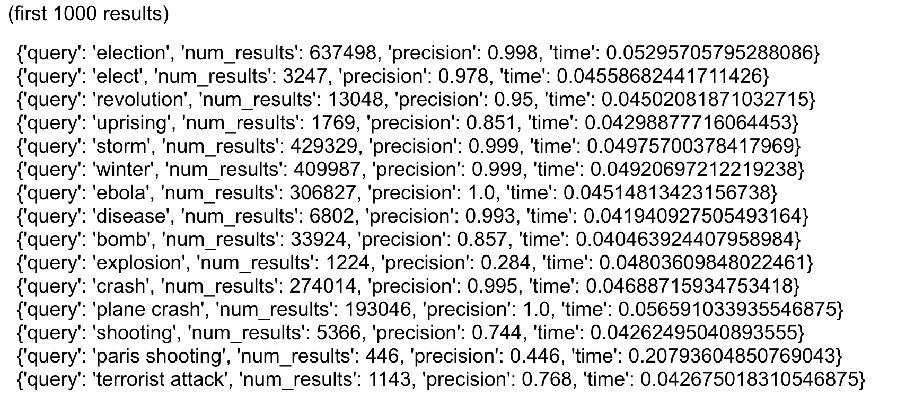
CS 5604: Information Retrieval
Search Performance (first 1000 results)

Slide 15
Acknowledgements
US National Science Foundation, DUE-1141209
US National Science Foundation, IIS-1319578

