Slide 1
http://hdl.handle.net/10919/47935 VT Web Archiving
Anthony Rinaldi and Dev Mehta
CS 4624
Clients: Mohamed Magdy and Tarek Kanan
Blacksburg, VA
5/6/2014
Edited by E. Fox for QNL on 21 May 2015

Slide 2
Project Goals
Setup a web-crawler with Heritrix
Archive files from vt.edu
Integrate with Wayback
Set-up Search with Solr (Stretch)

Slide 3
Work Accomplished
Working set-up of Heritrix that successfully crawls vt.edu web-pages.
Customized configuration to increase crawl depth.
Reject non-domain based URLs.
Working set-up of Wayback machine:
Processes warc files from Heritrix.
Front-end for Heritrix-based crawls.

Slide 4
Lessons Learned
Sometimes, documentation leaves much to be desired.
Crawls can be extremely large if not configured properly.

Slide 5
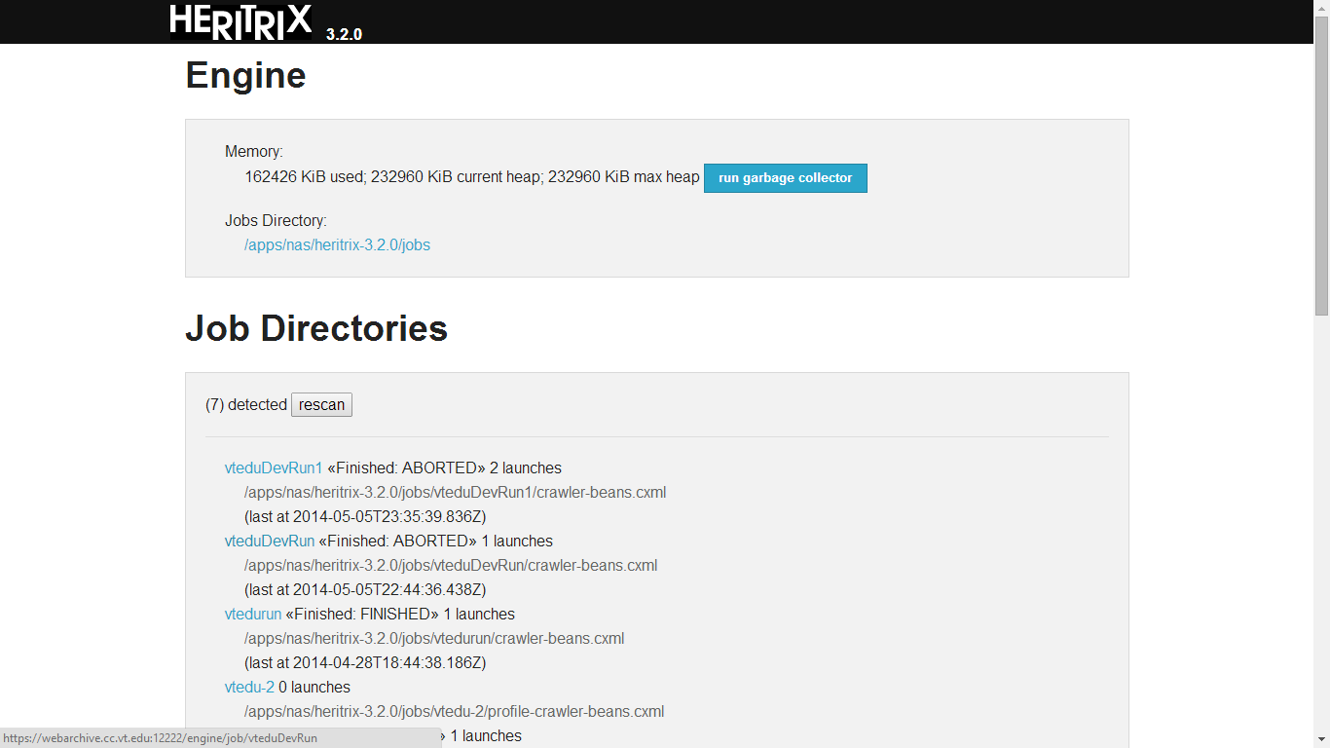

Slide 6
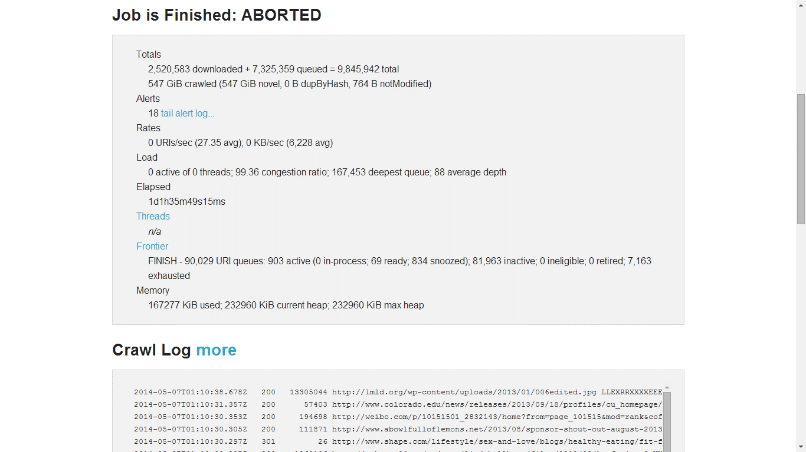

Slide 7
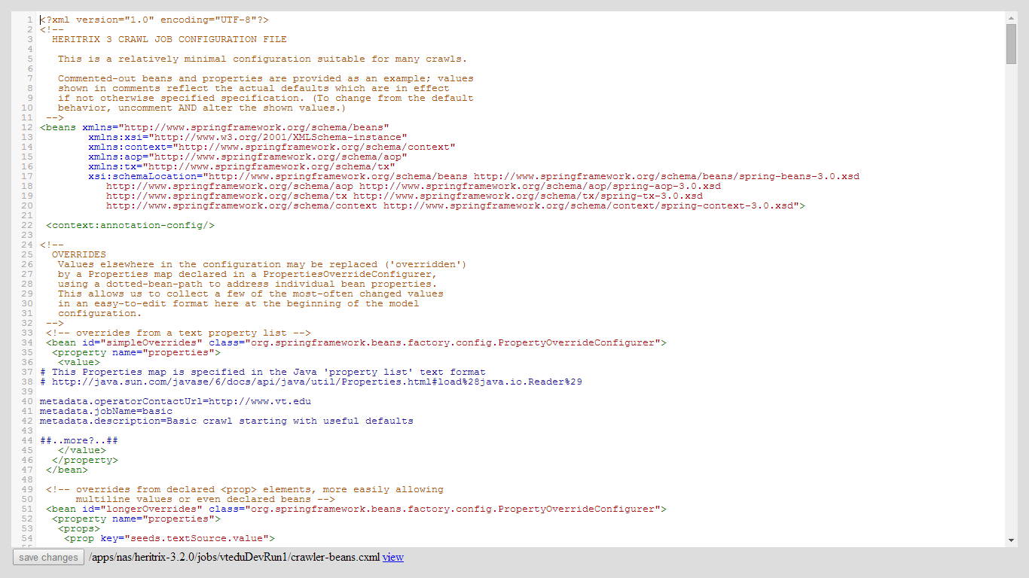

Slide 8
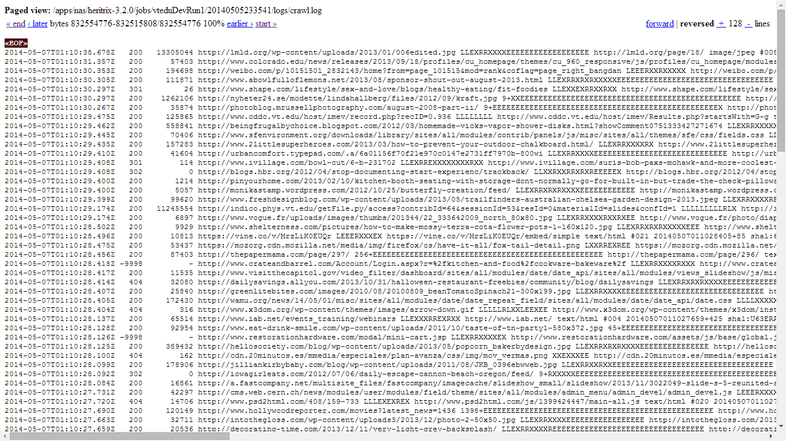

Slide 10
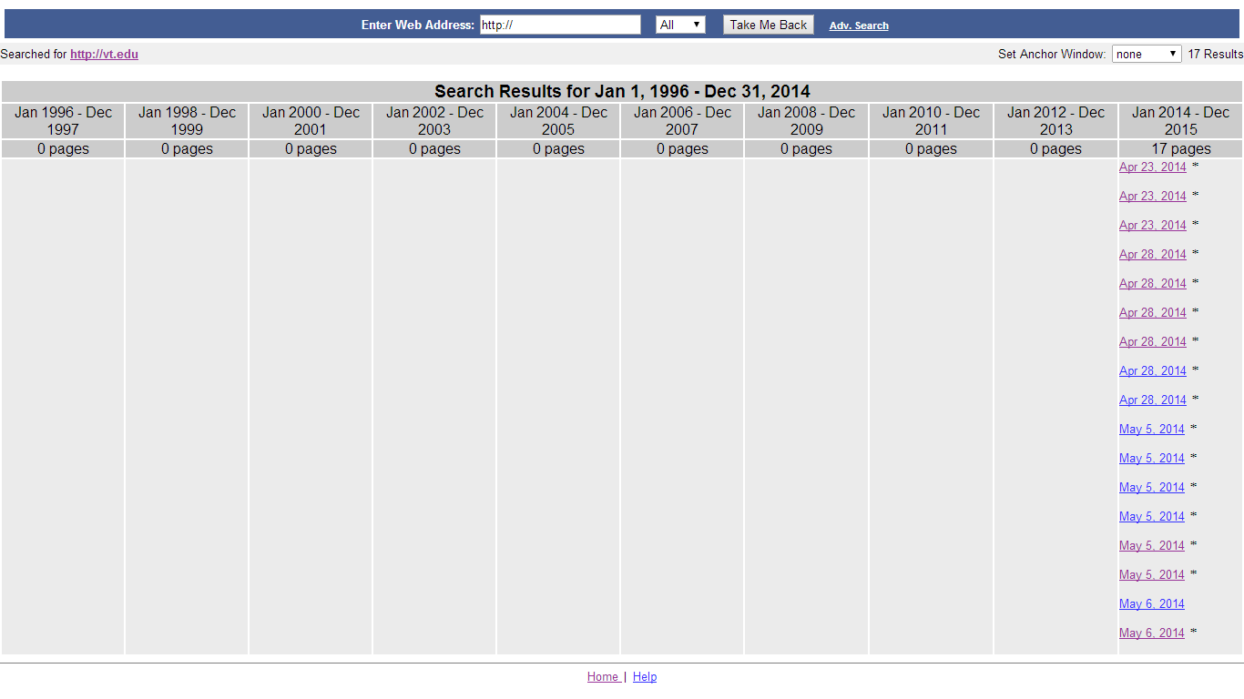

Slide 11
