Slide 1
Arabic Natural Language Processing: P-Stemmer, Browsing Taxonomy, Text Classification, RenA, ALDA, and Template Summaries — for Arabic News Articles
Tarek Kanan and Edward Fox
Virginia Tech, USA
May 2015

Slide 2
The Arabic Language
Arabic is a widely used global language that has major differences from the most popular, e.g., English and Chinese.
The Arabic language has many grammatical forms, varieties of word synonyms, and different word meanings that vary depending on factors like:
Word order
Diacritics
Notes:
Widely used language that is different from English
Right to left
Special character set
Arabic has many grammatical forms and different meanings of the same word that depending on many things like
Diacritics: special characters appear either above or below the characters, they give the characters different pronunciations and sometimes meaning,

Slide 3
The Arabic Language
It is different from English
Right to left
Special character set
Arabic has many grammatical forms and different meanings of the same word that depending on many things like
Diacritics: special characters appear either above or below the characters, they give the characters different pronunciations and sometimes meaning,

Slide 4
The Arabic Language

Slide 5
What is Stemming
The process for reducing inflected or derived words to their word stem, base or root form
Two type for Arabic stems:
Root, the goal of a root-based stemmer is to extract the very basic form for any given word.
Light, the goal of a light stemmer is to find the form of an Arabic word by removing prefixes and suffixes

Slide 6
P-Stemmer
Called Prefix Stemmer (P-Stemmer)
It is a modified version of Larkey’s light10 stemmer
Larkey’s stemmers are popular Arabic light stemmers
Larkey’s five versions of light stemmers:
Light1, Light2, Light3, Light5, and Light10
P-Stemmer, only removes prefixes

Slide 7
P-Stemmer Examples1

Slide 8
P-Stemmer
https://github.com/tarekll/P-Stemmer
Available after the Summer

Slide 9
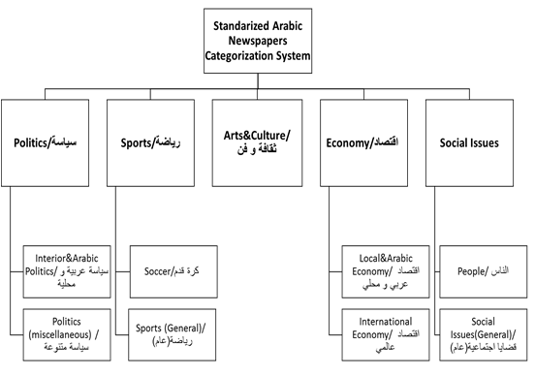
Standardized Taxonomy

Slide 10
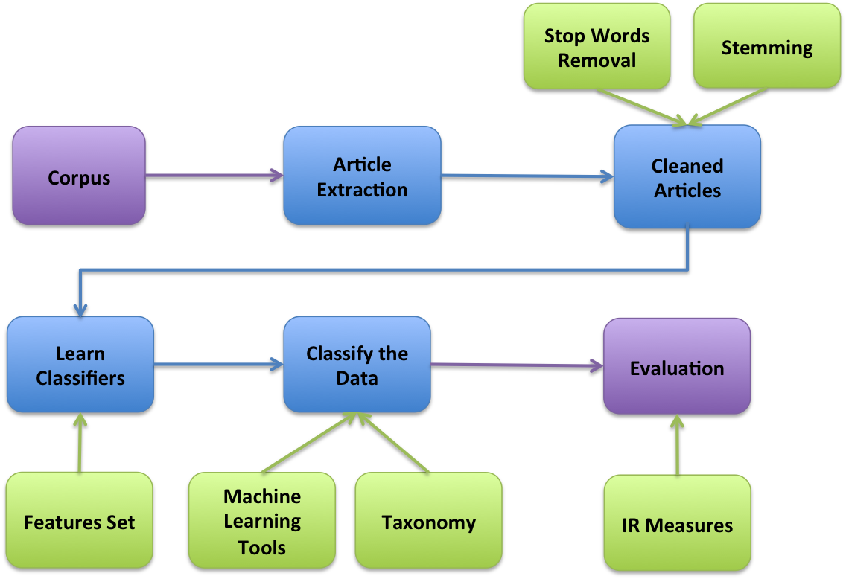
Arabic Text Classification

Slide 11
Arabic Text Classification
We used the SVM, NB, and RF classifiers to
Judge the performance of the P-Stemmer
Compared it with the other listed approaches
We categorized the data into one of five main categories
Sports
Economics
Politics
Art & Culture
Social Issues

Slide 12
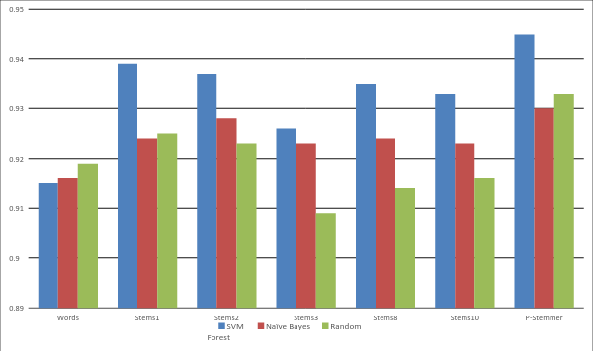
Arabic Text Classification Evaluation
F1

Slide 13
Dataset Preparation
5200 PDFs (Newspapers)
Acceptable
Filter
Discard
2700 Filtered PDFs
2500 PDFs (Images)
Extract
189K Articles
Filter
Discard
69K Articles (Ads, Images, Small articles)
Approved
120K Articles
1,000 Testing Random Sample
Notes:
We rejected around 50% of the pdf files because those were OCR-ed images that we could not extract any textual data from them
We rejected around 70K articles after that because those were mainly adds, very short articles, or images

Slide 14
Baseline Corpus
Could not find labeled Arabic news article corpus to:
Test and evaluate the NER results
Compare our NER with existing NERs
Decided to build our baseline corpus from our dataset
1000 articles, random sample
10 participants, each:
Assigned equal number of articles
Extract the 3 types of named entities (Person, Organization, and Location)
Extracted entities checked twice

Slide 15
NER
Named-entity recognition (NER) (also known as entity identification, entity chunking and entity extraction) is a subtask of information extraction
It seeks to locate and classify elements in text into pre-defined categories such as:
The names of persons, organizations, locations, expressions of times, dates, etc.

Slide 16
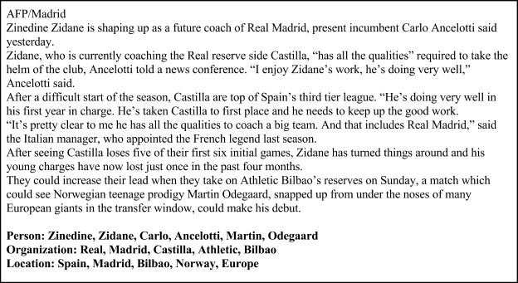
NER: Results (English)
Notes:
The NER results are single words but for our summarization purposes, we will extract the entities as bigrams or more.
-This will add more sense to persons and organizations names

Slide 17
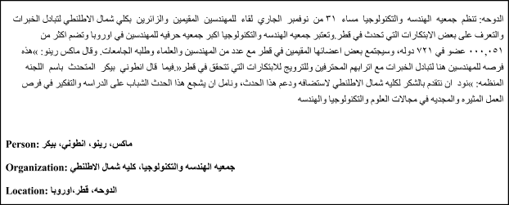
RenA: Results (Arabic)
Notes:
This is not a translation of the previous Arabic article.

Slide 18
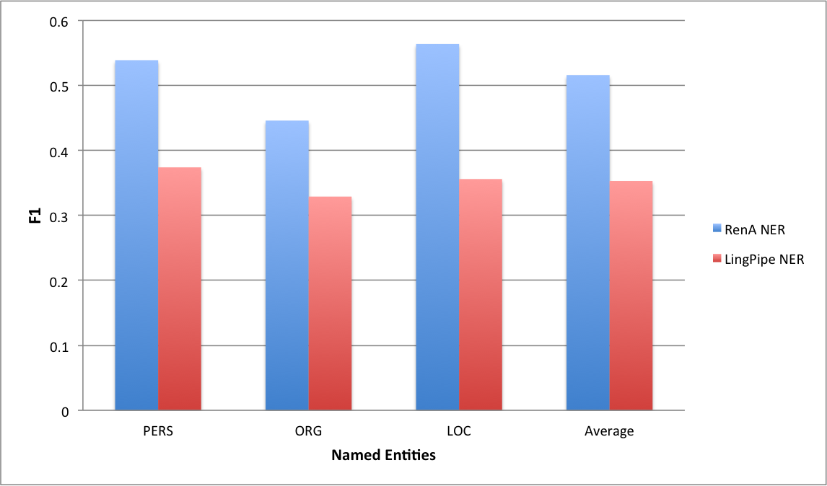
RenA: Evaluation

Slide 19
RenA
https://github.com/tarekll/RenA
Available after the Summer

Slide 20
Topic Identification
It’s the way to identify what is the topic(s) in a set of documents
Given that a document is about a particular topic, one would expect particular words to appear in the document more or less frequently
LDA, one of the popular Topic modeling algorithms

Slide 21
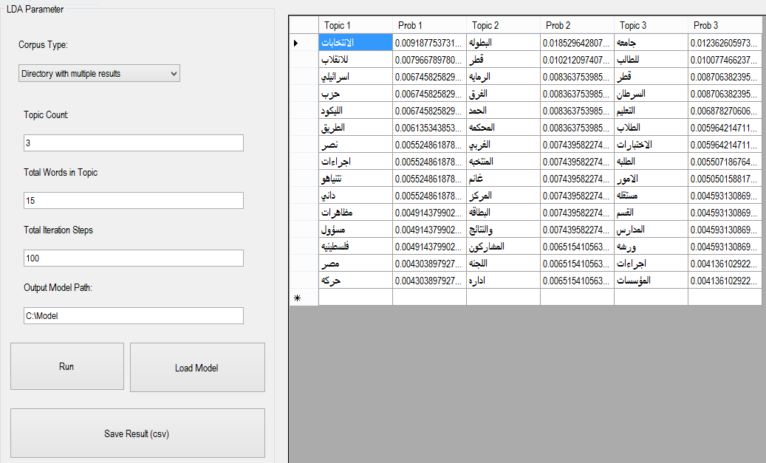
ALDA: Screen Shot

Slide 22
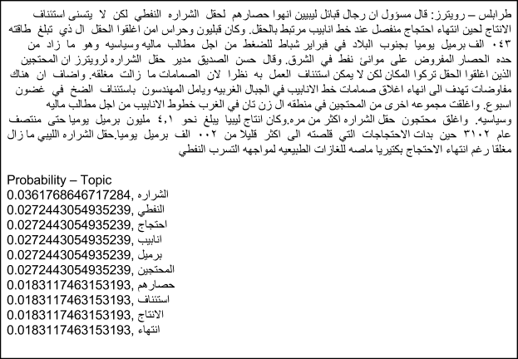
ALDA: Article/Topic (Arabic)
Notes:
This is the articles with its ALDA result.

Slide 23
ALDA: Article/Topic (English)
Tripoli - Routers: An official said the tribesmen from Libya ended their closure of the oil field of AlSharara, but it is not possible to resume production until the end of a separate protest connected to the field pipelines. The security guards blocked a field that has a capacity of 34 thousand barrels per day south of the country in the month of February to lobby for financial and political demands which increased the severity of the siege imposed on the oil. Hasan Alsadeq, AlSharara oil field director, said to Routers that the protesters left the field but can not resume work and that he hopes to resume work within a week. Closing the filed happened more than once. Libya's oil production was 4.1 million barrels per day.
AlSharara, Oil, Protest, Pipelines, Barrel, Protestors, Siege, Resume, Production, Ends
Notes:
This is a rough translation of the previous article and the words’ topic

Slide 24
ALDA: Evaluation
10 participants; each received 100 articles and their corresponding topics from the 1000 random sample
Participants asked to evaluate the relevance of the topics
Each topic/article pair evaluated twice, then averaged
Count the frequencies of each rating

Slide 25
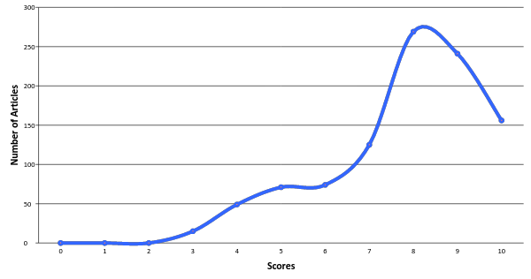
ALDA: Evaluation Results
Notes:
We can see that non of the topic were really irrelevant to their articles.
We can see that some of the topics were rated in the middle as 3,4,5,6
And most of the topic were getting good rating in term of relevancy

Slide 26
ALDA
https://github.com/tarekll/ALDA
Available after the Summer

Slide 27
Summary Template’s Attributes (English)
Arabic News Article Template
Title
Date
Writer
Topics
Named Entities
Category
Person
Organization
Notes:
This approach will be a new approach for Arabic news articles summarization
The category attribute’s work has been done before the prelim time, we submitted a paper about this

Slide 28
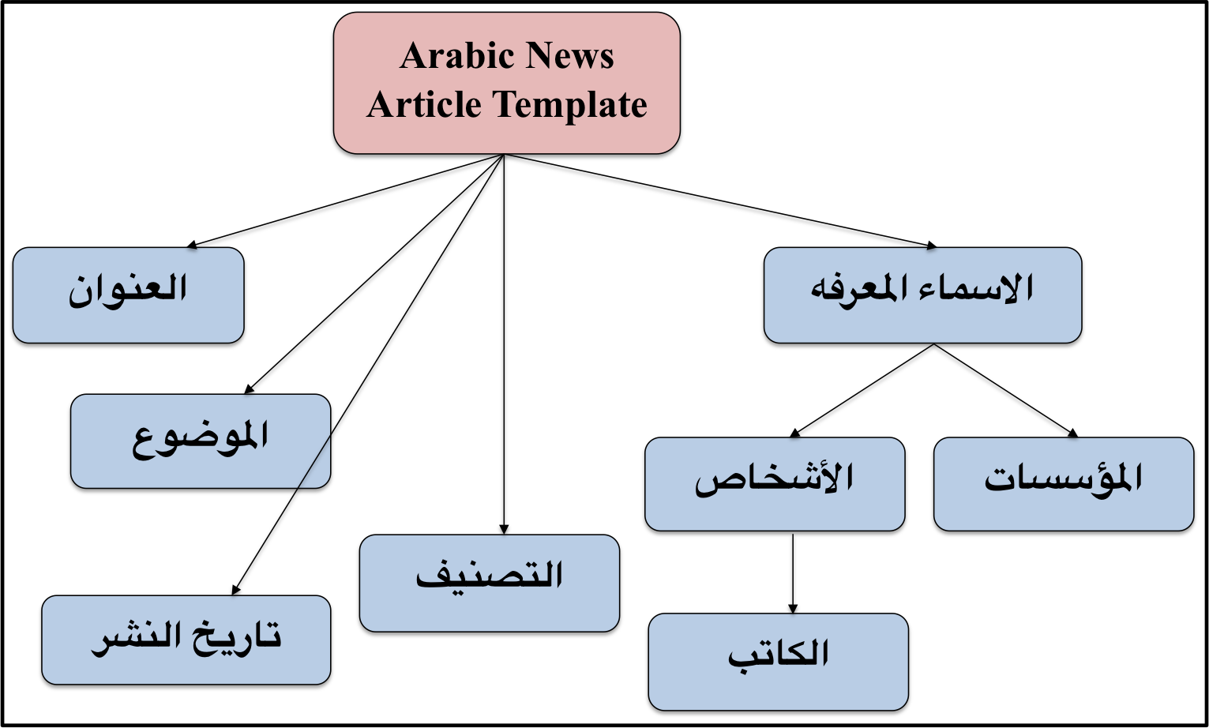
Summary Template’s Attributes (Arabic)

Slide 29
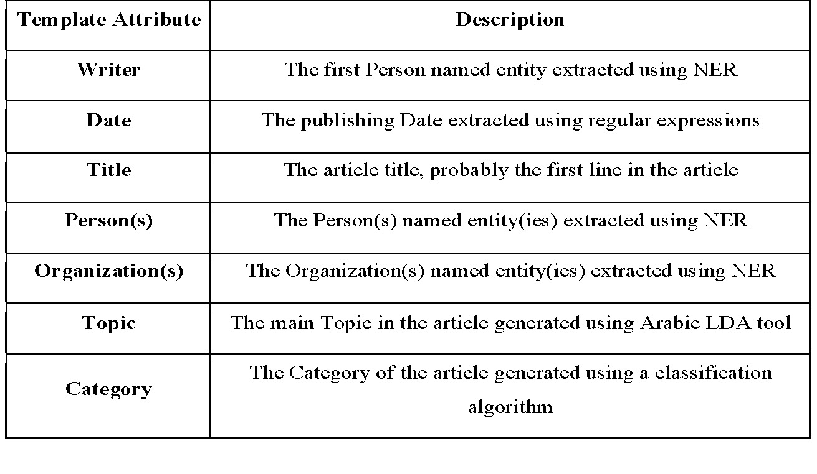
Template Summaries Description

Slide 30
Template (Arabic/English)

Slide 31
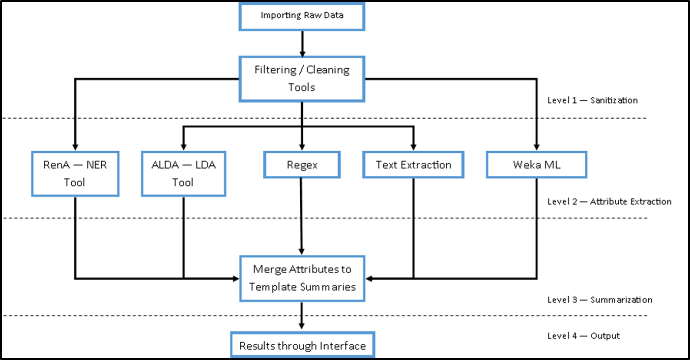
Overall Architecture Diagram

Slide 32
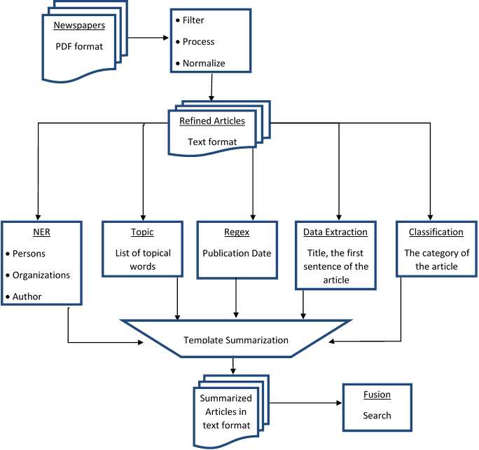
Overall Dataflow Diagram

Slide 33
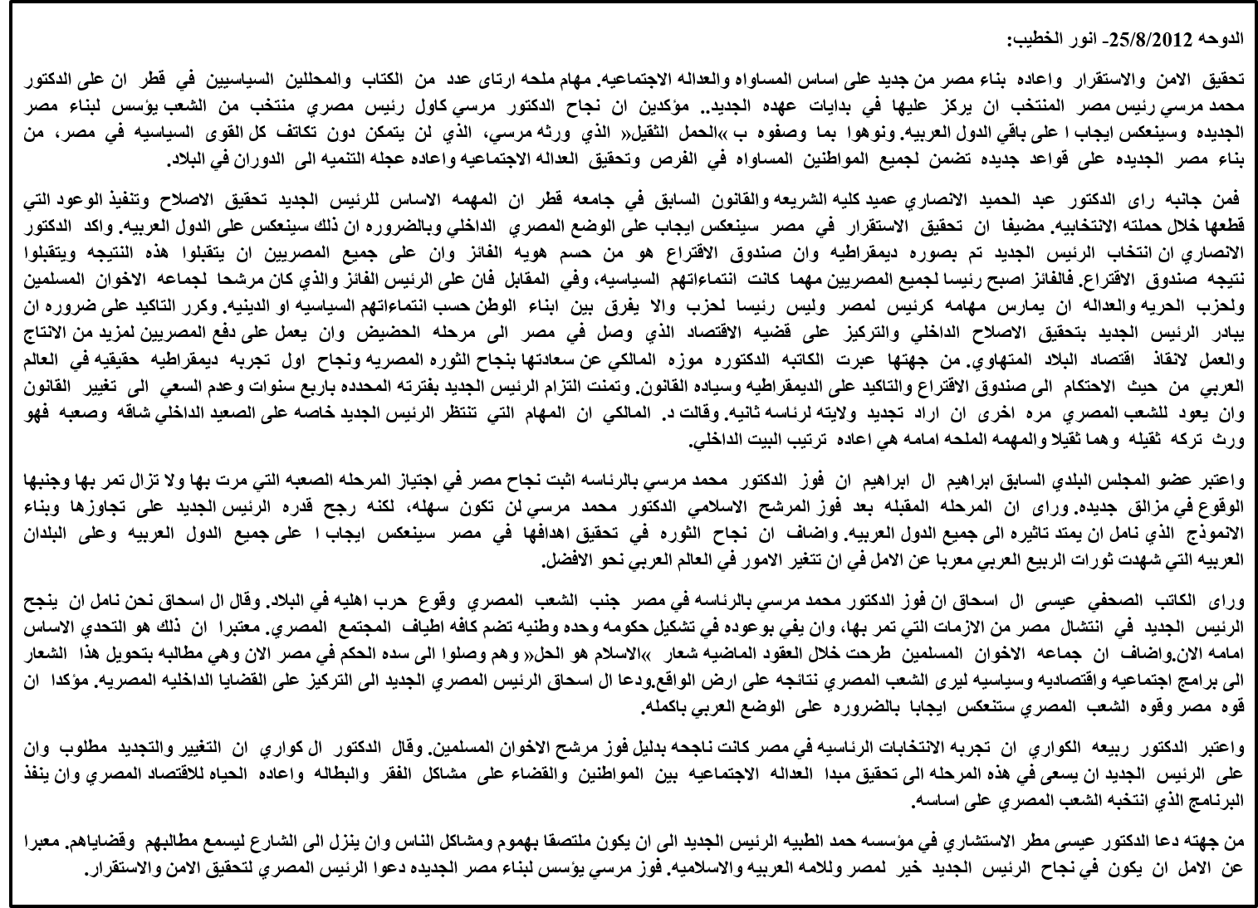
Arabic News Article Example

Slide 34
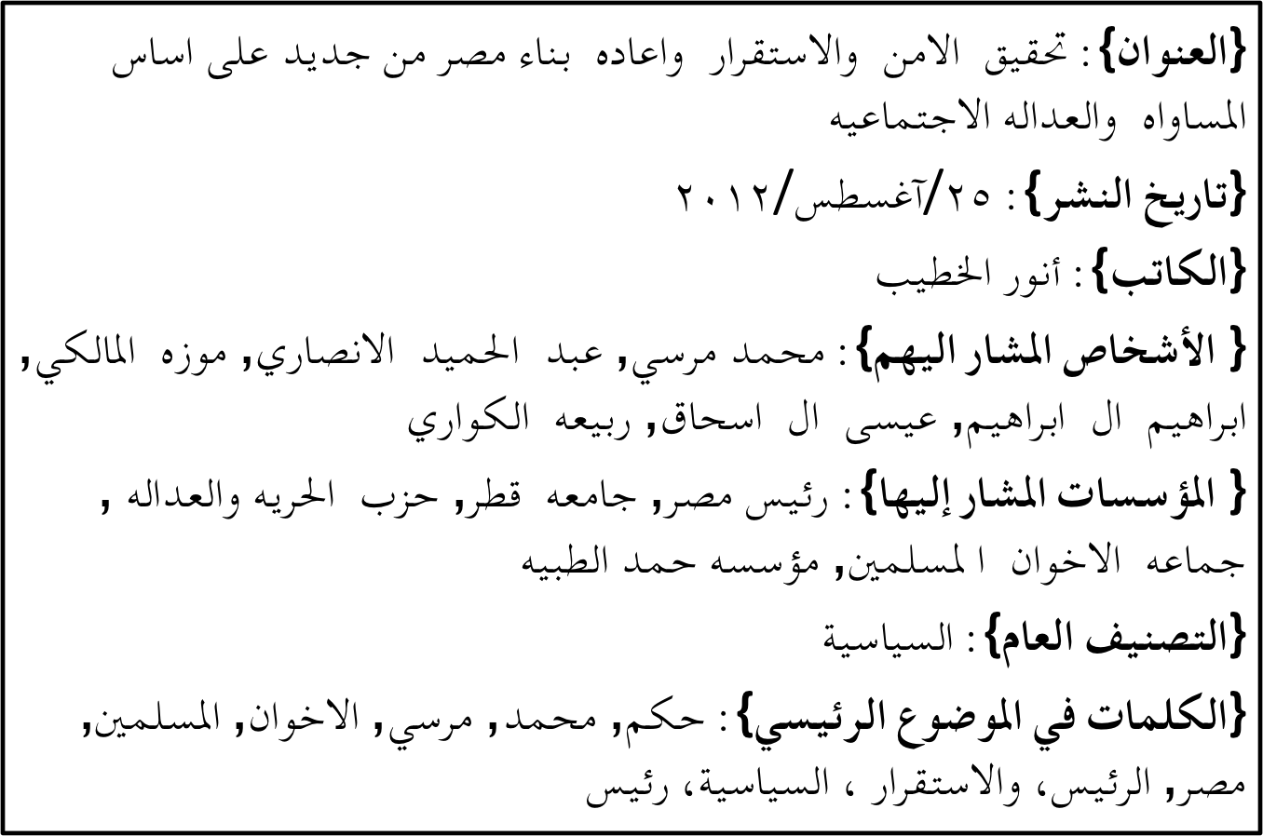
Template Summaries (Arabic Example)

Slide 35
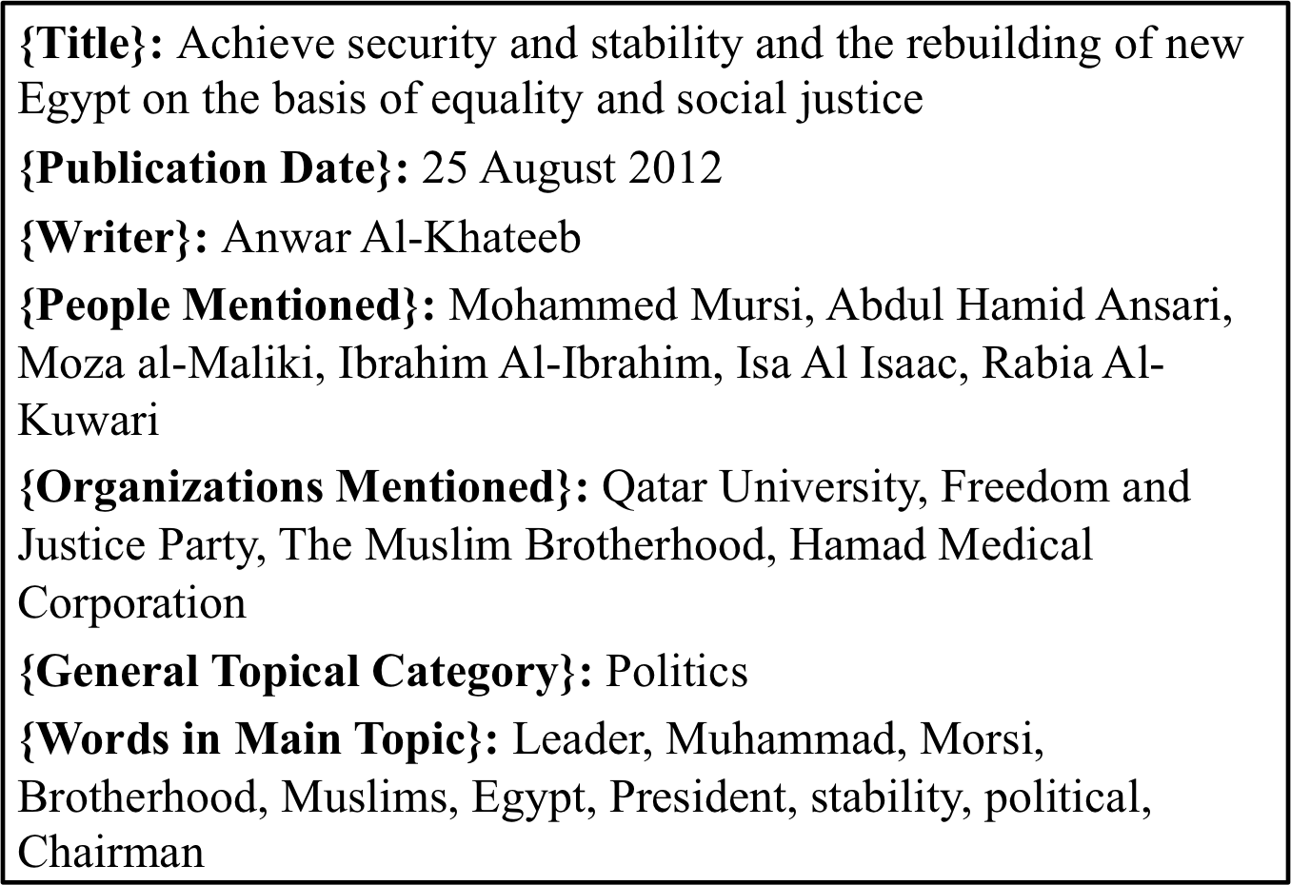
Template Summaries (English Example)

Slide 36
Fusion
The final results of this work is one of the collections that has been
Indexed and available to search through LucidWorks Fusion
http://10.100.121.44:8000
Choose “Arabic News Articles Template Summaries” collection

Slide 37
For more questions, please contact
Professor Edward A. Fox
Virginia Tech, Dept. of CS
+1-540-231-5113
fox@vt.edu
http://fox.cs.vt.edu
PhD Candidate, Tarek Kanan
Virginia Tech, Dept. of CS
tarekk@vt.edu

Slide 38
Thank You!
Questions ?

