Slide 1
ELISQ Discussion with QNL Director Lux
20 May 2015
Edward A. Fox
Professor, Computer Science, Virginia Tech
Blacksburg, VA 24061 USA
fox@vt.edu http://fox.cs.vt.edu
http://elisq.qu.edu.qa

Slide 2






Funding provided thru the ELISQ project:
Electronic Library Institute - SeerQ
Sponsored by QNRF
HTTP://qnl.qa
http://www.qu.edu.qa/
http://www.vt.edu/
http://www.psu.edu/
http://www.tamu.edu/

Slide 3
ELISQ Project Team
Qatar University, Qatar:
Mohammed Samaka (Ph.D., Co-Lead PI)
Sumaya Ali S A Al-Maadeed (Ph.D., PI)
Myrna Tabet
Asad Nafees
Kholoud Waheeb Khayal
Virginia Tech, USA:
Edward Fox (Ph.D., Lead-PI)
Tarek Kanan
Penn. State University, USA:
C. Lee Giles (Ph.D., PI)
Sagnik Ray Choudhury
Qatar National Library, Qatar:
Claudia Lux (PI)
Krishna Roy Chowdhury
Research Scientist - TBA
Consultants:
John Impagliazzo (Ph.D., Key Investigator)
Susan Lukesh (Ph.D.)
Carole Thompson
Texas A&M, USA:
Richard Furuta (Ph.D., PI)
Hamed Alhoori
This project was made possible by NPRP Grant # 4 - 029 - 1 – 007 from the Qatar National Research Fund (a member of Qatar Foundation).

Slide 4
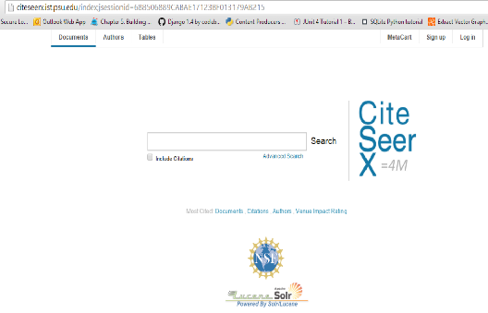
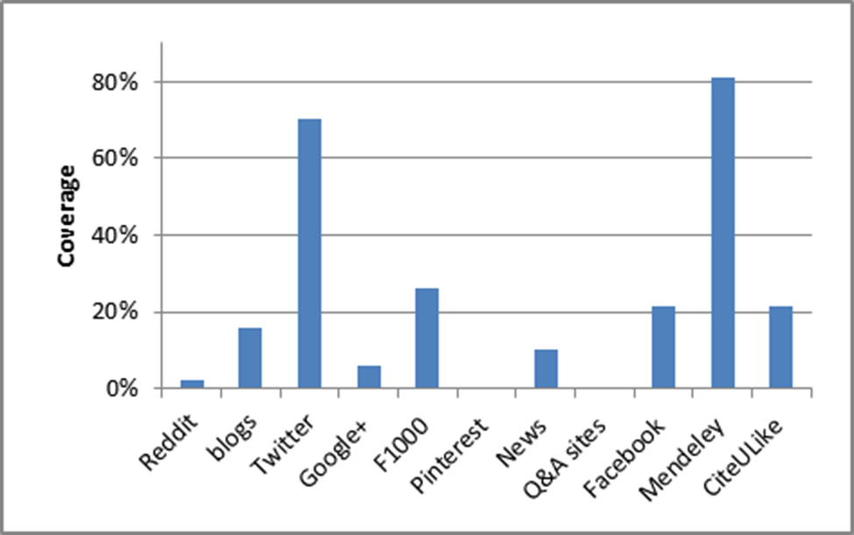
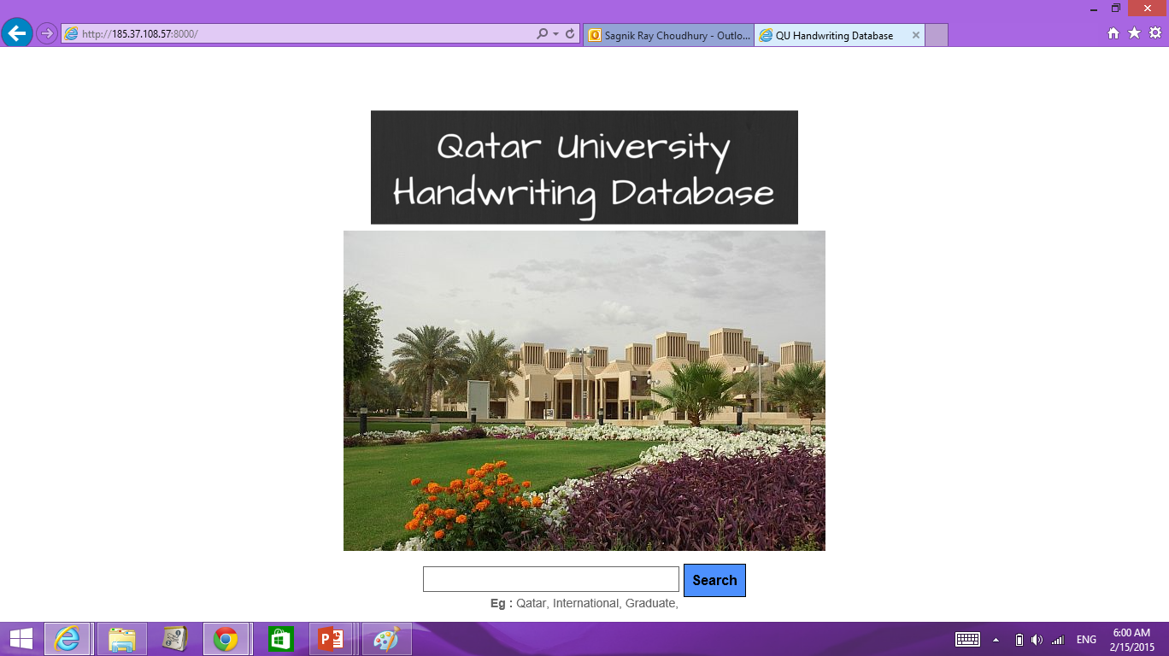
Goals and Achievements
Systems:
  SeerSuite for scholarly search
  Web crawling and archiving: Heritrix and Wayback Machine
  Fusion: Integrated solution for building and managing digital collections
Research
  Understanding social scholarly impact: Hamed
  Improving Arabic NLP by automated summarization with categorization: Tarek
  Understanding the semantics of figures in scholarly documents: Sagnik
Community Building / Outreach
  Motivating DL research and discussing improvements
  Reaching out to different departments to enhance information management: Computer Science, Chemical Engineering, Gulf Studies
  Working with Qatar National Library on crawling and archiving

Slide 5
Schedule
Tomorrow: Integrated Digital (Event) Archiving and Library, plus problem-based learning for IR/DL

Slide 6
Descriptions of Results Presented
Running systems
Accessible collections with digital library and archive service support
Advances at VT in Arabic text / natural language processing integrated with digital libraries
Advances at Penn State in SeerQ, extending SeerSuite, improving analysis of scholarly articles
Recommendations from analysis of digital library users based on studies in Qatar, USA, and from scholarly and social networks
So QU and QNL can continue and extend ELISQ aims

Slide 7
ELISQ Collections
SeerQ running with
  >2000 QScience articles, and
  >1700 crawled documents from QNL seedlist,
Special Solr-based system for images + bi-lingual text, for Dr. Somaya’s work with handwriting,
Heritrix + WayBack Machine with archive from QU’s Web,
plus:

Slide 8
SeerQ: SeerSuite for Qatar
SeerSuite: A digital library management system developed at Penn State
  Key features:
    Crawls web to gather scholarly documents
    Extracts metadata from PDFs (title, author name, citation) using machine learning
    Stores extracted metadata in a database and allows metadata and fulltext search.
  Differences from Google Scholar:
    Stores the metadata and exposes it through OAI-PMH
    Stores the citation graph which can be used later to measure scholarly impact
    Collects and stores the PDFs which can be used later for advanced processing such as table/ figure extraction, understanding the semantics
SeerQ: The instance of SeerSuite running in Qatar University crawling scholarly content from the Qatari Web

Slide 9
SeerQ: Components and Statistics
System running at http://10.100.121.41:8080 (available from within Qatar University)
Components:
  Heritrix 3 and OAI based crawler (PSU uses Heritrix 1.2)
  Solr 3.6 (PSU just moved from Solr 1.2)
  MySQL and front end (same as PSU)
Document collections:
  Documents crawled from QScience
  Documents crawled from the Web: seedlist provided by QNL

Slide 10
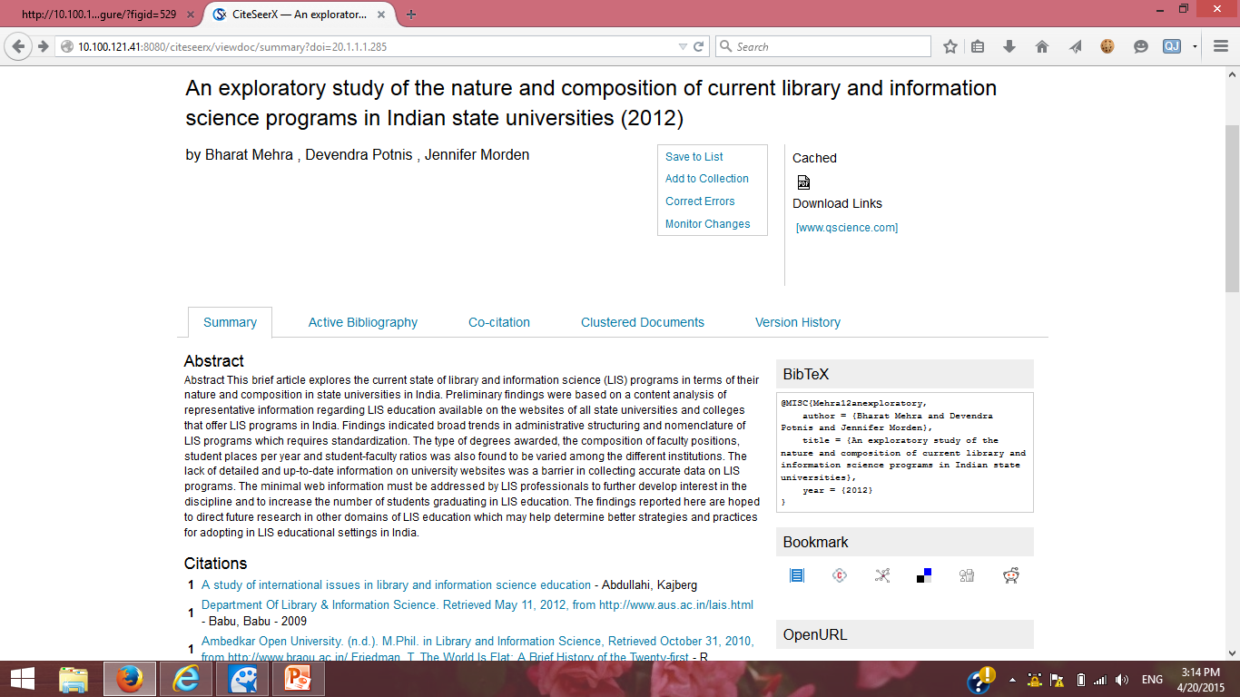
SeerQ: Details from Search Results

Slide 11
Arabic/English Bilingual Handwriting Database
A searchable database for handwritten documents (both in English and Arabic)
Motivation:
  Retrieve handwritten documents matching the search term
  Compare the difference in handwriting for Arabic words (recognize the writer)
Arabic handwriting project interface: http://10.100.121.42:8000/

Slide 12
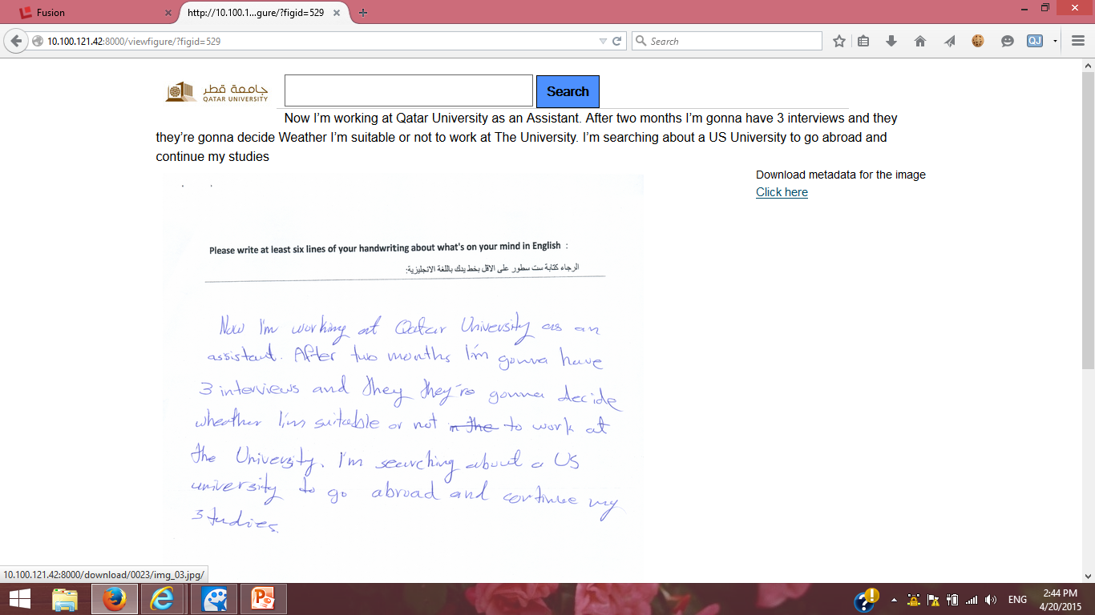
Handwriting Project: Image + Metadata

Slide 13
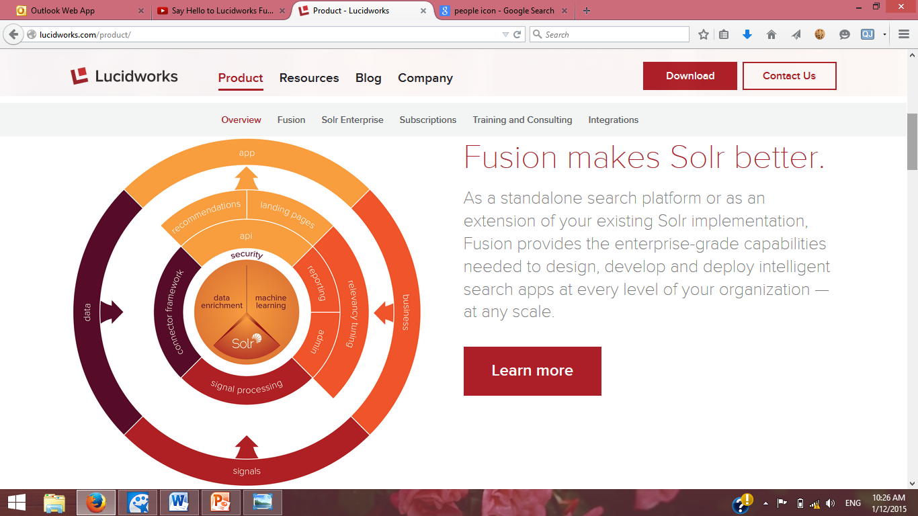
Fusion: A Search Eco System
Fusion is a free search eco-system developed by LucidWorks.
  Includes crawler, Solr for indexing, tools for query log analysis and error reporting
Advantages over simple Solr:
  Enhanced Admin UI
  Security
  Data Enrichment
  Machine Learning
  Advanced Relevancy Tuning
  Reporting
  Admin
  Signal Processing
  Recommendations
  API (Configuration, History, Node, System, Usage)
  Connector Framework

Slide 14
Using Fusion to build Qatari Digital Content
Around 2 million English & Arabic documents related to Qatar has been crawled and are accessible using Fusion.
Specific collections:
  Qatari Newspapers: >1 million documents from Al-Raya, Gulf-Times, Qatar-tribune
  Sports: QA domain sports sites, 5000 documents
  Government: government websites in Qatar, 14500 documents
  Arabic News Articles Templates Summary : 120,000 newspaper articles along with their summary, generated automatically (Tarek’s research)
  Qatar University
Interface for the search available on: http://10.100.121.44:8000/

Slide 15
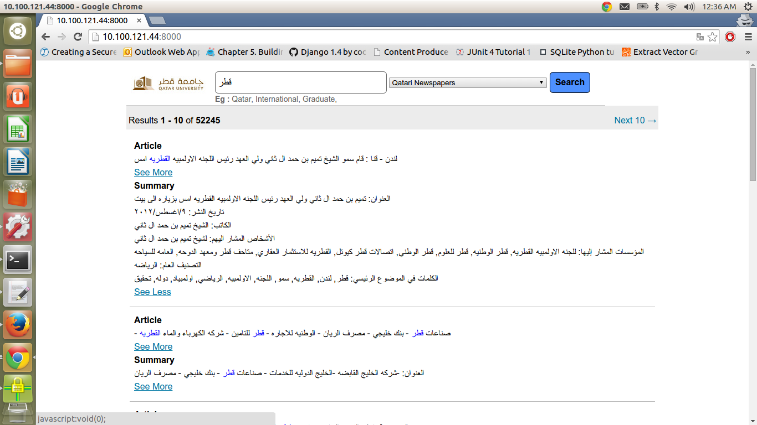
Result: News Article Summary

Slide 16
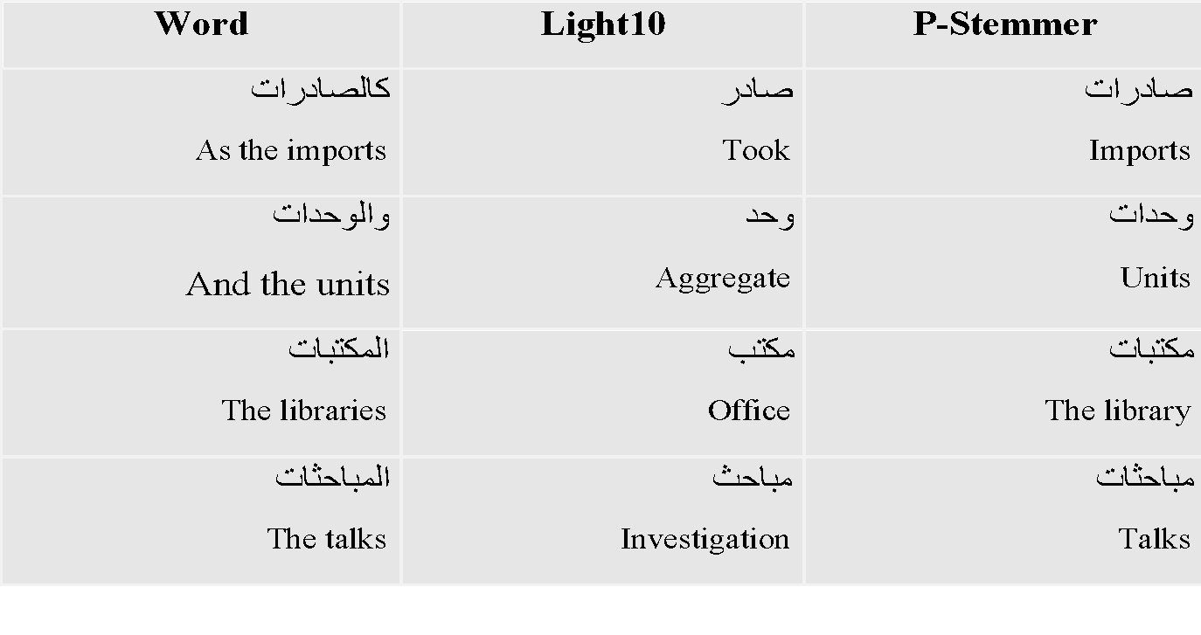
P-Stemmer Examples

Slide 17
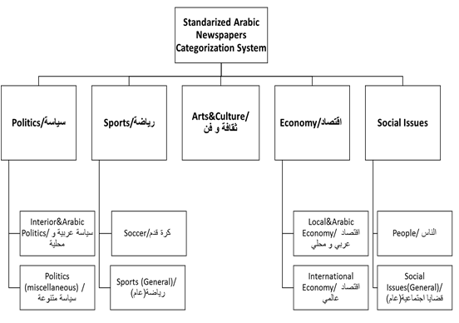
Standardized Taxonomy

Slide 18
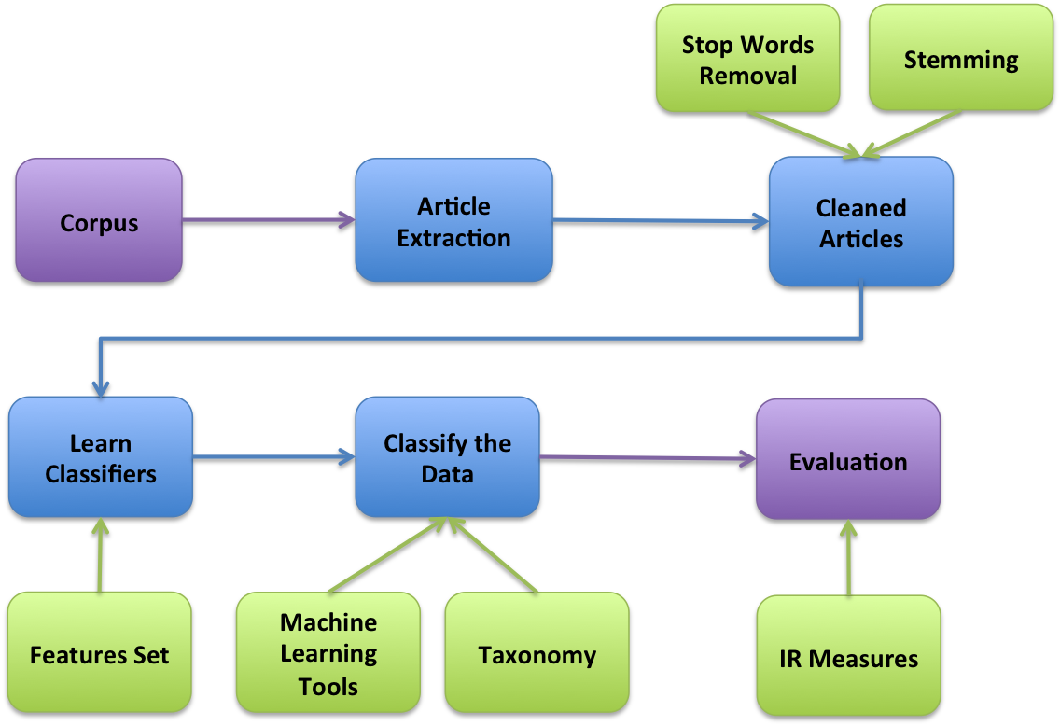
Arabic Text Classification

Slide 19
Arabic Text Classification
We used the SVM, NB, and RF classifiers to
  Judge the performance of the P-Stemmer
  Compared it with the other listed approaches
  We categorized the data into one of five main categories
    Sports
    Economics
    Politics
    Art & Culture
    Social Issues

Slide 20
Dataset Preparation
5200 PDFs (Newspapers)
Acceptable
Filter
Discard
2700 Filtered PDFs
2500 PDFs (Images)
Extract
189K Articles
Filter
Discard
69K Articles (Ads, Images, Small articles)
Approved
120K Articles
1,000 Testing Random Sample
Notes:
We rejected around 50% of the pdf files because those were OCR-ed images that we could not extract any textual data from them
We rejected around 70K articles after that because those were mainly adds, very short articles, or images

Slide 21
NER
Named-entity recognition (NER) (also known as entity identification, entity chunking and entity extraction) is a subtask of information extraction
It seeks to locate and classify elements in text into pre-defined categories such as:
  The names of persons, organizations, locations, expressions of times, dates, etc.

Slide 22
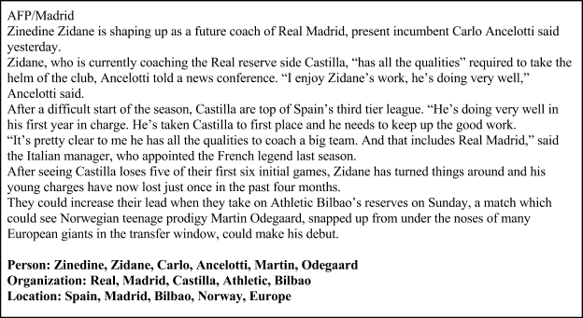
NER: Results (English)
Notes:
The NER results are single words but for our summarization purposes, we will extract the entities as bigrams or more.
-This will add more sense to persons and organizations names

Slide 23
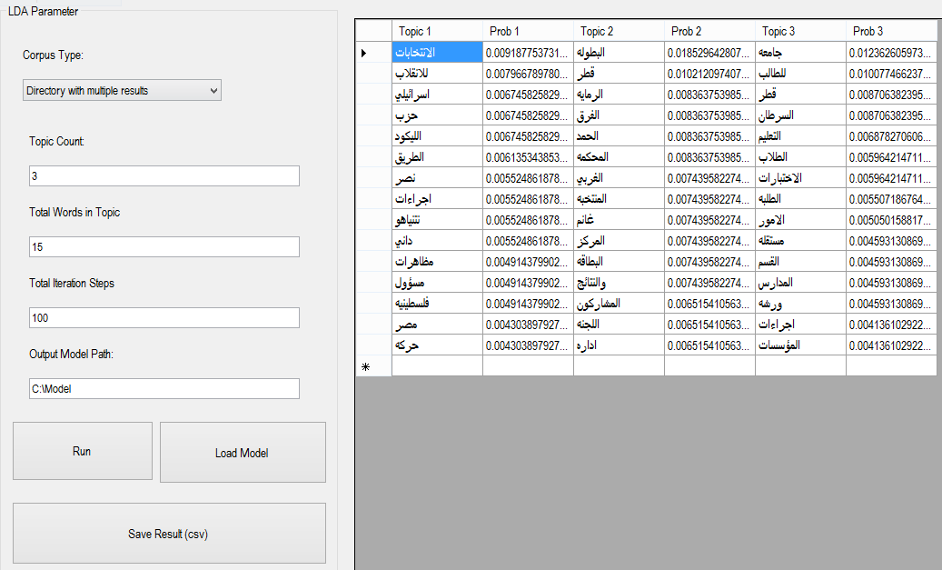
ALDA: Screen Shot

Slide 24
ALDA: Article/Topic (English)
Tripoli - Routers: An official said the tribesmen from Libya ended their closure of the oil field of AlSharara, but it is not possible to resume production until the end of a separate protest connected to the field pipelines. The security guards blocked a field that has a capacity of 34 thousand barrels per day south of the country in the month of February to lobby for financial and political demands which increased the severity of the siege imposed on the oil. Hasan Alsadeq, AlSharara oil field director, said to Routers that the protesters left the field but can not resume work and that he hopes to resume work within a week. Closing the filed happened more than once. Libya's oil production was 4.1 million barrels per day.
AlSharara, Oil, Protest, Pipelines, Barrel, Protestors, Siege, Resume, Production, Ends
Notes:
This is a rough translation of the previous article and the words’ topic

Slide 25
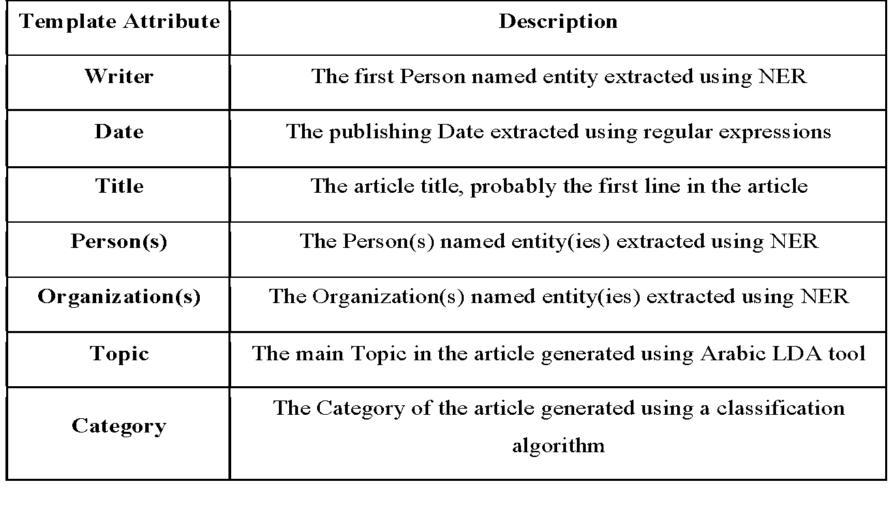
Template Summaries Description

Slide 26
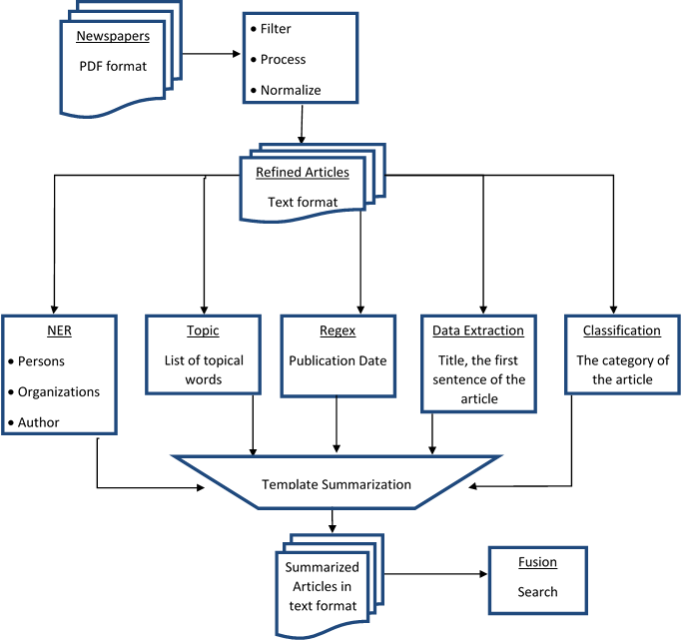
Overall Dataflow Diagram

Slide 27
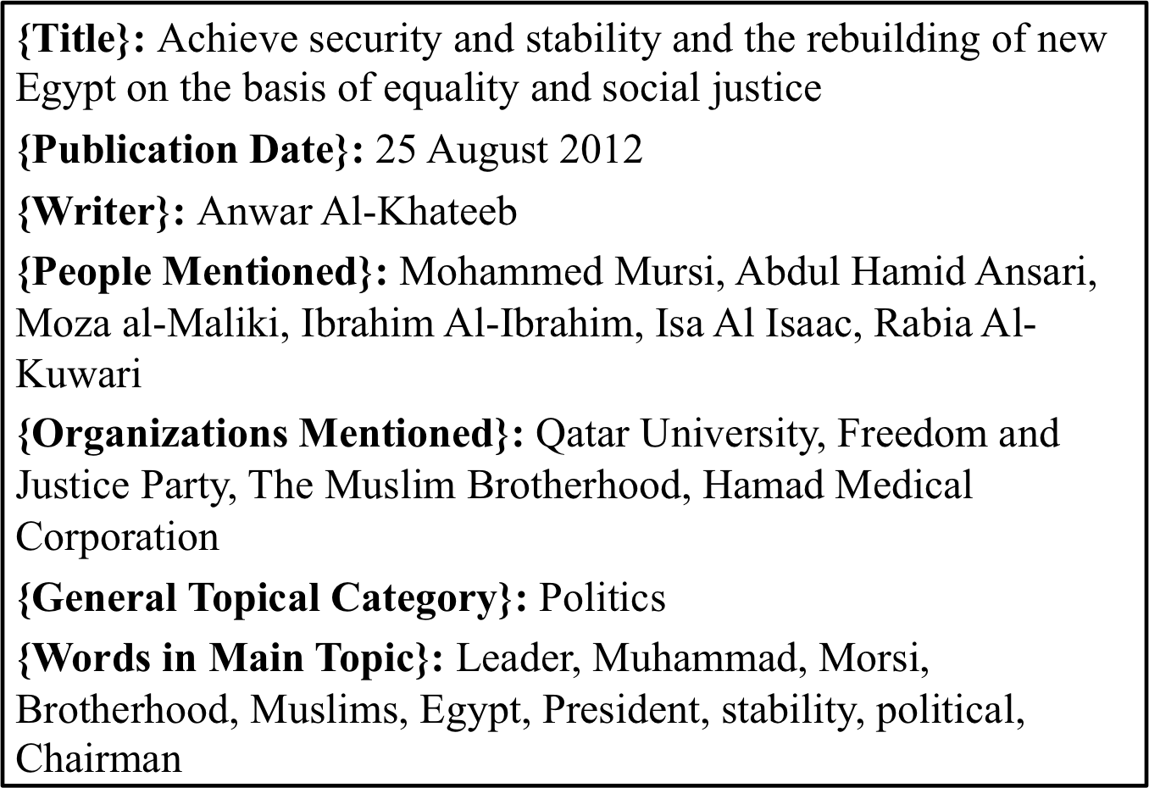
Template Summaries (English Example)

Slide 28


Understanding the international scholarly research challenges
H. Alhoori, C. Thompson, R. Furuta, J. Impagliazzo, E. Fox, M. Samaka, and S. Al-Maadeed, “The Evolution of Scholarly Digital Library Needs in an International Environment: Social Reference Management Systems and Qatar,” ICADL, 2013.
Notes:
185 researchers from US and Qatar
Some of our questions were
- How do researchers select and use resources to search for scholarly content?
- How do researchers organize and retrieve their scholarly content?
How do researchers collaborate?
What collaboration tools do they use?
- How do researchers stay up-to-date with new research relevant to their specialized area or to multidisciplinary areas?
How do researchers measure the impact of research?
What challenges they face?
We found many interesting findings:
And I am going to mention few of them

Slide 29
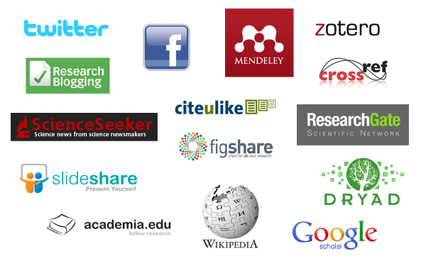

Beyond citations
Altmetrics = alternative metrics to the traditional metrics (e.g., citations)
Notes:
If we move beyond the main currency of scholarly impact we will find more diverse signals that became available in the last decade
We can see the academic social networks, where millions of users are using them with millions of articles added in various disciplines
We also can see that there are some other scholarly activities
For example, researchers read articles online, but not necessarily cite them for several reasons.
Researchers build online scholarly collections in sites like Mendeley and CiteULike
They discuss the results in twitter or facebook
We can see mentions of scholarly results in news outlets
They review manuscripts submitted for scholarly venues
All these metrics are not considered when measuring the scholarly impact
All those social based metrics, non-citation-based metrics come under the umbrella of alternative metrics or just altmetrics

Slide 30
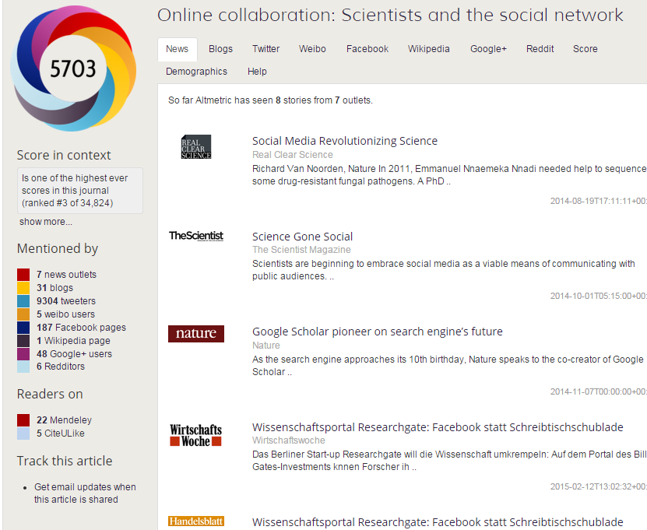
Altmetrics
http://www.altmetric.com/
Notes:
An implementation of altmetrics, altmetric.com
Question: what such data and mentions represent?

Slide 31
Research questions
How do social media platforms differ in the coverage, usage, and distribution of scholarly works?
Is the online attention received by research articles related to scholarly impact or may be due to other factors?
Do Open Access (OA) articles receive more altmetrics than Non-Open Access (NOA) articles?
Can altmetrics predict the research impact?
Can we use altmetrics to recommend scholarly content?
Notes:
Some of our questions are

Slide 32
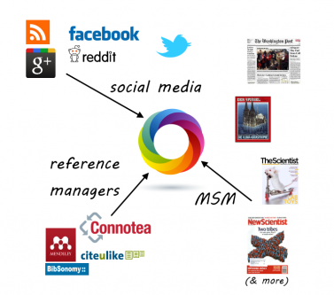
Data and methods
Used 14 data sources: Twitter, Facebook, CiteULike, Mendeley, F1000, blogs, mainstream news outlets, Google Plus, Pinterest, Reddit, Sina Weibo, the peer review sites PubPeer and Publons, policy documents, and sites running Stack Exchange (Q&A).
  13,221,827 altmetrics count
Altmetrics
  Article-level
  Access-level
Notes:
We built different datasets depending on our research question
We started by 1 data source, and in recent studies we used 14 data sources
820 – Web of science - Journal Citation Reports - Thomson Reuters
373,427 articles
More than 13 million altmetrics count
To the best of my knowledge – this is one of the biggest and more diverse studies on altmetrics

Slide 33
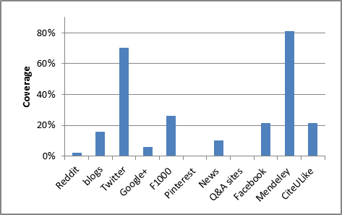
Coverage of research articles
Notes:
Twitter and Mendeley have the highest coverage of research articles
10% of the shared articles are covered in the mainstream news

Slide 34
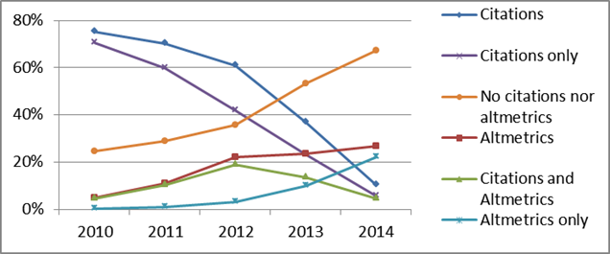
Altmetrics vs. citations
H. Alhoori, R. Furuta, M. Tabet, M. Samaka, and E. Fox, “Altmetrics for Country-Level Research Assessment,” ICADL 2014
Notes:
We compared Altmetrics and citations between the years 2010 and 2014
We found a significant yearly increase in the number of articles that received altmetrics.
Articles published in 2014 have more altmetrics (27%) than citations (10%) with significant difference.

Slide 35
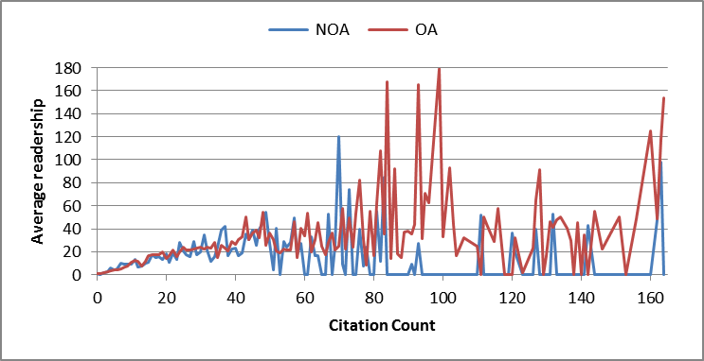
Average readership per citation count for NOA and OA articles
Notes:
Articles published in 2012 so that they had enough time to accumulate citations and readership
NOA articles - we found a weak significant correlation between citation count and average readership (ρ = 0.26).
OA articles - we found a moderate significant correlation between citation count and average readership (ρ = 0.56)
Articles that received more than 80 citations and more than 40 readership were mostly OA with significant difference, which shows a preference for sharing OA articles over NOA articles in academic social networks.

Slide 36
Citation-based & social-based metrics
Citation-based metric | Social-based metric
 | Readership | ARR | Article count
SCImago h-index | 0.581 | 0.566 | 0.534
Google’s h5-index | 0.336 | 0.354 | 0.349
Eigenfactor score | 0.688 | 0.669 | 0.665
Total citations | 0.675 | 0.625 | 0.632
Correlations between citation-based metrics and social metrics for the top 100 venues
Notes:
General/overall Ranking
We compared the general citation-based rankings of the top 100 venues with our social-based rankings and found strong positive relationships

Slide 37
Country-Level Altmetrics
35 countries
We used
  Gross domestic product (GDP)
  Gross domestic expenditure on research and development (GERD)
  GDP per capita
  Number of researchers
  Number of Internet users
  Number of mobile users
  Usage of social networks
Data from
  World Bank’s DataBank
  United Nation
  World Economic Forum’s Global Information Technology Report
  R&D Magazine
  SCIMago
Notes:
Scopus to download the bibliometric data, including DOI, citation, and year of publication
H-index for each country included in this study from SCIMago

Slide 38
Country-Level Altmetrics
Correlations between country-level altmetrics and traditional metrics
Notes:
The GERD had higher correlations than the GDP, since it is more related to the research and development
The number of Internet users, the number of mobile users, and usage of social networks have low-moderate correlations, which shows that altmetrics are not strongly related to the number of general users.

Slide 39
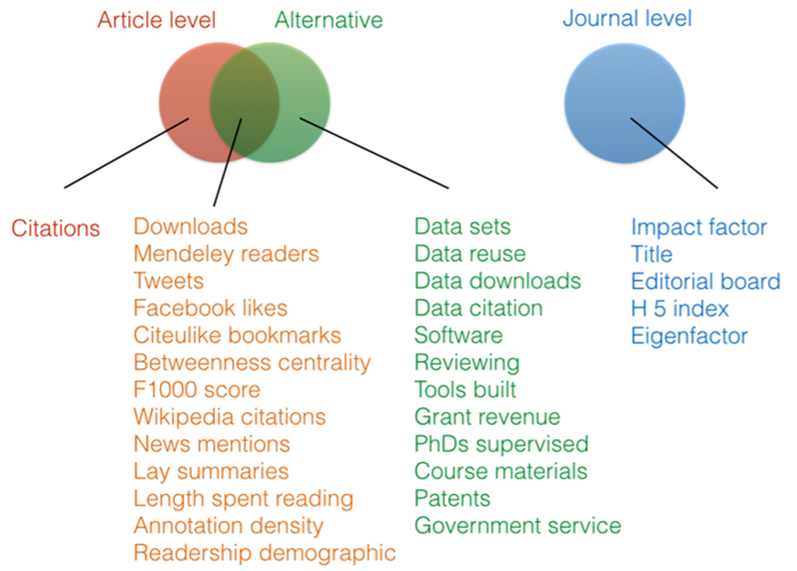
Future work
Notes:
- Adding more data sources, articles, and analysis
- We have many indicators that used to be hidden but we can measure them now
https://twitter.com/IanMulvany/status/424904870643384320/photo/1
- Previous work on altmetrics focused on articles, but we can apply them to a
datasets
software programs
People
Videos
Web pages

Slide 40
Transition Discussion
QNL gets data, software, and running systems
US sites continue assistance through Dec. (if allowed to continue spending QNRF approved funds)
Completion of 2 dissertations (VT, TAMU) and further progress on dissertation at Penn State
QU Library likely to start Web archiving
Recommendations for QNL
  Experiment with all systems and collections
  As staffing allows, get further training re ELISQ
  If Fusion fits a need, work out agreement with LucidWorks

