Slide 1
Big Data and Hadoop and DLRL Introduction to the DLRL Hadoop Cluster
Sunshin Lee and Edward A. Fox
DLRL, CS, Virginia Tech
Feb. 18, 2015 presentation for NLI:
Working with Big Data
Notes:
DLRL; digital library research lab

Slide 2
Google First
Notes:
First Google Storage Server now on exhibit in Huang Center at Stanford
Dr. Fox’s Name
There is no case, Lego Block that My 2nd and 3rd daughters like, is a case
Google always includes the term “commodity machines” in their all article.
I think Brinn and Page didn’t have enough money to buy computer case at that time. Really?
Let’s look at the first Google production server.

Slide 3
DLRL Cluster – Order Parts
Notes:
We ordered commodity parts like Google
But we also ordered Cases unlike Google.
Move: Mohamed

Slide 4
DLRL Cluster – Assemble
No-ODD such as DVD or CD-ROM
Notes:
We have case, so we don’t need to use wood or Velcro's

Slide 5
DLRL Cluster – Configure Network
Difficult things: configuring gateway(NAT) and Firewall

Slide 6
DLRL Cluster Spec. - 2014
# of Nodes: 11 + 1 (manager node)
CPU: Intel Xeon and i5
RAM: 208 GB
32GB * 2 (node1(master node) and node2)
16GB * 9 (all nodes)
HDD: 51.3 TB
12TB (node 1), 6TB (node 2)
3TB * 7, 2TB * 2 (remaining nodes)
8.3TB NAS Backup
Notes:
We need lots of RAM and HDD for Hadoop

Slide 7
DLRL Cluster – Architecture - 2014
Notes:
OS, Cloudera Manager, and CDH 5.0
Two networks
To build this system,

Slide 8
DLRL Cluster (Upgraded Feb. 2015)
Funding provided by CS to expand to 20 nodes
To support multiple courses as well as research
CS4984 Computational Linguistics
CS5604 Information Retrieval
CS4624 Multimedia, Hypertext&Information Access
Monitoring by Prof. Ali Butt and his students
Cloudera: CDH 5.3.1
High Availability architecture
Notes:
We need lots of RAM and HDD for Hadoop

Slide 9
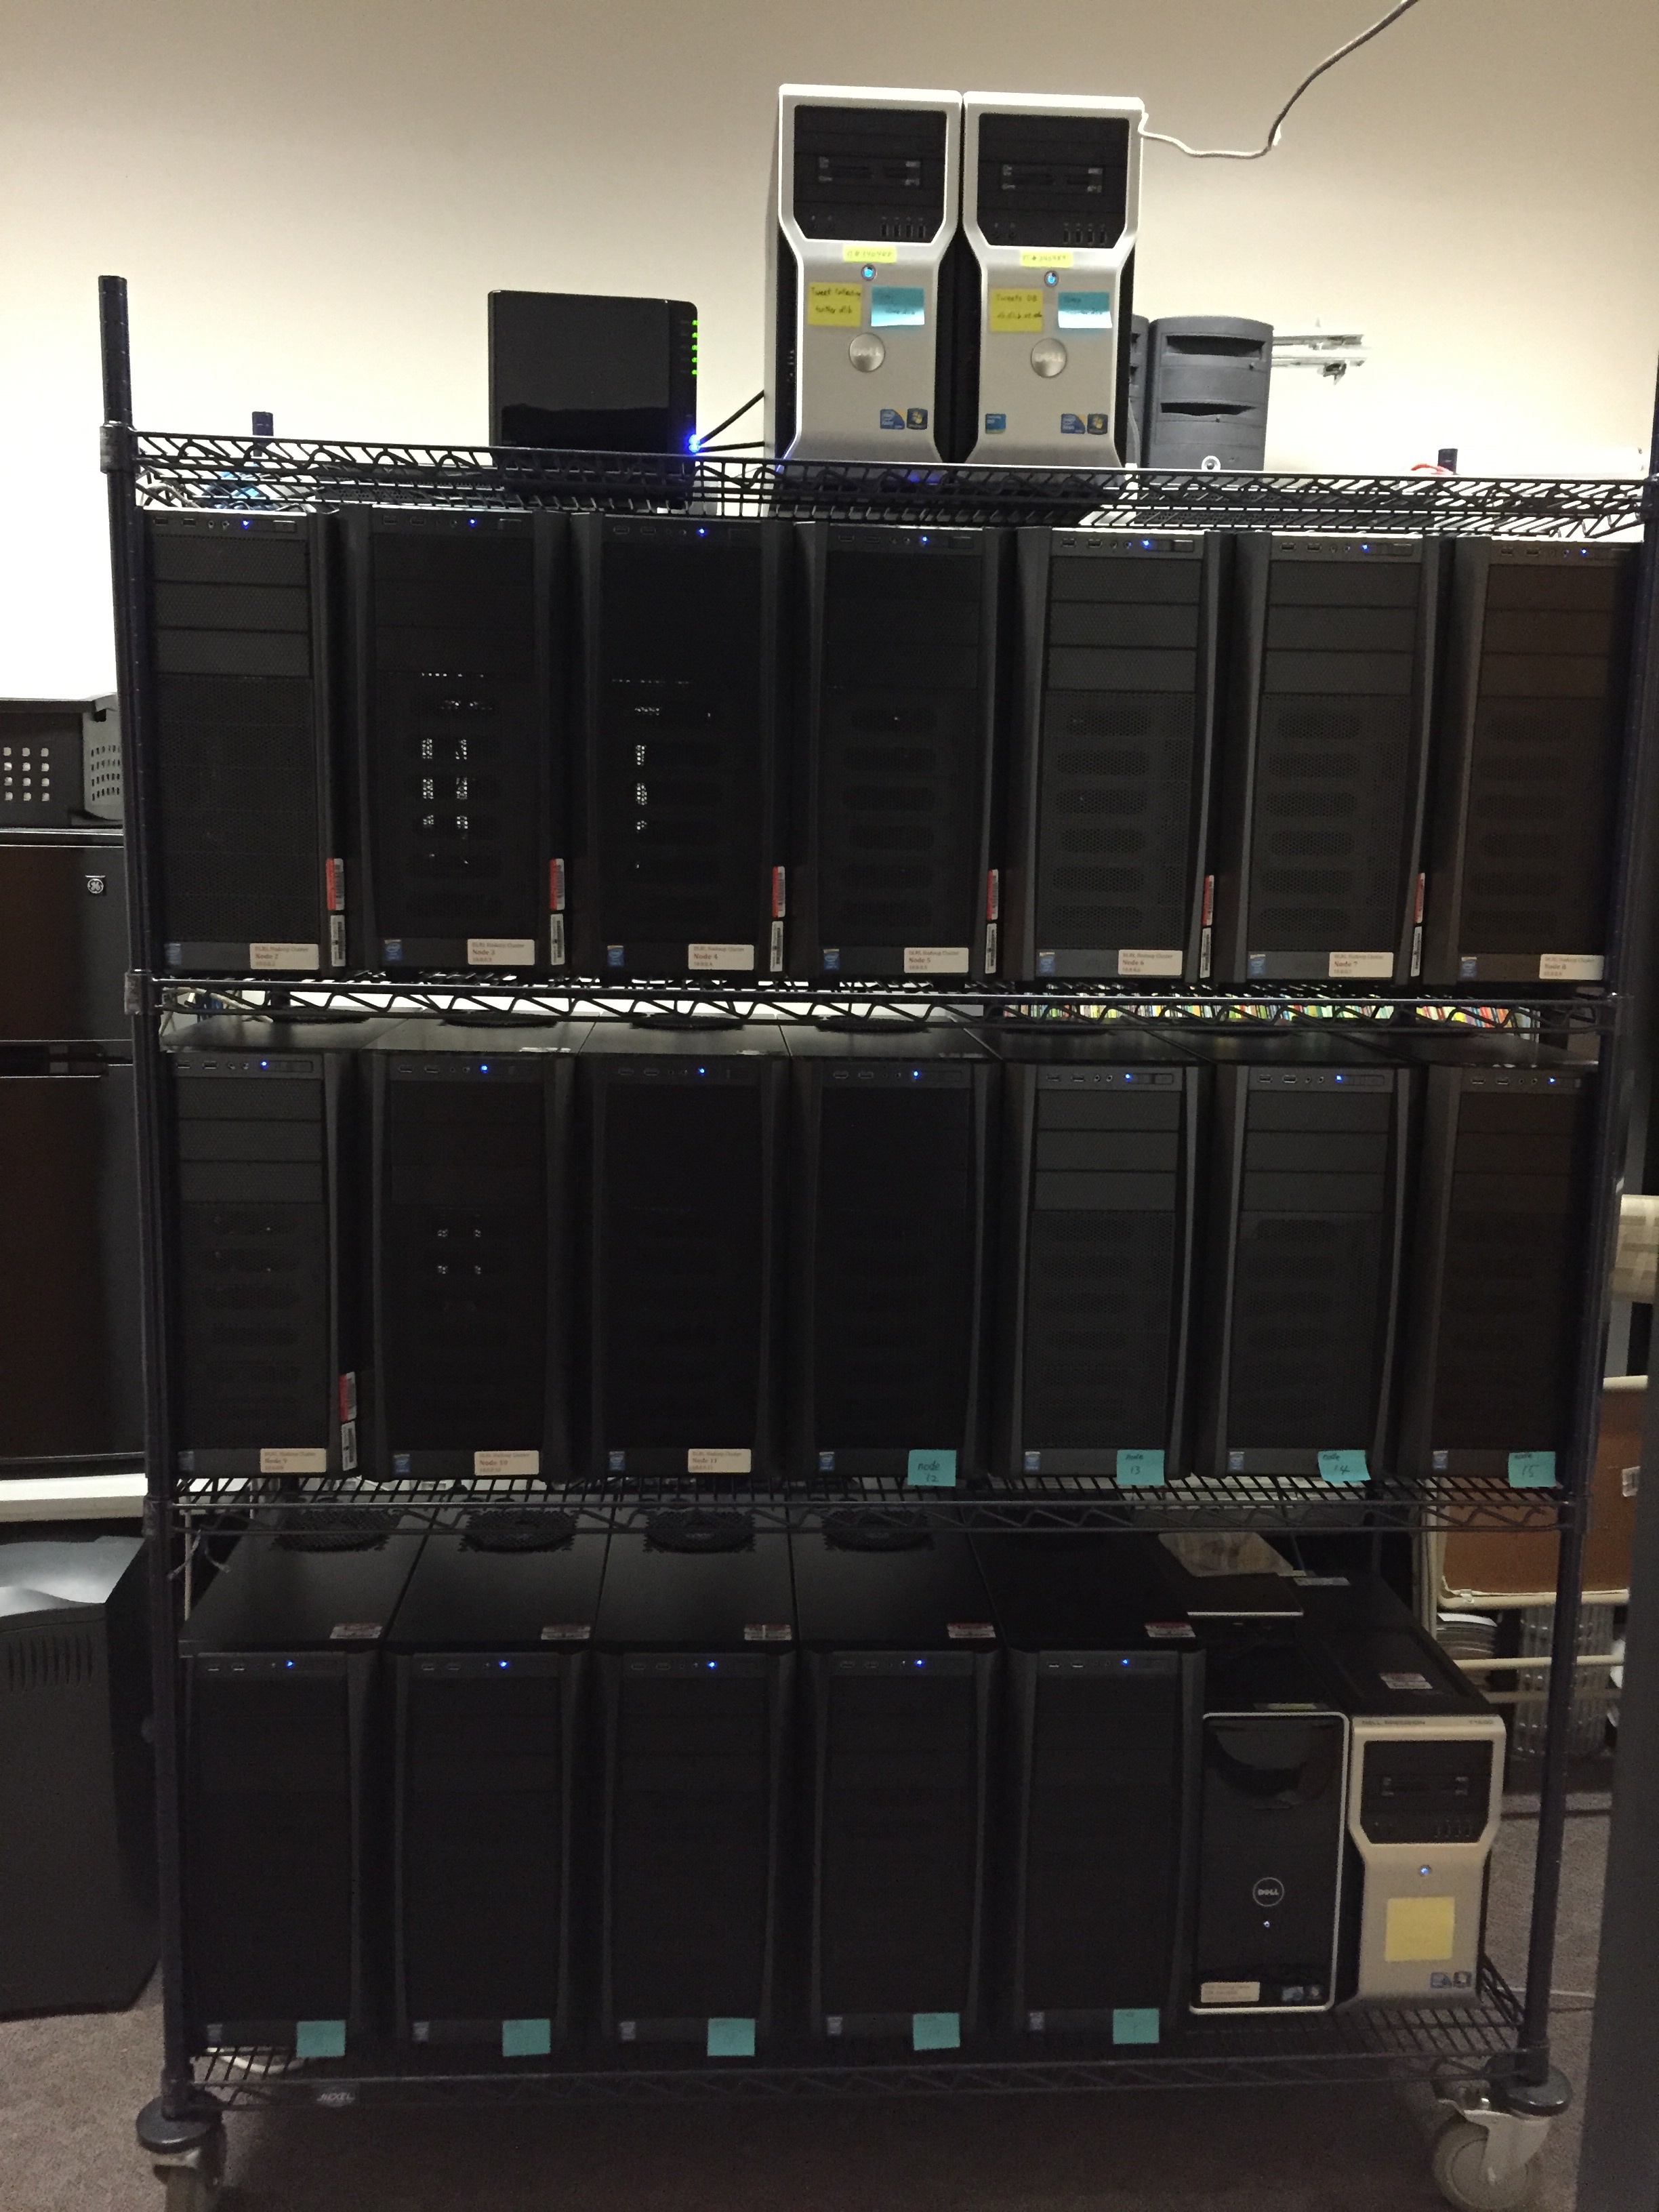
DLRL Cluster
Notes:
Looks Good?
We have case!!

Slide 10
DLRL Cluster Spec. - 2015
# of Nodes: 19 + 4
19 (Hadoop nodes) + 1 (manager node)
1 (HDFS backup) + 2 (tweet DB nodes)
CPU: Intel i5 Haswell Quad core 3.3Ghz, Xeon
RAM: 660 GB
32GB * 19 (Hadoop nodes) + 4GB * 1 (manger node)
16GB * 1 (HDFS backup) + 16GB * 2 (tweet DB nodes)
HDD: 60 TB + 11.3TB (backup) + 1.256TB SSD
3TB * 19 (Hadoop nodes, head node:6TB )
3TB (HDFS backup), 1TB + 256GB SSD (Tweet DB nodes)
8.3TB NAS Backup
Notes:
We need lots of RAM and HDD for Hadoop

Slide 11
DLRL Cluster - Architecture
Notes:
OS, Cloudera Manager, and CDH 5.0
Two networks
To build this system,

Slide 12
DLRL Cluster – Install Cloudera Hadoop

Slide 13
DLRL cluster - Services

Slide 14
Tools for research
Mahout: Classification, clustering, topic analysis (LDA), frequent patterns mining
Solr/Lucene: Search/(Faceted) Browse
Natural Language Processing and Named Entity Recognition
Hadoop Streaming
NLTK (Python) and SNER (Stanford NER)
Notes:
Hadoop Streaming
: The utility allows you to create and run Map/Reduce jobs with any executable or script as the mapper and/or the reducer

Slide 15
CS4984 Projects in IDEAL Project

Slide 16
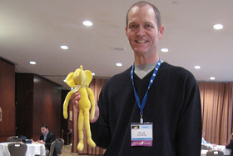
What is Big Data and Hadoop
Definition
Big data
a collection of data sets so large and complex that it becomes difficult to process using on-hand database management tools or traditional data processing applications.¹⁾
Apache Hadoop
a framework for distributed processing of large data sets across clusters of computers using simple programming models.²⁾
1) Big data definition: wikipedia.org
2) Hadoop definition: hadoop.apache.org
Notes:
Doug Cutting created open-source Hadoop Framework.
BigData
Hadoop
So, Apache Hadoop is one of the best solution for BigData
Let’s look at main two components in Hadoop

Slide 17
Hadoop solutions
Hadoop
MapReduce (YARN: MapReduce V2)
a programming model for processing large data sets with a parallel, distributed algorithm on a cluster.
HDFS
a distributed, scalable, and portable file-system written in Java for the Hadoop framework
Notes:
Main Two Component
MapReduce
HDFS
But this Hadoop is inspired by Google’s papers

Slide 18
Which Hadoop distributions¹⁾
Vanilla Apache Hadoop
Manual installation/configuration
Cloudera Hadoop
Oldest distribution, #1 Revenue²⁾, Open Source
Management Software: Cloudera Manager
Doug Cutting, Chief Architect
Recently Intel invested $740 million³⁾
MapR
Not Apache Hadoop, Modified HDFS, C not Java
1) https://www.youtube.com/watch?v=IvtyruO4dN4
2) http://wikibon.org/wiki/v/Big_Data_Vendor_Revenue_and_Market_Forecast_2012-2017
3) http://www.reuters.com/article/2014/03/31/us-intel-cloudera-idUSBREA2U0ME20140331

