Slide 1
From CTRnet to IDEAL
(and Qatar, VT, SiteStory, UPS, …)
NSF IA WIRE Workshop
Harvard -- June 16, 2014
Edward A. Fox, fox@vt.edu, http://fox.cs.vt.edu
Professor, Dept. of Computer Science, Virginia Tech
Director, Digital Library Research Laboratory
Director, Networked Digital Library of Theses and Dissertations
http://www.eventsarchive.org

Slide 2
Acknowledgments - 1
Related Funding:
  2007-2008: NSF IIS-0736055, DL-VT416: A Digital Library Testbed for Research Related to 4/16/2007 at Virginia Tech
  2009-2013: NSF IIS-0916733, Crisis, Tragedy, and Recovery network (CTRnet)
  2013-2016: NSF IIS-1319578, Integrated Digital Event Archive & Library (IDEAL)
  2012-2014: Villanova University (NSF DUE-1141209): Computing in Context
  2012-2015: Qatar NPRP 4-029-1-007, Establishing a Qatari Arabic-English Library Institute
  2014: Mellon/Columbia, Archiving Transactions Towards Uninterruptible Web Service (UPS – building on Memento and SiteStory)
The Internet Archive (Kristine Hanna, co-PI):
  Heritrix crawler and other tools and support
  Hosting the crawls and resulting archives
LucidWorks (software and support – open jobs, internships)

Slide 3
Acknowledgments - 2
IDEAL: VT: PI: Fox, co-PIs: Andrea Kavanaugh, Steve Sheetz, Don Shoemaker; GRAs: Mohamed Magdy, Sunshin Lee; Egypt: Riham Mansour
CTRnet: also Naren Ramakrishnan (co-PI); GRAs Seungwon Yang and Venkat Srinivasan
  DL-VT416: also Christopher North and Weiguo Fan
  Computing in Context: Villanova PI Robert Beck; Students: Xuan Zhang, Tarek Kanan: class to learn Computational Linguistics by 5-way better summarizing Web archive collections (extract words/sentences, find topics, use event templates)
Qatar: Lead PI Fox, Co-PIs Mohammed Samaka (Qatar U.), Somaya Al-maadeed (QU), Krishna RoyChowdhury (Qatar National Library), C. Lee Giles (Penn State), Rick Furuta (Texas A&M); consultant John Impagliazzo (Hofstra), VT GRA Tarek Kanan
Mellon: PI Zhiwu Xie, co-PI Fox, GRA Prashant Chandrasekar
Other students: Kiran Chitturi, Rachel Coston, Ishita Ganotra, S.M.Shamimul Hasan, Christopher Jones, Rohan Kaul, Jun Kim, Lin Tzi Li, Ying Ni, Braeden Sebastian, and teams in CS4624, 5604, 6604
Collaborators in: Egypt, Tunisia, Mexico, Philippines
WE WELCOME OTHER COLLABORATORS!

Slide 4
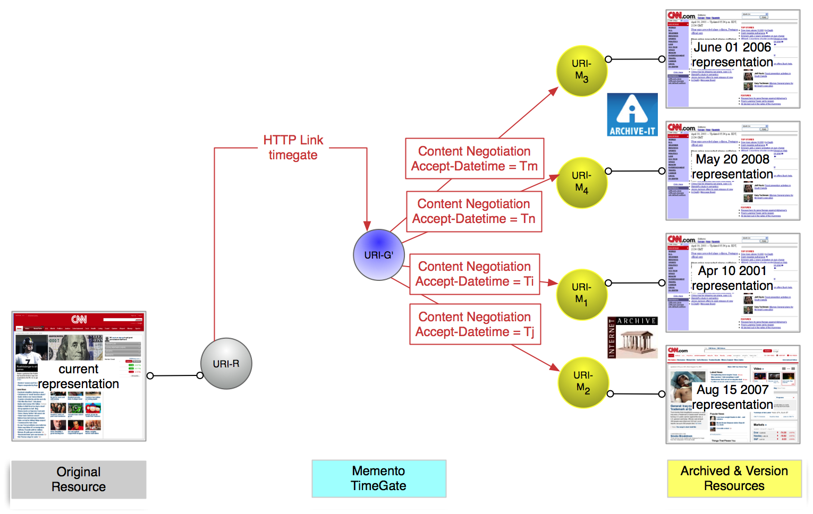
Memento – Time Travel for the Web: Across-Archive Method for Linking the Current & Past Web
http://bit.ly/memento-for-chrome
http://www.mementoweb.org/ RFC 7089 (Martin Klein)

Slide 5
Related Projects
Mellon/Columbia: enhance SiteStory by devising a webserver that also archives; use the archive automatically when server is down; capture the VT Web and bring up UPS on multiple campus sites
Qatar: at Qatar U., Qatar National Library
  Build a digital library community (consulting center)
    4 DL books with M&C + http://en.wikiversity.org/wiki/Curriculum_on_Digital_Libraries
  Build digital library infrastructure:
    SiteSeer (CiteSeerX, ChemXseer, TableSeer, …) with Arabic and CLIR support
    Heritrix, Wayback Machine, Solr, …

Slide 6
Web Archives
13 TB of IA Collections, e.g., 2013: Boko Haram attack, Boston Marathon blast, Global Emergency Overview, Texas fertilizer plant explosion
Category | No. of Archives
Accidents (plane crash, building collapse, ferry sinking) | 11
Bombings | 4
Earthquakes (Japan) | 12
Fires | 2
Floods | 4
Hurricanes (Sandy), Tsunami, Cyclones, Typhoons | 8
Shootings | 17

Slide 7
Tweet Collections
> 120 Event-specific and general collections
Total of 600 million tweets, from streaming API, using hashtags and keywords
Category | No. of collections
Accident (transportation) | 33
Bombing | 8
Community | 10
Earthquake | 18
Fire | 6
Flood | 11
General (including health) | 67
Hurricane, Tsunami | 39
Political (Middle East, Iran) | 40
Shooting | 29

Slide 8
CTRnet
  Collect, analyze, and visualize disaster information with a DL

Slide 9
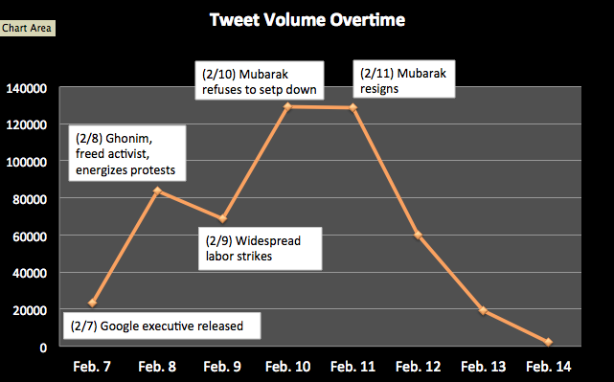
Social Media Use in Political Crisis (1/2)(2/7 - 2/14, 2011)
No. Tweets
Total 514,782 tweets

Slide 10
Social Media Use in Political Crisis (2/2)
Opinion Leadership in Egypt Uprising 2011
  514,782 tweets (one week around Mubarak’s resignation)
  Total 79,000 unique users
    Presumably posting from Egypt → 4,710
    Individuals excluding organizations → 3,675
  Opinion leaders
    500-27,000 followers in top 10% (365) individuals
    Bios: blogger/activist, writer/reporter, lawyer/executive director, social media consultant,… → ‘elite’ type actors

Slide 11
Visualizing Emergency Phases in Tweets (ISCRAM 2013) (1/2)
Four phases of emergency management model

Slide 12
Visualizing Emergency Phases in Tweets (2/2)

Slide 13
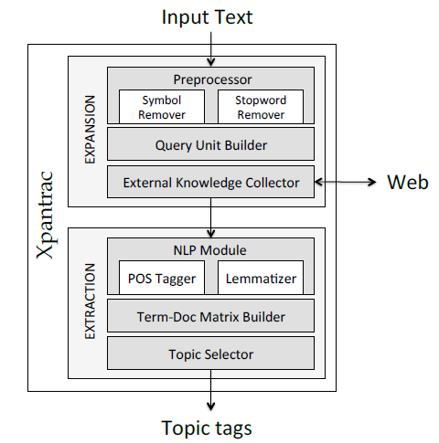
Topic Tagging of Webpages: Xpantrac - 1
Seungwon Yang dissertation
Input: text file
Build query
  Every 5 words, 1 word overlap
Send query to search API
  Web search (Seungwon)
  Wikipedia, our collection(s): CS4624 Spring 2014: Sloane Neidig, Samantha Johnson, David Cabrera, Erika Hoffman
Find topics in retrieved documents
  Frequency of words
Select most frequent as “topics”
Output: topics
Notes:
Sloane

Slide 14
Topic Tagging of Webpages: Xpantrac - 2
Seungwon Yang (GMU postdoc now)

Slide 15
Water Main Break Visualization
Sunshin Lee
Tweets collected with keywords
Selected tweets with location information
(lat/long, geonames)
Event locations displayed with details
Notes:
SNER extracts location information from each tweet message, and then it returns a set of geonames as location information. The selected dataset has 3333 tweets. Table 10 shows that we get 1,473 relevant tweets by extracting location information from text. In contrast, we only get 36 tweets using GPS data.

Slide 16
Integrated Digital Event Archive and Library (IDEAL) Project http://www.eventsarchive.org/
Extension of CTRnet with broadened scope:
  Event detection
  Event data archiving & processing
    Multimedia (images, videos) shared in social media
Digital government research
  Community issue detection
  Public opinion mining, mood perception, information flow
Technologies:
  Focused crawling, analysis/visualization services, integration of archive and DL capabilities

Slide 17
Event Ontology
Event model
  Who, What, When, Where, How
  Organizations/entities participating in the event
What
  Topics of the Event
Where
  Event location
When
  Event time frame (and later times of interest, e.g., anniversaries)

Slide 18
IDEAL Proposal Architecture

Slide 19
IDEAL System Architecture
Sunshin Lee (built low-cost cluster)
Notes:
IDEAL Project System Architecture
Highlights are my research-related components
Collect Source
Provide Services
Use Framework

Slide 20
IDEAL Data Architecture
Sunshin Lee
Notes:
나중에 관련있는 부분을 highlight 한다고 말할 것

Slide 21
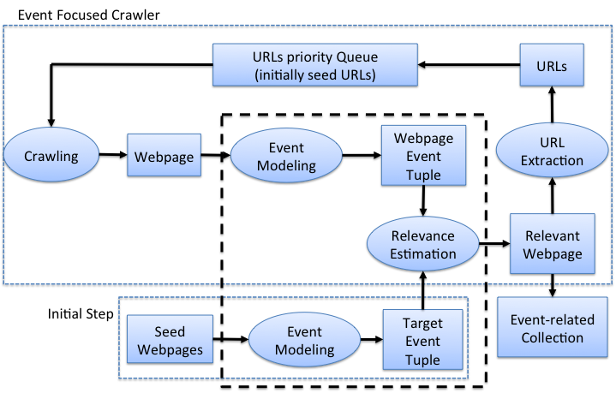
Event Focused Crawler
Mohamed Magdy
Focus of research

Slide 22
Baseline vs. Event Focused Crawler
Mohamed Magdy
Harvest ratio: relevant crawled webpages vs. cumulative set of crawled webpages

Slide 23
Extracted News Events on a Time Line
CS6604 Spring 2014: Tianyu Geng, Wei Huang, Ji Wang, Xuan Zhang
russia, bank, sanctions, ukraine, crisis, crimea
ukraine, tensions, data, rise, shares, china, stocks
ukraine, russia, talks, aid, crisis, sanctions, deal
ukraine, yanukovich, crisis, minister, sign, russian
gas, ukraine, russian, russia, europe, talks, energy
02/28
03/08
03/12
03/16
03/23
04/12
03/01
03/09
03/14
03/20
03/26
04/16
ukraine, crimea, crisis, putin, russia, minister
ukraine, house, imf, u.s, bill, white, aid
ukraine, aid, support, government, talks, house, russian
History:
3/7 referendum
annulled
3/14: UN draft
resolution
crimea, ukraine, russia, minister, referendum, vote
crimea, ukraine, russian, troops, border

Slide 24





News-Tweet Architecture
CS6604 Spring 2014: Tianyu Geng, Wei Huang, Ji Wang, Xuan Zhang
Event 3
Event 3
Event 2
Who
Event 2
Who
Topic
Topic
Event 1
Event 1
Who
Topic
Who
Topic
When
When
Topic
Who
Who
When
Topic
When
Where
Where
Event Extraction Sys.
When
When
Event Extraction Sys.
Where
Where
Pre-processor
Where
Where
Pre-processor
LDA
LDA
NER
Correlation
NER

Slide 25
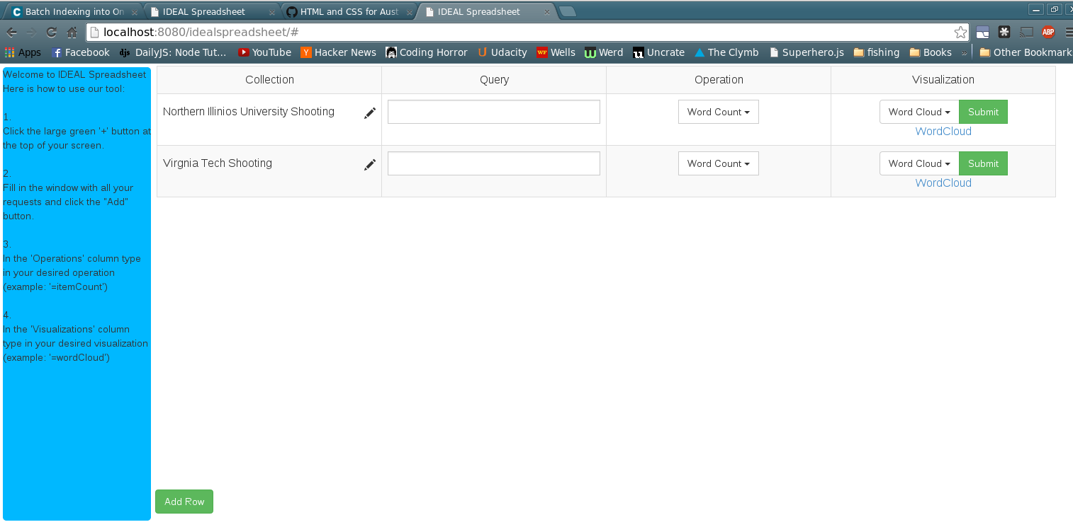
IDEAL Spreadsheet
CS4624 Spring 2014: Tony Ardura, Austin Burnett, Rex Lacy, Shawn Neumann
(based on ArcSpread by Andreas Paepcke et al.)

Slide 26
Recommended Collection-Level Metadata
CS6604 Spring 2014: Michael Shuffett
Dublin Core
  Title, Description
PROV-O
  Starting Point Classes
  Collection process, organization, hadMember, atLocation
ISO 3166-2 for locations
W3/XMLSchema#dateTime
PLUS: TweetID tool for tweet collections
  Extracts tweet and collection level metadata
  Compares / combines tweet collections

Slide 27
Thank you!
Questions/Comments? fox@vt.edu, http://fox.cs.vt.edu
540-231-5113
Office: 2160G Torgersen Hall
Campus Mail: 114 McBryde Hall, M/C 0106, Dept. of CS, Virginia Tech, Blacksburg, VA 24061

