Slide 1
Introduction to NDLTD and Brief History of the
ETD Movement
ETD 2013: 16th Int’l Symposium on ETDs
Hong Kong: ETDs for Rookies
Edward A. Fox
Executive Director, NDLTD, www.ndltd.org
Virginia Tech, Blacksburg, VA 24061 USA fox@vt.edu http://fox.cs.vt.edu/talks/2013

Slide 2
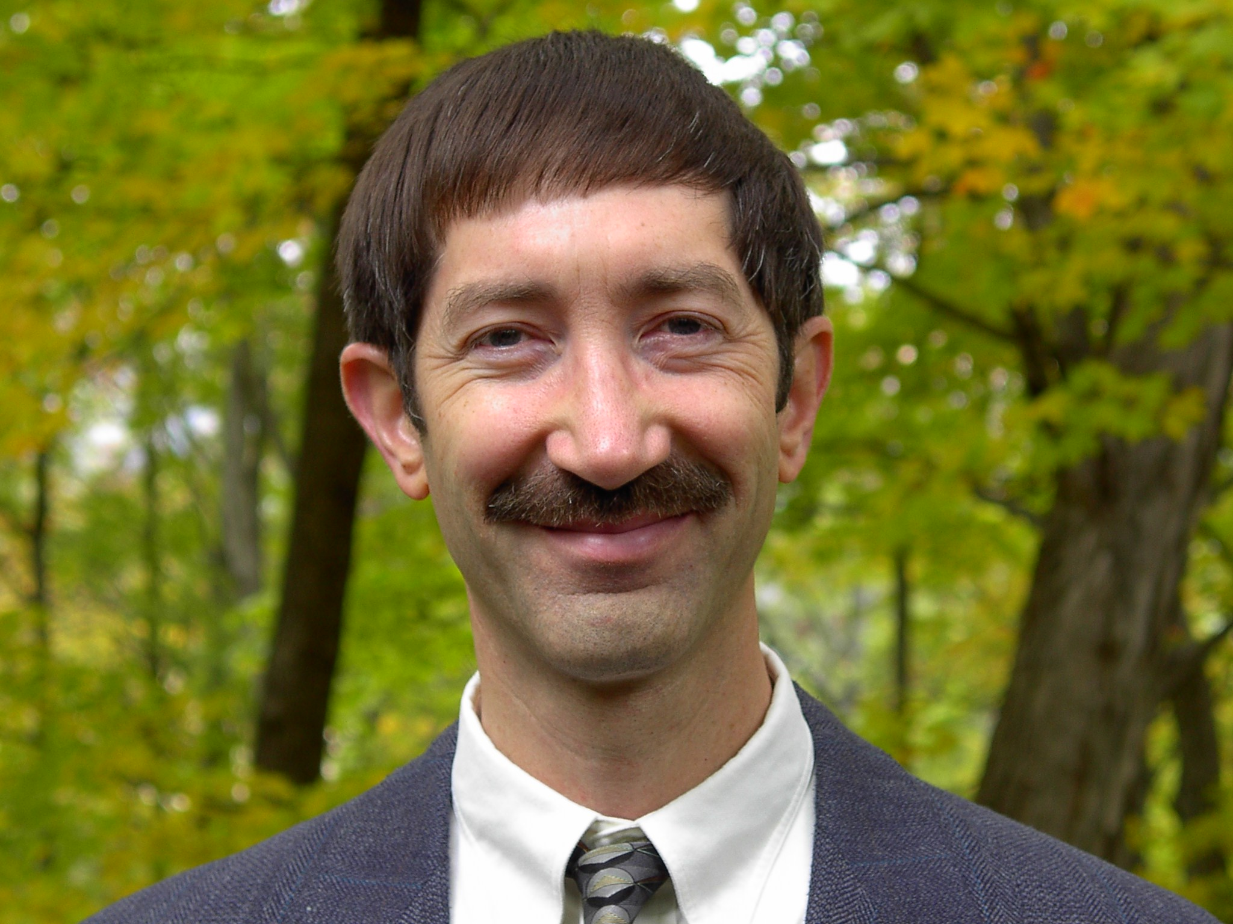

Slide 3
Outline
Acknowledgements
Digital Libraries
NDLTD
Background for Future Work
Summary

Slide 4
Acknowledgements
Family, mentors, teachers, students
All those working with ETDs
NDLTD, including its Members, Board, and Committees
ETD 2013 Conference Team
Sponsors
Presenters, Attendees

Slide 5
Acknowledgements (2): Mtgs
1987 mtg in Ann Arbor: UMI, VT, Arbortext, Softquad
1992 mtg in Washington: CNI, CGS, UMI, VT + 10U’s
1993 mtg in Atlanta: Monticello Electronic Library
1994 mtg at VT: std: PDF + SGML + multimedia
1996 mtg with funding by SURA and then also by the US Dept. of Education (FIPSE)
1997 meetings in UK, Germany, ...
1998 – 1st symposium – Memphis (20)
1999 – 2nd symposium – Blacksburg (70)
2000 – 3rd symposium – St. Petersburg, FL (225)
2001 – 4th symposium – Caltech, Pasadena (200)
2002 – 5th symposium – BYU, Provo, Utah
Cont’d …
Notes:
3
3

Slide 6
Acknowledgements (3): Mtgs
2003 – NDLTD incorporated as int’l non-profit
2003 – 6th symposium – Berlin (215 attendees)
2004 – 7th symposium – U. Kentucky, USA
2005 – 8th symposium – Sydney, Australia
2006 – 9th symposium – Quebec City, Canada
2007 – 10th symposium – Uppsala, Sweden
2008 – 11th symposium – Aberdeen, Scotland
2009 – 12th symposium – Pittsburgh, PA, USA
2010 – 13th symposium – Austin, TX, USA
2011 – 14th symposium – Cape Town, S. Africa
2013 – 15th symposium – Lima, Peru
Notes:
3
3

Slide 7
Outline
Acknowledgements
Digital Libraries
  Including ePrints, DSpace, Fedora
  Including (institutional) repositories
  Incl. Content/Courseware Management Systems
  Personal -> Group -> Publisher -> Global
NDLTD
Background for Future Work
Summary

Slide 8
Degree of Structure
Web
DLs
DBs
Chaotic
Organized
Structured

Slide 9
Modern Dissemination Methods
Social media
WWW (and Web 2.0)
Digital libraries
  Global tailored access through services like Scirus
  Global access through search engines
  -> Discovery, downloading, citing, re-usable science
What aids discovery?
  Title, abstract, categories
  Figures (image search if separate)
  Commenting, rating, tagging, recommending
Notes:
3
3

Slide 10
Informal 5S & DL Definitions
DLs are complex systems that
help satisfy info needs of users (societies)
provide info services (scenarios)
organize info in usable ways (structures)
present info in usable ways (spaces)
communicate info with users (streams)

Slide 11
DLs Support Many User Roles
Roles
Digital
Library
Students
Advisors
User
Readers
Teachers
Learners
Researchers
Librarians

Slide 12
Digital Libraries (DLs) -- Objectives
World Lit.: 24hr / 7day / from desktop
Ubiquitous
Integrated “super” information systems
Usable, Useful
Higher Quality, Lower Cost
Education, Knowledge Sharing, Discovery
Disintermediation -> Collaboration
Universities Reclaim Property
Interactive Courseware, Student Works

Slide 13
Why of Global Interest?
National projects can preserve antiquities and heritage: cultural, historical, linguistic, scholarly
Knowledge and information are essential to economic and technological growth, education
DL - a domain for international collaboration
  wherein all can contribute and benefit
  which leverages investment in networking
  which provides useful content on Internet & WWW
  which will tie nations and peoples together more strongly and through deeper understanding
Notes:
3
3

Slide 16
Information Life Cycle (adapted)
Creation
Active
Authoring
Modifying
Classifying
Tagging
Recommending
Indexing
Using
Social Context
Citing
Retention
/ Mining
Downloading
Storing
Retrieving
Discovering
Semi-
Active
Utilization
Filtering
Distributing
Networking
Inactive
Searching
Borgman et al. 1996
http://is.gseis.ucla.edu/research/dig_libraries/

Slide 17
completeness,
conformance
accuracy,
Active
accessibility, preservability
preservability,
Semi-active
authoring, modifying,
describing organizing, indexing
storing, archiving,
networking
similarity,
timeliness,
creation
distribution
utilization
seeking
pertinence,
searching,
browsing,
recommending
accessing,
filtering
significance,
relevance
accessibility,
Gonçalves et al. 2007
http://dx.doi.org/
10.1016/j.ipm.2006.11.010
Inactive
timeliness
Notes:
Information life cycle with respective dimensions of quality added for each major phrase and related activities

Slide 18
Students and the Info. Life Cycle
Learning
  Respect
Discovery
  Excitement
Documentation and reporting
  Expression
Dissemination
  Fame and Fortune
Community involvement
  Service
Community leadership
  Compassion
Notes:
3
3

Slide 19
Institutional Repositories - 1
“Institutional repositories are digital collections that capture and preserve the intellectual output of a single university or a multiple institution community of colleges and universities.”
Crow, R. “Institutional repository checklist and resource guide”, SPARC, Washington, D.C., USA
www.sparc.arl.org/resource/sparc-institutional-repository-checklist-resource-guide

Slide 20
Institutional Repositories - 2
“A university-based institutional repository is a set of services that a university offers to the members of its community for the management and dissemination of digital materials created by the institution and its community members. It is most essentially an organizational commitment to the stewardship of these digital materials, including long-term preservation where appropriate, as well as organization and access or distribution.”
Lynch, C.A. In ARL Bimonthly Report 226, pp. 1-7, Feb. 2003, www.arl.org/focus-areas/copyright-ip/1229

Slide 21


Slide 22
For More Information (Examples)
Magazine: www.dlib.org
  Books: MIT Press: Arms (1999), Bishop (2003), Borgman (2003, 2010), Licklider (1965)
  Morgan Kaufmann: Witten... (several), Lesk (2nd edition)
  M&C: https://sites.google.com/a/morganclaypool.com/dlibrary/ (4 books: foundations, key aspects, tech., appl.)
Conferences
  ICADL: http://www.icadl.org
  JCDL: http://www.jcdl.org
  TPDL: http://www.tpdl2013.info
Associations
  ASIS&T DL SIG: http://www.asis.org/SIG/dl.html
  IEEE TCDL: http://www.ieee-tcdl.org
NSF: http://www.dlib.org/dlib/july98/07griffin.html
Labs: Cape Town: http://www.cs.uct.ac.za/research/dll, VT: http://www.dlib.vt.edu, TAMU: www.csdl.tamu.edu/

Slide 23
Outline
Acknowledgements
Digital Libraries
NDLTD
Background for Future Work
Summary

Slide 24
NDLTD: www.ndltd.org
N D Ltd or Noodle TD
Vision: Every thesis and dissertation in the world is:
  Devised to take advantage of the most helpful electronic publishing methods
  Shared globally and easily found
  Supported by a suite of digital library services to aid authors, researchers, learners, universities
  Preserved and migrated permanently

Slide 25
ETDs: Library Goals
Improve library services
  Better turn-around time
  Always available
Reduce work
  catalog from e-text
  eliminate handling: mailing to commercial contractor, bindery prep, check-out, check-in, reshelving, etc.
Save space
Notes:
ETDs give libraries an avenue to demonstrate Information Age goals

Slide 26
What are we doing?
Aiding universities to enhance graduate education, publishing, and Intellectual Property Rights efforts
Helping improve the availability and content of theses and dissertations
Educating ALL future scholars so they can publish electronically and effectively use digital libraries (i.e., are Information Literate/Fluent, Computational Thinkers, and can be more expressive)
Notes:
4
4
4
3
2

Slide 27
Guiding students
Assuage fears and concerns
  Time and effort
  Ignorance regarding publishers, university presses
  Luddite faculty views of scholarly communication
Show immediate and long term benefits
Motivate to be more expressive
Guide to help ensure easy long-term preservation
Notes:
4
4
4
3
2

Slide 28
NDLTD Incorporation
Networked Digital Library of Theses and Dissertations incorporated May 20, 2003 in Virginia, USA
Charitable and educational purposes (501 c 3)
Officers (now)
  Executive Director (Ed Fox, fox@vt.edu)
  Secretary (Sharon.reeves@rogers.com)
  Treasurer (Austin.McLean@proquest.com)

Slide 29
Mission
The Networked Digital Library of Theses and Dissertations (NDLTD) is an international organization that, through leadership and innovation, promotes the adoption, creation, dissemination, use, and preservation of electronic theses and dissertations (ETDs).
The NDLTD encourages and supports the efforts of institutions of higher education & their communities
to advance and apply electronic publishing & digital libraries (including repositories), thus enabling them
to share knowledge more effectively in order
to unlock the potential benefits worldwide.

Slide 30
How You Can Participate
Primarily, a volunteer organization
Local and regional activities
NDLTD Committees (including):
  Awards, Communications,
  Conferences, Membership

Slide 31
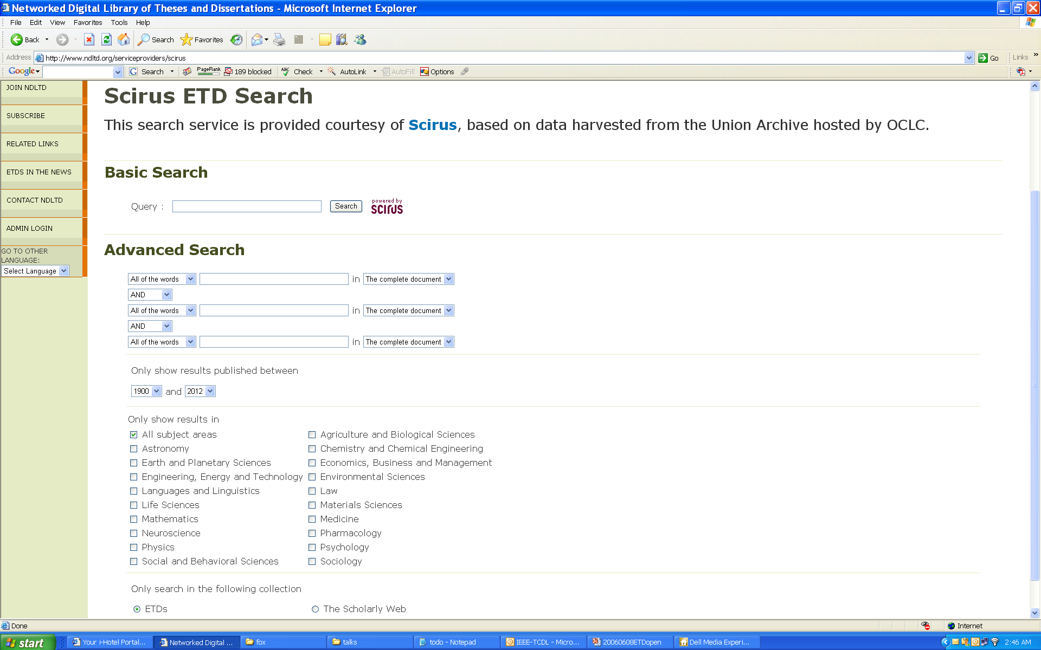
http://www.ndltd.org/serviceproviders/scirus-etd-search

Slide 32
Outline
Acknowledgements
Digital Libraries
NDLTD
Background for Future Work
Summary

Slide 33
Background for Future Work
Electronic Publishing
Computer Literacy/Fluency -> Computational Thinking
Scholarly Communication
Open Access
Institutional Repositories
Open Archives Initiative (OAI)

Slide 34
The World According to OAI
Service Providers
Discovery
Current
Awareness
Preservation
Metadata
harvesting
Data Providers

Slide 35
Metadata Objects (MDOs)
MARC
Dublin Core -> ETD-MS
RDF
OAI (Open Archives Initiative): PMH, ORE
Crosswalks, mappings
Ontologies, Classification systems

Slide 36
OAI – Black Box Perspective
OA 7
OA 4
OA 2
OA 3
OA 1
OA 6
OA 5

Slide 37
OAI – Repository Perspective
Required: Protocol
Set Structure
URI Scheme
MDO
MDO
MDO
MDO
Required: DC
MDO
MDO
MDO
MDO
DO
DO
DO
DO

Slide 38
Summary
Acknowledgements
Digital Libraries
NDLTD
Background for Future Work

Slide 39
Why ETDs? Short Answer
For Students:
  Gain knowledge and skills for the Knowledge Society
  Richer communication (digital information, multimedia, …)
For Universities:
  Easy way to enter the digital library field and benefit thereby (“no brainer” entrée into institutional repositories)
For the World:
  Global digital library – large, useful, many services
General:
  Save time and money
  Increased visibility for all associated with research results

Slide 40
Questions?
Discussion?
Recommendations?
Thank You!
fox@vt.edu
http://fox.cs.vt.edu

