Slide 1

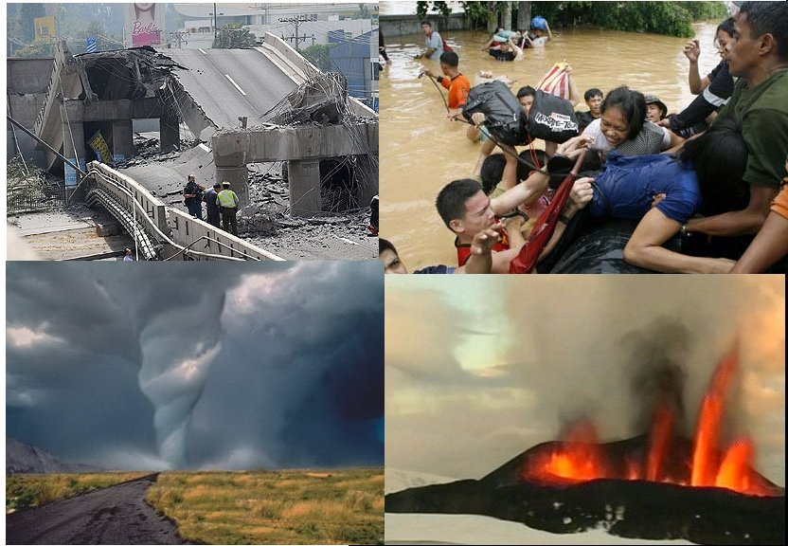
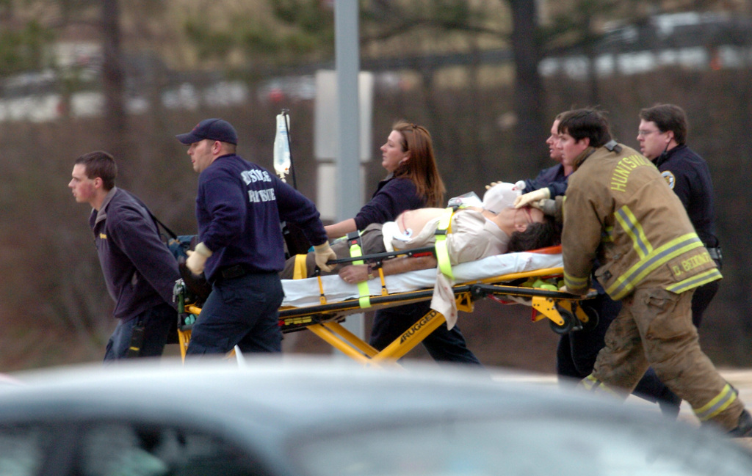
Crisis, Tragedy, and Recovery Network Digital Library (CTRnet)
+ Web Archiving in Qatar and VT
Edward A. Fox, Seungwon Yang, & CTRnet Team
Department of Computer Science, Virginia Tech
Workshop at WADL’13, July 25-26, 2013

Slide 2
Outline
Introduction
  Project goal
  Members & collaborators
Main Archiving Tasks
Sub-Projects
Dissemination Efforts
IDEAL Project
Qatar
VT
Acknowledgments
Collaboration

Slide 3
CTRnet Project Goal
Developing integrative approaches:
  Collect, analyze, and visualize disaster information with a DL

Slide 4
Members & Collaborators
Project members from multi-disciplinary areas
  Computer Science (HCI, Information Retrieval)
  Accounting and Information Systems
  Sociology
Collaboration with the Internet Archive (IA)
  Developed web archives
    Heritrix crawler
    Crawled data hosted by Wayback Machine in IA
    Raw data downloaded and locally analyzed
  Attended Archive-It Partners Meeting
    Introduced the CTRnet team’s crawling approach using tweets

Slide 5
Outline
Introduction
Main Archiving Tasks
  Disaster webpage archives
  Disaster tweet archives
Sub-Projects
Dissemination Efforts
IDEAL Project
Qatar
VT
Acknowledgment
Collaboration

Slide 6
Disaster Webpage Archives
Webpages, PDFs, and multimedia content crawled from the Web
  45 archives and growing (8.8 TB+)
  Active archives:
Boston marathon blast 2013 | Global Emergency Overview 2013
Boko Haram Attack 2013 | Hurricane Sandy 2012
Center for Research on the Epidemiology of Disasters (CRED) 2012 | Japan Earthquake 2011
CTRnet: Emergency Preparedness Information 2011 | Texas fertilizer plant explosion 2013

Slide 7
Disaster Tweet Archives
More than 120 tweet archives and growing
  Use Twitter Streaming API
  Hashtags and keyword-based archiving
Natural | floods, earthquakes, wildfires, tsunami, hurricanes
Man-made | shooting, transportation accidents, plane crash
Political | Middle East protests, Iran elections
Health | diabetes, obesity, cancer, mental illness

Slide 8
Outline
Introduction
Main Archiving Tasks
Sub-Projects
  Social media use during political crisis
  Topic tagging of webpages
  Visualizing emergency phases in tweets
  Water main break visualization
  Focused crawling
  LucidWorks tool for big data processing
Dissemination Efforts
IDEAL Project
Qatar
VT
Acknowledgment
Collaboration

Slide 9
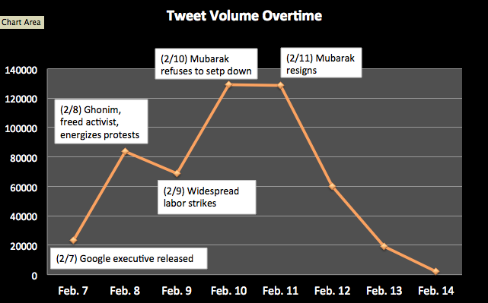
Social Media Use in Political Crisis (1/2)(2/7 - 2/14, 2011)
No. Tweets
Total 514,782 tweets

Slide 10
Social Media Use in Political Crisis (2/2)
Opinion Leadership in Egypt Uprising 2011
  514,782 tweets (one week around Mubarak’s resignation)
  Total 79,000 unique users
    Presumably posting from Egypt → 4,710
    Individuals excluding organizations → 3,675
  Opinion leaders
    500-27,000 followers in top 10% (365) individuals
    Bios: blogger/activist, writer/reporter, lawyer/executive director, social media consultant,… → ‘elite’ type actors

Slide 11
Topic Tagging of Webpages: Xpantrac

Slide 12
Visualizing Emergency Phases in Tweets (ISCRAM 2013) (1/2)
Four phases of emergency management model

Slide 13
Visualizing Emergency Phases in Tweets (2/2)
http://spare05.dlib.vt.edu/~ctrvis/phasevis/index_may.html

Slide 14
Water Main Break Visualization
Tweets collected with keywords
Selected tweets with location information
(lat/long, geonames)
Event locations displayed with details
Notes:
SNER extracts location information from each tweet message, and then it returns a set of geonames as location information. The selected dataset has 3333 tweets. Table 10 shows that we get 1,473 relevant tweets by extracting location information from text. In contrast, we only get 36 tweets using GPS data.

Slide 15
Focused Crawling
IA collections
  Identify a CTR event, list keywords
  Query online news sources, identify URLs in tweets
  Use URLs as initial seeds for crawling; IA provides access
Modified version of the LibSVM classifier
  Reduced noise
  3000 documents about school shootings
Next-generation focused crawler
  Combines evidence signals for relevance estimation (using Bayesian networks)
  Solves Tunneling problem using AI approaches (Reinforcement Learning)

Slide 16
LucidWorks Big Data Tool
Powerful tool with components:
  Hadoop – for distributed computing
  Lucene & Solr – for indexing, searching
  Hbase – distributed database for Hadoop
  Mahout – distributed machine learning
  Oozie – workflow
  Kafka: high throughput distributed messaging
  Zookeeper: maintaining distributed coordination
  Pig: high-level platform for creating MapReduce programs
Packaged as a virtual appliance in Ubuntu for easy installation
Processing of WARC files downloaded from IA

Slide 17
Outline
Introduction
Main Archiving Tasks
Sub-Projects
Dissemination Efforts
  Conferences
  Journal papers
  Meetings attended
IDEAL Project
Qatar
VT
Acknowledgment
Collaboration
Notes:
dg.o (Digital government research conference)
IJISCRAM (International Journal of Information Systems for Crisis Response and Management)
GIQ (Global Information Quarterly)

Slide 18
Dissemination Efforts
Conferences, Workshops
  JCDL, ISCRAM, Digital Government, CHI, WADL
Meetings Attended
  NSF workshop: Crisis Informatics 2012, 2011
  Archive-It Partners Meeting
    2012 (Annapolis, MD), 2011 (Lexington, KY)
Publications
  Please see http://www.ctrnet.net/publications

Slide 19
Outline
Introduction
Main Archiving Tasks
Sub-Projects
Dissemination Efforts
IDEAL Project
  Extension of CTRnet
  Scope broadened beyond crisis events (e.g., community)
  NSF funding pending
Qatar
VT
Acknowledgment
Collaboration

Slide 20
Integrated Digital Event Archive and Library (IDEAL) Project http://www.eventsarchive.org/
Extension of CTRnet with broadened scope:
  Continue disaster archiving
  Large social media data processing
  Multimedia (images, videos) shared in social media
Digital government research
  Public opinion mining, mood perception from tweets
  Community issue detection from tweets
Technologies: event detection, focused crawling, analysis/visualization, integration of archive + DL capabilities

Slide 21
Outline
Introduction
Main Archiving Tasks
Sub-Projects
Dissemination Efforts
IDEAL Project
Qatar
VT
Acknowledgment
Collaboration

Slide 22
Qatar Project NPRP 4-029-1-007
Project Objectives/Aims
Research and prototype digital library systems and infrastructure for Qatar, focusing initially on Qatari information related to government and scholarly activities.
  Leverage the crawling engine from Penn State‘s SeerSuite software infrastructure, and extend it beyond its current focus on English to support Arabic-English collections, and to cover a broad range of scholarly disciplines, and all types of government information.
… (with collaboration of National Library)

Slide 23
Qatar Project NPRP 4-029-1-007
Project Objectives/Aims (cont’d)
Research and build the digital library community in Qatar, supporting digital library use, services, collection development, tailored systems, and advancing toward a Knowledge Society.
  Study scholarly activities, and engage in community building in Qatar, so DLs can be tailored to specific domains and to the unique needs of Qatar. Through workshops, a consulting center at the proposed Institute, and collaborative efforts with libraries and museums in Qatar, we will identify particular needs and uses, and tailor collections, systems, and services, to lead toward the Qatari Knowledge Society.

Slide 24
VT
Half of campus web servers use the central CMS
Many other web servers cover varied content
Coverage by Internet Archive is OK, but for parts of the overall campus Web, crawling is infrequent
Discussions with IT, Library, University Relations, about
  Heretrix
  Memento support
  SiteStory

Slide 25
Outline
Introduction
Main Archiving Tasks
Sub-Projects
Dissemination Efforts
IDEAL Project
Qatar
VT
Acknowledgment
Collaboration

Slide 26
Acknowledgment
NSF for funding:
  Grant: CTRnet IIS-0916733
  Proposal: IDEAL IIS-1319578, Integrated Digital Event Archive and Library
The Internet Archive:
  Heritrix crawler
  hosting the crawls and resulting archives

Slide 27
Collaboration
We invite anyone to collaborate with us!
Contact:
  Edward A. Fox <fox@vt.edu>

Slide 28
Thank you!
Questions/Comments?

