Slide 1
JCDL 2013 Tutorial
(Indianapolis – 22 July)
“Introduction to
Digital Libraries” by Edward A. Fox
fox@vt.edu http://fox.cs.vt.edu
Dept. of Computer Science, Virginia Tech
Blacksburg, VA 24061 USA

Slide 2
Acknowledgements
Mentors (Licklider, Kessler, Salton)
Virginia Tech, CS, Digital Library Research Lab
NSF and other sponsors
Students, colleagues, co-investigators
Monika Akbar, Pranav Angara, Yinlin Chen, Lois Delcambre, Noha ElSherbiny, Alexandre Falcao, Eric Fouh, Marcos André Gonçalves, Doug Gorton, Nadia Kozievitch, Spencer Lee, Jonathan Leidig, Lin Tzy Li, Yi Ma, Mohamed Magdy, Uma Murthy, Sung Hee Park, Rao Shen, Clifford Shaffer, Venkat Srinivasan, Ricardo Torres, Xiaoyan Yu, ...
Barbara Wildemuth, Jeffrey Pomerantz, Sanghee Oh, Seungwon Yang

Slide 3
Outline
Selected Recent DL projects
Information sources: handouts, DL curric
Introduction, 5S, ETANA
Streams (Content), Structures
Archives / Repositories, Societies,
Scenarios, Services, Systems (5SSuite)
Case Studies: Education, CTRnet
Quality, Integration, Building DLs
Future: Chatham workshop, DELOS

Slide 4
Selected Recent DL Projects - 1
CITIDEL (NSDL CS): NSF DUE-0121679
ETANA-DL (Arch.): NSF IIS-0325579
Superimposed Info: NSF DUE-0435059
Digital Library Curricular Resources
  NSF IIS-0535057 & 0535060
CTRnet (Crisis, Tragedy & Recovery Net)
  NSF IIS-0916733
Ensemble (NSDL CS): NSF DUE-0840719
Digital Preserve
  NSF IIS-0910183 & 0910465

Slide 5
Selected Recent DL Projects - 2
CINET: Network Science Middleware
  NSF SDCI CCF-1032677
  Simulation, Cyberinfrastructure
Secure Digital Libraries
  MS thesis: Noha Ibrahim Mohamed ElSherbiny
Fingerprint Analysis/Distortion/Training DLs
  National Inst of Justice, BAE Systems
ETD Analysis, Extraction, Classification
Qatar Project NPRP 4-029-1-007

Slide 6
Selected DL Projects – 3: Qatar
Project Objectives/Aims
Research and prototype digital library systems and infrastructure for Qatar, focusing initially on Qatari information related to government and scholarly activities.
  Leverage the crawling engine fromPenn State‘s SeerSuite software infrastructure, and extend it beyond its current focus on English to support Arabic-English collections, and to cover a broad range of scholarly disciplines, and all types of government information.
Research and build the digital library community in Qatar, supporting digital library use, services, collection development, tailored systems, and advancing toward a Knowledge Society.
  Study scholarly activities, and engage in community building in Qatar, so DLs can be tailored to specific domains and to the unique needs of Qatar. Through workshops, a consulting center at the proposed Institute, and collaborative efforts with libraries and museums in Qatar, we will identify particular needs and uses, and tailor collections, systems, and services, to lead toward the Qatari Knowledge Society.

Slide 7
Information Sources
Handouts
Drafts of DL book0, and books 1-4
These slides
Slides based on DL books 3&4
2003 NSF DL workshop report from Chatham, MA
Major DELOS publications and a set of working group reports from Rome mtg
Selected 5S-related publications
List: VT ETD supervised, related to DL …

Slide 8
DL Book 0
Used in Fall 2011 to teach DL course at VT
Lightly edited Spring 2012 in preparation for having 4 DL books through Morgan & Claypool
Eventually the 4 DL books will be combined into a single volume, like this, but updated, especially geared toward the non-US market
527 pages, 15 chapters, mathematical preliminaries, glossary (14 pages)

Slide 9
DL Book 1:
Theoretical Foundations
(Fox, Goncalves, Shen)
~180 pages
1) Introduction
2) Exploration (searching, browsing, visualizing)
A) Mathematical Preliminaries
B) Minimal DL
C) Archaeological DLs
D) 5S Results: Lemmas, Proofs, 5SSuite
E) Glossary
Bibliography (263 references)

Slide 10
DL Book 2: Key Issues Regarding Digital Libraries
(Shen, Goncalves, Fox)
~110 pages
1) Evaluation
  Intro, Related Work, Formalization
  Digital Objects, Metadata Specs & Format, Collections, Metadata Catalogs, Repositories, Services, Case Study: 5SQual
2) Integration
  Intro, Related Work
  Case Study: ETANA-DL

Slide 11
DL Book 3: Technologies
(Fox, Torres)
~180 pages
1) Complex Objects
2) Subdocuments
3) Ontologies
4) Classification
5) Text Extraction
6) Security

Slide 12
DL Book 4: Applications
(Fox, Leidig)
~160 pages
1) Content-Based Image Retrieval (CBIR)
2) Education
3) Social Networks
4) Bioinformatics, Scientific, & Simulation DLs
5) Geospatial Information

Slide 13
DL Curric. Project - 1
NSF awards to VT and UNC-CH
CS and LIS
Project server: http://curric.dlib.vt.edu/
Wikiversity: http://en.wikiversity.org/wiki/Curriculum_on_Digital_Libraries

Slide 14
Curriculum Module Template
1. Module name
2. Scope
3. Learning objectives
4. 5S characteristics of the module (streams, structures, spaces, scenarios, society)
5. Level of effort required (in-class and out-of-class time required for students)
6. Relationships with other modules (flow between modules)
7. Prerequisite knowledge/skills required (what the students need to know prior to beginning the module; completion optional; complete only if prerequisite knowledge/skills are not included in other modules)
8. Introductory remedial instruction (the body of knowledge to be taught for the prerequisite knowledge/skills required; completion optional)
9. Body of knowledge (theory + practice; an outline that could be used as the basis for class lectures)
10. Resources (required readings for students; additional suggested readings for instructor and students)
11. Exercises / Learning activities
12. Evaluation of learning objective achievement (graded exercises or assignments)
13. Glossary
14. Additional useful links
15. Contributors (authors of module, reviewers of module)

Slide 15
DL Curriculum Framework
Introduction

Slide 16
Wikiversity Modules
Table 1: Core DL Curriculum (2 slides)
Table 2: Information Retrieval Packages
Table 3: LucidWorks Big Data Software
Table 4: Multimedia Software

Slide 17
DL Curric. Project - examples
Module 1-b: History of digital libraries and library automation
Module 2-c: File Formats, Transformation, and Migration
Module 3-b: Digitization
Module 4-b: Metadata
Module 5-a: Architecture overviews
…

Slide 18
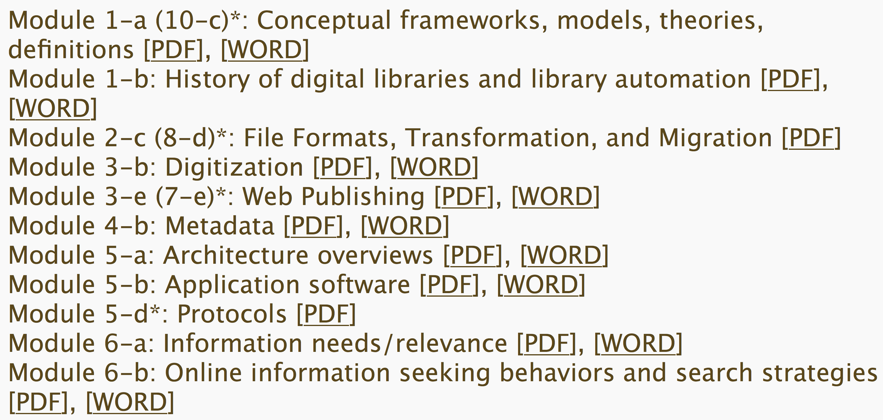

Slide 19
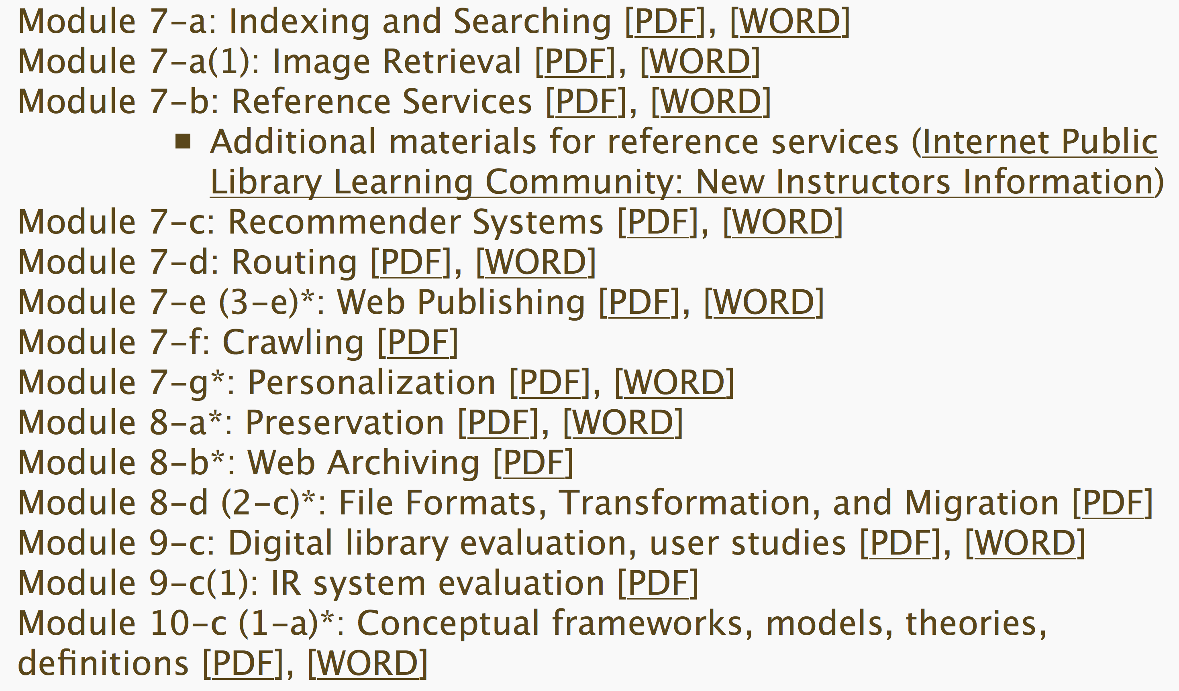

Slide 20
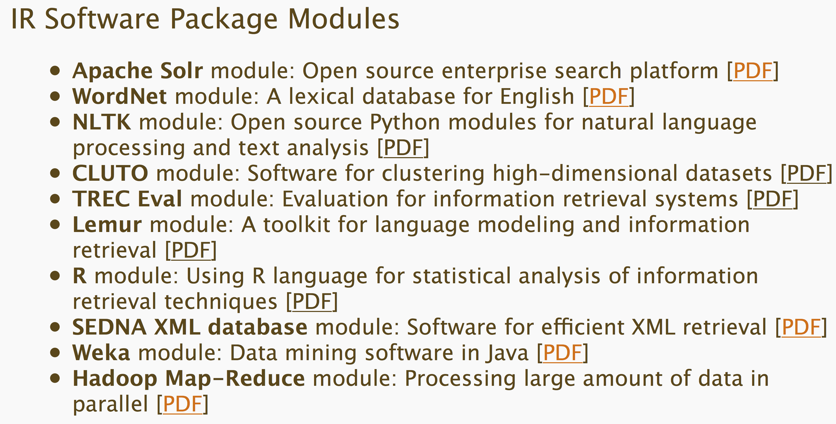


Slide 21
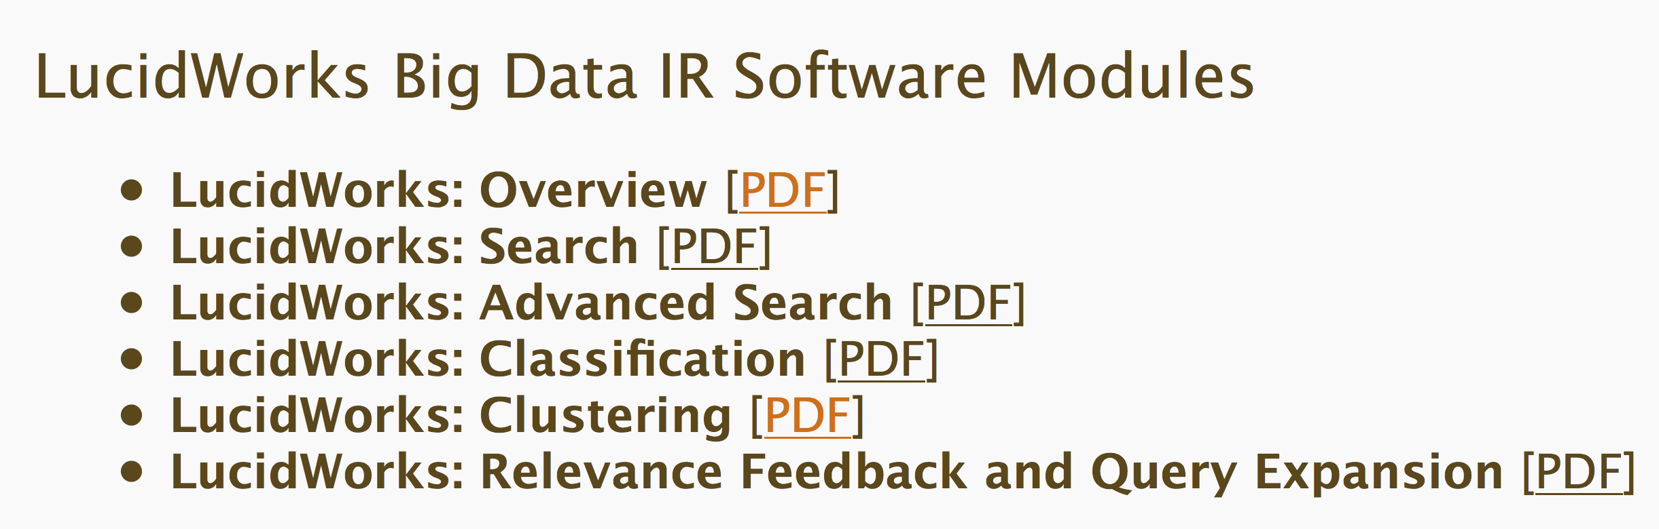

Slide 22
For More Information
Magazine: www.dlib.org
Books: http://fox.cs.vt.edu/DLSB.html (1994)
  MIT Press: Arms, plus by Borgman, Licklider (1965)
  Morgan Kaufmann: Witten... (several), Lesk (2nd edition)
Conferences
  ICADL: www.icadl.org
  JCDL: www.jcdl.org
  TPDL: www.tpdl2012.org
Associations
  ASIS&T DL SIG
  IEEE TCDL: www.ieee-tcdl.org (student awards, …)
NSF: http://dli.grainger.uiuc.edu/national.htm, http://www.nsf.gov/pubs/1998/nsf9863/nsf9863.htm
Labs: VT: www.dlib.vt.edu, Texas: www.csdl.tamu.edu

Slide 23
Introduction
Country, City, Languages you speak
Main discipline of training
# of digital libraries (DLs) used: list
# of DL conferences attended? JCDLs?
Other activities at conference
Why taking this course
Goals for today

Slide 24
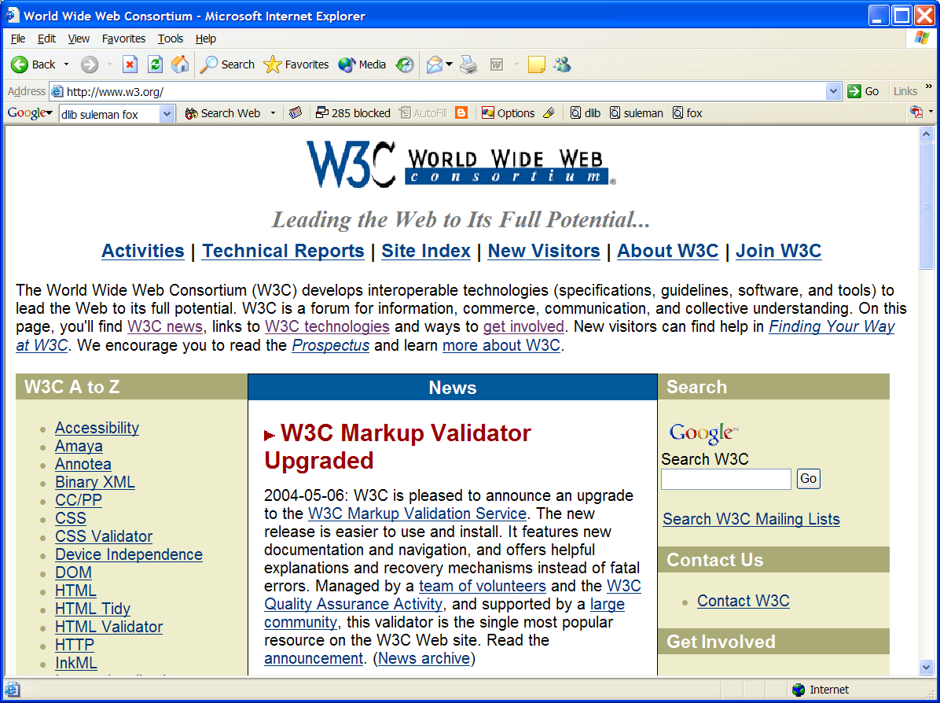

Slide 25
DL Challenges
Preservation - so people will trust DLs
Supporting infrastructure - networks, ...
Scalability, sustainability, interoperability
DL industry - critical mass by covering libraries, archives, museums, corporate info, govt info, personal info - “quality WWW” integrating IR, HT, MM, ...
  Need tools & methods to make them easier to build

Slide 26
DL Challenges – 2: Terminology
Digital / electronic / virtual library
Born digital, hybrid (digital/physical)
Universal access (all people/places/times)
  Accommodate disabilities (color, visual, auditory)
  Mobile (office, home, laptop, PDA, mobile)
Archiving, self-archiving
Open (source, standards, archives)

Slide 27
DL book 1: Introduction
Why do we need this book?
What are digital libraries (DLs)?
Why is 5S helpful in a DL book?
How do digital libraries work?
History: Memex, 1990s, proliferation
Related areas: LIS, linguistics, IR, AI, DBs, knowledge management, content management, probability/statistics

Slide 28
Synchronous
Scholarly Communication
Same time, Same or different place

Slide 29

Asynchronous, Digital Library Mediated Scholarly Communication
Different time and/or place

Slide 30
DL Overview
Why of Global Interest?
National projects can preserve antiquities and heritage: cultural, historical, linguistic, scholarly
Knowledge and information are essential to economic and technological growth, education
DL - a domain for international collaboration
  wherein all can contribute and benefit
  which leverages investment in networking
  which provides useful content on Internet & WWW
  which will tie nations and peoples together more strongly and through deeper understanding
Notes:
3
3

Slide 31
Digital Libraries --- Objectives
World Lit.: 24hr / 7day / from desktop
Integrated “super” information systems: 5S: Table of related areas and their coverage
Ubiquitous, Higher Quality, Lower Cost
Education, Knowledge Sharing, Discovery
Disintermediation -> Collaboration
Universities Reclaim Property
Interactive Courseware, Student Works
Scalable, Sustainable, Usable, Useful

Slide 32
Libraries of the Future
JCR Licklider, 1965, MIT Press
World
Nation
State
City
Community

Slide 33
Locating Digital Libraries in Computing and
Communications Technology Space
Digital Libraries technology
trajectory: intellectual
access to globally distributed information
Communications
(bandwidth, connectivity)
Computing (flops)
Digital content
Note: we should consider 4 dimensions: computing, communications,
content, and community (people)
less
more

Slide 34
AmericanSouth.Org – Roles, Content
SOLINET | Libraries (Data Providers) | Scholars
Intellectual Organization Controlled vocabulary Metadata extension development | Collection Decisions Selection Criteria | Selection Criteria Controlled vocabulary
Central Server Maintenance | Local Server Maintenance | Provision of Context
Metadata Repository | Metadata Creation/Maintenance | Organizational Structure and Annotation Tools
Central Interface Design/Maintenance | Local Interface Design/Maintenance | Selection of Other Annotation Tools
Central Indices Creation/Maintenance | Local Indices | Selection of Thesauri
Coordination of Metadata Gateway Development | Gateway Implementation | Concept Mapping
 | Digital Objects

Slide 35
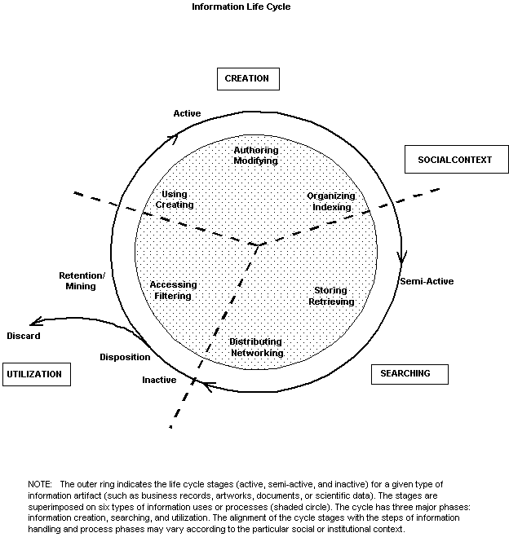
Information
Life
Cycle
Borgman et al.:
Workshop Report on
Social Aspects of
Digital Libraries:
http://www-lis.gseis.
ucla.edu/DL/
Notes:
Thanks to Christine Borgman and others at this workshop.

Slide 36
Information Life Cycle
Creation
Active
Authoring
Modifying
Social Context
Using
Creating
Organizing
Indexing
Retention
/ Mining
Accessing
Filtering
Storing
Retrieving
Semi-
Active
Utilization
Distributing
Networking
Inactive
Searching
Notes:
This is a simplification of the previous slide.

Slide 37
Digital Libraries
Shorten the Chain from
Author
Editor
Reviewer
Publisher
A&I
Consolidator
Library
Reader

Slide 38
DLs Shorten the Chain to
Roles
Digital
Library
Author
Teacher
User
Reader
Editor
Learner
Reviewer
Librarian

Slide 39
Application Domain | Related Institutions | Examples |  | Technical Challenges | Benefit / Impact
Publishing | Publishers, Eprint archives | OAI |  | Quality control, openness | Aggregation, organization
Education | Schools, colleges, universities | NSDL, NCSTRL |  | Knowledge management, reuseability | Access to data
Art, Culture | Museum | AMICO, PRDLA |  | Digitization, describing, cataloging | Global understanding
Science | Government, Academia, Commerce | NVO, PDG, SwissProt, UK eScience,European Union Commission |  | Data models | reproducibility, faster reuse, faster advance
(e) Government | Government Agencies (all levels) | Census |  | Intellectual property rights, privacy, multi-national | Accountability, homeland security
(e) Commerce, (e) Industry | Legal institutions | Court cases, patents |  | Developing standards | Standardization, economic development
History, Heritage | Foundations | American Memory |  | Content, context, interpretation | Long term view, perspective, documentation, recording, facilitating, interpretation, understanding
Cross-cutting | Library, Archive | Web, personal collections |  | Multi-language, preservation, scalability, interoperability, dynamic behavior, workflow, sustainability, ontologies, distributed data, infrastructure | Reduced cost, increased access, pereservation, democratization, leveling, peace, competitiveness
Reagan Moore
Ed Fox
June
2002
for
NSF

Slide 40
Running Examples
  Institutional repositories linked worldwide
    Building from partial vs. complete coverage
    Partial1: ETDs -> NDLTD
    Partial2: Courseware -> NSDL -> DLEs
  Archaeological information worldwide
    Sites -> ETANA -> …

Slide 41
Motivation
Digital Libraries (DLs): what are they??
  No definitional consensus
  Conflicting views
  Makes interoperability a hard problem
DLs are not benefiting from formal theories as are other CS fields: DB, IR, PL, etc.
DL construction: difficult, ad-hoc, lack of support for tailoring/customization
Conceptual modeling, requirements analysis, and methodological approaches are rarely supported in DL development.
  Lack of specific DL models, formalisms, languages

Slide 42
DL Definitions - 1
“A digital library is an organized and focused collection of digital objects, including text, images, video, and audio, along with methods of access and retrieval, and for selection, creation, organization, maintenance, and sharing of the collection.”
Witten & Bainbridge – “How to Build a Digital Library” – Morgan Kaufmann 2003

Slide 43
DL Definitions - 2
“Digital libraries are organizations that provide the resources, including the specialized staff, to select, structure, offer intellectual access to, interpret, distribute, preserve the integrity of, and ensure the persistence over time of collections of digital works so that they are readily and economically available for use by a defined community or set of communities”
Waters,D.J. CLIR Issues, July/August 1998
www.clir.org/pubs/issues/issues04.html

Slide 44
DL Definitions - 3
Issues and Spectra
  Collection vs. Institution
  Content vs. System
  Access vs. Preservation
  “Free” vs. Quality
  Managed vs. Comprehensive
  Centralized vs. Distributed

Slide 45
DL Definitions - 4
NOT a “digitized library”
NOT a “deconstruction” of existing systems and institutions, moving them to an electronic box in a Library
IS a new way to deal with knowledge
  Authoring, Self-archiving, Collecting,
  Organizing, Preserving,
  Accessing, Propagating, Re-using

Slide 47
Content Area Description | Audio | Digital | Finding Aid | MSS | Other | Photo | Video | MF | Print | Total
African-American cultural life | 6 | 4 | 6 | 9 | 4 | 12 | 3 | 10 | 18 | 72
Agricultural crisis of late 19th century | 1 |  | 1 | 3 | 1 | 1 |  | 4 | 8 | 19
Codification of segregation laws | 1 |  | 3 | 2 | 1 |  | 1 |  | 8 | 16
Configuration of white supremacy | 1 |  | 3 | 3 |  | 3 |  | 1 | 9 | 20
Cultural values and activities | 3 | 1 | 5 | 17 | 4 | 15 | 1 | 5 | 20 | 71
Disenfranchising movements | 1 |  | 2 | 2 | 1 | 2 | 1 |  | 6 | 15
Educational movements | 6 | 1 | 1 | 18 | 6 | 21 | 3 | 5 | 27 | 98
Emergence of Holiness & Pentecostal Groups |  |  | 1 | 1 |  | 1 |  |  | 7 | 10
Emergence of new musical forms | 3 | 1 |  |  |  | 1 |  | 1 | 2 | 8
Emergence of organized groups expressing farmers concerns |  |  |  | 2 |  | 2 |  | 1 | 8 | 13
… | … | … | … | … | … | … | … | … | … | …
Total Each Format | 41 | 14 | 51 | 161 | 38 | 133 | 13 | 79 | 301 | 831

Slide 48
Informal 5S & DL Definitions
DLs are complex systems that
help satisfy info needs of users (societies)
provide info services (scenarios)
organize info in usable ways (structures)
present info in usable ways (spaces)
communicate info with users (streams)

Slide 49
5S Layers
Societies
Scenarios
Spaces
Structures
Streams

Slide 50
Hypotheses
A formal theory for DLs can be built based on 5S.
The formalization can serve as a basis for modeling and building high-quality DLs.

Slide 51
Research Questions
1. Can we formally elaborate 5S?
2. How can we use 5S to formally describe digital libraries?
3. What are the fundamental relationships among the Ss and high-level DL concepts?
4. How can we allow digital librarians to easily express those relationships?
5. Which are the fundamental quality properties of a DL? Can we use the formalized DL framework to characterize those properties?
6. Where in the life cycle of digital libraries can key aspects of quality be measured and how?

Slide 52
5Ss
Ss | Examples | Objectives
Streams | Text; video; audio; image | Describes properties of the DL content such as encoding and language for textual material or particular forms of multimedia data
Structures | Collection; catalog; hypertext; document; metadata | Specifies organizational aspects of the DL content
Spaces | Measure; measurable, topological, vector, probabilistic | Defines logical and presentational views of several DL components
Scenarios | Searching, browsing, recommending | Details the behavior of DL services
Societies | Service managers, learners, teachers, etc. | Defines managers, responsible for running DL services; actors, that use those services; and relationships among them

Slide 53
5S and DL formal definitions and compositions (April 2004 TOIS)

Slide 54
ETANA-DL
Archaeological DL
Integrated DL
  Heterogeneous data handling
Applies and extends the OAI-PMH
  Open Archives Initiative Protocol for Metadata Handling
Design considerations
  Componentized
  Extensible
  Portable

Slide 55
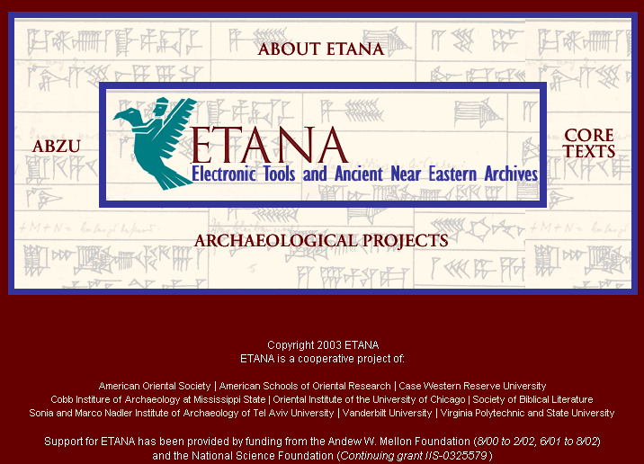

Slide 56
ETANA-DL Architecture
DigBase and DigKit
Lahav
D
A
T
A
B
A
S
E
W
R
A
P
P
E
R
S
Search
U
S
E
R
I
N
T
E
R
F
A
C
E
Browse
Nimrin
Recommend
Umayri
ETANA-DL
UNION
CATALOG
Note
Hisban
Personalize
Megiddo
Review
Jalul
Visualizations
Archaeology
Specific
…
New Sites
Work in progress

Slide 57
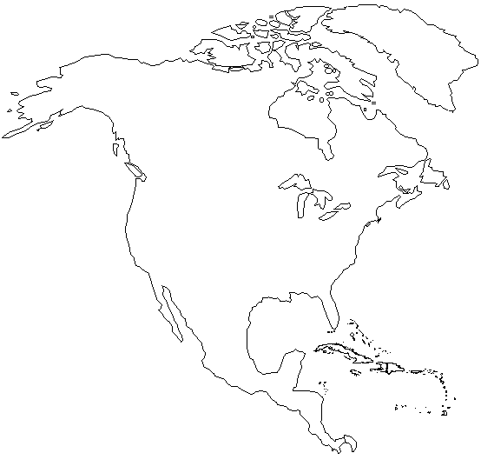
Initial ETANA-DL Member Locations
Canadian University College
Andrews University
CWRU
Walla Walla College
Willamette University
Virginia Tech
Vanderbilt University
Mississippi State University
Map courtesy: www.enchantedlearning.com

Slide 58
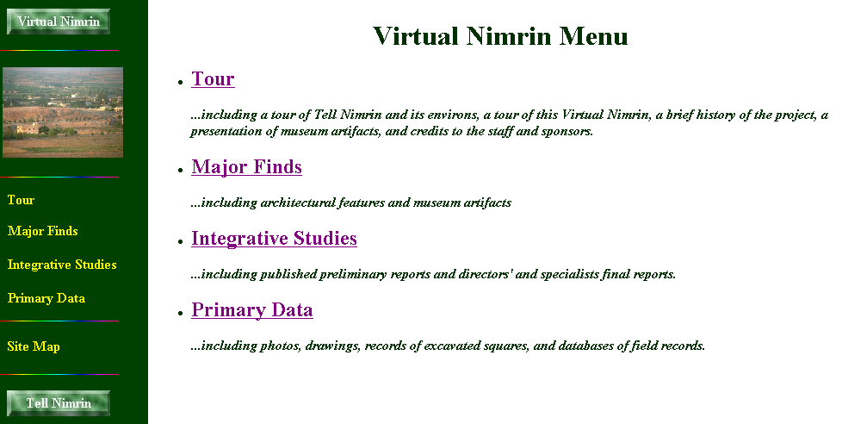

Slide 59
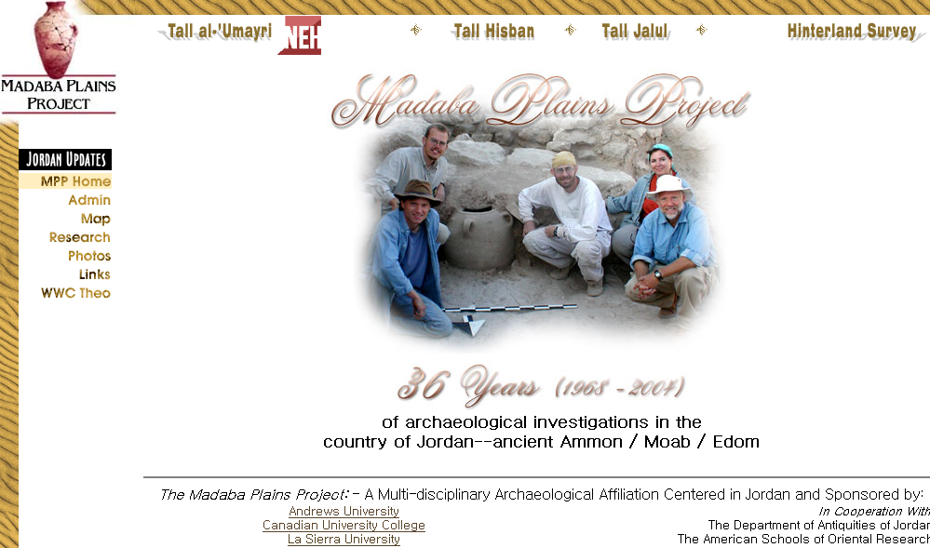

Slide 60
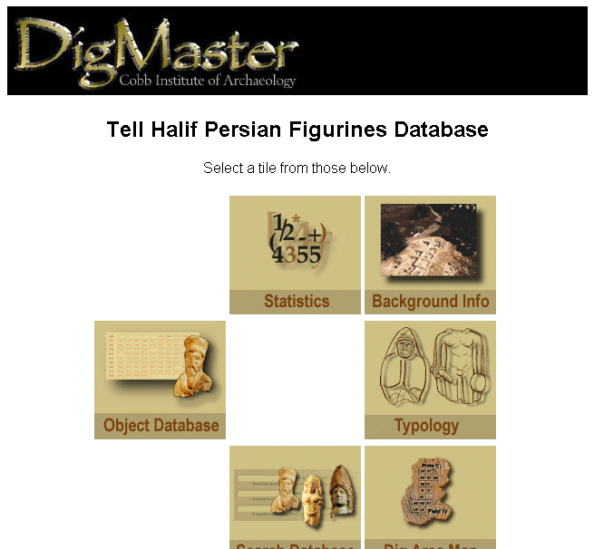
Lahav Website

Slide 61
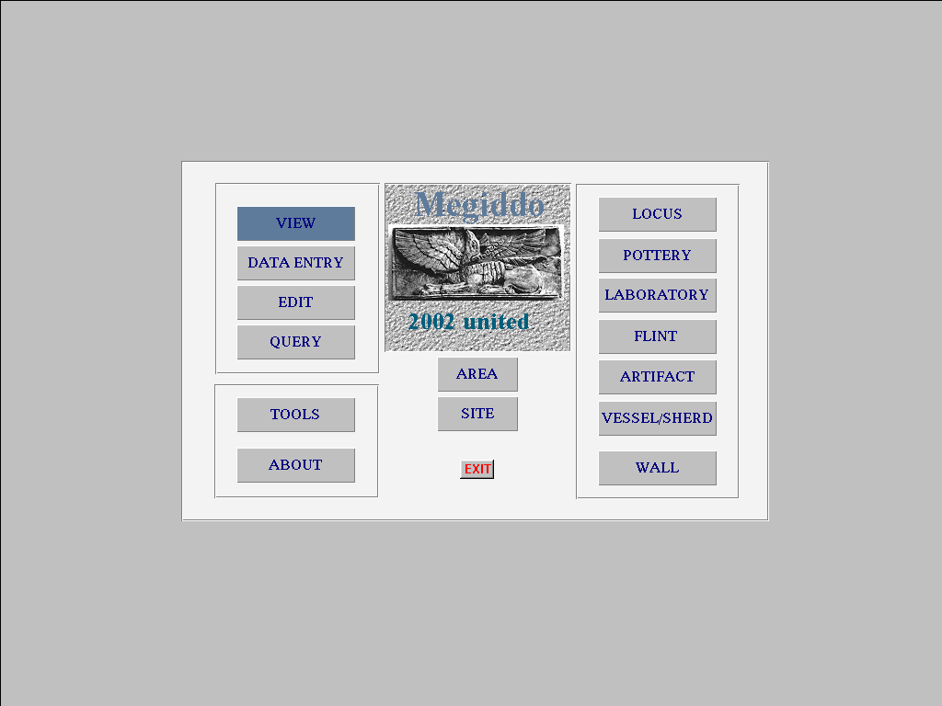
Megiddo Opening Screen

Slide 62
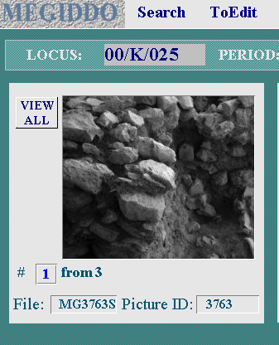
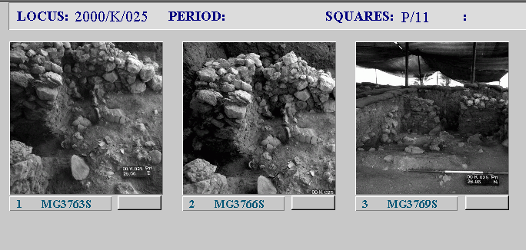
Locus Screen: Pictures
View all

Slide 63
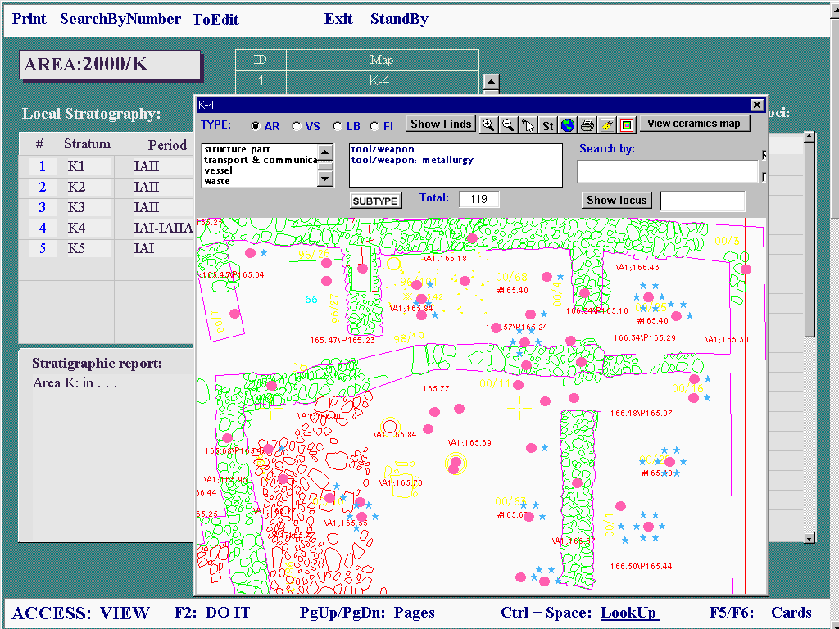
Area Screen

Slide 64
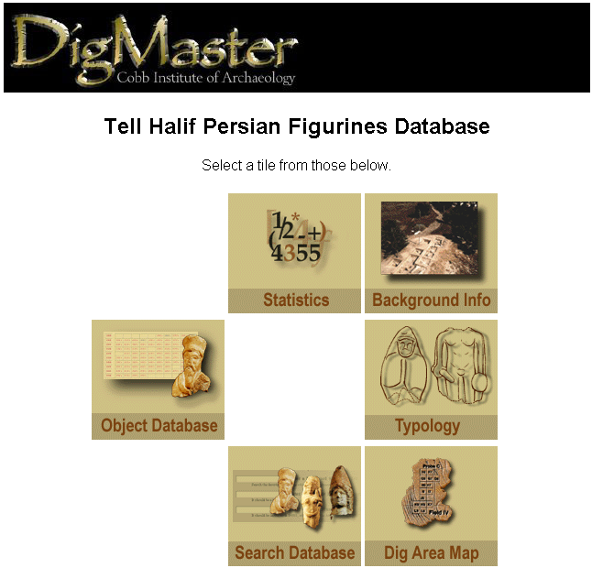
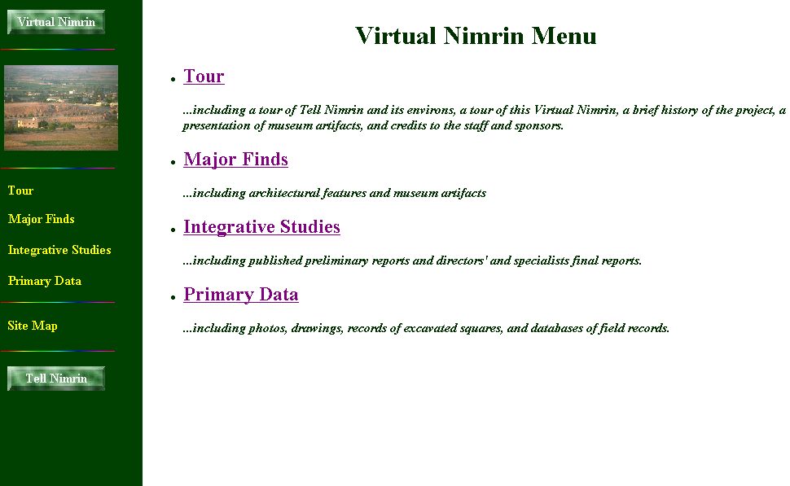
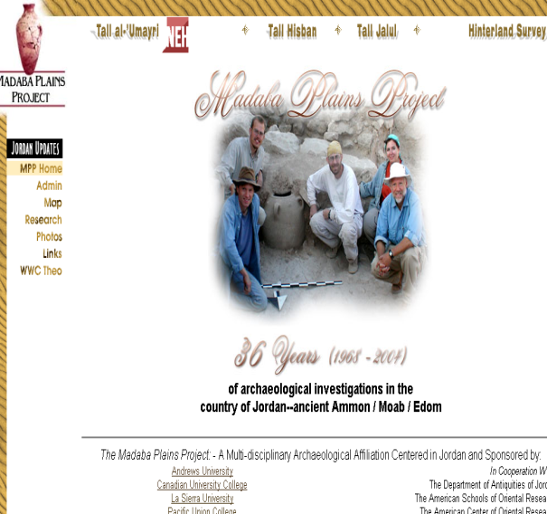
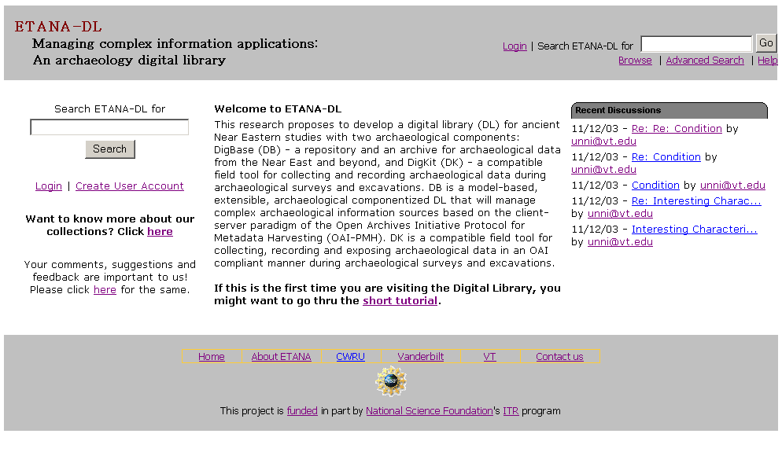

Slide 65
ETANA-DL Approach
Applying and extending Digital Library (DL) techniques to solve key problems: making primary data available, data preservation, and interoperability
Modeling archaeological information systems using 5S to better understand the domain and design the system and the supporting services
Rapidly prototyping DLs that handle heterogeneous archaeological data using componentized frameworks:
  eliciting requirements
  refining metamodel and union schema
  modeling sites
  mapping
  harvesting
  providing useful services

Slide 66
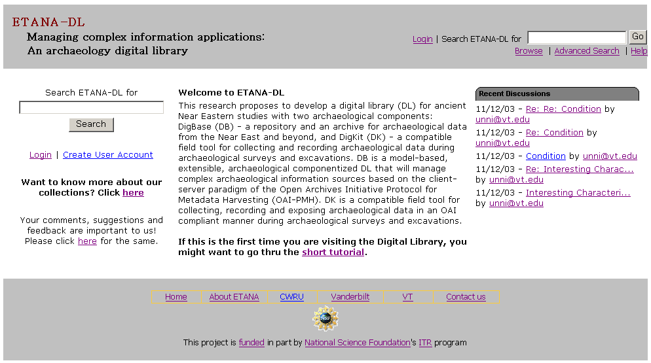
ETANA-DL Website

Slide 67
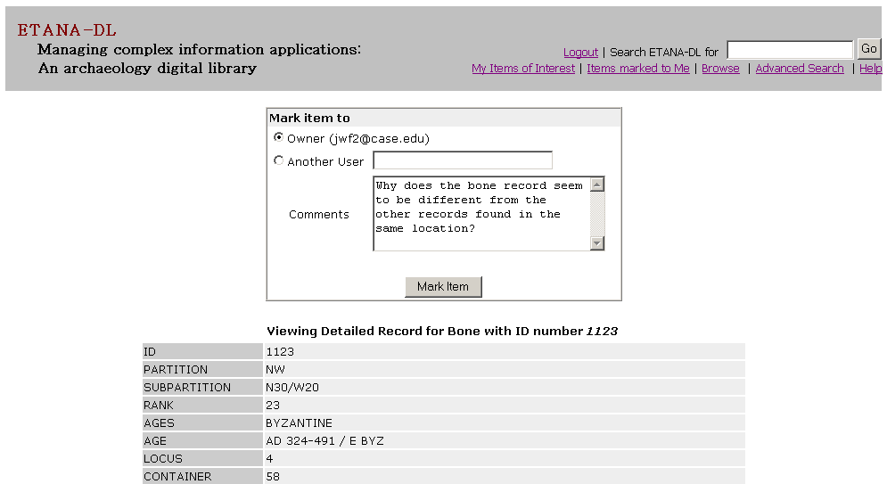
Marking – writing
notes for
a specific user
Marking Items

Slide 68
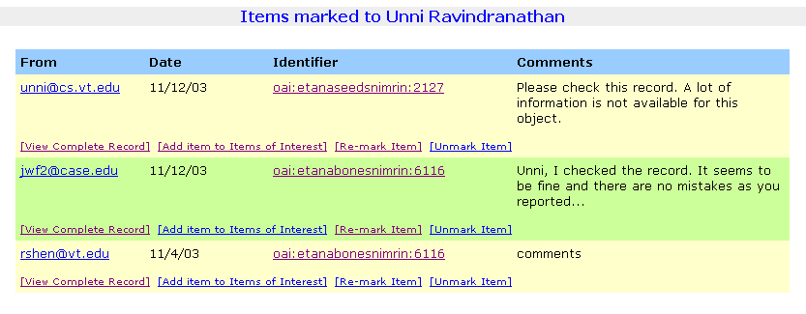
Sender, Date,
Object OAI ID
Sender
Comments
Options:
View Record,
Add record to Items Of Interest,
Re-mark item (Redirect),
Unmark item (Remove item from list)
Marked Items Display

Slide 69
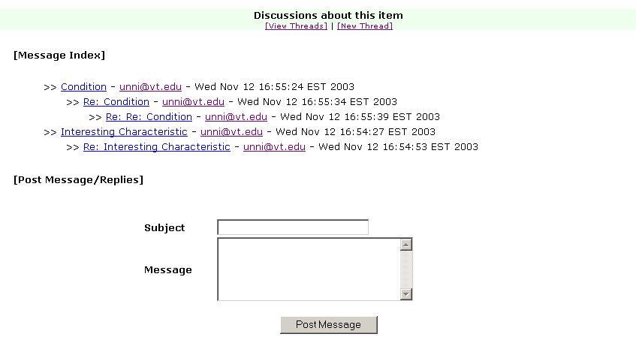
Discussions
about an
object
View/Post
messages,
create new
threads
Discussions Page

Slide 70
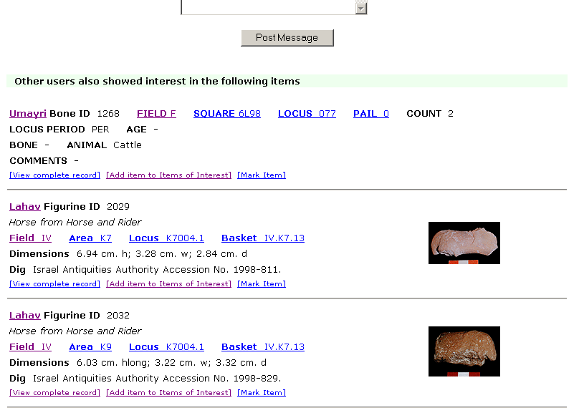
Items recommended
on the basis of
similar interests
Recommendations

Slide 71
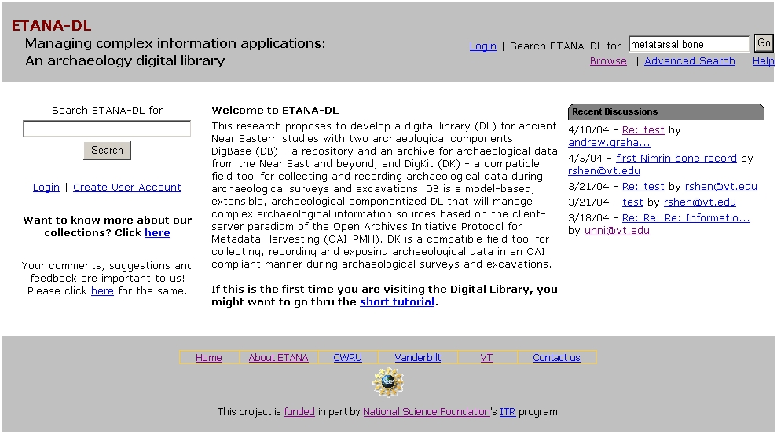
ETANA-DL Searching Service
Search

Slide 72
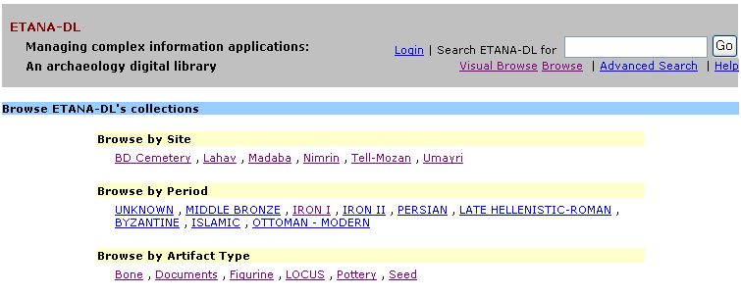
ETANA-DL Multi-dimensional Browsing
3 new sites
2 new types of artifacts

Slide 73
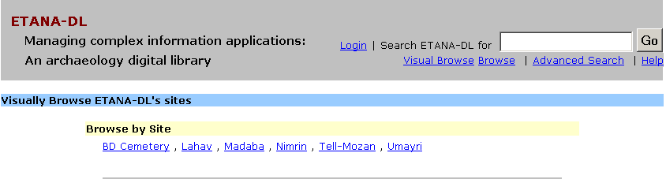
ETANA-DL Visual Browsing Service
Visual Browse
By site

Slide 74
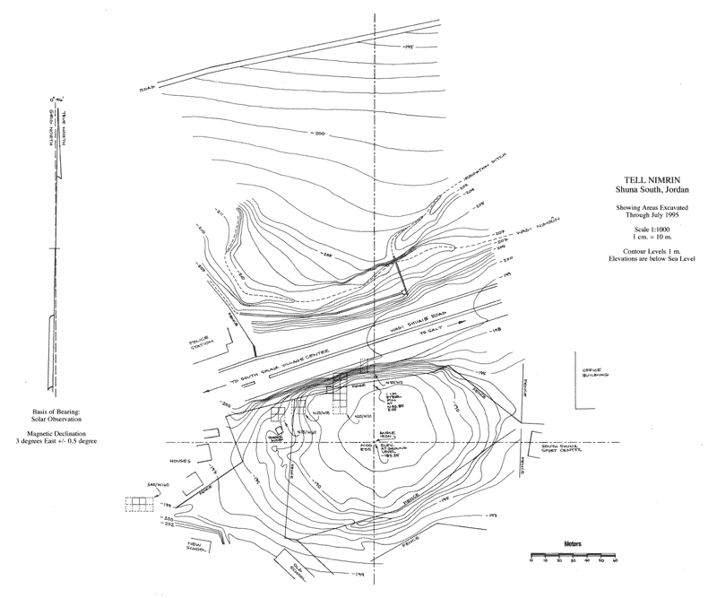
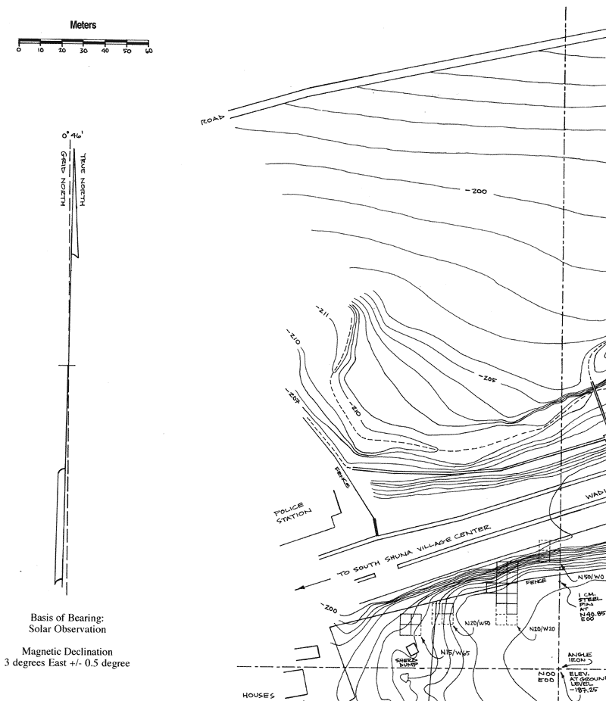
Visual Browsing Nimrin:
Topographical Drawings
Square:
N40/W20
Full site
North west quadrant

Slide 75
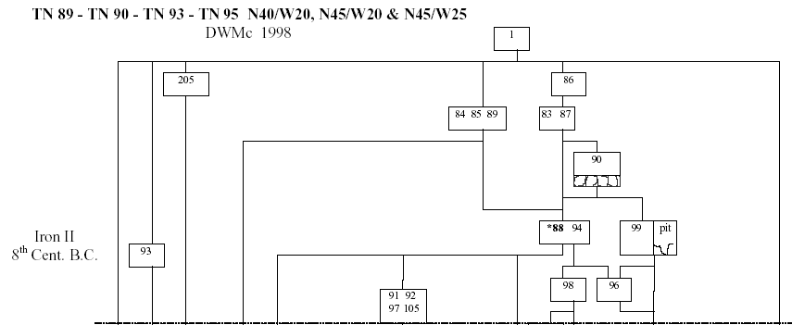
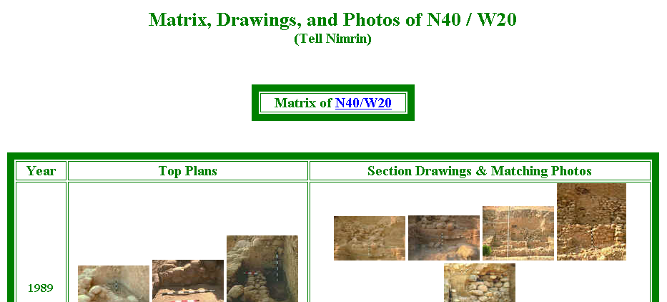
Visual Browsing Nimrin : Square information
Square:
N40/W20
Locus: 86
Loci layout

Slide 76
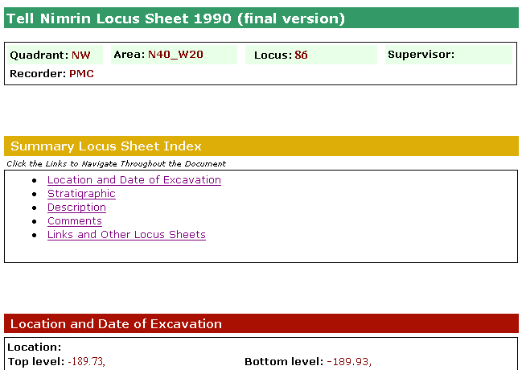
Visual Browsing Nimrin : locus sheet

Slide 77
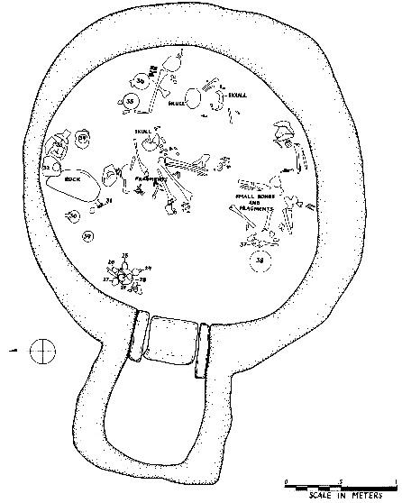
Visual Browsing
Bab edh-Dhra'
Cemetery
Pottery # 25

Slide 78
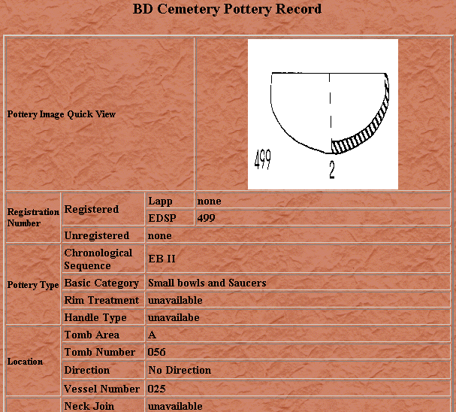
Visual Browsing
Bab edh-Dhra'
Cemetery
Pottery # 25

Slide 79
ETANA Societies - 1
Historic and pre-historic societies (being studied)
Archaeologists (in academic institutes, fieldwork settings, or local and national governmental bodies)
Project directors
Technical staff (consisting of photographers, technical illustrators, and their assistants)
Field staff (responsible for the actual work of excavation)
Camp staff (e.g., camp managers, registrars, tool stewards)
General public (e.g., educators, learners, citizens)

Slide 80
ETANA Societies - 2
Social issues
  Who owns the finds?
  Where should they be preserved?
  What nationality and ethnicity do they represent?
  Who has publication rights?
  What interactions took place between those at the site studied, and others? What theories are proposed by whom about this?

Slide 81
ETANA Scenarios
Life in the site in former times
Digital recording: the planning stage and the excavation stage
Planning stage: remote sensing, fieldwalking, field surveys, building surveys, consulting historical and other documentary sources, and managing the sites and monuments
Excavation
  Detailed information is recorded, including for each layer of soil, and for features such as pole holes, pits, and ditches.
  Data about each artifact is recorded together with information about its exact find spot.
  Numerous environmental and other samples are taken for laboratory analysis, and the location and purpose of each is carefully recorded.
  Large numbers of photographs are taken, both general views of the progress of excavation and detailed shots showing the contexts of finds.
Organization and storage of material
Analysis and hypotheses generation and testing
Publications, museum displays
Information services for the general public

Slide 82
ETANA Spaces
Geographic distribution of found artifacts
Temporal dimension (as inferred by archaeologists)
Metric or vector spaces
  used to support retrieval operations, and to calculate distance (and similarity)
  used to browse / constrain searches spatially
3D models of the past, used to reconstruct and visualize archaeological ruins
2D interfaces for human-computer interaction

Slide 83
ETANA Structures
Site Organization
  Region, site, partition, sub-partition, locus, …
Temporal orderings (ages, periods)
Taxonomies
  for bones, seeds, building materials, …
Stratigraphic relationships
  above, beneath, coexistent

Slide 84
ETANA Streams
successive photos and drawings of excavation sites, loci, unearthed artifacts
audio and video recordings of excavation activities and discussions
textual reports
3D models used to reconstruct and visualize archaeological ruins.

Slide 85
Exercise 1
Forms groups of 2.
Select a digital library you wish to build, improve, or study.
As was done for ETANA, discuss it using the 5S perspective.
Present a summary to the class and lead a discussion.

Slide 86
Streams (Content)
Multiple media types and representation
  See ch. 4 for IR (except some here for non-text)
  Standards for each, and for some combinations
Text
  Character strings, encoding (Unicode)
  Morphology -> Stemming
  Syntax, semantics -> stop words
  ** POS tagging, phrases
Images, Audio, Video, Graphics, Animation
  Capture, digitization, representation
  CBIR for each
** Compression, processing, analysis
**Synchronization, rendering, presentation, interchange
  RealVideo, SMIL, QoS

Slide 87

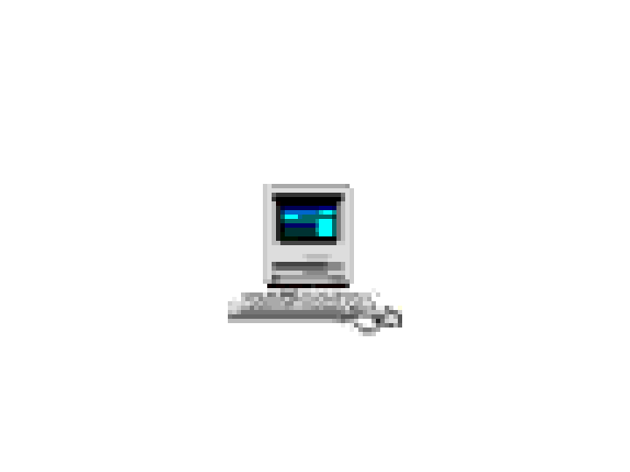

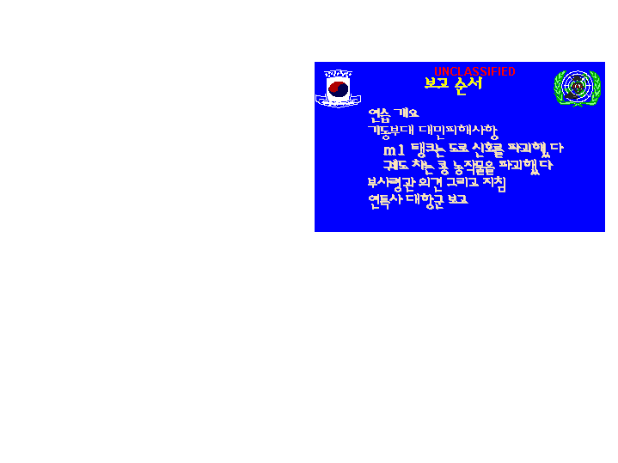
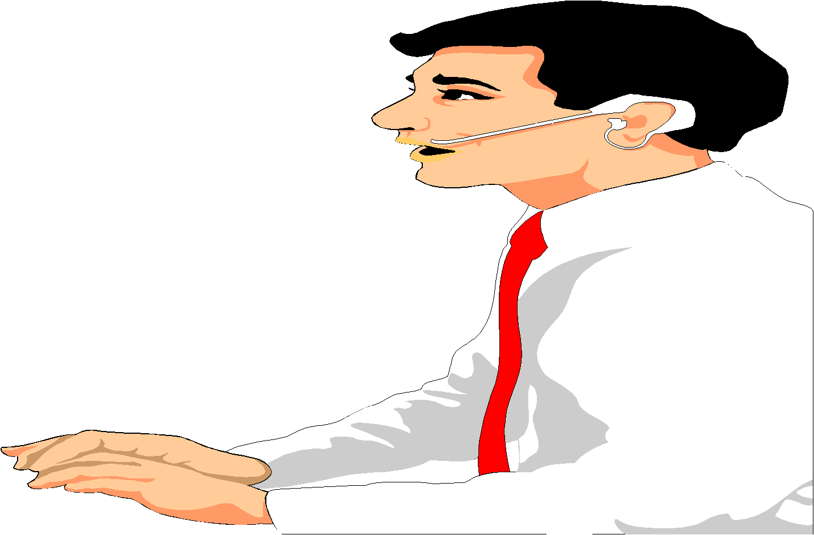

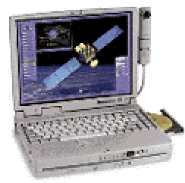
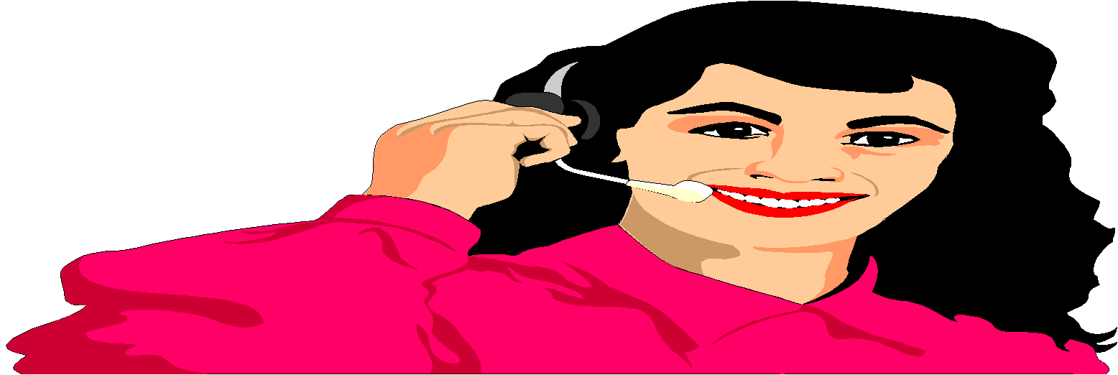
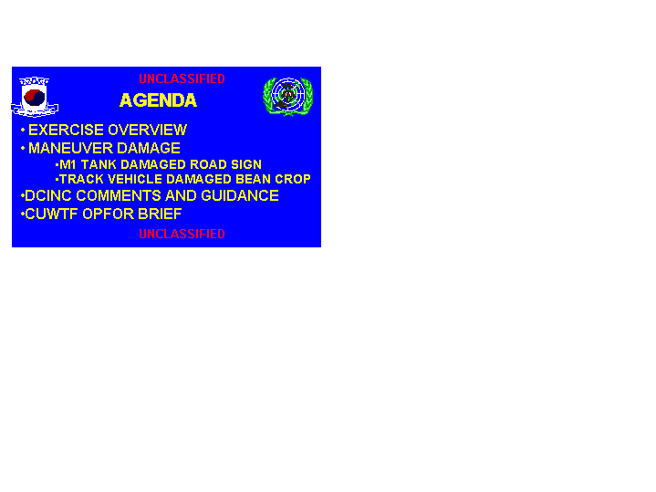
Integrated CCLINC
Translingual Information System
DARPA
CCLINC
SERVER
BugHanI IlBonE Ddo MiSaIlEul
BalSaHan Deus HaDa
Info Detection
2-way
Speech Transation
Extraction
What is the north korean
movement in the front line?
What is the status of nk
missile launch against japan?
Summarization
It seems that North Korea launch a missile again
After North Korea launched a Daipodong missile
last month, NK is perceived to proceed to an additional
test launch. Korea, US and Japan enter into an alert
state, and prepare for a joint response policy. Korea
estimates that the additional launch will be on 09/05.
Japan estimates that NK’s missile range is short. US
information says that there is no sign of launch yet.
Translation

Slide 88
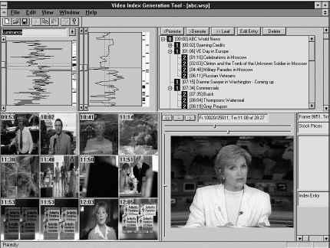
Structured Video Browser
(making video into hypermedia) www.learn.umd.edu
IBrowse
Expository multimedia
Narrative Structures

Slide 89
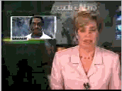
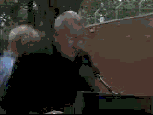
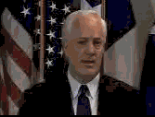
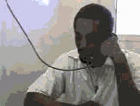
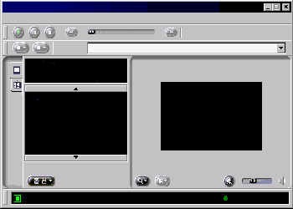
MPEG-7 Video Library Systems Tech.
MPEG-7 Video Library Systems Tech.
Architecture
Video Data
Description
Scheme
Description Schemes
Design Tool
Description Generator
Meta
Database
Video
Database
Presentation Module
Player
Retrieval Server
Module
ICU
Information and Communication
University

Slide 90






Tides in Early Texas History – Stephen F. Austin University

Slide 91
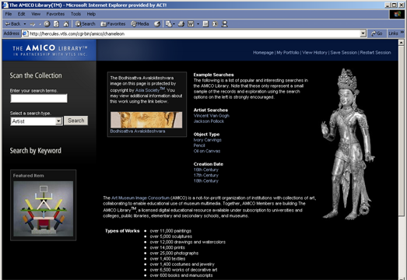
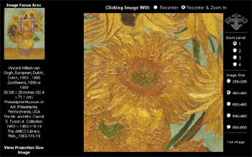
The AMICO Library™

Slide 92
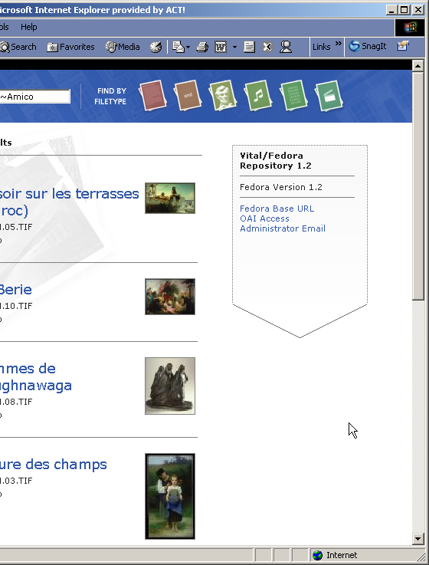
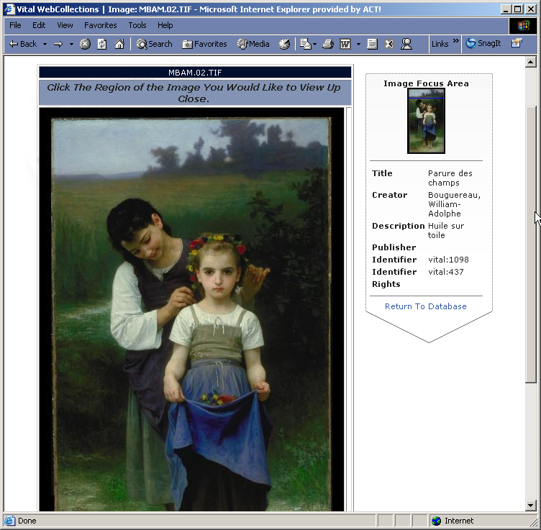

VITAL Web Portal
The AMICO Library in VITAL

Slide 93

Implementation Options
The Fedora™ package
  Fedora™ open source software (free)
  VTLS installation, training, and support

Slide 94
Collaborative Research: Torres
Torres at UNICAMP, Brazil
Hallerman in Fisheries at VT
Funding by Microsoft Research
Search in collections of fish images
using combination of
image properties (CBIR) and
textual descriptions
With superimposed information (Murthy, Delcambre, Cassel, …)

Slide 95

Textual information retrieval
Query on Google using Sunset and Rio de Janeiro
Query result

Slide 96


Content Based
Information
Retrieval

Slide 97
Structures
Digital Objects
  Documents, digitization, packaging (METS, ORE, DCC), interchange, standards, format conversion
  Genre: plays, encyclopedia, dictionaries, educational resources: courses (e.g., syllabi) and lessons
  Structural organizations (books, chapters, sections), excerpts/spans (mark, superimposed info)
Metadata: standards, markup
Knowledge Structures & Representations
  Databases, Schema, Ontologies, Thesauri, Lexicons, Authority files, Concept maps, Semantic networks
Indexes
  Inverted files, signature files, R-trees, Quad trees, etc.
Clusters & Classification Schemes

Slide 98
Degree of Structure
Web
DLs
DBs
Chaotic
Organized
Structured

Slide 99
Digital Objects (DOs)
Born digital
Digitized version of “real” object
  Is the DO version the same, better, or worse?
  Decision for ETDs: structured + rendered
Surrogate for “real” object
  Not covered explicitly in metamodel for a minimal DL
  Crucial in metamodel for archaeology DL

Slide 100
Metadata Objects (MDOs)
MARC
Dublin Core
RDF
IMS
OAI (Open Archives Initiative), ORE
Crosswalks, mappings
Ontologies
Topics maps, concept maps

Slide 101
Complex to Simple
+
thesis
MARC ($50)
Dublin Core (DC)

Slide 102
Also Important: Epub, SGML, XML
5S perspective: streams, structures, scenarios
Authoring
Rendering, presenting
Tagging, Markup, DOM
Semi-structured information
Dual-publishing, eBooks
Styles (XSL, XSLT)
Structured queries

Slide 103


Slide 104


Slide 105


Slide 106


Slide 107


Slide 108
Databases
5S perspective: structures, streams, scenarios
Extending database technology
Structured and unstructured info
Multimedia databases
Link databases
Performance, transaction processing
Replicated storage, rollback/recovery

Slide 109
Collections / Aggregations
Terminology: set, “database”
Distributed: basis, efficiency/effectiveness
Parallelism: federation, harvesting
Scale: object size, compression, replication, stream splitting
Intelligence/processing granularity: object, cluster, collection, repository

Slide 110
Catalogs
OPACs
Distributed vs. centralized
Coverage, breadth
Specificity, depth
Management: versioning, works

Slide 111
Archives, Repositories
Naming, identifiers
Architectures, interoperability
  OAI: harvesting
  SRU/SRW: federation
Preservation, archives
  LOCKSS, UVC, emulation/migration
Scalability, storage

Slide 112
LOCKSS
Lots of copies keep stuff safe
Stanford (Vicky Reich)
Initial focus on lower levels
Initial content: journals
Emory (Martin Halbert)
  Help deploy and adapt
  Help apply in other contexts
    Another registry
    Set of publisher manifests (information providers)
    Set of storage systems (archival storage)
  NDIIP: AmericanSouth, MetaArchive

Slide 113
Digitization and Preservation
Community and Activity (early)
Archivists worldwide
International collaboration
  Million book project in US, China, India (Reddy, Chen, Balakrishnan)
US Library of Congress
  Matching funds
  American Memory
  Infrastructure: NDIIP
Dutch National Library + IBM
Associations: ARL, DLF
People
  Harnad: Self-archiving movement
  Lorie: Universal virtual computer
  Gladney: technology, philosophy (http://home.pacbell.net/hgladney/ddq_3_1.htm)
  Besser, Trant, …

Slide 114
OAI - Open Archives Initiative
Advocacy for interoperability
Standard for transferring metadata among digital libraries
  Protocol for Metadata Harvesting (PMH)
    Simplicity
    Generality
    Extensibility
Support for PMH => Open Archive (OA)

Slide 115
OAI = Technical Umbrella for
Practical Interoperability…
Metadata Harvesting
Reference
Libraries
Museums
Publishers
E-Print
Archives
…that can be exploited by different communities

Slide 116
OAI – Repository Perspective
Required: Protocol
Set Structure
URI Scheme
MDO
MDO
MDO
MDO
Required: DC
MDO
MDO
MDO
MDO
DO
DO
DO
DO

Slide 117
OAI – Black Box Perspective
OA 7
OA 4
OA 2
OA 3
OA 1
OA 6
OA 5

Slide 118
The World According to OAI
Service Providers
Discovery
Current
Awareness
Preservation
Metadata
harvesting
Data Providers

Slide 119


Slide 120
Institutional Repositories - 1
“Institutional repositories are digital collections that capture and preserve the intellectual output of a single university or a multiple institution community of colleges and universities.”
Crow, R. “Institutional repository checklist and resource guide”, SPARC, Washington, D.C., USA
www.arl.org/sparc/IR/IR_Guide_v1.pdf

Slide 121
Institutional Repositories - 2
“A university-based institutional repository is a set of services that a university offers to the members of its community for the management and dissemination of digital materials created by the institution and its community members. It is most essentially an organizational commitment to the stewardship of these digital materials, including long-term preservation where appropriate, as well as organization and access or distribution.”
Lynch, C.A. In ARL Bimonthly Report 226, pp. 1-7, Feb. 2003, www.arl.org/newsltr/226/ir.html

Slide 122


Slide 123
Goals of Institutional Repositories
(by Steven Harnad, U. Southampton)
Self Archiving of Institutional Research
  Thesis and Dissertations (VTLS NDLTD Project)
  Article preprints and post prints
  Internal documents and maps
Management of digital collections
Preservation of materials – decentralized approach
Housing of teaching materials
Electronic Publishing of journals, books, posters, maps, audio, video and other multimedia objects
Adapted from Slide by V. Chachra, VTLS

Slide 124
Societies
User communities
  Authors, editors, teachers, students, readers
  Personal(ization), group(ware), community, global
  Accessibility, universal access
Librarians: reference, acquisition, operations
Research community
  Associations, conferences, publications, labs, projects
Economics
  Copyright, intellectual property rights, digital rights management, authorization, authentication, security, privacy, self-archiving (eprints)
  Publishers, catalogers, distributors, sustainability
  Open source, commercial, hybrid

Slide 125
Scenarios
Recall OO for streams – now have objects as well as scenarios – ex interface components
Information Access
  Searching: ad hoc, filtering/routing
  Browsing: using an organization, using a visualization, using links (i.e., hypertext, hypermedia)
  Workflow: sessions, feedback, etc.
Scenario-based Design
Usability: goals, tasks, claims

Slide 126
Exploration
Retrieval models
  Boolean, extended Boolean
  Vector, LSI
  Probabilistic: classical, belief network, inference network, language models
User interfaces and visualization

Slide 127
User interfaces and visualization
2D interfaces
3D interfaces
GIS
Other paradigms
Stepping Stones and Pathways
  http://fox.cs.vt.edu/SSP/

Slide 128
Services
Taxonomy of services
Ontology, composition, reuse
Evaluation
Key services in-depth:
  Crawling, indexing
  Clustering, classifying
  Recommending, using social networks
  Logging

Slide 129


Slide 130
Ontology: Applications
Expand definition of minimal DL by characterizing
  typical DL services
  in the context of “employs” and “produces” relationships
Use characterization to:
  Reason about how DL services can be built from other DL components
  As well as be composed with other services through extension or reuse

Slide 132

Ontology: Applications

Slide 136
XML-based DL Log Standard
Log analysis
  is a source of information on:
    How patrons really use DL services
    How systems behave while supporting user information seeking activities
Used to:
  Evaluate and enhance services
  Guide allocation of resources
Common practice in the web setting
  Supported by web servers, proxy caches
DL Logging can be more detailed

Slide 137
Systems
Architectures
  Client-server, service-oriented
  P2P, Grid
System descriptions and comparisons
  Personal DLs; Institutional to global
  DSpace, Eprints, Fedora, Greenstone, Kepler
ODL
5S Suite: language, visualization, generation, logging

Slide 138
Architectural Issues
Independent system vs. part of federation
Centralized vs. distributed vs. open services
Monolithic vs. modular vs. componentized
Topologies: bus vs. star vs. hierarchical vs. network
Decompositions vary
  search engine, browser, DBMS, MM support
  repository, handle server, client
  information resources + mediators, bus or agent collection + client with workspace/environment

Slide 139


Slide 140


Slide 141

What is Fedora™?
Flexible Extensible Digital Object Repository Architecture
Slides courtesy Vinod Chachra of VTLS

Slide 142
Fedora™ Terms
Metadata
Digital Objects (data)
Complex Objects (Object consisting of many objects in a complex/hierarchical relationship)
Content (Data and Metadata together)
Data-streams (are content for dissemination)
Disseminators (are services) – A dissemination is defined as a stream of data that manifests a view of the digital objects content.

Slide 143
Fedora™ Digital Object Architecture
Persistent ID (
PID
)
Globally unique persistent id
Disseminators
Public view: access methods for obtaining “disseminations” of digital object content
Internal view: metadata necessary to manage the object
System
Metadata
Datastreams
Protected view: content that makes up the “basis” of the object
EAD, TEI, DC, MARC,
VRA Core, MIX, etc.
Images, E-books, E-journals, Music, Video, etc.
The Mellon Fedora Project
Adapted from Slide by V. Chachra, VTLS

Slide 144
Fedora™
Repository
Web Service Exposure Layer
Adapted from Slide by V. Chachra, VTLS

Slide 145

VITAL / Fedora Relationship

Slide 146
ODL: Open Digital Library
Document
Program
Document
Program
Document
Program
1010100101010010101010010101010101010101
1010100101010010101010010101010101010101
?
1010100101010010101010010101010101010101
1010100101010010101010010101010101010101
1010100101010010101010010101010101010101
1010100101010010101010010101010101010101
Video
Image
Video
Image
Video
Image
1010100101010010101010010101010101010101
1010100101010010101010010101010101010101
1010100101010010101010010101010101010101
1010100101010010101010010101010101010101
1010100101010010101010010101010101010101
1010100101010010101010010101010101010101
users
digital objects

Slide 147
Monolithic
and/or
Custom-built
web-based
application
?
?
Document
Program
Document
Program
Document
Program
1010100101010010101010010101010101010101
1010100101010010101010010101010101010101
1010100101010010101010010101010101010101
1010100101010010101010010101010101010101
1010100101010010101010010101010101010101
1010100101010010101010010101010101010101
Video
Image
Video
Image
Video
Image
1010100101010010101010010101010101010101
1010100101010010101010010101010101010101
1010100101010010101010010101010101010101
1010100101010010101010010101010101010101
1010100101010010101010010101010101010101
1010100101010010101010010101010101010101
digital library

Slide 148
Document
Document
Document
1010100101010010101010010101010101010101
1010100101010010101010010101010101010101
1010100101010010101010010101010101010101
?
?
?
?
?
?
Program
Program
?
Program
1010100101010010101010010101010101010101
?
1010100101010010101010010101010101010101
?
1010100101010010101010010101010101010101
?
?
?
?
?
?
Image
Image
?
Image
?
1010100101010010101010010101010101010101
1010100101010010101010010101010101010101
?
?
1010100101010010101010010101010101010101
?
?
?
Video
Video
Video
1010100101010010101010010101010101010101
1010100101010010101010010101010101010101
1010100101010010101010010101010101010101
componentized digital library

Slide 149
Document
Document
Document
1010100101010010101010010101010101010101
1010100101010010101010010101010101010101
1010100101010010101010010101010101010101
XPMH
OA
OA
XPMH
OA
PMH
Program
Program
Program
XPMH
1010100101010010101010010101010101010101
OA
1010100101010010101010010101010101010101
XPMH
1010100101010010101010010101010101010101
XPMH
OA
XPMH
OA
XPMH
XPMH
Image
Image
Image
1010100101010010101010010101010101010101
XPMH
1010100101010010101010010101010101010101
OA
OA
1010100101010010101010010101010101010101
XPMH
OA
PMH
XPMH
Video
Video
Video
1010100101010010101010010101010101010101
1010100101010010101010010101010101010101
1010100101010010101010010101010101010101
open digital library

Slide 150
Open Digital Library
Network of Extended Open Archives where each node acts as either a provider of data, services or both.
Component = Node
Protocol = Arc

Slide 151
Example Open Digital Library
Document
Document
ETD-1
1010100101010010101010010101010101010101
1010100101010010101010010101010101010101
ODLRecent
1010100101010010101010010101010101010101
USER INTERFACE
Recent
ODLUnion
PMH
Program
Filter
Program
ETD-2
PMH
1010100101010010101010010101010101010101
1010100101010010101010010101010101010101
1010100101010010101010010101010101010101
ODLUnion
Browse
Union
PMH
Image
ODLBrowse
Image
ETD-3
1010100101010010101010010101010101010101
PMH
1010100101010010101010010101010101010101
ODLUnion
1010100101010010101010010101010101010101
Filter
PMH
Search
ODLSearch
Video
Video
ETD-4
1010100101010010101010010101010101010101
1010100101010010101010010101010101010101
1010100101010010101010010101010101010101
ETD DL for the Networked Digital Library of Theses and Dissertations (www.ndltd.org)
Students and
researchers
ETD collections

Slide 152


Slide 153


Slide 154


Slide 155


Slide 156
5SSuite: Tools/Applications

Slide 157
5SL: a DL design language
Domain specific languages
  Address a particular class of problems by offering specific abstractions and notations for the domain at hand
  Advantages: domain-specific analysis, program management, visualization, testing, maintenance, modeling, and rapid prototyping.
XML-based realization of 5S
  Interoperability
  Use of many sub-languages (e.g., MIME types, XML Schemas, UML notations)

Slide 158
5SL – The Minimal DL Metamodel

Slide 159
Example of
Document
declaration in the
Structures Model
Example of Actors
declaration in the
Societies Model
Example of Service
declaration in the
Scenario Model
<Society>
<Actor>
<Community name='Patron‘/>
<Attribute name='name‘
type='String'/>
<Attribute name='ID‘
type='Integer'/>
</Community>
<Community name='Student'>
<Service>Converting</Service>
</Community>
<Community name='ETDReviewer'>
<Service>Reviewing</Service>
</Community>
<Community name='ETDCataloguer'>
<Service>Cataloguing</Service>
</Community>
</Actor>
………
<SERVICE name ='Searching'>
<SCENARIO name='SimpleSearching'>
<NOTE>Simple scenario for an NDLTD
site searching service</NOTE>
<EVENT>
<SENDER>Patron</SENDER>
<RECEIVER>InterfaceManager</RECEIVER>
<OPERATION name=SearchCriteria/>
<PARAMETER>collection</PARAMETER>
<PARAMETER>query</PARAMETER>
</EVENT>
<EVENT>
<SENDER>InterfaceManager</SENDER>
<RECEIVER>SearchManager</RECEIVER>
<OPERATION name='Search'/>
<PARAMETER>collection</PARAMETER>
<PARAMETER>query</PARAMETER>
</EVENT>
<EVENT>
<SENDER>SearchManager</SENDER>
<RECEIVER>InterfaceManager</RECEIVER>
<PARAMETER name='Results'>WtdSet
</PARAMETER>
</EVENT> ….
<document name=`ETD'>
<stream_enumeration>
<stream
value=`ETDText'>
<stream
value=`ETDAudio'>
...
</stream_enumeration>
<structured_stream>
%XMLSchema%
<structured_stream>
</document>

Slide 160
5SGraph: A DL Modeling Tool
Help users model their own instances of a digital library (DL) in the 5S language (5SL).
A simple modeling process which enables rapid generation of digital libraries
Features
  5SGraph loads and displays a metamodel in a structured toolbox.
  The structured editor of 5SGraph provides a top-down visual building environment for the DL designer.
  5SGraph produces syntactically correct 5SL files according to the visual model built by the designer.

Slide 161

Overview of 5SGraph
Workspace
(instance model)
Structured
toolbox
(metamodel)

Slide 164


Slide 165


Slide 166
5SGen
Version 1 -- MARIAN as the target system
  Focused on rich structures: semantic networks
  Behavior attached to nodes/links
Version 2 -- Shifted for later work to componentized (ODL) approach
  Focused on scenarios/societies
  Structures/Spaces encapsulated within components (e.g., relational tables, indexes)
  Only textual streams supported
Version 3 – Practical DL (w. DSpace) – Doug Gorton

Slide 167
5SLGen – Version 2: ODL, Services, Scenarios

Slide 168
Case Studies
Education:
  CSTC, CITIDEL
  Ensemble
  NSDL
  NDLTD (ETDs)
CTRnet

Slide 169
CS Teaching Center (CSTC)
Instead of building large, expensive multimedia packages, that become obsolete and are difficult to re-use, concentrate on small knowledge units.
Learners benefit from having well-crafted modules that have been reviewed and tested.
Use digital libraries to build a powerful base of support for learners, upon which a variety of courses, self-study tutorials & reference resources can be built.
ACM support led to Journal of Educational Resources in Computing (JERIC), accessible from www.cstc.org
Notes:
3
3

Slide 170
Computing and Information Technology Interactive Digital Educational Library (CITIDEL)
Domain: computing / information technology
Genre: one-stop-shopping for teachers & learners: courseware (CSTC, JERIC), leading DLs (ACM, IEEE-CS, DB&LP, CiteSeer), PlanetMath.org, NCSTRL (technical reports), …
Submission & Collection: sub/partner collections ➔ www.citidel.org

Slide 171


Slide 172
CITIDEL -> NSDL
A collection project in the
National STEM (science, technolgy, engineering, and mathematics) education Digital Library – NSDL
National Science Digital Library
www.nsdl.org
(Next slides courtesy Lee Zia, NSF)
Notes:
3
3

Slide 173
Connects:
Users: students, educators, life-long learners
Content: structured learning materials; large real-time or archived datasets; audio, images, animations; primary sources; digital learning objects (e.g. applets); interactive (virtual, remote) laboratories; ...
Tools: search; refer; validate; integrate; create; customize; publish; share; notify; collaborate; ...

Slide 174
Collections
Discovery of content
Classification and cataloguing
Acquisition and/or linking; referencing
Disciplinary-based themes define a natural body of content, but other possibilities are also encouraged
Access to massive real-time or archived datasets
Software tool suites for analysis, modeling, simulation, or visualization
Reviewed commentary on learning materials and pedagogy

Slide 175
Services
Help services, frequently asked questions, etc.
Synchronous/asynchronous collaborative learning environments using shared resources
Mechanisms for building personal annotated digital information spaces
Reliability testing for applets or other digital learning objects
Audio, image, and video search capability
Metadata system translation
Community feedback mechanisms

Slide 176
NSDL Information Architecture
Essentially as developed by the Technical Infrastructure Workgroup
Portals &
Clients
Portals &
Clients
User Interfaces
Portals &
Clients
NSDL
Services
NSDL
Services
Other NSDL
Services
NSDL
Collections
Core
NSDL
“Bus”
NSDL
Collections
NSDL
Collections
Usage Enhancement
Collection
Building
Core Services:
information retrieval
CI Services
browsing
CI Services
authentication
referenced
items &
collections
Core Services:
metadata gathering
CI Services
personalization
referenced
items &
collections
Special
Databases
Core Collection-
Building Services
protocols
CI Services
discussion
Core Collection-
Building Services
harvesting
CI Services
annotation

Slide 177
Digital Libraries in Education
Analytical Survey, ed. Leonid Kalinichenko
© 2003, www.iite-unesco.org, info@iite.ru
Transforming the Way to Learn
DLs of Educational Resources & Services
Integrated/Virtual Learning Environment
Educational Metadata
Current DLEs: US (NSDL, DLESE, CITIDEL, NDLTD), Europe (Scholnet, Cyclades), UK (Distributed National Electronic Resource)

Slide 178
DLEs: Guiding Principles (p. 12)
Driven by educational and science needs
Facilitating educational innovation
Stable, reliable, permanent
Accessible to all
Leverage prior research: DL, courseware, …
Adaptable to new technologies
Supporting decentralized services
Resource integration thru tools/organization

Slide 179

Ensemble Portal
Edward A. Fox, Yinlin Chen, Monika Akbar
Virginia Tech
www.computingportal.org

Slide 180













The Ensemble Computing Portal
Many-to-Many Information Connections in a Distributed Digital Library Portal
Collections
Communities
ACM
CS1
FOCES
TECH Developers
Ensemble
LIKES
AP CS
Services
Search
Distributed DL Portal
Forum
Group
Blog
Browse
Notification
Tools
A collaborative research project to build a distributed portal with up-to-date contents for all computing communities.
http://www.computingportal.org/

Slide 181


Ensemble in Second Life
http://slurl.com/secondlife/Educators%20Coop%204/66/236/28
The Ensemble Pavilion offers:
• teleports to other computing sites in Second Life like the Digital Preserve
• hyperlinks to related computing websites
• RSS readers with feeds from computing and computing education blogs
• membership in the Ensemble Computing group in Second Life, Facebook, and Twitter

Slide 182






Selected Digital Preserve Personnel
Gary Octagon
Gary Marchionini
EdFox Rieko
Edward Fox
zamfir Paule
Spencer Lee
Uma Aldrin
Uma Murthy
Krad Proto
Seungwon Yang
mantruc Martian
Javier Velasco-Martin

Slide 183


DP areas
Poster Building
18 posters on display
Poster view tips
Video screen
Cafe
Beverages
Screens
Discussion areas

Slide 184
A Digital Library Case Study
Domain: graduate education, research
Genre:ETDs=electronic theses & dissertations
Submission: http://etd.vt.edu
Collection: http://www.theses.org
Project:
Networked Digital
Library of Theses
& Dissertations
(NDLTD)
http://www.ndltd.org

Slide 185
NDLTD: How can a university get involved?
Select planning/implementation team
  Graduate School
  Library
  Computing / Information Technology
  Institutional Research / Educ. Tech.
Join online, give us contact names
  www.ndltd.org/join
Adapt Virginia Tech or other proven approach
  Build interest and consensus
  Start trial / allow optional submission
Notes:
22
17
16
17
17

Slide 186
Student Gets Committee
Signatures and Submits ETD
Approval
form
Signed
Grad School
Notes:
10

Slide 187
Library Catalogs ETD, Access is
Opened to the New Research
WWW
NDLTD
Digital library access control
Notes:
12

Slide 188



http://scholar.lib.vt.edu/theses/available/etd-2227102539751141/
Notes:
http://scholar.lib.vt.edu/theses/available/etd-2227102539751141/
What is an ETD? What it can look like:
It can have the appearance of a paper document.
It can contain a video clip.
It can contain sound.
It can contain thumbnail pages and links to aid navigation.
It can have a unique layout.
It can have photomicrographs.
It can contain a simulation.
The library resources used in an ETD initiative can include

Slide 189
Union catalog: OCLC
OCLC will expand OAI data provider on TDs.
Is getting data from WorldCat (so, from many sites!).
Will harvest from all others who contact them.
Need DC and either ETD-MS or MARC.
Has a set for ETDs.

Slide 190


Slide 191


Slide 192


Slide 193

OCLC SRU Interface

Slide 194


Slide 195

VTLS Visualizer Service with NDLTD Union Catalog

Slide 196


Slide 197
ETDs: Library Goals
Improve library services
  Better turn-around time
  Always available
Reduce work
  catalog from e-text
  eliminate handling: mailing to ProQuest, bindery prep, check-out, check-in, reshelving, etc.
Save space
Notes:
ETDs give libraries an avenue to demonstrate Information Age goals

Slide 198
Why ETD? Short Answer
For Students:
  Gain knowledge and skills for the Information Age
  Richer communication (digital information, multimedia, …)
For Universities:
  Easy way to enter the digital library field and benefit thereby
For the World:
  Global digital library – large, useful, many services
General:
  Save time and money
  Increased visibility for all associated with research results

Slide 199

HTML5 Structuring Flowchart
HTML5
tag set
TXT/ HTML
ETD
structure
analyzer
Tagged TXT
PDFETD
Text/ Grammar
PDF2Text/HTML converter
HTML5
Converter
Multimedia file link extractor
Tagged TXT
HTML5ETD
TXT/ HTML
Tagged MM Source
HTML
Multimedia file source extractor

Slide 200
ETD Classification:
Algorithm Pipeline
ETDs categorized into a node of the category tree (after classification)
Category
Tree
ETD Collection
Category label for each node used as query
ETD metadata used for categorization
Categorized
ETDs
Google
Naïve Bayes Classifiers
Level-wise categorization
Top 50 webpages (for each node in the tree)
Training
Browsing
Web
Interface
Document
Sets
Training
Sets
Cleanup
(stemming,
stopword removal,
etc.)

Slide 201
Scholarship
Humans/
Humanities
DL curriculum
Ensemble
Living In the KnowlEdge
Society (LIKES): Book,
Part on Humanities
Needs
Areas
Approach
Supporting
Scholarship
About Humans
Through
Content &
Services
Content
Services
Digitized
ETDs
Born digital
(digital
natives)
DLs:
CTRnet
Ensemble
ETANA
NDLTD
Flattening
(cooperation,
collaboration)
Exploring
(search, browse)
Interoperability
Integration

Slide 202

Crisis, Tragedy, and Recovery
~10 TB, ~100 tweet + ~50 webpage collections
Human tragedies that result from man-made and natural events affect humans and communities significantly.
During and after a tragic event, there are a series of needs that have to be addressed.
  Compounded by communication failures and a confusing plethora of data and information

Slide 203

Build a networked digital library relating to CTR
www.citeulike.org group ctrnet
Citations
Papers, …
Integrate community, content, and services relating to CTR, making it accessible, and preserving it for long-term reuse
Support information exploration
Aided by an ontology
www.ctrnet.net

Slide 204

CTR stakeholders
Notes:
Help affected communities to recover more quickly and effectively
Provide global network with relevant information and resources
Support the research community, emergency personnel, decision makers, and the public in reacting to and recovering from crises

Slide 205

Haiti Photographs, Content Based Image Retrieval Evaluation

Slide 206
CTR Ontology
An ontology is
  Collection of words and phrases
  Graph of relationships, sometimes mostly hierarchical as in a taxonomy
  Covering the key concepts and terms in the discipline
  Supporting differing views on the field
Purposes
  Describes documents
    As tags, descriptors, keywords
  Supports navigation, learning, and research

Slide 207






Goals for Ontology for CTR
CTR literature
Browsing
sources
Searching
  Query
  expansion
Focus groups
CTR Ontology
Individual
Organizational
Community
Political
…
Tagging
Websites,
Internet Archive
Recommending
Social network
applications
Summarizing
uses
Multicultural/ linguistic input
Visualizing

Slide 208

Categories from focus group study
Results from focus group interviews following the April 16, 2007 tragedy at Virginia Tech

Slide 209
CTR keyword pairs
Extracted top keyword pairs from ISCRAM proceedings using the N-gram statistics package
emergency response | decision support | information systems | teams participants
decision making | data models | disaster monitoring | teams maps
command teams | disaster plan | crisis management | sms text-message
flood alerts | information seeking | situational awareness | disaster registry
physical communication | human disaster | teams access | decision preference
Notes:
International Conference on Information Systems for Crisis Response and Management

Slide 210
Data Cleaning, Extracting, Filtering, Storytelling
Classifying
Related files
Storytelling
Stories
Visualizing
Graph of stories
Analyzing
results
Goal: Discover relationships between tragic events.
  Examples: Shooting, study pressure, and mental disorders
formatting
Start and end docs

Slide 211
Hypothesis of school shooting
Immigration
Socially Different
Victim of Bullying
Isolation
Psychological Impact
School Impact
Out come
Keywords
Migration Geographical movement
Relocation
Keywords
Social Outsider
Social Stranger
Keywords
Homophobia Gay Taunts
Keywords
Rejection Seclusion
Keywords
Depression Frustration Anxiety Anger Aggression Stress Loneliness Low Self-esteem
Keywords
Truancy Poor Academic Performance
Low Grades School Drop-out
E.g., Any relations between
Violence and Migration?
Male
Female
Keywords
Delinquency Violence Fighting Masculinity Assault School Shooting
Keywords
Suicide Ideation Suicide Attempt Suicide

Slide 212
Quality
Information life cycle
Dimensions, Indicators
Definitions
Examples
Evaluation

Slide 213
Describing Quality in
Digital Libraries
What’s a “good” digital Library?
  Central Concept: Quality!
  Hypotheses of this work:
    Formal theory can help to define “what’s a good digital library” by:
    New formalizations of quality indicators for DLs within our 5S framework
    Contextualizing these measures within the Information Life Cycle

Slide 214
Quality Dimensions

Slide 215
Metadata Specifications and Metadata Format: Completeness
Refers to the degree to which values are present in the description, according to a metadata standard. As far as an individual property is concerned, only two situations are possible: either a value is assigned to the property in question, or not.
Completeness(ms_{x}) = 1 - (no. of missing attributes in ms_{x}/ total attributes of the schema to which ms_{x} conforms)

Slide 216
Metadata Specifications and Metadata Format: Completeness
OCLC NDLTD Union catalog

Slide 217
Services: Efficiency / Effectiveness
Effectiveness
  Very common measures: Precision, Recall, F1, 10-precision, R-Precision
  Other services may have different measures: e.g., Recommending, etc.
Efficiency
  let t(e) be the time of an event e
  let e_{ix} and e_{fx} be the initial and the final event of service se_{x} .
  For service se_{x}, efficiency is defined as:
    Efficiency(se_{x}) = t(e_{fx}) - t(e_{ix})

Slide 218
Quality and the Information Life Cycle

Slide 219
Exercise 2
Re-form into former groups of 2.
Recall the digital library you selected earlier.
Select the most important measures of quality for that digital library (from those discussed or others you feel are needed).
Work out the details of an evaluation using those measures.
Present a summary to the class and lead a discussion.

Slide 220
Integration
What is “DL Integration”
  Hide distribution
  Hide heterogeneity
  Enable autonomy of individual component
Why Integration
  island-DLs
  inability to seamlessly and transparently access knowledge across DLs
Utilize various autonomous DLs in concert

Slide 221
Integration: Rationale
We can read any paper book (ignoring limitations of language, vision, …).
Scholarship requires access, analysis, and synthesis spanning disciplines and sources.
New theories, systems, and services build upon our past accomplishments.
Our “Small World” and the “Internet Age” demand that we, and our computers, work together and interoperate.

Slide 222
Integration: Urgency, Longevity
If we collect, capture, acquire, or produce information, will it be usable in 100 years?
NSF Digital Archiving Program
Library of Congress National Digital Information Infrastructure and Preservation Program

Slide 223
Hypothesis and Research Questions
The 5S framework provides effective solutions to DL integration.
  Formally define the DL integration problem?
  Guide integration of domain focused DLs?
    How to formally model such domain specific DLs?
    How to integrate formally defined DL models into a union DL model?
    How to use the union DL model to help design and implement high quality integrated DLs?
  Assess the integration?

Slide 224
Related Work
DL interoperability approach
Consists of
Intermediary-based
mapping-based
Interrelated with
use
use
mediator
wrapper
agent
schema mapping
used in
use
two architectures
hybrid mapper
composite mapper
Consists of
has an example
has an example
federation
Union Archiving
SemInt
LSD

Slide 225
DL integration formalization
based on
DL interoperability approach
Consists of
Intermediary-based
mapping-based
Interrelated with
use
use
mediator
wrapper
agent
schema mapping
used in
use
two architectures
hybrid mapper
composite mapper
Consists of
trained by
federation
Union Archiving
GA

Slide 226
Formal Definition of DL Integration
DL_{i}=(R_{i}, DM_{i}, Serv_{i}, Soc_{i}), 1 i n
  R_{i} is a network accessible repository
  DM_{i} is a set of metadata catalogs for all collections
  Serv_{i} is a set of services
  Soc_{i} is a society
UnionRep
UnionCat
UnionServices
UnionSociety

Slide 227
Formal Definition of DL Integration (Cont.)
DL integration problem definition:
Given n individual libraries, integrate the n DLs to create a UnionDL.

Slide 228
Union Catalog Quality Measurement
Complete
  All the catalogs to be integrated are complete.
Consistent
  All the catalogs to be integrated are consistent.
  Each descriptive metadata specification in the union catalog describes only one digital object.

Slide 229
Architecture of a Union DL
DL1
Union DL
DL2
Union Society
Society
☺ ☺ ☺ ☺
Society
☺ ☺
☺ ☺
archaeologists
Archaeologists
General Public
General Public
Union Service
Service
Service
Searching
Harvesting, Mapping,
Searching, Browsing,
Clustering, Visualization
Browsing
Catalog1
Union
Catalog
Catalog2
Union
Repository
Repository1
Repository2

Slide 230
Union Catalog Integration
Mapping
Tool
Virtual Nimrin
(VN)
VN Metadata
Format
Union ArchDL
Union
Catalog
VN
Catalog
Wrapper
Global Metadata
Format
Halif DigMaster
(HD)
HD
Catalog
Wrapper
HD Metadata
Format
Mapping
Tool

Slide 231

local schema
global schema
Notes:
To invoke the mapping tool:
Double click the “run.bat” under the fold “schemamapper” which is extracted from schemapper.zip
File→ Open: “cemetery.xsd” under the fold “schemamapper” which is extracted from schemapper.zip
a local schema will display on the left
File→ Open: “etana1.1..xsd” under the fold “schemamapper” which is extracted from schemapper.zip
a global schema will display on the right

Slide 232

Mapping confirmation
Mapping history
Notes:
left click the suggested element on the global schema to confirm the mapping, then two mapped elements will display in the same color (pink?)
A mapping history will display at the bottom of the window
remove mapping: you can right click the element on the local schema, right click then click “Removing Mapping”

Slide 233
A Minimal ArchDL in the 5S Framework
Streams
Structures
Spaces
Scenarios
Societies
Descriptive Metadata specification
Structured Stream
services
SpaTemOrg
StraDia
Arch Descriptive Metadata specification
indexing
browsing
searching
ArchObj
hypertext
ArchDO
Arch Metadata catalog
ArchColl
ArchDColl
ArchDR
Minimal ArchDL

Slide 234
ArchDL Expert
5S Archaeology
MetaModel
ArchDL Designer
5SGraph
VN Metadata Format
HD Metadata Format
Scenario
Sub-model
ETANA-DL Metadata Format
ETANA-DL
Union Services
Descriptions
Harvesting
Mapping
Searching
Browsing
…
VN
Catalog
HD
Catalog
Mapping Tool
Wrapper4VN
Wrapper4HD
Structure
Sub-model
Inverted Files
XOAI
Search
Service
Web Interface
Index
Union
Catalog
Browse DB
Index
Browse
Service
Component
Pool
5SGen
Services DB
Other
ETANA-DL
Services
Browsing
XOAI
…

Slide 235
Building DLs
(Greenstone 3?)
  Requirements gathering
  Modeling with 5S-based approach
  Identifying good fit among existing systems or toolkits
  Adapting an existing DL to fit new needs
  Construction of new system from toolkit
  Domain specific enhancement

Slide 236


Slide 237


Slide 238


Slide 239

Digital Library Reference Model 1.0 p. 30 of 234

Slide 240

Digital Library Reference Model 1.0 p. 35 of 234

Slide 241

Digital Library Reference Model 1.0 p. 38 of 234

Slide 242

Digital Library Reference Model 1.0 p. 51 of 234

Slide 243
Summary
Selected Recent DL projects
Information sources: handouts, DL curric
Introduction, 5S, ETANA
Streams (Content), Structures
Archives / Repositories, Societies,
Scenarios, Services, Systems (5SSuite)
Case Studies: Education, CTRnet
Quality, Integration, Building DLs
Future: Chatham workshop, DELOS

Slide 244
Questions?
Discussion?
Thank You!

