Slide 1
Digital Library Research Laboratory Torgersen Hall 2030 – www.dlib.vt.edu (part of IT at VT) and Department of Computer Science CS4624: Multimedia, Hypertext, and Information Access Course Introduction and Overview January 23, 2013
Edward A. Fox
fox@vt.edu http://fox.cs.vt.edu
2160G Torgersen Hall, Virginia Tech
540-231-5113

Slide 2
Course Information
GBJ 100, CRN 12123, Scholar: CS_4624_12123_201301
Monday and Wednesday 2:30-3:45pm
Listserv email address multimedia2013@scholar.vt.edu
Instructor E. A. Fox, fox@vt.edu, http://fox.cs.vt.edu, 540-231-5113, office 2160G Torgersen Hall.
GTA Liangzhe Chen, liangzhe@vt.edu, (540) 315-0572
Final exam, as 14M, May 13, 2:05-4:05pm
ASAP: CS4624 prior knowledge (Tests & Quizzes)

Slide 3
Textbook
Online information on the textbook: http://www.pearsonhighered.com/educator/academic/product/0,3110,0132435802,00.html
ISBNs are 978-0-13-243580-2 and 0-13-243580-2
To purchase just the activeBook license, follow instructions from http://myphlip.pearsoncmg.com/phproducts/index.cfm?vbookid=749

Slide 4
Concept Maps
Key Concepts
Relationships
Clear Layout
Read out short ideas
IHMC software
http://cmap.ihmc.us/
VT server for teams

Slide 5
Textbook Chapters
1 Digital Data Representation and Communication | 2 Digital Image Representation
3 Digital Image Processing | 4 Digital Audio Representation
5 Digital Audio Processing | 6 Digital Video Data Representation and Communication
7 Digital Video Processing | 8 Multimedia Authoring
Outside the textbook, Module 9: | Information Access (search engines, info. retrieval)

Slide 6
Textbook Related Work
Pre-test (except Ch. 1)
Read
Prepare concept map
Work through online tutorials
Turn in (as teams) exercises for grading
Team concept map presentations
Post-test as individual
Some post-tests also as teams in same class session, with discussion

Slide 7
Field Trips / Guest Speakers
Innovation Space (2 sessions)
DISIS (music)
TV Studio
Videoconferencing (2 rooms)
Webmaster / CMS manager
ICAT Director

Slide 8
DL Projects
Digital Library Curricular Resources
NSF IIS-0535057 & 0535060
Builds upon a collaboration between Virginia Tech and the University of North Carolina, Chapel Hill.

Slide 9
DL Curriculum Framework
Introduction

Slide 10
Modules
http://en.wikiversity.org/wiki/Curriculum_on_Digital_Libraries
Table 1: Key Concepts in Information
Table 2: Information Retrieval Packages
Table 3: Multimedia Software
Teams will present 1 from Table 1, 1 from Tables 2/3
Teams will develop a new module and present it

Slide 11
Project Groups
2-4 people working all semester, roughly 5 hrs/wk
List of suggested topics, or your idea if approved
Must relate to course content areas
Real clients, who evaluate on deliverables, quantity, quality of work based on project jointly developed
Midterm presentation
Final presentation
Periodic demos and discussions with instructor
Report and deliverables into VTechWorks

Slide 12
Teams
~7 people
Often made up from 2 project groups
Team tests
Present modules

Slide 13
Class Calendar
Intro (today), Project List, Project Selection
Field Trips
Guest Presentations
Presentations about Existing Modules
Presentations about New Modules
Midterm Project Presentation
Final Project Presentation
Module 9: Information Access
Review

Slide 14
Areas of Research and Teaching
Digital Libraries
Information Retrieval
Library, Information Science
Search (engines), WWW, Web 2.0
Human-Computer Interaction
Visualization, Interfaces, VR, Usability, …
Multimedia / Hypermedia / ePublishing
Computing-related education

Slide 15
Introduction - Information Life Cycle
Creation
Active
Authoring
Modifying
Social Context
Using
Creating
Organizing
Indexing
Retention
/ Mining
Accessing
Filtering
Storing
Retrieving
Utilization
Semi-
Active
Distributing
Networking
Inactive
Searching
Notes:
This is a simplification of the previous slide.

Slide 16
Degree of Structure
Introduction
Web
DLs
DBs
Chaotic
Organized
Structured

Slide 17
Informal 5S & DL Definitions
Introduction
DLs are complex systems that:
help satisfy info needs of users (societies)
provide info services (scenarios)
organize info in usable ways (structures)
present info in usable ways (spaces)
communicate info with users (streams)

Slide 18
Introduction

Slide 19
DLs Shorten the Chain to
Introduction
Roles
Digital
Library
Author
Teacher
User
Reader
Editor
Learner
Reviewer
Librarian

Slide 20
Selected Projects
CTRnet (Crisis, Tragedy & Recovery Net)
NSF IIS-0916733
Provides a range of services relating to different kind of tragic events.
Collect and archive different types of CTR related information such as Web sites, videos, blogs and tweets.
Various collections about school shootings and natural disasters have been developed from collaboration with the Internet Archive.
www.ctrnet.net

Slide 21
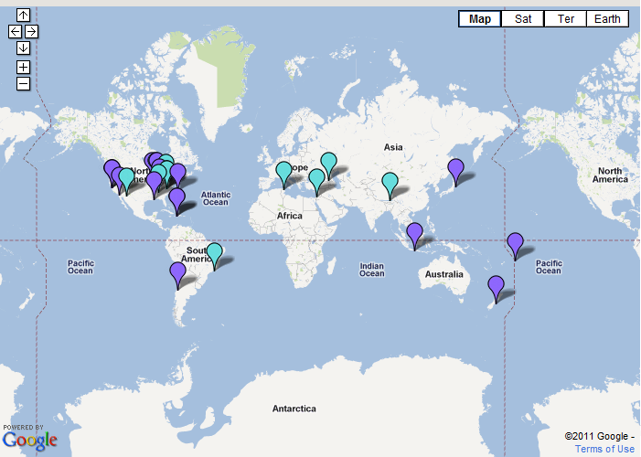
DL Projects
CTRnet (Crisis, Tragedy & Recovery Net)
Disaster Locations

Slide 22
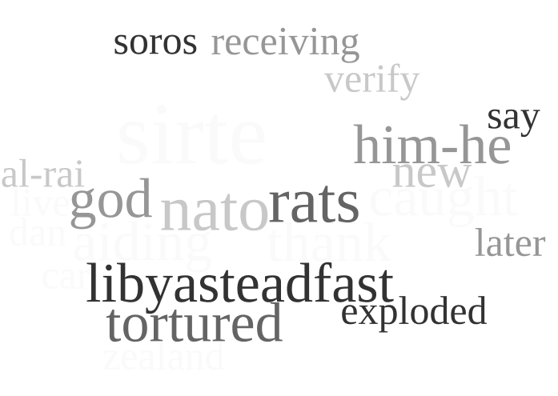
DL Projects
CTRnet (Crisis, Tragedy & Recovery Net)
Word Clouds of Japan Earthquake and Libya Revolution (using tweets)
Japan Earthquake,
Tsunami Disaster
Libya Revolution
Updated every 10 minutes

Slide 23
DL Projects
Ensemble (Computer Science Education)
NSF DUE-0840719
The Ensemble portal provides easy access to:
COLLECTIONS of educational resources hosted by our partners
COMMUNITIES that can create and share documents (within the group or with the public), discuss things on forums, and contribute educational resources.
TECHNOLOGIES that might be useful when you teach (for use in-class and out-of-class).
www.computingportal.org

Slide 24
DL Projects

Slide 25
DL Projects
CINET: Network Science Middleware
NSF SDCI 1032677
The research will develop a cyber infrastructure middleware (CINET) to support Network Science.
CINET will be pervasive, flexible and extensible. Users can contribute new networks, data, methods, hardware, and research results in an integrative way.
CINET will enable new ways by which researchers study and teach complex networks.
http://ndssl.vbi.vt.edu/cinet/

Slide 26
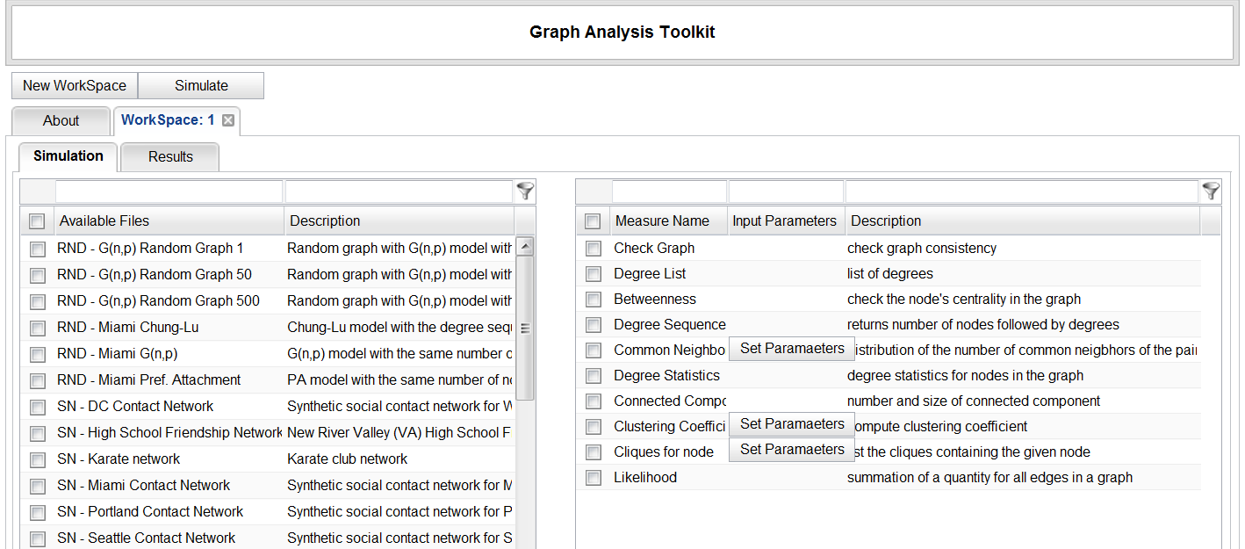
DL Projects
CINET: Network Science Middleware

Slide 27
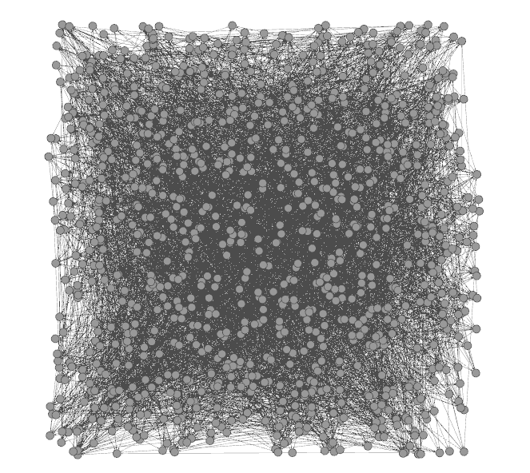
DL Projects
CINET: Network Science Middleware
Netviz: Course project aims to develop a visualization component for CINET which contains large network graphs. The visualization service will get Networks from CINET, convert from Galib to Gexf format, then visualize the graphs using Gelphi.
CINET network displayed using Gephi

Slide 28
Other DL Projects
Establishing a Qatari Arabic-English DL Institute: NPRP 4 - 029 - 1 – 007 pending
Fingerprint Analysis/Distortion/Training DLs
National Inst of Justice, BAE Systems
ETD Analysis, Extraction, Classification

Slide 29
Questions? Discussion?
Thank You!
(fox@vt.edu)

