Slide 1
Crisis, Tragedy and Recovery Network (CTRnet) http://www.ctrnet.net Slides by Kiran Chitturi, Edward A. Fox, and the CTRnet team

Slide 2
CTRnet
3+ year project started in August 2009 with grant from NSF
PI and Co-PIs
Edward A. Fox¹
Andrea L. Kavanaugh¹
Steven D. Sheetz²
Donald J. Shoemaker³
Naren Ramakrishnan¹
¹Dept. of Computer Science
²Dept. of Accounting and Information Systems
³Dept. of Sociology

Slide 3
CTRnet
Research the problem of integrating content, community, and services related to crises, tragedies, and recovery (CTR)
Goals:
Integrating heterogeneous information in a specific domain, making it accessible, and preserving it for long-term reuse;
Extending the scope of digital libraries so they are closely but flexibly coupled with a wide variety of services to support diverse emerging communities; and
Supporting information exploration with advanced methods (Stepping Stones and Pathways (SSP), PathRank, and Storytelling) that facilitate searching, browsing, and discovery
Building a domain specific distributed digital library, integrating information from many sources, with ontology support

Slide 4
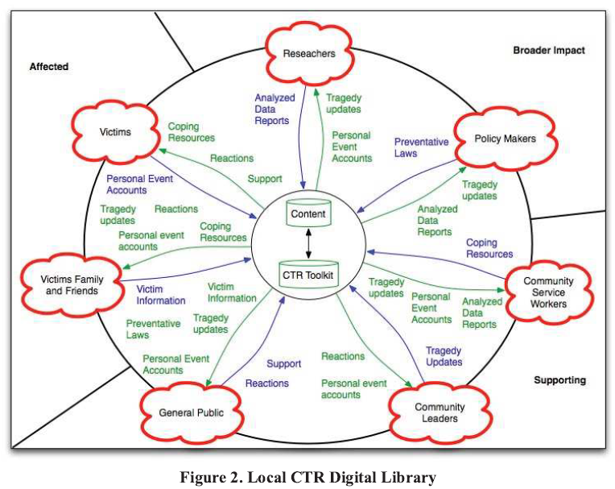
System Stakeholders

Slide 5
Collections archived so far
9.5 TB (45 + archive collections)
87 tweet archives (16 + million tweets)
Types of Collections
Middle East Revolutions
Earthquakes
Floods
School Shootings
Plane Crashes

Slide 6
Current work (CTRnet Digital Library)
Access to the archived data through a digital library.
Archive processing using LucidWorks Big Data Software
30 node cluster, on System G, at Virginia Tech
Cluster, classify and index archives, as well as tweets
Extracting additional metadata using openNLP
Data storage using Hadoop/Hbase
Integrated faceted search across different archive collections

Slide 7
References and Contact Info.
Seungwon Yang, Kiran Chitturi, Gregory Wilson, Mohamed Magdy, and Edward A. Fox.
A Study of Automation from Seed URL Generation to Focused Web
Archive Development: The CTRnet Context.
In Proceedings of the 12th ACM/IEEE-CS Joint Conference on Digital
Libraries (JCDL 2012), Washington D.C., June 10-14, 2012, 4 pages
See http://www.ctrnet.net
Contact information for additional information:
Professor Edward A. Fox, http://fox.cs.vt.edu, fox@vt.edu
540-231-5113

