Slide 1
Information Technology for
Civil Engineering
(Virginia Tech, 30 October 2012)
“Introduction to
Digital Libraries” by Edward A. Fox
fox@vt.edu http://fox.cs.vt.edu
Dept. of Computer Science, Virginia Tech
Blacksburg, VA 24061 USA

Slide 2
Connections with Civil Eng.
6 years as data processing manager for Vulcraft, Division of NUCOR Corp., responsible for steel joist computing
Son Greg Fox is
  VT alum from Civil Engineering (2000)
  Associate with A. Morton & Associates, Inc.
  PE and Rosgen IV certified (including geomorphic channel design)

Slide 3
Acknowledgements
Mentors
  MIT: Licklider, Kessler
  Cornell: Salton
Virginia Tech
  CS
  IT: Digital Library Research Laboratory
NSF and other sponsors
Students, colleagues, co-investigators

Slide 4
For More Information
Magazine: www.dlib.org
Books: http://fox.cs.vt.edu/DLSB.html (1994)
  MIT Press: Arms, plus by Borgman, Licklider (1965)
  Morgan Kaufmann: Witten... (several), Lesk (2nd edition)
Conferences
  ICADL: www.icadl.org
  JCDL: www.jcdl.org
  TPDL: www.tpdl2013.info
Associations
  ASIS&T DL SIG
  IEEE TCDL: www.ieee-tcdl.org (student awards, …)
NSF: http://dli.grainger.uiuc.edu/national.htm, http://www.nsf.gov/pubs/1998/nsf9863/nsf9863.htm
Labs: VT: www.dlib.vt.edu, TAMU: www.csdl.tamu.edu

Slide 5
Informal 5S DL Definition
DLs are complex systems that
help satisfy info needs of users (societies)
provide info services (scenarios)
organize info in usable ways (structures)
present info in usable ways (spaces)
communicate info with users (streams)

Slide 6
Selected DL Projects - 1
Digital Library Curricular Resources
  NSF IIS-0535057 & 0535060
CTRnet (Crisis, Tragedy & Recovery Net)
  NSF IIS-0916733
  Related: water main break visualization
Ensemble (Computer Science Education)
  NSF DUE-0840719 and partners
ETANA (CWRU): NSF IIS-0325579
Digital Preserve (Second Life)
  NSF IIS-0910183 & 0910465

Slide 7
Selected DL Projects - 2
CINET: Network Science Middleware
  NSF SDCI 1032677
  Simulation, Cyberinfrastructure
Secure DLs, Support for Info Security
  MS thesis: Noha Ibrahim Mohamed ElSherbiny
Fingerprint Analysis/Distortion/Training
  National Inst. of Justice, BAE Systems
ETD Analysis, Extraction, Classification
SuperIDR: Microsoft, Fisheries, UNICAMP

Slide 8
DL Curric. Project - 1
NSF awards to VT and UNC-CH
CS and LIS
Project server: http://curric.dlib.vt.edu/
Wikiversity: http://en.wikiversity.org/wiki/Curriculum_on_Digital_Libraries

Slide 9
DL Curriculum Framework

Slide 10
DL Curric. Project - 2
Module 1-a: Frameworks, models, theories, definitions
Module 1-b: History of digital libraries and library automation
Module 2-c: File formats, Transformation, and Migration
Module 3-b: Digitization
Module 3-e: Web publishing
Module 3-f: Crawling

Slide 11
DL Curric. Project - 3
Module 4-b: Metadata
Module 5-a: Architecture overview
Module 5-b: Application software
Module 5-d: Protocols
Module 6-a: Info needs/relevance
Module 6-b: Online information seeking behaviors and search strategies
Module 6-d: Interaction design and usability assessment

Slide 12
DL Curric. Project - 4
Module 7-a: Indexing and searching
Module 7-b: Reference services
Module 7-c: Recommender systems
Module 7-d: Routing
Module 7-g: Personalization
Module 8-a: Preservation
Module 8-b: Web archiving
Module 9-c: Evaluation, user studies
Plus 14 others by VT’s CS grads/ugrads

Slide 13
4 DL Books
Theoretical Foundations (July 2012)
Evaluation and Integration (Jan. 2013)
Technologies (summer 2013)
Applications (summer 2013)

Slide 14
Book 1 (180 pages)
Ch. 1. Introduction
Ch. 2. Exploration
App. A. Mathematical Preliminaries
App. B. Minimal Digital Library
App. C. Archaeological DL
App. D. 5S Results: Lemmas, Proofs, and 5SSuite
App. E. Glossary

Slide 15
Books 3 & 4
Technologies | Applications
Complex Objects | Images
Subdocuments | Education
Ontologies | Social Networks
Classification | E-Science and Simulation
Text Extraction | Geospatial Information
Security

Slide 16
Synchronous
Scholarly Communication
Same time, Same or different place

Slide 17

Asynchronous, Digital Library Mediated Scholarly Communication
Different time and/or place

Slide 18
Digital Libraries --- Objectives
World Lit.: 24hr / 7day / from desktop
Integrated “super” information systems: 5S: Table of related areas and their coverage
Ubiquitous, Higher Quality, Lower Cost
Education, Knowledge Sharing, Discovery
Disintermediation -> Collaboration
Universities Reclaim Property
Interactive Courseware, Student Works
Scalable, Sustainable, Usable, Useful

Slide 19
Locating Digital Libraries in Computing and
Communications Technology Space
Digital Libraries technology
trajectory: intellectual
access to globally distributed information
Communications
(bandwidth, connectivity)
Computing (flops)
Digital content
Note: we should consider 4 dimensions: computing, communications,
content, and community (people)
less
more

Slide 20
Information Life Cycle
Creation
Active
Authoring
Modifying
Social Context
Using
Creating
Organizing
Indexing
Retention
/ Mining
Accessing
Filtering
Storing
Retrieving
Semi-
Active
Utilization
Distributing
Networking
Inactive
Searching
Notes:
This is a simplification of the previous slide.

Slide 21
Digital Libraries
Shorten the Chain from
Author
Editor
Reviewer
Publisher
A&I
Consolidator
Library
Reader

Slide 22
DLs Shorten the Chain to
Roles
Digital
Library
Author
Teacher
User
Reader
Editor
Learner
Reviewer
Librarian

Slide 23
Application Domain | Related Institutions | Examples |  | Technical Challenges | Benefit / Impact
Publishing | Publishers, Eprint archives | OAI |  | Quality control, openness | Aggregation, organization
Education | Schools, colleges, universities | NSDL, NCSTRL |  | Knowledge management, reuseability | Access to data
Art, Culture | Museum | AMICO, PRDLA |  | Digitization, describing, cataloging | Global understanding
Science | Government, Academia, Commerce | NVO, PDG, SwissProt, UK eScience,European Union Commission |  | Data models | reproducibility, faster reuse, faster advance
(e) Government | Government Agencies (all levels) | Census |  | Intellectual property rights, privacy, multi-national | Accountability, homeland security
(e) Commerce, (e) Industry | Legal institutions | Court cases, patents |  | Developing standards | Standardization, economic development
History, Heritage | Foundations | American Memory |  | Content, context, interpretation | Long term view, perspective, documentation, recording, facilitating, interpretation, understanding
Cross-cutting | Library, Archive | Web, personal collections |  | Multi-language, preservation, scalability, interoperability, dynamic behavior, workflow, sustainability, ontologies, distributed data, infrastructure | Reduced cost, increased access, pereservation, democratization, leveling, peace, competitiveness
Reagan Moore
Ed Fox
June
2002
for
NSF

Slide 24
DL Definitions - 1
“A digital library is an organized and focused collection of digital objects, including text, images, video, and audio, along with methods of access and retrieval, and for selection, creation, organization, maintenance, and sharing of the collection.”
Witten & Bainbridge – “How to Build a Digital Library” – Morgan Kaufmann 2003

Slide 25
DL Definitions - 2
“Digital libraries are organizations that provide the resources, including the specialized staff, to select, structure, offer intellectual access to, interpret, distribute, preserve the integrity of, and ensure the persistence over time of collections of digital works so that they are readily and economically available for use by a defined community or set of communities”
Waters,D.J. CLIR Issues, July/August 1998
www.clir.org/pubs/issues/issues04.html

Slide 26
DL Definitions - 3
Issues and Spectra
  Collection vs. Institution
  Content vs. System
  Access vs. Preservation
  “Free” vs. Quality
  Managed vs. Comprehensive
  Centralized vs. Distributed

Slide 27
DL Definitions - 4
NOT a “digitized library”
NOT a “deconstruction” of existing systems and institutions, moving them to an electronic box in a Library
IS a new way to deal with knowledge
  Authoring, Self-archiving, Collecting,
  Organizing, Preserving,
  Accessing, Propagating, Re-using

Slide 29
5S Layers
Societies
Scenarios
Spaces
Structures
Streams

Slide 30
5Ss
Ss | Examples | Objectives
Streams | Text; video; audio; image | Describes properties of the DL content such as encoding and language for textual material or particular forms of multimedia data
Structures | Collection; catalog; hypertext; document; metadata | Specifies organizational aspects of the DL content
Spaces | Measure; measurable, topological, vector, probabilistic | Defines logical and presentational views of several DL components
Scenarios | Searching, browsing, recommending | Details the behavior of DL services
Societies | Service managers, learners, teachers, etc. | Defines managers, responsible for running DL services; actors, that use those services; and relationships among them

Slide 31
5S and DL formal definitions and compositions (April 2004 TOIS)

Slide 32
A Minimal ArchDL in the 5S Framework
Streams
Structures
Spaces
Scenarios
Societies
Descriptive Metadata specification
Structured Stream
services
SpaTemOrg
StraDia
Arch Descriptive Metadata specification
indexing
browsing
searching
ArchObj
hypertext
ArchDO
Arch Metadata catalog
ArchColl
ArchDColl
ArchDR
Minimal ArchDL

Slide 33
ETANA-DL
Archaeological DL
Integrated DL
  Heterogeneous data handling
Applies and extends the OAI-PMH
  Open Archives Initiative Protocol for Metadata Handling
Design considerations
  Componentized
  Extensible
  Portable

Slide 34
ETANA-DL Architecture
DigBase and DigKit
Lahav
D
A
T
A
B
A
S
E
W
R
A
P
P
E
R
S
Search
U
S
E
R
I
N
T
E
R
F
A
C
E
Browse
Nimrin
Recommend
Umayri
ETANA-DL
UNION
CATALOG
Note
Hisban
Personalize
Megiddo
Review
Jalul
Visualizations
Archaeology
Specific
…
New Sites
Work in progress

Slide 35
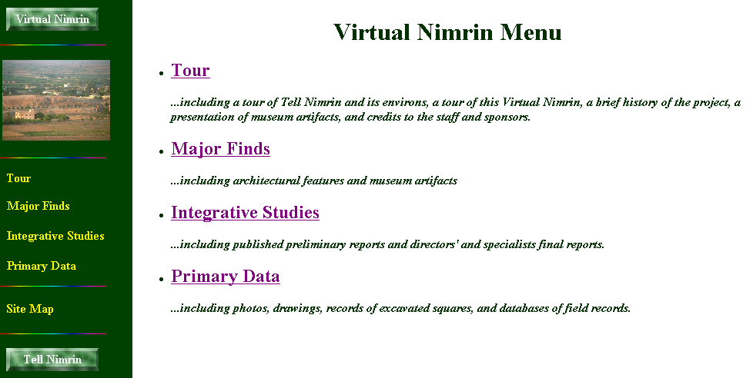

Slide 36
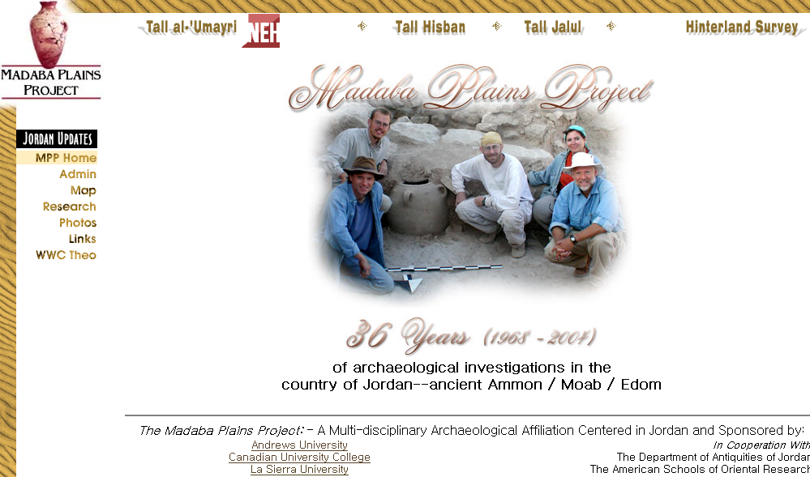

Slide 37
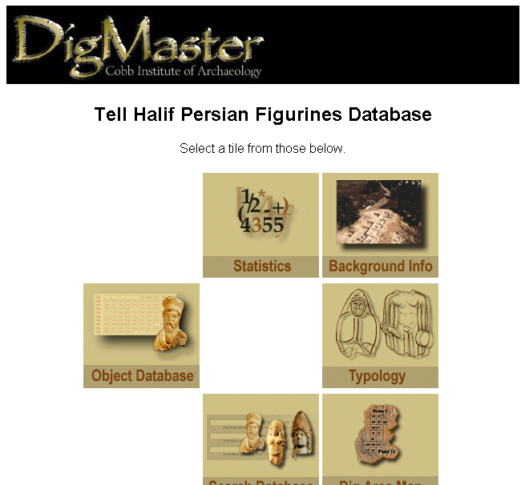
Lahav Website

Slide 38
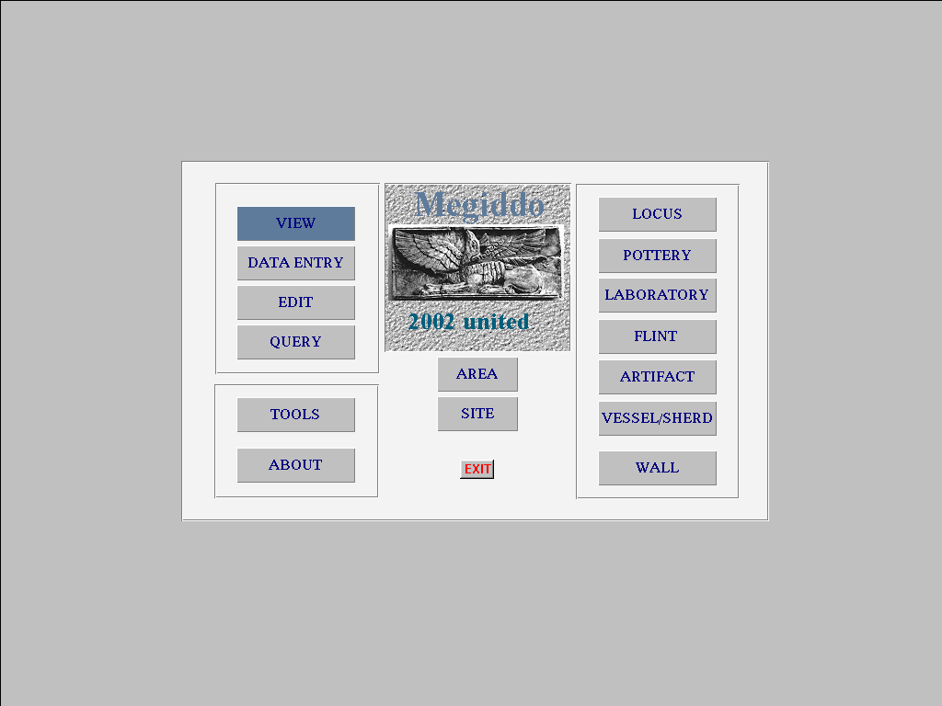
Megiddo Opening Screen

Slide 39
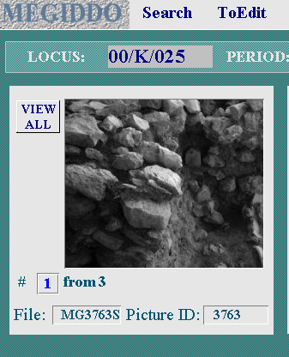
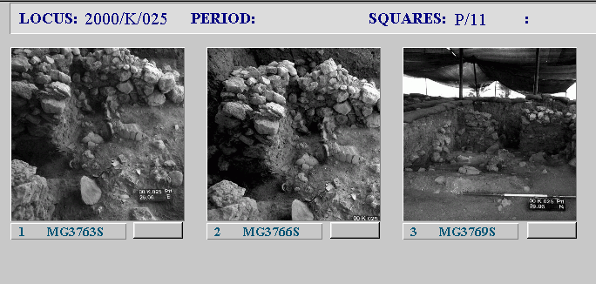
Locus Screen: Pictures
View all

Slide 40
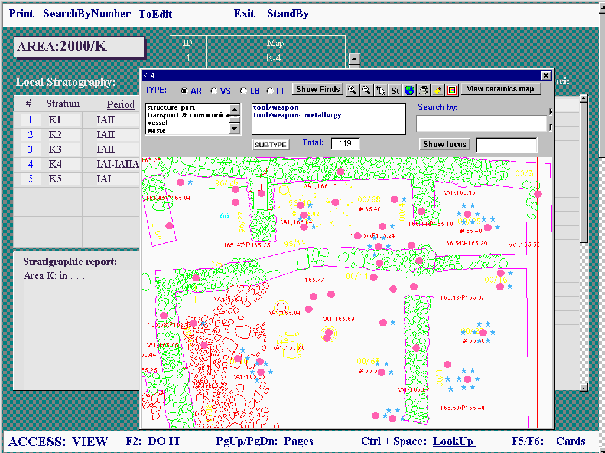
Area Screen

Slide 41
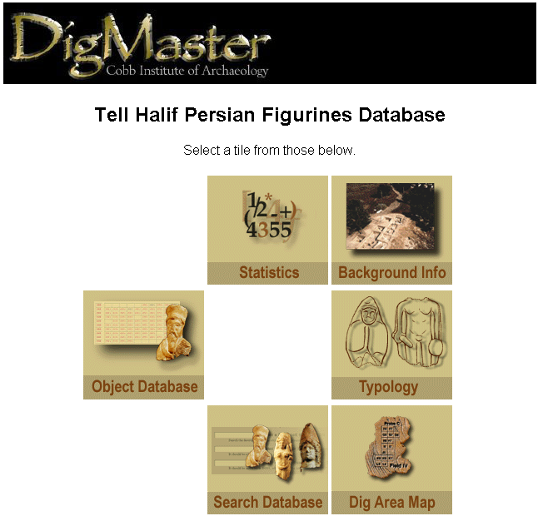
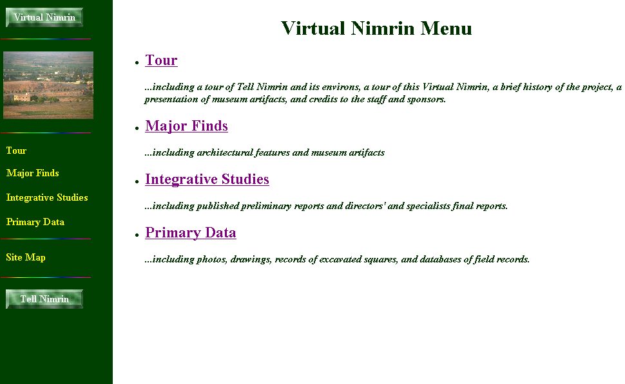
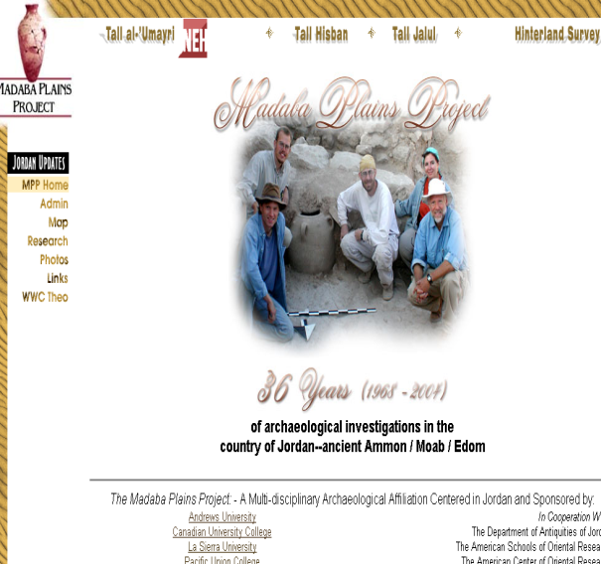
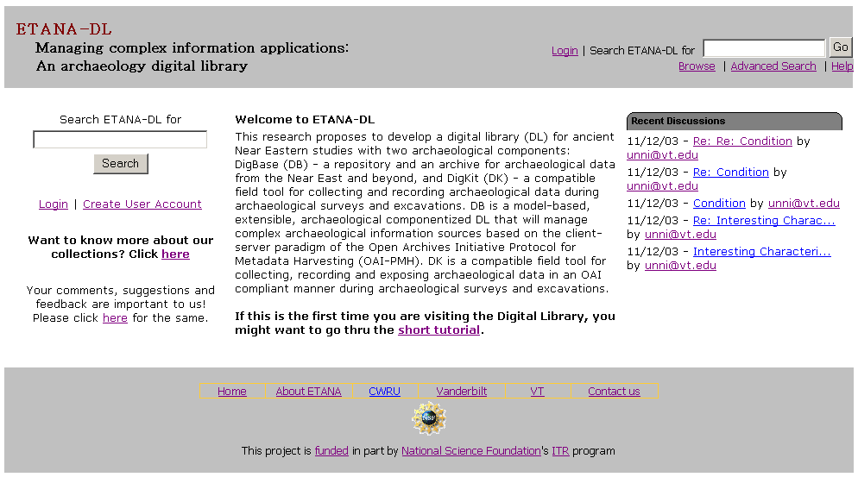

Slide 42
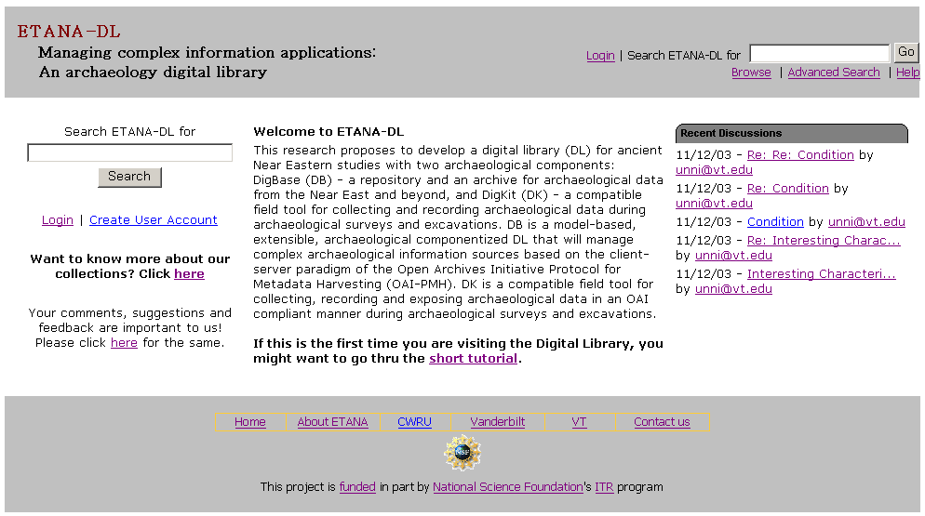
ETANA-DL Website

Slide 43
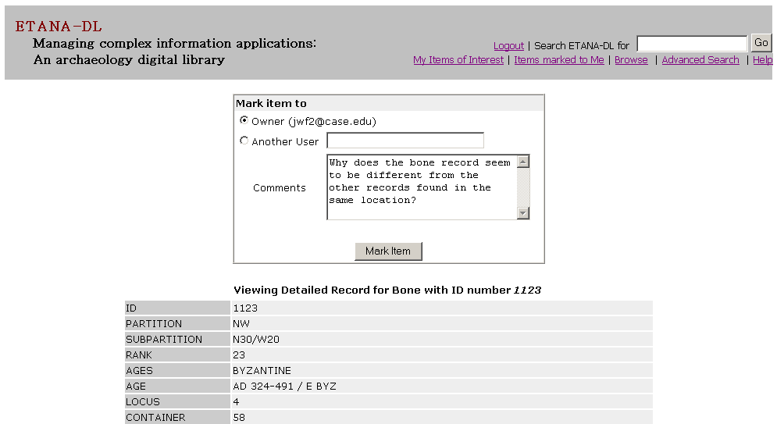
Marking – writing
notes for
a specific user
Marking Items

Slide 44
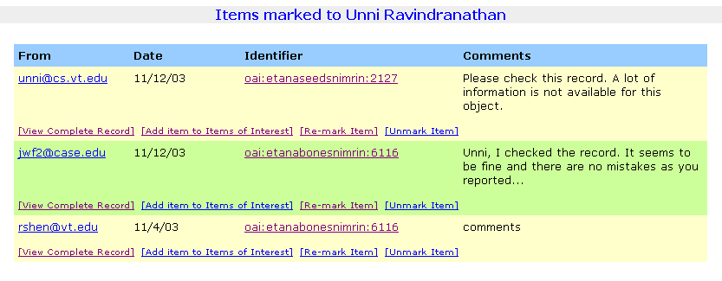
Sender, Date,
Object OAI ID
Sender
Comments
Options:
View Record,
Add record to Items Of Interest,
Re-mark item (Redirect),
Unmark item (Remove item from list)
Marked Items Display

Slide 45
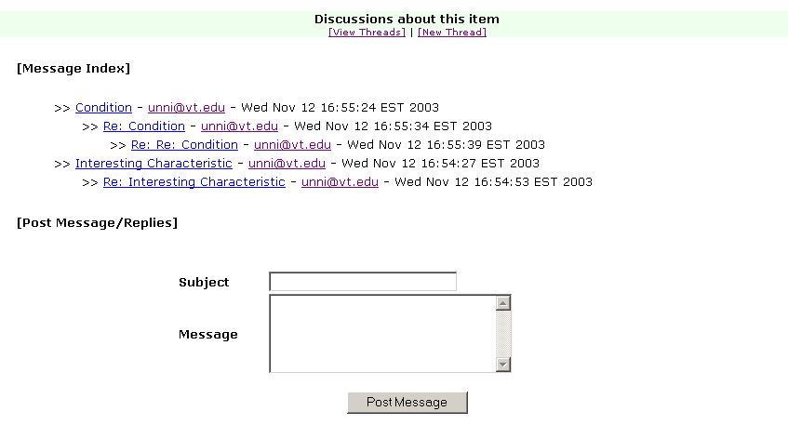
Discussions
about an
object
View/Post
messages,
create new
threads
Discussions Page

Slide 46
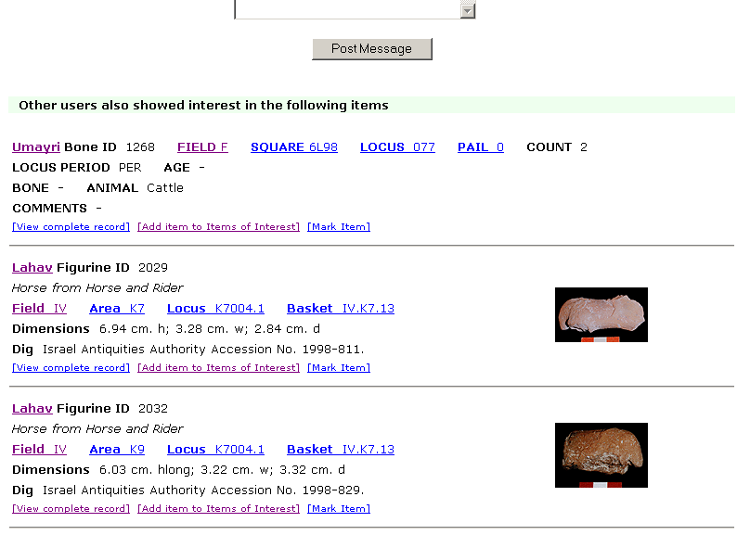
Items recommended
on the basis of
similar interests
Recommendations

Slide 47
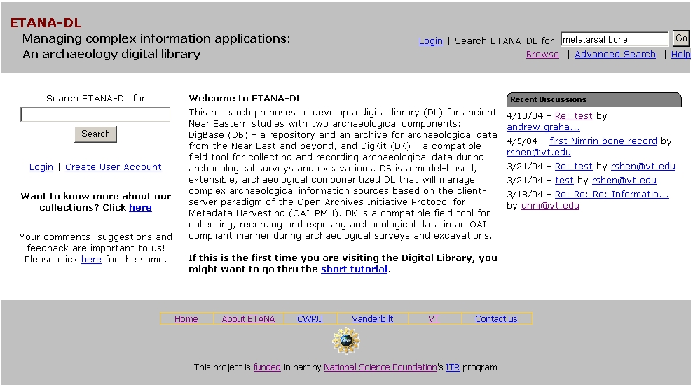
ETANA-DL Searching Service
Search

Slide 48
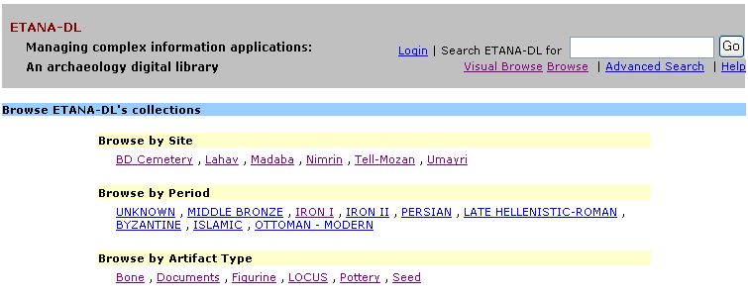
ETANA-DL Multi-dimensional Browsing
3 new sites
2 new types of artifacts

Slide 49
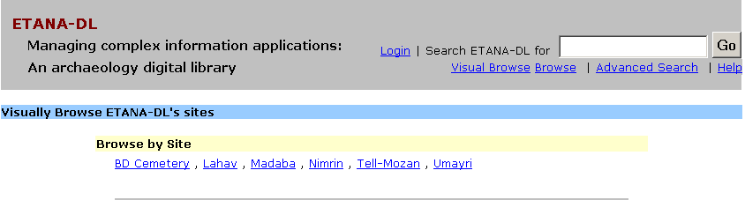
ETANA-DL Visual Browsing Service
Visual Browse
By site

Slide 50
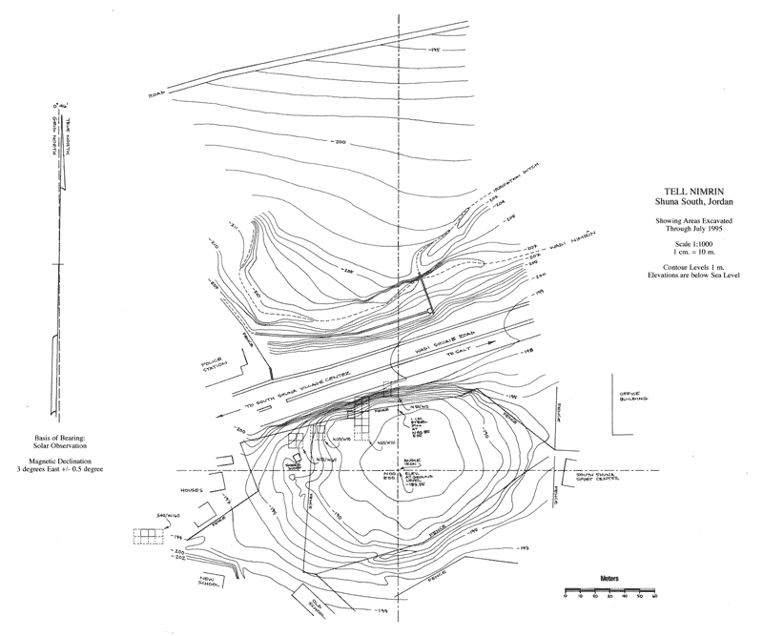
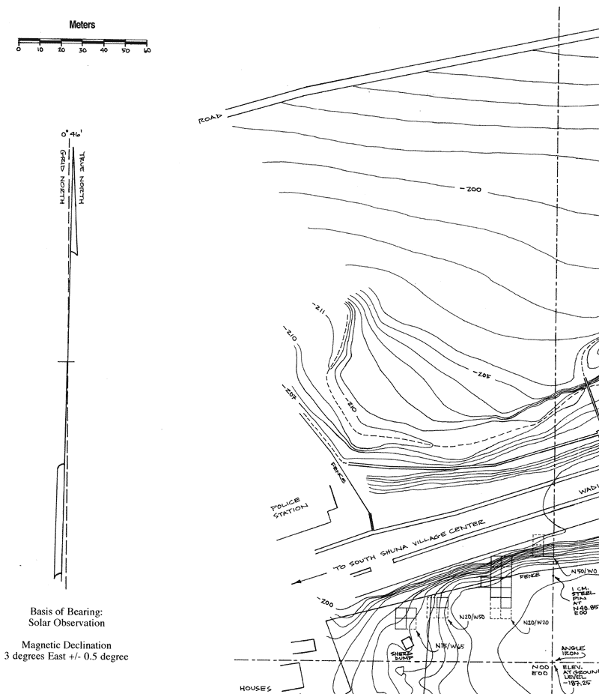
Visual Browsing Nimrin:
Topographical Drawings
Square:
N40/W20
Full site
North west quadrant

Slide 51
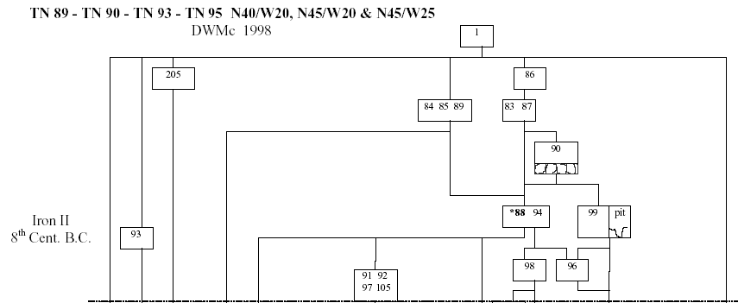
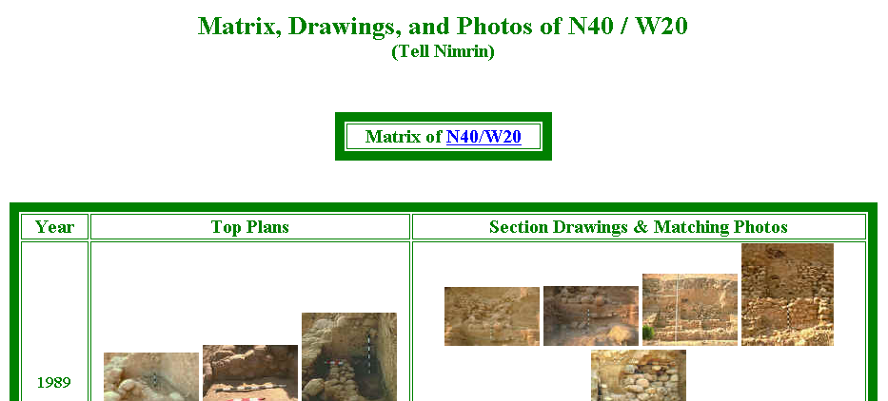
Visual Browsing Nimrin : Square information
Square:
N40/W20
Locus: 86
Loci layout

Slide 52
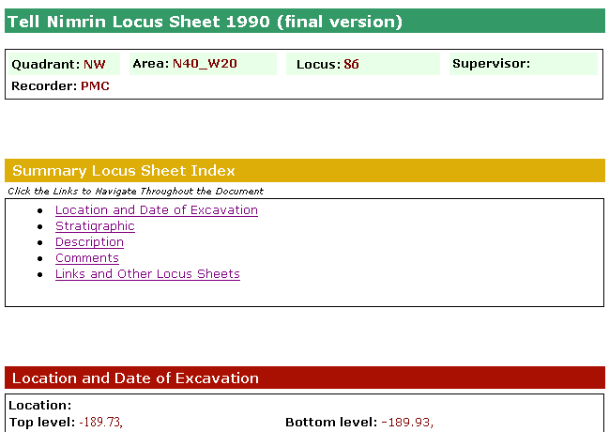
Visual Browsing Nimrin : locus sheet

Slide 53
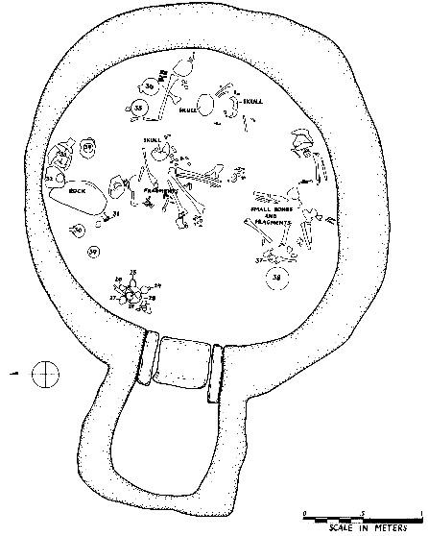
Visual Browsing
Bab edh-Dhra'
Cemetery
Pottery # 25

Slide 54
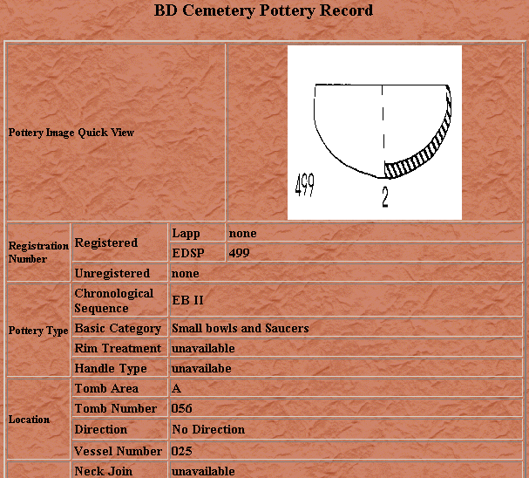
Visual Browsing
Bab edh-Dhra'
Cemetery
Pottery # 25

Slide 55
ETANA Societies - 1
Historic and pre-historic societies (being studied)
Archaeologists (in academic institutes, fieldwork settings, or local and national governmental bodies)
Project directors
Technical staff (consisting of photographers, technical illustrators, and their assistants)
Field staff (responsible for the actual work of excavation)
Camp staff (e.g., camp managers, registrars, tool stewards)
General public (e.g., educators, learners, citizens)

Slide 56
ETANA Societies - 2
Social issues
  Who owns the finds?
  Where should they be preserved?
  What nationality and ethnicity do they represent?
  Who has publication rights?
  What interactions took place between those at the site studied, and others? What theories are proposed by whom about this?

Slide 57
ETANA Scenarios
Life in the site in former times
Digital recording: the planning stage and the excavation stage
Planning stage: remote sensing, fieldwalking, field surveys, building surveys, consulting historical and other documentary sources, and managing the sites and monuments
Excavation
  Detailed information is recorded, including for each layer of soil, and for features such as pole holes, pits, and ditches.
  Data about each artifact is recorded together with information about its exact find spot.
  Numerous environmental and other samples are taken for laboratory analysis, and the location and purpose of each is carefully recorded.
  Large numbers of photographs are taken, both general views of the progress of excavation and detailed shots showing the contexts of finds.
Organization and storage of material
Analysis and hypotheses generation and testing
Publications, museum displays
Information services for the general public

Slide 58
ETANA Spaces
Geographic distribution of found artifacts
Temporal dimension (as inferred by archaeologists)
Metric or vector spaces
  used to support retrieval operations, and to calculate distance (and similarity)
  used to browse / constrain searches spatially
3D models of the past, used to reconstruct and visualize archaeological ruins
2D interfaces for human-computer interaction

Slide 59
ETANA Structures
Site Organization
  Region, site, partition, sub-partition, locus, …
Temporal orderings (ages, periods)
Taxonomies
  for bones, seeds, building materials, …
Stratigraphic relationships
  above, beneath, coexistent

Slide 60
ETANA Streams
successive photos and drawings of excavation sites, loci, unearthed artifacts
audio and video recordings of excavation activities and discussions
textual reports
3D models used to reconstruct and visualize archaeological ruins.

Slide 61
Streams
Text
  Messages
  Communication
Video
  With audio/speech, text captions
Images
  Art, photos
  Image retrieval

Slide 62

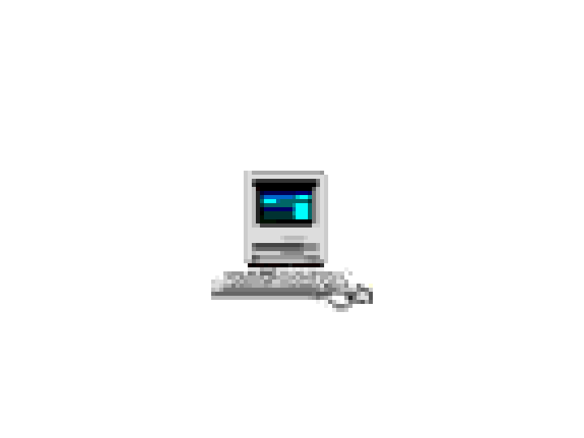

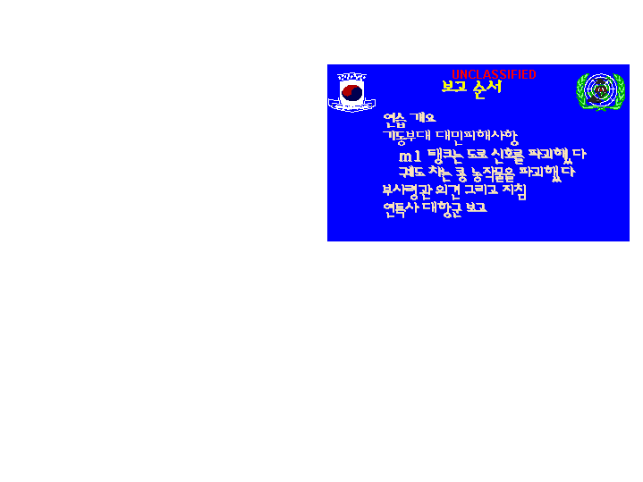
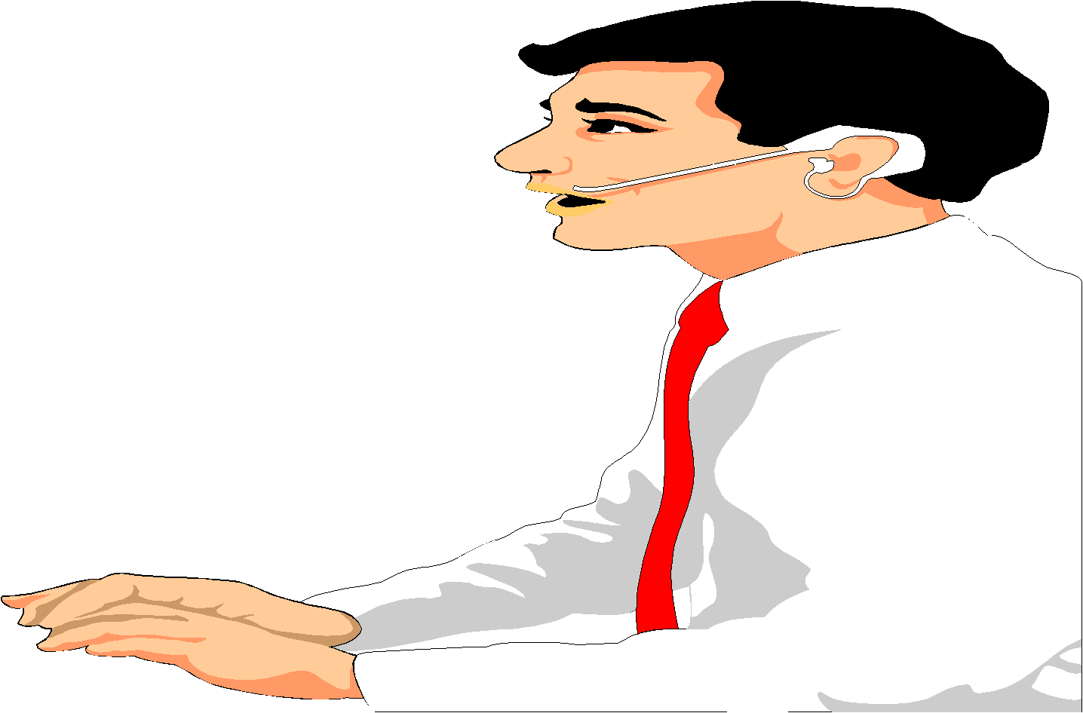

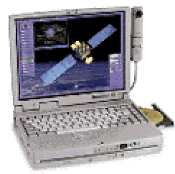
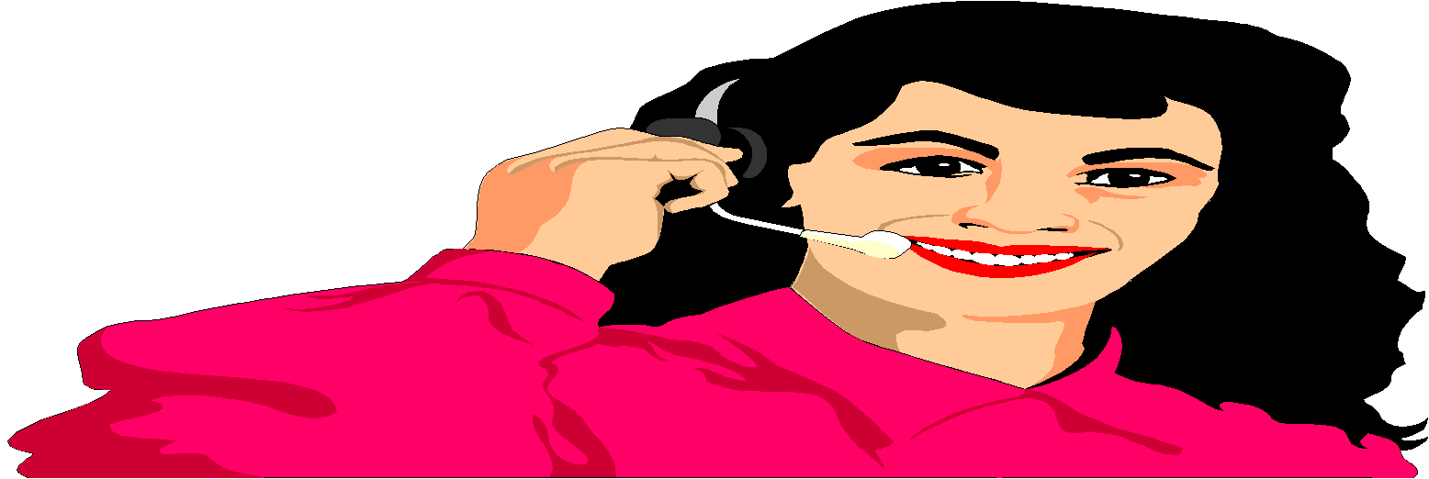
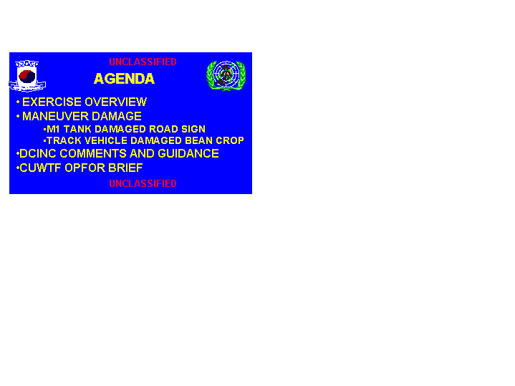
Integrated CCLINC
Translingual Information System
DARPA
CCLINC
SERVER
BugHanI IlBonE Ddo MiSaIlEul
BalSaHan Deus HaDa
Info Detection
2-way
Speech Transation
Extraction
What is the north korean
movement in the front line?
What is the status of nk
missile launch against japan?
Summarization
It seems that North Korea launch a missile again
After North Korea launched a Daipodong missile
last month, NK is perceived to proceed to an additional
test launch. Korea, US and Japan enter into an alert
state, and prepare for a joint response policy. Korea
estimates that the additional launch will be on 09/05.
Japan estimates that NK’s missile range is short. US
information says that there is no sign of launch yet.
Translation

Slide 63
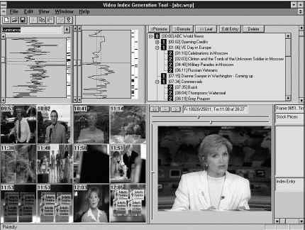
Structured Video Browser
(making video into hypermedia) www.learn.umd.edu
IBrowse
Expository multimedia
Narrative Structures

Slide 64
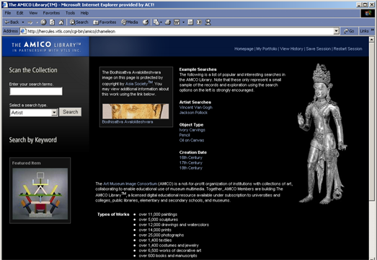
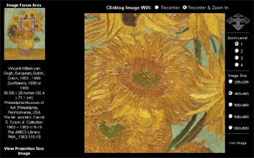
The AMICO Library™

Slide 65
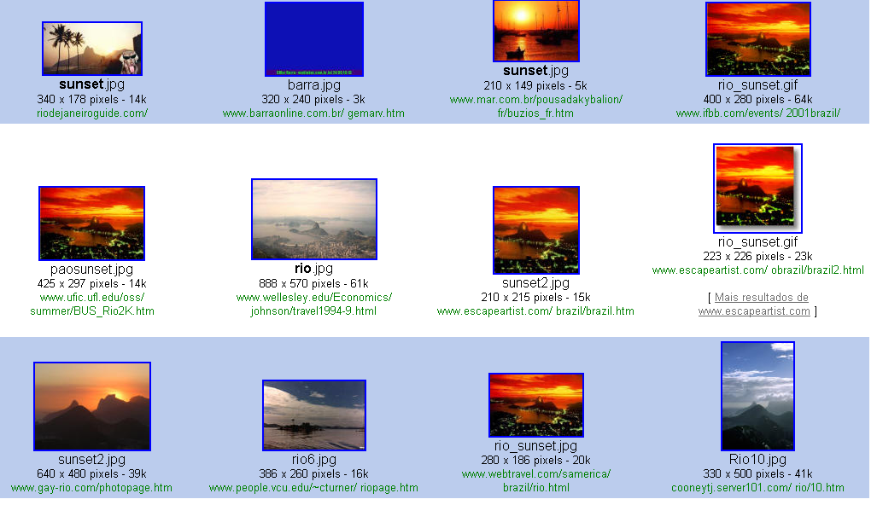
Textual information retrieval
Query on Google using Sunset and Rio de Janeiro
Query result

Slide 66
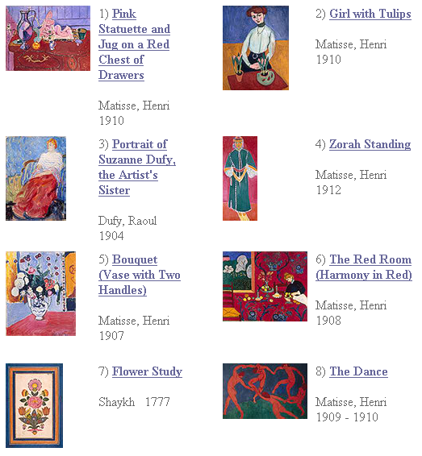
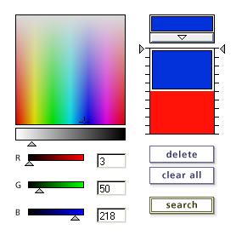
Content Based
Information
Retrieval

Slide 67
Structures
(Where / Degrees)
Web
DLs
DBs
Chaotic
Organized
Structured

Slide 68
Digital Objects (DOs)
Born digital
Digitized version of “real” object
  Is the DO version the same, better, or worse?
  Decision for ETDs: structured + rendered
Surrogate for “real” object
  Not covered explicitly in metamodel for a minimal DL
  Crucial in metamodel for archaeology DL

Slide 69
Metadata Objects (MDOs)
MARC
Dublin Core
RDF
IMS
OAI (Open Archives Initiative), ORE
Crosswalks, mappings
Ontologies
Topics maps, concept maps

Slide 70
Also Important: Epub, SGML, XML
5S perspective: streams, structures, scenarios
Authoring
Rendering, presenting
Tagging, Markup, DOM
Semi-structured information
Dual-publishing, eBooks
Styles (XSL, XSLT)
Structured queries

Slide 71
Databases
5S perspective: structures, streams, scenarios
Extending database technology
Structured and unstructured info
Multimedia databases
Link databases
Performance, transaction processing
Replicated storage, rollback/recovery

Slide 72
Spaces
User interfaces and visualization
  2D interfaces
  3D interfaces
GIS
Mathematical spaces:
  Vector
  Probability

Slide 73
Scenarios
Services (see taxonomy, next)
Services: Information Access
  Searching: ad hoc, filtering/routing
  Browsing: using an organization, using a visualization, using links (i.e., hypertext, hypermedia)
  Workflow: sessions, feedback, etc.
Scenario-based Design
Usability: goals, tasks, claims

Slide 75
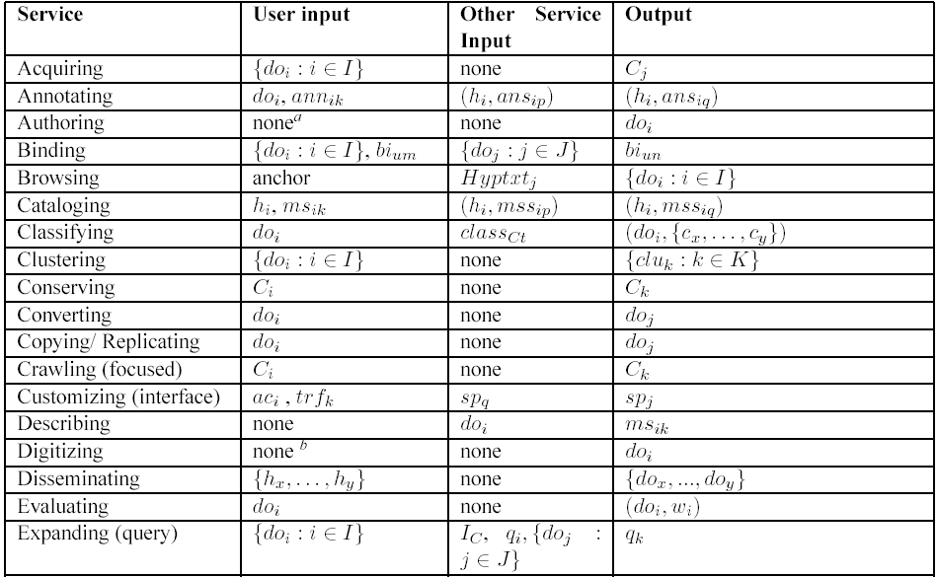
Services Ontology

Slide 76
Societies
User communities
  Authors, editors, teachers, students, readers
  Personal(ization), group(ware), community, global
  Accessibility, universal access
Librarians: reference, acquisition, operations
Research community
  Associations, conferences, publications, labs, projects
Economics
  Copyright, intellectual property rights, digital rights management, authorization, authentication, security, privacy, self-archiving (eprints)
  Publishers, catalogers, distributors, sustainability
  Open source, commercial, hybrid

Slide 78
Higher Level Constructs:
Collections
Terminology: set, “database”
Distributed: basis, efficiency/effectiveness
Parallelism: federation, harvesting
Scale: object size, compression, replication, stream splitting
Intelligence/processing granularity: object, cluster, collection, repository

Slide 79
Higher Level Constructs:
Catalogs
OPACs
Distributed vs. centralized
Coverage, breadth
Specificity, depth
Management: versioning, works

Slide 80
Higher Level Constructs:
Repositories, Archives
Naming, identifiers
Preservation, archives
  LOCKSS, UVC, emulation/migration
Architectures, interoperability
  OAI: harvesting
  SRU/SRW: federation
Scalability, storage

Slide 81
LOCKSS
Lots of copies keep stuff safe
Stanford (Vicky Reich)
Initial focus on lower levels
Initial content: journals
Emory –> N. Texas (Martin Halbert)
  Help deploy and adapt
  Help apply in other contexts
  NDIIP: AmericanSouth, MetaArchive

Slide 82
OAI - Open Archives Initiative
Advocacy for interoperability
Standard for transferring metadata among digital libraries
  Protocol for Metadata Harvesting (PMH)
    Simplicity
    Generality
    Extensibility
Support for PMH => Open Archive (OA)

Slide 83
OAI = Technical Umbrella for
Practical Interoperability…
Metadata Harvesting
Reference
Libraries
Museums
Publishers
E-Print
Archives
…that can be exploited by different communities

Slide 84
OAI – Repository Perspective
Required: Protocol
Set Structure
URI Scheme
MDO
MDO
MDO
MDO
Required: DC
MDO
MDO
MDO
MDO
DO
DO
DO
DO

Slide 85
OAI – Black Box Perspective
OA 7
OA 4
OA 2
OA 3
OA 1
OA 6
OA 5

Slide 86
The World According to OAI
Service Providers
Discovery
Current
Awareness
Preservation
Metadata
harvesting
Data Providers

Slide 87
Institutional Repositories - 1
“Institutional repositories are digital collections that capture and preserve the intellectual output of a single university or a multiple institution community of colleges and universities.”
Crow, R. “Institutional repository checklist and resource guide”, SPARC, Washington, D.C., USA
www.arl.org/sparc/IR/IR_Guide_v1.pdf

Slide 88
Institutional Repositories - 2
“A university-based institutional repository is a set of services that a university offers to the members of its community for the management and dissemination of digital materials created by the institution and its community members. It is most essentially an organizational commitment to the stewardship of these digital materials, including long-term preservation where appropriate, as well as organization and access or distribution.”
Lynch, C.A. In ARL Bimonthly Report 226, pp. 1-7, Feb. 2003, www.arl.org/newsltr/226/ir.html

Slide 89
Systems
Architectures
  Client-server, service-oriented
  P2P, Grid
System descriptions and comparisons
  Personal DLs; Institutional to global
  DSpace, Eprints, Fedora, Greenstone, Kepler
5S Suite: language, visualization, generation, logging

Slide 90
Architectural Issues
Independent system vs. part of federation
Centralized vs. distributed vs. open services
Monolithic vs. modular vs. componentized
Topologies: bus vs. star vs. hierarchical vs. network
Decompositions vary
  search engine, browser, DBMS, MM support
  repository, handle server, client
  information resources + mediators, bus or agent collection + client with workspace/environment

Slide 91
Fedora™ Digital Object Architecture
Persistent ID (
PID
)
Globally unique persistent id
Disseminators
Public view: access methods for obtaining “disseminations” of digital object content
Internal view: metadata necessary to manage the object
System
Metadata
Datastreams
Protected view: content that makes up the “basis” of the object
EAD, TEI, DC, MARC,
VRA Core, MIX, etc.
Images, E-books, E-journals, Music, Video, etc.
The Mellon Fedora Project
Adapted from Slide by V. Chachra, VTLS

Slide 92
Fedora™
Repository
Web Service Exposure Layer
Adapted from Slide by V. Chachra, VTLS

Slide 93
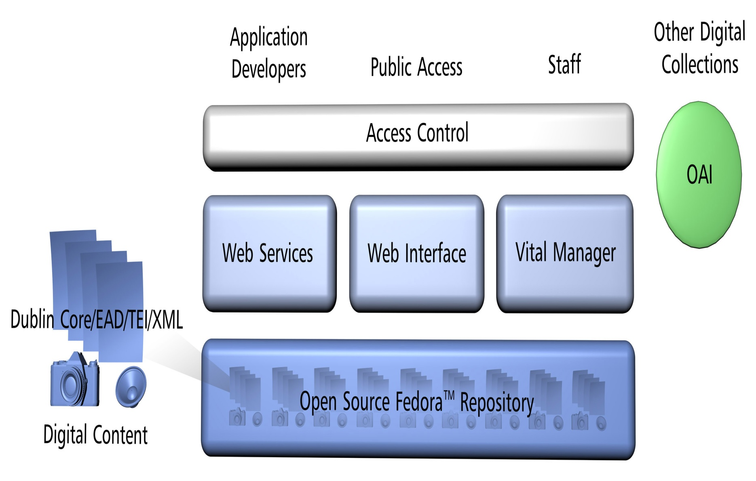
VITAL / Fedora Relationship

Slide 94
Tools/Applications

Slide 95
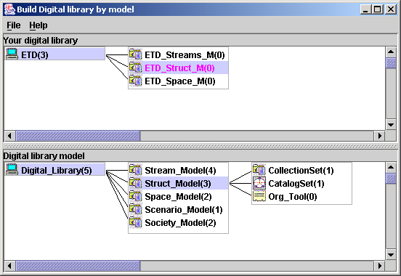
Overview of 5SGraph
Workspace
(instance model)
Structured
toolbox
(metamodel)

Slide 98
5SGen
Version 1 -- MARIAN as the target system
  Focused on rich structures: semantic networks
  Behavior attached to nodes/links
Version 2 -- Shifted for later work to componentized (ODL) approach
  Focused on scenarios/societies
  Structures/Spaces encapsulated within components (e.g., relational tables, indexes)
  Only textual streams supported
Version 3 – Practical DL (w. DSpace) – Doug Gorton

Slide 99
5SLGen – Version 2: ODL, Services, Scenarios

Slide 100
Computing and Information Technology Interactive Digital Educational Library (CITIDEL)
Domain: computing / information technology
Genre: one-stop-shopping for teachers & learners: courseware (CSTC, JERIC), leading DLs (ACM, IEEE-CS, DB&LP, CiteSeer), PlanetMath.org, NCSTRL (technical reports), …
Submission & Collection: sub/partner collections ➔ www.citidel.org

Slide 101
CITIDEL -> NSDL
A collection project in the
National STEM (science, technolgy, engineering, and mathematics) education Digital Library – NSDL
National Science Digital Library
www.nsdl.org
(Next slides courtesy Lee Zia, NSF)
Notes:
3
3

Slide 102
Connects:
Users: students, educators, life-long learners
Content: structured learning materials; large real-time or archived datasets; audio, images, animations; primary sources; digital learning objects (e.g. applets); interactive (virtual, remote) laboratories; ...
Tools: search; refer; validate; integrate; create; customize; publish; share; notify; collaborate; ...

Slide 103
Collections
Discovery of content
Classification and cataloguing
Acquisition and/or linking; referencing
Disciplinary-based themes define a natural body of content, but other possibilities are also encouraged
Access to massive real-time or archived datasets
Software tool suites for analysis, modeling, simulation, or visualization
Reviewed commentary on learning materials and pedagogy

Slide 104
Services
Help services, frequently asked questions, etc.
Synchronous/asynchronous collaborative learning environments using shared resources
Mechanisms for building personal annotated digital information spaces
Reliability testing for applets or other digital learning objects
Audio, image, and video search capability
Metadata system translation
Community feedback mechanisms

Slide 105
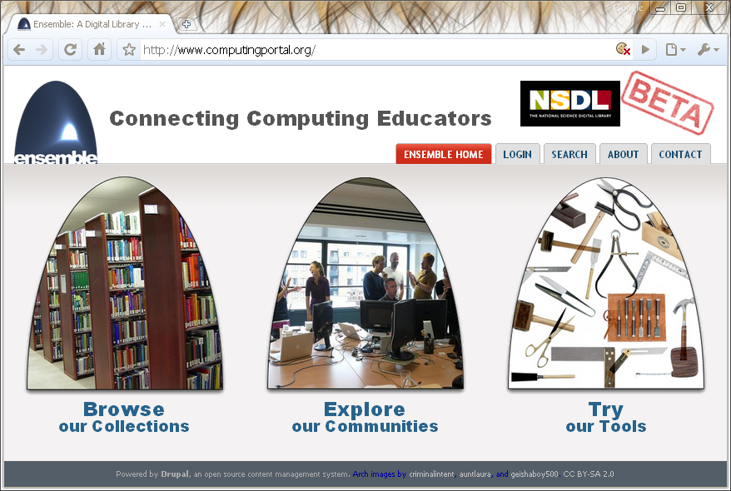
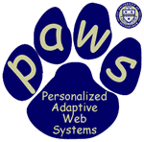




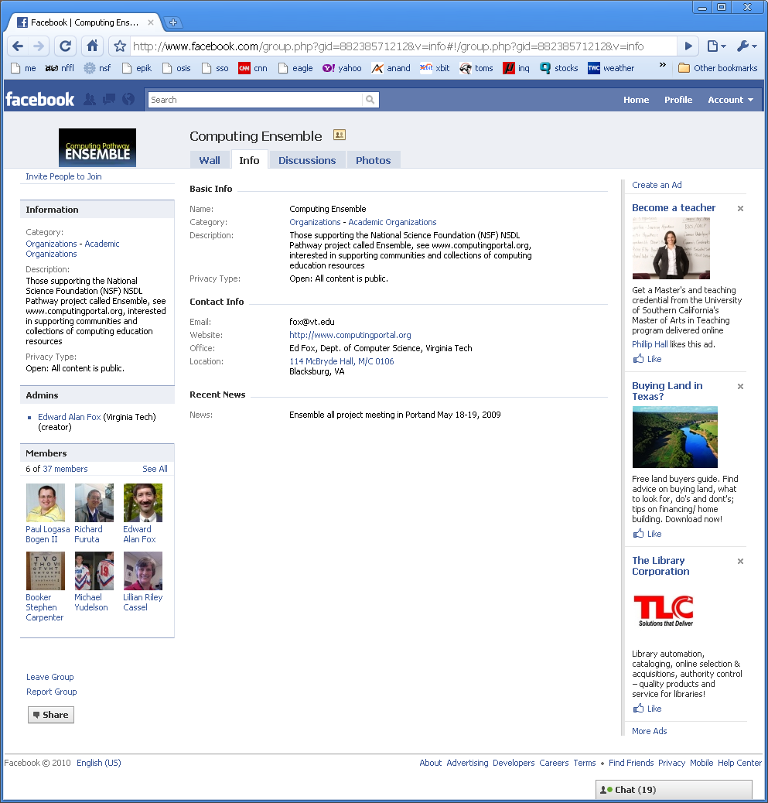
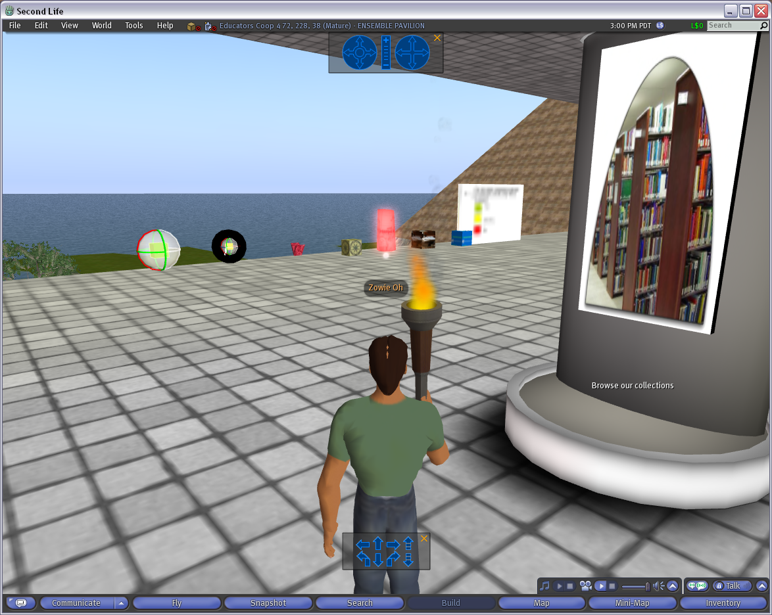
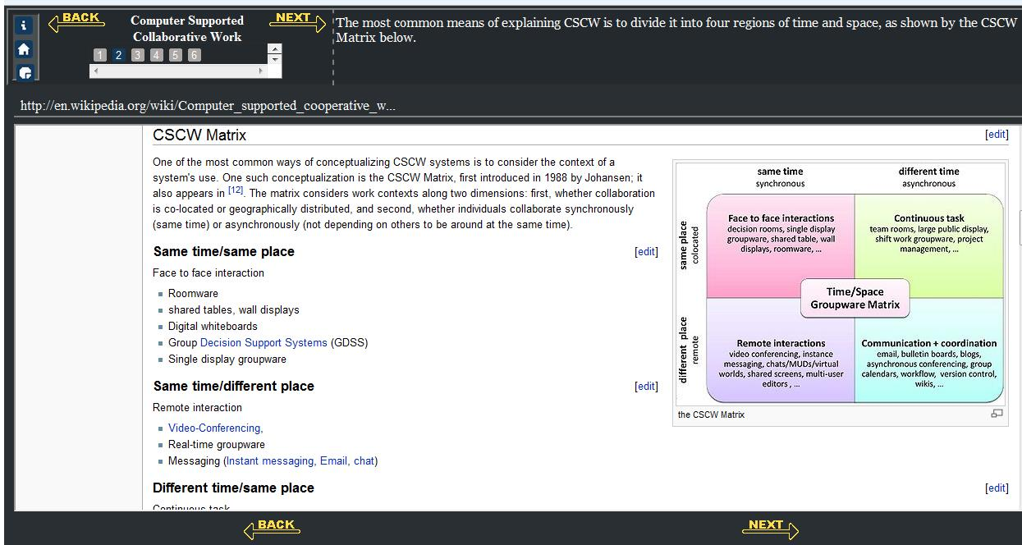
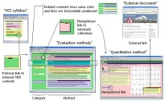



The Ensemble Computing Portal
Many-to-Many Information Connections in a Distributed Digital Library Portal
Collections
Communities
ACM
CS1
FOCES
TECH Developers
Ensemble
LIKES
AP CS
Services
Search
Distributed DL Portal
Forum
Group
Blog
Browse
Notification
Tools
A collaborative research project to build a distributed portal with up-to-date contents for all computing communities.
http://www.computingportal.org/

Slide 106
A Digital Library Case Study
Domain: graduate education, research
Genre:ETDs=electronic theses & dissertations
Submission: http://etd.vt.edu
Collection: http://www.theses.org
Project:
Networked Digital
Library of Theses
& Dissertations
(NDLTD)
http://www.ndltd.org

Slide 107
Student Gets Committee
Signatures and Submits ETD
Approval
form
Signed
Grad School
Notes:
10

Slide 108
Library Catalogs ETD, Access is
Opened to the New Research
WWW
NDLTD
Digital library access control
Notes:
12

Slide 109
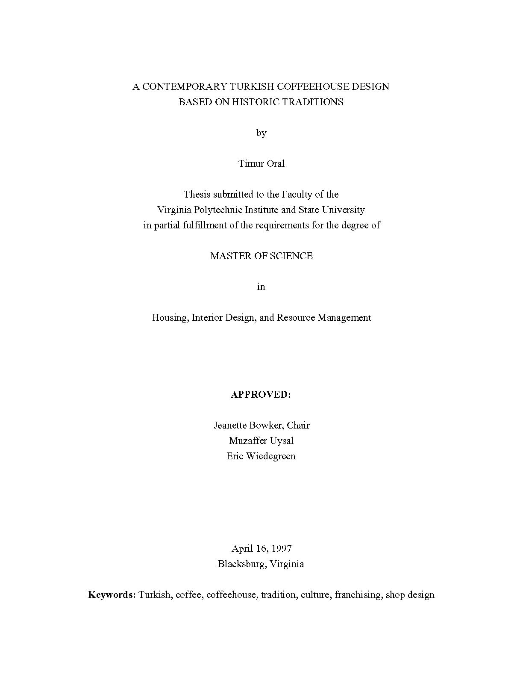
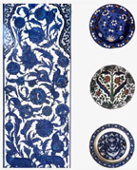
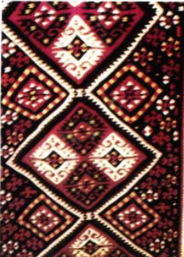
http://scholar.lib.vt.edu/theses/available/etd-2227102539751141/
Notes:
http://scholar.lib.vt.edu/theses/available/etd-2227102539751141/
What is an ETD? What it can look like:
It can have the appearance of a paper document.
It can contain a video clip.
It can contain sound.
It can contain thumbnail pages and links to aid navigation.
It can have a unique layout.
It can have photomicrographs.
It can contain a simulation.
The library resources used in an ETD initiative can include

Slide 110


Slide 111

VTLS Visualizer Service with NDLTD Union Catalog

Slide 112
ETD Classification:
Algorithm Pipeline
ETDs categorized into a node of the category tree (after classification)
Category
Tree
ETD Collection
Category label for each node used as query
ETD metadata used for categorization
Categorized
ETDs
Google
Naïve Bayes Classifiers
Level-wise categorization
Top 50 webpages (for each node in the tree)
Training
Browsing
Web
Interface
Document
Sets
Training
Sets
Cleanup
(stemming,
stopword removal,
etc.)

Slide 113

Crisis, Tragedy, and Recovery
Human tragedies that result from man-made and natural events affect humans and communities significantly (Hurricane Sandy)
During and after a tragic event, there are a series of needs that have to be addressed.
  Compounded by communication failures and a confusing plethora of data and information

Slide 114

Build a networked digital library relating to CTR
www.citeulike.org group ctrnet
Citations
Papers, …
Integrate community, content, and services relating to CTR, making it accessible, and preserving it for long-term reuse
Support information exploration
Aided by an ontology
www.ctrnet.net

Slide 115

CTR stakeholders
Notes:
Help affected communities to recover more quickly and effectively
Provide global network with relevant information and resources
Support the research community, emergency personnel, decision makers, and the public in reacting to and recovering from crises

Slide 116

Haiti Photographs, Content Based Image Retrieval Evaluation

Slide 117

Categories from focus group study
Results from focus group interviews following the April 16, 2007 tragedy at Virginia Tech

Slide 118
CTR keyword pairs
Extracted top keyword pairs from ISCRAM proceedings using the N-gram statistics package
emergency response | decision support | information systems | teams participants
decision making | data models | disaster monitoring | teams maps
command teams | disaster plan | crisis management | sms text-message
flood alerts | information seeking | situational awareness | disaster registry
physical communication | human disaster | teams access | decision preference
Notes:
International Conference on Information Systems for Crisis Response and Management

Slide 119
Hypothesis of school shooting
Immigration
Socially Different
Victim of Bullying
Isolation
Psychological Impact
School Impact
Out come
Keywords
Migration Geographical movement
Relocation
Keywords
Social Outsider
Social Stranger
Keywords
Homophobia Gay Taunts
Keywords
Rejection Seclusion
Keywords
Depression Frustration Anxiety Anger Aggression Stress Loneliness Low Self-esteem
Keywords
Truancy Poor Academic Performance
Low Grades School Drop-out
E.g., Any relations between
Violence and Migration?
Male
Female
Keywords
Delinquency Violence Fighting Masculinity Assault School Shooting
Keywords
Suicide Ideation Suicide Attempt Suicide

Slide 120
DL Integration
What is “DL Integration”
  Hide distribution
  Hide heterogeneity
  Enable autonomy of individual component
Why Integration
  island-DLs
  inability to seamlessly and transparently access knowledge across DLs
Utilize various autonomous DLs in concert

Slide 121
Formal Definition of DL Integration
DL_{i}=(R_{i}, DM_{i}, Serv_{i}, Soc_{i}), 1 i n
  R_{i} is a network accessible repository
  DM_{i} is a set of metadata catalogs for all collections
  Serv_{i} is a set of services
  Soc_{i} is a society
UnionRep
UnionCat
UnionServices
UnionSociety

Slide 122
Architecture of a Union DL
DL1
Union DL
DL2
Union Society
Society
☺ ☺ ☺ ☺
Society
☺ ☺
☺ ☺
archaeologists
Archaeologists
General Public
General Public
Union Service
Service
Service
Searching
Harvesting, Mapping,
Searching, Browsing,
Clustering, Visualization
Browsing
Catalog1
Union
Catalog
Catalog2
Union
Repository
Repository1
Repository2

Slide 123
Union Catalog Integration
Mapping
Tool
Virtual Nimrin
(VN)
VN Metadata
Format
Union ArchDL
Union
Catalog
VN
Catalog
Wrapper
Global Metadata
Format
Halif DigMaster
(HD)
HD
Catalog
Wrapper
HD Metadata
Format
Mapping
Tool

Slide 124

local schema
global schema
Notes:
To invoke the mapping tool:
Double click the “run.bat” under the fold “schemamapper” which is extracted from schemapper.zip
File→ Open: “cemetery.xsd” under the fold “schemamapper” which is extracted from schemapper.zip
a local schema will display on the left
File→ Open: “etana1.1..xsd” under the fold “schemamapper” which is extracted from schemapper.zip
a global schema will display on the right

Slide 125

Mapping confirmation
Mapping history
Notes:
left click the suggested element on the global schema to confirm the mapping, then two mapped elements will display in the same color (pink?)
A mapping history will display at the bottom of the window
remove mapping: you can right click the element on the local schema, right click then click “Removing Mapping”

Slide 126
ArchDL Expert
5S Archaeology
MetaModel
ArchDL Designer
5SGraph
VN Metadata Format
HD Metadata Format
Scenario
Sub-model
ETANA-DL Metadata Format
ETANA-DL
Union Services
Descriptions
Harvesting
Mapping
Searching
Browsing
…
Structure
Sub-model
VN
Catalog
HD
Catalog
Mapping Tool
Wrapper4VN
Wrapper4HD
Inverted Files
XOAI
Search
Service
Web Interface
Index
Union
Catalog
Browse DB
Index
Browse
Service
Component
Pool
5SGen
Services DB
Other
ETANA-DL
Services
Browsing
XOAI
…

Slide 127

Digital Library Reference Model 1.0 p. 30 of 234

Slide 128
Quality and the Information Life Cycle

Slide 129
SimDL: A Model Ontology Driven Digital Library for Simulation Systems
Jonathan Leidig
Edward A. Fox
Kevin Hall
Madhav Marathe
Henning Mortveit
JCDL: June 13-17, 2011, Ottawa, Canada
Network Dynamics and
Simulation Science Laboratory
Digital Library Research Laboratory (DLRL) @ Virginia Tech

Slide 130




Domain: Computational Epidemiology
NIH: infectious diseases
Gates Foundation: malaria modeling
Model diseases and populations
Study of the health of a population - simulate epidemics
Test public policies, interventions, adaptive behavior, economics
Network Dynamics and
Simulation Science Laboratory
Digital Library Research Laboratory (DLRL) @ Virginia Tech

Slide 131





Simulation Community Goals
Integrate isolated models
Manage and expose simulation content
Link and workflow models and content
Minimize domain-expert contributions
Network Dynamics and
Simulation Science Laboratory
Digital Library Research Laboratory (DLRL) @ Virginia Tech

Slide 132
Prototypes
Cyberinfrastructure
Communication
SimDL
Simulation
Models
Analyses
Computational
Platforms
Interfaces
Swiss Tropical Institute
  Malaria simulation models
Virginia Bioinformatics Institute
  Disease and network models
Network science cyberinfrastructure
  Network simulation & analysis
Network Dynamics and
Simulation Science Laboratory
Digital Library Research Laboratory (DLRL) @ Virginia Tech

Slide 133




Use of Subimages in Fish Species Identification: A Qualitative Study
15 June 2011
JCDL Ottawa
http://umurthy.com/research/superidr
Uma Murthy
Eric Hallerman
Edward Fox
Manuel Perez-Quinones
Lin Tzy Li Ricardo Torres
Lois Delcambre
Notes:
INTRODUCE YOURSELF
Say title
Part of Uma Murthy’s dissertation work
Acknowledge Dr. Fox’s presence
>

Slide 134

Scenario
While learning how to identify fish, a student might make use of an advanced query that involves searching for subimages, in context of other information, incl. other subimages:
Find me species that are darters that have a dorsal fin that looks like this, which is connected to another dorsal fin that looks like this, which might has an orange-colored edge
Notes:
Consider a scenario where a student is making use of an advanced query to search for a species.
She makes use of images and text to describe her query.
In this scenario, she is looking for a species of the darter family and one that has a dorsal fin <CLICK> connected to another dorsal fin <CLICK>, which has an orange-colored edge <CLICK>.
Thus she is looking for a species from a specific family of fishes and which has three parts that are connected as described.

Slide 135
Searching for such fine-grain contextual information is not supported by current DLs
Darter
Find me species that are darters that have a dorsal fin that looks like this, which is connected to another dorsal fin that looks like this, which might have an orange hue on its edge
Two dorsal fins connected
Orange edge
Notes:
Such searching is not currently supported by DLs.
The student is looking for an digital object with some metadata property, which is the family of darters and which in turn contains other objects (images), which in turn contain the specific parts and are associated that need to be present together. i.e. she is looking for a species that has two dorsal fins connected that look like the subimages shown. with textual descriptions as described.
Since subdocuments are not described and stored separately, they are not indexed and cannot be explicitly searched for.

Slide 136


Superimposed information (SI) enables working with contextualized subdocuments
superimposed (new) information
base (existing) information
Notes:
To help work with subdocuments in a DL, we bring in the notion of superimposed information.
Superimposed information enables working with parts of documents, while retaining the original information context of that subdocument/part. So we can work with the tail fin of a fish in the context of the whole fish image.

Slide 137

Task: fish species identification
Involves working with parts of fishes and fish images
1a Paired fins absent; jaws absent, mouth in an oral
disk (the disk mostly surrounded by a fleshy hood
in larvae); 7 external gill openings present in row
behind eye .......... Lampreys - Petromyzontidae p. ooo
1b Paired fins present (at least 1 set); jaws present;
1 external gill opening per side ................................... 2
2a Caudal fin heterocercal or abbreviate heterocercal
(Figure 5) ............................................................ 3
2b Caudal fin protocercal (Figure 13, Part 2, upper left)
or homocercal (Figure 5) ............................................ 6
Dichotomous keys
Personal Notes
Notes:
Test the SuperIDR-> choose fish
“specimen”
Our next step was to test SuperIDR, our prototype SI-DL in a scholarly task and how SuperIDR would support that scholarly task
Chose fish species identification as it inherently involves working with parts of fishes and fish images.
In fish identification, one is given an unknown fish specimen (TOP). Various fish ID materials such as a dichotomous key, text books, annotated pictures, and personal notes are used to identify the species of the unknown fish specimen. In most cases, a combination of these materials are used.
IF TIME PERMITS OR SOMEONE ASKS
There are various fish ID methods, but typically focus on distinguishing characteristics, dealing with descriptions of parts of the fish.
Dichotomous keys are akin to decision trees, where at each node a question is asked and depending on the answer, further questions are asked till one arrives at the species. Students might make notecards to study about species, which they might later use to identify the species.

Slide 138

SuperIDR: species details interface
Notes:
1. Customized SuperIDR to work with fish data and images.
2. Slide shows the details of a species, with a description of the species, all its images, subimages on each image and associated annotations.

Slide 139


Color:
Red spots or bars, some blue bars
Location:
Eyes almost on top of head
Notes:
Top-right: has to do with color of the part
Bottom-left: describes the location of a part

Slide 140


Morphological comparison:
Tail fins with pointed lobes about equal in length
Connection/relationship:
Dorsal fins connected
Notes:
Both these are examples of description of multiple parts:
Top-right: In these kinds of subimages, comparison of size of a part or a ratio
Bottom-left: Subimage/annotation shows a connection between two parts

Slide 141

Comparing similar species
(manual inspection)
Notes:
SuperIDR has a comparison feature, which allows a user to pull up two images side by side and browse through their subiamges and associated annotations.
This was especially useful because all participants wanted to manually inspect and analyze images/subimages.
Even if the search result returned the correct species as the topmost one, they would still want to browse through similar species just to make sure they had got it right. They would analyze and look at similarities and differences – for example in this case, one tail is forked whereas another has a slightly forked edge, etc.

Slide 142


SuperIDR: combined search
Query interface
Search results
Notes:
Before showing an example of how subimages were used in the query interface, I will describe the combined search function in SuperIDR
In this search interface, a user might specify a query using images and text. Further, they can mark-up part of the image and use that subimage as the query.
In the text part they can give keywords and search on annotations, descriptions of species, or both.
Search results are organized by images and by subimages/annotations.

Slide 143

SuperIDR architecture

Slide 144


Slide 145
Questions?
Discussion?
Thank You!

