Slide 1
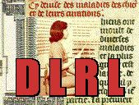
Digital Library Research Laboratory Torgersen Hall 2030 – www.dlib.vt.edu by: Edward A. Fox Sherif H. Elmeligy
fox@vt.edu http://fox.cs.vt.edu
Dept. of Computer Science, Virginia Tech
Blacksburg, VA 24061 USA

Slide 2
Contents
Digital Library Overview
Digital Library Projects
Co-Authored Publications
Grants
Areas of Research and Teaching
DL Book Draft

Slide 3
Introduction - Information Life Cycle
Creation
Active
Authoring
Modifying
Social Context
Using
Creating
Organizing
Indexing
Retention
/ Mining
Accessing
Filtering
Storing
Retrieving
Utilization
Semi-
Active
Distributing
Networking
Inactive
Searching
Notes:
This is a simplification of the previous slide.

Slide 4
Degree of Structure
Introduction
Web
DLs
DBs
Chaotic
Organized
Structured

Slide 5
Informal 5S & DL Definitions
Introduction
DLs are complex systems that:
help satisfy info needs of users (societies)
provide info services (scenarios)
organize info in usable ways (structures)
present info in usable ways (spaces)
communicate info with users (streams)

Slide 6
Introduction

Slide 7
For More Information (Examples)
Introduction
Magazine: www.dlib.org
Books: Online: Fox, http://fox.cs.vt.edu/DLSB.html (1993)
MIT Press: Licklider (1965), Arms (1999), Bishop (2003), Borgman (2003, 2010), Morgan Kaufmann: Witten... (several), Lesk (2nd edition)
Conferences
TPDL: www.tpdl2011.org
ICADL: www.icadl.org
JCDL: www.jcdl.org
Associations
ASIS&T DL SIG: www.asis.org/SIG/dl.html
IEEE TCDL: www.ieee-tcdl.org
NSF call: www.nsf.gov/pubs/1998/nsf9863/nsf9863.htm
Labs: VT: www.dlib.vt.edu, TAMU: www.csdl.tamu.edu/

Slide 8
DLs Shorten the Chain to
Introduction
Roles
Digital
Library
Author
Teacher
User
Reader
Editor
Learner
Reviewer
Librarian

Slide 9
Why of Global Interest?
Introduction
National projects can preserve antiquities and heritage: cultural, historical, linguistic, scholarly
Knowledge and information are essential to economic and technological growth, education
DL - a domain for international collaboration
wherein all can contribute and benefit
which leverages investment in networking
which provides useful content on Internet & WWW
which will tie nations and peoples together more strongly and through deeper understanding
Notes:
3
3

Slide 10
Introduction
DL Challenges
Benefits
Application Domain | Related Institutions | Examples |  | Technical Challenges | Benefit / Impact
Publishing | Publishers, Eprint archives | OAI |  | Quality control, openness | Aggregation, organization
Education | Schools, colleges, universities | NSDL, NCSTRL |  | Knowledge management, reuseability | Access to data
Art, Culture | Museum | AMICO, PRDLA |  | Digitization, describing, cataloging | Global understanding
Science | Government, Academia, Commerce | NVO, PDG, SwissProt, UK eScience,European Union Commission |  | Data models | reproducibility, faster reuse, faster advance
(e) Government | Government Agencies (all levels) | Census |  | Intellectual property rights, privacy, multi-national | Accountability, homeland security
(e) Commerce, (e) Industry | Legal institutions | Court cases, patents |  | Developing standards | Standardization, economic development
History, Heritage | Foundations | American Memory |  | Content, context, interpretation | Long term view, perspective, documentation, recording, facilitating, interpretation, understanding
Cross-cutting | Library, Archive | Web, personal collections |  | Multi-language, preservation, scalability, interoperability, dynamic behavior, workflow, sustainability, ontologies, distributed data, infrastructure | Reduced cost, increased access, pereservation, democratization, leveling, peace, competitiveness
June
2002

Slide 11
DL Curriculum Framework
Introduction

Slide 12
DL Projects
Digital Library Curricular Resources
NSF IIS-0535057 & 0535060
Builds upon a collaboration between Virginia Tech and the University of North Carolina, Chapel Hill.

Slide 13
DL Projects
CTRnet (Crisis, Tragedy & Recovery Net)
NSF IIS-0916733
Provides a range of services relating to different kind of tragic events.
Collect and archive different types of CTR related information such as Web sites, videos, blogs and tweets.
Various collections about school shootings and natural disasters have been developed from collaboration with the Internet Archive.
www.ctrnet.net

Slide 14
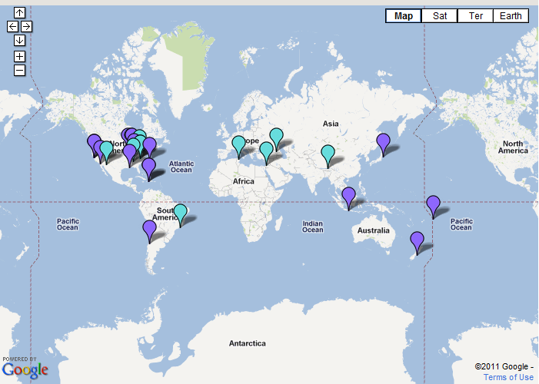
DL Projects
CTRnet (Crisis, Tragedy & Recovery Net)
Disaster Locations

Slide 15
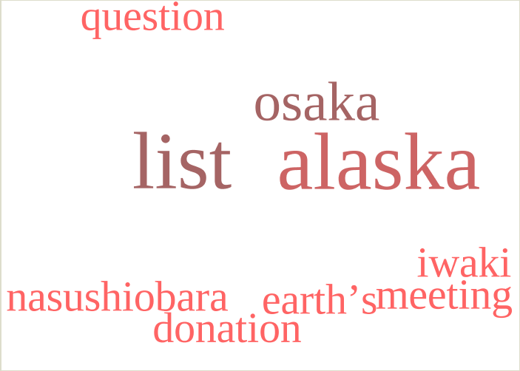
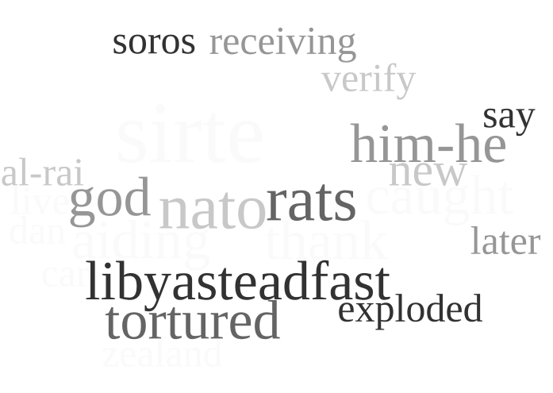
DL Projects
CTRnet (Crisis, Tragedy & Recovery Net)
Word Clouds of Japan Earthquake and Libya Revolution (using tweets)
Japan Earthquake,
Tsunami Disaster
Libya Revolution
Updated every 10 minutes

Slide 16
DL Projects
Ensemble (Computer Science Education)
NSF DUE-0840719
The Ensemble portal provides easy access to:
COLLECTIONS of educational resources hosted by our partners
COMMUNITIES that can create and share documents (within the group or with the public), discuss things on forums, and contribute educational resources.
TECHNOLOGIES that might be useful when you teach (for use in-class and out-of-class).
www.computingportal.org

Slide 17
DL Projects

Slide 18
DL Projects
The worldwide Network of Physics Departments and Documents - provides a set of information services for physicists (e.g., PhysDep, PhysDoc, PhysJobs, Journals, Conferences, Workshops and Summer Schools).
All information of PhysNet is kept, stored and maintained by its creators at their local institution's server or individual homepage.
www.physnet.net

Slide 19
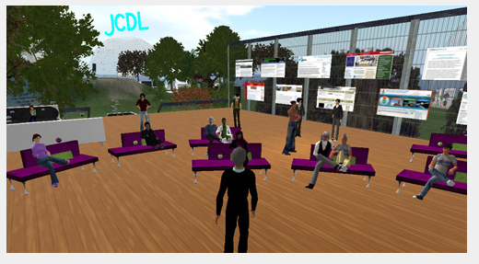
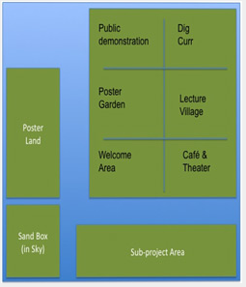
DL Projects
Digital Preserve
NSF IIS-0910183 & 0910465
We are conducting exploratory research to demonstrate how Second Life (SL) can be leveraged in the digital curation community for purposes of improving work practices and training.
Our island on Second Life is called the Digital Preserve

Slide 20
DL Projects
CINET: Network Science Middleware
NSF SDCI 1032677
The research will develop a cyber infrastructure middleware (CINET) to support Network Science.
CINET will be pervasive, flexible and extensible. Users can contribute new networks, data, methods, hardware, and research results in an integrative way.
CINET will enable new ways by which researchers study and teach complex networks.
http://ndssl.vbi.vt.edu/cinet/

Slide 21
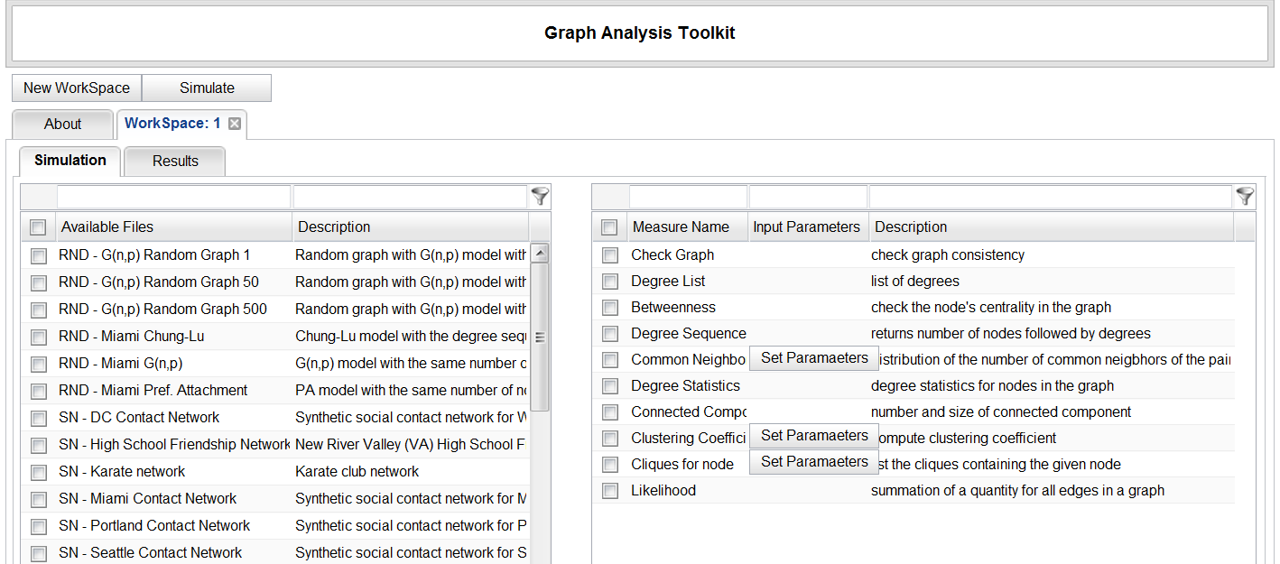
DL Projects
CINET: Network Science Middleware

Slide 22
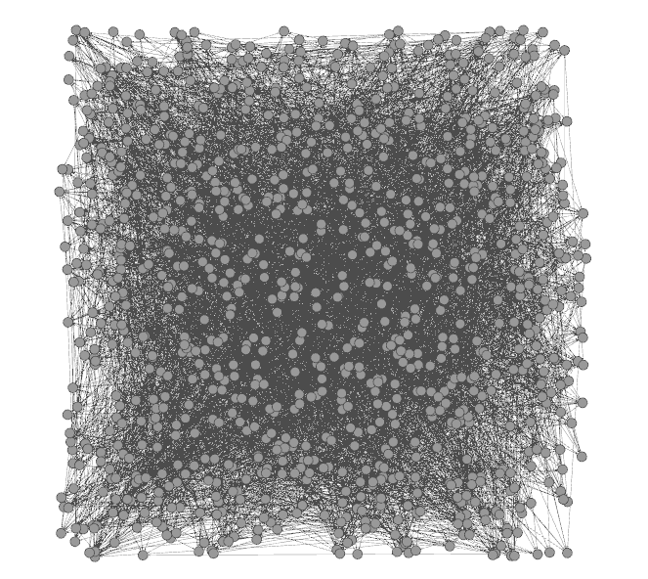
DL Projects
CINET: Network Science Middleware
Netviz: Course project aims to develop a visualization component for CINET which contains large network graphs. The visualization service will get Networks from CINET, convert from Galib to Gexf format, then visualize the graphs using Gelphi.
CINET network displayed using Gephi

Slide 23
Other DL Projects
Establishing a Qatari Arabic-English DL Institute: NPRP 4 - 029 - 1 – 007 pending
Fingerprint Analysis/Distortion/Training DLs
National Inst of Justice, BAE Systems
ETD Analysis, Extraction, Classification

Slide 24
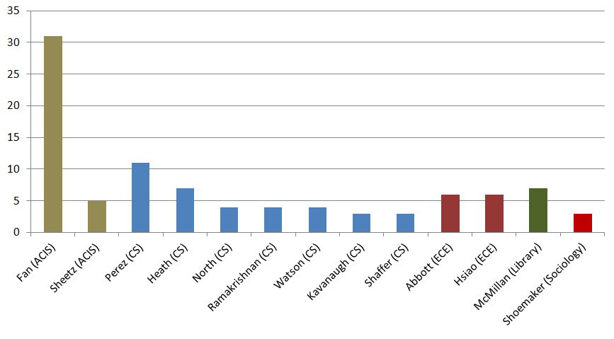
Co-Authored Publications

Slide 25
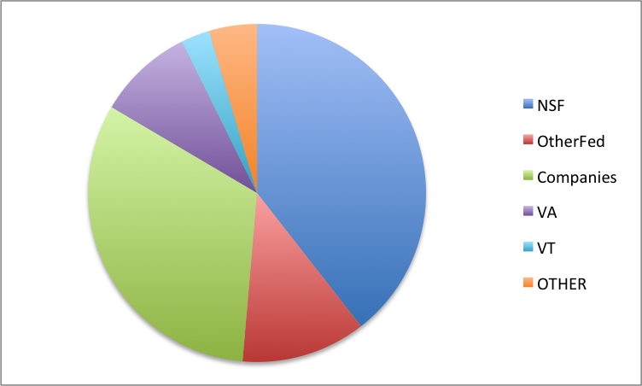
Sponsors for 110 Grants

Slide 26
Areas of Research and Teaching
Digital Libraries
Information Retrieval
Library, Information Science
Search (engines), WWW, Web 2.0
Human-Computer Interaction
Visualization, Interfaces, VR, Usability, …
Multimedia / Hypermedia / ePublishing
Computing-related education

Slide 27
DL Book Draft
Chapter Authors
Monika Akbar
Pranav Angara
Yinlin Chen
Lois M. Delcambre (Portland)
Noha Elsherbiny
Eric Fouh, Marcos André Gonçalves (Brazil)
Nádia P. Kozievitch (Brazil)
Spencer Lee, Jonathan Leidig
Lin Tzy Li (Brazil)
Mohamed Magdy Gharib Farag
Uma Murthy (Seattle)
Sung Hee Park
Rao Shen (Yahoo!)
Venkat Srinivasan
Ricardo da Silva Torres
Seungwon Yang

Slide 28
DL Book Draft
Frontmatter
1 Basic Concepts
1 Introduction (5S Formal framework)
2 Exploration (Archaeology)
3 Evaluation (Quality Assessment Toolkit)
2 Advanced Concepts
4 Complex objects (Fingerprints)
5 Integration (Archaeology)
6 Subdocuments (Fish Species Identification)
7 Ontologies (Crisis, Tragedy, and Recovery network)
8 Classification (Electronic Theses & Dissertations)

Slide 29
DL Book Draft
3 Applications
9 Content-based Image Retrieval (CBIR)
10 Online Communities & Social Networks (AlgoViz)
11 Education (AlgoViz, Ensemble)
12 Bioinformatics, Scientific, and Simulation DLs (Epidemiology, Fingerprints, Network Simulations)
13 Geospatial Information (VT Buildings)
14 Security (CTR network)
15 Text Extraction (References in ETDs)
Backmatter: References, Mathematical Preliminaries, Glossary

Slide 30
Questions? Discussion?
Thank You!
(fox@vt.edu)

