Slide 1
Linking Research and Education in Digital Libraries
TPDL 2011 Workshop
28-29 September, Berlin
“Living In the KnowlEdge Society: the double duty of a librarian” by Edward A. Fox
fox@vt.edu http://fox.cs.vt.edu
Dept. of Computer Science, Virginia Tech
Blacksburg, VA 24061 USA

Slide 2
Outline
Acknowledgments
Digital libraries, 5S
LIKES, CTRnet
Curricular efforts
Book efforts

Slide 3
Acknowledgements
Mentors (Licklider, Kessler, Salton)
Virginia Tech, CS, Digital Library Research Lab
NSF and other sponsors
Students, colleagues, co-investigators
Monika Akbar, Yinlin Chen, Marcos André Gon-çalves, Doug Gorton, Tarek Kanan, Nadia Ko- zievitch, Spencer Lee, Jonathan Leidig, Yi Ma, Uma Murthy, Sung Hee Park, Rao Shen, Ven-kat Srinivasan, Ricardo Torres, Xiaoyan Yu, ...
Barbara Wildemuth, Jeffrey Pomerantz, Sanghee Oh, Seungwon Yang

Slide 4
Acknowledgements – 2
VT Digital Library Research Laboratory
  Digital Libraries
  Information Retrieval
  Human-Computer Interaction
  Multimedia / Hypermedia / ePublishing
  Computing-related education

Slide 5
Selected DL Projects
Digital Library Curricular Resources
  NSF IIS-0535057 & 0535060
CTRnet (Crisis, Tragedy & Recovery Net)
  NSF IIS-0916733
Ensemble (Computer Science Education)
  NSF DUE-0840719
Digital Preserve
  NSF IIS-0910183 & 0910465
  http://slurl.com/secondlife/Digital%20Preserve/140/126/29

Slide 6
Selected DL Projects - 2
CINET: Network Science Middleware
  NSF SDCI 1032677
  Simulation, Cyberinfrastructure
  Metadata-based Generation
Establishing a Qatari Arabic-English DL Institute: NPRP 4 - 029 - 1 – 007 pending
Fingerprint Analysis/Distortion/Training DLs
  National Inst of Justice, BAE Systems
ETD Analysis, Extraction, Classification

Slide 7
2 duties of digital librarians
Raise ability of patrons
  Literacy -> facility -> computational thinking
  University graduates -> general public
Make content accessible now & forever
  Discover, explore, search, browse (libraries)
  Preserve (archives and museums)
What to do as a digital librarian?
How to prepare to be a digital librarian?

Slide 8
Locating Digital Libraries in Computing and
Communications Technology Space
Digital Libraries technology
trajectory: intellectual
access to globally distributed information
Communications
(bandwidth, connectivity)
Computing (flops)
Digital content
Note: we should consider 4 dimensions: computing, communications,
content, and community (people)
less
more

Slide 9
Information Life Cycle
Creation
Active
Authoring
Modifying
Social Context
Using
Creating
Organizing
Indexing
Retention
/ Mining
Accessing
Filtering
Storing
Retrieving
Semi-
Active
Utilization
Distributing
Networking
Inactive
Searching
Notes:
This is a simplification of the previous slide.

Slide 10
Informal 5S & DL Definitions
DLs are complex systems that
help satisfy info needs of users (societies)
provide info services (scenarios)
organize info in usable ways (structures)
present info in usable ways (spaces)
communicate info with users (streams)

Slide 11
A Minimal DL in the 5S Framework
Streams
Structures
Spaces
Scenarios
Societies
Structured Stream
Structural Metadata Specification
services
Descriptive Metadata Specification
indexing
browsing
searching
hypertext
Digital Object
Metadata Catalog
Collection
Repository
Minimal DL

Slide 13
Quality Dimensions

Slide 14
Requirements (1)
Analysis (2)
5S
DL
Meta
5SGraph
Designer
DL
Model
Expert
Practitioner
5SL
Teacher
DL
Model
c
omponent
pool
Design (3)
ODLSearch,
Researcher
ODLBrowse,
Tailored
ODLRate,
5SLGen
DL
ODLReview,
…….
Services
Implementation (4)
5SSuite for DL R&D
5SGraph
5SGen
Mapping Tool

Slide 15
Digital Libraries --- Objectives
World Lit.: 24hr / 7day / from desktop
Integrated “super” information systems: 5S: Table of related areas and their coverage
Ubiquitous, Higher Quality, Lower Cost
Education, Knowledge Sharing, Discovery
Disintermediation -> Collaboration
Universities Reclaim Property
Interactive Courseware, Student Works
Scalable, Sustainable, Usable, Useful

Slide 16
DL Overview
Why of Global Interest?
National projects can preserve antiquities and heritage: cultural, historical, linguistic, scholarly
Knowledge and information are essential to economic and technological growth, education
DL - a domain for international collaboration
  wherein all can contribute and benefit
  which leverages investment in networking
  which provides useful content on Internet & WWW
  which will tie nations and peoples together more strongly and through deeper understanding
Notes:
3
3

Slide 17
Outline
Acknowledgments
Digital libraries, 5S
LIKES, CTRnet
Curricular efforts
Book efforts

Slide 18




Living In the KnowlEdge Society (LIKES)
North Carolina A & T
Santa Clara University
Villanova University
Virginia Tech
NSF CPATH: CCF-0722259,
0722276,
0722289,
and 0752865

Slide 19
LIKES Workshops
SCU, 2007: Defining Problems & Applications of Knowledge Society
NC A&T, 2008: Biology, Geography, Music, Physics, Statistics, University Studies
VT, 2008: defining key terms related to knowledge society, identifying key computing concepts, mapping disciplinary needs with computing concepts
Villanova, 2009: interdisciplinary connections, modules/tools/pedagogy/assessment
VT, 2009: Curricular Guidelines Connecting Computing with Other Disciplines
Durham, 2010: biology, chemistry, physics, computational science, business/social sciences

Slide 20
LIKES Vision
Build a community leading the way to change how computing concepts are taught in both computing-related disciplines and the disciplines of the broader workforce and society.

Slide 21
Overall LIKES Objectives
Students should have the ability to apply
  Computing concepts
  Methods
  Computational thinking skills
to the needs of the emerging
knowledge society,
in modern times and
in the future

Slide 22
Computing Concepts of Broad Interest (to other disciplines)
data, information, and knowledge
algorithms, analysis, problem solving, programming, work flows, and software engineering
interaction, interfaces, graphics, games, visualization, and virtual environments
modeling and simulation

Slide 23
Disciplines
Economics
English
Marketing
Chemistry
Geography
Political
Science
Algorithms
HCI
Geology
Math
Visualization
Database
Archi-
tecture
Social &
Ethical
History
Knowledge
Society
Systems
Analysis
& Design
Sociology
Health-
care
Intelligent
Systems
Simulation
Physics
Biology
Programming
Knowledge
Management
Finance
Architecture
Net-Centricity
Music
Commun-
ications
Psychology
Engi-
neering
Library /
Information
Science
Art

Slide 24
Applications
Digital
Government
Multi
Media
Algorithms
HCI
Semantic
Web
Visualization
Database
Social &
Ethical
Knowledge
Society
Systems
Analysis
& Design
GIS
CSCW
Intelligent
Systems
Simulation
Programming
Knowledge
Management
Healthcare
Online
Shopping
Architecture
Net-Centricity
Services
Library
Information
Science

Slide 25
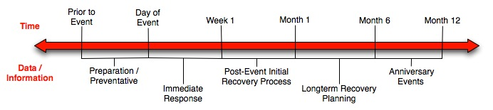
Crisis, Tragedy, and Recovery
Human tragedies that result from man-made and natural events affect humans and communities significantly.
During and after a tragic event, there are a series of needs that have to be addressed.
  Compounded by communication failures and a confusing plethora of data and information

Slide 26
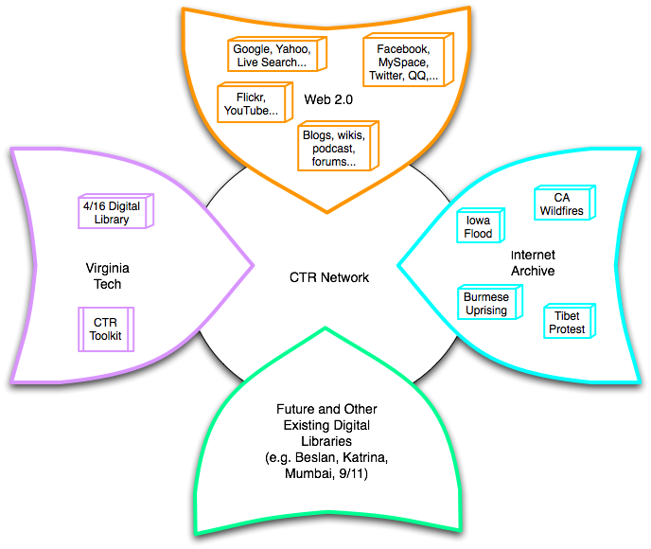
Build a networked digital library relating to CTR
www.citeulike.org group ctrnet
Citations
Papers, …
Integrate community, content, and services relating to CTR, making it accessible, and preserving it for long-term reuse
Support information exploration
Aided by an ontology
www.ctrnet.net

Slide 27





Goals for Ontology for CTR
CTR literature
Browsing
sources
Searching
  Query
  expansion
Focus groups
CTR Ontology
Individual
Organizational
Community
Political
…
Tagging
Websites,
Internet Archive
Recommending
Social network
applications
Summarizing
uses
Multicultural/ linguistic input
Visualizing

Slide 28
Generalizing CTRnet
Precursor: www.dl-vt-416.org
Sequel: Event Archiving
  Related to work of national libraries to archive internet of interest (as in plans for Qatar Digital Library Institute)
  Related to International Internet Preservation Consortium (IIPC, www.netpreserve.org)
  Related to Archive-it (www.archive-it.org) and its Spontaneous Events collections (seehttp://www.archive-it.org/public/topic.html?topic=spontaneousEvents)

Slide 29
Outline
Acknowledgments
Digital libraries, 5S
LIKES, CTRnet
Curricular efforts
Book efforts

Slide 30
CS2008 Information Management Areas beside DL#
Information models* | Transaction processing
Database systems* | Distributed DBs
Data modeling* | Physical DB design
Indexing | Data mining
Relational DBs | Information storage and retrieval#
Query languages | Hypermedia
Relational DB design | Multimedia systems
* Core components #DL moved to ISR for 2013

Slide 31
DL Curriculum Framework

Slide 32
DL Curric. Project - 1
NSF awards to VT and UNC-CH
CS and LIS
Project server: http://curric.dlib.vt.edu/
Wikiversity: http://en.wikiversity.org/wiki/Curriculum_on_Digital_Libraries

Slide 33
DL Curric. Project - 2
Module 1-a (10-c): Conceptual frameworks, models, theories, defns
Module 1-b: History of digital libraries and library automation
Module 2-c (8-d): File Formats, Transformation, and Migration
Module 3-b: Digitization
Module 3-e (7-e): Web publishing
Module 4-b: Metadata
Module 5-a: Architecture overviews

Slide 34
DL Curric. Project - 3
Module 5-b: Application software
Module 5-d: Protocols
Module 6-a: Information needs/relevance
Module 6-b: Online information seeking behaviors and search strategies
Module 6-d: Interaction design and usability assessment
Module 7-a: Indexing and searching
Module 7-a(1): Image retrieval

Slide 35
DL Curric. Project - 4
Module 7-b: Reference Services
Module 7-c: Recommender systems
Module 7-d: Routing
Module 7-f: Crawling
Module 7-g: Personalization
Module 8-a: Preservation
Module 8-b: Web archiving
Module 9-c: Digital library evaluation, user studies

Slide 36
DL Curric. Project – 5
Modules and Cloud Instances
IR | Apache Solr | Lemur
IR | WordNet | R
IR | NLTK | SEDNA XML DB
IR | CLUTO | Weka
IR | TREC Eval | Hadoop Map-Reduce
MM | Media Computation | Audacity
MM | PureData | Fingerprint

Slide 37
Module Development – What?
Digital Libraries
Information Retrieval tools (cloud)
Multimedia tools (cloud)
Biometrics Training
  Especially fingerprint analysis

Slide 38
Module Development – Who?
Experts
  DL
  Biometrics
Teams in a 6000-level DL Course: 4
Teams in a 5000-level IR Course: 5 (+5)
Teams in a 4000 MM Course: 4

Slide 39
Outline
Acknowledgments
Digital libraries, 5S
LIKES, CTRnet
Curricular efforts
Book efforts

Slide 40
Old Planned Book: Parts
Ch. 1. Introduction (Motivation, Synopsis)
Part 1 – The “Ss”
Part 2 – Higher DL Constructs
Part 3 – Advanced Topics
Appendix

Slide 41
Old Planned Book: Part 2
Part 2 – Higher DL Constructs
  Ch. 7: Collections
  Ch. 8: Catalogs
  Ch. 9: Repositories and Archives
  Ch. 10: Services
  Ch. 11: Systems
  Ch. 12: Case Studies

Slide 42
Old Planned Book: Part 3 …
Part 3 – Advanced Topics
  Ch. 13: Quality
  Ch. 14: Integration
  Ch. 15: How to build a digital library
  Ch. 16: Research Challenges, Future Perspectives
Appendix
  A: Mathematical preliminaries
  B: Formal Definitions: Ss
  C: Formal Definitions: DL terms, Minimal DL
  D: Formal Definitions: Archeological DL
  E: Glossary of terms, mappings

Slide 43
Book(s) for 2012
Morgan-Claypool lecture manuscript for Synthesis digital library series – planned
Book for CS6604, Digital Libraries, Fall 2011
  See highlights in next slides
  Being considered by publishers for 2012 release
  Accompanied by slides and other supplemental materials
  Available for test use for classes in January

Slide 44
Book Draft Chapter Authors
Monika Akbar, Pranav Angara, Yinlin Chen, Lois M. Delcambre, Noha Elsherbiny, Eric Fouh, Marcos André Gonçalves, Nádia P. Kozievitch, Spencer Lee, Jonathan Leidig, Lin Tzy Li, Mohamed Magdy Gharib Farag, Uma Murthy, Sung Hee Park, Rao Shen, Venkat Srinivasan, Ricardo da Silva Torres, and Seungwon Yang

Slide 45
Book Draft - 1
Frontmatter
1 Basic Concepts
  1 Introduction
  2 Exploration
  3 Evaluation
2 Advanced Concepts
  4 Complex objects
  5 Integration
  6 Subdocuments
  7 Ontologies
  8 Classification

Slide 46
Book Draft - 2
3 Applications
  9 Content-based Image Retrieval (CBIR)
  10 Online Communities and Social Networks
  11 Education
  12 Bioinformatics, Scientific, and Simulation DLs
  13 Geospatial Information
  14 Security
  15 Text Extraction
Backmatter: References, Mathematical Preliminaries, Glossary

Slide 48
Summary
Acknowledgments
Digital libraries, 5S
LIKES, CTRnet
Curricular efforts
Book efforts

Slide 49
Questions?
Discussion?
Thank You!
(fox@vt.edu)

