Slide 1
Experiment and Analysis Services in a Fingerprint Digital Library
Sung Hee Park¹, Jonathan P. Leidig¹, Lin Tzy Li^{1;3;4}, Edward A. Fox¹, Nathan J. Short², Kevin E. Hoyle², A. Lynn Abbott², and Michael S. Hsiao²
¹ Digital Library Research Laboratory, Virginia Tech, USA
² Department of Electrical and Computer Engineering, Virginia Tech, USA
³ Institute of Computing, University of Campinas, Brazil
⁴ CPqD Foundation, Campinas, Brazil
TPDL: Sept 25-29, 2011, Berlin, Germany
Network Dynamics and Simulation Science Laboratory
Digital Library Research Laboratory (DLRL) @ Virginia Tech

Slide 2
Contents
Introduction
Fingerprint Image Collections
Algorithms, Analyses, and Experiments Services
Framework and Prototype
Related Work
Conclusion & Future Work
Network Dynamics and Simulation Science Laboratory
Digital Library Research Laboratory (DLRL) @ Virginia Tech

Slide 3
Introduction
Lack of a fingerprint digital library
Focus:
human expert training: DOJ, FBI
the developing, testing, and training of fingerprint identification algorithms: VT, Campinas
Fingerprint DL services manage
collections
image processing and matching algorithms
experiment results
experiment analyses
The goal of this work
end-to-end image-based experimentation and analysis services, framework, and implementation
Network Dynamics and Simulation Science Laboratory
Digital Library Research Laboratory (DLRL) @ Virginia Tech
Notes:
Fingerprint collections – some of the largest image collections 100’s of millions of images

Slide 4
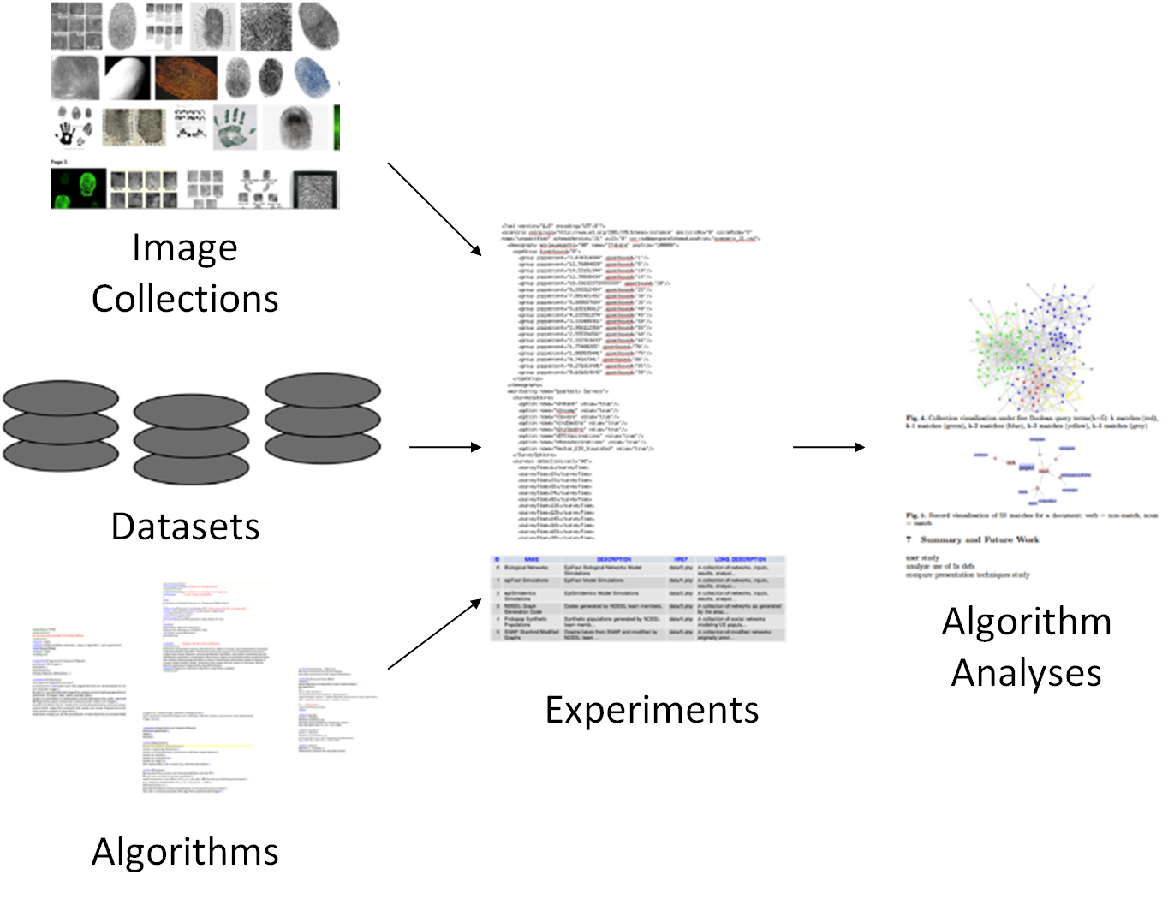
Experimentation Workflow
Network Dynamics and Simulation Science Laboratory
Digital Library Research Laboratory (DLRL) @ Virginia Tech
Notes:
Databases: latent, fbi crimescene, police databases, distorted images, research dbs
Templates
Fig. 1. Workflow framework: fingerprint images, feature or distortion datasets, and image-processing algorithms are used in experiments to analyze algorithm performance.

Slide 5
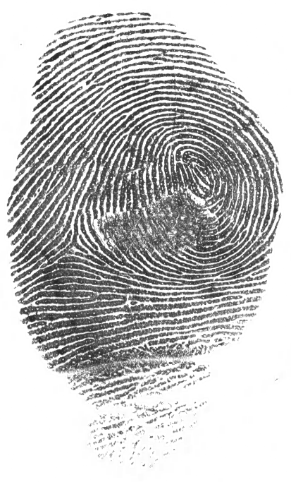
Fingerprint Image Collections
Fingerprint features
Minutiae
Ridges
Classifications
Humidity
Pressure
Distortion
Skin distortion
Rolling
Analysis challenges
Ridges merged
Pressured impressions
Humidity on fingertips
Partial prints
Simultaneous prints
Network Dynamics and Simulation Science Laboratory
Digital Library Research Laboratory (DLRL) @ Virginia Tech
Notes:
Additional image considerations important for image retrieval and matching algorithms

Slide 6
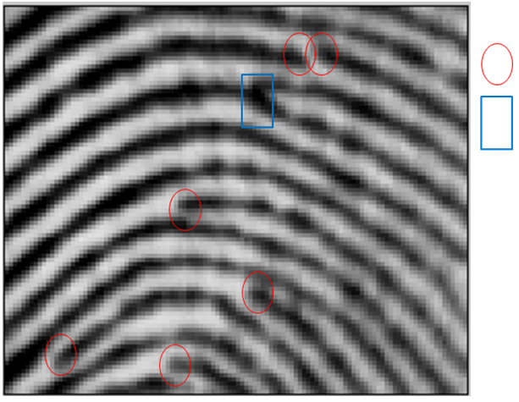
Fingerprint Minutiae Features
Termination
Bifurcation
Ridge
Notes:
Fig. 2. Highlighted ridge termination and bifurcation minutiae.

Slide 7
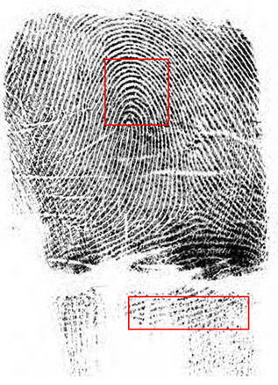
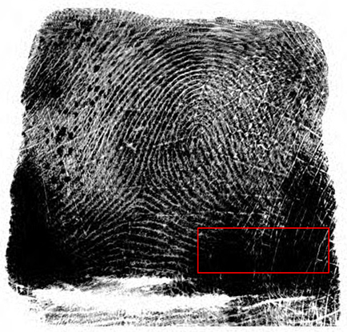
Ridge Tracing Classifications
Proper
Wet
Dry
Network Dynamics and Simulation Science Laboratory
Digital Library Research Laboratory (DLRL) @ Virginia Tech
Notes:
Fig. 3. Fingerprint humidity.

Slide 8
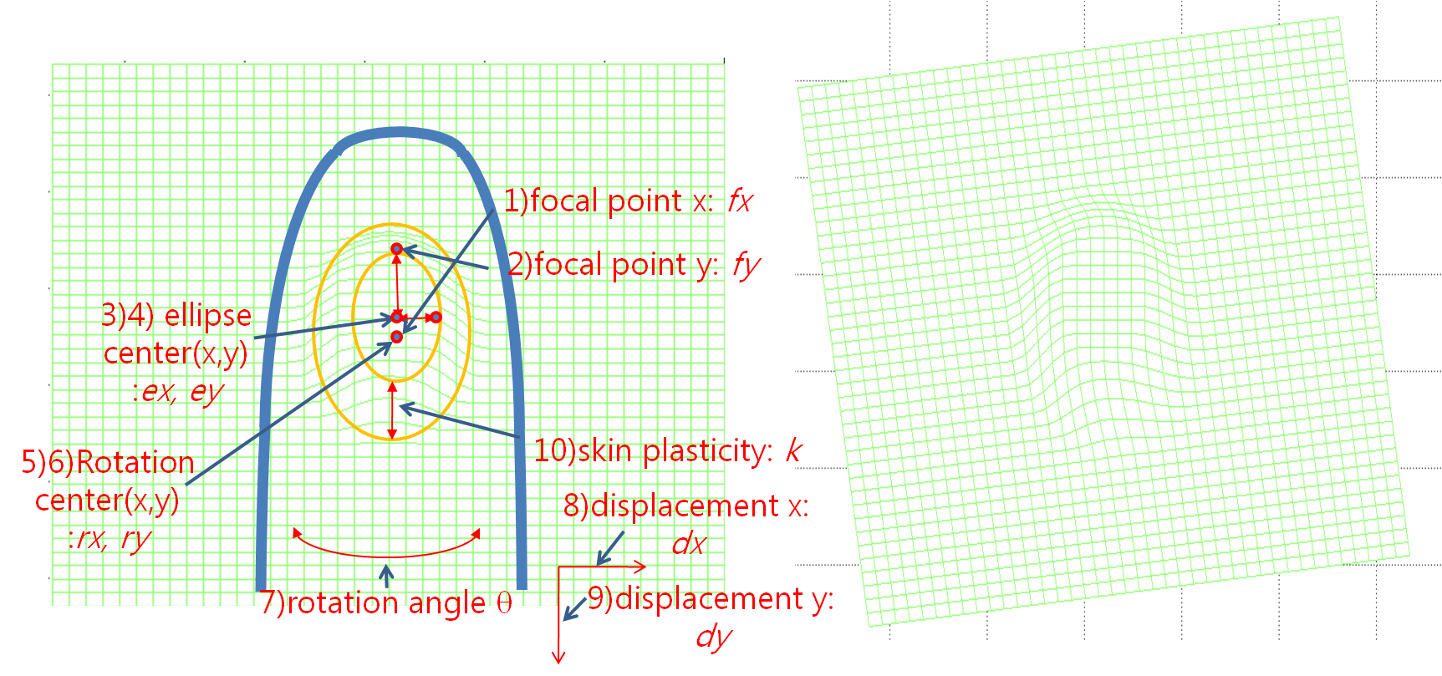
Physical Distortions
Network Dynamics and Simulation Science Laboratory
Digital Library Research Laboratory (DLRL) @ Virginia Tech
Notes:
Fig. 4. Fingerprint distortion parameters indicated (left) and skin distortions [6] (rotation and translation) model example (right).

Slide 9
Rotation and Displacement Distortions
Network Dynamics and Simulation Science Laboratory
Digital Library Research Laboratory (DLRL) @ Virginia Tech

Slide 10
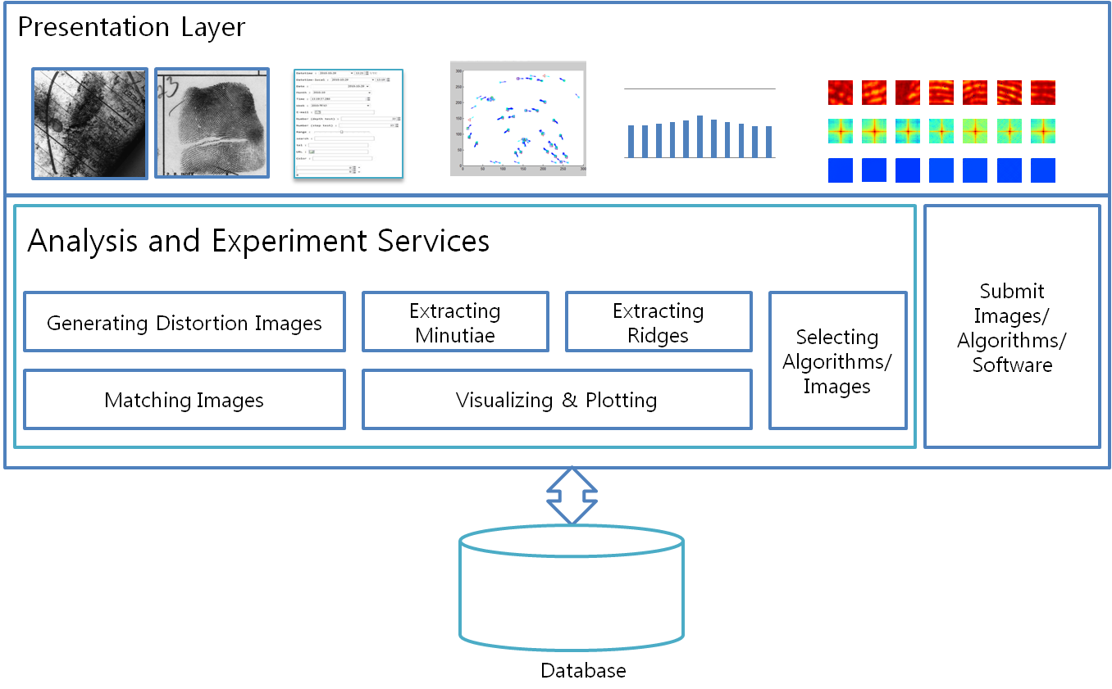
Analysis and Experiment Services in DL Framework
Network Dynamics and Simulation Science Laboratory
Digital Library Research Laboratory (DLRL) @ Virginia Tech

Slide 11
Basic Notation – 5S Formalisms
Term | Definition | Term | Definition
DO_{i};DO_{j} | digital objects i, j ∈ C | V | Vertex
C | a collection∈ Coll | Stm_{i} | Ψ ij.Dom
Coll | a set of collections | Ψ_{ij}.Dom | V × Streams
stm_{j} | a stream | S³ | Streams Structures Spaces
st_{j} | a structure | tfr | S³ × Spaces
 | V × Streams → (N × N) | sp_{j} | a space j
St² | a set of functions Ψ
Network Dynamics and Simulation Science Laboratory
Digital Library Research Laboratory (DLRL) @ Virginia Tech

Slide 12
Distortion Generation & Image Processing
Function
Generate modified images based on a distortion function based on:
streams,
structures, or
structured streams as defined in the 5S framework
Input
a function f and a digital object (DO) do_{i}
Product
a distorted version of the DO do_{j}
Pre-condition and post-condition
∃ C ∈ Coll : do_{i} ∈ C and ∃ C ∈ Coll : do_{j} ∈ C
Definition
f : do_{i} ⇒ do_{j} , given a digital object do_{i}
Network Dynamics and Simulation Science Laboratory
Digital Library Research Laboratory (DLRL) @ Virginia Tech

Slide 13
Ridge Tracing & Minutiae Extraction
Function
identify the locations and quality of major features
e.g., ridge bifurcation and termination
Input
stm_{i}
Product
st_{j} ; Ψ_{ij}
Pre-condition and post-condition
stm_{i} ∈ Streams and st_{j} ∈ Structs; Ψ_{ij}∈ St²; stm_{i}∈Ψ_{ij}.Dom; stj.V ∈ Ψ_{ij}.Dom, respectively
Definition
given a digital object (stm_{i}) produce a descriptor from the object (st_{j} ; Ψ_{ij}) that represents the digital object
Network Dynamics and Simulation Science Laboratory
Digital Library Research Laboratory (DLRL) @ Virginia Tech
Notes:
Minutiae extraction: requires analysis on: the number, pixel location, and quality of identified minutiae
Ridge tracing requires: quantification and analysis on ridge identification

Slide 14
Matching Algorithms & Searching
Function
identify matches between two images as groups of minutiae
use 3, 6, or 9-point triangles of high-quality minutiae locations
less susceptible to distortions
reduce the effects of small distortions on the identification of minutiae location and quality
Input
two images, do_{i}; do_{j}
Product
similarity score k based on minutiae matches
Definition
binary operation service
f(do_{i}; do_{j}) = k; k∈R,
unary services (e.g., rating and measuring)
f(do_{i}) = k; k ∈ R, where a real number k is a similarity score
Match
Network Dynamics and Simulation Science Laboratory
Digital Library Research Laboratory (DLRL) @ Virginia Tech
Notes:
Searching: existing definitions that use matching algorithms to compute ranked lists.
Matching requires analysis: to determine if the set of selected minutiae was sufficient in making a match

Slide 15
Service Specific Evaluating (Sufficiency)
Function
given an image, determine if there is sufficient data for a match
Input
do_{i}
Output
do_{i};w_{i}
Pre-condition
∃ C ∈ Coll : do_{i} ∈ C
Post-condition
w_{i} ∈ [a; b] ⊂ R
Definition
given a digital object
an evaluating service produces an evaluation (i.e., a real number) for it
49,234 / 51,294
Network Dynamics and Simulation Science Laboratory
Digital Library Research Laboratory (DLRL) @ Virginia Tech

Slide 16
Visualizing & Plotting
Function
projection of information into measurable spaces
charts, histograms, plots, or meshes
visualization techniques: analyze the appearance and disappearance of minutiae over distortion degrees
Input
a collection C and a transformation k
Output
a space j
Pre-conditions and post-conditions
C ∈ Coll and tfr k(C) = sp_{j} ∈ Metric
Definition
given a collection C
produce visualizations in a space j
Network Dynamics and Simulation Science Laboratory
Digital Library Research Laboratory (DLRL) @ Virginia Tech

Slide 17
Example DL Experiment Scenarios
Matching score accuracy experiment
How are minutiae relocated after distortions?
Minutiae count and reliability
Are minutiae still identifiable after distortions?
How confidently can minutiae be matched after distortions?
Minutiae plotting on fingerprint
What can we learn from minutiae analysis?
Network Dynamics and Simulation Science Laboratory
Digital Library Research Laboratory (DLRL) @ Virginia Tech

Slide 18
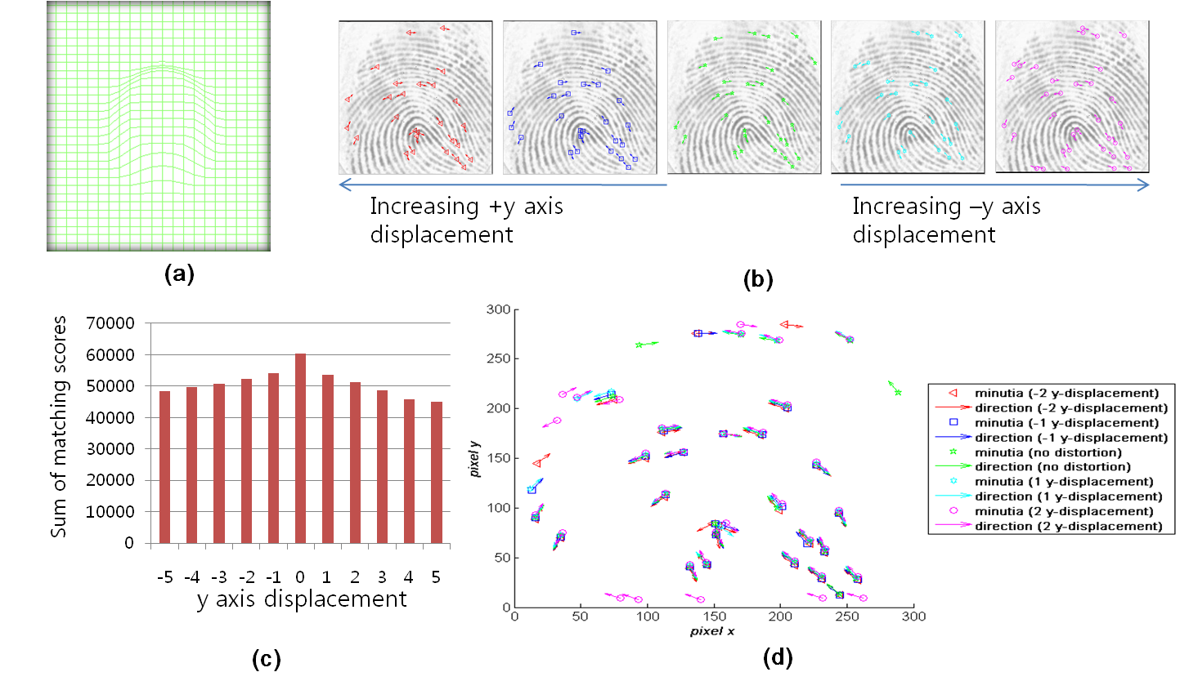
Matching Score Accuracy Experiment
Network Dynamics and Simulation Science Laboratory
Digital Library Research Laboratory (DLRL) @ Virginia Tech
Notes:
40-100 images
NBIS Bozorth3(matching), MINDTCT (minutia detection algorithm)
Fig. 6. Example analyzing effects of y-axis displacements on matching quality: (a) skin distortion model selected; (b) distorted images; (c) histogram of y displacement versus sum of matching score; (d) plotting of minutiae spatial distribution.

Slide 19
Minutia Count Experiment
Network Dynamics and Simulation Science Laboratory
Digital Library Research Laboratory (DLRL) @ Virginia Tech
Notes:
Fig. 7. Number of minutiae in translation distortion.

Slide 20
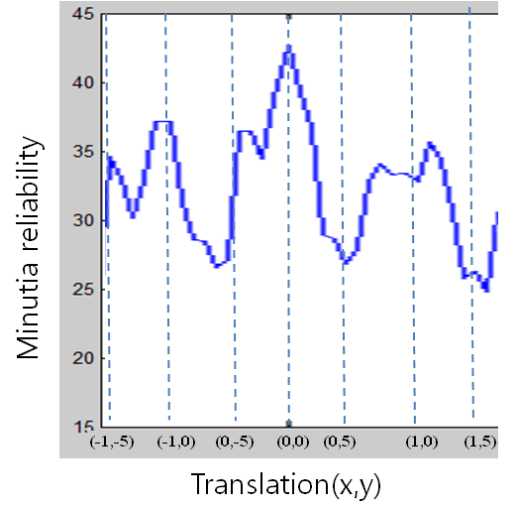
Minutiae Reliability Experiment
Network Dynamics and Simulation Science Laboratory
Digital Library Research Laboratory (DLRL) @ Virginia Tech
Notes:
exp 3: minutia detection algorithm detects quality, sum of reliability, divide by number of minutia, avg 0-100
inside move - global translation
outside move - distortion - elasticity
Fig. 8. Average minutiae reliability: images distorted by translation.

Slide 21
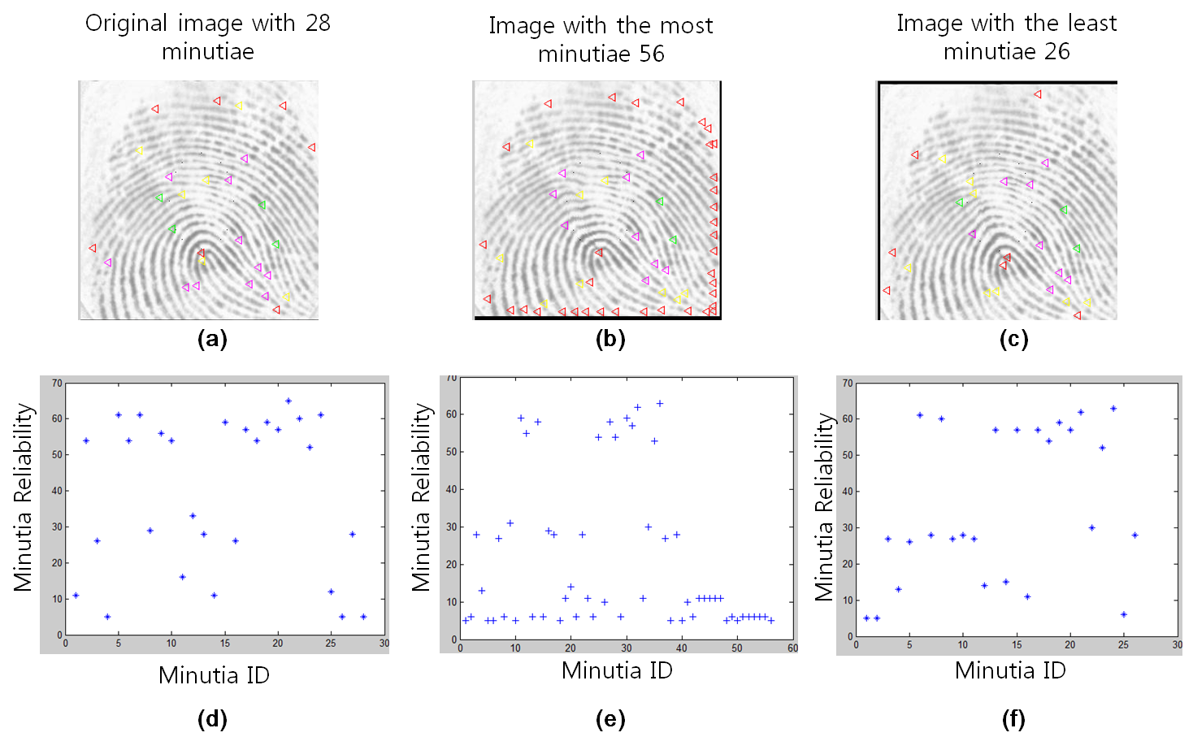
Minutiae Plotting on a Fingerprint
Network Dynamics and Simulation Science Laboratory
Digital Library Research Laboratory (DLRL) @ Virginia Tech
Notes:
Fig. 9. Spatial distributions of minutia reliability: (a) original image with 28 minutiae; images which increased (b) and (c) the most in minutia points after distortion (56 and 26 minutiae respectively); and (d)-(f) minutia reliability of each image.

Slide 22
Experimentation, Workflow, and Analysis Framework
Image-based experimentation steps
User selects a collection of images, algorithms, and inputs
Algorithm-specific analysis scripts identify and extract the phenomenon being tested from the algorithm output
Experimentation workflow
Execute each algorithm with a specific collection
Visualization services display the results based on distortion parameters
Framework consists of building workflows or compositions
Collections, algorithms, and analyses
Network Dynamics and Simulation Science Laboratory
Digital Library Research Laboratory (DLRL) @ Virginia Tech
Notes:
When designing an image-based experiment, a user selects a collection of images
and an algorithm to execute. Each algorithm in our framework is paired, by the
algorithm developer, with an algorithm-specific analysis script to identify and
extract the phenomenon being tested from the algorithm output. Our experi-
mentation workow involves executing each algorithm with a specic collection,
e.g., a set of distorted images. After termination of the algorithm, the analysis
service determines the dierences in the algorithm results between the images.
Metadata, such as distortion parameter values, then can be used to analyze each
parameter's eect on the algorithm's results. Thus, the framework consists of
building workows of compositions of collections, algorithms, and analyses.
As an example workow, the number of minutiae located and the assigned
quality score (0.0 to 1.0) for each minutiae is provided by the minutiae extrac-
tion algorithm. An analysis script extracts the Cartesian location and assigned
quality scores. The results from executing this algorithm on the entire set of
distorted images from a base image then is matched with distortion parameters.
The predened analysis script is executed to specically determine the statistical
signicance of each factor in hindering the identication of minutiae. This algo-
rithm requires the distortion generation algorithm as a pre-requisite, forming a
workow involving several algorithmic executions and subsequent analysis.

Slide 23
Prototype Overview
Image-based DL services
Manage a real and distorted image collection
Automated generation of distorted images from real fingerprints
Select and execute image-based algorithms
Match automated analyses
Prototype and web-interface
Online collection of original and distorted images
System for selecting and composing service workflows
Google chart API presents the results of completed analysis tasks
Images: 137,785 prints
FVC 2000/02: 3520, 3520
SD27: 516
Self-collected: 629
Distorted: 129,600 (<1 sec generation)
Network Dynamics and Simulation Science Laboratory
Digital Library Research Laboratory (DLRL) @ Virginia Tech
Notes:
Plug-in system for easier integration of new algorithms

Slide 24
Prototype Training
A web-interface
Browse the image collection, image information, distortion parameters used to generate specific images, extracted minutiae, and ridge information
Successful minutia extraction visualizations
Humidity
x-translations
y-translations
Rotations
Skin plasticity
Network Dynamics and Simulation Science Laboratory
Digital Library Research Laboratory (DLRL) @ Virginia Tech

Slide 25
Related Work – Existing Fingerprint Databases
FBI's Integrated Automated Fingerprint Identification System (IAFIS)
Large fingerprint management system
Tens of millions of images
Search capabilities against both latent and ten prints
Digitized images
Lacks:
training experts
experiment setting
distorting
plotting
visualizing
The Universal Latent Workstation (ULW)
First latent workstation
Supports interoperability
Shares latent identification services with local and state authorities, and with the FBI IAFIS, all with a single encoding
Network Dynamics and Simulation Science Laboratory
Digital Library Research Laboratory (DLRL) @ Virginia Tech

Slide 26
Related Work – Fingerprint Experimentation
Experiment Database & Collaboration Framework
Penatti et al. [9] proposed an experiment management tool - Eva
evaluates descriptors in content-base image retrieval
provides image descriptors image management
runs comparative experiments
stimulated the development of our holistic DL experiment framework
Previous work also supported scientific communities in a web-based integration framework [10]
Workflow systems: Kepler, Pegasus, Traverna, Triana
Simulation system models and analyses
Network Dynamics and Simulation Science Laboratory
Digital Library Research Laboratory (DLRL) @ Virginia Tech

Slide 27
Related Work – Fingerprint Analysis
The Analysis, Comparison, Evaluation and Verification (ACE-V)
Scientific Working Group on Friction Ridge Analysis, Study and Technology (SWGFAST) groups
Oliveira et al. [8]
Novel tools for reconnecting broken ridges in fingerprint images
Huang et al. [1]
Singular point detection
Kozievitch et al. [4]
Compound object (CO) scheme based on the 5S framework to integrate four different very-large fingerprint digital libraries
Allows uniform use in an integrated DL
Our work:
DL framework design from a services perspective
Delivers experimentation and analytical results
Integrates related services designed by different researchers
Network Dynamics and Simulation Science Laboratory
Digital Library Research Laboratory (DLRL) @ Virginia Tech

Slide 28
Conclusion & Future Work
Contribution
DL supports collaborative research for DOJ/FBI trainers and researchers
Services
generating distorted image datasets
testing different algorithms (e.g., for minutia detection and matching)
managing and work-flowing scientific research datasets, algorithms, and analysis results
ridge tracing: improve poor images, sharpen, predict distortion events based on profile, train existing algorithms and people, predict failures
Status & Future Work
Algorithm development and analysis
Incorporate (training and development) algorithms from other types of fingerprint DLs
Experiment e.g., Identify the distortion chain between two images
Teach the effect of distortions on minutiae points
Other Applications
Astronomy and geo-location identification image processing
Useful for cross-domain generalization
Network Dynamics and Simulation Science Laboratory
Digital Library Research Laboratory (DLRL) @ Virginia Tech
Notes:
Our main contribution is supporting collaborative research for researchers and trainers with services for generating distorted image datasets, testing different algorithms (e.g., for minutia detection and matching), and managing and work-flowing scientific research datasets, algorithms, and analysis results. We are integrating each implemented service under the proposed framework. We plan to verify this prototype in terms of algorithm correctness before and after integration. In addition, we will confirm that findings of experiments relate to the practice of researchers and fingerprint analysts. We also plan to incorporate (training and matching) algorithms from three other types of fingerprint DLs [4] with our collection of distorted images. Astronomy and geo-location identification domains provide a parallel corpus of algorithms that compare images based on feature extraction. Comparisons of these algorithms would be useful for cross-domain generalization.

Slide 29
Jonathan Leidig - leidig@vt.edu
Q & A
Network Dynamics and Simulation Science Laboratory
Digital Library Research Laboratory (DLRL) @ Virginia Tech

Slide 30
Analysis and Experiment Services
Fingerprint-specific services
Analysis and experiment setting
Distortion generation & image processing
Minutiae extraction & ridge tracing
Matching & searching
Evaluating
Visualizing & plotting
Network Dynamics and Simulation Science Laboratory
Digital Library Research Laboratory (DLRL) @ Virginia Tech

Slide 31
Analysis and Experiment Setting
Algorithms in experiments require an algorithm-specific description
Distortion generation algorithm
Minutiae extraction algorithm
Ridge tracing algorithm
Matching algorithm
Network Dynamics and Simulation Science Laboratory
Digital Library Research Laboratory (DLRL) @ Virginia Tech

Slide 32
Example Workflow
Minutiae extraction algorithm
# of minutiae located by distortion parameters
The assigned quality score (0.0 to 1.0) for each minutiae
Executing this algorithm
On the entire set of distorted images
From a base image
With respect to distortion parameters
Statistical significance test
Identify factors hindering the identification of minutiae
Pre-requisite
The distortion generation algorithm prior to forming a workflow involving algorithmic executions and subsequent analysis
Network Dynamics and Simulation Science Laboratory
Digital Library Research Laboratory (DLRL) @ Virginia Tech
Notes:
Or second example:
Identify the distortion chain between two images

