Slide 1
Data Curation Workshop Some Reflections on Students’ Roles ETD 2011: 14th Int. Symp. on ETDs Cape Town, South Africa Edward A. Fox Executive Director, NDLTD, www.ndltd.org fox@vt.edu http://fox.cs.vt.edu/talks/2011 Virginia Tech, Blacksburg, VA 24061 USA

Slide 2
Information Life Cycle
Creation
Active
Authoring
Modifying
Social Context
Using
Creating
Organizing
Indexing
Retention
/ Mining
Accessing
Filtering
Storing
Retrieving
Semi-
Active
Utilization
Distributing
Networking
Inactive
Searching
Notes:
This is a simplification of the previous slide.

Slide 3
Case Study – Uma Murthy
umurthy21@gmail.com, umurthy@vt.edu
http://scholar.lib.vt.edu/theses/available/etd-04142011-175752/
Fish image database
Software (SuperIDR) w. data for SI, fish ID
Experimental user study data
Details of ETD (with multiple files)

Slide 4
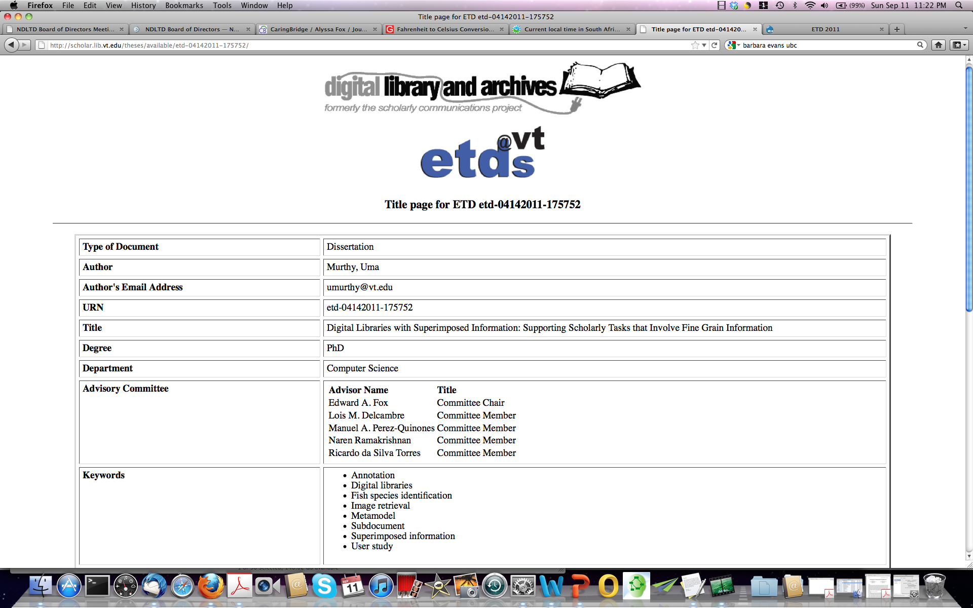
Uma’s ETD Title (splash) page with initial portion of metadata, from April 2011

Slide 5
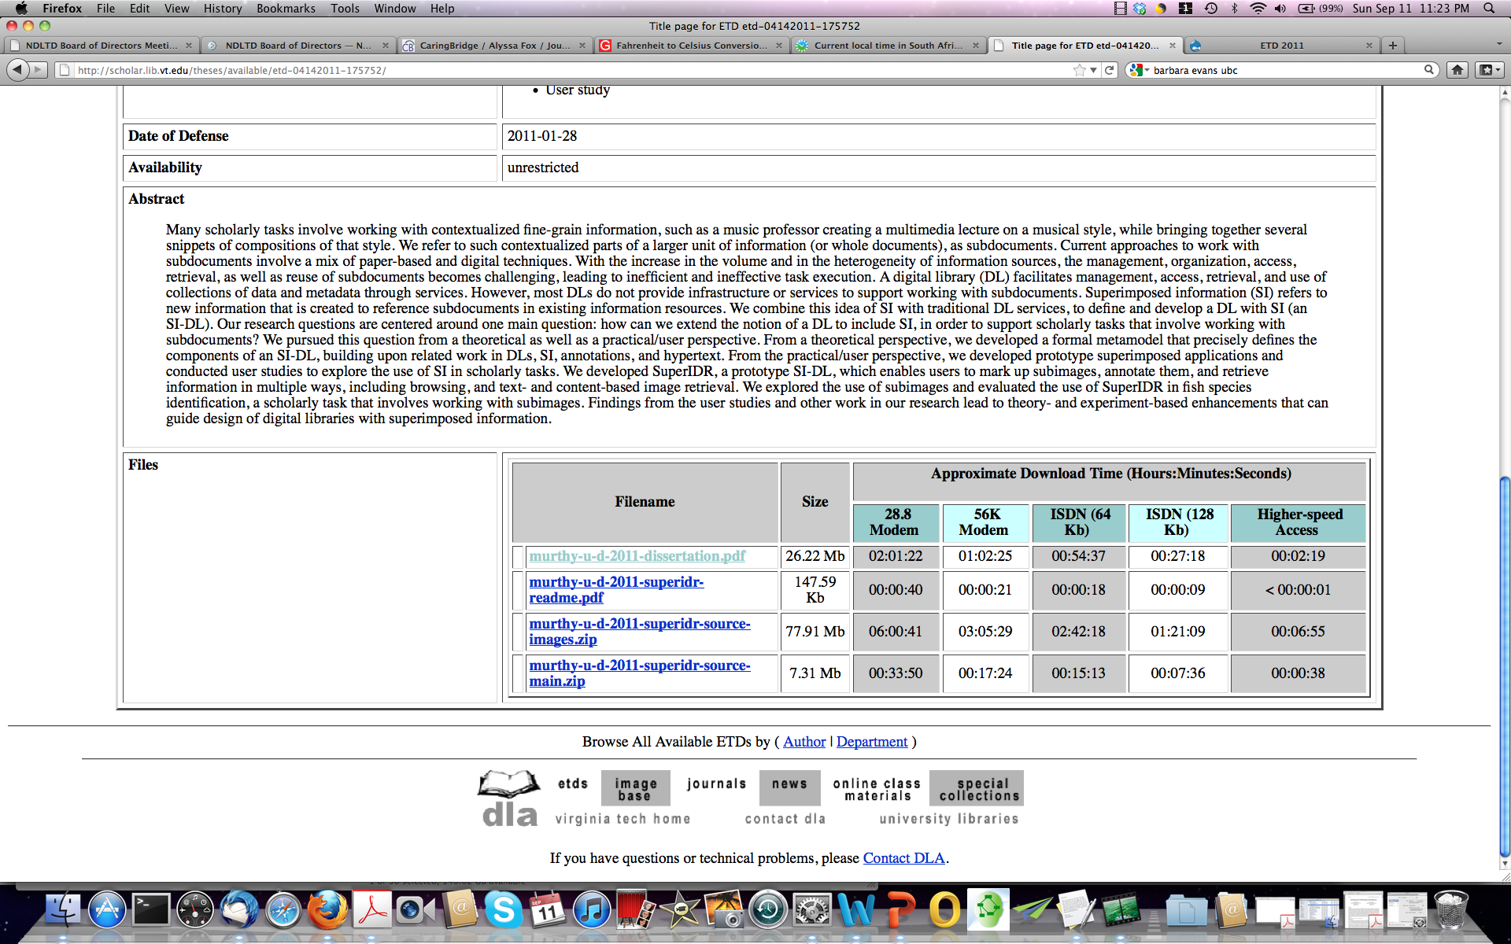
Uma’s ETD Title (splash) page with final portion of metadata, from April 2011

Slide 6
Uma’s ETD Readme file, explaining the 2 compressed files, s/w, DB, from April 2011

Slide 7
CS Perspective
Data
All types, for all types of research, application
Variety of standard, proprietary, new formats
Data, dataset, database, archived version
Software
Dependencies on hardware, software
Frequent version shifts, making code obsolete
Preservation: Raymond Lorie, IBM: UVC

Slide 8
Needs, Problems
NSF and others require a data management plan.
Many research studies cannot be replicated since the student left, and with them went crucial information about data.
There are no funds assigned to this work.
Faculty lack time and knowledge.
Few projects have professional staff to carry out this type of work.

Slide 9
Data with ETDs
Students are the naturals for this task.
They can learn and contribute through working with content near and dear to them.
They are the only ones in many cases who can provide the full provenance.
It must be recorded before the student graduates, else this golden opportunity is lost.

Slide 10
Conclusion
We have a good case study – Uma Murthy.
I argue that ETD authors are the natural ones to learn about and engage in data curation, as they finalize their ETDs.

