Slide 1
Enriching the VT ETD-db with Reference Metadata
Sung Hee Park
Edward A. Fox
Digital Library Research Laboratory
Department of Computer Science, Virginia Tech, USA
ETD 2011, Sep. 13-17, Cape Town, South Africa

Slide 2
Contents
Introduction
Related Work
ETD MS
ETD Reference Extraction
Experiment & Discussion
Conclusion & Future Work

Slide 3
Introduction
A thesis or dissertation
One of the scholarly works
A partial fulfillment of the requirements of a degree
Virginia Tech ETDs
ETD initiatives since 1987
The collection > 19,000 manuscripts

Slide 4
Extending Metadata
Several types of metadata
Descriptive metadata (including bibliographic information)
Administrative metadata
Technical metadata
To extend use of the ETD database:
The reference sections need to be extracted and
Included as part of the browsing page for each ETD.
Accordingly, automation is required since reference section extraction by hand is time-consuming.

Slide 5
ACM DL vs. VT ETD db System
Scholarly works
journal articles
conference papers
technical reports
ACM Digital Library “reference tab”
VT ETD “splash” page

Slide 6
ACM Digital Library
Reference Metadata

Slide 7
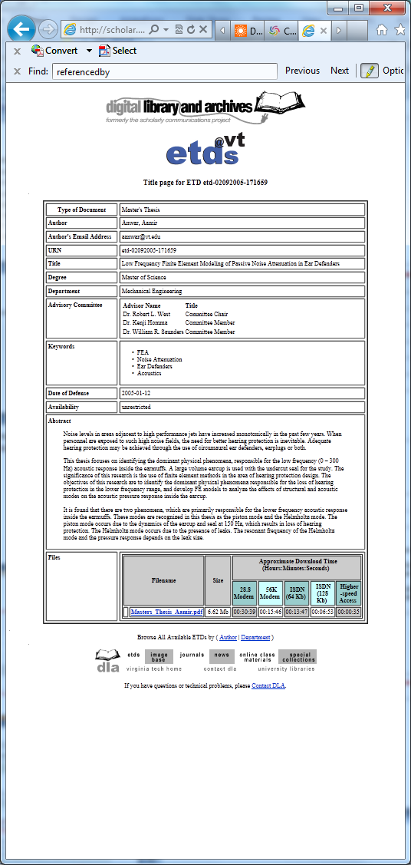
ETD Metadata

Slide 8
Problems & Methods
Reference section extraction Problem
Information extraction problem
Document segmentation problem
Methods
Classification techniques
Pattern recognition
Data mining
Approaches
Regular expressions (Chapter [0-9]*)
Rule based approach (page number on bottom)
Machine learning approach (train, apply)

Slide 9
Challenges
Brute force techniques using regular expressions
Have been found to be inadequate
Because of the various different types of references.
We adopt machine learning techniques
To improve the efficiency and accuracy of reference extraction over naïve methods.
To robustly extract reference sections from ETDs.

Slide 10
Types of References
References at the end of the document
Chapter references
Footnotes

Slide 11
Types of References
Reference Section

Slide 12
Types of References
Chapter References

Slide 13
Types of References
Footnote References

Slide 14
Objectives
Goals:
To extend ETD-MS to include references in the metadata.
To automatically extract these references from ETDs.
Final References section
Footnotes
Chapter references
To manage the references inside ETD-db,
Providing browse, search, and presentation services.

Slide 15
Research Questions
How can we implement metadata schema for bibliographic information?
What machine learning methods are effective to extract reference sections including footnotes and chapter references?

Slide 16
Related Work (1/5)
Text Information Extraction (IE)
Reference Section Extraction
Reference Metadata Schema

Slide 17
Related Work (2/5)
Text Information Extraction (IE)
Linguistic String Project (Sager, 1981)
An early IE system directed by Naomi Sager focused on the medical domain
Message Understanding Conference (MUC) (Grishman & Sundheim, 1996)
Sponsored by the U. S. Defense Advanced Research Projects Agency (DARPA)
Encouraged IE research from 1987 to 1998.
Notes:
MUC encouraged a focus on extracting four elements: named entities, co-references, template elements, and template relations.

Slide 18
Related Work (3/5)
Ex. MUC-7
Evaluation of extraction of useful information from news messages about Airplane crashes and Rocket/Missile Launches.
Named entities (dates, people, cities, …), co-references, template elements, and template relations.
The Automatic Content Extraction (ACE) evaluation project
The National Institute of Standards and Technology (NIST) from 2000 to 2008.
Extract entities from language data and then infer relations among them.

Slide 19
Related Work(4/5)
Reference Section Extraction
(Han et al., 2003)
Automatic document metadata extraction
Using support vector machines (SVM)
(Councill, Giles, & Kan, 2008)
ParsCit
An open source package in CiteSeerX
To extract reference strings from a document & parse them.
Based on some heuristics,
E.g., using regular expressions like ‘/[R|r][eferences]/’ or ‘/[B|b][ibliography]/’.

Slide 20
Related Work (5/5)
Reference Metadata Schema
General Metadata Schema
Dublin Core Metadata Element Set:
Qualified DC Terms
Metadata Object Description Schema (MODS)
Metadata Schema Dedicated to ETDs
ETD MS (Metadata Standard)
TDL MODS

Slide 21
Reference Metadata Implementation 1
DC | DC Terms | MODS | Extended ETD-MS | TDL ETD MODS
dc .relation. references | dcterms :references | mods :relatedItem | dc :relation dcterms :references | N/A

Slide 22
Reference Metadata Implementation 2
HTML/XHTML:
It can be represented using link and meta tags.
URL or references as an attribute;
Human readable (e.g., a plain text) or
A machine readable form (e.g., OpenURL ContextObject )
XML:
Reference metadata using the value of metadata property/elements/tags.
OAI-PMH
A protocol for interoperable metadata harvesting
Notes:
reference metadata using the value of metadata property/elements/tags.
The Guideline for Dublin Core Implementation with XML (Powell, 2003):
some recommendations regarding implementing with XML.
This XML representation including metadata for references can be used in OAI-PMH, a protocol for interoperable metadata harvesting, to harvest/provide metadata for ‘references’ from/for other syste

Slide 23
Reference Metadata Implementation 3
RDF (Resource Description Framework)
Constructs and vocabularies used in DC metadata
DC Abstract Model (DCAM)
A RDF conceptual model, which builds on RDF undertaken by W3C.
The nature of component used and expresses how for the components to be combined to create information structures.
Examples: application profile

Slide 24
Application Profile
An application profile
A set of metadata elements, properties, vocabularies, terms, and guidelines defined for a specific application.
E.g., Dublin Core Application Profile (DCAP)
Guidelines for use of DC metadata in a specific context (Coyle, 2009).
Scholarly Work Application Profile (SWAP)
A DCAP for scholarly works (Allinson, Johnston, & Powell, 2007).
To support
Browsing, searching, and presentation services
Providing metadata as well as contents of references
Open Archive Initiative-Object Reuse and Exchange (OAI-ORE)
A standard for describing the exchange of aggregations of Web resources (Lagoze et al., 2008)

Slide 25
Example ETD MS
Property | Syntax Encoding Scheme URI | Value String
dc:title |  | Low Frequency Finite Element Modeling of Passive Noise Attenuation in Ear Defenders
dc:creator |  | Aamir Anwar
dc:contri- butor |  | Mechanical Engineering, Virginia Tech
dc: publisher |  | Virginia Tech
dcterms: references |  | L.E. Kinsler, A.R. Frey, A.B. Coppens, J.V. Sanders, Fundamentals of Acoustics, 4 th ed., John Wiley & Sons Inc. New York, 2000.
dcterms: references | Info:ofi/fmt:kev:mtx:ctx | &ctx_ver=Z39.88-2004& rft_val_fmt=info%3Aofi%2Ffmt%3Akev%3Amtx%3Abook &rfr_id=info%3Asid%2Focoins.info%3Agenerator&rft.genre=book&rft.btitle=Fundamentals+of+Acoustics &rft.title=Fundamentals+of+Acoustics&rft.aulast=Kinsler &rft.aufirst=L.+&rft.auinit=L.E.K.&rft.aucorp=Frey+A.R. &rft.au=L.++L.E.K.+Kinsler&rft.au=Coppens+A.B. &rft.au=Sanders+J.V.+&rft.date=2000&rft.pub=John+Wiley+%26+Sons+Inc. &rft.place=New+York&amp;rft.edition=4+th+ed.

Slide 26
Example of Extended ETD MS in XML and (X)HTML
 | Reference to a Book Encoded in XML | Reference to a Book Encoded in (X)HTML
Schema declara-tion | <?xml versino="1.0" encoding="UTF-8"?> <thesis xmlns = http://www.ndltd.org/standards/metadata/etdms/1.0/ xmlns:dcterms = http://purl.org/dc/terms/ xsi:schemaLocation = "http://www.ndltd.org/startds/metdata/etdms/1.0/ http://www.ndltd.org/standards/metadata/etdms/1.0/etdms.xsd"> | <link rel="schema.etdms" href = "http://www.ndltd.org/standards/metadata/etdms/1.0/" /><link rel="schema.dcterms" href="http://purl.org/dc/terms/" /><link rel=”schema.KEV” href=”info:ofi/fmt:kev:mtx:” />
Title, | <title>Low Frequency Finite Element Modeling of Passive Noise Attenuation in Ear Defenders</title> | <meta name="etdms.Title" content="Low Frequency Finite Element Modeling of Passive Noise Attenuation in Ear Defenders"/>
Author, etc. | <!— Below is ETD-MS v.1.0 metadata --> ... | <!— Below is traditional ETD-MS metadata --> ...
A single ref. | <!— The reference is described --> <dcterms:references id="1">L.E. Kinsler, A.R. Frey, A.B. Coppens, J.V. Sanders, Fundamentals of Acoustics, 4 th ed., John Wiley & Sons Inc. New York, 2000. </dcterms:references> <dcterms:references id="1" scheme=”KEV.ctx” > ctx_ver=Z39.88-2004 &rft_val_fmt=info%3Aofi%2Ffmt%3Akev%3Amtx%3Abook &rfr_id=info%3Asid%2Focoins.info%3Agenerator&rft.genre=book&rft.btitle=Fundamentals+of+Acoustics &rft.title=Fundamentals+of+Acoustics&rft.aulast=Kinsler &rft.aufirst=L.+&rft.auinit=L.E.K.&rft.aucorp=Frey+A.R. &rft.au=L.++L.E.K.+Kinsler&rft.au=Coppens+A.B. &rft.au=Sanders+J.V.+&rft.date=2000&rft.pub=John+Wiley+%26+Sons+Inc. &rft.place=New+York&rft.edition=4+th+ed. </dcterms:references> | <!— The first reference is described --> <meta name="dcterms.references" id="1" content="L.E. Kinsler, A.R. Frey, A.B. Coppens, J.V. Sanders, Fundamentals of Acoustics, 4 th ed., John Wiley & Sons Inc. New York, 2000."/><meta name="dcterms.references" scheme=”KEV.ctx” id="1" content="ctx_ver=Z39.88-2004 &rft_val_fmt=info%3Aofi%2Ffmt%3Akev%3Amtx%3Abook &rfr_id=info%3Asid%2Focoins.info%3Agenerator &rft.genre=book&rft.btitle=Fundamentals+of+Acoustics &rft.title=Fundamentals+of+Acoustics&rft.aulast=Kinsler &rft.aufirst=L.+&rft.auinit=L.E.K.&rft.aucorp=Frey+A.R. &rft.au=L.++L.E.K.+Kinsler&rft.au=Coppens+A.B. &rft.au=Sanders+J.V.+&rft.date=2000&rft.pub=John+Wiley+%26+Sons+Inc. &rft.place=New+York&rft.edition=4+th+ed."/>
Rest of refs | <!— The rest of references are described--> ... </thesis> | <!— The rest of references are described-->

Slide 27
Example of SWAP
@prefix dc: <http://purl.org/dc/elements/1.1/> . @prefix dcterms: <http://purl.org/dc/terms/> . @prefix eprints: <http://purl.org/eprint/terms/> . @prefix etdms: <http://www.ndltd.org/etdms/terms/> . DescriptionSet{ Description { Resource URI (<http://parsifal.dlib.vt.edu:3001/browse/etd-02092005-171659> Statement { Property URI { dc:type } Value URI ( <http://purl.org/eprint/entityType/ScholarlyWork> ) } Statement { Property URI { dc:title } Literal Value String("Low Frequency Finite Element Modeling of Passive Noise Attenuation in Ear Defenders") } # Basic Metadata (e.g., authors, keywords, department, existing in ETD MS ... Statement ( Property URI ( dcterms:references ) Value String ( "L.E. Kinsler, A.R. Frey, A.B. Coppens, J.V. Sanders, Fundamentals of Acoustics, 4 th ed., John Wiley & Sons Inc. New York, 2000." ) Value String("&ctx_ver=Z39.88-2004&rft_val_fmt=info%3Aofi%2Ffmt%3Akev%3Amtx%3Abook &rfr_id=info%3Asid%2Focoins.info%3Agenerator&rft.genre=book&rft.btitle=Fundamentals+of+Acoustics &rft.title=Fundamentals+of+Acoustics&rft.aulast=Kinsler&rft.aufirst=L.+&rft.auinit=L.E.K. &rft.aucorp=Frey+A.R.&rft.au=L.++L.E.K.+Kinsler&rft.au=Coppens+A.B.&rft.au=Sanders+J.V.+&rft.date=2000 &rft.pub=John+Wiley+%26+Sons+Inc.&rft.place=New+York&rft.edition=4+th+ed.") Syntax Encoding Scheme URI ( kev:ctx ) ) ... Statement { Property URI ( eprint:isExpressedAs) ValueURI(<http://scholar.lib.vt.edu/theses/available/etd-02092005-171659/unrestricted/Masters_Thesis_Aamir.pdf>) } } Description { Resource URI(<http://scholar.lib.vt.edu/theses/available/etd-02092005-171659/unrestricted/MastersThesisAamir.pdf>) ...

Slide 28
Example of OAI-ORE
<?xml version='1.0' encoding='unicode' ?> <rdf:RDF xmlns:ore="http://www.openarchives.org/ore/terms/" xmlns:rdf="http://www.w3.org/1999/02/22-rdf-syntax-ns#" xmlns:dcterms="http://purl.org/dc/terms/" xmlns:foaf="http://xmlns.com/foaf/0.1/" xmlns:dc="http://purl.org/dc/elements/1.1/"> <rdf:Description rdf:about="http://parsifal.dlib.vt.edu:3001/rem/ref/etd-02092005-171659"> <ore:describes rdf:resource="http://parsifal.dlib.vt.edu:3001/rem/ref/etd-02092005-171659" /> <dcterms:creator rdf:parseType="Resource"> <foaf:name>Sung Hee Park</foaf:name> <foaf:page rdf:resource="http://scholar.lib.vt.edu/" /> </dcterms:creator> <dcterms:created rdf:dataType="http://www.w3.org/2001/XMLSchema#dateTime"> 2005-02-09T17:16:59 </dcterms:created> <dc:rights>This Resource Map is available under the Creative Commons Attribution- Noncommerial 2.5 Generic license</dc:rights> <dcterms:rights rdf:resource="http://creativecommons.org/licenses/by-nc/2.5/" /> </rdf:Description> <rdf:Description rdf:about="http://parsifal.dlib.vt.edu:3001/browse/etd-02092005-171659"> <ore:isDescribedBy rdf:resource="http://parsifal.dlib.vt.edu:3001/browse/etd-02092005-171659" /> <dc:title>ETD with References</dc:title> <dcterms:creator rdf:parseType="Resource"> <foaf:name>Anwar, Aamir</foaf:name> <foaf:mbox rdf:resource="aanwar@vt.edu" /> </dcterms:creator> <ore:aggregates rdf:resource="Human Start Page Link" /> <ore:aggregates rdf:resource="PDF Link" /> <dcterms:references rdf:resource="Reference_1" /> ... <dcterms:references rdf:resource="Reference_n" /> <rdf:type rdf:resource="Link to Type of Aggregation" /> <ore:aggregates rdf:resource="Reference_1" /> ... </rdf:Description> ... <rdf:Description rdf:about="http://addison.vt.edu/record=b2077343"> <dc:title>Fundamentals of acoustics</dc:title> <dc:language>en</dc:language> </rdf:Description> ... </rdf:RDF>

Slide 29
System Architecture
Extracting
Reference
Sections
ETD
Repository
Searching,
Browsing,
Manipulating
Metadata
with
References
Users
Web App
(ETD db)

Slide 30
Dataflow of Reference Section Extraction
Training data
Feature
Extraction
Learning
Pdf2 txt
Feature Extraction
Reference Section Extraction
ETD in PDF
Tagged data

Slide 31
Features
Feature Name | Descriptions | Examples
Word local features | 28 different string patterns | Types of punctuation, capitalization, etc.
Line features | Patterns in a line | Number of words in the line, percentage of capitalized words
Contextual features | Patterns of a neighborhood | Class (‘REF’ or ‘NON-REF’) of neighbor lines before and after the current line

Slide 32
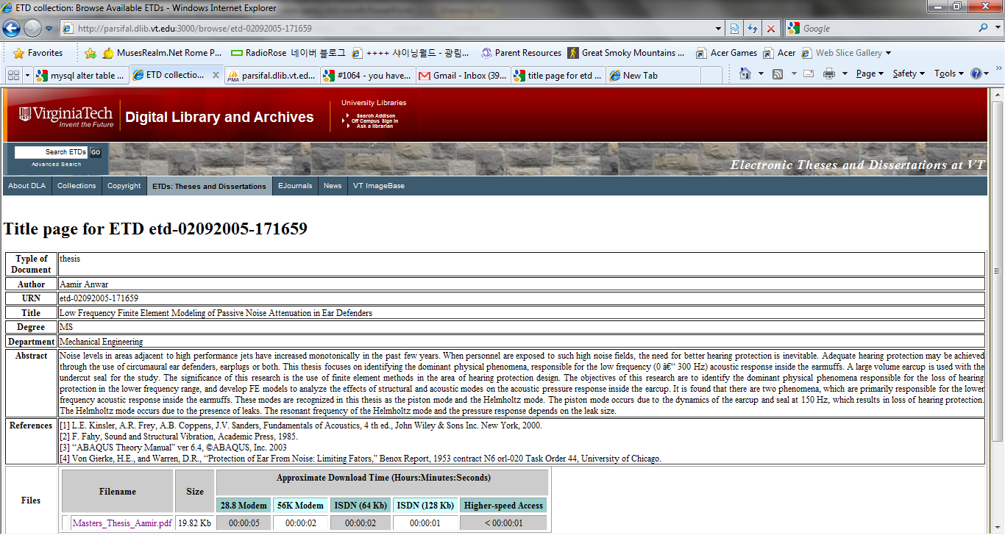
VT ETD-db with Reference Metadata

Slide 33
Data Used in Evaluation
Items | Document1 | Document2 | Document3 | Document4 | Document5 | Document6
# of lines | 4,818 | 4,899 | 2,237 | 6,178 | 2,369 | 2,254
# of reference lines (location) | 324 (end) | 291 (end) | 63 (end) | 214 (end) | 145 (end) | 73 (end)
Percentage of reference lines | 6.7% | 5.9% | 2.8% | 3.5% | 6.1% | 3.2%
# of features | 5,185 | 5,493 | 3,208 | 6,061 | 3,393 | 4,097

Slide 34
Evaluation of rule based techniques
Experiments on chapter reference section starting with “Literature Cited”
ParsCit failed
saying “Citation text cannot be found: ignoring”.
ParsCit probably does not include “Literature Cited” as a starting word of a reference section.
Experiment with chapter reference sections starting with ‘References’,
ParsCit extracted only the references in the last chapter;
Failed to find the end of the reference section.
Contextual features
Document 6 (which showed the worst performance)
Performance was improved by adding these features.

Slide 35
Conclusion
Software developed:
To extract reference information:
chapter references and footnotes as well as
references at the end of the manuscript
To extend ETD-MS to include reference information.
Main contributions
Easy access to reference information stored in PDF format
Integration of the automatic reference metadata
Machine learning techniques
Show great potential for reference extraction
Extract specific data from references

Slide 36
Future work
We plan
To improve the performance of reference section extraction.
To parse the reference strings to put into a canonical (database suitable) form
To implement applications of extended ETD-MS (e.g., OAI-ORE)

Slide 37
Q & A

