Slide 1
VT College of Engineering
STEP
Edward A. Fox
fox@vt.edu http://fox.cs.vt.edu
Monika Akbar, Eric Fouh, Lin Tzy Li, Mohamed Magdy, Nathan Short, Seungwon Yang, Sloane Neidig, Uma Murthy
Department of Computer Science, Virginia Tech
Blacksburg, VA 24061
Outreach Activity, July 15, 2011

Slide 2
About Instructor
Started studying about computers when 15 years old;
enthralled; knew that would be my profession.
BS (Elect. Eng.) from MIT, MS and PhD from Cornell in Computer Science.
Professor at VT, teaching since 1983.
Executive Director for a non-profit: Networked Digital Library of Theses and Dissertations
Married 40 years, 4 sons, 3 grandsons; in 45 countries; teach energy healing.
Involved in computer applications to:
archaeology, archives, autos, biology, business, chemistry, civil engineering, education, entertainment, fishes, geography, government, health, justice, language, law, libraries, math, navy, physics, sociology

Slide 3
Students Who Helped Prepare the Activities
Eric Fouh
  Cameroon
Lin Tzy Li
  Brazil
Mohamed Magdy
  Egypt
Monika Akbar
  Bangladesh
Nathan Short
  USA
Seungwon Yang
  South Korea
Sloane Neidig
  USA
Uma Murthy
  India

Slide 4
Overview of the Class
VT Fingerprint project
  Looking closely at fingerprints
Image Search
  How Google may do it
Light-bot
  Programming through a game
Greenfoot
  Simulate real-life activities
WorldWide Telescope
  Making your computer a virtual telescope, looking beyond the horizon, on earth, across space, and through time
All materials are available at
http://www.computingportal.org/step

Slide 5
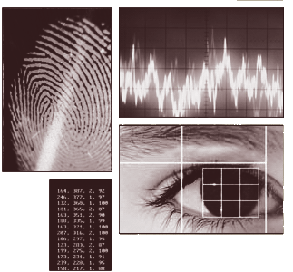
Biometrics:
Fingerprint Recognition

Slide 6
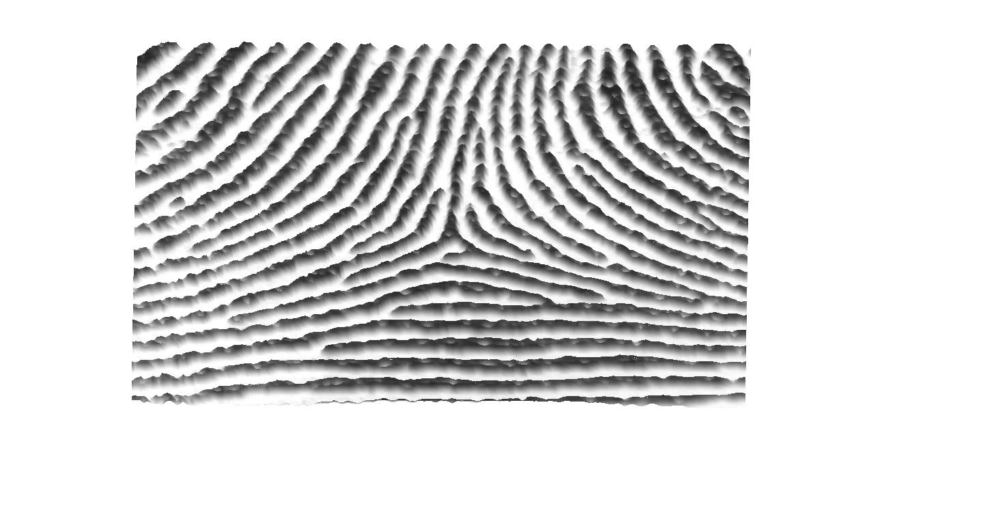
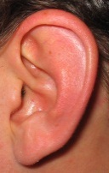

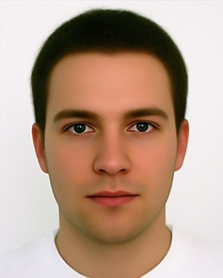

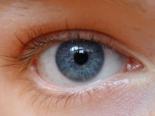

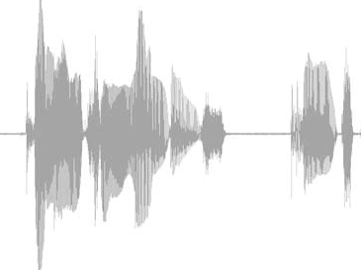
Biometrics – Human Identification
Ear
Hand
Face
Valleys
Ridges
Iris
Fingerprint
Speech

Slide 7
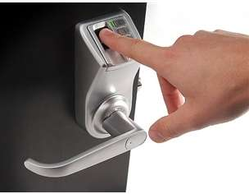
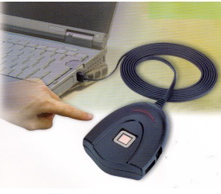

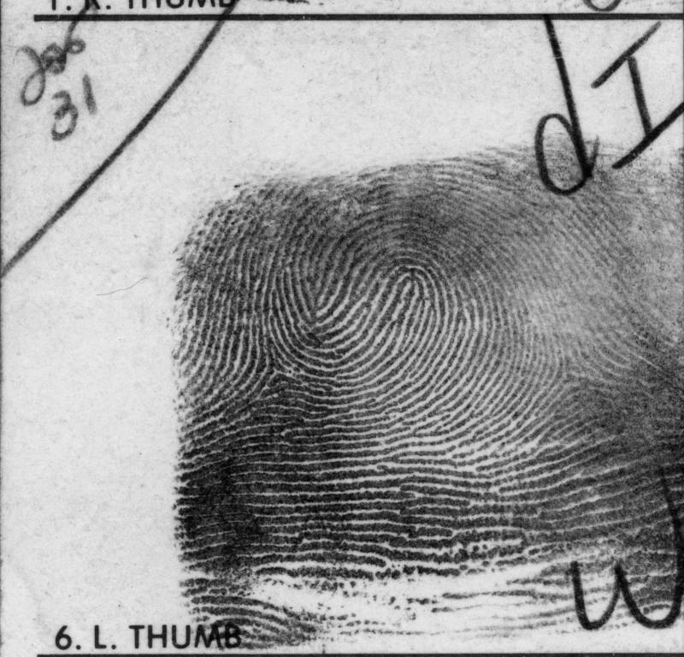
Why Fingerprints?
Friction Ridge Surface
  Provide friction for grasping objects
Universal
Unique
Verification
Identification

Slide 8
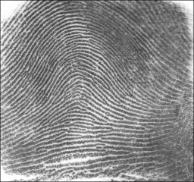
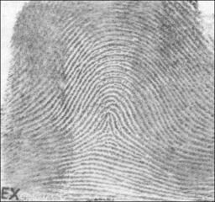
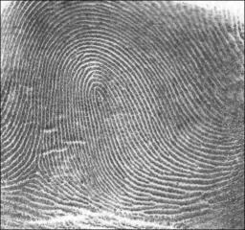
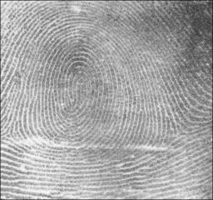
Fingerprint Types and Singular points
Fingerprint Types
Cores
Deltas
Tented
Arch
Arch
Loop
(right)
Loop
(left)
Whorl

Slide 9
Minutia Points - Definition
Defining features
  used for finding a matching print
Terminations
Bifurcations

Slide 10
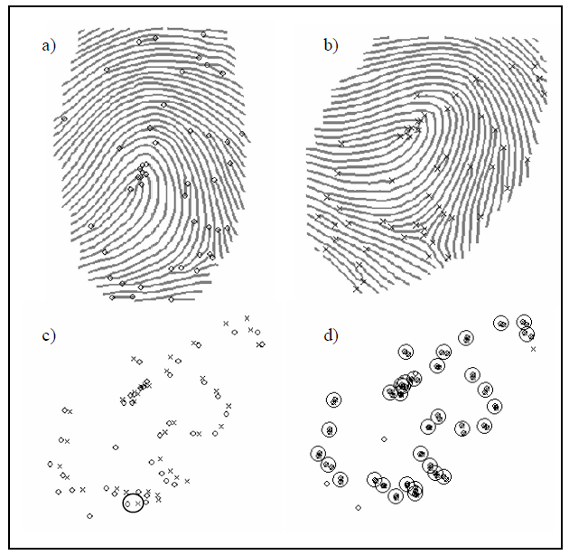
Minutia Points – Matching
Spatial Alignment
  Translation
  Rotation
Please line up in small groups, if you want a printout, to work on Ex. 1

Slide 11
Image Search using Google Image

Slide 12
Information Retrieval
Query
Q
Search
Results
Ranking
D
Documents
Best matches (Q with D) selected
Notes:
- Query running against a collection to yield result set
- Match of query with collection entries is done by mapping Q and D to feature vectors,
computing sim of Q with each vector, ranking, and selecting best matches of Q and D

Slide 13
Search Module Detail
Similarity Function
Feature vector Q
Query Q
S = Sim(Q,D1)
Document D1
Feature vectors
D1
Notes:
- Match of query with collection entries is done by mapping Q and D to feature vectors,
computing sim of Q with each vector, ranking, and selecting best matches of Q and D

Slide 14
Concept
Search based on visual content of images
  Color
  Shape
  Texture

Slide 15
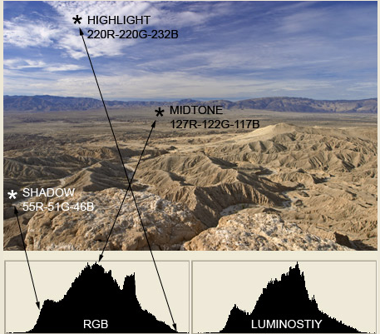

Color
Notes:
Images from: http://www.sphoto.com/techinfo/histograms/histograms2.htm

Slide 16
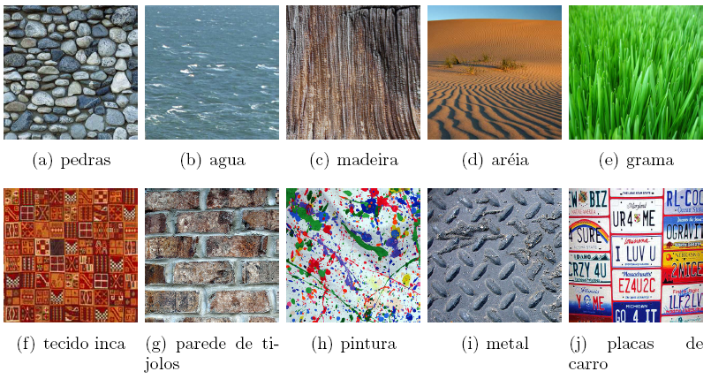
Texture
(a) Stone (b) Water (c) Wood (d) Sand (e) Grass
(f) Inca fabric (g) Brick Wall (h) Painting (i) Metal (j) Car plates

Slide 17
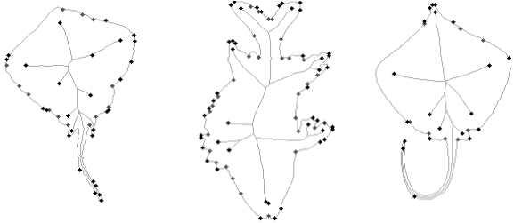
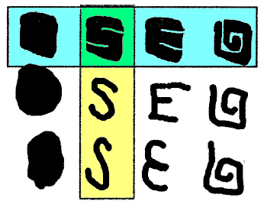
Shape
Multiscale Fractal Dimension

Slide 18
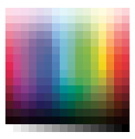
Activity 1: Multicolr Search
Go to http://labs.ideeinc.com/multicolr/
From its page, in the color palette,
choose blue color
  How many of the results
  are all natural (not human-made)?
  - look just at first page

Slide 19
Activity 1: Multicolr Search (2)
  Repeat it, but add/click on green
    Write down your guess:
    Why does having 50% each of 2 colors yield this result?
  Next, add/click on red
    Write down your guess:
    Why does having 33% of each of
    3 colors yield the result you see?

Slide 20
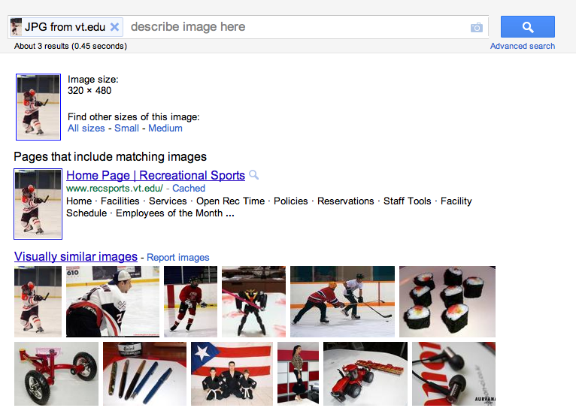
Activity 2: Precision is ?
Notes:
goo.gl/4nS7G
http://www.recsports.vt.edu/sites/drupal.recsports.vt.edu/files/slideshow-images/2011.01.22_08.49.10-6179_1.JPG

Slide 21
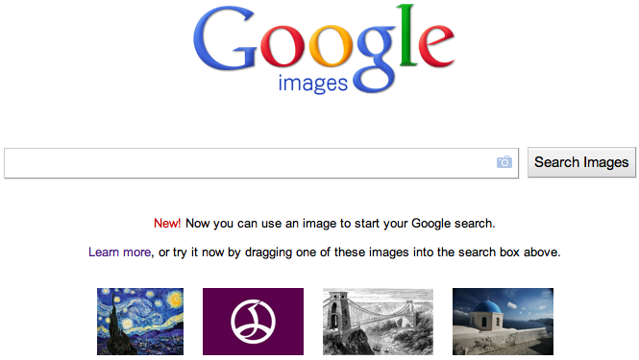
Activity 2: Google Image Search
http://images.google.com/
Click on this icon

Slide 22




Activity 2: Copy & Paste Image Links
For each link below, take a look at its results for “Visually similar images”
http://goo.gl/IN077
http://goo.gl/GcV6b
http://goo.gl/f3QCu
And, for each, follow instructions
on next slide
Notes:
http://goo.gl/IN077
http://i.telegraph.co.uk/multimedia/archive/01708/christchurch-rubbl_1708546g.jpg - good
http://goo.gl/GcV6b
(http://nelsonsvinonotes.files.wordpress.com/2011/03/800px-sh-60b_helicopter_flies_over_sendai.jpg) – medium?
ttp://goo.gl/f3QCu
http://www.4908.cn/upload/2011_04/110425172244253.jpg – bad?

Slide 23
Activity 2: Write Answers
For each of the 3, considering the similar photos found by Google Image Search, compute precision (i.e., the percentage of the supposedly similar photos that really are similar). Write down these 3 percentages.
Explain why some image queries work well while others do not.
Note: These images related to www.ctrnet.net, our Crisis, Tragedy, and Recovery network project.

Slide 24
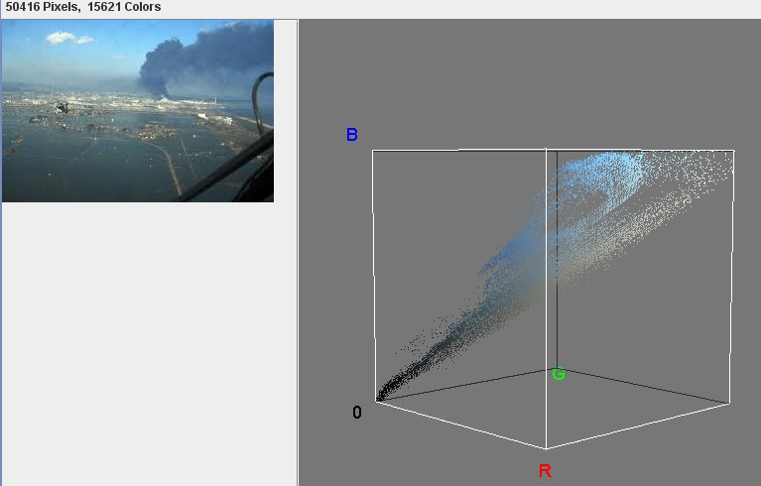
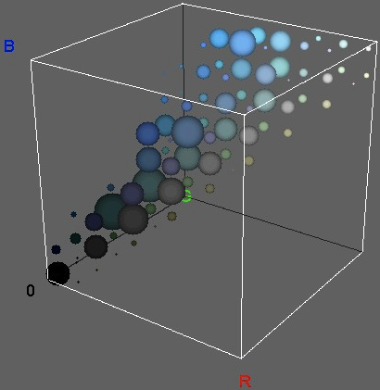
Activity 3: Histogram for 2nd Query Image

Slide 25
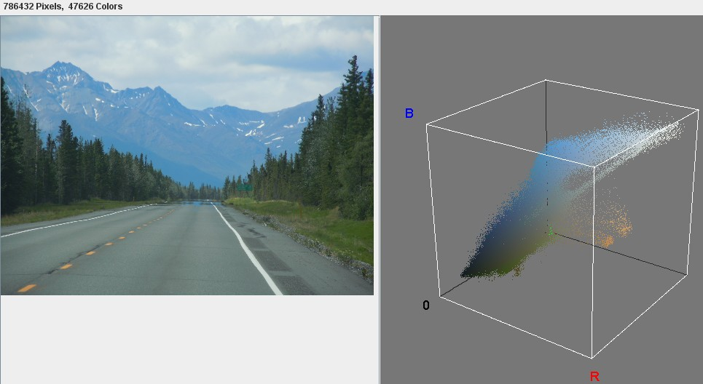
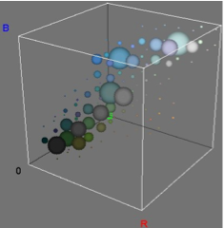
Activity 3: Is it similar? Why shown?

Slide 26
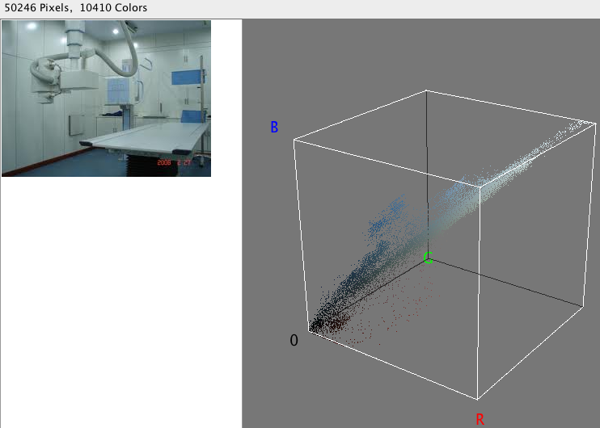
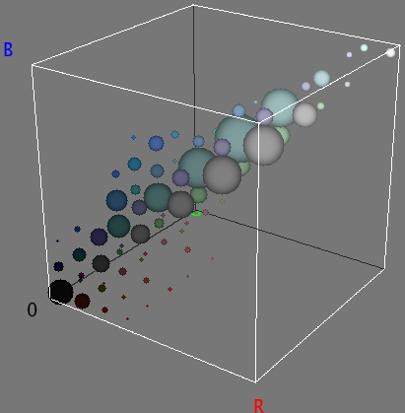
Activity 3:
Is it similar?
Why shown?
Notes:
Just to show a different one picture with different color.

Slide 27

Light-Bot

Slide 28
Goals
Light up all of the blue tiles with the Light Bot
Learn basic programming techniques while having fun!
  Main methods
  Functions
CHALLENGE
  Who can complete the highest level?
  Who can complete Light Bot in the least amount of “total commands”?

Slide 29
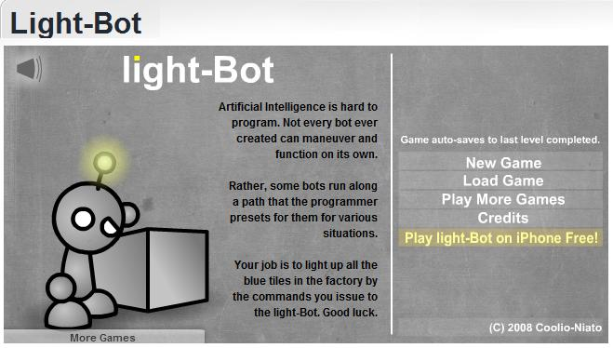
Open Light-Bot
http://armorgames.com/play/2205/light-bot
OR, Google “Light Bot” and open the first link
Ignore all the ads!

Slide 30
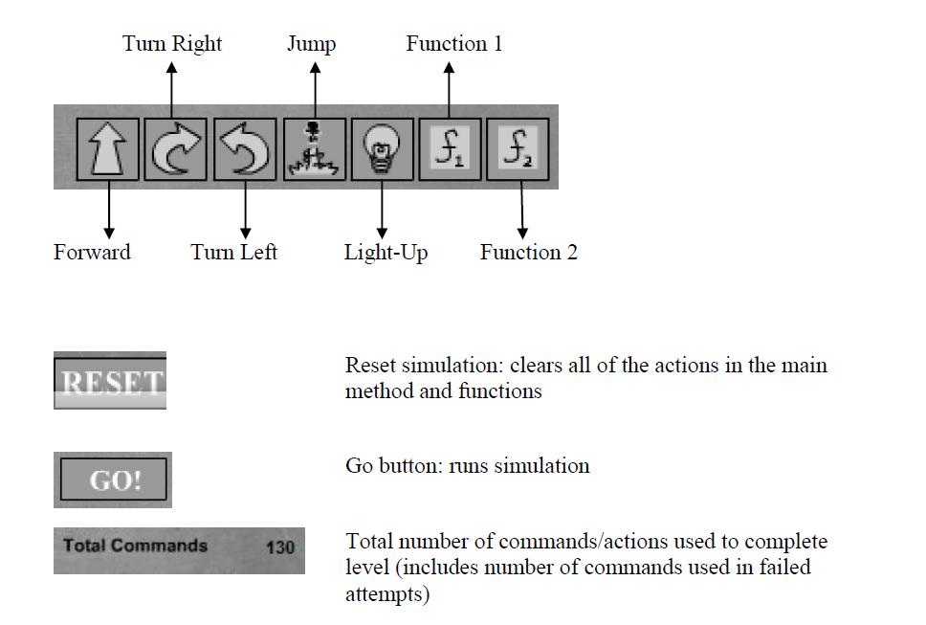
Command Key

Slide 31
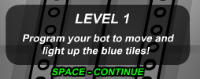
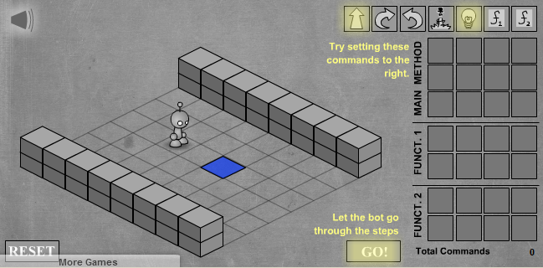
TUTORIAL: LEVEL 1
Drag and Drop Commands to the Main Method!
What is the best solution to this level?

Slide 32
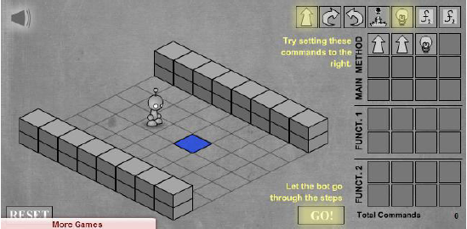
Possible Solution
Many ways to approach a problem
  Programming solutions need to be efficient and effective
Here is a possible solution to Level 1:

Slide 33
CHALLENGE
Continue to complete the remaining 11-levels, keeping the challenge in mind.
  Who can complete the highest level?
  Who can complete Light Bot in the least amount of “total commands”?

Slide 34
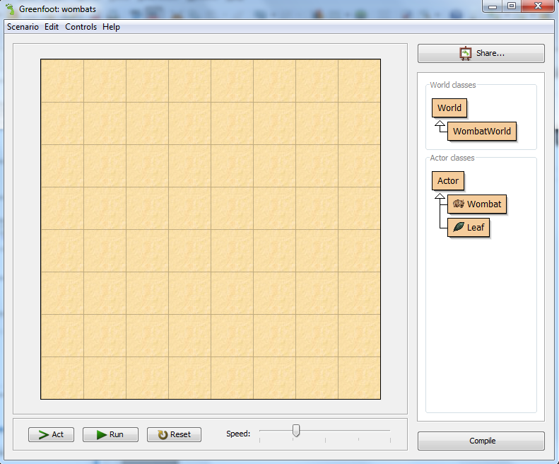
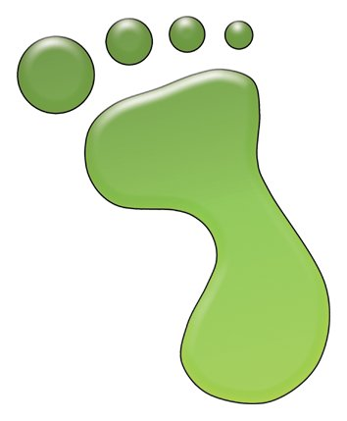
GREENFOOT
Greenfoot¹ is a framework used to simulate and visualize scenarios representing solutions to problems.
Greenfoot is a project at the University of Kent at Canterbury (UK) and Deakin University, Melbourne (Australia), supported by Sun Microsystems.
Click on the Greenfoot icon on the desktop, to start.
¹www.greenfoot.org

Slide 35
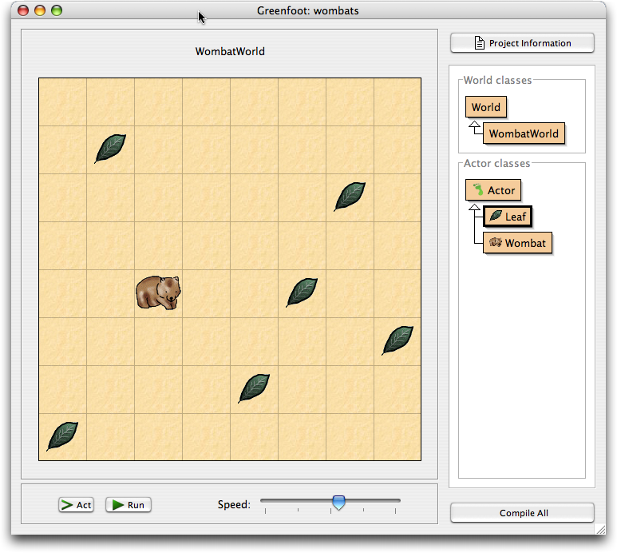
Wombat Scenario
Scenario represents the problem or the world to be solved or simulated.

Slide 36
GREENFOOT Interface

Slide 37
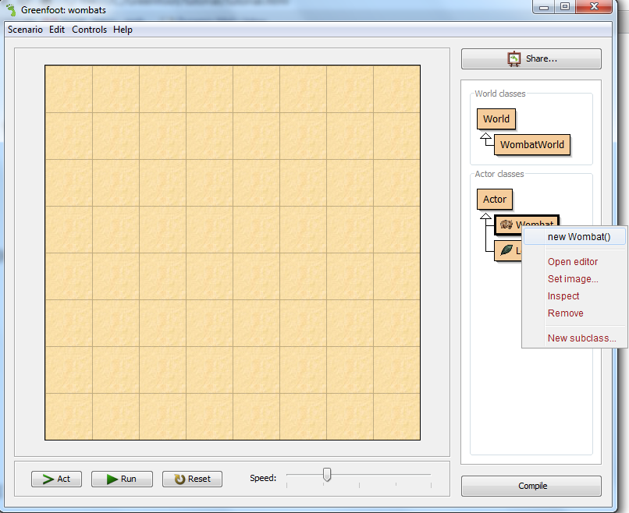
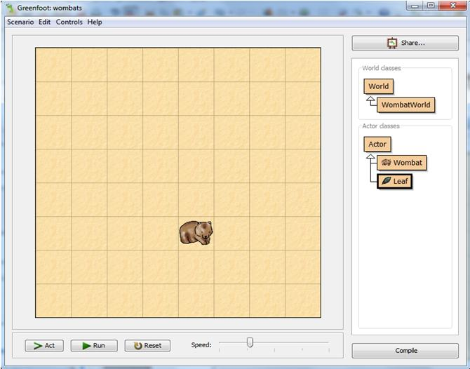
Add a Wombat
To add a wombat, right click on the Wombat class in the right panel and choose new Wombat().
Use the mouse to place the Wombat in a cell.

Slide 38
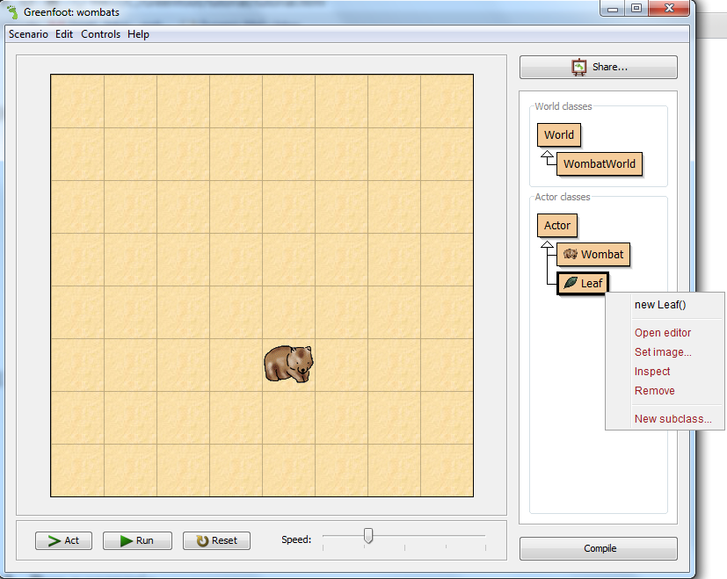
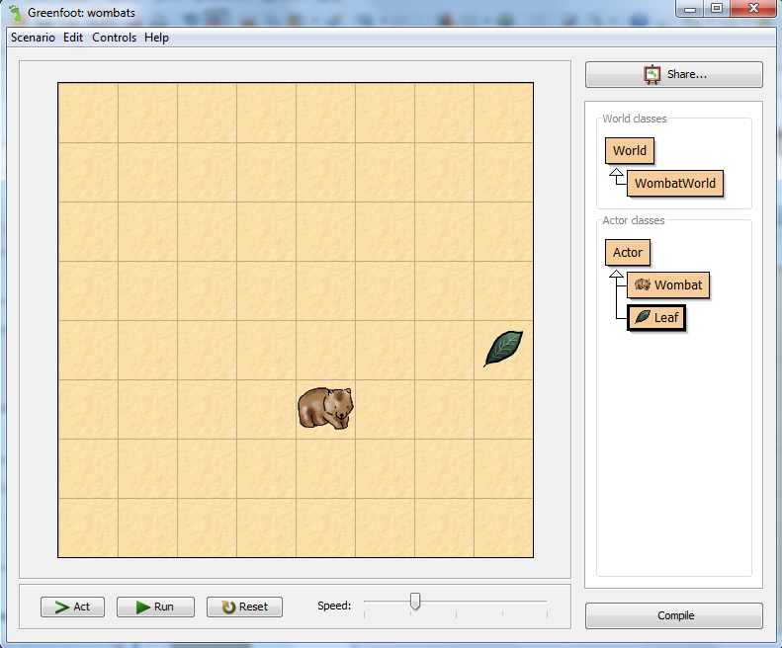
Add a Leaf
To add a leaf, right click on the Leaf class in the right panel and choose new Leaf().
Use the mouse to place the Leaf in a cell.

Slide 39
Make Objects Act
Click the ‘Act’ button in the execution controls. Each object now does whatever it wants to do.
What objects want to do depends on how they are defined.
Wombats like to eat leaves. If they happen to come across a leaf in their path, they will eat it.

Slide 40
Run a Scenario
Click the ‘Run’ button. This is equivalent to clicking the Act button over and over again, very quickly.
The slider next to the Act and Run buttons sets the speed.
Try various speeds, and then shift to a slow speed for the rest of the exercise.

Slide 41
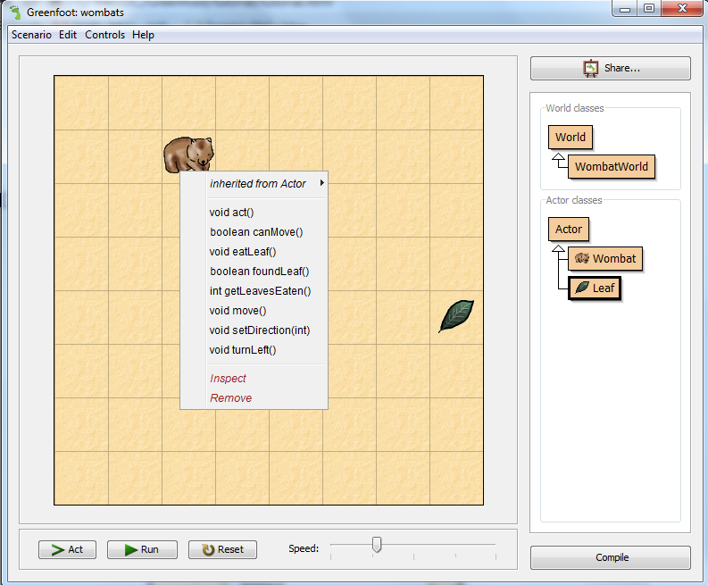
Invoke Methods Directly
Right click on the Wombat object and choose the act() method.

Slide 42
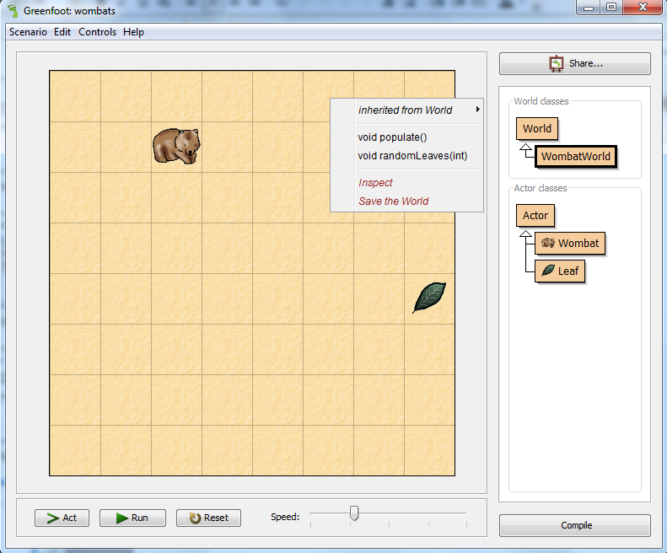
Invoke a World Method
Right click on the world grid and choose the populate() method. This will fill the world with arbitrary numbers of Wombats and leaves.

Slide 43
Create a New World
If you want to start all over, there is one easy option: throw away the world and create a new one.
This is usually done by clicking the 'Reset' button at the bottom of the screen.
Try 'Reset’, and experiment till comfortable with the overall scenario.

Slide 44
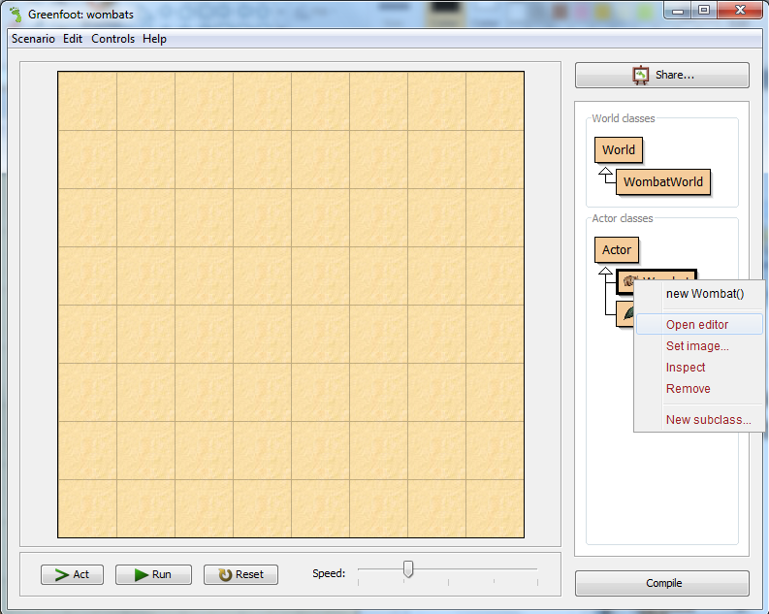
Change the Behavior of an Object
The Wombat always takes the Left direction in each action. We will now make it take a random direction.
Right click on the Wombat class and choose Open editor.

Slide 45
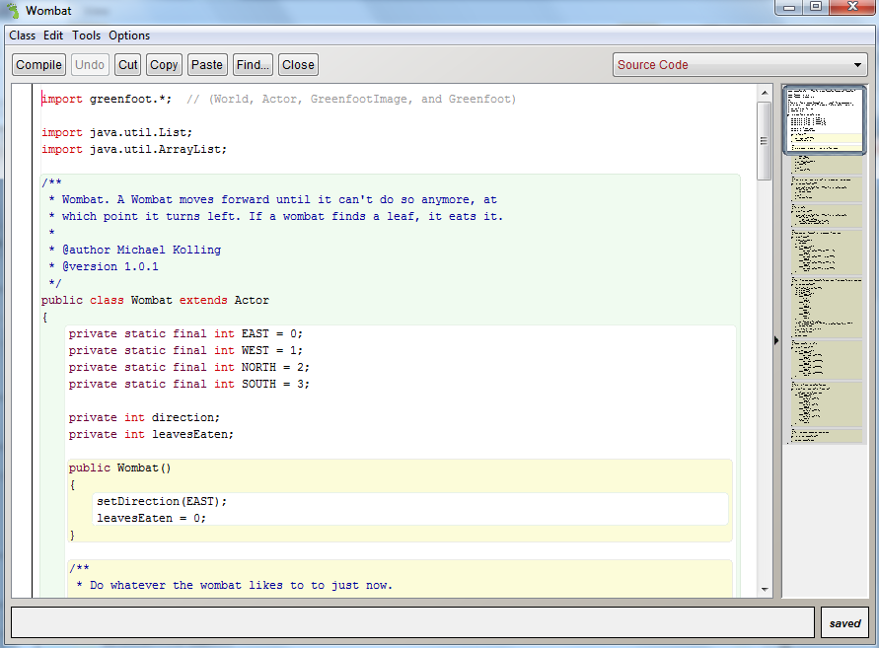
Change the Behavior of an Object (cont.)
View of the controlling program, using an editor:
Wombat
class

Slide 46
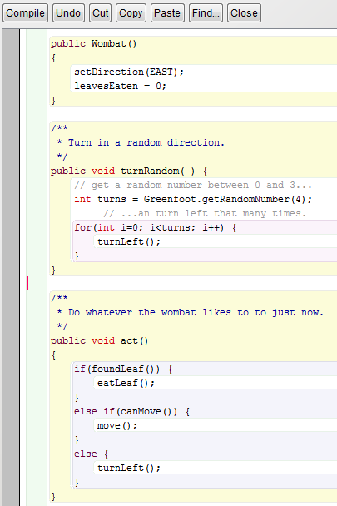
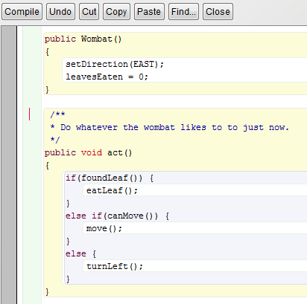
Change the Behavior of an Object (cont.)
Add the lines in http://www.greenfoot.org/doc/tutorial/tutorial.html#TOC10505 in the position shown.

Slide 47
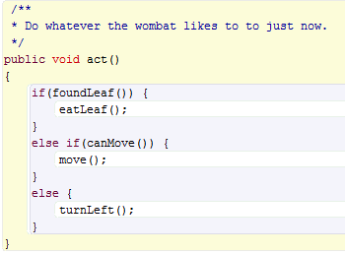
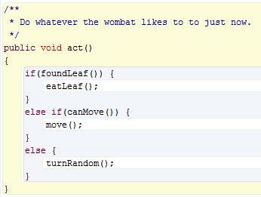
Change the Behavior of an Object (cont.)
Inside the act() function, change turnLeft() to turnRandom(), then press the Close button at the top.
Press the Compile button at the bottom right. Place some Wombats and leaves again.
Press the Run button to see how the Wombat will change its direction randomly.

Slide 48
More on Greenfoot
To learn more about Greenfoot, visit www.greenfoot.org/about/
Use their tutorial to gain more in-depth knowledge
  http://www.greenfoot.org/doc/tutorial/tutorial.html
At your leisure, later, try out scenarios in the Greenfoot gallery: http://greenfootgallery.org/
Now, try out some examples, and for each, jot down a sentence summarizing what you learned:
  http://greenfootgallery.org/scenarios/772 (queues, scheduling)
  http://greenfootgallery.org/scenarios/597 (waves in Physics)
  http://greenfootgallery.org/scenarios/1857 (flocking behavior)

Slide 49

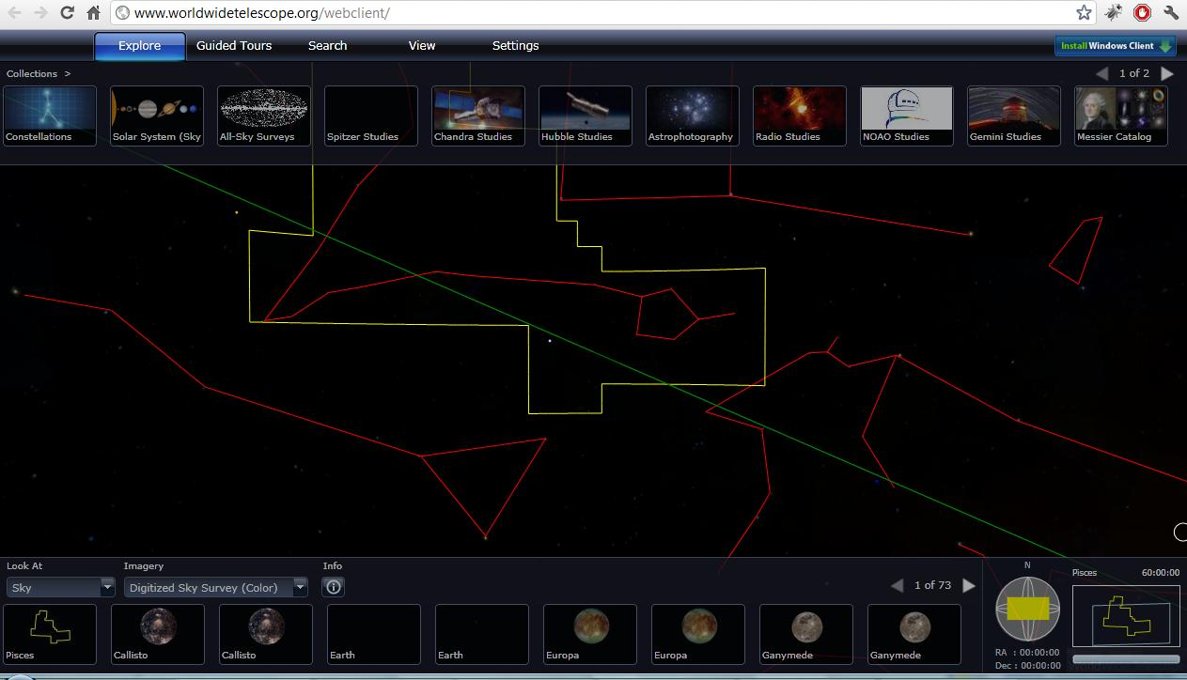
World Wide Telescope (WWT)
Explore the universe through the images taken from a number of ground and space-based telescopes.
Open Internet Explorer
We are going to use the web-client available at the following location: www.worldwidetelescope.org/webclient/
WWT might not load on the first try. It might seem like the site is down.
The browser should be refreshed (f5) 2-3 times to load the page.
Notes:
WWT might not load on the first try. It might seem like the site is down. The browser should be refreshed (f5) 2-3 times to load the page.

Slide 50
Navigating through WWT
Explore collections, search
Available images
Context
(constellation, field of view)
Notes:
On top, various collections contain images, maps, and surveys of the sky taken by a number of telescopes.
Lower left section contains all the images of various objects (e.g., stars, galaxies, constellations) for the areas currently in view (in the middle).
Lower right section gives contextual information such as where the constellation (red outlines) appear in the sky at earth, name of the constellation, size of the field of view (in blue rectangle box). In the middle, the yellow box selects the constellation. As we zoom in, these boxes (yellow constellation box and blue field of view box) disappear from the main section, but they are still present in the context box.

Slide 51
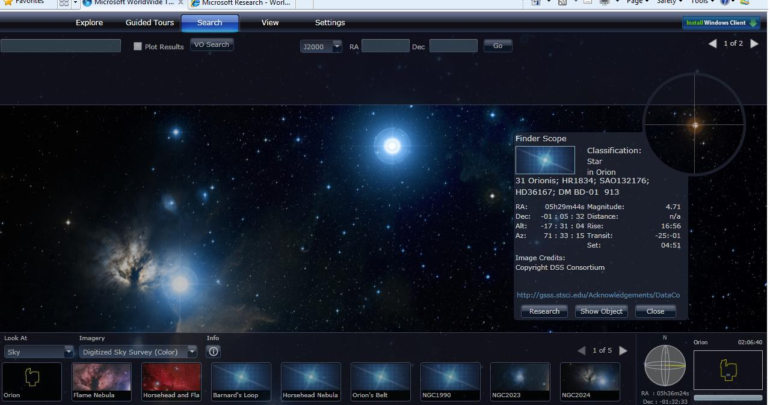
Navigating through WWT (cont.)
Finderscope (Shift+click)
Search
Notes:
There are two ways to find objects in WWT.
Use the search box and type in the word. Checking the plot box next to the search text box will allow us to see the search results visually. Blue circles are used to plot the search results.
Findersope is another way to find more information on things that are in our view. First click on an object to select it, then press shift+click to bring in the finderscope. Once up, finderscope can be dragged to select other objects. The ‘close’ button should be used to close finderscope. The ‘Research’ button provides more options such as finding more information on the object.

Slide 52
Task I
Where is the Grand Canyon of Mars?
  Set ‘Look at’ to ‘Planet’ (at the lower left corner)
  Set ‘Imagery’ to ‘Mars’ (near the lower left corner)
  See the next slide, and navigate as suggested.
Please raise your hand if you have any question or need any help.
Notes:
Note: WWT can sometime behave unpredictably (like spinning, rotating without control). Browser should be refreshed when this happens.

Slide 53
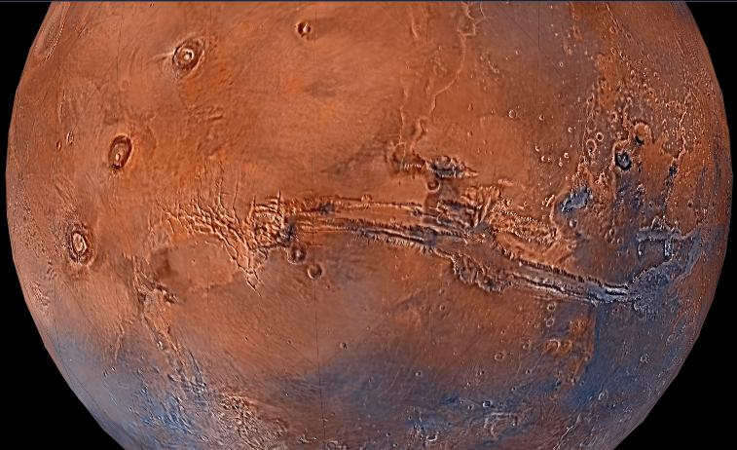
Here is the Grand Canyon of Mars!
Look for these 3 big spots in a row; the canyon is close to them!
Grand Canyon of Mars
Notes:
Note: WWT can sometime behave unpredictably (like spinning, rotating without control). Browser should be refreshed when this happens.

Slide 54
Task II
Find the Constellation of Cat’s Eye Nebula
  Click Search (Menu in the upper part, 3rd from left, using VO Cone Search, entering query in box at left)
  Type ‘cat’s eye’
  Click on any image (e.g., the 3rd). Zoom in.
Q: Which constellation includes the Cat’s eye Nebula?
Notes:
A. Draco

Slide 55

Constellation of Cat’s Eye
Find constellation name in bottom right

Slide 56
Task III
What is your favorite planet in the solar system? Why?
  Set ‘Look at’ to ‘Planet’ (at the lower left corner)
  Set ‘Imagery’ to one planet after another that you wish to explore (near the lower left corner)
Q: What is there new and exciting about that planet, that you found out today, using WWT?
Notes:
A: Helix Nebula, also known as NGC 7293

Slide 57
Task IV
Where are we meeting now?
  Set ‘Look at’ to ‘Earth’ (at the lower left corner)
  Set ‘Imagery’ to ‘Virtual Earth Hybrid’ (near the lower left corner)
Q: What are the names of the 3 roads closest to this room? What is our longitude and latitude?
Notes:
A: 700 light years.

Slide 58
Computing in WWT
Data & Information
  Information storage, retrieval, search, modeling, mapping, representation.
  Gather information about planets, stars (e.g., names, coordinates) in the galaxy, etc.
  Store data in a structured way (XML files)
Information Visualization
  Visual mapping
  Scaling large dataset: zooming and panning
  Contextual navigation
Computer Graphics
  Images, Videos, Animations of planets, stars, etc.
Numerical Analysis
  Curve fitting: orbits of planets

Slide 59
How All the Pieces Fit Together
VT Fingerprint project
  Pattern matching.
Image Search
  Finding out how Google Image search performs.
Lightbot
  Program machines to do things.
Greenfoot
  Simulate real-world scenarios, a closer look at programming.
  Using objects gives terser, more organized approach to programming (aka Object-oriented programming).
WWT
  End result of data collection, storage, and programming. An interface that allows users to easily navigate through the universe!

Slide 60
For More
Computer Science Website http://www.cs.vt.edu
Videos and posters http://www.dlib.vt.edu/DLRL_Outreach.html
Email: fox@vt.edu
Following are some of the areas of Computer Science¹
  Discrete Structures (DS)
  Programming Fundamentals (PF)
  Algorithms and Complexity (AL)
  Programming Languages (PL)
  Architecture and Organization (AR)
  Operating Systems (OS)
  Net-Centric Computing (NC)
  Human-Computer Interaction (HC)
  Graphics and Visual Computing (GV)
  Intelligent Systems (IS)
  Information Management (IM)
  Software Engineering (SE)
  Social and Professional Issues (SP)
  Computational Science and Numerical Methods (CN)
¹http://www.acm.org/education/curric_vols/cc2001.pdf, PDF p. 239

Slide 61
More on Computing
Online videos about CS faculty / students and posters
  www.dlib.vt.edu/DLRL_Outreach.html
Some of the very best jobs are related to computing
  System designer
  Graphics designer
  Game developer
  Software Engineer
  Network specialist
Some of the very best companies are connected with computing
  Apple
  Google
  Microsoft
  IBM
  Intel
Many of the world's greatest challenges cannot be addressed without computing
  Genome sequencing
  Weather forecast
  Simulation

Slide 62
Questions
Thank you!

