Slide 1
IMAGINATION
Edward A. Fox
fox@vt.edu http://fox.cs.vt.edu
Monika Akbar, Eric Fouh, Lin Tzy Li, Mohamed Magdy, Nathan Short, Seungwon Yang, Sloane Neidig, Uma Murthy
Department of Computer Science, Virginia Tech
Blacksburg, VA 24061
Outreach Activity, July 12, 2011

Slide 2
About Instructor
Started studying about computers when 15 years old;
enthralled; knew that would be my profession.
BS (Elect. Eng.) from MIT, MS and PhD from Cornell in Computer Science.
Professor at VT, teaching since 1983.
Executive Director for a non-profit: Networked Digital Library of Theses and Dissertations
Married 40 years, 4 sons, 3 grandsons; in 45 countries; teach energy healing.
Involved in computer applications to:
archaeology, archives, autos, biology, business, chemistry, civil engineering, education, entertainment, fishes, geography, government, health, justice, language, law, libraries, math, navy, physics, sociology

Slide 3
Students Who Helped Prepare the Activities
Eric Fouh
  Cameroon
Lin Tzy Li
  Brazil
Mohamed Magdy
  Egypt
Monika Akbar
  Bangladesh
Nathan Short
  USA
Seungwon Yang
  South Korea
Sloane Neidig
  USA
Uma Murthy
  India

Slide 4
Overview of the Class
VT Fingerprint project
  Looking closely at fingerprints.
Light-bot
  Programming through a game.
WorldWide Telescope
  Make your computer a virtual telescope, look beyond the horizon, on earth, across space and time.
All materials are available at
http://www.computingportal.org/imagination

Slide 5
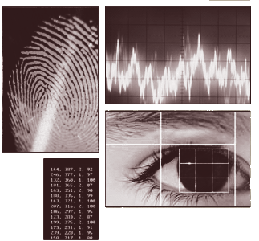
Biometrics:
Fingerprint Recognition

Slide 6
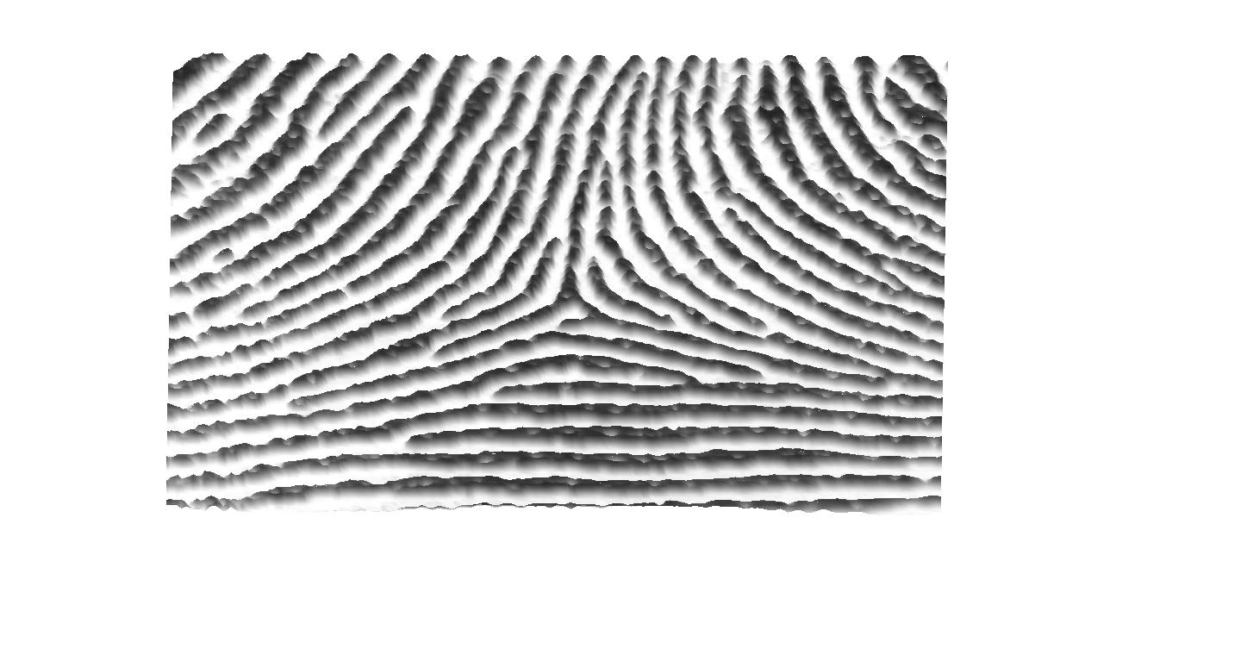
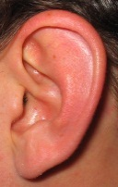

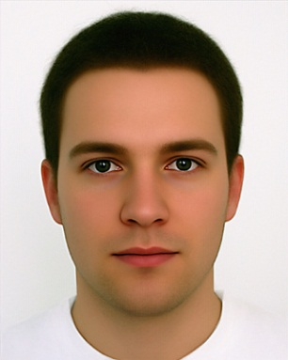

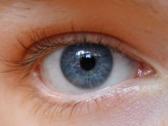

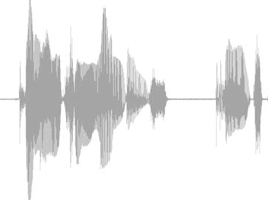
Biometrics – Human Identification
Ear
Hand
Face
Valleys
Ridges
Iris
Fingerprint
Speech

Slide 7
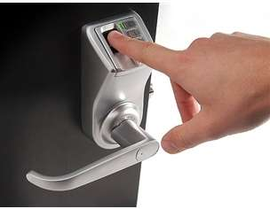
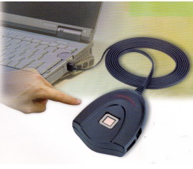

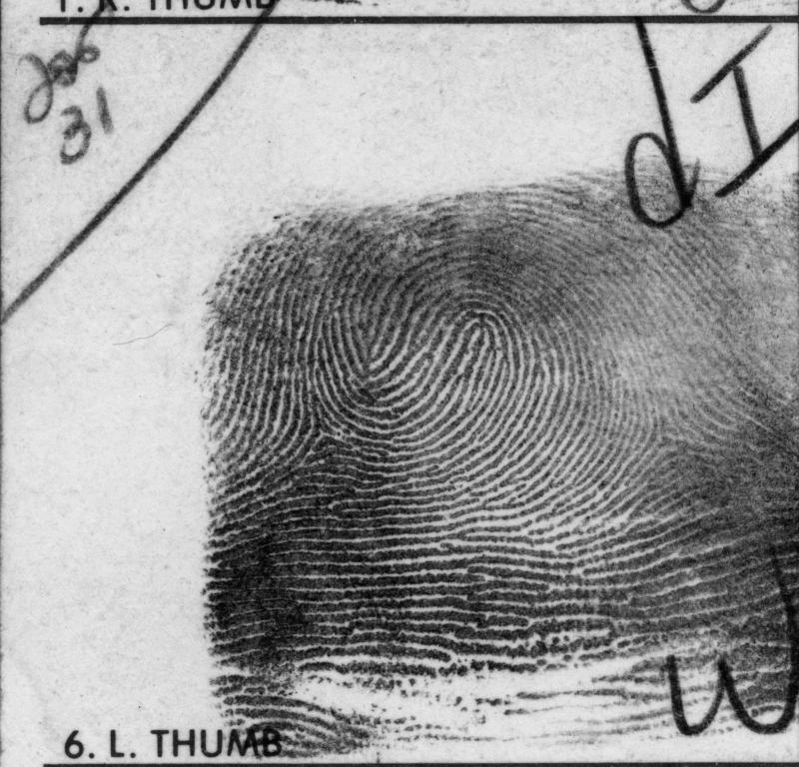
Why Fingerprints?
Friction Ridge Surface
  Provide friction for grasping objects
Universal
Unique
Verification
Identification

Slide 8
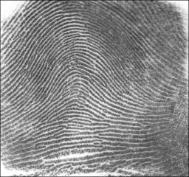
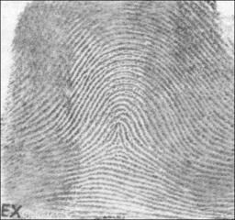
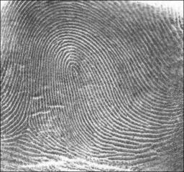
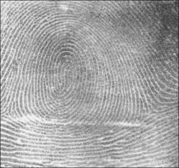
Fingerprint Types and Singular points
Fingerprint Types
Cores
Deltas
Tented
Arch
Arch
Loop
(right)
Loop
(left)
Whorl

Slide 9
Minutia Points - Definition
Defining features
  used for finding a matching print
Terminations
Bifurcations

Slide 10
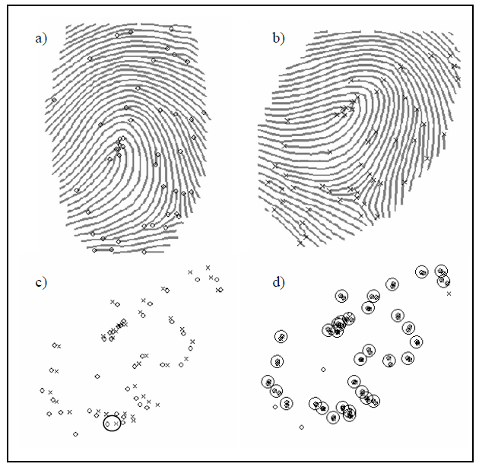
Minutia Points – Matching
Spatial Alignment
  Translation
  Rotation

Slide 11

Light-Bot

Slide 12
Goals
Light up all of the blue tiles with the Light Bot
Learn basic programming techniques while having fun!
  Main methods
  Functions
CHALLENGE
  Who can complete the highest level?
  Who can complete Light Bot in the least amount of “total commands”?

Slide 13
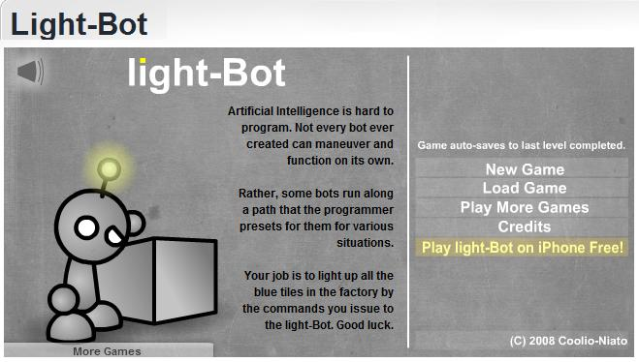
Open Light-Bot
http://armorgames.com/play/2205/light-bot
OR, Google “Light Bot” and open the first link
Ignore all the ads!

Slide 14
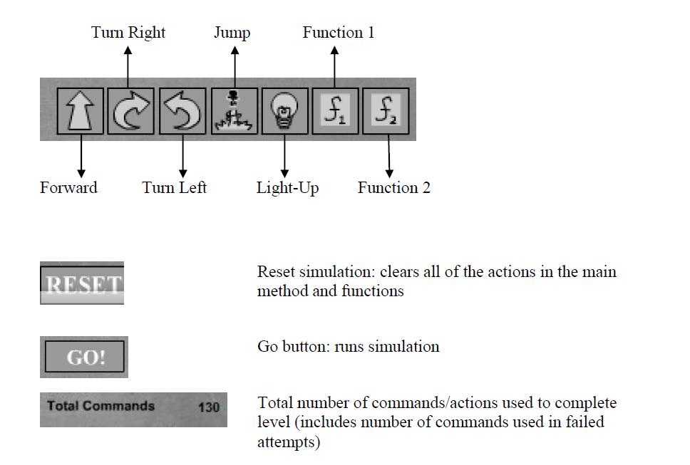
Command Key

Slide 15
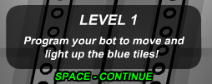
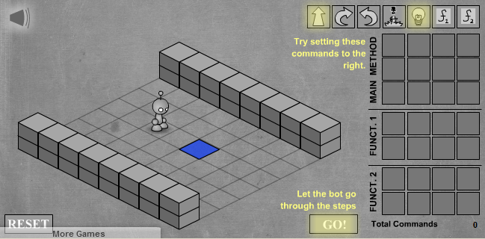
TUTORIAL: LEVEL 1
Drag and Drop Commands to the Main Method!
What is the best solution to this level?

Slide 16
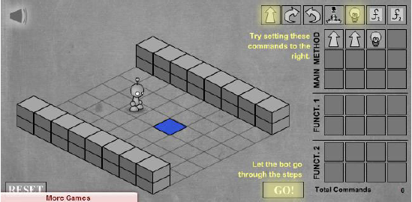
Possible Solution
Many ways to approach a problem
  Programming solutions need to be efficient and effective
Here is a possible solution to Level 1:

Slide 17
CHALLENGE
Continue to complete the remaining 11-levels, keeping the challenge in mind.
  Who can complete the highest level?
  Who can complete Light Bot in the least amount of “total commands”?

Slide 18

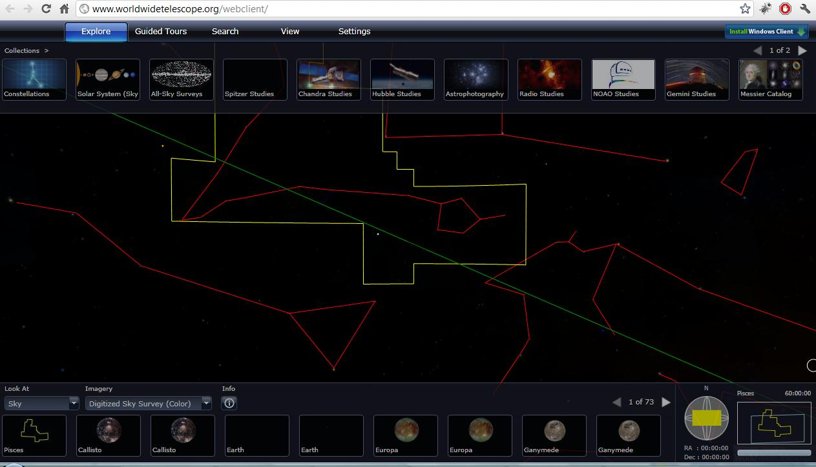
World Wide Telescope (WWT)
Explore the universe through the images taken from a number of ground and space-based telescopes.
Open Internet Explorer
We are going to use the web-client available at the following location: www.worldwidetelescope.org/webclient/
WWT might not load on the first try. It might seem like the site is down.
The browser should be refreshed (f5) 2-3 times to load the page.
Notes:
WWT might not load on the first try. It might seem like the site is down. The browser should be refreshed (f5) 2-3 times to load the page.

Slide 19
Navigating through WWT
Explore collections, search
Available images
Context
(constellation, field of view)
Notes:
On top, various collections contain images, maps, and surveys of the sky taken by a number of telescopes.
Lower left section contains all the images of various objects (e.g., stars, galaxies, constellations) for the areas currently in view (in the middle).
Lower right section gives contextual information such as where the constellation (red outlines) appear in the sky at earth, name of the constellation, size of the field of view (in blue rectangle box). In the middle, the yellow box selects the constellation. As we zoom in, these boxes (yellow constellation box and blue field of view box) disappear from the main section, but they are still present in the context box.

Slide 20
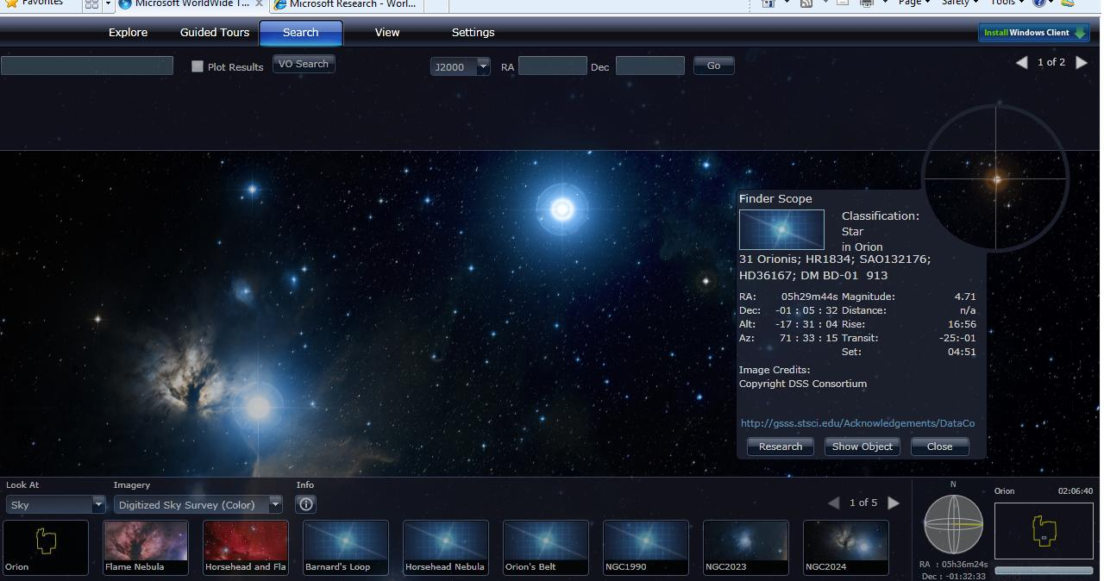
Navigating through WWT (cont.)
Finderscope (Shift+click)
Search
Notes:
There are two ways to find objects in WWT.
Use the search box and type in the word. Checking the plot box next to the search text box will allow us to see the search results visually. Blue circles are used to plot the search results.
Findersope is another way to find more information on things that are in our view. First click on an object to select it, then press shift+click to bring in the finderscope. Once up, finderscope can be dragged to select other objects. The ‘close’ button should be used to close finderscope. The ‘Research’ button provides more options such as finding more information on the object.

Slide 21
Task I
Where is the Grand Canyon of Mars?
  Set ‘Look at’ to ‘Planet’ (at the lower left corner)
  Set ‘Imagery’ to ‘Mars’ (near the lower left corner)
  See the next slide, and navigate as suggested.
Please raise your hand if you have any question or need any help.
Notes:
Note: WWT can sometime behave unpredictably (like spinning, rotating without control). Browser should be refreshed when this happens.

Slide 22
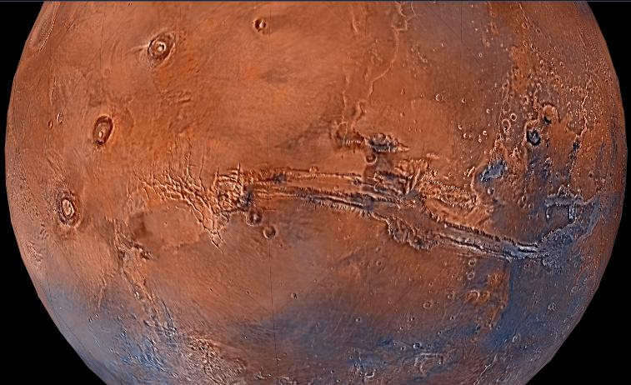
Here is the Grand Canyon of Mars!
Look for these 3 big spots in a row; the canyon is close to them!
Grand Canyon of Mars
Notes:
Note: WWT can sometime behave unpredictably (like spinning, rotating without control). Browser should be refreshed when this happens.

Slide 23
Task II
Find the Constellation of Cat’s Eye Nebula
  Click Search (Menu in the upper part, 3rd from left, using VO Cone Search, entering query in box at left)
  Type ‘cat’s eye’
  Click on any image (e.g., the 3rd). Zoom in.
Q: Which constellation includes the Cat’s eye Nebula?
Notes:
A. Draco

Slide 24
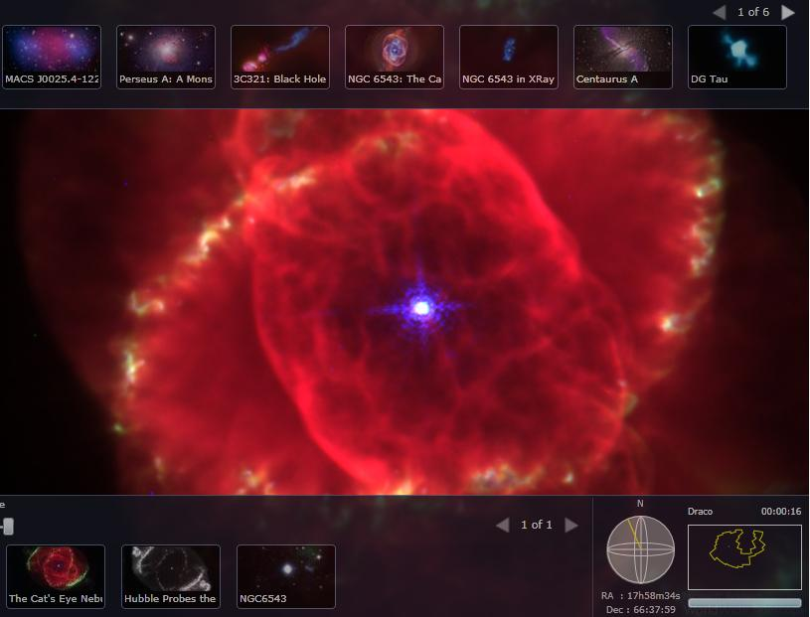
Constellation of Cat’s Eye
Find constellation name in bottom right

Slide 25
Task III
What is your favorite planet in the solar system? Why?
  Set ‘Look at’ to ‘Planet’ (at the lower left corner)
  Set ‘Imagery’ to one planet after another that you wish to explore (near the lower left corner)
Q: What is there new and exciting about that planet, that you found out today, using WWT?
Notes:
A: Helix Nebula, also known as NGC 7293

Slide 26
Task IV
Where are we meeting now?
  Set ‘Look at’ to ‘Earth’ (at the lower left corner)
  Set ‘Imagery’ to ‘Virtual Earth Hybrid’ (near the lower left corner)
Q: What are the names of the 3 roads closest to this room? What is our longitude and latitude?
Notes:
A: 700 light years.

Slide 27
Task V
Q: How does WWT know where to place the stars, galaxies, etc.?
Various ways of storing structured data – see next slide
  Database, XML files, Excel files
To plot the stars, what information do you need to store?
Notes:
A: Name of the star, co-ordinate, constellation information, distance, etc.

Slide 28
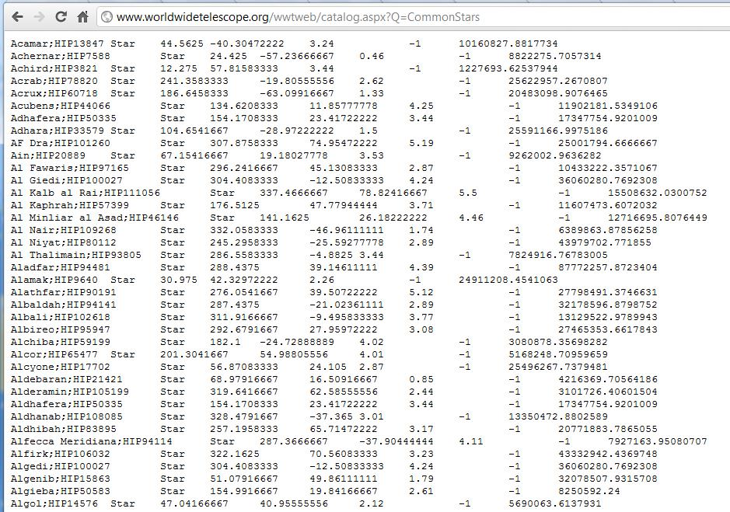
WWT Data on Star Co-ordinates
Open a new Internet Explorer window and type http://www.worldwidetelescope.org/wwtweb/catalog.aspx?Q=CommonStars
Can you guess the heading/label for each column?
Hint: See http://www.kidscosmos.org/kid-stuff/celestial.html

Slide 29
Computing in WWT
Data & Information
  Information storage, retrieval, search, modeling, mapping, representation.
  Gather information about planets, stars (e.g., names, coordinates) in the galaxy, etc.
  Store data in a structured way (XML files)
Information Visualization
  Visual mapping
  Scaling large dataset: zooming and panning
  Contextual navigation
Computer Graphics
  Images, Videos, Animations of planets, stars, etc.
Numerical Analysis
  Curve fitting: orbits of planets

Slide 30
How All the Pieces Fit Together
VT Fingerprint project
  Pattern matching.
Lightbot
  Program machines to do things.
WWT
  End result of data collection, storage, and programming. An interface that allows users to easily navigate through the universe!

Slide 31
For More
Computer Science Website http://www.cs.vt.edu/
Email: fox@vt.edu
Following are some of the areas of Computer Science¹
  Discrete Structures (DS)
  Programming Fundamentals (PF)
  Algorithms and Complexity (AL)
  Programming Languages (PL)
  Architecture and Organization (AR)
  Operating Systems (OS)
  Net-Centric Computing (NC)
  Human-Computer Interaction (HC)
  Graphics and Visual Computing (GV)
  Intelligent Systems (IS)
  Information Management (IM)
  Software Engineering (SE)
  Social and Professional Issues (SP)
  Computational Science and Numerical Methods (CN)
¹http://www.acm.org/education/curric_vols/cc2001.pdf, PDF p. 239

Slide 32
Questions?
Thank you!

