Slide 1
C-Tech²
Edward A. Fox
fox@vt.edu http://fox.cs.vt.edu
Monika Akbar, Eric Fouh, Lin Tzy Li, Mohamed Magdy, Nathan Short, Seungwon Yang, Sloane Neidig, Uma Murthy
Department of Computer Science, Virginia Tech
Blacksburg, VA 24061
Outreach Activity, July 7, 2011

Slide 2
About Instructor
Started studying about computers when 15 years old; enthralled; knew that would be my profession.
BS (Elect. Eng.) from MIT, MS and PhD from Cornell in Computer Science.
Professor at VT, teaching since 1983.
Executive Director for a non-profit: Networked Digital Library of Theses and Dissertations
Married 40 years, 4 sons, 3 grandsons; in 45 countries; teach energy healing.
Involved in computer applications to: archaeology, archives, autos, biology, business, chemistry, civil engineering, education, entertainment, fishes, geography, government, health, justice, language, law, libraries, math, navy, physics, sociology

Slide 3
Students Who Helped Prepare the Activities
Eric Fouh
Cameron
Lin Tzy Li
Brazil
Mohamed Magdy
Egypt
Monika Akbar
Bangladesh
Nathan Short
USA
Seungwon Yang
South Korea
Sloane Neidig
USA
Uma Murthy
India

Slide 4
Overview of the Class
Wayback machine
Digital preservation: Looking back in time.
Light-bot
Programming through a game.
SuperIDR
Find the fishes.
WorldWide Telescope
Make your computer a virtual telescope, look beyond the horizon, on earth, across space and time.
All materials are available at
http://www.computingportal.org/ctech

Slide 5
What is the Wayback Machine?
The Wayback Machine is an historical archive of preserved web pages.
Type in a URL and start surfing through time.
The archive of pages goes back to 1996.
Its original interface was released in 2001 with about 10 billion pages.
http://faq.web.archive.org/what-is-the-wayback-machine/

Slide 6
What is the Internet Archive (IA)?
Non-profit organization founded to build an Internet library for researchers, scholars, lawyers, and historians.
Preserve and provide historical collections (e.g., texts, audio, images, videos) in digital format.
Founded in 1996 and located in San Francisco.
Partner with us in our Crisis, Tragedy, and Recovery project (www.ctrnet.net).
http://faq.web.archive.org/what-is-the-wayback-machine/
http://www.archive.org/about/about.php

Slide 7
Adding Your Site to Wayback Machine
Most sites are crawled during the regular archiving efforts.
This probably applies to your school, sports activities, local government, etc.
But some are missed. Here are steps so sites you like can be included:
Get your site listed in major directories
Go to http://www.dmoz.org (Open Directory)
Find a category for your site to be listed
Click ‘Add URL’ and enter your site’s URL
Fix your site’s robots.txt rules to allow crawlers to capture your site.
http://faq.web.archive.org/my-sites-not-archived-how-can-i-add-it/

Slide 8
Exercise I
Go to http://wayback.archive.org/web/
Find your high school’s earliest archived homepage in the Wayback Machine, by entering your school’s URL and clicking the ‘Show All’ button.
Record your answers to the 2 questions on following slides on paper, and when everyone is done, use that information when raising your hand.
Notes:
Ask for a show of hands for the 2 parts to Q1: - 1996-1999, 2000-2004, after, not at all - crawled 0-9, 10-99, 100-499, more times

Slide 9
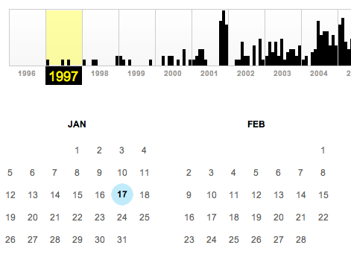
Exercise I
Q1. When was it archived for the first time?
Hint: Click the earliest year in the timeline toolbar on top of the page and find the date from the calendar.
Notes:
A1: student groups will have different dates. Find the group that has the oldest archived page.

Slide 10
Exercise I
Q2. How many times has it been crawled (see the example below)?
Notes:
A2: answers will be different. Check if they could find the number or not.

Slide 11
Exercise II
Go to http://wayback.archive.org/web/
Find archived pages of the Blacksburg Electronic Village in the Wayback Machine, by entering ‘www.bev.net’ and clicking the ‘Show All’ button.

Slide 12
Exercise II
Find the page archived on May 16, 2001
Q1: What are the 3 upcoming events given on this ‘Calendar’ page?
Find the page archived on Feb. 8, 1999
Q2: Who planned to visit VT on March 30, 1999?
Notes:
A1: Blacksburg high school class reunion (1991), YMCA worlds largest run registration, BEV online calendar, Dracula, Breastfeeding study, Movies are back, and starting a community network.
A2: General Colin L. Powell (Ret.)
Q1: Please raise you hand if you can give one event you found Q2: Please raise your hand if you know who

Slide 13
Exercise III
Go to http://wayback.archive.org/web/
Find archived pages of the Blacksburg Electronic Village in the Wayback Machine, by entering ‘www.bev.net’ and clicking the ‘Show All’ button.
Q1: Give the date when this site was last archived.
Q2: What is the most probable reason that the archiving of the site has stopped?
Notes:
A1: 10/7/2009
A2: Students might answer it is because of ‘robots.txt’ file. The file exists in the server, but it allows crawling of the main page (excluding other folders). Also, the fact that we can access the historic archived pages of bev.net tells us that it is not the reason.
Q1: Please raise you hand if you can explain why this date was chosen Q2: Please raise your hand if you can suggest a reason

Slide 14
Light-Bot

Slide 15
Goals
Light up all of the blue tiles with the Light Bot
Learn basic programming techniques while having fun!
Main methods
Functions
CHALLENGE
Who can complete the highest level?
Who can complete Light Bot in the least amount of “total commands”?

Slide 16
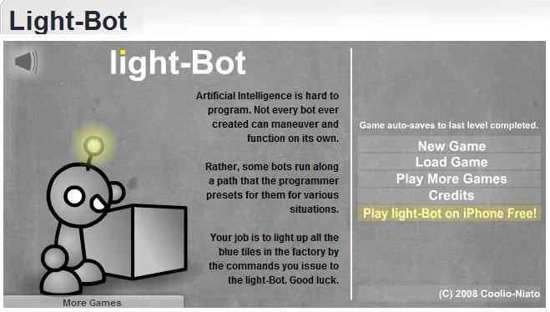
Open Light-Bot
http://armorgames.com/play/2205/light-bot
OR, Google “Light Bot” and open the first link
Ignore all the ads!

Slide 17
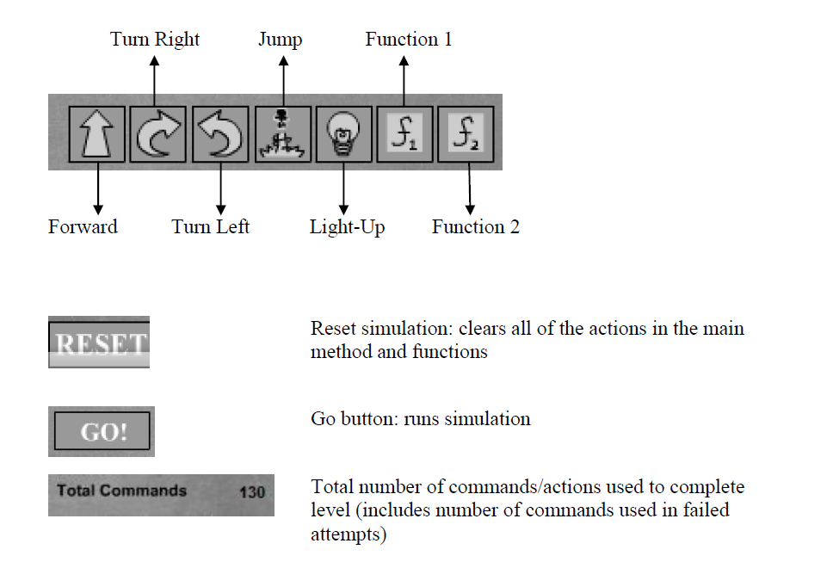
Command Key

Slide 18
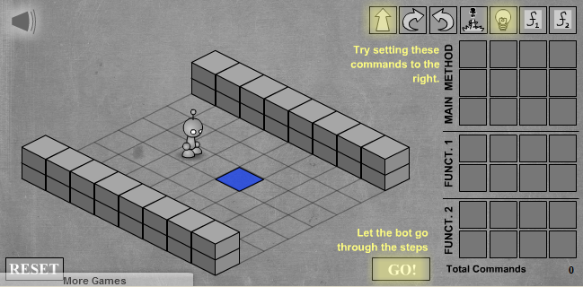
TUTORIAL: LEVEL 1
Drag and Drop Commands to the Main Method!
What is the best solution to this level?

Slide 19
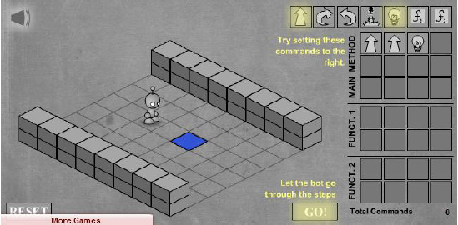
Possible Solution
Many ways to approach a problem
Programming solutions need to be efficient and effective
Here is a possible solution to Level 1:

Slide 20
CHALLENGE
Continue to complete the remaining 11-levels, keeping the challenge in mind.
Who can complete the highest level?
Who can complete Light Bot in the least amount of “total commands”?

Slide 21
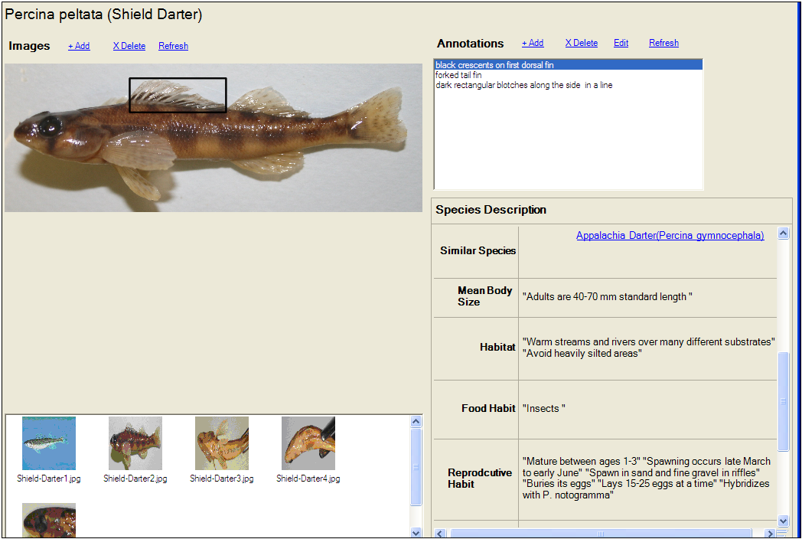
SuperIDR
Concepts
Text retrieval
Images, subimages, annotations
Content-based image retrieval
SuperIDR: text, image, and combined search

Slide 22
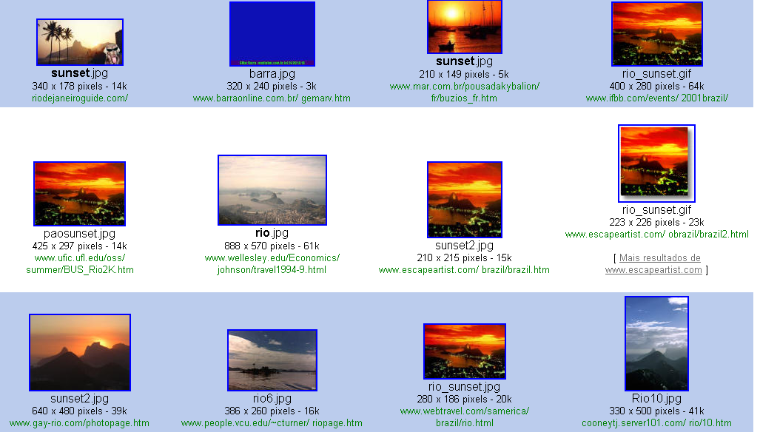
Textual information Retrieval
Query on Google using Sunset and Rio de Janeiro
Query result

Slide 23
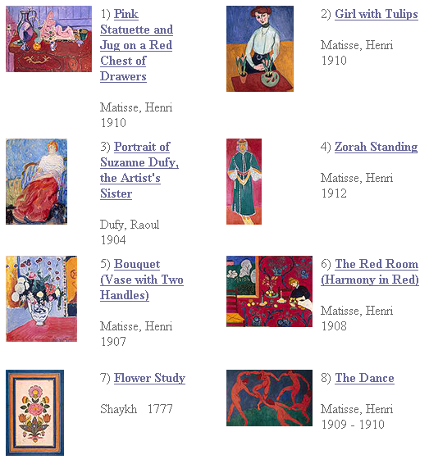
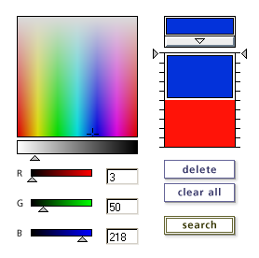
Content-based Information Retrieval

Slide 24
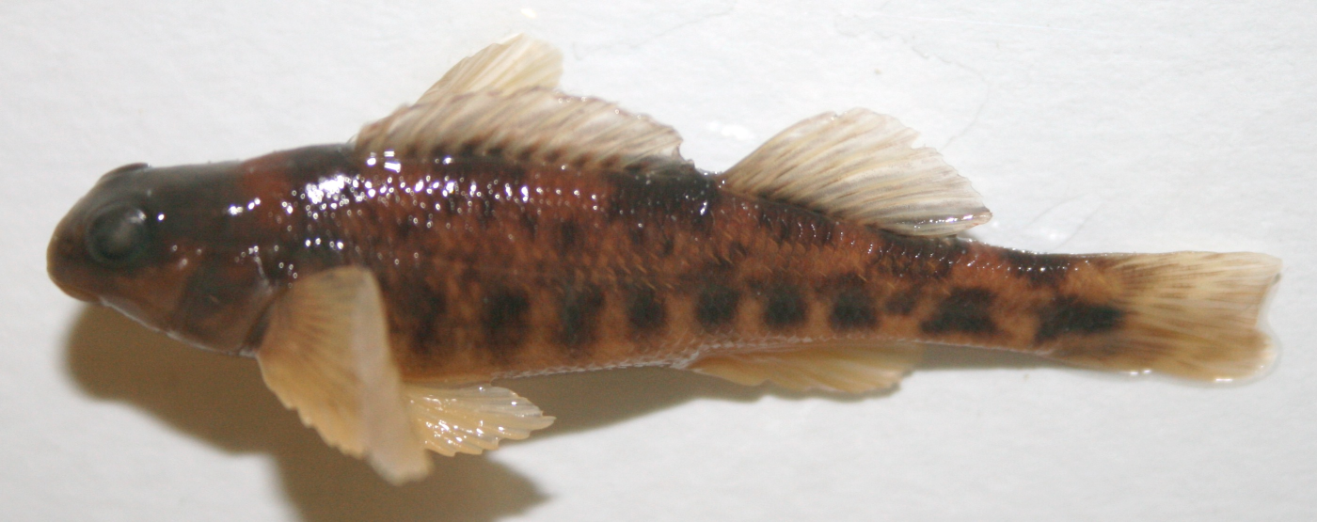
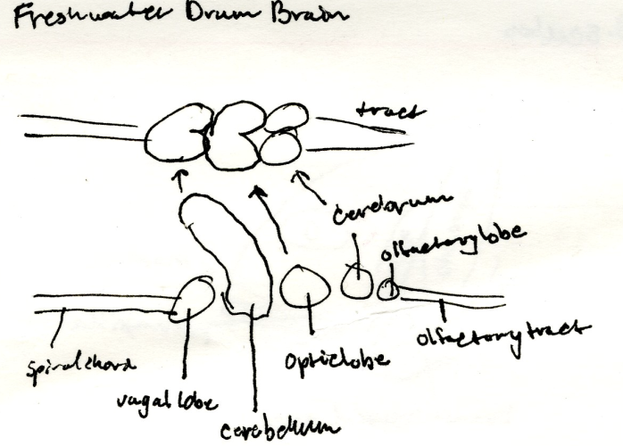
Fish Species Identification
Involves working with parts of fishes and fish images
1a Paired fins absent; jaws absent, mouth in an oral
disk (the disk mostly surrounded by a fleshy hood
in larvae); 7 external gill openings present in row
behind eye .......... Lampreys - Petromyzontidae p. ooo
1b Paired fins present (at least 1 set); jaws present;
1 external gill opening per side ................................... 2
2a Caudal fin heterocercal or abbreviate heterocercal
(Figure 5) ............................................................ 3
2b Caudal fin protocercal (Figure 13, Part 2, upper left)
or homocercal (Figure 5) ............................................ 6
Dichotomous keys
Personal Notes
Notes:
Our next step was to test SuperIDR, our prototype SI-DL in a scholarly task and how SuperIDR would support that scholarly task
Chose fish species identification as it inherently involves working with parts of fishes and fish images.
In fish identification, one is given an unknown fish specimen (TOP). Various fish ID materials such as a dichotomous key, text books, annotated pictures, and personal notes are used to identify the species of the unknown fish specimen. In most cases, a combination of these materials are used.
IF TIME PERMITS OR SOMEONE ASKS
There are various fish ID methods, but typically focus on distinguishing characteristics, dealing with descriptions of parts of the fish.
Dichotomous keys are akin to decision trees, where at each node a question is asked and depending on the answer, further questions are asked till one arrives at the species. Students might make notecards to study about species, which they might later use to identify the species.

Slide 25
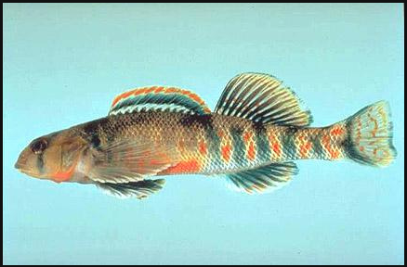
Scenario
While learning how to identify fish, a student might make use of an advanced query that involves searching for parts of images, in the context of other information:
Find me species that are darters that have a dorsal fin that looks like this, which
is connected to another dorsal fin that looks like this
Notes:
Consider a scenario where a student is making use of an advanced query to search for a species.
She makes use of images and text to describe her query.
In this scenario, she is looking for a species of the darter family and one that has a dorsal fin <CLICK> connected to another dorsal fin <CLICK>, which has an orange-colored edge <CLICK>.
Thus she is looking for a species from a specific family of fishes and which has three parts that are connected as described.

Slide 26
SuperIDR: An Image Description and Retrieval Tool
Enables marking and annotating images
Combines text- and content-based image description, retrieval, and browsing, including for subimages
Notes:
We developed a prototype of an SI-DL, SuperIDR that enables working with parts of images.
It allows a user to mark-up and annotate parts of images and later retrieve information, including subimages, in multiple ways, including text- and content-based image retrieval.

Slide 27
SuperIDR: Species Details Interface
Notes:
1. Customized SuperIDR to work with fish data and images.
2. Slide shows the details of a species, with a description of the species, all its images, subimages on each image and associated annotations.

Slide 28
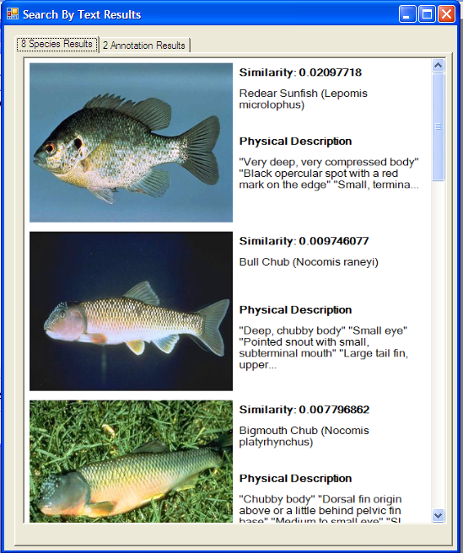
SuperIDR: Text-based Retrieval

Slide 29
SuperIDR: Content-based Image Retrieval

Slide 30
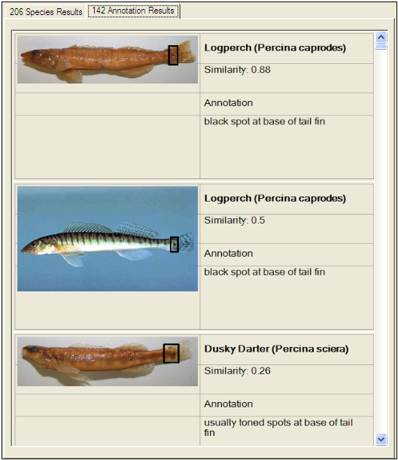
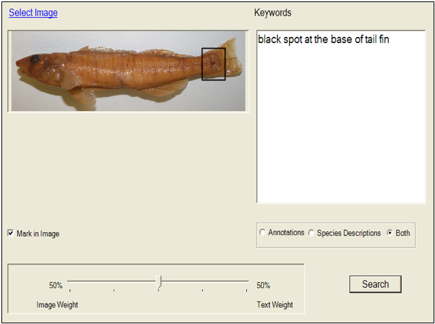
SuperIDR: Combined Search
Query interface
Search results
Notes:
Before showing an example of how subimages were used in the query interface, I will describe the combined search function in SuperIDR
In this search interface, a user might specify a query using images and text. Further, they can mark-up part of the image and use that subimage as the query.
In the text part they can given keywords and search on annotations, descriptions of species, or both.
Search results are organized by images and by subimages/annotations.

Slide 31
Activity
Run text queries listed in the file “outreach-superidr-queries.txt” in SuperIDR’s text search
Run image-based queries listed in the file “outreach-superidr-queries.txt” using images in superidr/query-images/ in SuperIDR’s image search
Run image+text queries listed in the file “outreach-superidr-queries.txt” using images in superidr/query-images in SuperIDR’s combined search
What are other fishes that also have orange in their body? (Besides image “iq-2.jpg” in folder “query-images”)
What is the fish of image “iq-5.jpg”? How many fishes are in that family?
What other fishes also have “two dorsal fins almost connected”?

Slide 32
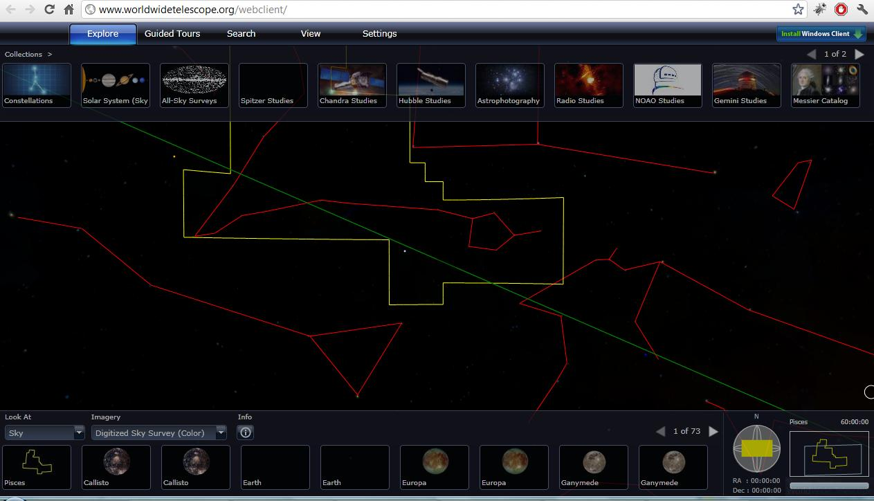
World Wide Telescope (WWT)
Explore the universe through the images taken from a number of ground and space-based telescopes.
Open Internet Explorer
We are going to use the web-client available at the following location: www.worldwidetelescope.org/webclient/
WWT might not load on the first try. It might seem like the site is down.
The browser should be refreshed (f5) 2-3 times to load the page.
Notes:
WWT might not load on the first try. It might seem like the site is down. The browser should be refreshed (f5) 2-3 times to load the page.

Slide 33
Navigating through WWT
Explore collections, search
Available images
Context
(constellation, field of view)
Notes:
On top, various collections contain images, maps, and surveys of the sky taken by a number of telescopes.
Lower left section contains all the images of various objects (e.g., stars, galaxies, constellations) for the areas currently in view (in the middle).
Lower right section gives contextual information such as where the constellation (red outlines) appear in the sky at earth, name of the constellation, size of the field of view (in blue rectangle box). In the middle, the yellow box selects the constellation. As we zoom in, these boxes (yellow constellation box and blue field of view box) disappear from the main section, but they are still present in the context box.

Slide 34
Navigating through WWT (cont.)
Finderscope (Shift+click)
Search
Notes:
There are two ways to find objects in WWT.
Use the search box and type in the word. Checking the plot box next to the search text box will allow us to see the search results visually. Blue circles are used to plot the search results.
Findersope is another way to find more information on things that are in our view. First click on an object to select it, then press shift+click to bring in the finderscope. Once up, finderscope can be dragged to select other objects. The ‘close’ button should be used to close finderscope. The ‘Research’ button provides more options such as finding more information on the object.

Slide 35
Task I
Where is the Grand Canyon of Mars?
Set ‘Look at’ to ‘Planet’ (at the lower left corner)
Set ‘Imagery’ to ‘Mars’ (near the lower left corner)
See the next slide, and navigate as suggested.
Please raise your hand if you have any question or need any help.
Notes:
Note: WWT can sometime behave unpredictably (like spinning, rotating without control). Browser should be refreshed when this happens.

Slide 36
Here is the Grand Canyon of Mars!
Look for these 3 big spots in a row; the canyon is close to them!
Grand Canyon of Mars
Notes:
Note: WWT can sometime behave unpredictably (like spinning, rotating without control). Browser should be refreshed when this happens.

Slide 37
Task II
Find the Constellation of Cat’s Eye Nebula
Click Search (Menu in the upper part, 3rd from left, using VO Cone Search, entering query in box at left)
Type ‘cat’s eye’
Click on any image (e.g., the 3rd). Zoom in.
Q: Which constellation includes the Cat’s eye Nebula?
Notes:
A. Draco

Slide 38
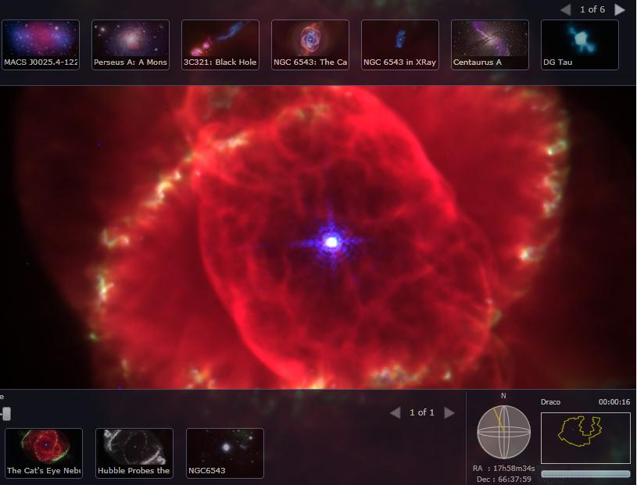
Constellation of Cat’s Eye
Find constellation name in bottom right

Slide 39
Task III
What is your favorite planet in the solar system? Why?
Set ‘Look at’ to ‘Planet’ (at the lower left corner)
Set ‘Imagery’ to one planet after another that you wish to explore (near the lower left corner)
Q: What is there new and exciting about that planet, that you found out today, using WWT?
Notes:
A: Helix Nebula, also known as NGC 7293

Slide 40
Task IV
Where are we meeting now?
Set ‘Look at’ to ‘Earth’ (at the lower left corner)
Set ‘Imagery’ to ‘Virtual Earth Hybrid’ (near the lower left corner)
Q: What are the names of the 3 roads closest to this room? What is our longitude and latitude?
Notes:
A: 700 light years.

Slide 41
Task V
Q: How does WWT know where to place the stars, galaxies, etc.?
Various ways of storing structured data – see next slide
Database, XML files, Excel files
To plot the stars, what information do you need to store?
Notes:
A: Name of the star, co-ordinate, constellation information, distance, etc.

Slide 42
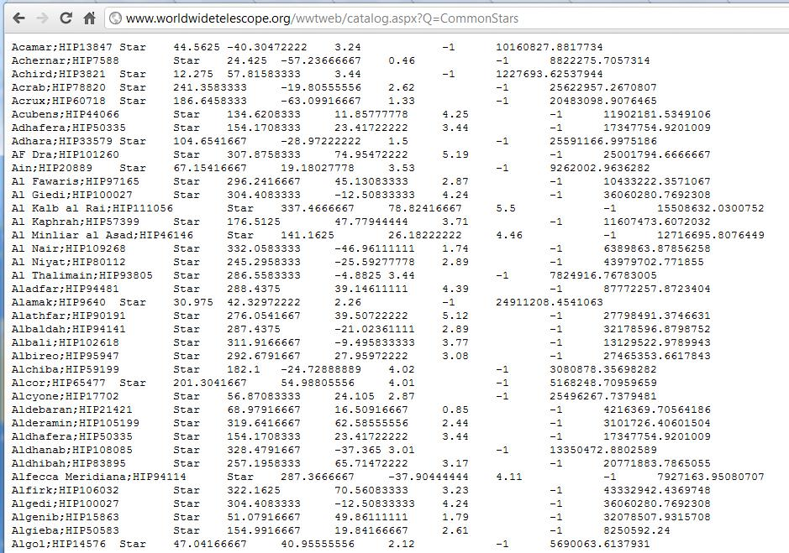
WWT Data on Star Co-ordinates
Open a new Internet Explorer window and type http://www.worldwidetelescope.org/wwtweb/catalog.aspx?Q=CommonStars
Can you guess the heading/label for each column?
Hint: See http://www.kidscosmos.org/kid-stuff/celestial.html

Slide 43
Computing in WWT
Data & Information
Information storage, retrieval, search, modeling, mapping, representation.
Gather information about planets, stars (e.g., names, coordinates) in the galaxy, etc.
Store data in a structured way (XML files)
Information Visualization
Visual mapping
Scaling large dataset: zooming and panning
Contextual navigation
Computer Graphics
Images, Videos, Animations of planets, stars, etc.
Numerical Analysis
Curve fitting: orbits of planets

Slide 44
How All the Pieces Fit Together
Wayback machine
Information storage and retrieval.
Lightbot
Program machines to do things.
SuperIDR
Extending common text search: to images, and to images with annotations.
WWT
End result of data collection, storage, and programming. An interface that allows users to easily navigate through the universe!

Slide 45
For More
Computer Science Website http://www.cs.vt.edu/
Email: fox@vt.edu
Following are some of the areas of Computer Science¹
Discrete Structures (DS)
Programming Fundamentals (PF)
Algorithms and Complexity (AL)
Programming Languages (PL)
Architecture and Organization (AR)
Operating Systems (OS)
Net-Centric Computing (NC)
Human-Computer Interaction (HC)
Graphics and Visual Computing (GV)
Intelligent Systems (IS)
Information Management (IM)
Software Engineering (SE)
Social and Professional Issues (SP)
Computational Science and Numerical Methods (CN)
¹http://www.acm.org/education/curric_vols/cc2001.pdf, PDF p. 239

Slide 46
Questions?
Thank you!

