Slide 1
NASA INSPIRE
Edward A. Fox
fox@vt.edu http://fox.cs.vt.edu
Monika Akbar, Eric Fouh, Lin Tzy Li, Mohamed Magdy, Nathan Short, Seungwon Yang, Sloane Neidig, Uma Murthy
Department of Computer Science, Virginia Tech
Blacksburg, VA 24061
Outreach Activity, July 5, 2011

Slide 2
About Instructor
Started studying about computers when 15 years old; enthralled; knew that would be my profession.
BS (Elect. Eng.) from MIT, MS and PhD from Cornell in Computer Science.
Professor at VT, teaching since 1983.
Executive Director for a non-profit: Networked Digital Library of Theses and Dissertations
Married 40 years, 4 sons, 3 grandsons; in 45 countries; teach energy healing.
Involved in computer applications to: archaeology, archives, autos, biology, business, chemistry, civil engineering, education, entertainment, fishes, geography, government, health, justice, language, law, libraries, math, navy, physics, sociology

Slide 3
Students Who Helped Prepare the Activities
Eric Fouh
Cameroon
Lin Tzy Li
Brazil
Mohamed Magdy
Egypt
Monika Akbar
Bangladesh
Nathan Short
USA
Seungwon Yang
South Korea
Sloane Neidig
USA
Uma Murthy
India

Slide 4
Overview of the Class
Wayback machine
Digital preservation: Looking back in time.
Light-bot
Programming through a game.
Greenfoot
Simulate real-life activities.
WorldWide Telescope
Make your computer a virtual telescope, look beyond the horizon, on earth, across space and time.
All materials are available at
http://www.computingportal.org/NASA

Slide 5
What is the Wayback Machine?
The Wayback Machine is an historical archive of preserved web pages.
Type in a URL and start surfing through time.
The archive of pages goes back to 1996.
Its original interface was released in 2001 with about 10 billion pages.
http://faq.web.archive.org/what-is-the-wayback-machine/

Slide 6
What is the Internet Archive (IA)?
Non-profit organization founded to build an Internet library for researchers, scholars, lawyers, and historians.
Preserves and provides historical collections (e.g., texts, audio, images, videos) in digital format.
Founded in 1996 and located in San Francisco.
Partner with us in our Crisis, Tragedy, and Recovery project (www.ctrnet.net).
http://faq.web.archive.org/what-is-the-wayback-machine/
http://www.archive.org/about/about.php

Slide 7
Adding Your Site to Wayback Machine
Most sites are crawled during the regular archiving efforts.
This probably applies to your school, sports activities, local government, etc.
But some are missed. Here are steps so sites you like can be included:
Get your site listed in major directories
Go to http://www.dmoz.org (Open Directory)
Find a category for your site to be listed
Click ‘Add URL’ and enter your site’s URL
Fix your site’s robots.txt rules to allow crawlers to capture your site.
http://faq.web.archive.org/my-sites-not-archived-how-can-i-add-it/

Slide 8
Exercise I
Go to http://wayback.archive.org/web/
Find your high school’s earliest archived homepage in the Wayback Machine, by entering your school’s URL and clicking the ‘Show All’ button.
Record your answers to the 2 questions on following slides on paper, and when everyone is done, use that information when raising your hand.
Notes:
Ask for a show of hands for the 2 parts to Q1: - 1996-1999, 2000-2004, after, not at all - crawled 0-9, 10-99, 100-499, more times

Slide 9
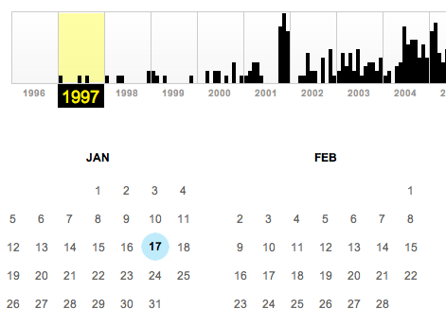
Exercise I
Q1. When was it archived for the first time?
Hint: Click the earliest year in the timeline toolbar on top of the page and find the date from the calendar.
Notes:
A1: student groups will have different dates. Find the group that has the oldest archived page.

Slide 10
Exercise I
Q2. How many times has it been crawled (see the example below)?
Notes:
A2: answers will be different. Check if they could find the number or not.

Slide 11
Exercise II
Go to http://wayback.archive.org/web/
Find archived pages of the Blacksburg Electronic Village in the Wayback Machine, by entering ‘www.bev.net’ and clicking the ‘Show All’ button.

Slide 12
Exercise II
Find the page archived on May 16, 2001
Q1: What are the events on its ‘Calendar’ page?
Find the page archived on Feb. 8, 1999
Q2: Who planned to visit VT on March 30, 1999?
Notes:
A1: Blacksburg high school class reunion (1991), YMCA worlds largest run registration, BEV online calendar, Dracula, Breastfeeding study, Movies are back, and starting a community network.
A2: General Colin L. Powell (Ret.)
Q1: Please raise you hand if you can give one event you found Q2: Please raise your hand if you know who

Slide 13
Exercise III
Go to http://wayback.archive.org/web/
Find archived pages of the Blacksburg Electronic Village in the Wayback Machine, by entering ‘www.bev.net’ and clicking the ‘Show All’ button.
Q1: Give the date when this site was last archived.
Q2: What is the most probable reason that the archiving of the site has stopped?
Notes:
A1: 10/7/2009
A2: Students might answer it is because of ‘robots.txt’ file. The file exists in the server, but it allows crawling of the main page (excluding other folders). Also, the fact that we can access the historic archived pages of bev.net tells us that it is not the reason.
Q1: Please raise you hand if you can explain why this date was chosen Q2: Please raise your hand if you can suggest a reason

Slide 14
Light-Bot

Slide 15
Goals
Light up all of the blue tiles with the Light Bot
Learn basic programming techniques while having fun!
Main methods
Functions
CHALLENGE
Who can complete the highest level?
Who can complete Light Bot in the least amount of “total commands”?

Slide 16
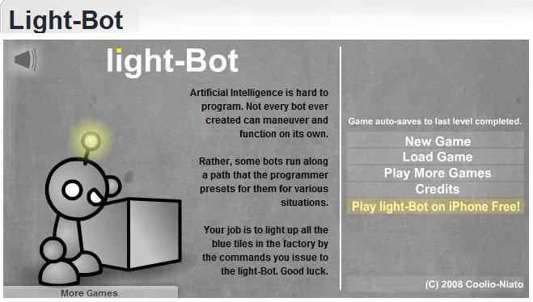
Open Light-Bot
http://armorgames.com/play/2205/light-bot
OR, Google “Light Bot” and open the first link
Ignore all the ads!

Slide 17
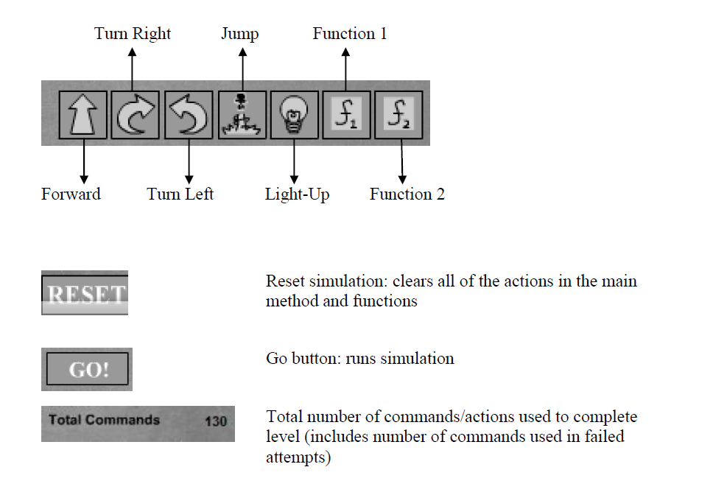
Command Key

Slide 18
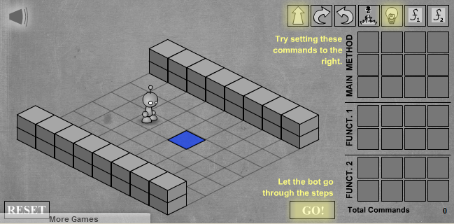
TUTORIAL: LEVEL 1
Drag and Drop Commands to the Main Method!
What is the best solution to this level?

Slide 19
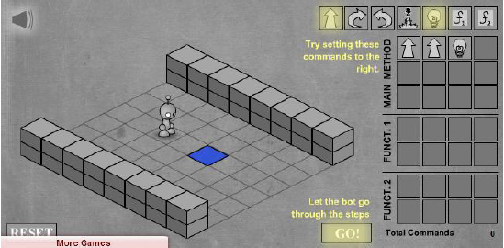
Possible Solution
Many ways to approach a problem
Programming solutions need to be efficient and effective
Here is a possible solution to Level 1:

Slide 20
CHALLENGE
Continue to complete the remaining 11-levels, keeping the challenge in mind.
Who can complete the highest level?
Who can complete Light Bot in the least amount of “total commands”?
Different: programming styles, patterns for efficiency
Combination of planning ahead, testing, revision
Nobody using paper. Some used prior programming.
Having learned, would you do better the 2nd time?
Would it be faster if working in teams?

Slide 21
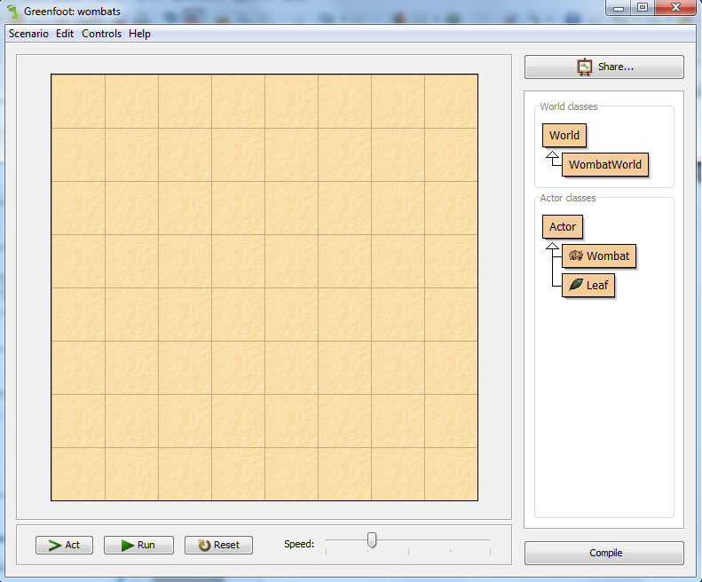
GREENFOOT
Greenfoot¹ is a framework used to simulate and visualize scenarios representing solutions to problems.
Greenfoot is a project at the University of Kent at Canterbury (UK) and Deakin University, Melbourne (Australia), supported by Sun Microsystems.
Click on the Greenfoot icon on the desktop, to start.
¹www.greenfoot.org

Slide 22
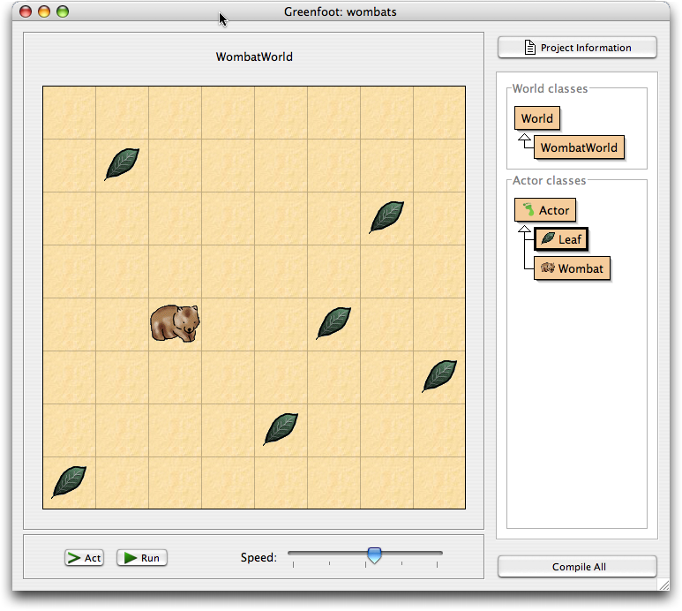
Wombat Scenario
Scenario represents the problem or the world to be solved or simulated.

Slide 23
GREENFOOT Interface

Slide 24
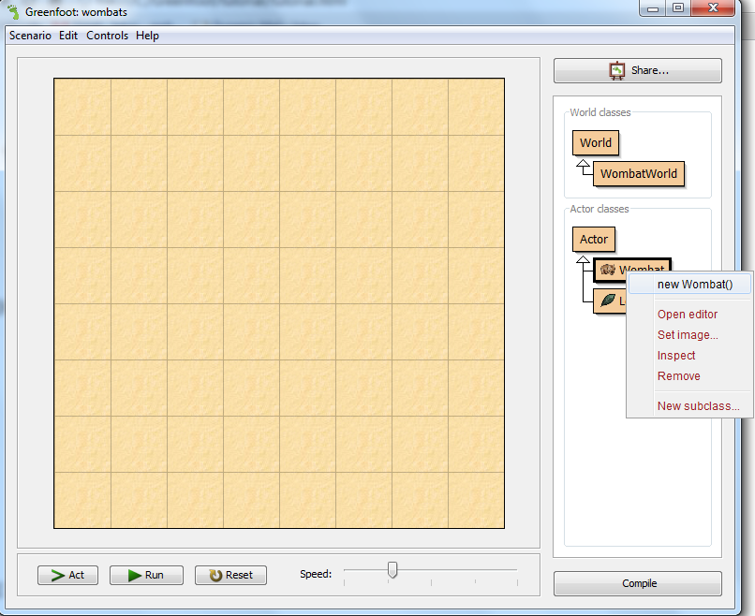
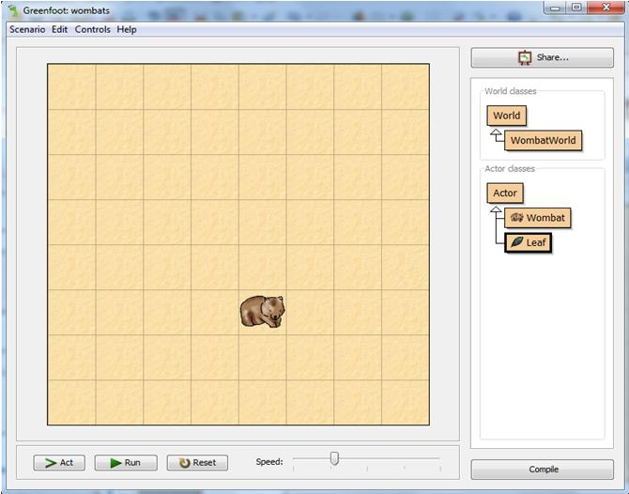
Add a Wombat
To add a wombat, right click on the Wombat class in the right panel and choose new Wombat().
Use the mouse to place the Wombat in a cell.

Slide 25
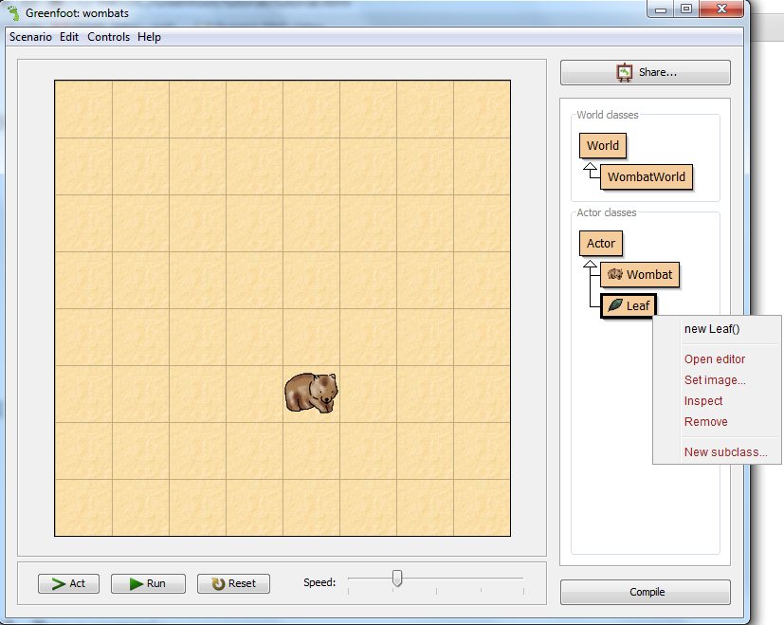
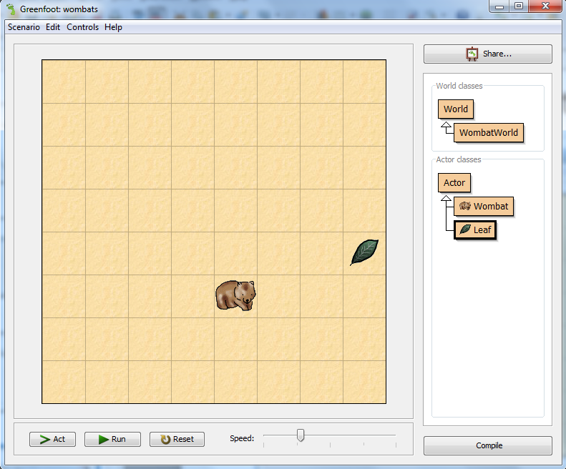
Add a Leaf
To add a leaf, right click on the Leaf class in the right panel and choose new Leaf().
Use the mouse to place the Leaf in a cell.

Slide 26
Make Objects Act
Click the ‘Act’ button in the execution controls. Each object now does whatever it wants to do.
What objects want to do depends on how they are defined.
Wombats like to eat leaves. If they happen to come across a leaf in their path, they will eat it.

Slide 27
Run a Scenario
Click the ‘Run’ button. This is equivalent to clicking the Act button over and over again, very quickly.
The slider next to the Act and Run buttons sets the speed.
Try various speeds, and then shift to a slow speed for the rest of the exercise.

Slide 28
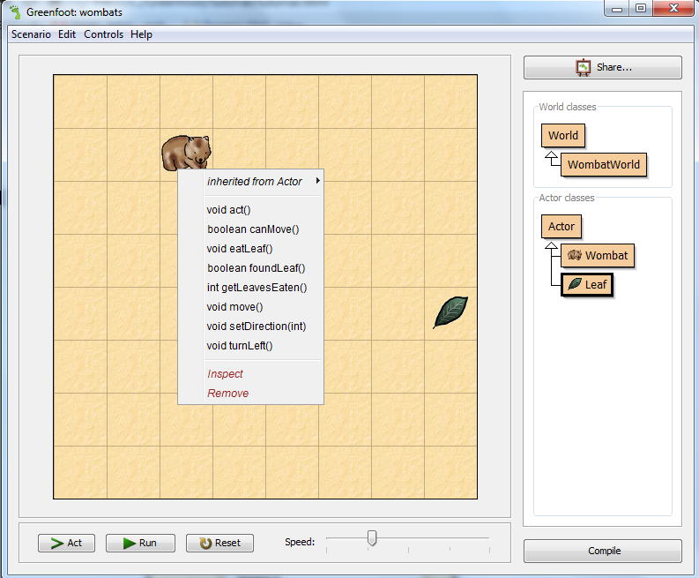
Invoke Methods Directly
Right click on the Wombat object and choose the act() method.

Slide 29
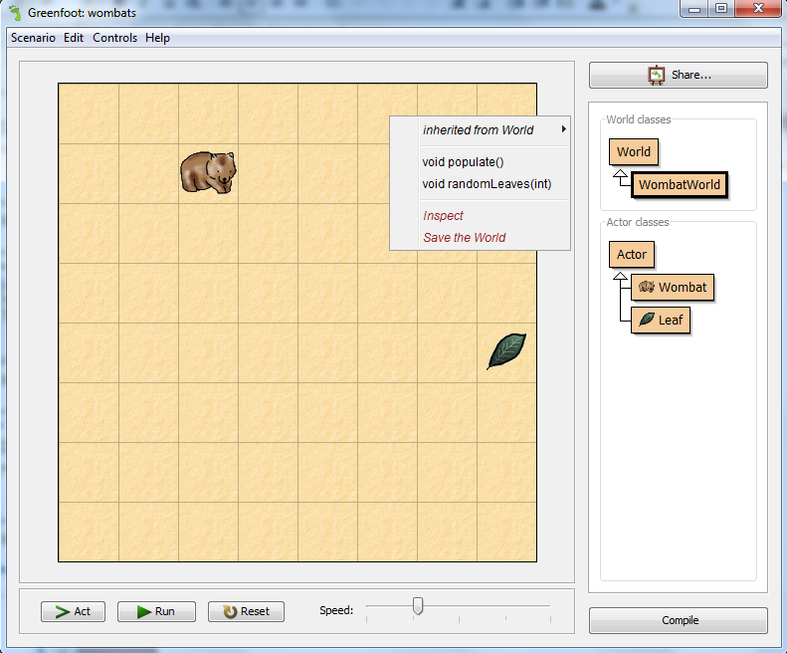
Invoke a World Method
Right click on the world grid and choose the populate() method. This will fill the world with arbitrary numbers of Wombats and leaves.

Slide 30
Create a New World
If you want to start all over, there is one easy option: throw away the world and create a new one.
This is usually done by clicking the 'Reset' button at the bottom of the screen.
Try 'Reset’, and experiment till comfortable with the overall scenario.

Slide 31
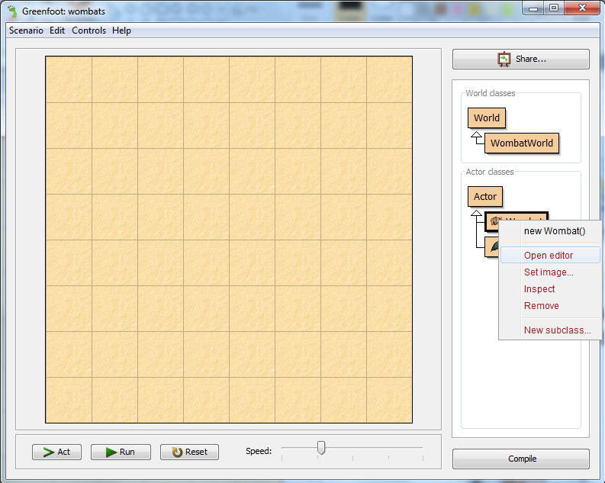
Change the Behavior of an Object
The Wombat always takes the Left direction in each action. We will now make it take a random direction.
Right click on the Wombat class and choose Open editor.

Slide 32
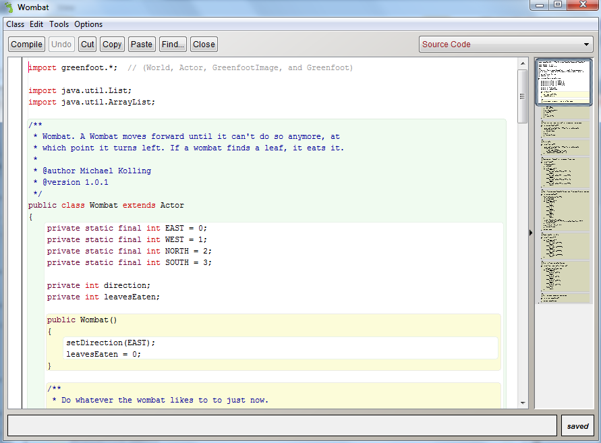
Change the Behavior of an Object (cont.)
View of the controlling program, using an editor:
Wombat
class

Slide 33
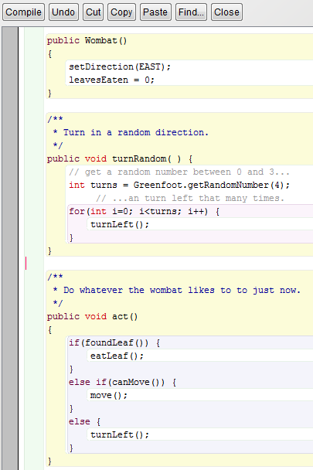
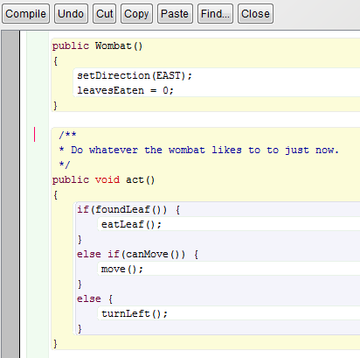
Change the Behavior of an Object (cont.)
Add the lines in http://www.greenfoot.org/doc/tutorial/tutorial.html#TOC10505 in the position shown.

Slide 34
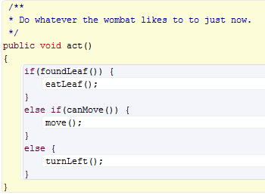
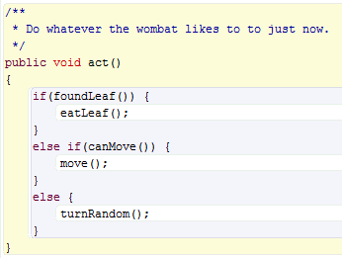
Change the Behavior of an Object (cont.)
Inside the act() function, change turnLeft() to turnRandom(), then press the Close button at the top.
Press the Compile button at the bottom right. Place some Wombats and leaves again.
Press the Run button to see how the Wombat will change its direction randomly.

Slide 35
More on Greenfoot
To learn more about Greenfoot, visit www.greenfoot.org/about/
Use their tutorial to gain more in-depth knowledge
http://www.greenfoot.org/doc/tutorial/tutorial.html
At your leisure, later, try out scenarios in the Greenfoot gallery: http://greenfootgallery.org/
Now, try out some examples, and for each, jot down a sentence summarizing what you learned:
http://greenfootgallery.org/scenarios/772 (queues, scheduling)
http://greenfootgallery.org/scenarios/597 (waves in Physics)
http://greenfootgallery.org/scenarios/1857 (flocking behavior)

Slide 36
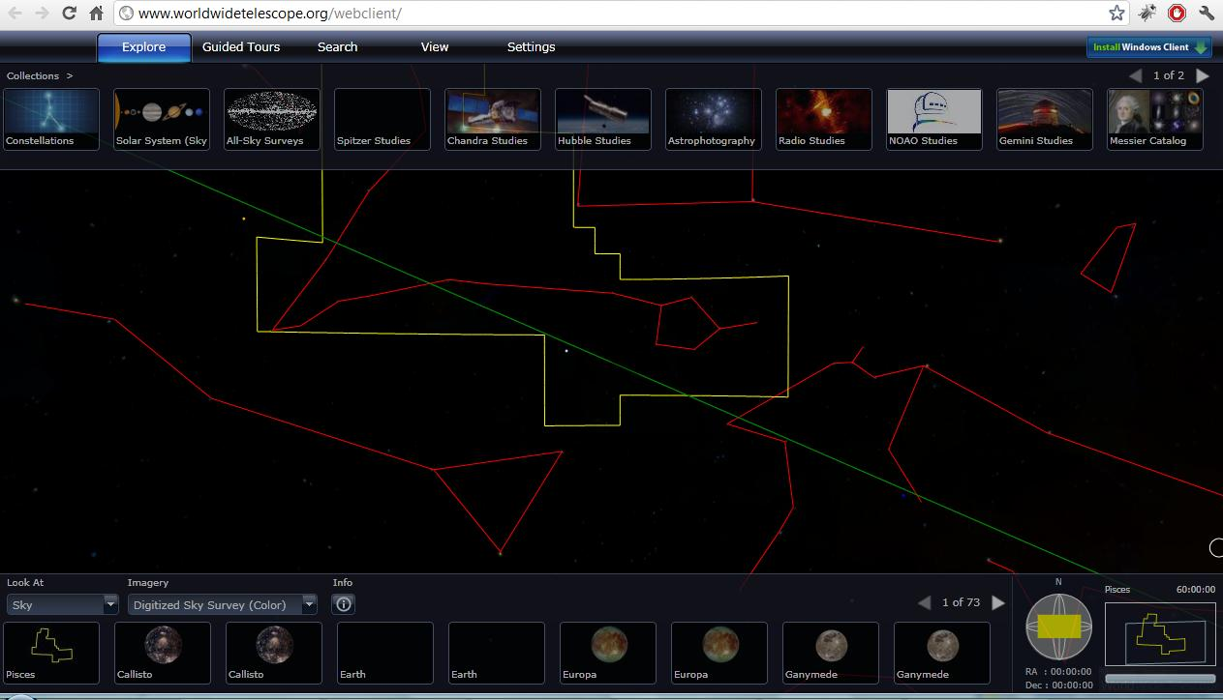
World Wide Telescope (WWT)
Explore the universe through the images taken from a number of ground and space-based telescopes.
Open Internet Explorer
We are going to use the web-client available at the following location: www.worldwidetelescope.org/webclient/
WWT might not load on the first try. It might seem like the site is down.
The browser should be refreshed (f5) 2-3 times to load the page.
Notes:
WWT might not load on the first try. It might seem like the site is down. The browser should be refreshed (f5) 2-3 times to load the page.

Slide 37
Navigating through WWT
Explore collections, search
Available images
Context
(constellation, field of view)
Notes:
On top, various collections contain images, maps, and surveys of the sky taken by a number of telescopes.
Lower left section contains all the images of various objects (e.g., stars, galaxies, constellations) for the areas currently in view (in the middle).
Lower right section gives contextual information such as where the constellation (red outlines) appear in the sky at earth, name of the constellation, size of the field of view (in blue rectangle box). In the middle, the yellow box selects the constellation. As we zoom in, these boxes (yellow constellation box and blue field of view box) disappear from the main section, but they are still present in the context box.

Slide 38
Navigating through WWT (cont.)
Finderscope (Shift+click)
Search
Notes:
There are two ways to find objects in WWT.
Use the search box and type in the word. Checking the plot box next to the search text box will allow us to see the search results visually. Blue circles are used to plot the search results.
Findersope is another way to find more information on things that are in our view. First click on an object to select it, then press shift+click to bring in the finderscope. Once up, finderscope can be dragged to select other objects. The ‘close’ button should be used to close finderscope. The ‘Research’ button provides more options such as finding more information on the object.

Slide 39
Task I
Find the Grand Canyon of Mars
Set ‘Look at’ to ‘Planet’ (at the lower left corner)
Set ‘Imagery’ to ‘Mars’ (at the lower left corner)
Please raise your hand if you have any question or need any help.
Notes:
Note: WWT can sometime behave unpredictably (like spinning, rotating without control). Browser should be refreshed when this happens.

Slide 40
Here is the Grand Canyon of Mars!
Look for these 3 big spots in a row; the canyon is close to them!
Grand Canyon of Mars
Notes:
Note: WWT can sometime behave unpredictably (like spinning, rotating without control). Browser should be refreshed when this happens.

Slide 41
Task II
Wave spectrum: Human eyes can only see a small portion of the electromagnetic spectrum (i.e., visible light).
But, with the right equipment, we can view things that are invisible otherwise!
Image Cross-fade in WWT: Use it to compare images taken at different wave-lengths.
Set ‘Look at’ to ‘Sky’ (at lower left corner)
Set ‘Imagery’ to ‘Digitized Sky Survey (color)’ (at lower left)
Set ‘Collections’ to ‘Hubble Studies’ (upper left)
Select ‘Nebulae’ then select ‘Messier 42;M42’
Move the slider called “Image Crossfade” (lower middle)
Q: What happens when you move the slider? Can you find some stars that are not visible in one image?
Notes:
A: Crab-nebula image changes from being colorful to black-and-white.
“Many objects featured in WISE’s infrared images look radically different in visible light. You can check out these differences yourself by using the WorldWide Telescope (WWT). You can also use WWT to compare WISE images to other data sets from missions like Spitzer, Hubble, Chandra or previous infrared surveys. Visualizing WISE images in WWT helps place them in their broader context in the sky.”
http://wise.ssl.berkeley.edu/gallery_wwt.html

Slide 42
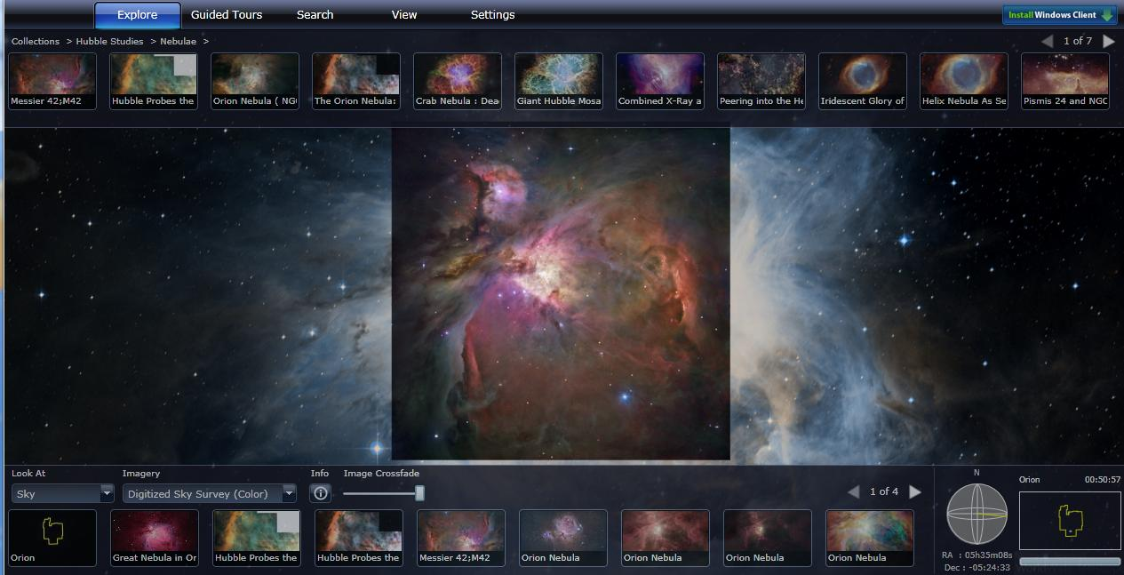
Image Crossfade in WWT
Hubble Image of M42 (foreground image)
Image crossfading
Image crossfading
Digitized sky survey image of M42 (background image)

Slide 43
Task III
Find the nebula inside the Aquarius constellation.
Use ‘Search’ to find nebula, constellation, etc.
Check the ‘plot’ box to identify the nebula from far away.
Q: What is the name of the nebula?
Notes:
A: Helix Nebula, also known as NGC 7293

Slide 44
Helix Nebula/NGC 7293

Slide 45
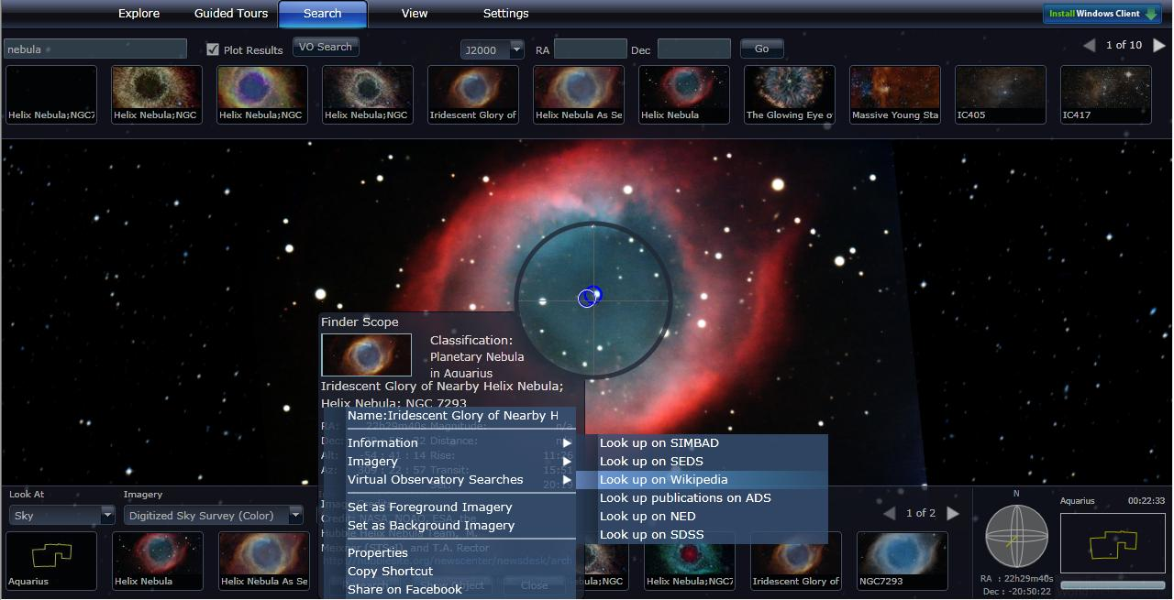
Task III (cont.)
Use ‘Finderscope’ to find more information on the object.
Within Finderscope go to ‘Research’ > ‘Information’ > ‘Wikipedia’
Q: How far (in light years) is the nebula from us?
Notes:
A: 700 light years.

Slide 46
Activity IV
Q: How does WWT know where to place the stars, galaxies, etc.?
Various ways of storing structured data
Database, XML files, Excel files
To plot the stars, what information do you need to store?
Notes:
A: Name of the star, co-ordinate, constellation information, distance, etc.

Slide 47
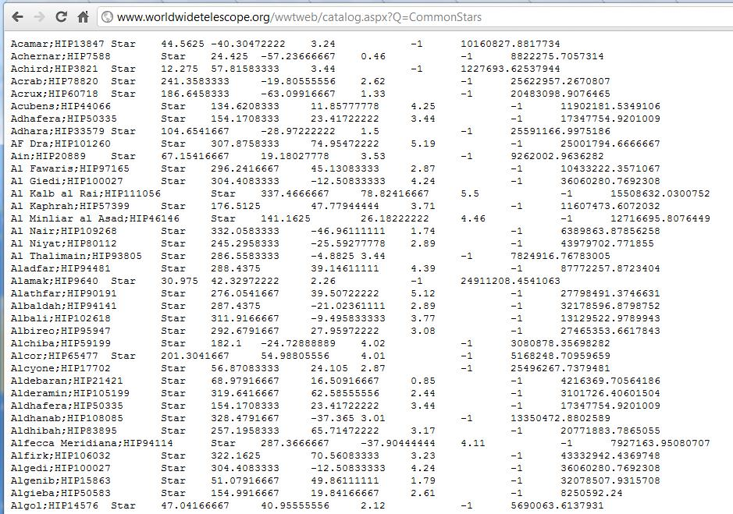
WWT Data on Star Co-ordinates
Open a new Internet Explorer window and type http://www.worldwidetelescope.org/wwtweb/catalog.aspx?Q=CommonStars
Can you guess the heading/label for each column?

Slide 48
Computing in WWT
Data & Information
Information storage, retrieval, search, modeling, mapping, representation.
Gather information about planets, stars (e.g., names, coordinates) in the galaxy, etc.
Store data in a structured way (XML files)
Information Visualization
Visual mapping
Scaling large dataset: zooming and panning
Contextual navigation
Computer Graphics
Images, Videos, Animations of planets, stars, etc.
Numerical Analysis
Curve fitting: orbits of planets

Slide 49
How All the Pieces Fit Together
Wayback machine
Information storage and retrieval.
Lightbot
Program machines to do things.
Greenfoot
Simulate real-world scenarios, a closer look at programming.
Using objects gives terser, more organized approach to programming (aka Object-oriented programming).
WWT
End result of data collection, storage, and programming. An interface that allows users to easily navigate through the universe!

Slide 50
For More
Computer Science Website http://www.cs.vt.edu/
Email: fox@vt.edu
Following are some of the areas of Computer Science¹
Discrete Structures (DS)
Programming Fundamentals (PF)
Algorithms and Complexity (AL)
Programming Languages (PL)
Architecture and Organization (AR)
Operating Systems (OS)
Net-Centric Computing (NC)
Human-Computer Interaction (HC)
Graphics and Visual Computing (GV)
Intelligent Systems (IS)
Information Management (IM)
Software Engineering (SE)
Social and Professional Issues (SP)
Computational Science and Numerical Methods (CN)
¹http://www.acm.org/education/curric_vols/cc2001.pdf, PDF p. 239

Slide 51
More on Computing
Online videos about CS faculty / students and posters
www.dlib.vt.edu/DLRL_Outreach.html
Some of the very best jobs are related to computing
System designer
Graphics designer
Game developer
Software Engineer
Network specialist
Some of the very best companies are connected with computing
Apple
Google
Microsoft
IBM
Intel
Many of the world's greatest challenges cannot be addressed without computing
Genome sequencing
Weather forecast
Simulation

Slide 52
Questions
Thank you!

